Slide 1
Sexually Transmitted Infections
Surveillance 2023
Racial and Ethnic Minorities
Notes:
This slide set was prepared by the Division of STD Prevention, National Center for HIV, Viral Hepatitis, STD, and TB Prevention (NCHHSTP), Centers for Disease Control and Prevention (CDC). These slides display trends for STIs in the United States through 2023. Data presented include case notifications provided to CDC through the National Notifiable Diseases Surveillance System (NNDSS) and data collected through projects and programs that monitor STIs in various settings, including the STI Surveillance Network (SSuN).
For more information on data sources, data collection and reporting practices, and case definitions, please see the Technical Notes, available at https://www.cdc.gov/sti-statistics/annual/technical-notes.html.
All data points for figures presented in these slides are available at https://www.cdc.gov/sti-statistics/media/files/2024/11/2023-STI-Surveillance-Report-Data-Points.zip.
NOTE: This slide set is in the public domain. You may reproduce these slides without permission; however, citation as to source is appreciated.
Centers for Disease Control and Prevention. Sexually Transmitted Infections Surveillance 2023. Atlanta: U.S. Department of Health and Human Services; 2024.
You are also free to adapt and revise these slides; however, you must remove the CDC name and logo if changes are made.

Slide 2
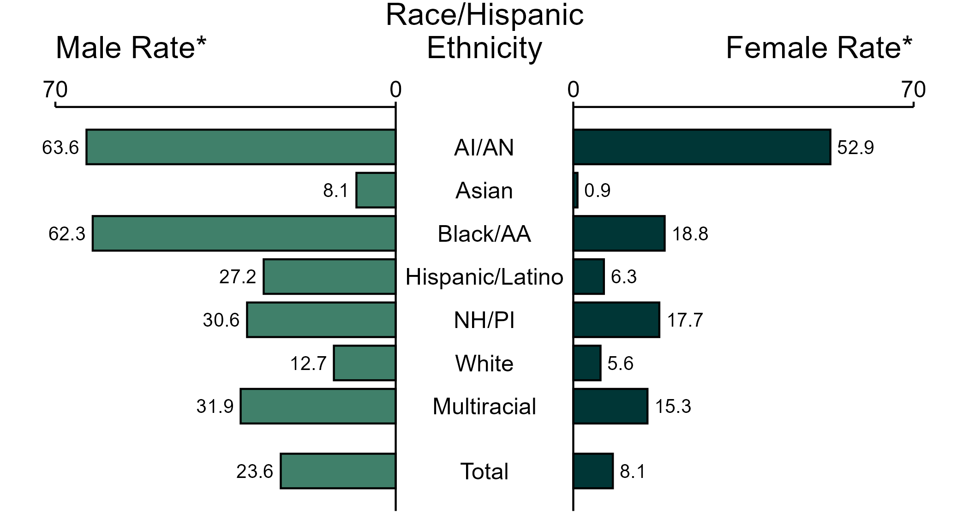
Primary and Secondary Syphilis — Rates of Reported Cases by Race/Hispanic Ethnicity and Sex, United States, 2023
* Per 100,000
ACRONYMS: AI/AN = American Indian or Alaska Native; Black/AA = Black or African American; NH/PI = Native Hawaiian or other Pacific Islander
NOTE: In 2023, 2,292 primary and secondary syphilis cases among men (5.8%) and 647 cases among women (4.7%) had missing, unknown, or other race and were not reported to be of Hispanic ethnicity. These cases are included in the total rates.
Notes:
In 2023, the rate of reported primary and secondary syphilis was higher among men (23.6 per 100,000) compared to women (8.1 per 100,000).
Among men, non-Hispanic American Indian or Alaska Native men had the highest rate of reported cases of primary and secondary syphilis (63.6 per 100,000), followed by non-Hispanic Black or African American men (62.3 per 100,000) and non-Hispanic men of multiple races (31.9 per 100,000). Among women, non-Hispanic American Indian or Alaska Native women also had the highest rate of reported cases of primary and secondary syphilis (52.9 per 100,000), followed by non-Hispanic Black or African American women (18.8 per 100,000) and non-Hispanic Native Hawaiian or other Pacific Islander women (17.7 per 100,000).
Using non-Hispanic White persons as the referent category, the greatest relative disparity in rates of reported primary and secondary syphilis by race and Hispanic ethnicity across both sexes was observed among non-Hispanic American Indian or Alaska Native women, with a rate ratio of 9.4 times that of non-Hispanic White women. Among men, the greatest relative disparity was observed among non-Hispanic American Indian or Alaska Native men as well, with a rate 5.0 times that of non-Hispanic White men.
This report includes data from years that coincide with the COVID-19 pandemic, which introduced uncertainty and difficulty in interpreting STI surveillance data. See Impact of COVID-19 on STIs (https://www.cdc.gov/sti-statistics/about/impact-of-covid-19.html) for more information.
See Technical Notes (https://www.cdc.gov/sti-statistics/annual/technical-notes.html) for information on STI case reporting formats and practices, including collected and derived variables displayed in this report. Table A (https://www.cdc.gov/sti-statistics/data-vis/table-selected-percunknown.html) provides information on unknown, missing, or invalid values of select variables.
Data for all figures are available at https://www.cdc.gov/sti-statistics/media/files/2024/11/2023-STI-Surveillance-Report-Data-Points.zip. The file “PS Syphilis - Rates by Race Hispanic Ethnicity and Sex (US 2023).xlsx” contains the data for the figure presented on this slide.

Slide 3
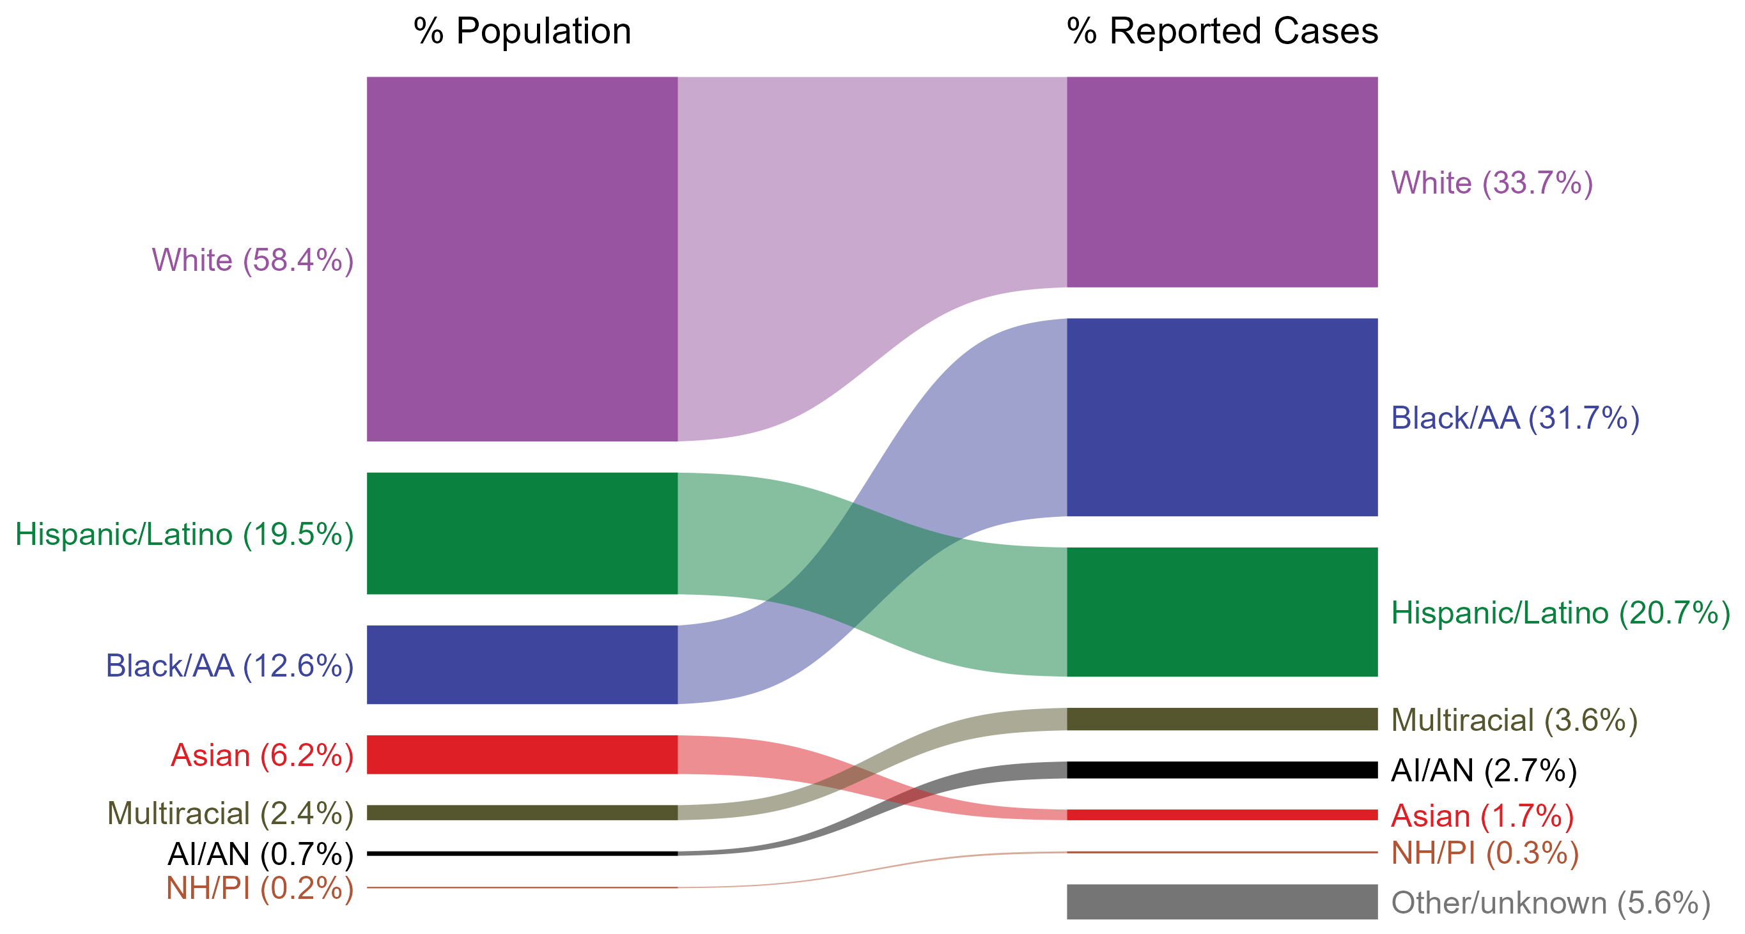
Primary and Secondary Syphilis — Total Population and Reported Cases by Race/Hispanic Ethnicity, United States, 2023
ACRONYMS: AI/AN = American Indian or Alaska Native; Black/AA = Black or African American; NH/PI = Native Hawaiian or other Pacific Islander
NOTE: In 2023, a total of 2,947 primary and secondary (P&S) syphilis cases (5.6%) had missing, unknown, or other race and were not reported to be of Hispanic ethnicity. These cases are included in the “other/unknown” category.
Notes:
The percentages of primary and secondary (P&S) syphilis cases by race and Hispanic ethnicity were disproportionate to the percentages among the total population of the United States in 2023. The greatest absolute disparity was observed among non-Hispanic Black or African American persons, who represented 31.7% of reported P&S syphilis cases (n = 16,793; 33.5% of P&S syphilis cases with reported race or Hispanic ethnicity) despite being 12.6% of the US population, or 19.1% more cases than would be expected based on their proportion of the population. The greatest relative disparity was among non-Hispanic American Indian or Alaska Native persons, who represented 2.7% of reported P&S syphilis cases (n = 1,415; 2.8% of P&S syphilis cases with reported race or Hispanic ethnicity) despite being 0.7% of the US population, or a burden 3.9 times what would be expected based on their proportion of the population. Additionally, non-Hispanic Native Hawaiian or other Pacific Islander persons, non-Hispanic persons of multiple races, and Hispanic or Latino persons of any race(s) were also overrepresented among P&S syphilis cases relative to their proportion of the population.
This report includes data from years that coincide with the COVID-19 pandemic, which introduced uncertainty and difficulty in interpreting STI surveillance data. See Impact of COVID-19 on STIs (https://www.cdc.gov/sti-statistics/about/impact-of-covid-19.html) for more information.
See Technical Notes (https://www.cdc.gov/sti-statistics/annual/technical-notes.html) for information on STI case reporting formats and practices, including collected and derived variables displayed in this report. Table A (https://www.cdc.gov/sti-statistics/data-vis/table-selected-percunknown.html) provides information on unknown, missing, or invalid values of select variables.
Data for all figures are available at https://www.cdc.gov/sti-statistics/media/files/2024/11/2023-STI-Surveillance-Report-Data-Points.zip. The file “PS Syphilis - Population and Cases by Race Hispanic Ethnicity (US 2023).xlsx” contains the data for the figure presented on this slide.

Slide 4
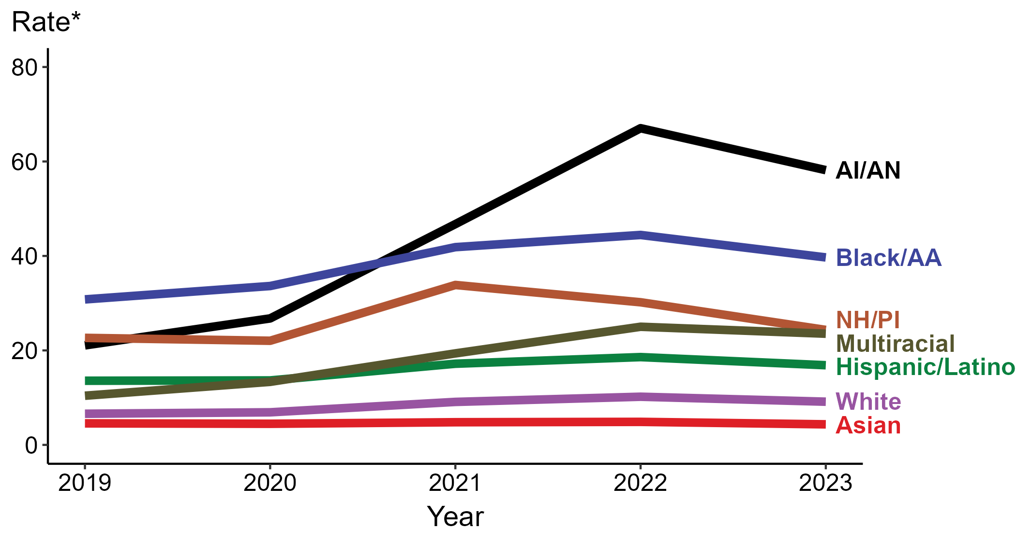
Primary and Secondary Syphilis — Rates of Reported Cases by Race/Hispanic Ethnicity and Year, United States, 2019–2023
* Per 100,000
ACRONYMS: AI/AN = American Indian or Alaska Native; Black/AA = Black or African American; NH/PI = Native Hawaiian or other Pacific Islander
NOTE: During 2019 to 2023, the percentage of all primary and secondary syphilis cases with missing, unknown, or other race and not reported to be of Hispanic ethnicity was 6.5%, from a low of 5.6% (n = 2,947) in 2023 to a high of 7.2% (n = 2,822) in 2019. These cases are not shown in this figure.
Notes:
In 2023, the highest rate of reported primary and secondary (P&S) syphilis cases was among non-Hispanic American Indian or Alaska Native persons (58.2 per 100,000), followed by non-Hispanic Black or African American persons (39.7 per 100,000).
There were no increases in the rate of reported P&S syphilis cases among any race or Hispanic ethnicity group during 2022 to 2023. Non-Hispanic American Indian or Alaska Native persons had the greatest five-year increase in rate of reported P&S syphilis (21.1 to 58.2 per 100,000; 175.8% increase from 2019).
During 2022 to 2023, the greatest decrease in rate of reported P&S syphilis cases was among non-Hispanic Native Hawaiian or other Pacific Islander persons (30.2 to 24.3 per 100,000; 19.5% decrease). Non-Hispanic Asian persons had the only five-year decrease in rate of reported P&S syphilis (4.6 to 4.4 per 100,000; 4.3% decrease from 2019).
This report includes data from years that coincide with the COVID-19 pandemic, which introduced uncertainty and difficulty in interpreting STI surveillance data. See Impact of COVID-19 on STIs (https://www.cdc.gov/sti-statistics/about/impact-of-covid-19.html) for more information.
See Technical Notes (https://www.cdc.gov/sti-statistics/annual/technical-notes.html) for information on STI case reporting formats and practices, including collected and derived variables displayed in this report. Table A (https://www.cdc.gov/sti-statistics/data-vis/table-selected-percunknown.html) provides information on unknown, missing, or invalid values of select variables.
Data for all figures are available at https://www.cdc.gov/sti-statistics/media/files/2024/11/2023-STI-Surveillance-Report-Data-Points.zip. The file “PS Syphilis - Rates by Race Hispanic Ethnicity (US 2019-2023).xlsx” contains the data for the figure presented on this slide.

Slide 5
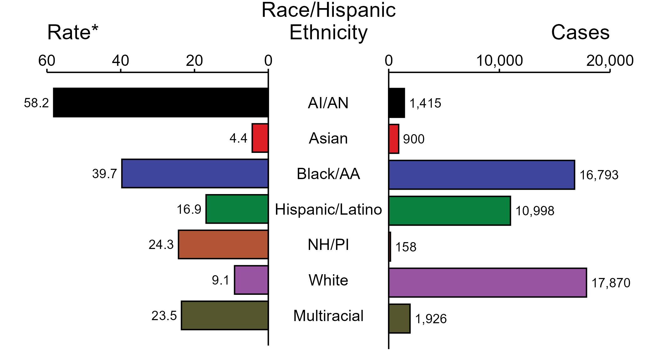
Primary and Secondary Syphilis — Case Counts and Rates of Reported Cases by Race/Hispanic Ethnicity, United States, 2023
* Per 100,000
ACRONYMS: AI/AN = American Indian or Alaska Native; Black/AA = Black or African American; NH/PI = Native Hawaiian or other Pacific Islander
NOTE: In 2023, a total of 2,947 primary and secondary (P&S) syphilis cases (5.6%) had missing, unknown, or other race and were not reported to be of Hispanic ethnicity. These cases are not shown in this figure. Including these cases, there were a total of 53,007 cases of P&S syphilis reported among states and the District of Columbia for a rate of 15.8 per 100,000 persons.
Notes:
In 2023, rates of primary and secondary (P&S) syphilis were highest among non-Hispanic American Indian or Alaska Native persons (58.2 per 100,000), followed by non-Hispanic Black or African American persons (39.7 per 100,000) and non-Hispanic Native Hawaiian or other Pacific Islander persons (24.3 per 100,000). The greatest number of reported P&S syphilis cases was among non-Hispanic White persons (17,870 cases), followed by non-Hispanic Black or African American persons (16,793 cases) and Hispanic or Latino persons of any race(s) (10,998 cases).
This report includes data from years that coincide with the COVID-19 pandemic, which introduced uncertainty and difficulty in interpreting STI surveillance data. See Impact of COVID-19 on STIs (https://www.cdc.gov/sti-statistics/about/impact-of-covid-19.html) for more information.
See Technical Notes (https://www.cdc.gov/sti-statistics/annual/technical-notes.html) for information on STI case reporting formats and practices, including collected and derived variables displayed in this report. Table A (https://www.cdc.gov/sti-statistics/data-vis/table-selected-percunknown.html) provides information on unknown, missing, or invalid values of select variables.
Data for all figures are available at https://www.cdc.gov/sti-statistics/media/files/2024/11/2023-STI-Surveillance-Report-Data-Points.zip. The file “PS Syphilis - Cases and Rates by Race Hispanic Ethnicity (US 2023).xlsx” contains the data for the figure presented on this slide.

Slide 6
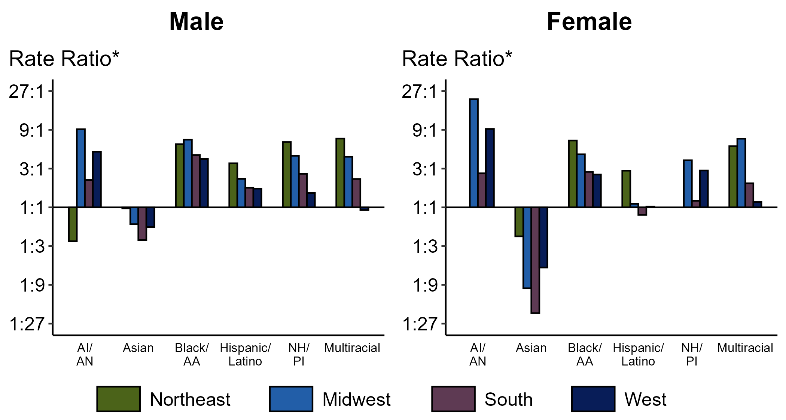
Primary and Secondary Syphilis — Ratios of Rates of Reported Cases by Sex, Race/Hispanic Ethnicity, and Region, United States, 2023
* For the rate ratios, non-Hispanic White persons are the referent population. Y-axis is log scale.
ACRONYMS: AI/AN = American Indian or Alaska Native; Black/AA = Black or African American; NH/PI = Native Hawaiian or other Pacific Islander
Notes:
Among men and women, rate ratios of rates of reported primary and secondary (P&S) syphilis by race/Hispanic ethnicity (using non-Hispanic White persons as the referent population) varied by region in 2023. Among men, the greatest rate ratio was in the Midwest where the rate of reported P&S syphilis among non-Hispanic American Indian or Alaska Native men was 9.1 times the rate among non-Hispanic White men. Among women, the greatest rate ratio was in the Midwest where the rate of reported P&S syphilis among non-Hispanic American Indian or Alaska Native women was 21.5 times the rate among non-Hispanic White women.
This report includes data from years that coincide with the COVID-19 pandemic, which introduced uncertainty and difficulty in interpreting STI surveillance data. See Impact of COVID-19 on STIs (https://www.cdc.gov/sti-statistics/about/impact-of-covid-19.html) for more information.
See Technical Notes (https://www.cdc.gov/sti-statistics/annual/technical-notes.html) for information on syphilis case reporting, race/Hispanic ethnicity categorization, and reporting of race/Hispanic ethnicity for STI cases. Table A (https://www.cdc.gov/sti-statistics/data-vis/table-selected-percunknown.html) provides information on unknown, missing, or invalid values of select variables.
Data for all figures are available at https://www.cdc.gov/sti-statistics/media/files/2024/11/2023-STI-Surveillance-Report-Data-Points.zip. The file “PS Syphilis - Ratios by Sex Race Hispanic Ethnicity and Region (US 2023).xlsx” contains the data for the figure presented on this slide.

Slide 7
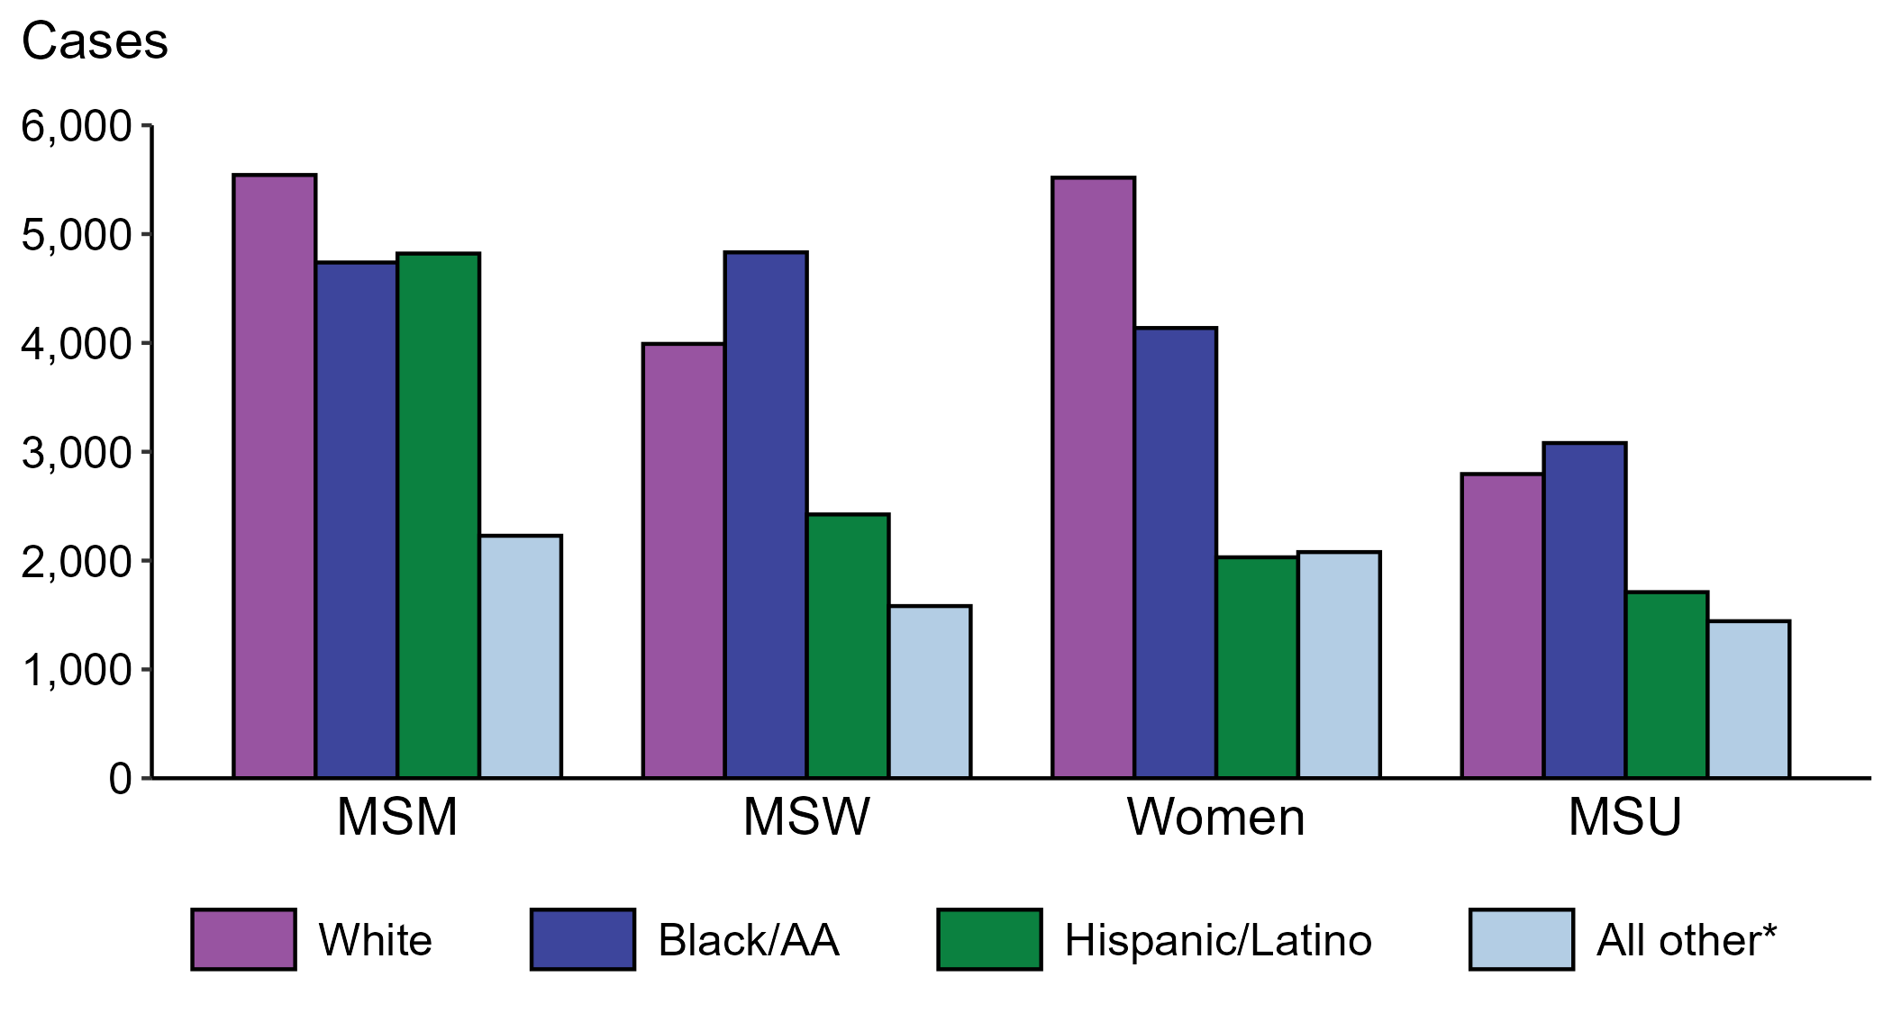
Primary and Secondary Syphilis — Reported Cases by Sex, Sex of Sex Partners, and Race/Hispanic Ethnicity, United States, 2023
* Includes persons with missing or unknown race who were not reported with Hispanic ethnicity.
ACRONYMS: MSM = Men who have sex with men; MSW = Men who have sex with women only; MSU = Men with unknown sex of sex partners
Notes:
The largest percentage of all primary and secondary (P&S) syphilis cases were reported to be men who have sex with men (MSM; 32.7%). When looking within categories of sex and sex of sex partners, P&S syphilis cases reported as non-Hispanic White were the largest percentage among women (40.1%) and MSM (32.0%). P&S syphilis cases reported as non-Hispanic Black or African American were the largest percentage among men who have sex with women only (MSW; 37.7%) and men with unknown sex of sex partners (MSU; 34.1%).
This report includes data from years that coincide with the COVID-19 pandemic, which introduced uncertainty and difficulty in interpreting STI surveillance data. See Impact of COVID-19 on STIs (https://www.cdc.gov/sti-statistics/about/impact-of-covid-19.html) for more information.
See Technical Notes (https://www.cdc.gov/sti-statistics/annual/technical-notes.html) for information on STI case reporting formats and practices, including collected and derived variables displayed in this report. Table A (https://www.cdc.gov/sti-statistics/data-vis/table-selected-percunknown.html) provides information on unknown, missing, or invalid values of select variables.
Data for all figures are available at https://www.cdc.gov/sti-statistics/media/files/2024/11/2023-STI-Surveillance-Report-Data-Points.zip. The file “PS Syphilis - Cases by Sex Sex of Sex Partners and Race Hispanic Ethnicity (US 2023) .xlsx” contains the data for the figure presented on this slide.

Slide 8
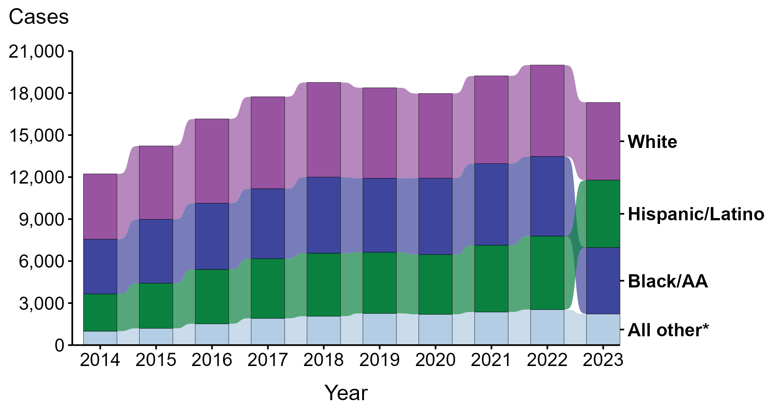
Primary and Secondary Syphilis — Reported Cases Among Men Who Have Sex with Men by Race and Hispanic Ethnicity, United States, 2014–2023
* Includes all cases not captured in the labeled race and Hispanic ethnicity categories, including those with unknown or missing race and Hispanic ethnicity. This category is intended to show the balance of primary and secondary (P&S) syphilis cases among men who have sex with men (MSM) and should not be interpreted independently.
Notes:
During 2014 to 2023, the largest percentage (34.9%) of primary and secondary (P&S) syphilis cases among men who have sex with men (MSM) were reported to be non-Hispanic White.
During 2022 to 2023, case counts decreased among non-Hispanic Black or African American MSM (16.7% decrease; 5,689 to 4,739 cases), non-Hispanic White MSM (15.1% decrease; 6,528 to 5,543 cases), and Hispanic or Latino MSM of any race(s) (8.2% decrease; 5,250 to 4,821 cases).
During 2014 to 2023, case counts increased among Hispanic or Latino MSM of any race(s) (81.2% increase; 2,660 to 4,821 cases), non-Hispanic Black or African American MSM (21.3% increase; 3,907 to 4,739 cases), and non-Hispanic White MSM (18.8% increase; 4,664 to 5,543 cases).
This report includes data from years that coincide with the COVID-19 pandemic, which introduced uncertainty and difficulty in interpreting STI surveillance data. See Impact of COVID-19 on STIs (https://www.cdc.gov/sti-statistics/about/impact-of-covid-19.html) for more information.
See Technical Notes (https://www.cdc.gov/sti-statistics/annual/technical-notes.html) for information on STI case reporting formats and practices, including collected and derived variables displayed in this report. Table A (https://www.cdc.gov/sti-statistics/data-vis/table-selected-percunknown.html) provides information on unknown, missing, or invalid values of select variables.
Data for all figures are available at https://www.cdc.gov/sti-statistics/media/files/2024/11/2023-STI-Surveillance-Report-Data-Points.zip. The file “PS Syphilis - Cases MSM by Race Hispanic Ethnicity (US 2014-2023) .xlsx” contains the data for the figure presented on this slide.

Slide 9
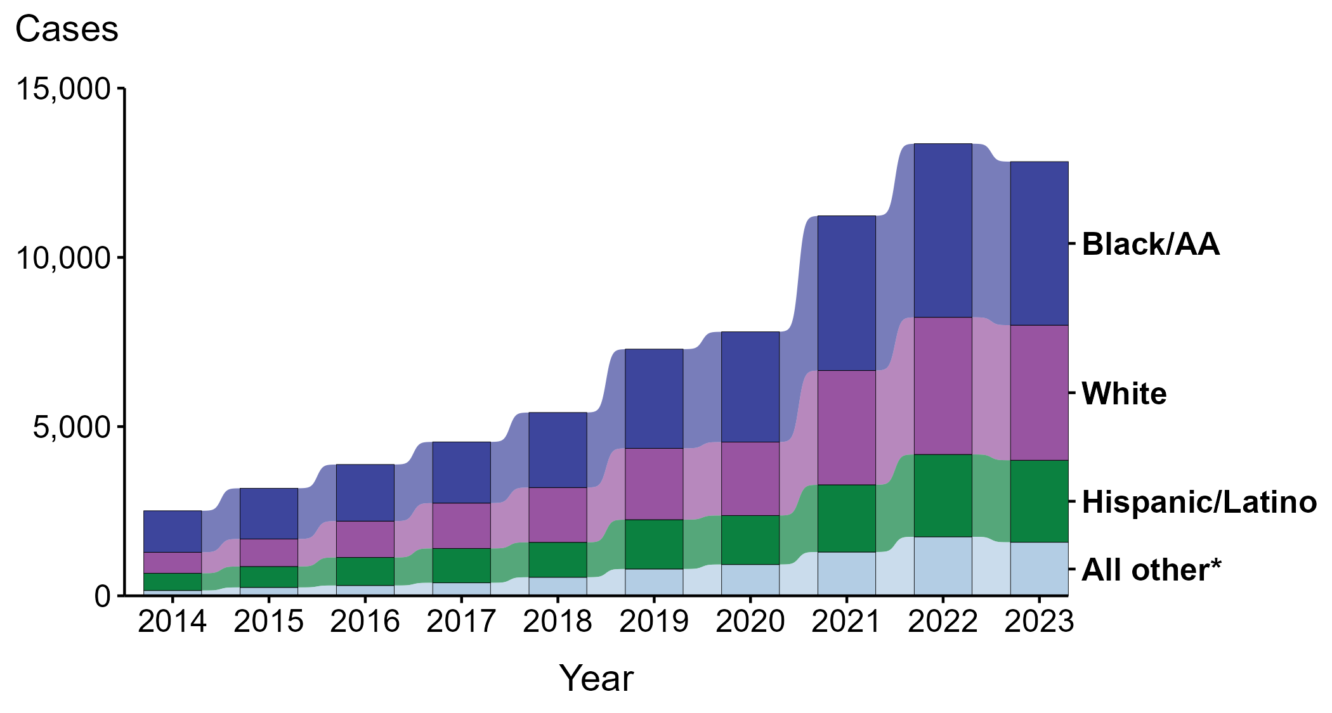
Primary and Secondary Syphilis — Reported Cases Among Men Who Have Sex with Women Only by Race and Hispanic Ethnicity, United States, 2014–2023
* Includes all cases not captured in the labeled race and Hispanic ethnicity categories, including those with unknown or missing race and Hispanic ethnicity. This category is intended to show the balance of primary and secondary (P&S) syphilis cases among men who have sex with women only (MSW) and should not be interpreted independently.
Notes:
During 2014 to 2023, the largest percentage (40.5%) of primary and secondary (P&S) syphilis cases among men who have sex with women only (MSW) were reported to be non-Hispanic Black or African American.
During 2022 to 2023, case counts decreased among non-Hispanic Black or African American MSW (5.8% decrease; 5,130 to 4,832 cases) and non-Hispanic White MSW (1.5% decrease; 4,052 to 3,991 cases). Case counts did not change substantially among Hispanic or Latino MSW of any race(s) (<1.0% change; 2,433 to 2,424 cases).
During 2014 to 2023, case counts increased among non-Hispanic White MSW (543.7% increase; 620 to 3,991 cases), Hispanic or Latino MSW of any race(s) (375.3% increase; 510 to 2,424 cases), and non-Hispanic Black or African American MSW (294.1% increase; 1,226 to 4,832 cases).
This report includes data from years that coincide with the COVID-19 pandemic, which introduced uncertainty and difficulty in interpreting STI surveillance data. See Impact of COVID-19 on STIs (https://www.cdc.gov/sti-statistics/about/impact-of-covid-19.html) for more information.
See Technical Notes (https://www.cdc.gov/sti-statistics/annual/technical-notes.html) for information on STI case reporting formats and practices, including collected and derived variables displayed in this report. Table A (https://www.cdc.gov/sti-statistics/data-vis/table-selected-percunknown.html) provides information on unknown, missing, or invalid values of select variables.
Data for all figures are available at https://www.cdc.gov/sti-statistics/media/files/2024/11/2023-STI-Surveillance-Report-Data-Points.zip. The file “PS Syphilis - Cases MSW and Race Hispanic Ethnicity (US 2014-2023) .xlsx” contains the data for the figure presented on this slide.

Slide 10
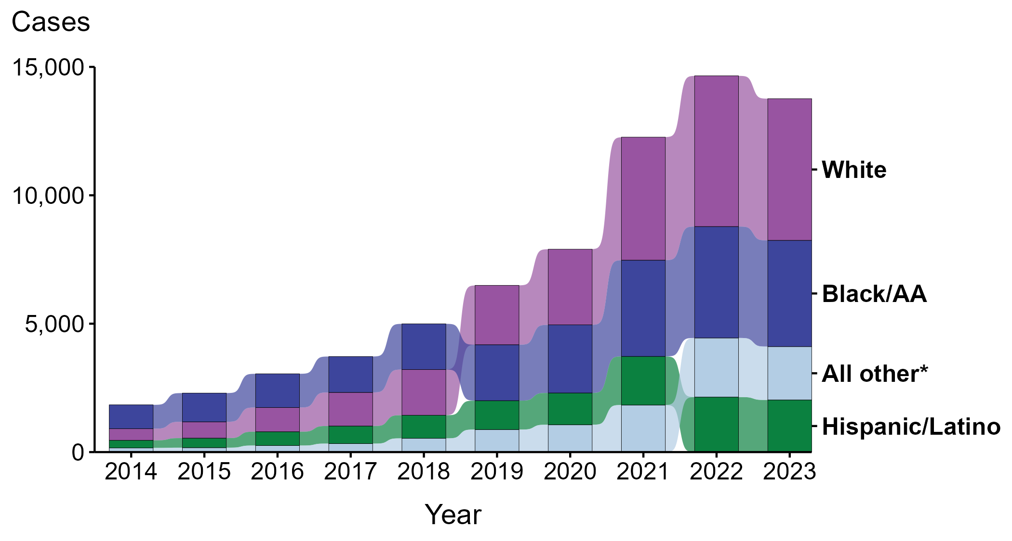
Primary and Secondary Syphilis — Reported Cases Among Women by Race and Hispanic Ethnicity, United States, 2014–2023
* Includes all cases not captured in the labeled race and Hispanic ethnicity categories, including those with unknown or missing race and Hispanic ethnicity. This category is intended to show the balance of primary and secondary (P&S) syphilis cases among women and should not be interpreted independently.
Notes:
During 2014 to 2023, the largest percentage (37.4%) of primary and secondary (P&S) syphilis cases among women were reported to be non-Hispanic White.
During 2022 to 2023, case counts decreased among non-Hispanic White women (6.0% decrease; 5,869 to 5,518 cases), Hispanic or Latino women of any race(s) (5.2% decrease; 2,142 to 2,030 cases), and non-Hispanic Black or African American women (4.7% decrease; 4,339 to 4,137 cases).
During 2014 to 2023, case counts increased among non-Hispanic White women (1,115.4% increase; 454 to 5,518 cases), Hispanic or Latino women of any race(s) (585.8% increase; 296 to 2,030 cases), and non-Hispanic Black or African American women (345.8% increase; 928 to 4,137 cases).
This report includes data from years that coincide with the COVID-19 pandemic, which introduced uncertainty and difficulty in interpreting STI surveillance data. See Impact of COVID-19 on STIs (https://www.cdc.gov/sti-statistics/about/impact-of-covid-19.html) for more information.
See Technical Notes (https://www.cdc.gov/sti-statistics/annual/technical-notes.html) for information on STI case reporting formats and practices, including collected and derived variables displayed in this report. Table A (https://www.cdc.gov/sti-statistics/data-vis/table-selected-percunknown.html) provides information on unknown, missing, or invalid values of select variables.
Data for all figures are available at https://www.cdc.gov/sti-statistics/media/files/2024/11/2023-STI-Surveillance-Report-Data-Points.zip. The file “PS Syphilis - Cases Women by Race Hispanic Ethnicity (US 2014-2023) .xlsx” contains the data for the figure presented on this slide.

Slide 11
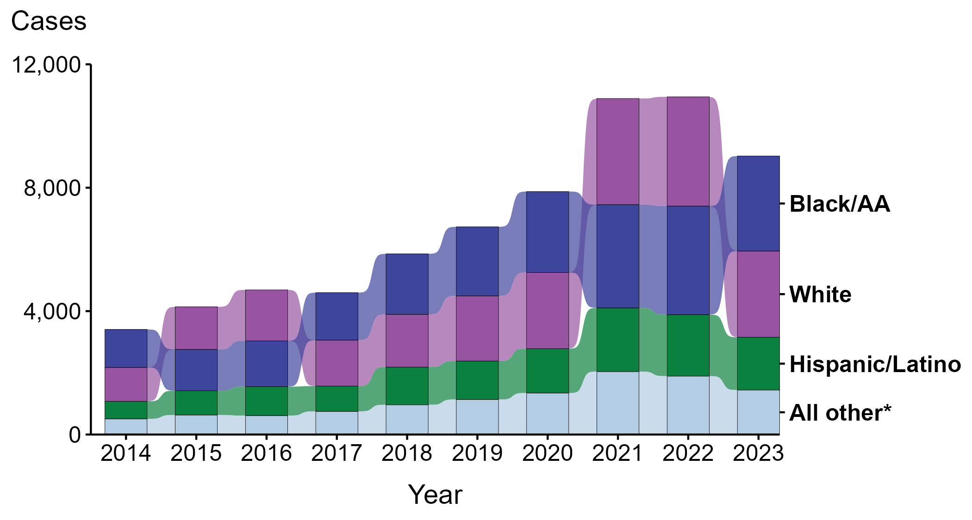
Primary and Secondary Syphilis — Reported Cases Among Men with Unknown Sex of Sex Partners by Race and Hispanic Ethnicity, United States, 2014–2023
* Includes all cases not captured in the labeled race and Hispanic ethnicity categories, including those with unknown or missing race and Hispanic ethnicity. This category is intended to show the balance of primary and secondary (P&S) syphilis cases among men with unknown sex of sex partners (MSU) and should not be interpreted independently.
Notes:
During 2014 to 2023, the largest percentage (32.8%) of primary and secondary (P&S) syphilis cases among men with unknown sex of sex partners (MSU) were reported to be non-Hispanic Black or African American.
During 2022 to 2023, case counts decreased among non-Hispanic White MSU (21.1% decrease; 3,541 to 2,795 cases), Hispanic or Latino MSU of any race(s) (14.2% decrease; 1,993 to 1,710 cases), and non-Hispanic Black or African American MSU (12.5% decrease; 3,519 to 3,080 cases).
During 2014 to 2023, case counts increased among Hispanic or Latino MSU of any race(s) (201.1% increase; 568 to 1,710 cases), non-Hispanic White MSU (154.8% increase; 1,097 to 2,795 cases), and non-Hispanic Black or African American MSU (149.8% increase; 1,233 to 3,080 cases).
This report includes data from years that coincide with the COVID-19 pandemic, which introduced uncertainty and difficulty in interpreting STI surveillance data. See Impact of COVID-19 on STIs (https://www.cdc.gov/sti-statistics/about/impact-of-covid-19.html) for more information.
See Technical Notes (https://www.cdc.gov/sti-statistics/annual/technical-notes.html) for information on STI case reporting formats and practices, including collected and derived variables displayed in this report. Table A (https://www.cdc.gov/sti-statistics/data-vis/table-selected-percunknown.html) provides information on unknown, missing, or invalid values of select variables.
Data for all figures are available at https://www.cdc.gov/sti-statistics/media/files/2024/11/2023-STI-Surveillance-Report-Data-Points.zip. The file “PS Syphilis - Cases MSU by Race Hispanic Ethnicity (US 2014-2023) .xlsx” contains the data for the figure presented on this slide.

Slide 12
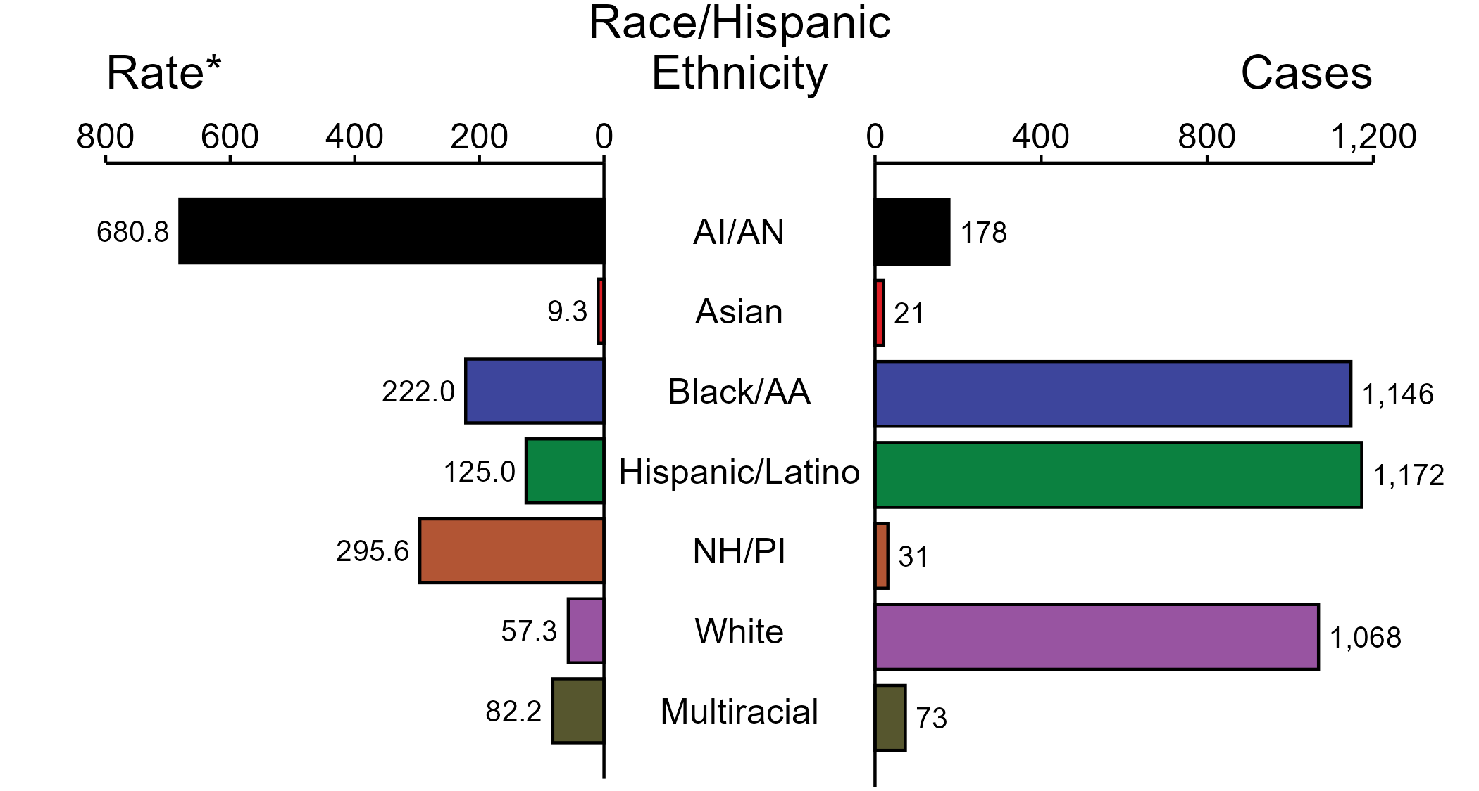
Congenital Syphilis — Case Counts and Rates of Reported Cases by Race/Hispanic Ethnicity of Birth Parent, United States, 2023
* Per 100,000 live births
ACRONYMS: AI/AN = American Indian or Alaska Native; Black/AA = Black or African American; NH/PI = Native Hawaiian or other Pacific Islander
NOTE: In 2023, a total of 193 congenital syphilis (CS) cases (5.0%) had missing, unknown, or other race and were not reported to be of Hispanic ethnicity. These cases are not shown in this figure. Including these cases, there were a total of 3,882 cases of CS reported among states and the District of Columbia for a rate of 105.8 per 100,000 live births.
Notes:
In 2023, there were a total of 3,882 cases of congenital syphilis (CS) reported among states and the District of Columbia for a rate of 105.8 per 100,000 live births.
In 2023, rates of CS were highest among birth parents who were non-Hispanic American Indian or Alaska Native (680.8 per 100,000 live births), followed by birth parents who were non-Hispanic Native Hawaiian or other Pacific Islander (295.6 per 100,000 live births) and birth parents who were non-Hispanic Black or African American (222.0 per 100,000 live births). The greatest number of reported CS cases was among birth parents who were Hispanic or Latino and of any race(s) (1,172 cases), followed by birth parents who were non-Hispanic Black or African American (1,146 cases) and birth parents who were non-Hispanic White (1,068 cases).
This report includes data from years that coincide with the COVID-19 pandemic, which introduced uncertainty and difficulty in interpreting STI surveillance data. See Impact of COVID-19 on STIs (https://www.cdc.gov/sti-statistics/about/impact-of-covid-19.html) for more information.
See Technical Notes (https://www.cdc.gov/sti-statistics/annual/technical-notes.html) for information on STI case reporting formats and practices, including collected and derived variables displayed in this report. Table A (https://www.cdc.gov/sti-statistics/data-vis/table-selected-percunknown.html) provides information on unknown, missing, or invalid values of select variables.
Data for all figures are available at https://www.cdc.gov/sti-statistics/media/files/2024/11/2023-STI-Surveillance-Report-Data-Points.zip. The file “CS - Counts and Rates by Race Hispanic Ethnicity of Birth Parent (US 2023).xlsx” contains the data for the figure presented on this slide.

Slide 13
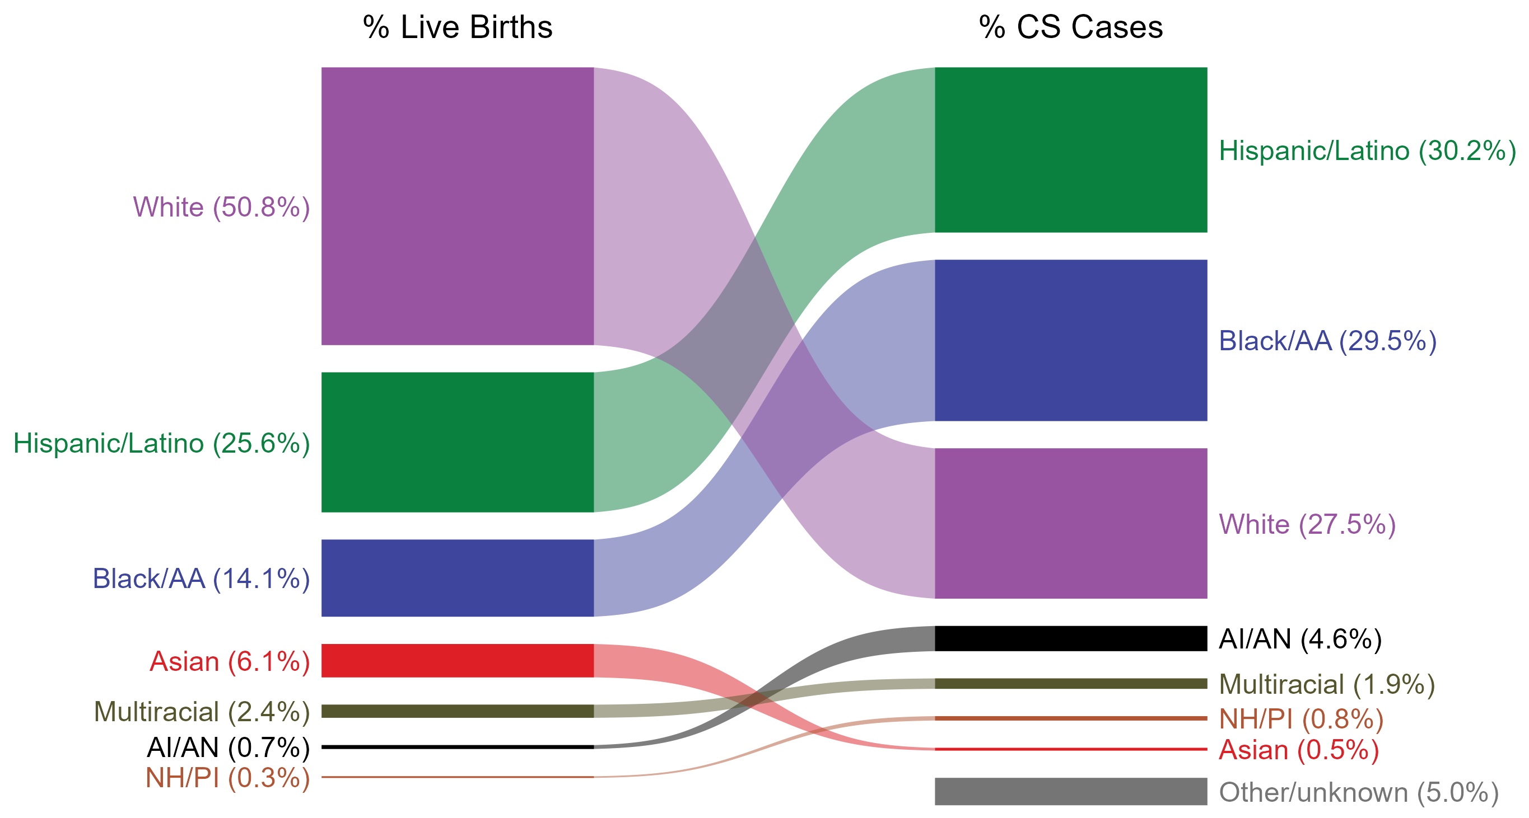
Congenital Syphilis — Total Live Births and Reported Cases by Race/Hispanic Ethnicity of Birth Parent, United States, 2023
NOTE: In 2023, a total of 193 congenital syphilis cases (5.0%) had missing, unknown, or other race and were not reported to be of Hispanic ethnicity. These cases are included in the “other/unknown” category.
ACRONYMS: AI/AN = American Indian or Alaska Native; Black/AA = Black or African American; NH/PI = Native Hawaiian or other Pacific Islander
Notes:
In 2023, there were a total of 3,882 cases of congenital syphilis (CS) reported among states and the District of Columbia for a rate of 105.8 per 100,000 live births.
The percentages of CS cases by race/Hispanic ethnicity of birth parent were disproportionate to the percentages among live births in the United States in 2023. The greatest absolute disparity was observed among non-Hispanic Black or African American birth parents, who represented 29.5% of reported CS cases (n = 1,146; 29.5% of CS cases with reported race or Hispanic ethnicity of birth parent) despite being 14.1% of the live births, or 15.4% more cases than would be expected based on their proportion of live births. The greatest relative disparity was among non-Hispanic American Indian or Alaska Native birth parents, who represented 4.6% of reported CS cases (n = 178; 4.6% of CS cases with reported race or Hispanic ethnicity of birth parent) despite being 0.7% of live births, or a burden 6.6 times what would be expected based on their proportion of live births. Additionally, Hispanic or Latino birth parents of any race(s) and non-Hispanic Native Hawaiian or other Pacific Islander birth parents were also overrepresented among CS cases relative to their proportion of live births.
This report includes data from years that coincide with the COVID-19 pandemic, which introduced uncertainty and difficulty in interpreting STI surveillance data. See Impact of COVID-19 on STIs (https://www.cdc.gov/sti-statistics/about/impact-of-covid-19.html) for more information.
See Technical Notes (https://www.cdc.gov/sti-statistics/annual/technical-notes.html) for information on STI case reporting formats and practices, including collected and derived variables displayed in this report. Table A (https://www.cdc.gov/sti-statistics/data-vis/table-selected-percunknown.html) provides information on unknown, missing, or invalid values of select variables.
Data for all figures are available at https://www.cdc.gov/sti-statistics/media/files/2024/11/2023-STI-Surveillance-Report-Data-Points.zip. The file “CS - Live Births and Cases by Race Hispanic Ethnicity of Birth Parent (US 2023).xlsx” contains the data for the figure presented on this slide.

Slide 14
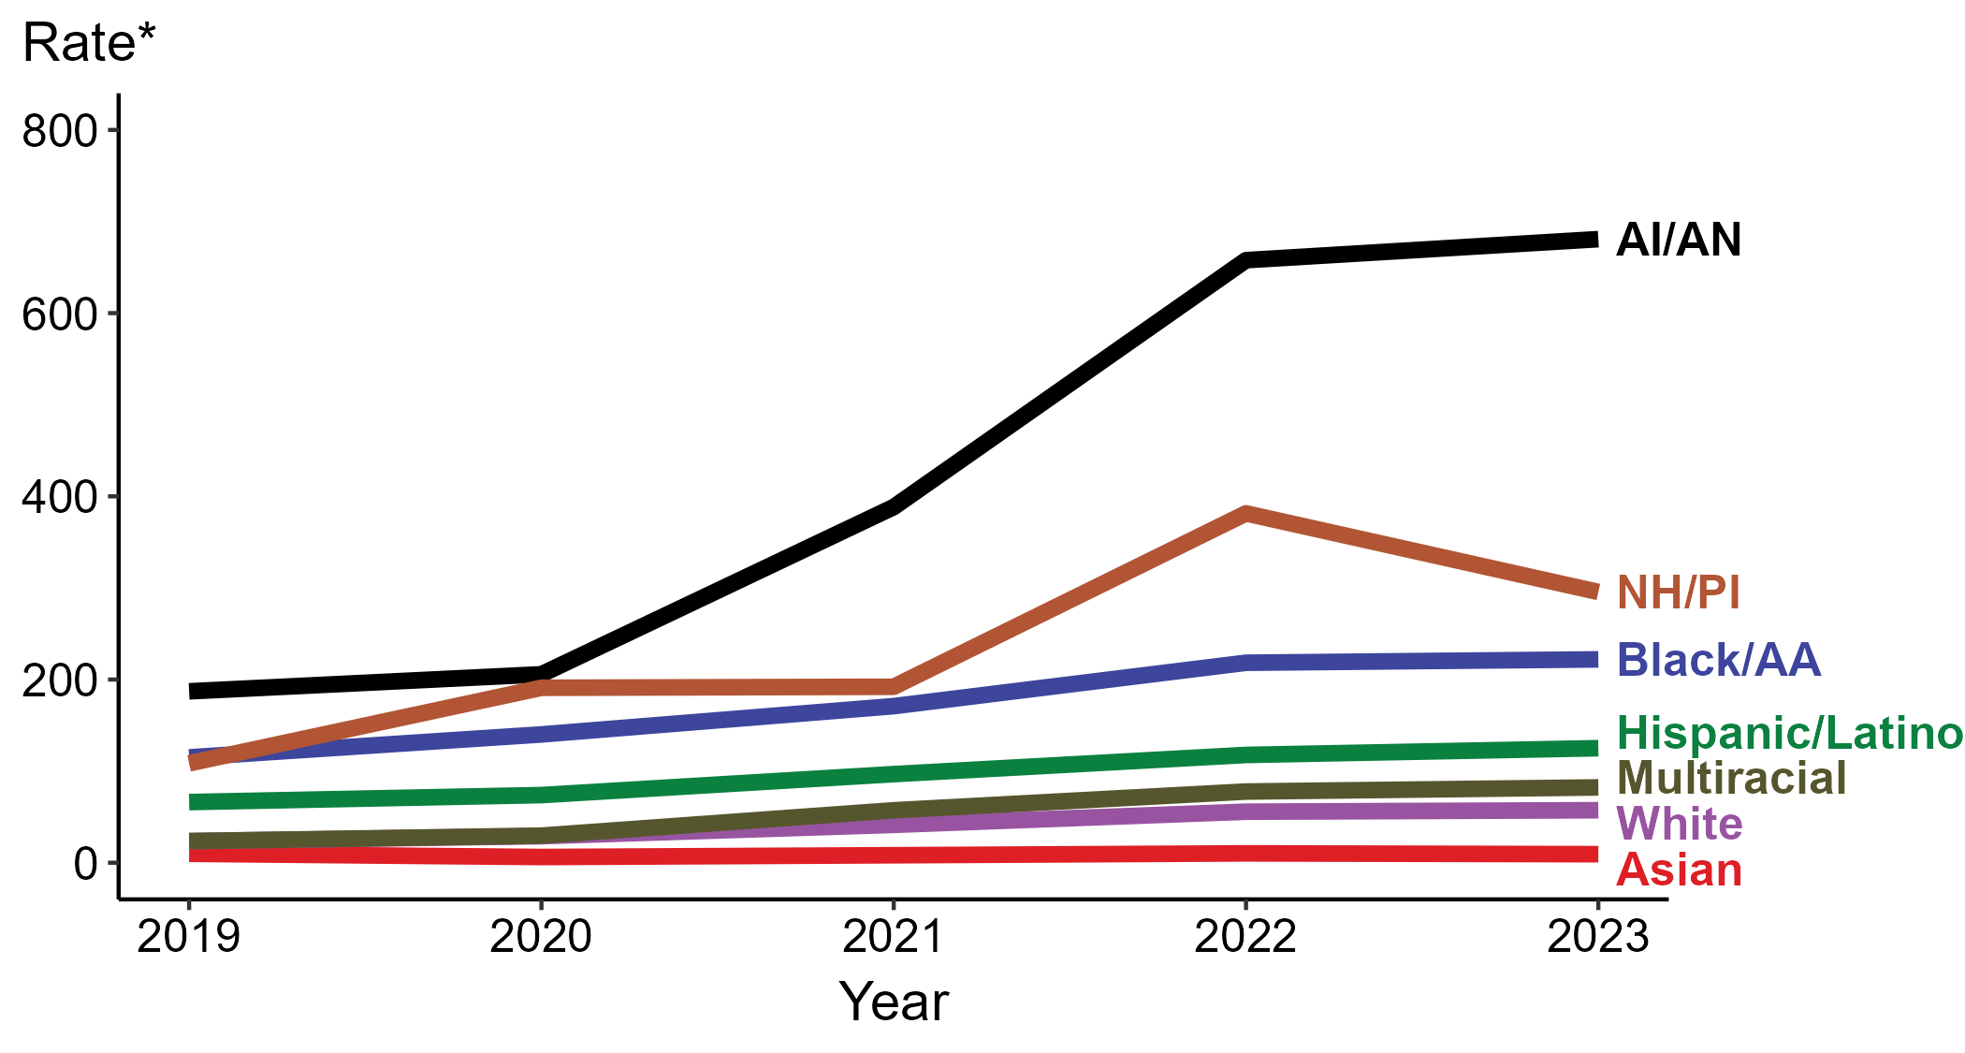
Congenital Syphilis — Rates of Reported Cases by Race/Hispanic Ethnicity of Birth Parent and Year of Birth, United States, 2019–2023
* Per 100,000 live births
ACRONYMS: AI/AN = American Indian or Alaska Native; Black/AA = Black or African American; NH/PI = Native Hawaiian or other Pacific Islander
NOTE: During 2019 to 2023, the percentage of all congenital syphilis cases with missing, unknown, or other race and not reported to be of Hispanic ethnicity was 5.2%, from a low of 5.0% (n = 193) in 2023 and 2019 to a high of 5.5% (n = 119) in 2020. These cases are not shown in this figure.
Notes:
In 2023, there were a total of 3,882 cases of congenital syphilis (CS) reported among states and the District of Columbia for a rate of 105.8 per 100,000 live births.
In 2023, the highest rate of reported cases of CS per 100,000 live births was among birth parents who were non-Hispanic American Indian or Alaska Native (680.8), followed by birth parents who were non-Hispanic Native Hawaiian or other Pacific Islander (295.6).
During 2022 to 2023, the greatest increase in rate of reported cases of CS per 100,000 live births was among birth parents who were Hispanic or Latino and of any race(s) (117.7 to 125.0; 6.2% increase). Birth parents who were non-Hispanic American Indian or Alaska Native had the greatest five-year increase in rate of CS (187.1 to 680.8; 263.9% increase from 2019).
During 2022 to 2023, the greatest decrease in rate of reported cases of CS per 100,000 live births was among birth parents who were non-Hispanic Native Hawaiian or other Pacific Islander (381.4 to 295.6; 22.5% decrease). Birth parents who were non-Hispanic Asian had the only five-year decrease in rate of CS (9.8 to 9.3; 5.1% decrease from 2019).
This report includes data from years that coincide with the COVID-19 pandemic, which introduced uncertainty and difficulty in interpreting STI surveillance data. See Impact of COVID-19 on STIs (https://www.cdc.gov/sti-statistics/about/impact-of-covid-19.html) for more information.
See Technical Notes (https://www.cdc.gov/sti-statistics/annual/technical-notes.html) for information on STI case reporting formats and practices, including collected and derived variables displayed in this report. Table A (https://www.cdc.gov/sti-statistics/data-vis/table-selected-percunknown.html) provides information on unknown, missing, or invalid values of select variables.
Data for all figures are available at https://www.cdc.gov/sti-statistics/media/files/2024/11/2023-STI-Surveillance-Report-Data-Points.zip. The file “CS - Rates by Race Hispanic Ethnicity of Birth Parent (US 2019-2023).xlsx” contains the data for the figure presented on this slide.

Slide 15
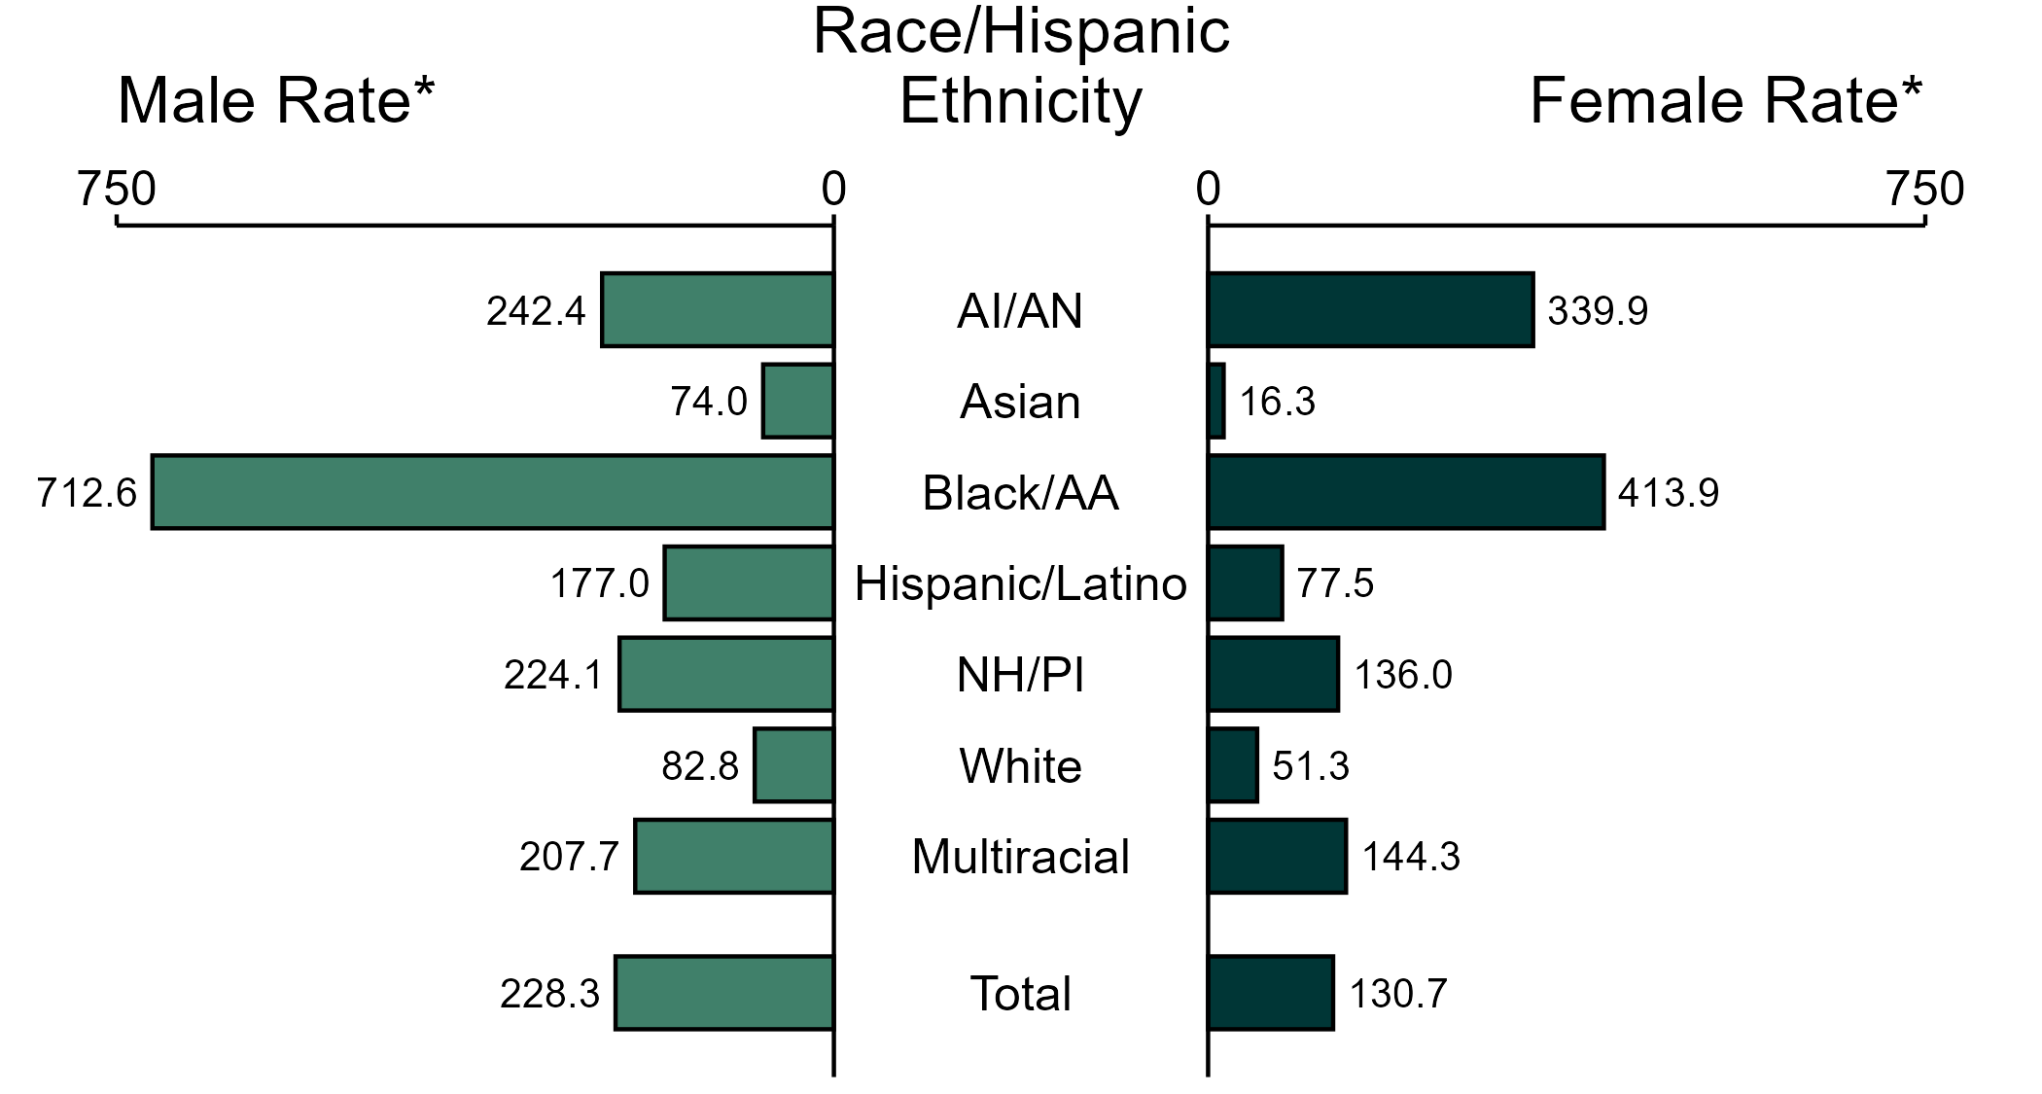
Gonorrhea — Rates of Reported Cases by Race/Hispanic Ethnicity and Sex, United States, 2023
* Per 100,000
ACRONYMS: AI/AN = American Indian or Alaska Native; Black/AA = Black or African American; NH/PI = Native Hawaiian or other Pacific Islander
NOTE: In 2023, 75,705 gonorrhea cases among men (20.0%) and 42,245 cases among women (19.1%) had missing, unknown, or other race and were not reported to be of Hispanic ethnicity. These cases are included in the total rates.
Notes:
In 2023, the rate of reported gonorrhea was higher among men (228.3 per 100,000) compared to women (130.7 per 100,000).
Among men, non-Hispanic Black or African American men had the highest rate of reported cases of gonorrhea (712.6 per 100,000), followed by non-Hispanic American Indian or Alaska Native men (242.4 per 100,000) and non-Hispanic Native Hawaiian or other Pacific Islander men (224.1 per 100,000). Among women, non-Hispanic Black or African American women also had the highest rate of reported cases of gonorrhea (413.9 per 100,000), followed by non-Hispanic American Indian or Alaska Native women (339.9 per 100,000) and non-Hispanic women of multiple races (144.3 per 100,000).
Using non-Hispanic White persons as the referent category, the greatest relative disparity in rates of reported gonorrhea by race and Hispanic ethnicity across both sexes was observed among non-Hispanic Black or African American men, with a rate ratio of 8.6 times that of non-Hispanic White men. Among women, the greatest relative disparity was observed among non-Hispanic Black or African American women as well, with a rate 8.1 times that of non-Hispanic White women.
This report includes data from years that coincide with the COVID-19 pandemic, which introduced uncertainty and difficulty in interpreting STI surveillance data. See Impact of COVID-19 on STIs (https://www.cdc.gov/sti-statistics/about/impact-of-covid-19.html) for more information.
See Technical Notes (https://www.cdc.gov/sti-statistics/annual/technical-notes.html) for information on STI case reporting formats and practices, including collected and derived variables displayed in this report. Table A (https://www.cdc.gov/sti-statistics/data-vis/table-selected-percunknown.html) provides information on unknown, missing, or invalid values of select variables.
Data for all figures are available at https://www.cdc.gov/sti-statistics/media/files/2024/11/2023-STI-Surveillance-Report-Data-Points.zip. The file “GC - Rates by Race Hispanic Ethnicity and Sex (US 2023).xlsx” contains the data for the figure presented on this slide.

Slide 16
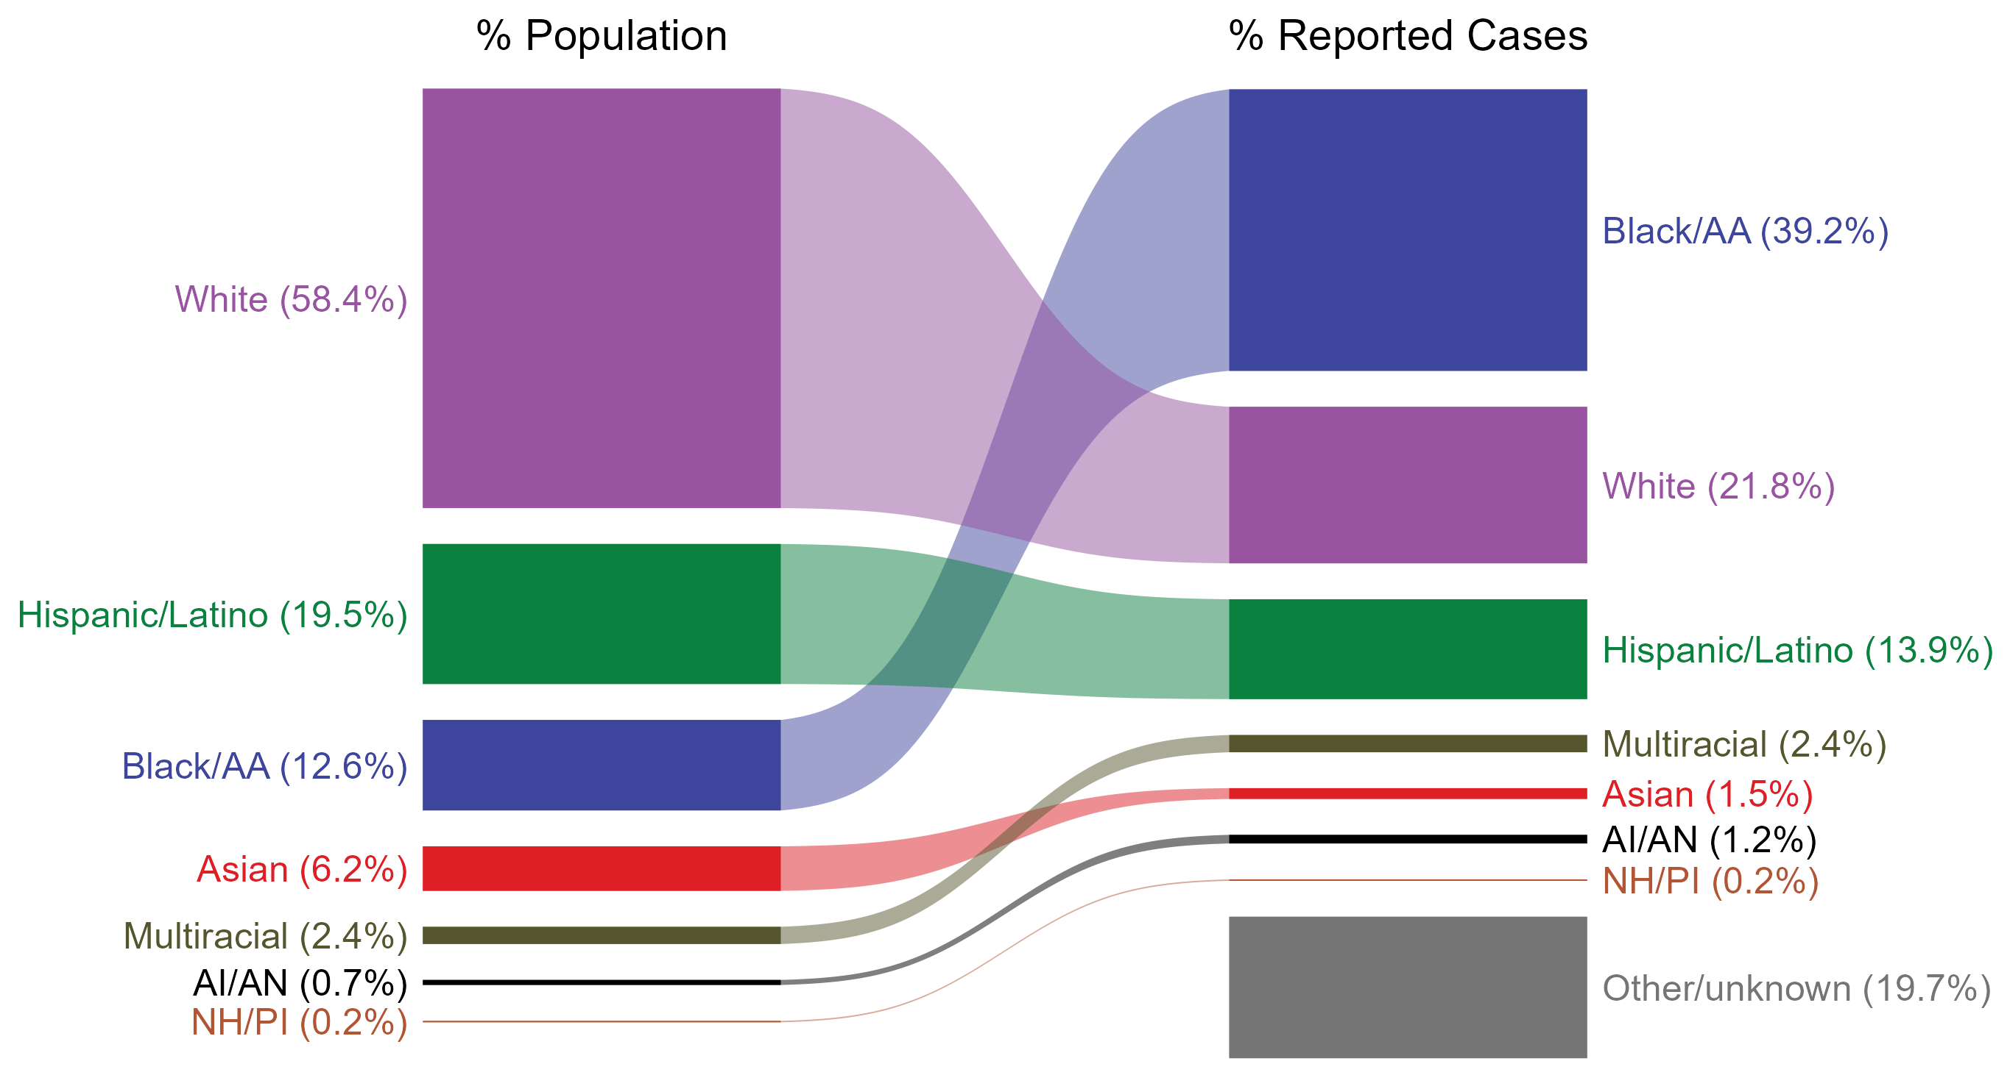
Gonorrhea — Total Population and Reported Cases by Race/Hispanic Ethnicity, United States, 2023
ACRONYMS: AI/AN = American Indian or Alaska Native; Black/AA = Black or African American; NH/PI = Native Hawaiian or other Pacific Islander
NOTE: In 2023, a total of 118,750 gonorrhea cases (19.7%) had missing, unknown, or other race and were not reported to be of Hispanic ethnicity. These cases are included in the “other/unknown” category.
Notes:
The percentages of gonorrhea cases by race and Hispanic ethnicity were disproportionate to the percentages among the total population of the United States in 2023. The greatest absolute and relative disparities were observed among non-Hispanic Black or African American persons, who represented 39.2% of reported gonorrhea cases (n = 236,011; 48.9% of gonorrhea cases with reported race or Hispanic ethnicity) despite being 12.6% of the US population. This means that the burden of gonorrhea among non-Hispanic Black or African American persons was 26.6% greater than — or 3.1 times — what would be expected based on their proportion of the population. Additionally, non-Hispanic American Indian or Alaska Native persons were also overrepresented among gonorrhea cases relative to their proportion of the population.
This report includes data from years that coincide with the COVID-19 pandemic, which introduced uncertainty and difficulty in interpreting STI surveillance data. See Impact of COVID-19 on STIs (https://www.cdc.gov/sti-statistics/about/impact-of-covid-19.html) for more information.
See Technical Notes (https://www.cdc.gov/sti-statistics/annual/technical-notes.html) for information on STI case reporting formats and practices, including collected and derived variables displayed in this report. Table A (https://www.cdc.gov/sti-statistics/data-vis/table-selected-percunknown.html) provides information on unknown, missing, or invalid values of select variables.
Data for all figures are available at https://www.cdc.gov/sti-statistics/media/files/2024/11/2023-STI-Surveillance-Report-Data-Points.zip. The file “GC - Population and Cases by Race Hispanic Ethnicity (US 2023).xlsx” contains the data for the figure presented on this slide.

Slide 17
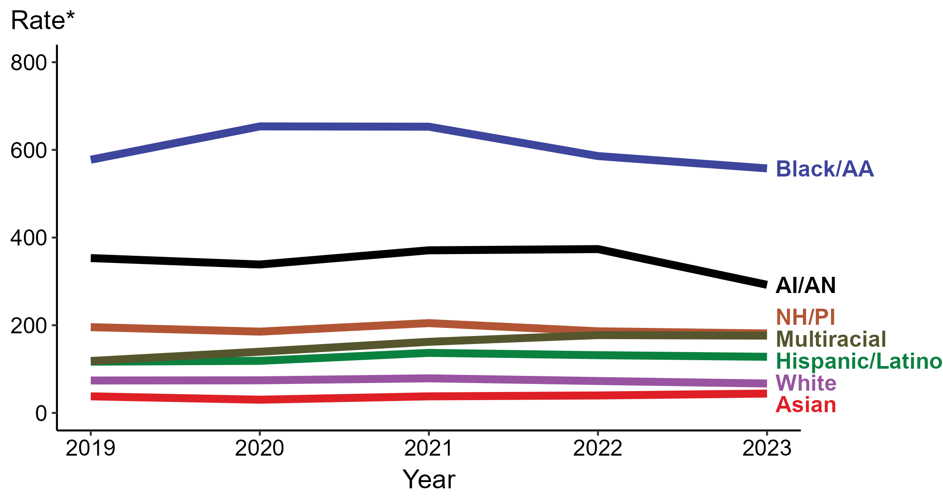
Gonorrhea — Rates of Reported Cases by Race/Hispanic Ethnicity, United States, 2019–2023
* Per 100,000
ACRONYMS: AI/AN = American Indian or Alaska Native; Black/AA = Black or African American; NH/PI = Native Hawaiian or other Pacific Islander
NOTE: During 2019 to 2023, the percentage of all gonorrhea cases with missing, unknown, or other race and not reported to be of Hispanic ethnicity was 22.2%, from a low of 19.7% (n = 118,750) in 2023 to a high of 23.4% (n = 158,822) in 2020. These cases are not shown in this figure.
Notes:
In 2023, the highest rate of reported gonorrhea cases was among non-Hispanic Black or African American persons (557.8 per 100,000), followed by non-Hispanic American Indian or Alaska Native persons (292.2 per 100,000).
During 2022 to 2023, the only increase in rate of reported gonorrhea cases was among non-Hispanic Asian persons (39.8 to 44.2 per 100,000; 11.1% increase). Non-Hispanic persons of multiple races had the greatest five-year increase in rate of reported gonorrhea (118.4 to 176.3 per 100,000; 48.9% increase from 2019).
During 2022 to 2023, the greatest decrease in rate of reported gonorrhea cases was among non-Hispanic American Indian or Alaska Native persons (373.7 to 292.2 per 100,000; 21.8% decrease). Non-Hispanic American Indian or Alaska Native persons also had the greatest five-year decrease in rate of reported gonorrhea (353.2 to 292.2 per 100,000; 17.3% decrease from 2019).
This report includes data from years that coincide with the COVID-19 pandemic, which introduced uncertainty and difficulty in interpreting STI surveillance data. See Impact of COVID-19 on STIs (https://www.cdc.gov/sti-statistics/about/impact-of-covid-19.html) for more information.
See Technical Notes (https://www.cdc.gov/sti-statistics/annual/technical-notes.html) for information on STI case reporting formats and practices, including collected and derived variables displayed in this report. Table A (https://www.cdc.gov/sti-statistics/data-vis/table-selected-percunknown.html) provides information on unknown, missing, or invalid values of select variables.
Data for all figures are available at https://www.cdc.gov/sti-statistics/media/files/2024/11/2023-STI-Surveillance-Report-Data-Points.zip. The file “GC - Rates by Race Hispanic Ethnicity (US 2019-2023).xlsx” contains the data for the figure presented on this slide.

Slide 18
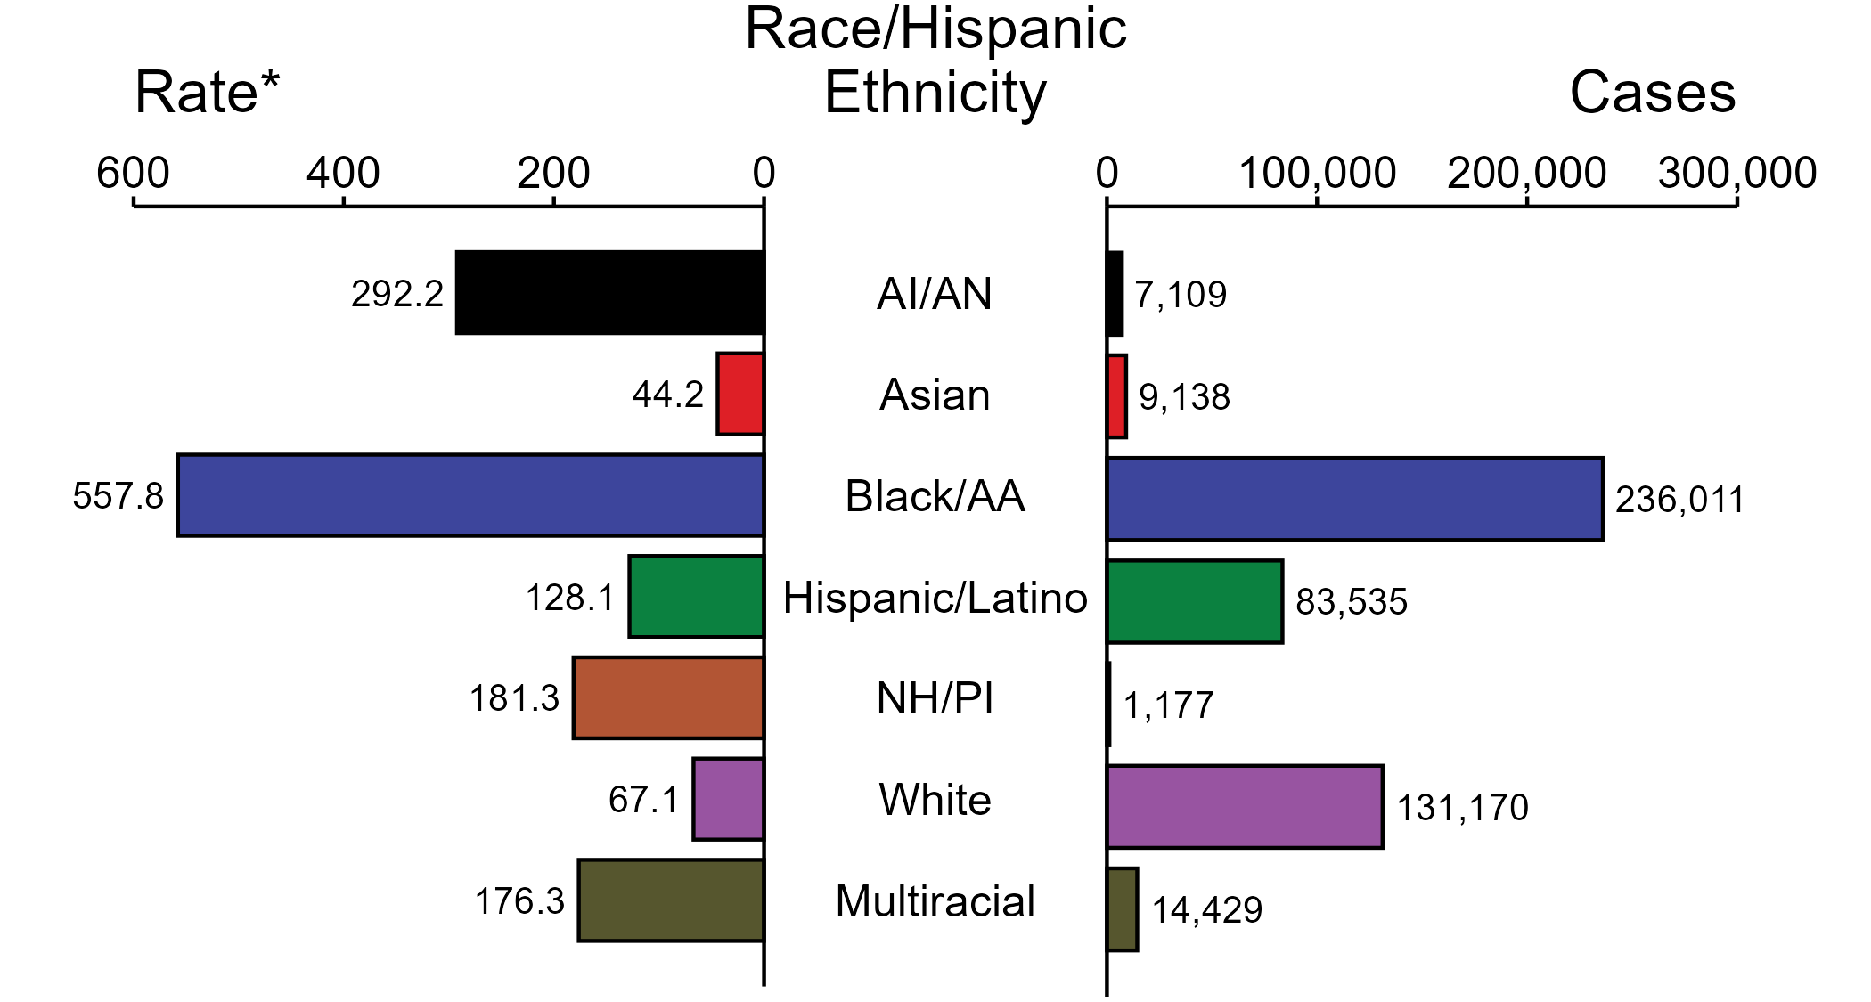
Gonorrhea — Case Counts and Rates of Reported Cases by Race/Hispanic Ethnicity and Year, United States, 2023
* Per 100,000
ACRONYMS: AI/AN = American Indian or Alaska Native; Black/AA = Black or African American; NH/PI = Native Hawaiian or other Pacific Islander
NOTE: In 2023, a total of 118,750 gonorrhea cases (19.7%) had missing, unknown, or other race and were not reported to be of Hispanic ethnicity. These cases are not shown in this figure. Including these cases, there were a total of 601,319 cases of gonorrhea reported among states and the District of Columbia for a rate of 179.5 per 100,000 persons.
Notes:
In 2023, rates of gonorrhea were highest among non-Hispanic Black or African American persons (557.8 per 100,000), followed by non-Hispanic American Indian or Alaska Native persons (292.2 per 100,000) and non-Hispanic Native Hawaiian or other Pacific Islander persons (181.3 per 100,000). The greatest number of reported gonorrhea cases was among non-Hispanic Black or African American persons (236,011 cases), followed by non-Hispanic White persons (131,170 cases) and Hispanic or Latino persons of any race(s) (83,535 cases).
This report includes data from years that coincide with the COVID-19 pandemic, which introduced uncertainty and difficulty in interpreting STI surveillance data. See Impact of COVID-19 on STIs (https://www.cdc.gov/sti-statistics/about/impact-of-covid-19.html) for more information.
See Technical Notes (https://www.cdc.gov/sti-statistics/annual/technical-notes.html) for information on STI case reporting formats and practices, including collected and derived variables displayed in this report. Table A (https://www.cdc.gov/sti-statistics/data-vis/table-selected-percunknown.html) provides information on unknown, missing, or invalid values of select variables.
Data for all figures are available at https://www.cdc.gov/sti-statistics/media/files/2024/11/2023-STI-Surveillance-Report-Data-Points.zip. The file “GC - Cases and Rates by Race Hispanic Ethnicity (US 2023).xlsx” contains the data for the figure presented on this slide.

Slide 19
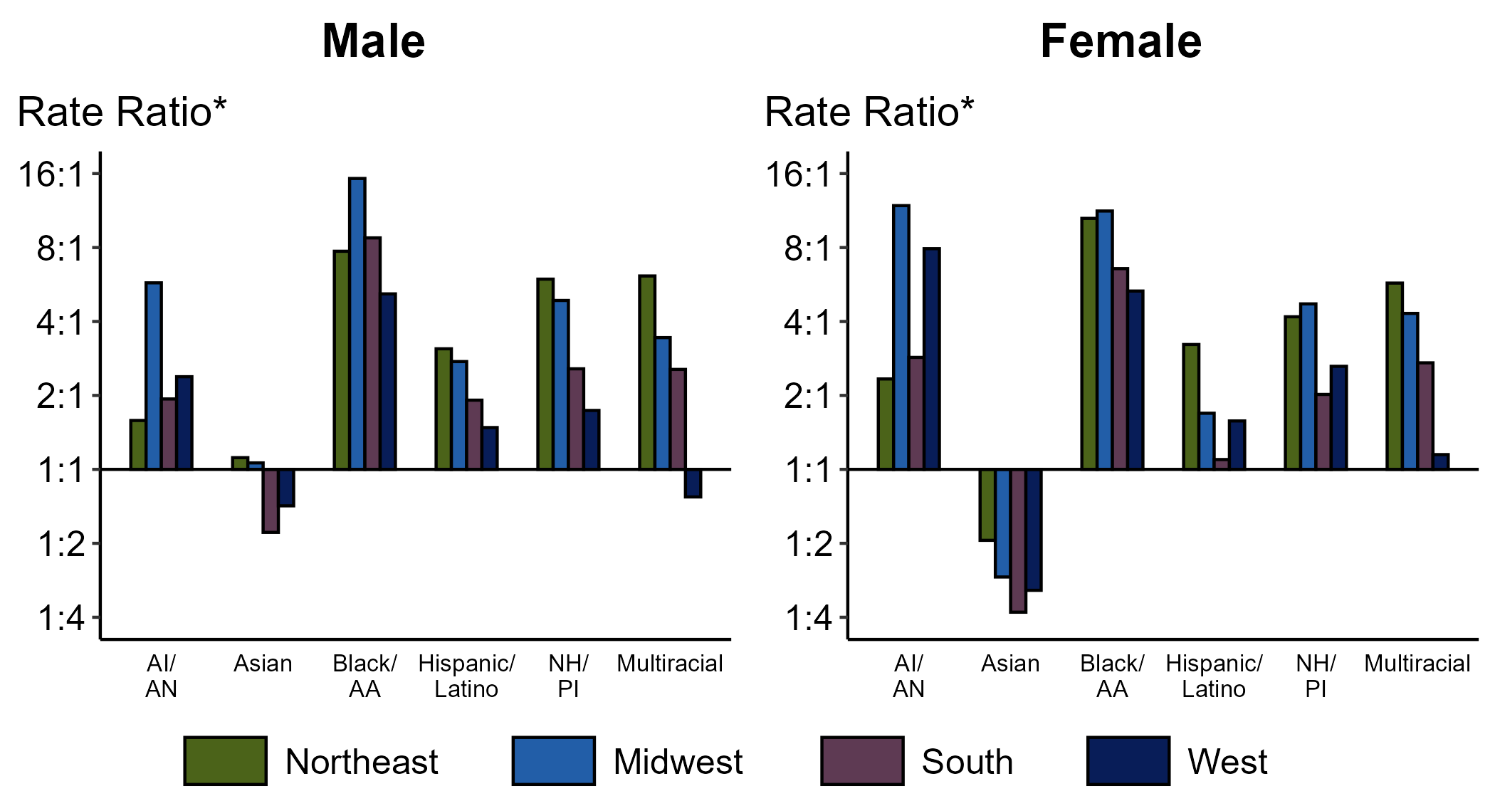
Gonorrhea — Ratios of Rates of Reported Cases by Sex, Race/Hispanic Ethnicity, and Region, United States, 2023
* For the rate ratios, non-Hispanic White persons are the referent population. Y-axis is log scale.
ACRONYMS: AI/AN = American Indian or Alaska Native; Black/AA = Black or African American; NH/PI = Native Hawaiian or other Pacific Islander
Notes:
Among men and women, rate ratios of rates of reported gonorrhea by race/Hispanic ethnicity (using non-Hispanic White persons as the referent population) varied by region in 2023. Among men, the greatest rate ratio was in the Midwest where the rate of reported gonorrhea among non-Hispanic Black or African American men was 15.3 times the rate among non-Hispanic White men. Among women, the greatest rate ratio was in the Midwest where the rate of reported gonorrhea among non-Hispanic American Indian or Alaska Native women was 11.9 times the rate among non-Hispanic White women.
This report includes data from years that coincide with the COVID-19 pandemic, which introduced uncertainty and difficulty in interpreting STI surveillance data. See Impact of COVID-19 on STIs (https://www.cdc.gov/sti-statistics/about/impact-of-covid-19.html) for more information.
See Technical Notes (https://www.cdc.gov/sti-statistics/annual/technical-notes.html) for information on STI case reporting formats and practices, including collected and derived variables displayed in this report. Table A (https://www.cdc.gov/sti-statistics/data-vis/table-selected-percunknown.html) provides information on unknown, missing, or invalid values of select variables.
Data for all figures are available at https://www.cdc.gov/sti-statistics/media/files/2024/11/2023-STI-Surveillance-Report-Data-Points.zip. The file “GC - Ratios of Rates by Sex Race Hispanic Ethnicity and Region (US 2023).xlsx” contains the data for the figure presented on this slide.

Slide 20
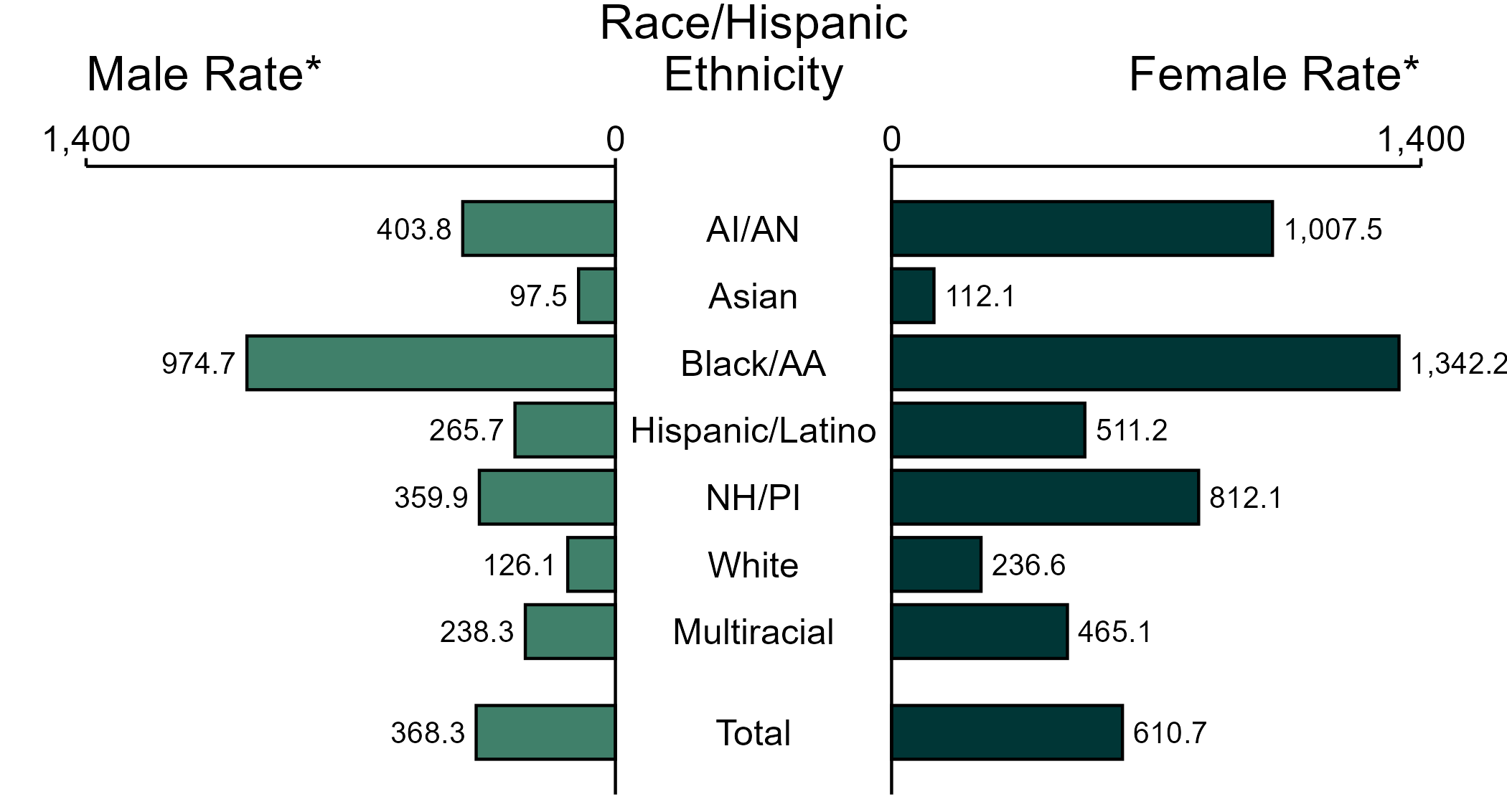
Chlamydia — Rates of Reported Cases by Race/Hispanic Ethnicity and Sex, United States, 2023
* Per 100,000
ACRONYMS: AI/AN = American Indian or Alaska Native; Black/AA = Black or African American; NH/PI = Native Hawaiian or other Pacific Islander
NOTE: In 2023, 177,355 chlamydia cases among men (29.1%) and 293,445 cases among women (28.4%) had missing, unknown, or other race and were not reported to be of Hispanic ethnicity. These cases are included in the total rates.
Notes:
In 2023, the rate of reported chlamydia was higher among women (610.7 per 100,000) compared to men (368.3 per 100,000).
Among women, non-Hispanic Black or African American women had the highest rate of reported cases of chlamydia (1,342.2 per 100,000), followed by non-Hispanic American Indian or Alaska Native women (1,007.5 per 100,000) and non-Hispanic Native Hawaiian or other Pacific Islander women (812.1 per 100,000). Among men, non-Hispanic Black or African American men also had the highest rate of reported cases of chlamydia (974.7 per 100,000), followed by non-Hispanic American Indian or Alaska Native men (403.8 per 100,000) and non-Hispanic Native Hawaiian or other Pacific Islander men (359.9 per 100,000).
Using non-Hispanic White persons as the referent category, the greatest relative disparity in rates of reported chlamydia by race and Hispanic ethnicity across both sexes was observed among non-Hispanic Black or African American men, with a rate ratio of 7.7 times that of non-Hispanic White men. Among women, the greatest relative disparity was observed among non-Hispanic Black or African American women as well, with a rate 5.7 times that of non-Hispanic White women.
This report includes data from years that coincide with the COVID-19 pandemic, which introduced uncertainty and difficulty in interpreting STI surveillance data. See Impact of COVID-19 on STIs (https://www.cdc.gov/sti-statistics/about/impact-of-covid-19.html) for more information.
See Technical Notes (https://www.cdc.gov/sti-statistics/annual/technical-notes.html) for information on STI case reporting formats and practices, including collected and derived variables displayed in this report. Table A (https://www.cdc.gov/sti-statistics/data-vis/table-selected-percunknown.html) provides information on unknown, missing, or invalid values of select variables.
Data for all figures are available at https://www.cdc.gov/sti-statistics/media/files/2024/11/2023-STI-Surveillance-Report-Data-Points.zip. The file “CT - Rates by Race Hispanic Ethnicity and Sex (US 2023).xlsx” contains the data for the figure presented on this slide.

Slide 21
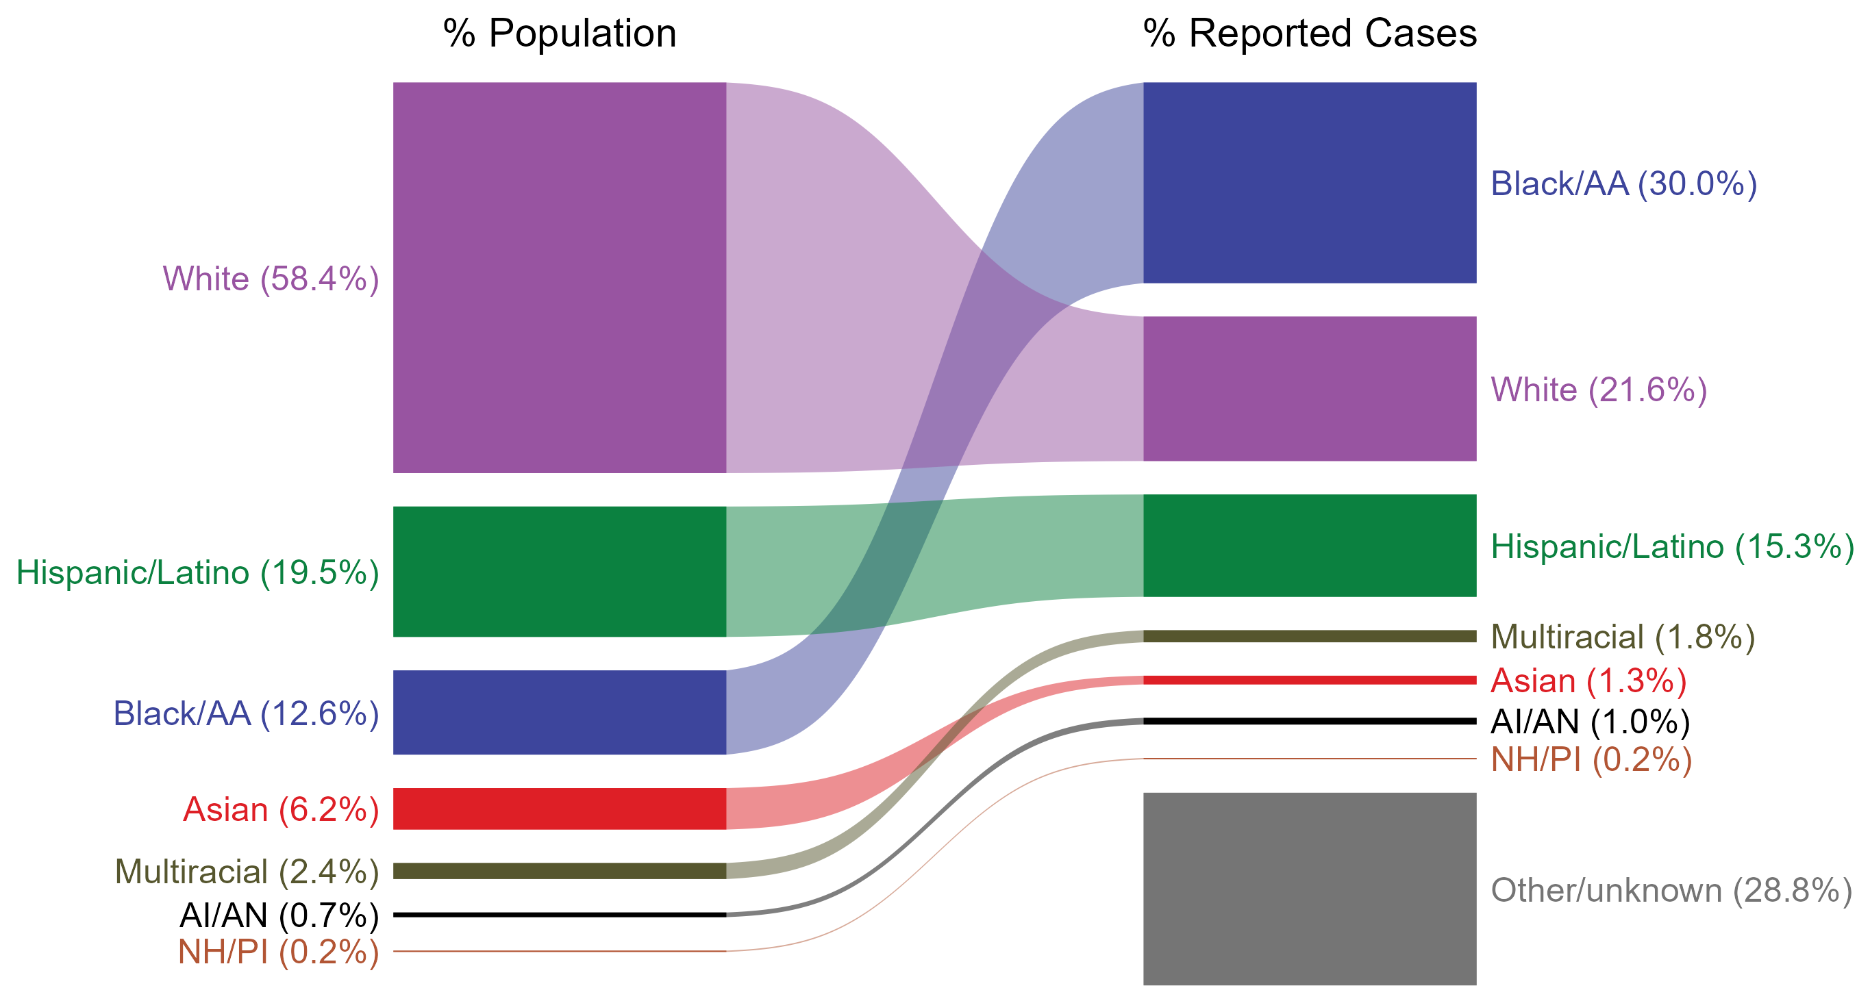
Chlamydia — Total Population and Reported Cases by Race/Hispanic Ethnicity, United States, 2023
ACRONYMS: AI/AN = American Indian or Alaska Native; Black/AA = Black or African American; NH/PI = Native Hawaiian or other Pacific Islander
NOTE: In 2023, a total of 474,218 chlamydia cases (28.8%) had missing, unknown, or other race and were not reported to be of Hispanic ethnicity. These cases are included in the “other/unknown” category.
Notes:
The percentages of chlamydia cases by race and Hispanic ethnicity were disproportionate to the percentages among the total population of the United States in 2023. The greatest absolute and relative disparities were observed among non-Hispanic Black or African American persons, who represented 30.0% of reported chlamydia cases (n = 493,754; 42.0% of chlamydia cases with reported race or Hispanic ethnicity) despite being 12.6% of the US population. This means that the burden of chlamydia among non-Hispanic Black or African American persons was 17.4% greater than — or 2.4 times — what would be expected based on their proportion of the population. Additionally, non-Hispanic American Indian or Alaska Native persons were also overrepresented among chlamydia cases relative to their proportion of the population.
This report includes data from years that coincide with the COVID-19 pandemic, which introduced uncertainty and difficulty in interpreting STI surveillance data. See Impact of COVID-19 on STIs (https://www.cdc.gov/sti-statistics/about/impact-of-covid-19.html) for more information.
See Technical Notes (https://www.cdc.gov/sti-statistics/annual/technical-notes.html) for information on STI case reporting formats and practices, including collected and derived variables displayed in this report. Table A (https://www.cdc.gov/sti-statistics/data-vis/table-selected-percunknown.html) provides information on unknown, missing, or invalid values of select variables.
Data for all figures are available at https://www.cdc.gov/sti-statistics/media/files/2024/11/2023-STI-Surveillance-Report-Data-Points.zip. The file “CT - Population and Cases by Race Hispanic Ethnicity (US 2023).xlsx” contains the data for the figure presented on this slide.

Slide 22
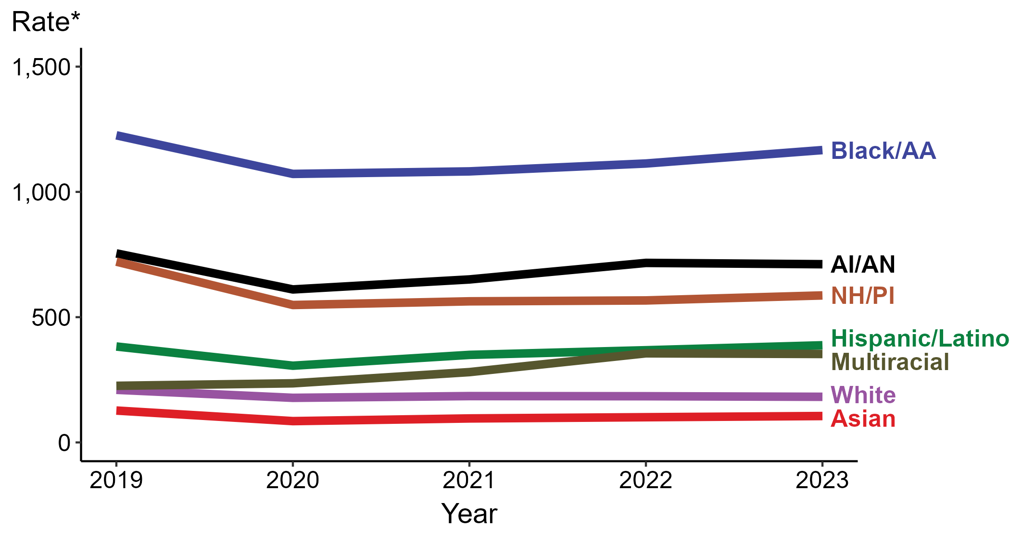
Chlamydia — Rates of Reported Cases by Race/Hispanic Ethnicity and Year, United States, 2019–2023
* Per 100,000
ACRONYMS: AI/AN = American Indian or Alaska Native; Black/AA = Black or African American; NH/PI = Native Hawaiian or other Pacific Islander
NOTE: During 2019 to 2023, the percentage of all chlamydia cases with missing, unknown, or other race and not reported to be of Hispanic ethnicity was 32.1%, from a low of 28.8% (n = 474,218) in 2023 to a high of 34.1% (n = 538,834) in 2020. These cases are not shown in this figure.
Notes:
In 2023, the highest rate of reported chlamydia cases was among non-Hispanic Black or African American persons (1,166.9 per 100,000), followed by non-Hispanic American Indian or Alaska Native persons (711.3 per 100,000).
During 2022 to 2023, the greatest increase in rate of reported chlamydia cases was among Hispanic or Latino persons of any race(s) (368.0 to 387.7 per 100,000; 5.4% increase). Non-Hispanic persons of multiple races had the greatest five-year increase in rate of reported chlamydia (226.0 to 353.0 per 100,000; 56.2% increase from 2019).
During 2022 to 2023, the only decrease in rate of reported chlamydia cases was among non-Hispanic White persons (184.3 to 182.1 per 100,000; 1.2% decrease). Non-Hispanic Native Hawaiian or other Pacific Islander persons had the greatest five-year decrease in rate of reported chlamydia (721.6 to 586.7 per 100,000; 18.7% decrease from 2019).
This report includes data from years that coincide with the COVID-19 pandemic, which introduced uncertainty and difficulty in interpreting STI surveillance data. See Impact of COVID-19 on STIs (https://www.cdc.gov/sti-statistics/about/impact-of-covid-19.html) for more information.
See Technical Notes (https://www.cdc.gov/sti-statistics/annual/technical-notes.html) for information on STI case reporting formats and practices, including collected and derived variables displayed in this report. Table A (https://www.cdc.gov/sti-statistics/data-vis/table-selected-percunknown.html) provides information on unknown, missing, or invalid values of select variables.
Data for all figures are available at https://www.cdc.gov/sti-statistics/media/files/2024/11/2023-STI-Surveillance-Report-Data-Points.zip. The file “CT - Rates by Race Hispanic Ethnicity (US 2019-2023).xlsx” contains the data for the figure presented on this slide.

Slide 23
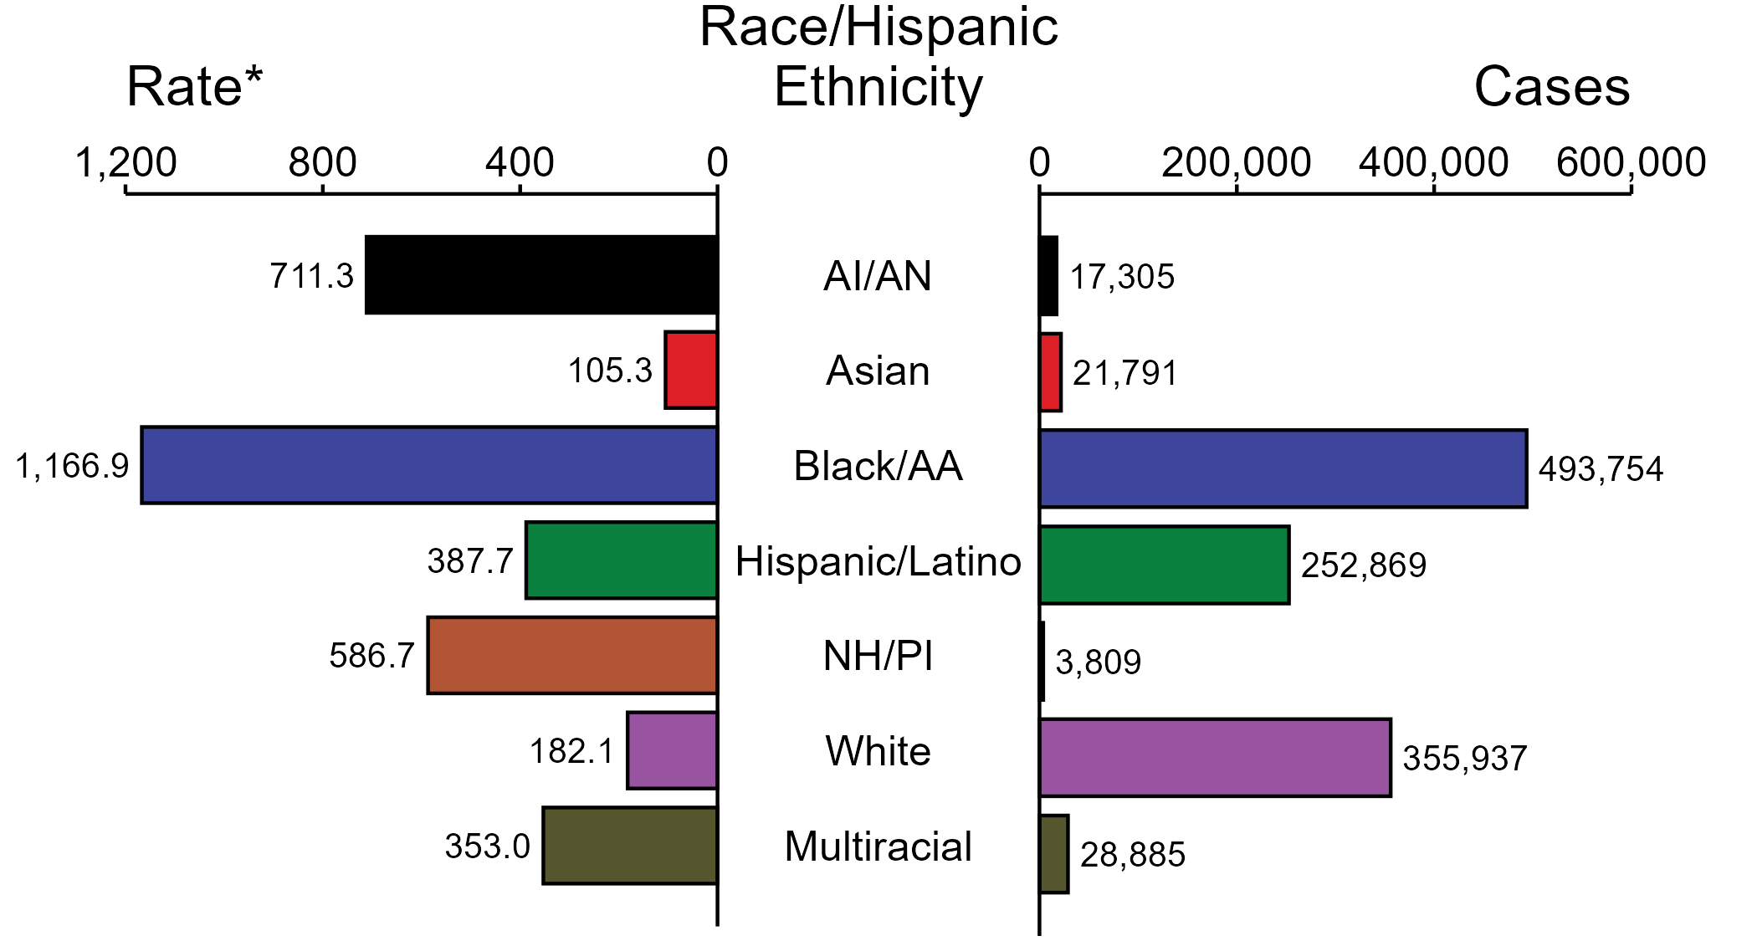
Chlamydia — Case Counts and Rates of Reported Cases by Race/Hispanic Ethnicity, United States, 2023
* Per 100,000
ACRONYMS: AI/AN = American Indian or Alaska Native; Black/AA = Black or African American; NH/PI = Native Hawaiian or other Pacific Islander
NOTE: In 2023, a total of 474,218 chlamydia cases (28.8%) had missing, unknown, or other race and were not reported to be of Hispanic ethnicity. These cases are not shown in this figure. Including these cases, there were a total of 1,648,568 cases of chlamydia reported among states and the District of Columbia for a rate of 492.2 per 100,000 persons.
Notes:
In 2023, rates of chlamydia were highest among non-Hispanic Black or African American persons (1,166.9 per 100,000), followed by non-Hispanic American Indian or Alaska Native persons (711.3 per 100,000) and non-Hispanic Native Hawaiian or other Pacific Islander persons (586.7 per 100,000). The greatest number of reported chlamydia cases was among non-Hispanic Black or African American persons (493,754 cases), followed by non-Hispanic White persons (355,937 cases) and Hispanic or Latino persons of any race(s) (252,869 cases).
This report includes data from years that coincide with the COVID-19 pandemic, which introduced uncertainty and difficulty in interpreting STI surveillance data. See Impact of COVID-19 on STIs (https://www.cdc.gov/sti-statistics/about/impact-of-covid-19.html) for more information.
See Technical Notes (https://www.cdc.gov/sti-statistics/annual/technical-notes.html) for information on STI case reporting formats and practices, including collected and derived variables displayed in this report. Table A (https://www.cdc.gov/sti-statistics/data-vis/table-selected-percunknown.html) provides information on unknown, missing, or invalid values of select variables.
Data for all figures are available at https://www.cdc.gov/sti-statistics/media/files/2024/11/2023-STI-Surveillance-Report-Data-Points.zip. The file “CT - Cases and Rates by Race Hispanic Ethnicity (US 2023).xlsx” contains the data for the figure presented on this slide.

Slide 24
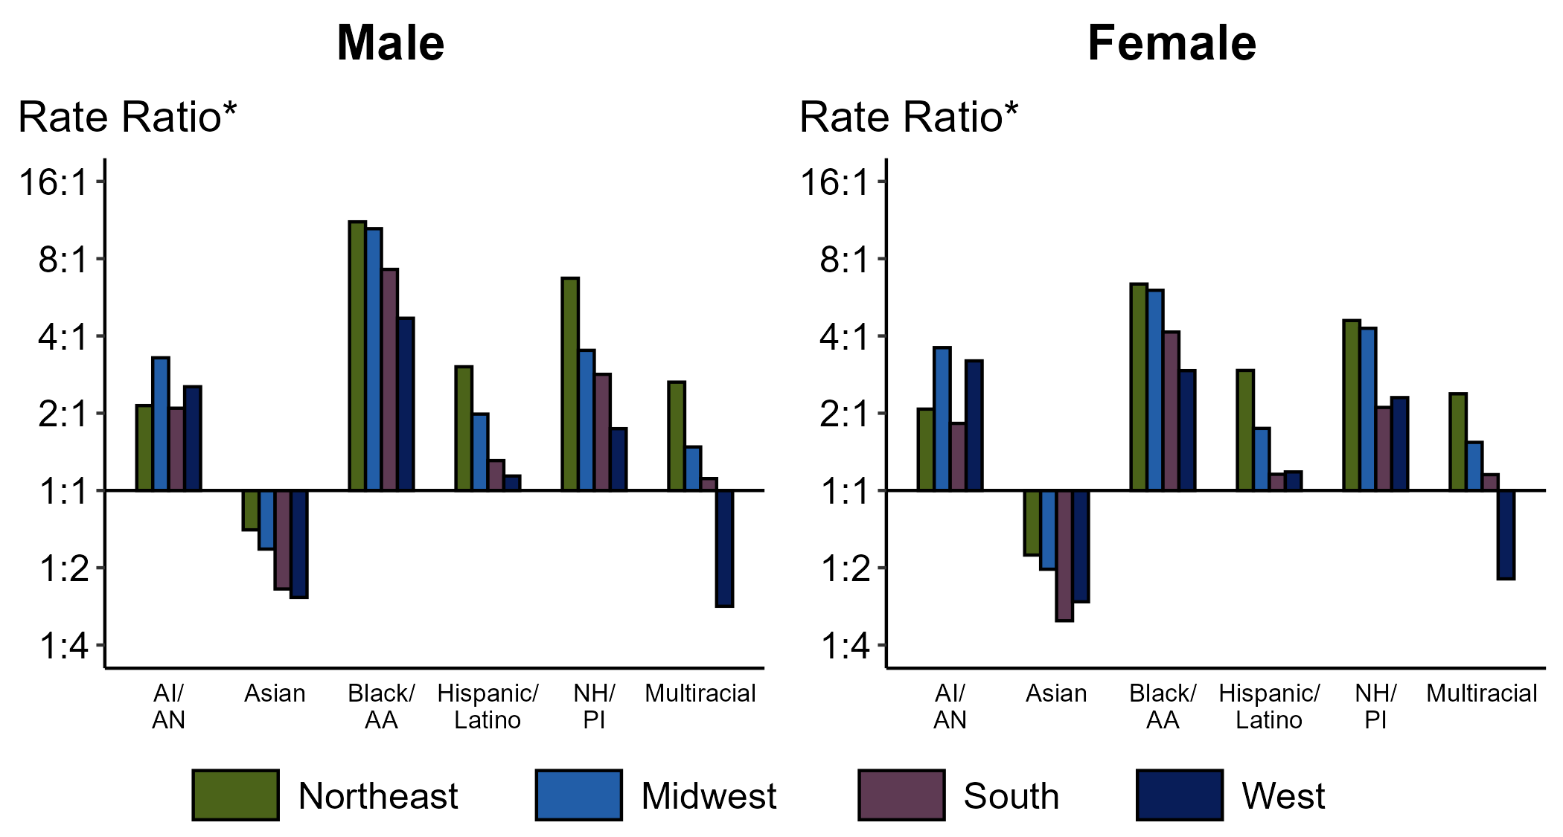
Chlamydia — Ratios of Rates of Reported Cases Among Persons Aged 15–24 Years by Sex, Race/Hispanic Ethnicity, and Region, United States, 2023
* For the rate ratios, non-Hispanic White persons are the referent population. Y-axis is log scale.
ACRONYMS: AI/AN = American Indian or Alaska Native; Black/AA = Black or African American; NH/PI = Native Hawaiian or other Pacific Islander
Notes:
Among men and women, rate ratios of rates of reported chlamydia by race/Hispanic ethnicity (using non-Hispanic White persons as the referent population) varied by region in 2023. Among men, the greatest rate ratio was in the Northeast where the rate of reported chlamydia among non-Hispanic Black or African American men was 11.1 times the rate among non-Hispanic White men. Among women, the greatest rate ratio was in the Northeast where the rate of reported chlamydia among non-Hispanic Black or African American women was 6.4 times the rate among non-Hispanic White women.
This report includes data from years that coincide with the COVID-19 pandemic, which introduced uncertainty and difficulty in interpreting STI surveillance data. See Impact of COVID-19 on STIs (https://www.cdc.gov/sti-statistics/about/impact-of-covid-19.html) for more information.
See Technical Notes (https://www.cdc.gov/sti-statistics/annual/technical-notes.html) for information on STI case reporting formats and practices, including collected and derived variables displayed in this report. Table A (https://www.cdc.gov/sti-statistics/data-vis/table-selected-percunknown.html) provides information on unknown, missing, or invalid values of select variables..
Data for all figures are available at https://www.cdc.gov/sti-statistics/media/files/2024/11/2023-STI-Surveillance-Report-Data-Points.zip. The file “CT - Ratios of Rates Persons 15-24 Years by Sex Race Hispanic Ethnicity and Region (US 2023).xlsx” contains the data for the figure presented on this slide.

Slide 25
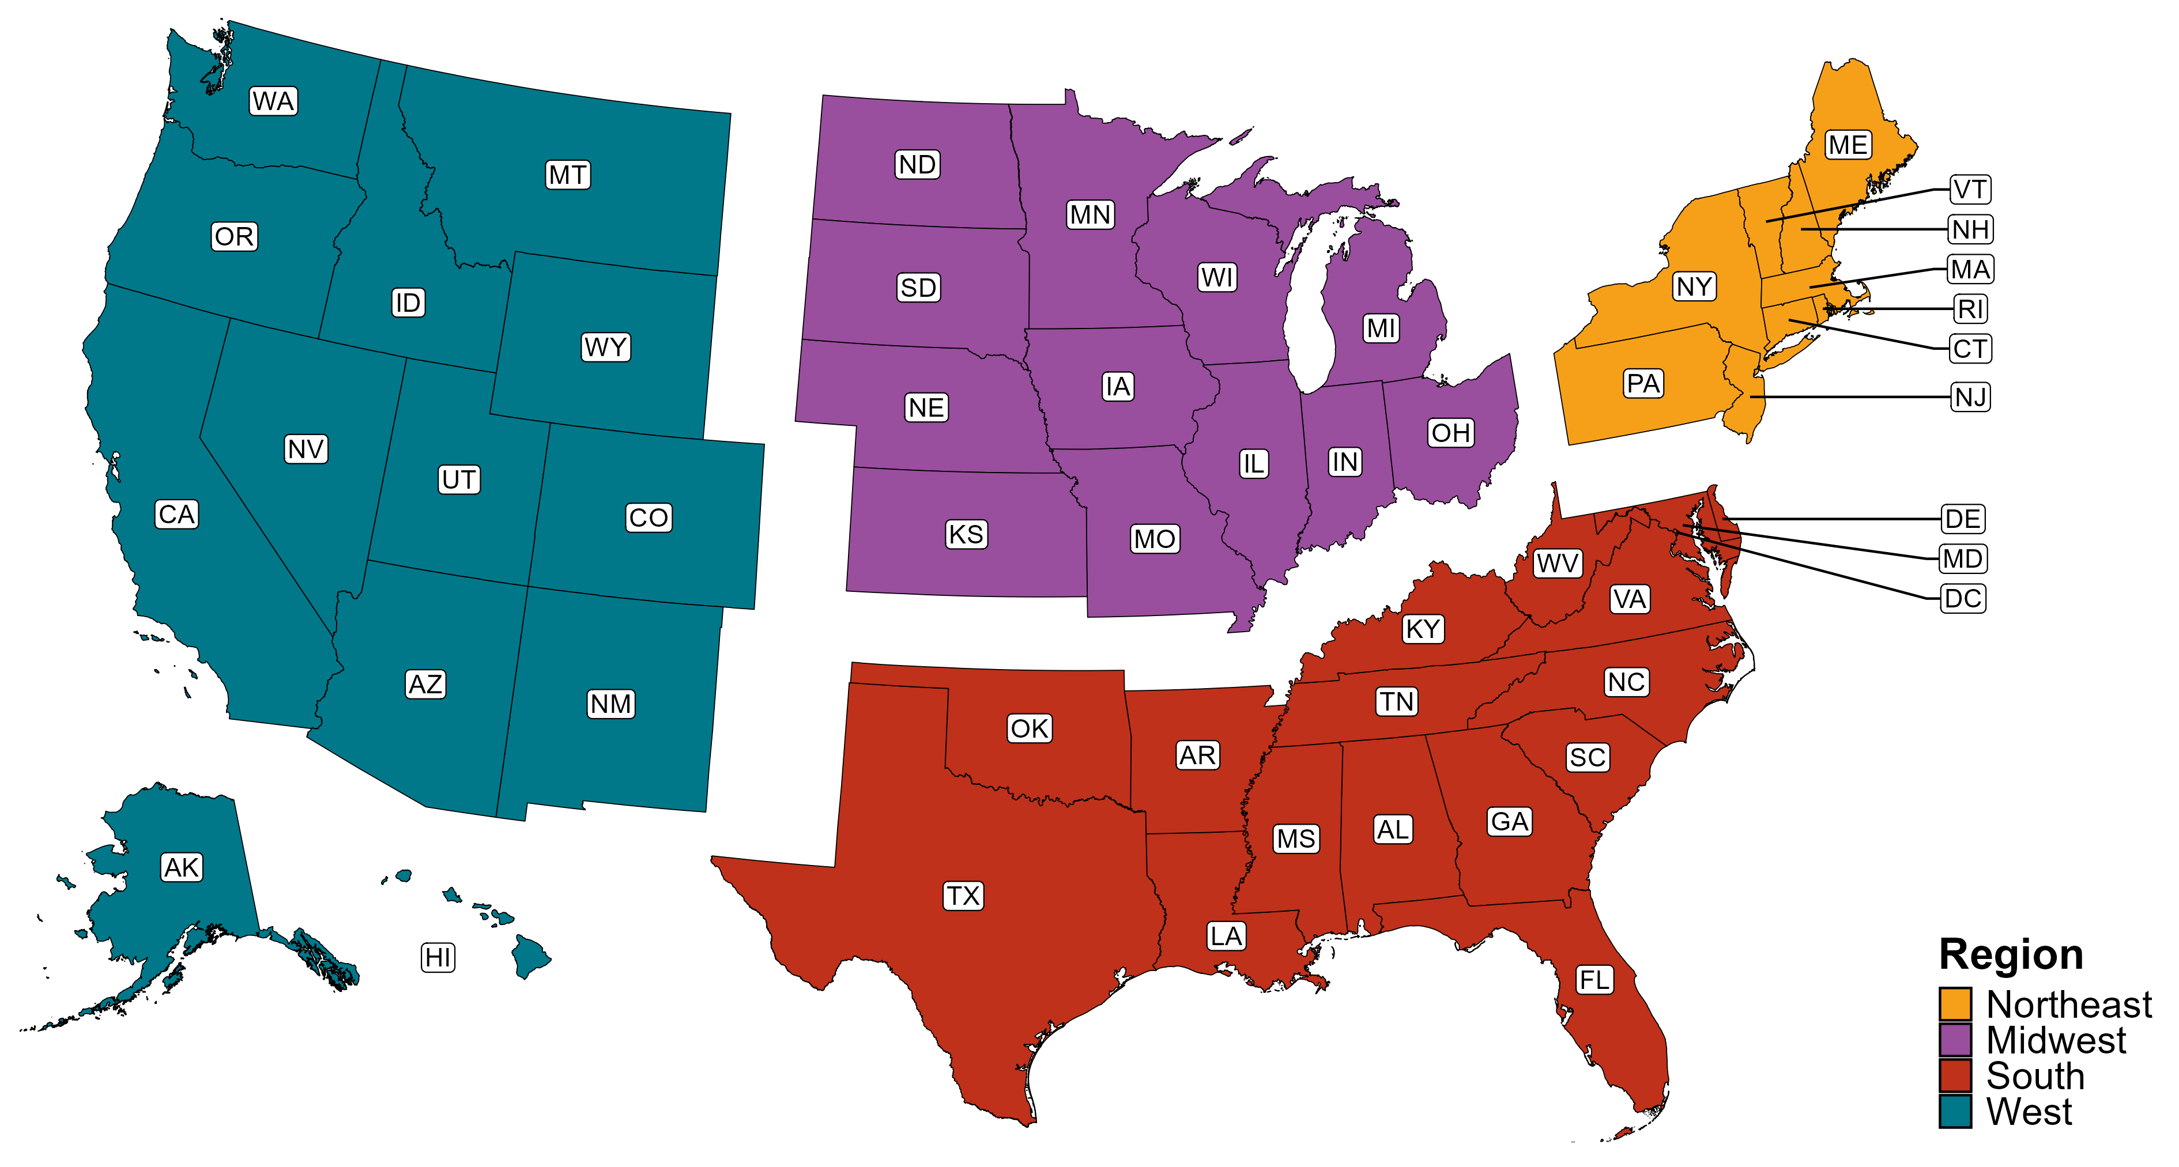
Reference Map of US Census Regions

