Slide 1
Integrate Classroom Physical Activity
Getting Students Active During School
Notes:
NARRATIVE:
Welcome! This presentation explains the importance of providing classroom physical activity to students from kindergarten through high school. Classroom physical activity is an important way to increase student physical activity and improve their behavior and learning. The presentation also highlights evidence-based strategies to ensure that all students have a positive experience with classroom physical activity.
NOTES FOR PRESENTER:
Presenters can personalize this presentation by adding local policy and activity references to the slides, where appropriate. Places for personalization will also be noted in the “NOTES FOR PRESENTER” section. Depending on audience interaction and questions, allow 25 to 30 minutes to present the information in this presentation.

Slide 2

Purpose
Define classroom physical activity.
Explain the benefits of classroom physical activity.
Describe national guidance for classroom physical activity.
Share new resources for classroom physical activity.
Notes:
NARRATIVE:
This presentation provides an overview of classroom physical activity, including the definition, benefits, and national guidance. In addition, it highlights resources that are available to help educators promote and plan for classroom physical activity. These resources were developed by CDC and Springboard to Active Schools.
Springboard to Active Schools is an initiative of the National Network of Public Health Institutes and Health Resources in Action through Cooperative Agreement CDC-RFA-DP16-1601 with CDC.
NOTES FOR PRESENTER:
Presenters can personalize this presentation by focusing on what is happening in their schools related to classroom physical activity.

Slide 3
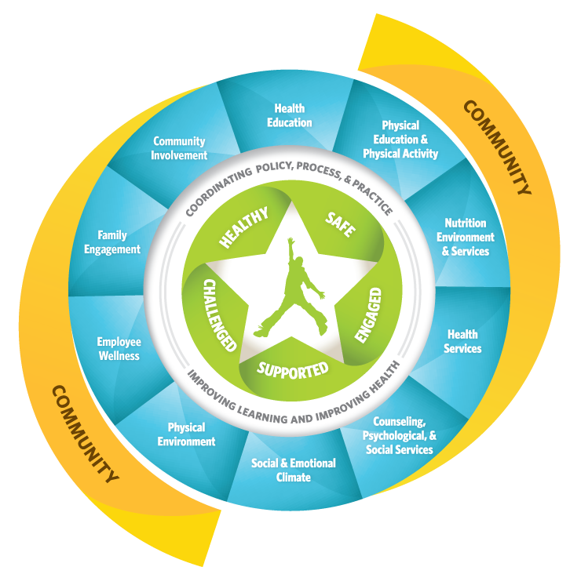
Whole Community, Whole School, Whole Child Model
www.cdc.gov/healthyyouth/wscc/
Notes:
NARRATIVE:
An important framework that guides school health work is the Whole School, Whole Community, Whole Child (WSCC, and it is pronounced “whisk”) model. The WSCC model builds on CDC’s Coordinated School Health Model and ASCD’s Whole Child Approach. This model represents greater alignment of both education and public health goals. The 10 components surrounding the whole child show the full range of health topics that need to be addressed by the school and community to help support the health and learning of the child.
The WSCC model supports opportunities for physical education and physical activity (noted by the red circle around the component for physical education and physical activity in the model). But how do schools address this component of the WSCC model?
NOTES FOR PRESENTER:
For more information about the WSCC model, see www.cdc.gov/healthyschools/wscc/index.htm.

Slide 4
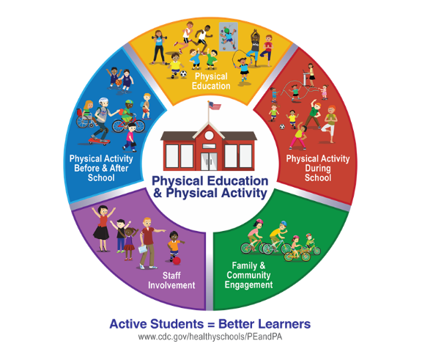
Comprehensive School Physical Activity Program
www.cdc.gov/healthyschools/physicalactivity/cspap.htm
Notes:
NARRATIVE:
Schools can support opportunities for physical education and physical activity through a Comprehensive School Physical Activity Program. The goal of a Comprehensive School Physical Activity Program is to increase physical activity opportunities before, during, and after school and to increase students’ overall physical activity and health.
There are five components in a Comprehensive School Physical Activity Program. They include physical education as the foundation, physical activity during school, physical activity before and after school, staff involvement, and family and community engagement. All of these components are important to helping students get the nationally recommended 60 minutes of physical activity each and every day.
Within the component for physical activity during school, two types of activities are included—classroom physical activity and recess. The focus of this presentation is classroom physical activity.
NOTES FOR PRESENTER:
For more information about a Comprehensive School Physical Activity Program and the five components, see www.cdc.gov/healthyschools/physicalactivity/cspap.htm.

Slide 5

Definition of Classroom Physical Activity
Any physical activity done in the classroom.
Takes place at any time.
Occurs in one or several brief periods.
Occurs at all school levels.
Offered in addition to PE and recess.
Notes:
NARRATIVE:
CDC defines classroom physical activity as “any physical activity done in the classroom.” Classroom physical activity can take place at any time and occur in one or several brief periods of time during the school day. Classroom physical activity should be offered in addition to physical education and recess and at all school levels (elementary, middle, and high school).
NOTES FOR PRESENTER:
Physical activity is defined as any bodily movement produced by skeletal muscles that requires energy expenditure. Examples include walking, dancing, jumping, and yoga.

Slide 6

Approaches to Classroom Physical Activity
Integrated into planned academic instruction.
Outside of planned academic instruction.
Notes:
NARRATIVE:
The two primary approaches for classroom physical activity are:
Physical activity integrated into planned academic instruction: This means physical activity can be added to a teacher’s lesson planning process to ensure that activities reinforce the desired content and academic standards.
Physical activity outside of planned academic instruction: This means physical activity is not necessarily tied to the lesson being taught.

Slide 7

Benefits of Classroom Physical Activity
Improves concentration and ability to stay on task.
Reduces disruptive behavior.
Improves motivation and engagement.
Improves academic performance.
Increases daily physical activity.
Notes:
NARRATIVE:
There are benefits to integrating physical activity in the classroom. Classroom physical activity:
Improves students’ concentration and ability to stay on task.
Reduces disruptive behavior.
Improves students’ motivation and engagement in the learning process.
Helps to improve students’ academic performance (higher grades and test scores).
Increases students’ daily physical activity.
All of these benefits help improve student’s engagement in school, which leads to improved school connectedness and overall school climate.
NOTES FOR PRESENTER:
If you have examples of benefits that your school or classroom has experienced from providing classroom physical activity, consider sharing them during this slide.

Slide 8
National Perspective: State Policy
Colorado is the only state that requires classroom physical activity breaks in elementary schools.
No states require breaks in middle or high schools.
Source: 2016 Shape of the Nation.
35 states responded to the question about requires classroom-based physical activity breaks.
Notes:
NARRATIVE:
Across states, school districts, and schools, implementation of classroom physical activity through policies and practices is limited. For example, in a recent study, only Colorado requires classroom-based physical activity breaks in elementary schools. None of the states require breaks in middle or high schools.
NOTES FOR PRESENTER:
You can replace this slide with your state data if they are available.
For more information about the 2016 Shape of the Nation Report, see https://www.shapeamerica.org/advocacy/son/2016/upload/Shape-of-the-Nation-2016_web.pdf.

Slide 9

National Perspective: District Policy
 | Percentage of Districts
District Practice | Elementary | Middle Schools | High Schools
Requires schools provide regular classroom physical activity breaks* during the school day | 11% | 8% | 2%
Recommends schools provide regular classroom physical activity breaks* during the school day | 50% | 39% | 28%
Source: School Health Policies and Practices Study, 2016.
*For elementary schools, classroom physical activity breaks are defined as "outside of physical education class and recess. For middle and high schools, they are defined as "outside of physical education class."
Notes:
NARRATIVE:
At the district level, only 11% of school districts require elementary schools to provide regular classroom physical activity breaks during the school day. This percentage is lower for middle schools (8%) and high schools (2%).
A similar pattern is found for school districts that recommend schools provide regular classroom physical activity breaks during the school day: 50% of elementary schools, 39% of middle schools, and 28% of high schools.
NOTES FOR PRESENTER:
You can replace this slide with your district data if they are available.
For more information about the Results from the School Health Policies and Practices Study 2016, see www.cdc.gov/healthyyouth/data/shpps/pdf/shpps-results_2016.pdf.

Slide 10


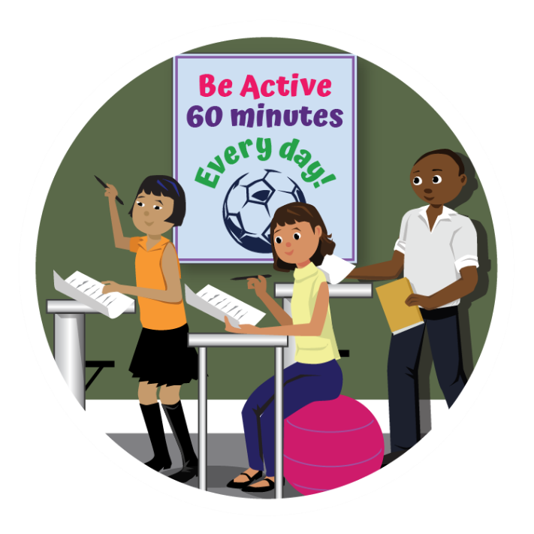
National Perspective: School Practice
Students participate in regular physical activity breaks* during the school day
43% of Elementary Schools
64% of Middle Schools
27% of High Schools
Source: School Health Policies and Practices Study, 2014.
*For elementary schools, physical activity breaks are defined as "outside of physical education class and recess."
For middle and high schools, they are defined as “outside of physical education class.”
Notes:
NARRATIVE:
Across all school levels, only 45% of schools have students participate in regular physical activity breaks outside of physical education during the school day. This percentage differs across school level: 43% of elementary schools, 64% of middle schools, and 27% of high schools.
Data from the state, district, and school perspective highlight opportunities for improvement in classroom physical activity policies and practices.
NOTES FOR PRESENTER:
You can replace this slide with your school data if they are available.
For more information about the Results from the School Health Policies and Practices Study 2014, see www.cdc.gov/healthyyouth/data/shpps/results.htm.

Slide 11
National Guidance for
Classroom Physical Activity
Incorporate classroom physical activity in CSPAP.
Do not replace physical education and recess.
Integrate physical activity into academic instruction.
Provide physical activity outside of academic instruction.
Reinforce skills learned in physical education.
Minimize barriers.
Do not withhold classroom physical activity.
Provide ongoing professional development.
Notes:
NARRATIVE:
This national guidance identifies practices that schools can use to promote classroom physical activity. This guidance can also be used to inform policy language for classroom physical activity at the state, district, and school level.
This guidance encourages schools to:
Incorporate classroom physical activity into the planning for a Comprehensive School Physical Activity Program.
Not replace physical education and recess with classroom physical activity.
Integrate physical activity into planned academic instruction to reinforce academic concepts.
Provide physical activity outside of planned academic instruction—for example, physical activity breaks.
Use classroom physical activity as a way to reinforce skills learned in physical education.
Ensure that barriers to classroom physical activity, such as lack of equipment or available space, are minimized.
Not withhold classroom physical activity from students as a disciplinary approach.
Provide teachers with ongoing professional development on classroom physical activity.
NOTES FOR PRESENTER:
This national guidance for classroom physical activity can be found on page 7 in CDC’s Strategies for Classroom Physical Activity in Schools, www.cdc.gov/healthyschools/physicalactivity/pdf/ClassroomPAStrategies_508.pdf and www.schoolspringboard.org/CRPAstrategies.

Slide 12

RESOURCES FOR CLASSROOM PHYSICAL ACTIVITY
Notes:
NARRATIVE:
To help school districts and schools increase opportunities for physical activity during the school day, CDC and Springboard to Active Schools have developed resources that educators can use to bring physical activity to the classroom. These resources provide educators with evidence-based strategies for integrating physical activity into the classroom.
NOTES FOR PRESENTER:
“Classroom” is defined as any place where students in kindergarten through 12th grade can learn or gain experience. The strategies identified can be applied in any space where teachers might want to engage students in physical activity and learning—such as classrooms, hallways, multipurpose rooms, auditoriums, and outdoor areas. However, these strategies will primarily be discussed in the context of classrooms. These strategies can also be used in other contexts, such as before-school and after-school extended day programs.

Slide 13
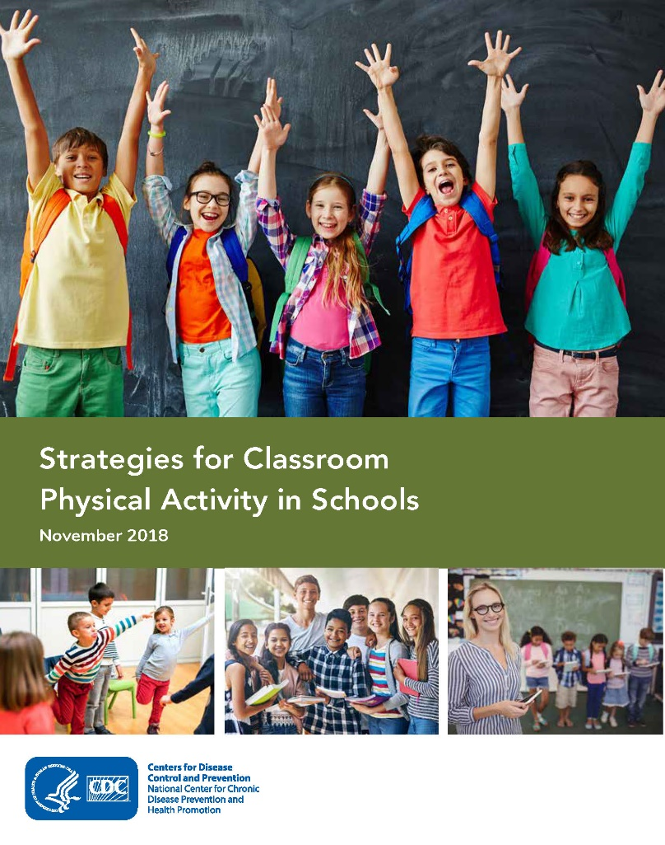
Strategies for Classroom
Physical Activity in Schools
This document describes
10 strategies for promoting and planning classroom physical activity.
Notes:
NARRATIVE:
To help strengthen classroom physical activity in schools, CDC and Springboard to Active Schools collaboratively developed Strategies for Classroom Physical in Schools. This document identifies 10 evidence-based strategies for promoting and planning classroom physical activity.
NOTES FOR PRESENTER:
For more information, see Strategies for Classroom Physical Activity in Schools at www.cdc.gov/healthyschools/physicalactivity/pdf/ClassroomPAStrategies_508.pdf and www.schoolspringboard.org/resources/CRPAstrategies.

Slide 14
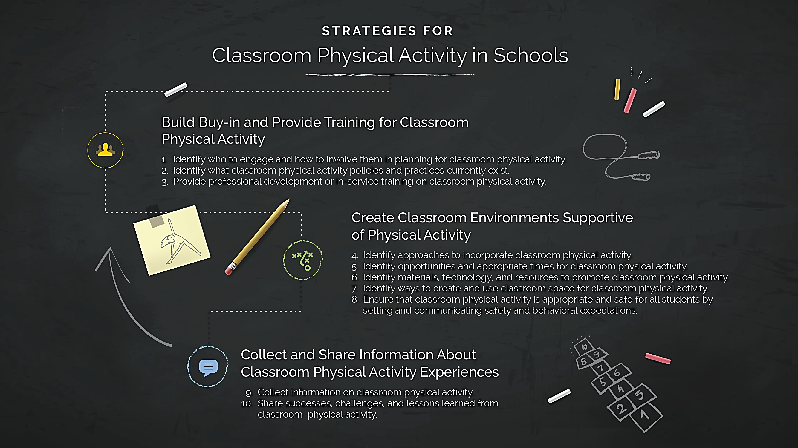
Strategies for Classroom
Physical Activity in Schools
Identify who to engage and how to involve them in planning for classroom physical activity (PA)
Identify what PA activity policies and practices currently exist
Provide professional development or in-service training on classroom PA
Identify approaches to incorporate classroom PA
Identify opportunities and appropriate times for classroom PA
Identify materials, technology, and resources to promote classroom PA
Identify ways to create and use classroom space for PA
Ensure that classroom PA is appropriate and safe for all students
Collect information on classroom physical activity
Share successes, challenges, and lessons learned from classroom physical activity
Notes:
NARRATIVE:
The 10 strategies are organized into the following 3 categories:
Category 1: Build Buy-in and Provide Training for Classroom Physical Activity.
Category 2: Create Classroom Environments Supportive of Physical Activity.
Category 3: Collect and Share Information About Classroom Physical Activity Experiences.
NOTES FOR PRESENTER:
For more information, see Strategies for Classroom Physical Activity in Schools at www.cdc.gov/healthyschools/physicalactivity/pdf/ClassroomPAStrategies_508.pdf and www.schoolspringboard.org/resources/CRPAstrategies.

Slide 15
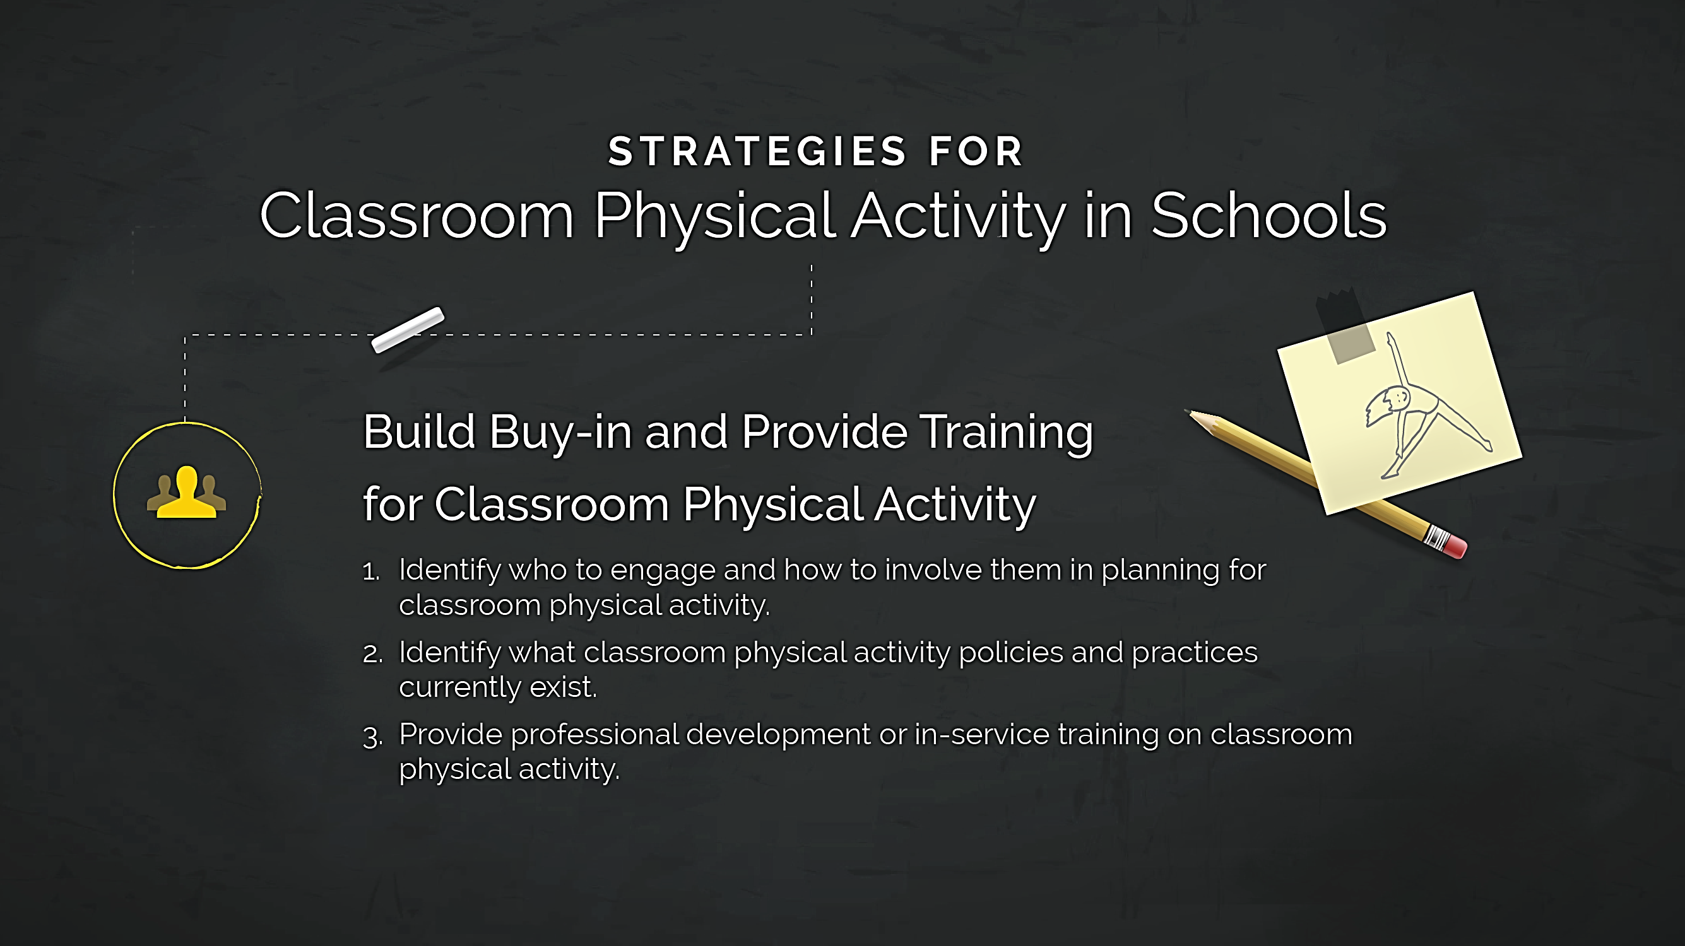
Strategies for Classroom
Physical Activity in Schools
Notes:
NARRATIVE:
The first category of strategies is Build Buy-in and Provide Training for Classroom Physical Activity. This category addresses staff buy-in and training necessary to promote widespread and sustainable classroom physical activity practices at district, school, and classroom levels. Initial steps include identifying champions and experts, identifying existing classroom physical activity policies and practices, and giving educators and other physical activity champions the training they need to implement classroom physical activity.
NOTES FOR PRESENTER:
For more information, see Strategies for Classroom Physical Activity in Schools at www.cdc.gov/healthyschools/physicalactivity/pdf/ClassroomPAStrategies_508.pdf and www.schoolspringboard.org/resources/CRPAstrategies.

Slide 16
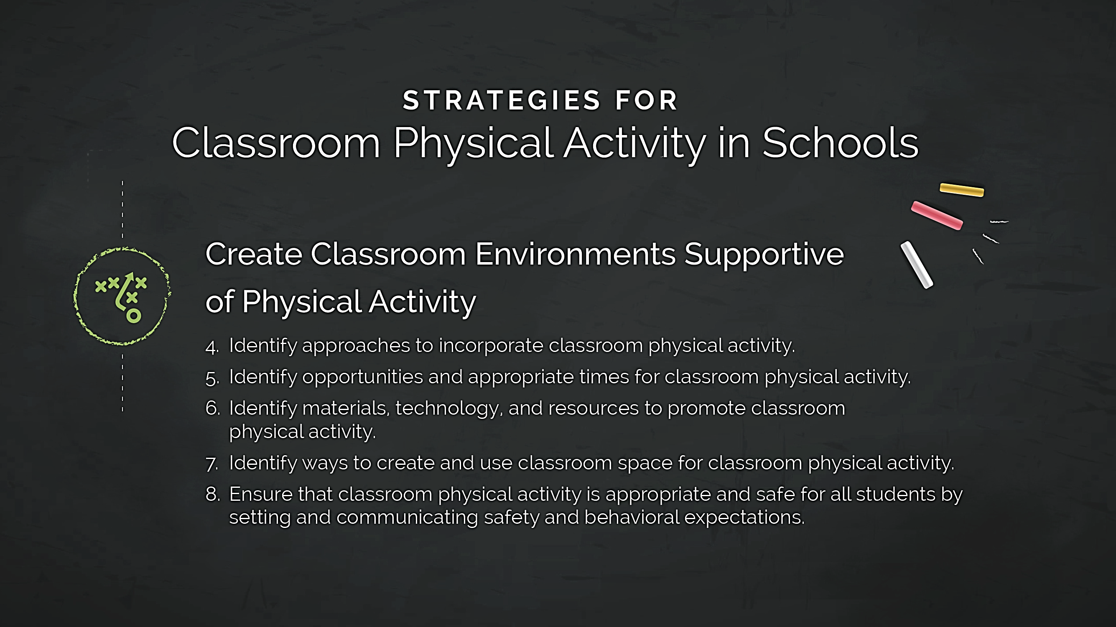
Strategies for Classroom
Physical Activity in Schools
Notes:
NARRATIVE:
The second category is Create Classroom Environments Supportive of Physical Activity. This category addresses what happens in the classroom. To build a culture of physical activity in the classroom, teachers must be able to readily identify approaches and opportunities to add physical activity; access the necessary materials, technology, and resources; use their classroom space effectively; and ensure the safety, inclusion, and well-being of all students.
NOTES FOR PRESENTER:
For more information, see Strategies for Classroom Physical Activity in Schools at www.cdc.gov/healthyschools/physicalactivity/pdf/ClassroomPAStrategies_508.pdf and www.schoolspringboard.org/resources/CRPAstrategies.

Slide 17
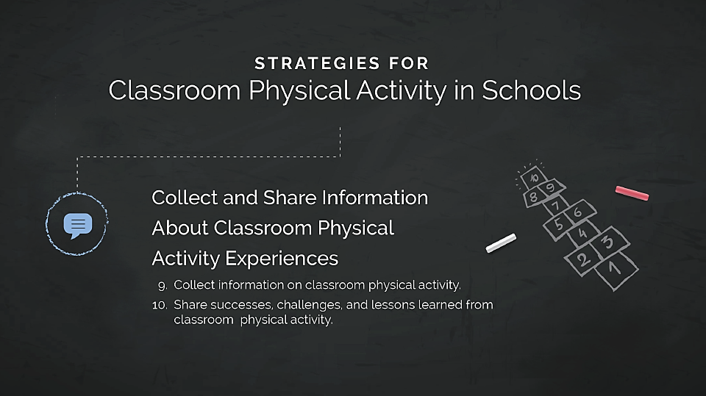
Strategies for Classroom
Physical Activity in Schools
Notes:
NARRATIVE:
The third and final category is Collect and Share Information About Classroom Physical Activity Experiences. This category addresses the type of information that needs to be collected and shared to improve and increase physical activity in the classroom. The strategies here will help teachers, administrators, and other physical activity champions promote ongoing buy-in for long-term sustainability of physical activity in the classroom.
NOTES FOR PRESENTER:
For more information, see Strategies for Classroom Physical Activity in Schools at www.cdc.gov/healthyschools/physicalactivity/pdf/ClassroomPAStrategies_508.pdf and www.schoolspringboard.org/resources/CRPAstrategies.

Slide 18
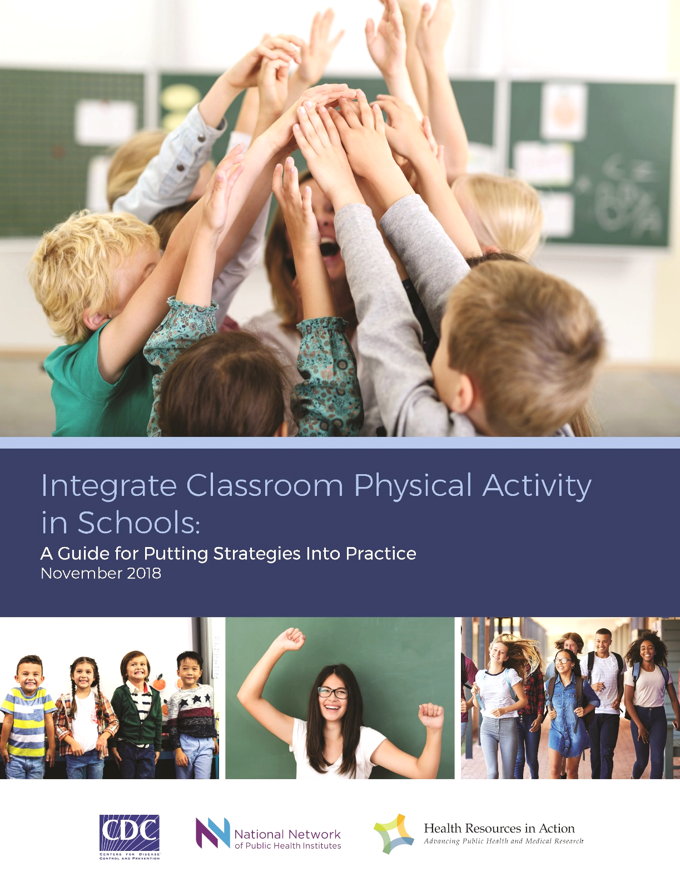
Integrate Classroom Physical Activity in Schools:
A Guide for Putting Strategies Into Practice
This resource can be used to:
Assess current practices.
Identify opportunities to enhance or sustain strategies.
Take practical steps to integrate physical activity into the classroom.
Notes:
NARRATIVE:
Springboard to Active Schools, in collaboration with CDC, created a complementary document called Integrate Classroom Physical Activity in Schools: A Guide for Putting Strategies Into Practice. This document helps educators adopt, promote, enhance, and sustain strategies identified in Strategies for Classroom Physical Activity in Schools.
Educators, school staff, school partners, and other physical activity champions can use this guide to:
Assess current classroom physical activity practices.
Identify opportunities to enhance or sustain classroom physical activity strategies already in place.
Take practical steps to integrate physical activity into the classroom.
Educators can select strategies that are feasible for their school to implement and document how they will incorporate these strategies into the classroom.
NOTES FOR PRESENTER:
For more information, see Integrate Classroom Physical Activity in Schools: A Guide for Putting Strategies Into Practice at www.schoolspringboard.org/resources/CRPAguide.

Slide 19
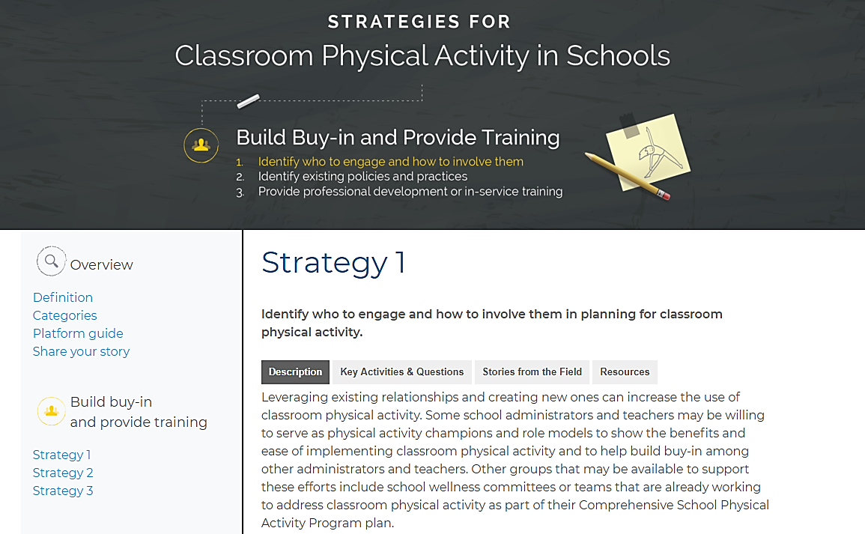
Online Platform:
Integrate Classroom Physical Activity in Schools
Notes:
NARRATIVE:
Springboard to Active Schools, in collaboration with CDC, developed an online platform called Integrate Classroom Physical Activity in Schools. This online platform provides templates, tools, resources, and stories from the field to help educators implement the 10 strategies for classroom physical activity. It helps educators explore each of the strategies in more depth.
NOTES FOR PRESENTER:
For more information, see Online Platform: Integrate Classroom Physical Activity in Schools at www.schoolspringboard.org/classroomphysicalactivity.

Slide 20
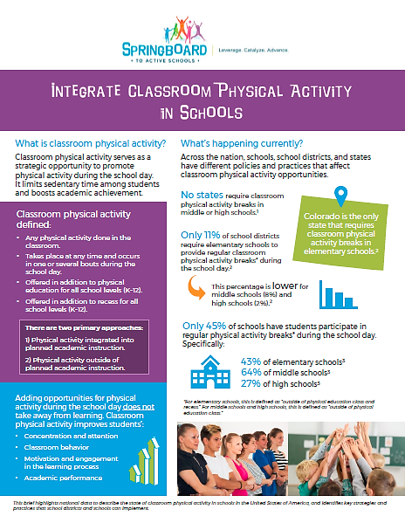
Data Brief:
Integrate Classroom Physical Activity in Schools
This brief provides:
The definition.
Snapshot of practices.
Ways to improve.
Notes:
NARRATIVE:
The Integrate Classroom Physical Activity in Schools data brief defines classroom physical activity, provides a snapshot of current classroom physical activity practices in the United States, and highlights ways to improve classroom physical activity through national guidance and practical strategies and resources. It can be used as a tool to make the case for classroom physical to school administrators, teachers, and others who can influence whether classroom physical activity is provided to students.
NOTES FOR PRESENTER:
This data brief can be found at www.schoolspringboard.org/resources/CRPAbrief.

Slide 21

Additional Resources
Ideas for Parents: Classroom Physical Activity
Classroom Physical Activity in Schools Promotion Kit
Notes:
NARRATIVE:
CDC and Springboard to Active Schools also collaboratively developed:
Ideas for Parents: Classroom Physical Activity: This one-pager outlines for parents how they can promote classroom physical activity in their child’s school.
Classroom Physical Activity in Schools Promotion Kit: This kit provides ideas for sharing and promoting resources for classroom physical activity in schools.
NOTES FOR PRESENTER:
For more information, see CDC’s Classroom Physical Activity website at www.cdc.gov/healthyschools/physicalactivity/classroom-pa.htm.

Slide 22

Take Action!
Educate the school community.
Include in the local school wellness policy.
Share the 10 evidence-based strategies.
Use the Integrate Classroom Physical Activity in Schools: A Guide for Putting Strategies Into Practice to take practical steps to integrate classroom physical activity.
Visit the Online Platform: Integrate Classroom Physical Activity in Schools
Notes:
NARRATIVE:
Here are some potential actions to promote classroom physical activity in schools:
Educate the school community—principals, educators, parents, and students—about the importance of classroom physical activity.
Include classroom physical activity in the local school wellness policy.
Share the 10 evidence-based strategies in the Strategies for Classroom Physical Activity in Schools with educators and others in the school community.
Use the Integrate Classroom Physical Activity in Schools: A Guide for Putting Strategies Into Practice to take practical steps to integrate physical activity into the classroom.
Visit the Online Platform: Integrate Classroom Physical Activity in Schools to view stories from the field and get additional resources to integrate classroom physical activity.
NOTES TO PRESENTER:
Edit these actions, as needed, to ensure that they are consistent with what is possible at your school.

Slide 23

Thank You!
List speakers and contact information.
For more information, contact the Centers for Disease Control and Prevention:
Visit www.cdc.gov/healthyschools/
Contact CDC-INFO at www.cdc.gov/cdc-info
Call 1-800-CDC-INFO (232-4636); TTY: 1-888-232-6348
Notes:
NARRATIVE:
Thank you for your participation!

