Slide 1
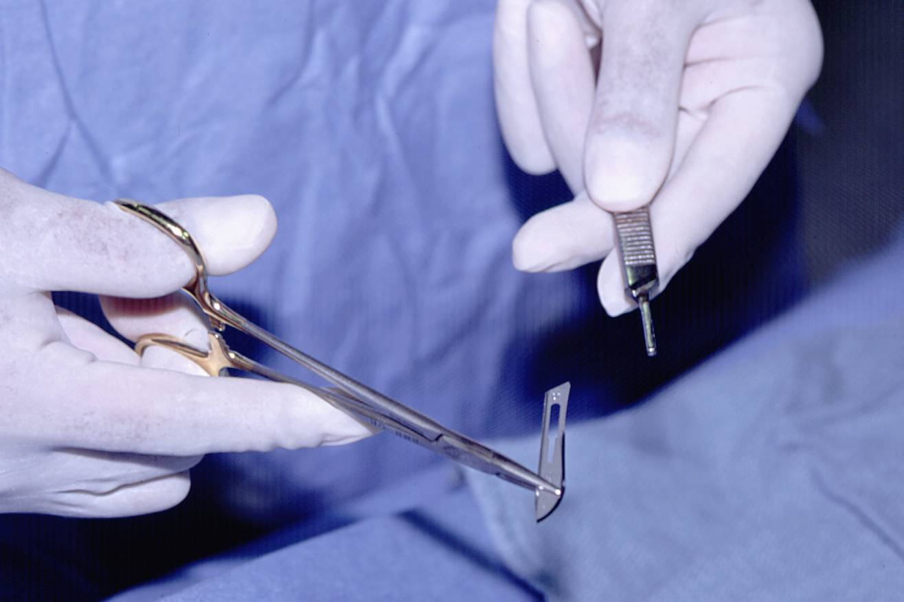
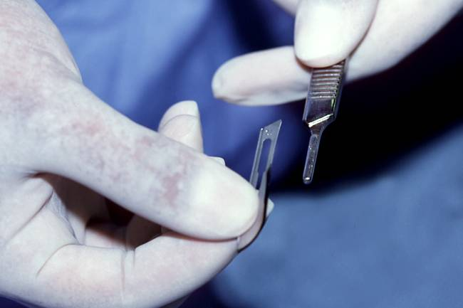
Loading
Improper techniques can lead to sharps injuries
USE SAFE TECHNIQUE
IMPROPER
You may choose to insert your own pictures of staff members modeling proper and improper techniques. (delete this text box)
Insert facility logo here
For more information contact [insert name]: ext. 9999

