Slide 1
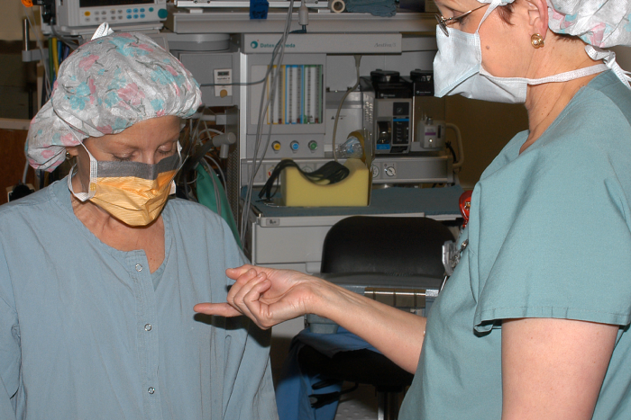
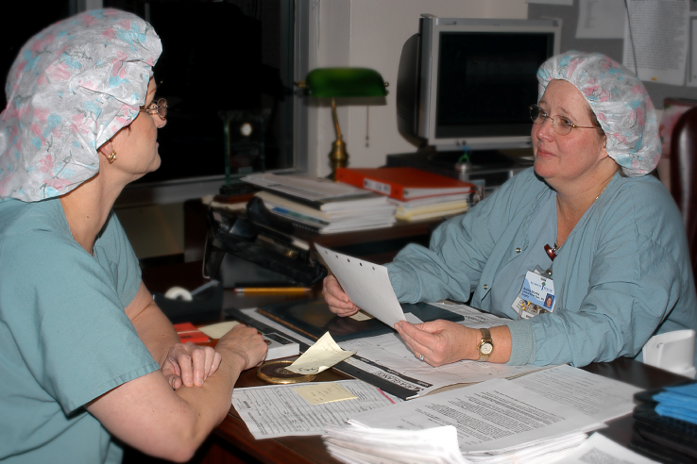
Post-Exposure Best Practices:
Wash sticks and cuts with soap and water.
Flush splashes with water.
Irrigate eyes with water, saline, or sterile irrigates.
Seek medical treatment immediately.
Report incident to your supervisor.
Discuss the risk of infection based on the circumstances of the injury
REPORTING helps PREVENTION
Insert your own pictures of staff members modeling the reporting of a sharps injury (delete this text box)
Insert facility logo here
For more information contact [insert name]: ext. 9999

