Slide 1
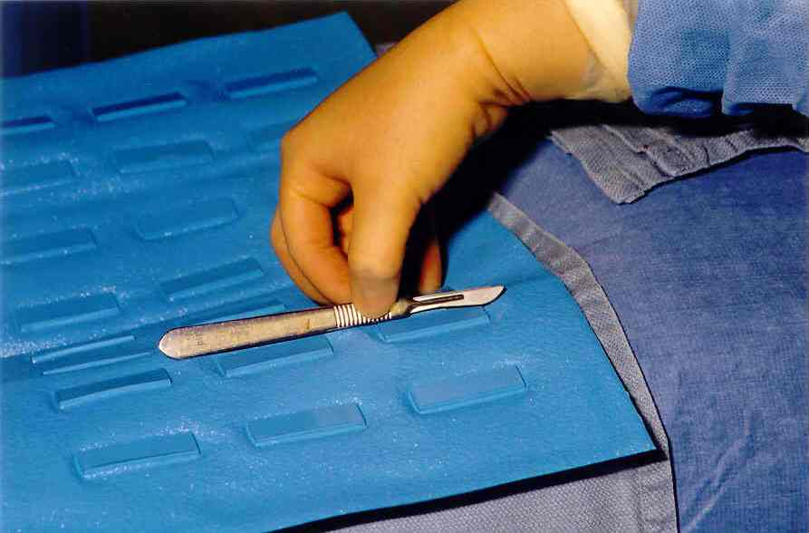
Create a Neutral Zone
Protect yourself, co-workers, and patients:
Limit certain areas for sharps only.
Define the area, but allow flexibility for emergency situations.
Allow one instrument at a time in the zone.
Openly communicate what, when, and how the neutral zone will work.
You may choose to insert your own picture of neutral zone devices used in your facility. (delete this text box)
Insert facility logo here
For more information contact [insert name]: ext. 9999

