Slide 1
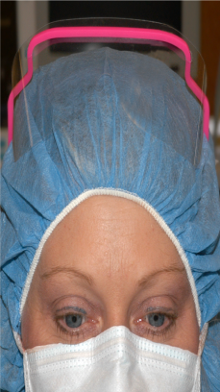
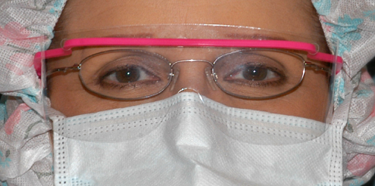
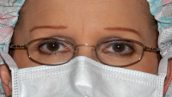
Insert your own pictures of staff members modeling safe and unsafe use of eye protection and position the yellow Xs appropriately. The shadows are added in picture styles under format. (delete this text box)
X
X
Insert facility logo here
For more information contact [insert name]: ext. 9999

