Slide 1
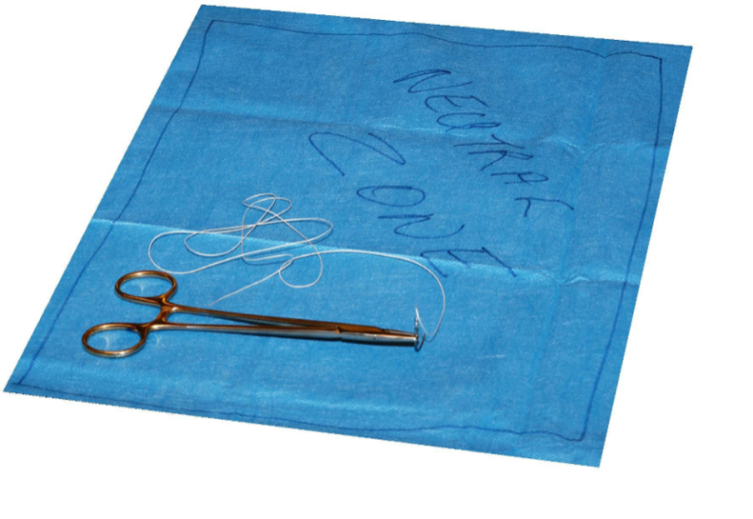
Establish Neutral Zone
Sharps only
Defined, but flexible
Allow only 1 instrument at
a time in the zone
Require open communication
Use Blunt Suture Needles
(where appropriate)
provide specific percentage for the proportion of sharps injuries due to sutures in your facility (delete this text box and the arrow)
43% of sharps injuries occur from SUTURING
[facility name] OR Occurrences [insert date range] (e.g., Jan–Nov ’09)
Insert facility logo here
For more information contact [insert name]: ext. 9999

