Slide 1
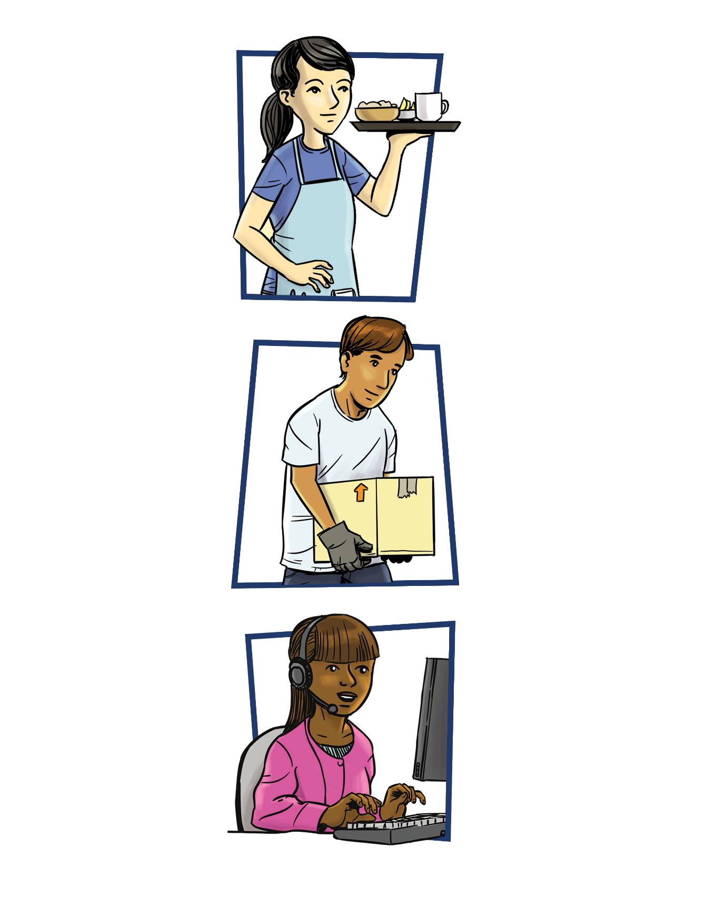


Safety Matters
Safety
Matters
Safety
Matters
A Safety & Health Training for
Young Workers

Slide 2
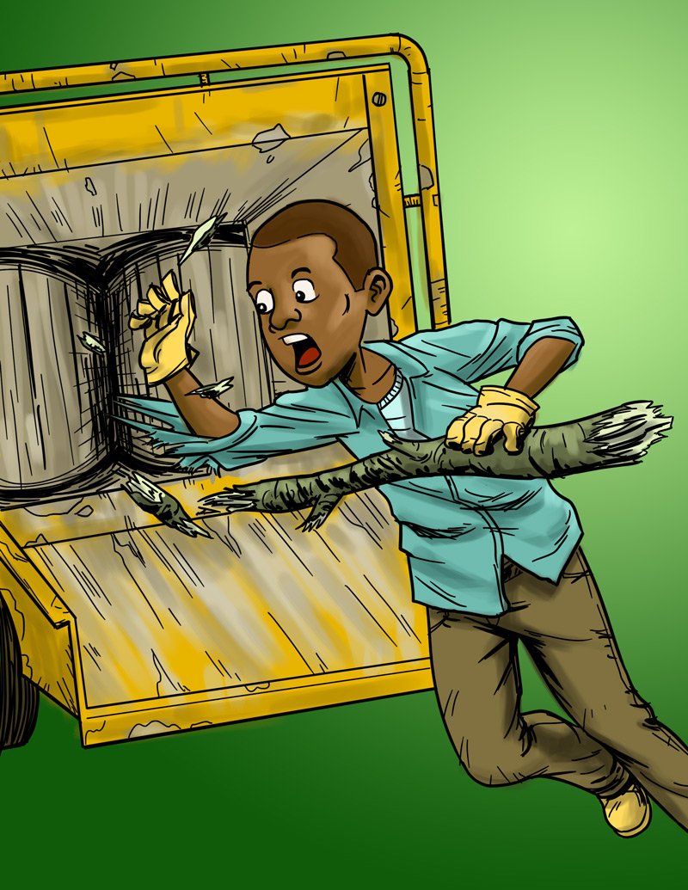
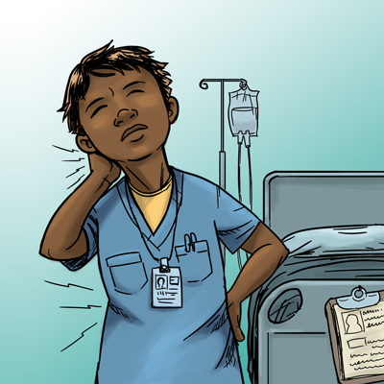


Young Worker Injuries

Slide 3
Teen Worker Injury Statistics
Approximately 1.6 million teens (aged 15–17) in the United States work. About 50% of 10th graders and 75% of 12th graders have jobs.
A teenager in the U.S. is injured on the job every 9 minutes.
On average, each year
    59,800 workers younger than 18 are sent to the ER for job-related injuries, but actual injury statistics are probably much higher.
    37 workers younger than 18 die on the job.
  Young workers are twice as likely to be injured than adult workers.
CDC 2010 www.cdc.gov/niosh/topics/youth/chartpackage.html www.cdc.gov/mmwr/preview/mmwrhtml/mm5915a2.htm

Slide 4

Mallory’s Story
What are some factors that contributed to this incident?
What could have kept Mallory from being hurt?
How might this affect Mallory’s future life choices?

Slide 5
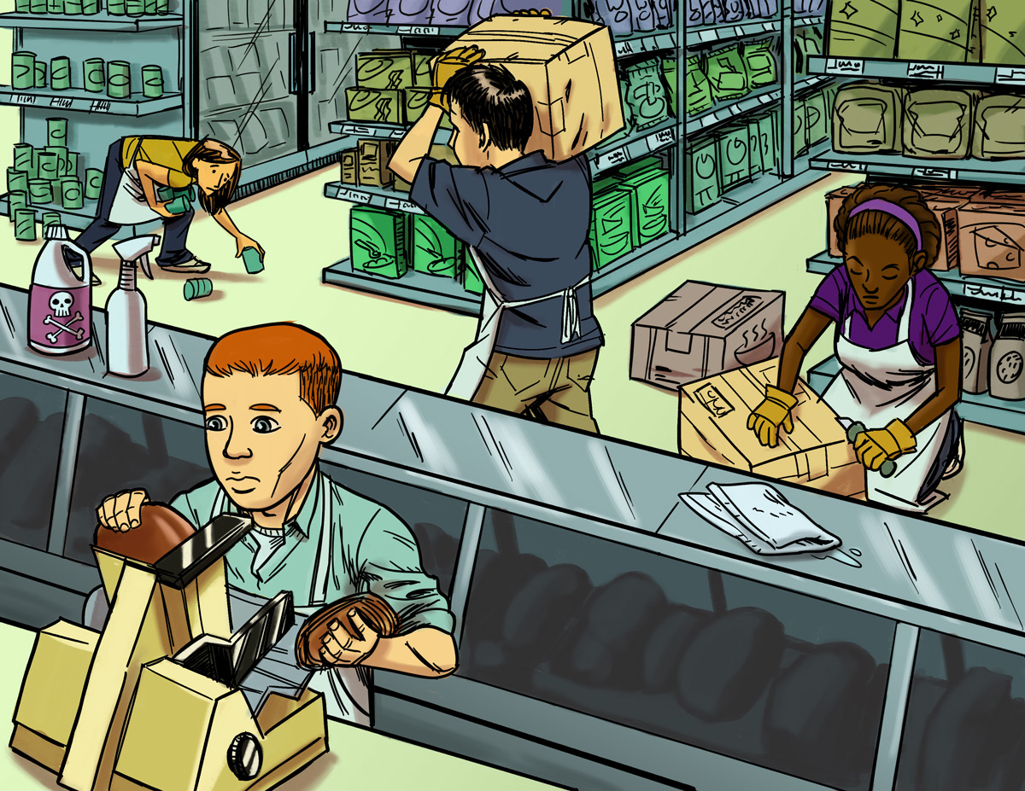
Finding Hazards

Slide 6
Workplace Hazards
All workplaces have hazards that can be identified and corrected.
What is a Job Hazard?
  A job hazard is anything at work that can hurt you either physically or mentally.
4 categories:
  Safety
  Chemical
  Biological
  Other health hazards

Slide 7
Job Hazards
Safety hazards can cause immediate injuries
  Knives, hot grease
Chemical hazards are gases, vapors, liquids, or dusts that can harm your body
  Cleaning products, pesticides
Biological hazards are living things that can cause sickness or disease, such as:
  HIV/AIDS, hepatitis, tuberculosis
  Bacteria, viruses

Slide 8
Job Hazards (continued)
Other health hazards are other harmful things that can injure you or make you sick. Some are not obvious because they may not cause health problems right away.
  Noise, radiation, repetitive movements, heat, cold, stress, violence
  Can you think of other job hazards?

Slide 9
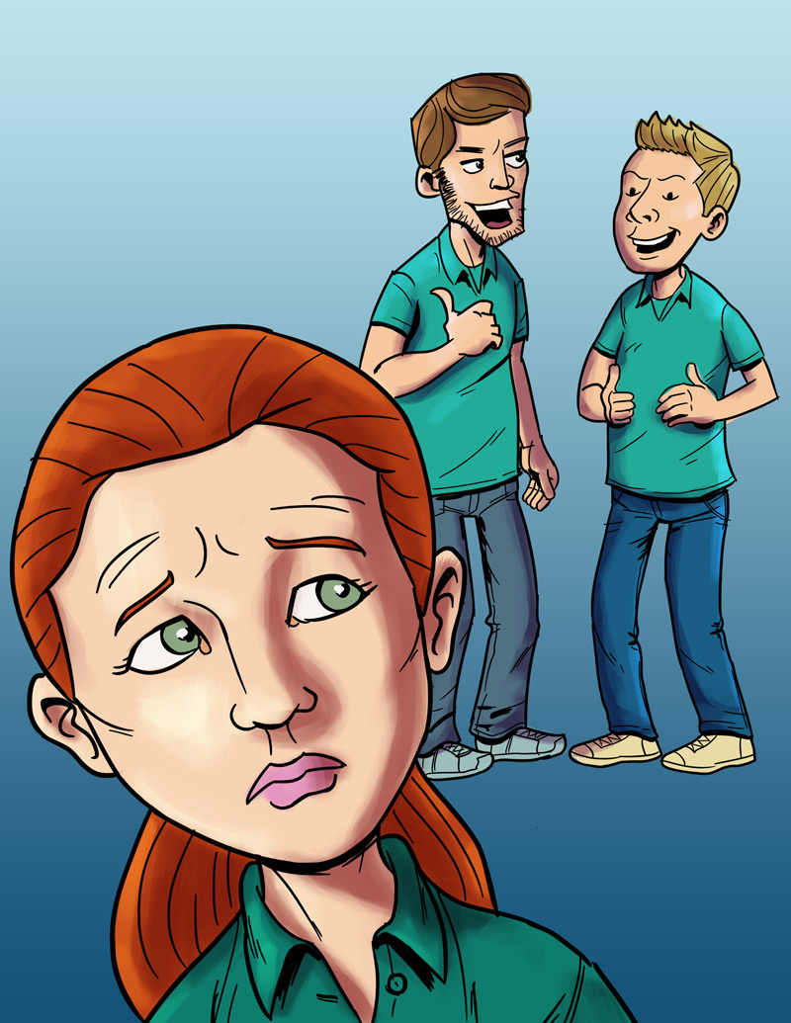
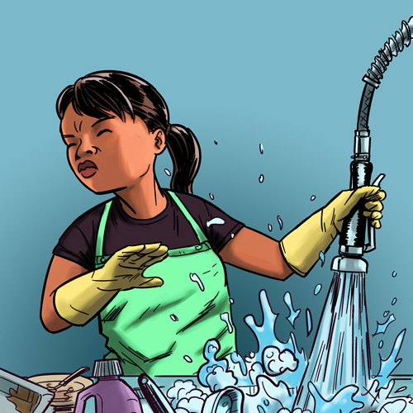
Making the Job Safer

Slide 10
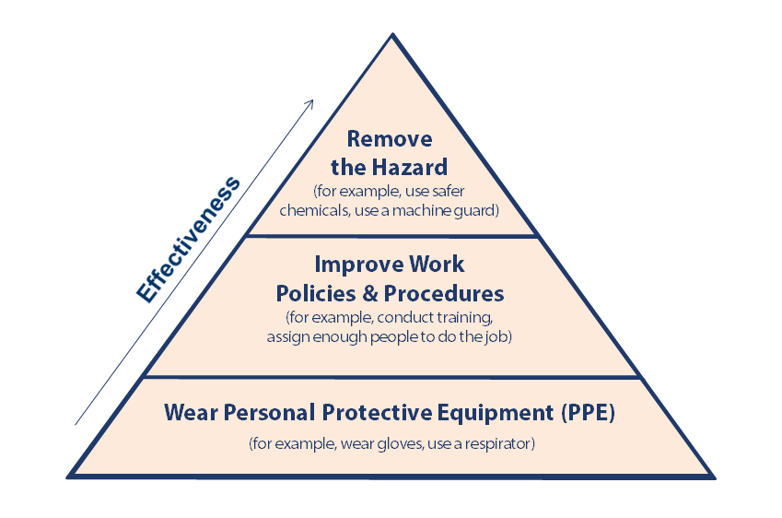
Controlling Job Hazards

Slide 11
Controlling Job Hazards: Three Methods
Remove the Hazard = the best way
  Example: Buy precut vegetables so that employees don’t have to use knives.
  Good safety policies
  Examples: Train workers, give regular breaks, assign enough people to do the job safely
Personal protective equipment (PPE) = the least effective (but use when provided!)
  Examples: Gloves, steel-toed shoes, hard hats, respirators, safety glasses, hearing protectors, lab coats or smocks

Slide 12
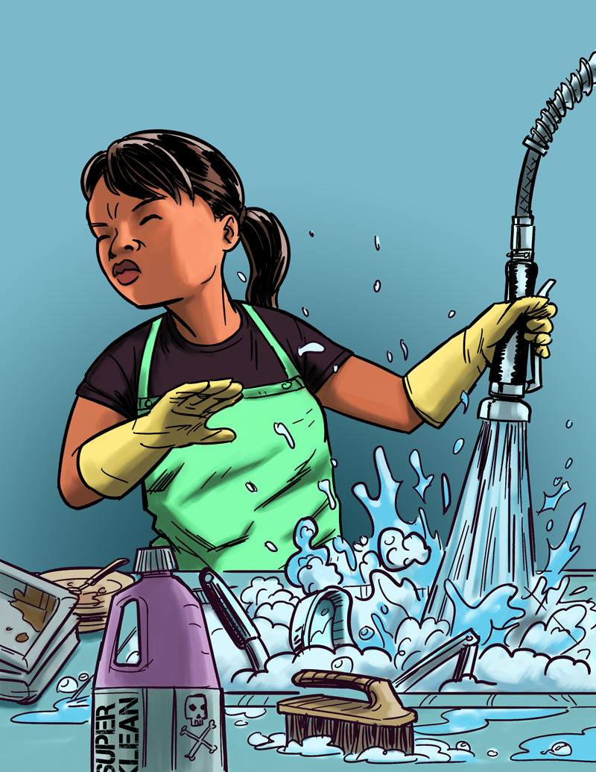
Removing or Reducing Hazards
Jasmin’s Story
Job: Hospital dishwasher
Hazard: Chemical dishwashing solution
Injury: Chemical burn to the eye
What solutions can you think of that
might prevent this injury from
happening again?

Slide 13
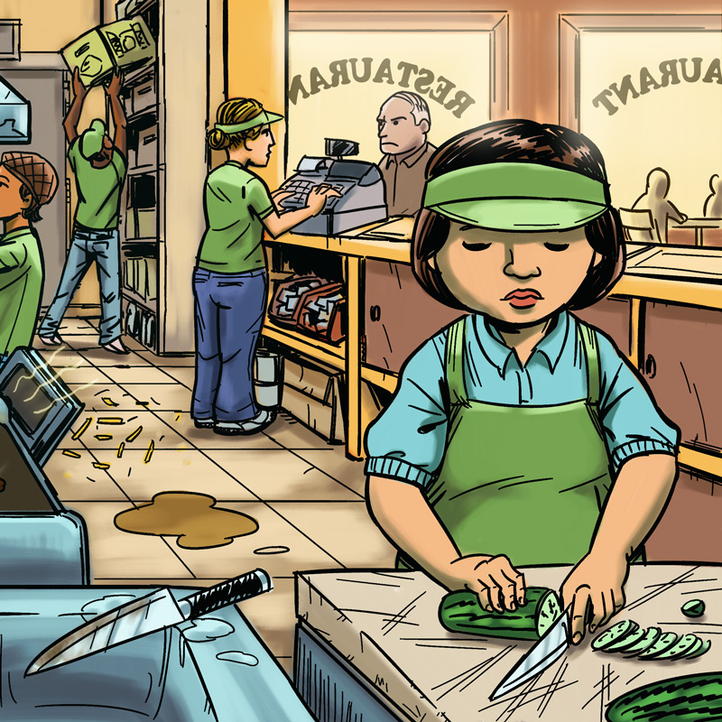
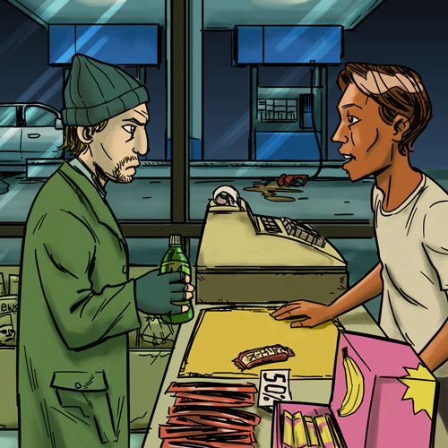
Know Your Rights and Responsibilities

Slide 14
Who Protects Teen Workers?
Employers
Teens
Government agencies
    The Occupational Safety and Health Administration (OSHA)
    Federal and State Departments of Labor
    U.S. Equal Employment Opportunity Commission (EEOC)

Slide 15
Are You a Teen Worker?
What is the minimum wage in our state?
If you are under 18 years old do you need a work permit before you start a new job?
During the school year, how late can 14- and 15-year-olds work at night?
During the school year, how late can 16- and 17-year-olds work at night?

Slide 16
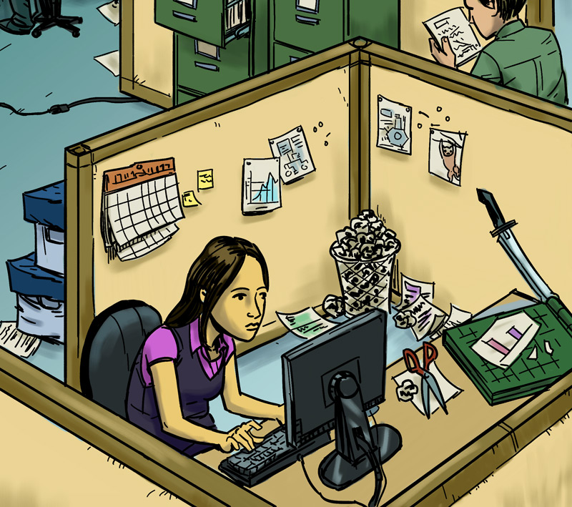
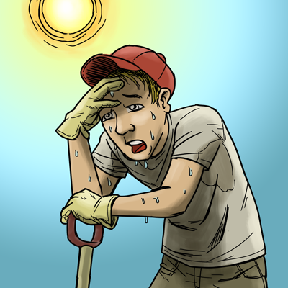
Being Prepared,
Taking Action

Slide 17
Emergencies at Work
What is an emergency at work?
An unplanned event that harms or threatens employees, customers, or the public; that shuts down business operations; or that causes physical or environmental damage.

Slide 18
Emergencies at Work - Examples
Man Made | Natural
Toxic releases | Hurricanes
Power outages | Blizzards
Fires | Wild fires
Chemical spills | Tornadoes
Terrorism | Ice storms
Explosions | Earthquakes
Violence | Floods

Slide 19
Speaking Up
  Never feel bad about seeking help or asking questions. Trust your instincts!
  Don’t be silent when confronted with a problem at work. It could get worse, and you or a co-worker could get hurt!
  It is illegal for an employer to fire someone for reporting work hazards or other safety problems at work!

Slide 20
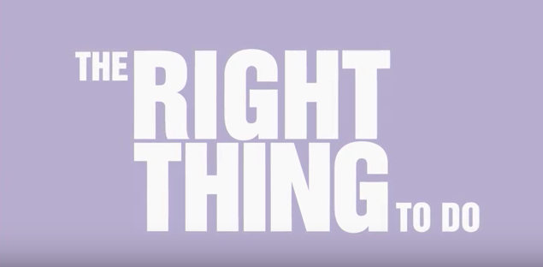
What Do OSH Professionals Do?
  Occupational safety and health (OSH) professionals:
  Help prevent harm to workers, the environment, and the general public.
  Design safe workspaces, study or treat work-related diseases, inspect machines, or test air quality.
  This video can also be viewed at https://www.youtube.com/watch?v=0k7GPWBoCa0

Slide 21
Safety Matters: Summing Up (1)
Everyone is at risk for being hurt on the job, and all jobs have hazards.
Young workers are more likely than any other age group to get hurt or killed at work.
Workplace injuries are NOT accidents. They can be predicted and prevented.

Slide 22
Safety Matters: Summing Up (2)
You need to know about the types of hazards so you can recognize potential health and safety problems.
The best way to prevent a workplace injury or illness is to remove the hazard.
If this can’t be done, then control the hazard through work policies, procedures or the use of PPE.

Slide 23
Safety Matters: Summing Up (3)
OSHA enforces health and safety laws.
Employers are responsible for providing a safe and healthy workplace, safety training and safety equipment.
Young people should know their rights in the workplace but they also need to know their responsibilities, like reporting hazards and following all safety rules.

Slide 24
Safety Matters: Summing Up (4)
Remember to trust your instincts and don’t be afraid to speak up if you have a problem at work!
A work injury (or illness) can change your life forever!
Learn about the risks and hazards at work and take action to protect yourselves and others.

Slide 25
Stay Safe & Healthy at Work!
The skills you’ve learned in the NIOSH/AIHA Safety Matters training will help keep you safe and healthy on the job, now and throughout your work lives.
Thank you!

