Slide 1
ANACoD:
Analysing Mortality Levels &
Cause-of-Death Data
These materials have been developed by the National Center for Health Statistics, International Statistics Program, Hyattsville, Md., as part of the CDC Global Program for Civil Registration and Vital Statistics Improvement.
Notes:
A country’s vital statistics system should be periodically evaluated to see whether the needs of the system are being adequately met. Two major aspects should be examined: the quality of the resulting vital statistics and an evaluation of the overall CRVS system. We’ll look at different models that have been proposed for evaluation. As well, we’ll discuss the importance of evaluating the adequacy of government provisions for the CRVS system and the importance of system flexibility.

Slide 2
Assessing the Quality of
Mortality Data: 10 step process
Prepare basic tabulations of deaths by age, sex and cause of death
Review crude death rates
Review age and sex-specific death rates
Review the age distribution of deaths
Review child mortality rates
Review the distribution of major causes of death
Review age patterns of major causes of death
Review leading causes of death
Review ratio of noncommunicable to communicable disease deaths
Review ill-defined causes of death
SOURCES:
World Health Organization (2011). Analysing mortality levels and causes of death (ANACoD) Electronic Tool. Department of Health Statistics and Information Systems. Geneva, World Health Organization. Available from healthstat@who.int (ANACoD)
AbouZahr C, Mikkelsen L, Rampatige R, and Lopez A. Mortality statistics: a tool to improve understanding and quality. Health Information Systems Knowledge Hub, University of Queensland. Working Paper Series 13. November 2010. http://www.uq.edu.au/hishub/wp13 (UQ Working Paper 13)
Notes:
Notes:
Steps for assessing the quality of mortality data are outlined in a 10 step process in a publication entitled “Mortality statistics: a tool to improve understanding and quality” from the Health Information Systems Knowledge Hub at the University of Queensland. The process may be applied to any mortality data. Common sources of mortality data include: national civil registration and vital statistics systems, censuses, longitudinal demographic surveillance, and routine health information systems. The purpose of assessing the quality of mortality data is to identify weaknesses and opportunities for improvement in the data. The assessment process, followed by corrective action, should be conducted on an ongoing basis and integrated into routine activities of health information systems.
The subsequent slides will review each of these steps. An Excel tool developed by the World Health Organization (ANACoD) can be used to automate the data quality assessment process described in these 10 steps.
Before continuing, it might be helpfult to do a brainstorming session with the class to see what they know of general patterns of mortality in different kinds of countries. We will see how these patterns are used to assess the quality of a country’s mortality data. (potential prompt: In what age groups do we expect to see the greatest number of deaths? – 0-4 years and >65 years).

Slide 3
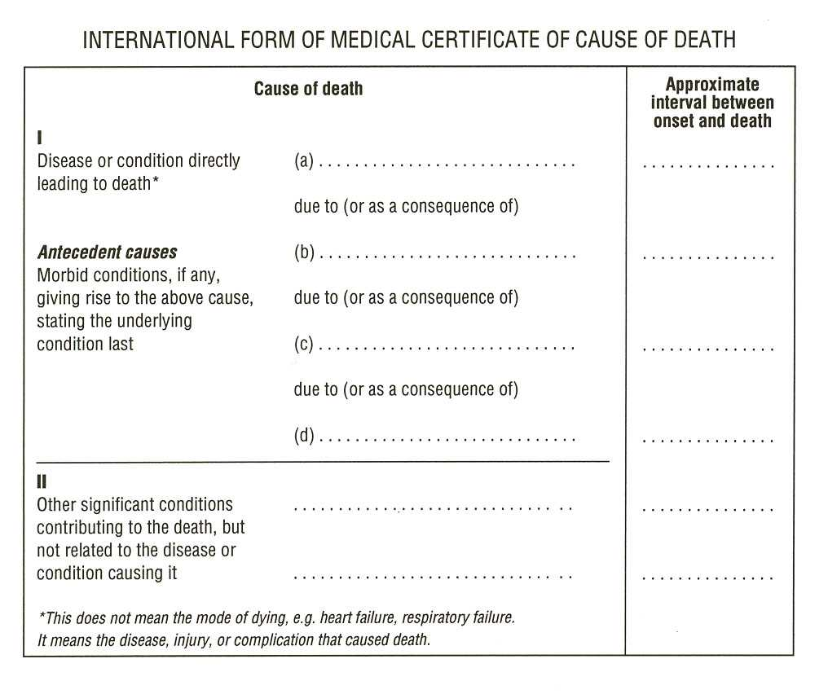
WHO recommends the use of the International Form of Medical Certification of Cause of Death to document the underlying cause of death
Traumatic shock
Internal injuries
Pedestrian hit by car
AIDS
Notes:
Let’s take a minute to review where medically certified cause of death information comes from. Countries that follow WHO’s international standards for medical certification of cause of death use the international form of medical certificate of cause of death– shown on this slide. The form is separated into two parts. Events directly leading to the death are listed in part one. Other significant conditions contributing to the death but that are not directly related it are listed in part two.
Part one contains 4 lines for recording conditions, each with a line to record the approximate time interval between the onset of the listed condition and death.
The disease or condition directly leading to the death should be listed in line a. Conditions giving rise to the condition directly leading to the death should be listed in subsequent lines, such that the underlying condition giving rise to all other events directly leading to the death is listed on the lowest line (blue circle).
For public health purposes, this is the condition in which we are most interested– the underlying cause of death. It is this condition that is captured in the public health statistics for a country– that that which we will use to assess the quality of a country’s mortality data.
For a complete review of medical certification of cause of death and the ICD system, see Slide Set 4 on Death Records.

Slide 4
International Statistical Classification of Diseases and Related Health Problems: 10th Revision (ICD-10) includes natural causes & external causes of death
Chapter Blocks Title
I A00-B99 Certain infectious and parasitic diseases
II C00-D48 Neoplasms
III D50-D89 Diseases of the blood and blood-forming organs…
IV E00-E90 Endocrine, nutritional and metabolic diseases
V F00-F99 Mental and behavioral disorders
VI G00-G99 Diseases of the nervous system
VII H00-H59 Diseases of the eye and adnexa
VIII H60-H95 Diseases of the ear and mastoid process
IX I00-I99 Diseases of the circulatory system
X J00-J99 Diseases of the respiratory system
XI K00-K93 Diseases of the digestive system
XII L00-L99 Diseases of the skin and subcutaneous tissue
XIII M00-M99 Diseases of the musculoskeletal system and connective tissue
XIV N00-N99 Diseases of the genitourinary system
XV O00-O99 Pregnancy, childbirth and the puerperium
XVI P00-P96 Certain conditions originating in the perinatal period
XVII Q00-Q99 Congenital malformations, deformations and chromosomal abnormalities
XVIII R00-R99 Symptoms, signs and abnormal clinical and laboratory findings…
XIX S00-T98 Injury, poisoning and certain other consequences of external causes
XX V01-Y98 External causes of morbidity and mortality
XXI Z00-Z99 Factors influencing health status and contact with health services
IU00-U99 Codes for special purposes
Notes:
Once a medical certificate of cause of death is completed, the listed conditions are reviewed and coded using the International Classification of Diseases (ICD) system (currently in 10th revision). This slide lists the contents of the ICD-10 system-- conditions are broken down into 21 chapters, coded by 3 or 4 character “blocks.” These blocks are used to tabulate the vital statistics from a country’s mortality data– to make them useable for public health purposes.

Slide 5

ANACoD:
Analysing mortality levels & cause-of-death data
An electronic tool to automate the 10 step process
Step-by-step tool for analysis of data on mortality levels and cause of death
Developed by:
  WHO
  The University of Queensland Health Info. Systems Knowledge Hub
  Health Metrics Network (financial support)
SOURCES FOR ANACoD SLIDES:
(ANACoD) World Health Organization (2011). Analysing mortality levels and causes of death (ANACoD) Electronic Tool. Department of Health Statistics and Information Systems. Geneva, World Health Organization. Available from healthstat@who.int.;
(UQWP13) AbouZahr C, Mikkelsen L, Rampatige R, and Lopez A. Mortality statistics: a tool to improve understanding and quality. Health Information Systems Knowledge Hub, University of Queensland. Working Paper Series 13. November 2010. (http://www.uq.edu.au/hishub/wp13)
Notes:
Notes:
A copy of the ANACoD Excel file is available with the curriculum package; contact EKNichols@cdc.gov. It is recommended that course participants use the ANACoD Excel program during the lecture. It is also recommended that prior to this section, participants read guidance on using this tool provided in handout “ANACoD version 1.0 Guidance.” This document can also be accessed by clicking on the “Guidance” button at the top, right of the screen for any sheet in the ANACoD program. This guidance is also referenced in the Working Paper on the 10 step process: AbouZahr C, Mikkelsen L, Rampatige R, and Lopez A. Mortality statistics: a tool to improve understanding and quality. Health Information Systems Knowledge Hub, University of Queensland. Working Paper Series 13. November 2010. (http://www.uq.edu.au/hishub/wp13). For some topics, the Working Paper 13 offers additional guidance– references are included in relevant slides.
The “Analysing mortality levels and causes of death” (ANACoD) electronic tool provides a step-by-step approach to enable users to quickly conduct a comprehensive analysis of data on mortality levels and causes of death. The tool automatically reviews the data for errors, tabulates the information, presents the results in the form of easy to use tables and charts, and provides the opportunity to compare the findings with those from other groups of countries.
With the growing demand for more results, faster, ANACoD provides an easy to use, free software solution.

Slide 6
Notes:
Activity: Distribute “ANACoD_Activity Guide” handout. The first two pages of the handout are the standard instructions for starting ANACoD. Notes for course participants have been added to the instructions in italics. Participants should read the first two pages of the handout and open the ANACoD program (ANACoD version 1.1 2013Feb_activity.xls) to the menu sheet.
Notes:
The ANACoD tool is an Excel-based application. Only knowledge of basic Excel commands and a basic understanding of ICD-10 is needed. All analyses are automated. Each step operates from a separate worksheet in Excel. The “Menu” worksheet is shown above.

Slide 7
CAUSES OF DEATH ANALYSIS
INPUT DATA
MORTALITY
LEVELS
ANALYSIS
Notes:
The tool has 3 parts: I. Input data (Steps 0-1); II. Mortality Levels analysis (Steps 2-5); and III. Causes of deaths analysis (Steps 6-10).

Slide 8
Getting Started
Open Excel file: ANACoD version 1.1 2013Feb_blank.xls
Enable macros
Go to sheet “step0-Input data”
Enter information at top of page:
  Country: Colombia
  Year: 2009
  Source of data: Civil registration
  ICD level used: ICD-10, 4-character codes
Input data from Excel file: Country Data_Anacod.xlsx
  Copy “Population” data; paste into ANACoD tool, starting in E14
  Copy “Deaths: data; paste into ANACoD tool, starting in C20
Notes:
Activity: Participants should review through Step 0 (p 1-4) in the ANACoD version 1.0 Guidance” document.
Course participants should follow the instructions on pages 1-3 of the “ANACoD_Activity Guide” to open the ANACoD tool and enter country data from the ‘Country Data_Anacod’ Excel file in the ‘step0-Input data’ sheet. Participants and instructors should refer to the ‘ANACoD version 1.0 Guidance’ document, Step 0, for additional information about the aggregation and tabulation of mortality data.

Slide 9
ANACoD - PART I: INPUT DATA
Step 0 - Input data: raw mortality data by age and sex and ICD 3 or 4 character codes; population data by sex and age
Notes:
Activity: Participants should confirm the numbers in their ANACoD tool sheet for Step0 match those on the slide.
The next several slides review the content of the ANACoD software.
Step 0: Input data: raw mortality data by age and sex and ICD 3 or 4 character (cause of death; see next slide) codes; population data by sex and age

Slide 10
ANACoD - PART I: INPUT DATA
Step 1 - Basic check of input data
Population: The entered data automatically generate a table and population pyramid (discussed further in Step 2).
Notes:
Activity: For each step, it is suggest that the participant first click the ”Guidance” button at the top right of the Excel worksheet for each step (also available in the “ANACoD version 1.0 Guidance” handout). Starting on Page 3, the handout ‘ANACoD_Activity Guide_participant’ provides additional guidance to participants on how to interpret the tables and figures in Steps 1-10. It is recommended that the instructor discuss and highlight important points for interpretation from each table and figure that is produced throughout the program. See the instructor guide (‘ANACoD_Activity Guide_instructor’) for points to emphasize. The instructor guide includes guidance on all tables and figures generated in the ANACoD program. Select tables and figures are additionally described in the following slides.
The ANACoD guidance is also referenced in the Working Paper on the 10 step process: AbouZahr C, Mikkelsen L, Rampatige R, and Lopez A. Mortality statistics: a tool to improve understanding and quality. Health Information Systems Knowledge Hub, University of Queensland. Working Paper Series 13. November 2010. (http://www.uq.edu.au/hishub/wp13). For some topics, the Working Paper 13 offers additional guidance– references are included in relevant slides.
Step 1: Note that for the purposes of this exercise, no corrections will be made to the original data.
Notes:
Step1: Basic check of input data – When the user clicks on sheet ‘step1-check first’, various tables and figures will automatically be generated. These tables and figures can be used to flag basic errors in the data.
ANACoD automatically generates a summary of the population information enetered in table and pyramid form.

Slide 11
ANACoD - PART I: INPUT DATA
Step 1 - Basic check of input data
Any non-zero numbers indicate age groups for which country data are not consistent.
 | sex | all ages | 0 | 1-4 | 5-9 | 10-14 | 15-19 | 20-24 | …
No deaths in "AAA": all causes
 | m | 113327 | 5333 | 1121 | 629 | 848 | 3604 | 5622 | …
 | f | 83354 | 4225 | 931 | 469 | 523 | 1042 | 1255 | …
Sum of deaths in all other codes
 | m | 113327 | 5333 | 1121 | 629 | 848 | 3604 | 5622 | …
 | f | 83354 | 4225 | 931 | 469 | 523 | 1042 | 1255 | …
Difference: should be zero
 | m | 0 | 0 | 0 | 0 | 0 | 0 | 0 | …
 | f | 0 | 0 | 0 | 0 | 0 | 0 | 0 | …
An attempt should be made to query and correct the specific death certificate.
See cite slide 54.
Notes:
Step 1: Note that for the purposes of this exercise, no corrections will be made to the original data.
Notes:
Step1: Basic check of input data – When the user clicks on sheet ‘step1-check first’, various tables and figures will automatically be generated. These tables and figures can be used to flag basic errors in the data.
Table 2.1 is checking to see if the total number of deaths reported from “all causes” from a country (AAA, first row) equals the sum of all the deaths that were reported by the individual ICD 10 codes (second row). All numbers in the third row of Table 2.1 should sum to “0”. If something does not equal “0”, Table 2.1 will give an indication of in which age group the country data are not consistent.
Are the number of deaths from “all causes” consistent with the sum of all deaths reported by individual ICD 10 codes for this country? Yes.
Table 2.2: The number of deaths for “all ages” in Table 2.2 should equal the number of deaths for “all ages” listed in Table 2.1. However, the deaths for which age is missing or unknown (MUN column in Table 2.1) are distributed proportionally across all age categories in Table 2.2. Thus, the age-specific number of deaths in Table 2.2 may vary slightly from those in Table 2.1.
The age distribution of reported deaths figure is another way of presenting the “Percentage of total deaths” column in Table 2.2. The distribution of total death is further explored in Step 4.
If potential errors are detected, go back to Step 0 and correct data as needed. (for this exercise, no corrections will be made to the original data)

Slide 12
ANACoD - PART I: INPUT DATA
Step 1 - Basic check of input data
Look for expected patterns:
Deviations may indicate errors in age or sex information.
MALES > Females
Males < FEMALES
Higher percentages in the 0 and 65+ age groups
Higher percentages for males compared to females in the 15-64 age groups, due to a higher number of deaths from external causes
Higher percentages for females compared to males in the oldest age groups
Notes:
Step 1: Note that for the purposes of this exercise, no corrections will be made to the original data.
Notes:
Step1: Basic check of input data – When the user clicks on sheet ‘step1-check first’, various tables and figures will automatically be generated. These tables and figures can be used to flag basic errors in the data.
Table 2.1 is checking to see if the total number of deaths reported from “all causes” from a country (AAA, first row) equals the sum of all the deaths that were reported by the individual ICD 10 codes (second row). All numbers in the third row of Table 2.1 should sum to “0”. If something does not equal “0”, Table 2.1 will give an indication of in which age group the country data are not consistent.
Are the number of deaths from “all causes” consistent with the sum of all deaths reported by individual ICD 10 codes for this country? Yes.
Table 2.2: The number of deaths for “all ages” in Table 2.2 should equal the number of deaths for “all ages” listed in Table 2.1. However, the deaths for which age is missing or unknown (MUN column in Table 2.1) are distributed proportionally across all age categories in Table 2.2. Thus, the age-specific number of deaths in Table 2.2 may vary slightly from those in Table 2.1.
The age distribution of reported deaths figure is another way of presenting the “Percentage of total deaths” column in Table 2.2. The distribution of total death is further explored in Step 4.
If potential errors are detected, go back to Step 0 and correct data as needed. (for this exercise, no corrections will be made to the original data)

Slide 13
ANACoD - PART I: INPUT DATA
Step 1 - Basic check of input data
Check for standard patterns:
Generally higher rates of male versus female mortality.
Smooth, increasing lines after age 35 years.
Notes:
Notes:
Step1: Basic check of input data – When the user clicks on sheet ‘step1-check first’, various tables and figures will automatically be generated. These tables and figures can be used to flag basic errors in the data.
This table and figure are calculated from data entered in Step 0 and population data for the country. The age- and sex- distribution of deaths are further explored in Steps 3 & 4.
A graph of the log mortality rates facilitates a quick visual test for abnormalities across age groups. Standard patterns observed in a graph of log mortality rates include:
Generally higher rates of male mortality compared to female mortality across all ages;
Lines that increase smoothly and linearly with age after about age 35.
Do the data in Table/Figure 2.3 follow expected patterns? Yes.

Slide 14
ANACoD - PART I: INPUT DATA
Step 1 - Basic check of input data
Checking for invalid ICD codes -- All cells should contain a “0” or “0%.”
…
…
…
Click to see a list of valid ICD codes for underlying cause of death or to see where non valid codes are flagged.
Notes:
Notes:
Step1: Basic check of input data – When the user clicks on sheet ‘step1-check first’, various tables and figures will automatically be generated. These tables and figures can be used to flag basic errors in the data.
If data are entered correctly, all cells should contain a “0” or “0%,” indicating that there are no deaths with ICD10 codes that should not be used for causes of deaths or that all codes used exist in ICD10.
Are there any cells without a “0” or “0%”. No. Participants can click the “ICD10” button or the “ICD 10 list” sheet to see a list of valid ICD codes for underlying causes of death. They can also click the button “Go” to see column AB in sheet ‘step0-Input data,’ where non valid codes are (or would be) flagged. If errors were detected, they should be corrected in Step 0.

Slide 15
ANACoD - PART I: INPUT DATA
Step 1 - Basic check of input data
Sex specific codes. Pink: female only, blue: male only
ICD | Disease | No of deaths
O00-O99 | Pregnancy, child birth and the puerperium - male | 0
C53 | Cervix uteri cancer - male | 0
C54-C55 | Corpus uteri cancer - male | 0
C56 | Ovary cancer - male | 0
C61 | Prostate cancer - female | 0
N40 | Benign prostatic hypertrophy - female | 0
Pls check if sum is not equal to zero ---> |  | 0
An attempt should be made to query and correct the death certificate for any deaths listed in these columns that indicate unlikely disease/sex combinations or unlikely causes of death.
Notes:
Notes:
Step1: Basic check of input data – When the user clicks on sheet ‘step1-check first’, various tables and figures will automatically be generated. These tables and figures can be used to flag basic errors in the data.
Are any deaths indicated in the upper left table, cells F111-117? Deaths in this column would indicate clearly incorrect causes of death, based on implausible sex/cause of death combinations. No. If there were deaths listed in this column, an attempt should be made to query and correct the specific death certificate. (for this exercise, no corrections will be made to the original data)
Are any deaths indicated in the lower left table, cells F122-132? Deaths in this column would indicate likely incorrect causes of death, based on diseases unlikely to cause death. Yes- 8 deaths. An attempt should be made to query and correct the specific death certificates. (for this exercise, no corrections will be made to the original data)

Slide 16
ANACoD - PART I: INPUT DATA
Step 1 - Basic check of input data
An attempt should be made to query and correct the death certificate for any deaths listed in this column that indicates an unlikely disease/age combination.
Notes:
Notes:
Step1: Basic check of input data – When the user clicks on sheet ‘step1-check first’, various tables and figures will automatically be generated. These tables and figures can be used to flag basic errors in the data.
Are any deaths indicated in the table to the right, cells O110-139? Deaths in this column would indicate likely incorrect causes of death, based on implausible disease/age combinations. Yes. An attempt should be made to query and correct the specific death certificates. (for this exercise, no corrections will be made to the original data)

Slide 17
ANACoD - PART II:
MORTALITY LEVELS ANALYSIS
  Steps 2-5
  Focus on simple steps to assess the plausibility of the mortality levels.
  The tool compiles and formats the raw data to enable the calculation of:
  crude death rates
  age-specific mortality rates
  life expectancy at birth
  child mortality

Slide 18
ANACoD - PART II: MORTALITY LEVELS ANALYSIS
Step 2: Crude death rates (CDR)
Enables users to:
Calculate the CDR and use the country’s population pyramid to helps in the interpretation of the CDR
Crude death rate = Number of deaths in resident population in given year X 1000
Size of the midyear resident population in that year
Use the CDR as an approximate indicator of completeness of death registration
Compare the CDR to the expected CRD based on life expectancy and population growth rates
Notes:
Activity: Participants and instructors should review the ‘ANACoD version 1.0 Guidance’ document, Step 2, for additional information about the use of crude death rates.
Notes:
Recall that the Crude Death Rate (CDR) is a measure of the number of deaths in a population, relative to the size of that population over a given period of time.

Slide 19
ANACoD - PART II: MORTALITY LEVELS ANALYSIS
Step 2: Crude death rates
Population data to aid in interpretation of crude death rates:
 | Age-group (yrs) | No of deaths |  | Population |  | Proportion of
 |  | male | female | male | female
 | All ages | 113 327 | 83 354 | 22 464 882 | 23 189 162
 | 0 | 5 368 | 4 234 | 466 526 | 446 815
 | 1-4 | 1 128 | 933 | 1 828 674 | 1 753 044
 | 5-9 | 633 | 470 | 2 250 657 | 2 160 252
 | 10-14 | 854 | 524 | 2 240 827 | 2 155 587
 | 15-19 | 3 628 | 1 044 | 2 201 572 | 2 130 962
 | 20-24 | 5 659 | 1 258 | 2 050 933 | 2 019 554
 | 25-29 | 6 112 | 1 289 | 1 894 170 | 1 912 832
 | 30-34 | 4 863 | 1 361 | 1 707 701 | 1 774 594
 | 35-39 | 4 197 | 1 582 | 1 510 151 | 1 612 906
 | 40-44 | 4 187 | 2 117 | 1 479 874 | 1 603 908
 | 45-49 | 4 646 | 2 791 | 1 275 551 | 1 399 558
 | 50-54 | 5 129 | 3 525 | 1 040 753 | 1 158 799
 | 55-59 | 6 046 | 4 132 | 833 936 | 945 156
 | 60-64 | 6 808 | 4 863 | 600 560 | 697 959
 | 65-69 | 8 366 | 6 323 | 408 106 | 492 649
 | 70-74 | 9 990 | 8 396 | 289 037 | 366 559
 | 75-79 | 11 431 | 10 206 | 193 494 | 261 311
 | 80+ | 24 281 | 28 307 | 192 360 | 296 717
 | Completeness of civil registration data is estimated by dividing the reported deaths by the UN estimates* => |  |  |  |  |  |  |  |  | 78%
CDR as approximate indicator of completeness of death registration: ≥ 90% is defined as “good” by UN standards.
Notes:
Notes:
The table and population pyramid presented at the top of Step 2 review information presented in Step 1. The population pyramid aids in understanding the population’s age-sex structure, and thus helps in the interpretation of the CDR. Populations that have a high proportion of the population in age groups where mortality rates are highest (i.e., below 4 years and 60+ years) can be expected to have a higher CDR.
The population pyramid for this country shows the highest proportion of the population in the 0-4 age group, where mortality rates are highest– thus we expect this country to have a higher crude death rate (see next slide). If it does not, it could be an indication of under-reporting.
Step 2 also presents the estimated completeness of civil registration data, based on dividing the reported deaths by UN estimates. We’ll look for consistency between the estimated completeness of registration data and conclusions drawn from the crude death rate. In this case, the estimated completion of 78% is lower than the UN standard goal of 90% completion for “good completion.” We will expect that the CDR is also low.

Slide 20
ANACoD - PART II: MORTALITY LEVELS ANALYSIS
Step 2: Crude deaths rates
CDRs < 5.0 are suspiciously low and indicate under-reporting.
Observed
Crude death rate per 1000 population |  |  | Both sexes |  |  | 4.3 | Life expectancy at birth (years) |  |  | Both sexes |  | 77.2
 |  |  | Males |  |  | 5.0 |  |  |  | Males |  | 73.6
 |  |  | Females |  |  | 3.6 |  |  |  | Females |  | 80.8
% Annual rate of population growth (UN*) |  |  | Both sexes |  |  | 1.46
 |  |  | Males |  |  | 1.43
 |  |  | Females |  |  | 1.48
*UN source: United Nations, World Population Prospects the 2010 revision
Expected crude death rates at different levels of life expectancy and population growth (based on Coale-Demeny West model)
Male |  | Annual rate of population growth (percent)
 | 10 | 5 | 3 | 2.5 |  | 2 | 1.5 | 1 | 0.5 | 0 | -0.5 | -1
Life expectancy at birth (years) | 40 | 26.7 | 23.6 | 23.2 |  | 23.1 | 23.1 | 23.4 | 24.1 | 25.0 | 26.3 | 27.9
 | 45 | 20.8 | 19.0 | 18.9 |  | 19.1 | 19.4 | 20.1 | 21.0 | 22.2 | 23.8 | 25.7
 | 50 | 16.0 | 15.2 | 15.4 |  | 15.8 | 16.4 | 17.3 | 18.5 | 20.0 | 21.8 | 24.0
 | 55 | 12.0 | 12.1 | 12.5 |  | 13.1 | 14.0 | 15.1 | 16.5 | 18.2 | 20.2 | 22.6
 | 60 | 8.7 | 9.5 | 10.1 |  | 10.9 | 11.9 | 13.2 | 14.8 | 16.7 | 18.9 | 21.4
 | 65 | 5.9 | 7.3 | 8.0 |  | 9.0 | 10.2 | 11.6 | 13.3 | 15.4 | 17.7 | 20.4
 | 70 | 3.8 | 5.6 | 6.4 |  | 7.4 | 8.7 | 10.2 | 12.1 | 14.3 | 16.8 | 19.6
 | 75 | 2.3 | 4.2 | 5.1 |  | 6.2 | 7.6 | 9.2 | 11.1 | 13.3 | 15.9 | 18.8
 | 85
Female |  | Annual rate of population growth (percent)
 | 10 | 5 | 3 | 2.5 |  | 2 | 1.5 | 1 | 0.5 | 0 | -0.5 | -1
Life expectancy at birth (years) | 40 | 27.4 | 24.1 | 23.6 |  | 23.4 | 23.6 | 24.1 | 24.1 | 25.0 | 26.2 | 27.8
 | 45 | 21.6 | 19.5 | 19.3 |  | 19.4 | 19.6 | 20.2 | 21.1 | 22.2 | 23.7 | 25.6
 | 50 | 16.8 | 15.7 | 15.8 |  | 16.1 | 16.7 | 17.5 | 18.6 | 20.0 | 21.8 | 23.9
 | 55 | 12.7 | 12.5 | 12.9 |  | 13.4 | 14.2 | 15.2 | 16.5 | 18.2 | 20.2 | 22.5
 | 60 | 9.4 | 9.9 | 10.4 |  | 11.1 | 12.1 | 13.3 | 14.8 | 16.7 | 18.8 | 21.3
 | 65 | 6.6 | 7.7 | 8.4 |  | 9.2 | 10.3 | 11.7 | 13.4 | 14.8 | 16.7 | 19.5
 | 70 | 4.3 | 5.8 | 6.6 |  | 7.6 | 8.8 | 10.4 | 12.2 | 14.3 | 16.7 | 19.5
 | 75 | 2.6 | 4.4 | 5.2 |  | 6.3 | 7.6 | 9.2 | 11.1 | 13.3 | 15.9 | 18.8
 | 80 | 1.5 | 3.4 | 4.2 |  | 5.3 | 6.7 | 8.3 | 10.2 | 12.5 | 15.1 | 18.1
Compare the observed CDR to the expected CRD based on life expectancy and population growth rates
Notes:
Activity: Participants and instructors should review the ‘ANACoD version 1.0 Guidance’ document, Step 2, for a useful explanation on the lower limits of CDRs.
Notes:
The lower limit for the CDR in any country is around 5 per 1000; CDRs below 5 per 1000 should be considered suspicious. If the age distribution shown in the population pyramid suggests that a country should have a higher CDR (as is the case in this country), and the observed CDR based on a country’s mortality data is suspiciously low, under-reporting of deaths and incomplete civil registration are expected. In this example, the country’s CDR for females (3.6) is suspiciously low. This observation is further confirmed by the estimates the completeness of civil registration data (78% as shown on previous slide).
Estimates of life expectancy and population growth rates can also be used to determine what a plausible CDR should be for a country. Step 2 lists these indicators with a table of the expected CDRs at different levels of life expectancy and population growth. The CDRs provided in the table for the appropriate indicators for a give country can be used to approximate by how much the country’s CDR (based on the entered mortality data) is under- or over-estimated. For this country, the expected crude death rate is 10.2 versus the observed 5.0 for males and 8.3 versus 3.6 for females– further confirmation that deaths are likely under-reported.
See the UQ Working Paper 13 for an additional explanation about trends in crude death rates.

Slide 21
ANACoD - PART II: MORTALITY LEVELS ANALYSIS
Step 3. Age and sex-specific death rates
Enables users to:
Calculate the mortality rate specific to a population age group (usually a five-year grouping), known as the age-specific mortality rate (ASMR)
deaths in a specific age group in a ASMR = population during a specified time period × 100 000 total mid-year population in the same age group, population and time period
Compare relative age patterns in ASMR for country to expected global patterns to identify potential under registration at certain ages
Compare patterns in male:female ASMR ratio to countries with various infant mortality rates to identify issues with completeness of registration
Look for deviations in expected patterns of the log ASMR to indicate under-reporting at certain ages or mis-reporting of correct age of death
Notes:
Activity: Participants and instructors should review the ‘ANACoD version 1.0 Guidance’ document, Step 3, for additional information about the use of crude death rates.
Notes: Since mortality rates are generally higher among males than females, and mortality risks vary across age groups, age- and sex-specific mortality rates can be used to identify possible age misreporting of deaths.
See the UQ Working Paper 13 for an additional explanation about dealing with fluctuations in the ASMR due to small population numbers.

Slide 22
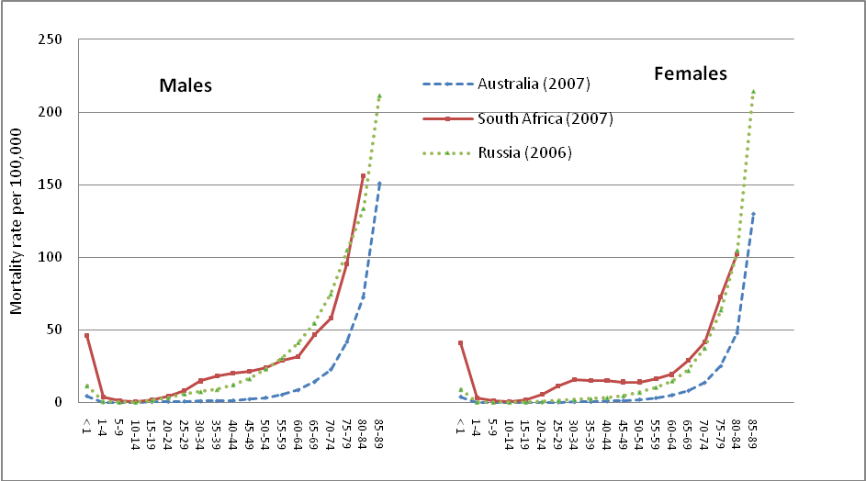
ANACoD - PART II: MORTALITY LEVELS ANALYSIS
Step 3. Age and sex-specific death rates
Compare relative age patterns to expected patterns in ASMR: Deviations may indicate under-registration in certain age groups and/or missing age or sex information.
Figure 3: ASMR for Australia, Russia and South Africa, males and females, 2000 (ANACoD)
Notes:
Notes:
A comparison of patterns in the ASMR data with an independent source (e.g. the census or data from a similar country/setting) can be used to assess plausibility of the observed data. In the absence of data for comparison, observed patterns in the data can be judged against expected patterns in ASMR, including:
Mortality rates should be highest during infancy and early childhood and lowest between 5 and 14 years (note, South Africa has particularly high infant mortality rates);
Mortality rates should increase exponentially beyond about 35 years;
A “bump” in mortality during reproductive years may indicate premature mortality due to HIV/AIDS or high maternal mortality (South Africa).
Deviations from these patterns may indicate under-registration of deaths in certain age groups and/or missing age or sex information for registered deaths. Note: it is the relative ASMR age pattern across age groups, not the level of mortality, that is of importance in this comparison. This highlights the importance of checking the plausibility of age-patterns of mortality, and to test for underreporting of deaths in certain age groups by plotting the graph of ln(m_{x}) versus age (x), as described in Step 3.

Slide 23
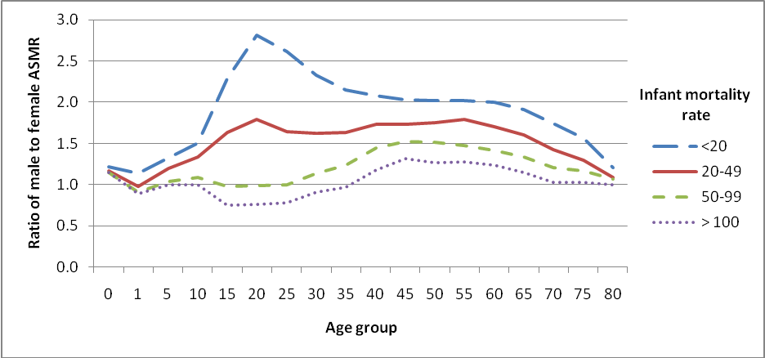
ANACoD - PART II: MORTALITY LEVELS ANALYSIS
Step 3. Age and sex-specific death rates
Compare patterns in ratio of male:female ASMR: Deviations may indicate country abnormalities or under-registration.
Figure 5: Ratio of male to female age-specific mortality rates at different levels of infant mortality (expected patterns)
IMR* = 16.0 per 1 000 live births
(WHO Global Health Observatory; 2010)
* From a source independent of the value from the data being assessed.
Notes:
Activity: The instructor should explain the implications of the various infant mortality rates and how they are indicative of a country’s socioeconomic status.
Notes:
Calculating the ratio of male to female ASMR can display male-female differences to see if observed patterns are consistent with expected patterns. Male death rates are higher than female death rates across all age categories in almost all societies, except those with very poor female status. Thus, a ratio > 1.0 for all ages is expected. However variation in the magnitude of the ratio can be seen across different infant mortality rates (a proxy for different standards of living and health). Figure 5 from the ‘ANACoD version 1.0 Guidance’ document shows the expected patterns in male:female ASMR ratio across age groups for various infant mortality rates. Expected patterns include:
A bump between 15 and 29 years, indicating higher death rates among males
A secondary peak in male:female ratio around ages 55-64, due to the tendency for males to die at higher rates from chronic disease compared to females, from increased risk factors for tobacco use, poor diet, and overweight and obesity
Comparing the examples presented: Like in Figure 5, the country (green line) has a bump between ages 10-14 and 45-49, indicating an increase in deaths among males, likely due to accidents and other violent deaths. However, the magnitude of the bump is greater in the country, compared to Figure 5, which indicates that there may be an abnormally high number of male deaths in these age categories for this country. For ages > 49, the ratio for the country is a little lower than the figure, but the general pattern observed is as expected.

Slide 24
ANACoD - PART II: MORTALITY LEVELS ANALYSIS
Step 3. Age and sex-specific deaths rates
Look for deviations in the expected patterns of the log ASMR: Deviations may indicate systematic underreporting at a given age.
Notes:
Notes:
Since death rates increase exponentially after about 35 years of age, using a logarithmic scale to graph mortality rates should yield a straight line as age increases. Graphing ASMR on a log scale enables the user to examine the data for irregular or implausible changes across age groups. General patterns that are expected in countries with complete registration data include the following:
The ASMR is expected to sharply decline between 0-4 years and 5-9 age groups, since the 0-4 year age category experiences the highest mortality rates.
In countries with high maternal or injury mortality in young adults (especially males), death rates will rise steeply around age 15 years, peak around 25 years, and decline at about 35 years. A similar bump is expected in countries with high AIDS-related mortality.
The ASMR will rise linearly with age, starting at about 35 years of age.
By comparing the log graph for your population with similar countries with good quality mortality data, it is possible to assess the extent to which deaths are being systematically underreported at all ages.

Slide 25
ANACoD - PART II: MORTALITY LEVELS ANALYSIS
Step 4: Review the age distribution of deaths
Enables users to:
Examine the age distribution of reported deaths
Compare the calculated distribution of deaths to expected distributions corresponding to:
  Country income group (ANACoD guidance)
  Country infant mortality rate (UQ Working Paper 13)
Notes:
Activity: Participants and instructors should review the ‘ANACoD version 1.0 Guidance’ document, Step 4, for additional information about the age distribution of deaths.
See the UQ Working Paper 13 for an additional explanation about comparing age distribution of deaths to countries with similar infant mortality rates.

Slide 26
Step 4: Review the age distribution of deaths
Look for expected patterns in age-specific mortality:
Deviations may indicate selective bias in age-specific death reporting.
MALE > female mortality, except in oldest age groups
    In countries with low income/high infant mortality, female rates may be comparable to male rates.
Peak in overall mortality in:
  0-4 years (less so in countries with high income/low infant mortality)
  Oldest age groups (less so in countries with low income/high infant mortality)
Peak in male mortality between 15-44 years due to external causes
Notes:
Step 4 facilitates a comparison of the age distribution of reported deaths for the country of interest to that of other countries in the same income group (the University of Queensland Working Paper 13 discusses comparisons to countries with similar levels of infant mortality).
Standard patterns observed in age-specific mortality rates include:
Generally higher rates of male mortality compared to female mortality across all ages; for low income countries and countries with high infant mortality rates, female rates may be more comparable to male rates;
A peak in both male and female mortality in the 0-4 age group and the oldest age groups; the peak in the 0-4 age group is generally less pronounced in high income countries and countries with low infant mortality rates; and the peak in the oldest age groups is less pronounced in low income countries and countries with high infant mortality rates;
A peak in male mortality between the ages of 15 and 44, accounting for an increase in external causes.
Significant departures from these model age-distributions of deaths suggest that the reporting of deaths by age may be selectively biased. One reason for such bias may be the way age at death is reported. For example, people tend to have a strong preference to report age at death as a number ending in 0 or 5 (e.g. 45, 50, 55). This is commonly known as digit preference or age-heaping. In other instances, the age of the deceased person may be misreported; it is common for families to report that the deceased person was older than was actually the case. This highlights the importance of checking the plausibility of age-patterns of mortality, and to test for underreporting of deaths in certain age groups by plotting the graph of ln(m_{x}) versus age (x), as described in Step 3.

Slide 27
ANACoD - PART II: MORTALITY LEVELS ANALYSIS
Step 4: Review the age distribution of deaths
Compare the calculated distribution of deaths to expected distributions corresponding to: country income group
Notes:
Step 4 facilitates a comparison of the age distribution of reported deaths for the country of interest to that of other countries in the same income group (the University of Queensland Working Paper 13 discusses comparisons to countries with similar levels of infant mortality).
Do the figures show similar patterns? Generally, yes, though there is a more pronounced bump in male deaths between 15 and 34 years. This is consistent with previous observations indicating an abnormally high number of deaths from external causes among males in this age group in Colombia.

Slide 28
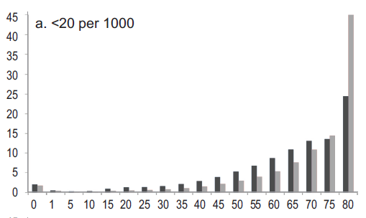
ANACoD - PART II: MORTALITY LEVELS ANALYSIS
Step 4: Review the age distribution of deaths
Compare the calculated distribution of deaths to expected distributions corresponding to: infant mortality group
Notes:
Observations are similar using countries with similar infant mortality rates for comparison.

Slide 29
ANACoD - PART II: MORTALITY LEVELS ANALYSIS
Step 5: Child mortality rates
Enables users to:
Calculate & interpret indicators of under-five mortality
  Infant mortality rate (ANACoD, UQWP13)
  Probability (per 1,000 live births) of a child born in a specified year dying before reaching the age of 1 if subject to current ASMRs
  Under 5 mortality rate (ANACoD, UQWP13)
  Probability (1,000 live births) of a child born in a specified year dying before reaching the age of 5 if subject to current ASMRs
  Neonatal mortality rate (UQWP13)
  Post neonatal mortality rate (UQWP13)
Use under-five mortality indicators from various sources to analyze the quality of mortality data
Notes:
See slide set 5 on analysis of vital statistics for more information on how to calculate the indicators of under-five mortality.

Slide 30
ANACoD - PART II: MORTALITY LEVELS ANALYSIS
Step 5: Child mortality rates
Calculate indicators of
under-five mortality:
1. Child deaths by age and calculation of mortality indicators:
Data from Civil registration, 2009
 | x | n | Population | Deaths | _{n}m_{x} | _{n}q_{x}
 | 0 | 1 | 913341 | 9601.941 | 0.0105 | 0.0104
 | 1 | 4 | 3581718 | 2061.323 | 0.0006 | 0.0023
 | Infant mortality rate per 1000 live births |  |  |  | = 1000* ₁q₀ |  | ==> | 10.4
 | Under-5 mortality rate per 1000 live births |  |  |  | = 1000*[1-(1-₁q₀)(1-₄q₁)] ==> |  |  | 12.7
x = beginning of the age interval
n = number of years in the interval
Population = from entered data; sum of male and female population in Step 2.
Deaths = from entered data; sum of male and femal deaths in Step 2.
_{n}m_{x} = mortality rate (ASMR) for age x to age n; Deaths/Population.
_{n}q_{x} = probability of a child dying between age x and age n; automatically calculated (see ANACoD guidance for calculation details).
Notes:
The calculations used to determine infant and under-5 mortality rates are performed automatically using the entered data. See the ANACoD Guidance document for Step 5 for more details on how to calculate the probability of a child dying between age x and age n.

Slide 31
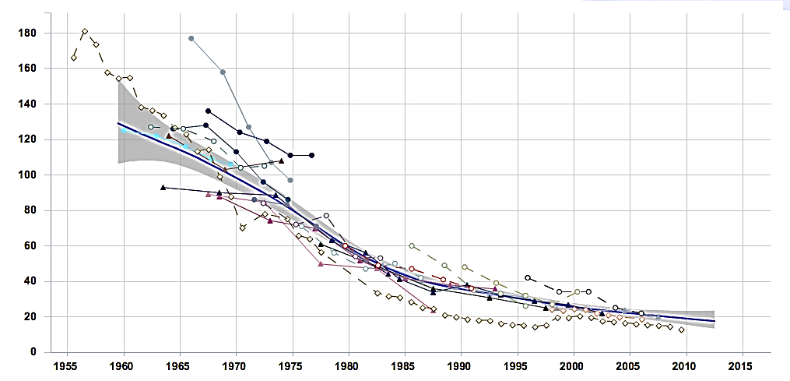
ANACoD - PART II: MORTALITY LEVELS ANALYSIS
Step 5: Child mortality rates
Use under-five mortality indicators from various sources to analyze the quality of mortality data: Deviations from “best fit” line indicate over- or under- reporting.
Under-Five Mortality Rate, Columbia
Child Mortality Estimates
www.childmortality.org
“Best fit”
Census data
Various surveys
Vital registration data
Notes:
Step 5 instructs users to www.childmortality.org. If internet is not available, the instructor may complete this step ahead of time to generate the relevant graph for reference, or the class may interpret the graph presented on the slide.
To interpret the Under-Fiver Mortality Rate, Step 5 refers users to www.childmortality.org to generate a graph comparing the country’s Under-Five Mortality Rate, as measured by various data sources, including the census, surveys, and vital registration data. Large differences between the levels of under-five mortality rates calculated from the reported data and other sources, such as censuses, household surveys or estimates developed by UN international agencies are likely to be due to underreporting of child deaths in the country.
There are particular reasons why deaths occurring in young children are less likely to be registered than deaths in adulthood. In settings where civil registration is not universal, deaths are generally only registered when there are some benefits attached to doing so, for example to claim land ownership and inheritance or to claim compensation by the dependants. Registering the death of a child is not usually linked to such a benefit and as a result many such deaths remain unregistered. In such settings, data on infant and child mortality estimated from censuses and surveys tend to be more reliable.
For additional information on ways to measure incompleteness of death reporting, see Step 5 in the ANACoD guidance document and UQWP13.

Slide 32
ANACoD - PART III:
CAUSES OF DEATH ANALYSIS
  Steps 6-10
  Focus on simple steps to assess the plausibility of data on causes of death
The objectives of steps 6-10 are to enable users to:
  Calculate broad patterns of causes of death
  Critically analyse and interpret cause of death data
  Assess the plausibility of the cause of death patterns emerging from the data

Slide 33
ANACoD - PART III: CAUSES OF DEATH ANALYSIS
Step 6: Distribution of death according to the Global Burden of Disease list
Enables users to:
Calculate the percentage distribution of deaths by broad disease groups
Compare distribution to what would be expected for the population (based on level of life expectancy)
Identify potential problems in quality of data based on deviations from expected patterns
Notes:
Activity: Participants and instructors should review the ‘ANACoD version 1.0 Guidance’ document, Step 6 for additional information about the distribution of death according to the Global Burden of Disease list.

Slide 34
ANACoD - PART III: CAUSES OF DEATH ANALYSIS
Step 6: Distribution of death according to the Global Burden of Disease list
Global Burden of Disease cause list:
Group I: Communicable diseases, e.g.:
TB, pneumonia, diarrhoea, malaria, measles
Maternal and perinatal causes (e.g. maternal haemorrhage, birth trauma)
Nutritional conditions (e.g. protein-energy malnutrition)
Group II: Non-communicable diseases, e.g.:
Cancer, diabetes, heart disease, stroke
Group III: External causes of mortality , e.g.:
Accidents, homicide, suicide
Notes:
A first step in any quality assessment of cause of death data is to calculate the percentage distribution of deaths by broad disease groups and compare the results with what would be expected given the level of life expectancy for the population. ANACoD uses the broad disease group of the Global Burden of Disease.

Slide 35
ANACoD - PART III: CAUSES OF DEATH ANALYSIS
Step 6: Distribution of death according to the Global Burden of Disease list
Compare distribution to what would be expected for the population (based on life expectancy): Deviations suggest potential problems with the certification and/or coding of causes of deaths.
Calculating proportions of groups 1, 2 and 3 after redistribution of deaths from unknown sex and ill-defined diseases
…
Proportions to total deaths
grp1 | 0.11
grp2 | 0.71
grp3 | 0.18
 | 1.00
New totals after all the above adjustments | 196681
Colombia life expectancy, 2011: 78 years
(WHO Global Health Observatory)
Table 2: Expected distribution of causes of death according to life expectancy by broad groups
Life Expectancy | 55 years | 60 years | 65 years | 70 years
Group I causes of death (communicable) | 22% | 16% | 13% | 11%
Group II causes of death (non-communicable) | 65% | 70% | 74% | 78%
Group III causes of death (external) | 13% | 14% | 13% | 11%
Notes:
Step 6 requires an estimate of life expectancy (independent of the civil registration system). If internet is available, participants may get estimates from WHO’s Global Health Observatory: http://apps.who.int/gho/data/node.main.3?lang=en. If internet is not available, the instructor may complete this step ahead of time and provide the information to the participants.
In Step 6, from the data entered in Step 0, ANACoD shows the number of deaths assigned to the various ICD codes by sex and by age. A second table starting in row 173 shows the redistribution of deaths from 1) unknown age (despite incorrect title indicating redistribution of deaths from unknown sex), and 2) ill-defined diseases. In rows 184-186, this table shows the proportion of total deaths distributed to Groups 1, 2, and 3 after redistribution for both unknown age and ill-defined diseases. (Note that the UQWP13 suggests that ill-defined causes should be excluded from the calculation of percentage of death assigned to groups 1, 2, and 3).
The expected percentage distribution of causes of death into these three broad groups varies in different countries according to where they stand in relation to the so called “health transition” – an interrelated set of changes in demographic structures, patterns of disease and risk factors. A simple but effective way of checking the plausibility of mortality data is to compare the observed patterns of causes of death with what would be expected given the local levels of life expectancy (at birth). As a general rule, countries with low life expectancy are characterised by high levels of mortality due to infectious and parasitic diseases especially in childhood, along with high maternal mortality (i.e. Group I causes). As life expectancy rises, the pattern of mortality changes, with more deaths occurring in older age groups due to non-communicable conditions such as cardiovascular diseases and cancers (i.e. Group II causes).
In making this comparison, it is important to use an independent source of life expectancy data (e.g. WHO, or the United Nations, or from your census), not the life expectancy calculated from the civil registration data, as this may be unreliable if the system is incomplete. Estimates from WHO’s Global Health Observatory: http://apps.who.int/gho/data/node.main.3?lang=en; for Colombia in 2011 – 78 for both sexes.
Significant departures from these patterns suggest potential problems with the certification and/or coding of causes of deaths.

Slide 36
ANACoD - PART III: CAUSES OF DEATH ANALYSIS
Step 7: Age pattern of broad groups of causes of death (Distribution of major causes of death)
Enables users to:
Observe age-pattern of deaths from broad causes
Check if pattern is consistent with expected patterns of countries from same income level
Identify potential problems associated with:
  Poor medical certification of cause of death
  Poor coding practices
  Age-misreporting of deaths
  Bias in reporting certain infectious diseases
Notes:
Activity: Participants and instructors should review the ‘ANACoD version 1.0 Guidance’ document, Step 7, for additional information about the use of age patterns of broad groups of causes of death.
Demographers and epidemiologists have used many years of data and observations on patterns of causes of death in different settings to develop the expected age patterns for cause of death. Any significant deviation from the expected pattern that cannot be explained by some local, external factor should be viewed as a potential problem with the quality of the cause of death data.

Slide 37
ANACoD - PART III: CAUSES OF DEATH ANALYSIS
Step 7: Age pattern of broad groups of causes of death (Distribution of major causes of death)
Colombia, 2009 -- Observed
Upper middle income countries -- Expected
Group 1: Communicable
Group 2: Non-communicable
Group 3: External
Notes:
In Step 7, ANACoD automatically generates a figure with the distribution of the broad causes of death groups for both males and females. While the expected age-patterns do not change very much with increasing life expectancy, for comparison, ANACoD provides a unique distribution for each of four income levels.
While the pattern for communicable diseases among males in Colombia appear to follow the general expected pattern, being more common in the younger ages and again in the oldest ages, the distribution is lower than expected among 15-50 year olds. This may indicate a bias in reporting certain infectious diseases (e.g., HIV/AIDS). Non-communicable diseases from Group II also follow the same general pattern as expected, being most common in the older ages, with a slight peak between 5 and 15 years. However, they are a little lower than expected between about 15 and 55 years. This observation might be explained by corresponding deviations in external causes from Group III, which are higher than expected among males 15-55 years. This observation is consistent with findings from previous steps and may be an indication of real increases in deaths due to external causes among males in this age group.

Slide 38
ANACoD - PART III: CAUSES OF DEATH ANALYSIS
Step 7: Age pattern of broad groups of causes of death (Distribution of major causes of death)
Colombia, 2009 -- Observed
Upper middle income countries -- Expected
Group 1: Communicable
Group 2: Non-communicable
Group 3: External
Notes:
Comparing females, we see a similar issue as for males: the pattern for communicable diseases (Group I) appears to follow the general expected pattern for the youngest and oldest age groups, though the distribution is much lower than expected among 15-50 year olds; again, this may indicate a bias in reporting certain infectious diseases (e.g., HIV/AIDS). Non-communicable diseases from Group II follow the same general pattern as expected, though the proportions remain consistently higher than expected for those under 35 years, likely accounting for some of the possible under-reporting from Group 1. Finally, the observed data follow the general expected pattern for external causes from Group III, though again we see higher than expected proportions among females about 20 to 35 years of age, which, like males, may be an indication of real increases in deaths due to external causes in this age group.

Slide 39
ANACoD - PART III: CAUSES OF DEATH ANALYSIS
Step 8: Leading causes of death
Enables users to:
Determine the distribution of leading causes of death for the country
Compare observed distribution to distributions expected in other countries of similar income level
Identify deviations that would be indicative of potential biases in certification and coding practices
Notes:
Activity: Participants and instructors should review the ‘ANACoD version 1.0 Guidance’ document, Step 8, for additional information about leading causes of death.
An analysis of the leading causes of death can indicate certain biases in the certification and coding of causes of death thus indicating the degree of reliability of the cause of death data from the civil registration system. Significant departures from the average rankings of leading causes of death from countries with similar income levels are suggestive of problems with the quality of cause of death data.

Slide 40
ANACoD - PART III: CAUSES OF DEATH ANALYSIS
Step 8: Leading causes of death
Compare distribution of leading causes:
Deviations may indicate biases in certification or coding practices
20 leading causes of death, all ages
 | Both sexes | Nos | %total
1 | Ischaemic heart disease | 27,597 | 14.0
2 | Homicide | 19,680 | 10.0
3 | Cerebrovascular disease | 13,870 | 7.1
4 | Chronic obstructive pulmonary dis. | 10,265 | 5.2
5 | Other cardiovascular diseases | 8,674 | 4.4
6 | Other digestive diseases | 7,111 | 3.6
7 | Diabetes mellitus | 6,469 | 3.3
8 | Lower respiratory infections | 6,442 | 3.3
9 | Other malignant neoplasms | 6,441 | 3.3
10 | Road traffic accidents | 6,377 | 3.2
11 | Hypertensive disease | 5,664 | 2.9
12 | Stomach cancer | 4,450 | 2.3
13 | Ill-defined diseases (ICD10 R00-99) | 4,289 | 2.2
14 | Trachea, bronchus and lung cancers | 3,898 | 2.0
15 | Nephritis and nephrosis | 3,199 | 1.6
16 | Other respiratory diseases | 2,732 | 1.4
17 | Colon and rectum cancers | 2,575 | 1.3
18 | Prostate cancer | 2,419 | 1.2
19 | HIV | 2,340 | 1.2
20 | Self-inflicted injuries | 2,259 | 1.1
Upper middle income countries
 | Both sexes | Nos (000) | %total
1 | Ischaemic heart disease | 1,508 | 19.1
2 | Cerebrovascular disease | 1,035 | 13.1
3 | Other cardiovascular diseases | 419 | 5.3
4 | HIV | 377 | 4.8
5 | Lower respiratory infections | 295 | 3.7
6 | Diabetes mellitus | 248 | 3.2
7 | Hypertensive disease | 224 | 2.8
8 | Road traffic accidents | 196 | 2.5
9 | Chronic obstructive pulm. dis | 189 | 2.4
10 | Other malignant neoplasms | 189 | 2.4
11 | Other digestive diseases | 183 | 2.3
12 | Other unintentional injuries | 178 | 2.3
13 | Trachea, bronchus ,lung can. | 175 | 2.2
14 | Homicide | 171 | 2.2
15 | Cirrhosis of the liver | 146 | 1.8
16 | Stomach cancer | 122 | 1.5
17 | Other respiratory diseases | 117 | 1.5
18 | Colon and rectum cancers | 113 | 1.4
19 | Other infectious diseases | 108 | 1.4
20 | Inflammatory heart diseases | 104 | 1.3
Notes:
The percentage distribution of leading causes (by specific disease groups) globally, and in low-income, middle-income and high-income countries (using World Bank definitions) are shown in the spreadsheet. These charts can assist countries to ascertain divergences in their reported leading causes of death compared with leading causes of death estimated by WHO. These global estimates refer to the average experience of all countries in each of the country groups, and hence it is unlikely that the percentage distribution of deaths in any one country would exactly match them. However, significant departures from these average rankings of leading causes of death are suggestive of problems with the quality of cause of death data.
In this example, Colombia has a particularly high percentage of deaths from homicide (yellow), compared to other upper middle income countries; consistent with previous observations, this may be indicative of an epidemic level of homicides in Colombia. The percentage of HIV (blue) for Columbia is notably low; consistent with previous observations regarding infectious disease, this may be indicative of biased reporting practices.
Lastly, it is recommended practice that countries include ill-defined causes as a category in their rankings in order to see how frequently these causes are coded. In many cases, ill-defined causes may be in the top 3 or 4 leading causes of death. This suggests serious problems with certification and/or coding in the country. These ill-defined causes, while unfortunately commonly reported, are of absolutely NO value for informing public health policies and debates in countries. In this case, ill-defined causes are only 2.2% of deaths, which is not an alarming number. (note: ill-defined causes were not included as a category in the comparison tables).

Slide 41
ANACoD - PART III: CAUSES OF DEATH ANALYSIS
Step 9: Ratio of non-communicable to communicable causes of death
Enables users to:
Calculate the ratio of deaths from non-communicable diseases to communicable diseases for the country
Compare the country ratio to the world and 4 income groupings
Identify deviations that are suggestive of errors in cause of death data
Notes:
Activity: Participants and instructors should review the ‘ANACoD version 1.0 Guidance’ document, Step 9, for additional information about the use of the ratio of non-communicable to communicable diseases.

Slide 42
ANACoD - PART III: CAUSES OF DEATH ANALYSIS
Step 9: Ratio of non-communicable to communicable causes of death
Compare ratio for country to similar income group:
Deviations indicate potential errors in cause of death data
Notes:
As countries develop their health systems, communicable diseases such as diarrhoea and pneumonia, as well as maternal, perinatal and nutritional risks will be increasingly brought under control. As a result, more and more people will survive to adulthood where chronic diseases such as ischaemic heart disease, stroke, cancer and chronic obstructive pulmonary diseases, claim more and more lives. Hence, the simple ratio of Group II deaths/Group I deaths should progressively increase as a country moves through the epidemiological transition (i.e. as life expectancy increases).
Deviations from the ratios for countries in similar income levels indicate potential errors in the cause of death data.
For Colombia, an upper middle income country, the ratios are similar, though Colombia may slightly overestimate the number of non-communicable deaths. This observation is consistent with previous findings that suggest HIV and other communicable diseases may be under-reported.

Slide 43
ANACoD - PART III: CAUSES OF DEATH ANALYSIS
Step 10: Ill-defined causes of death
Enables users to:
Calculate the proportion of deaths attributed to ill-defined causes of death
Evaluate the proportion of ill-defined causes of death against recommended levels
Identify target areas for remedial action to reduce usage of ill-defined causes of death
Notes:
Activity: Participants and instructors should review the ‘ANACoD version 1.0 Guidance’ document, Step 10, for additional information about ill-defined causes of death.
When a death occurs and is medically certified, every effort should be made to correctly ascertain the underlying cause of death in order to be able to draw conclusions about the leading causes and about the need for priority public health interventions. Classification of deaths to ill-defined conditions does not generate information of public health value. Where a high proportion of all deaths is classified as being due to ill-defined causes, the cause-of-death distribution will be biased and unreliable.

Slide 44
Ill-defined causes are: ‘symptoms, signs and abnormal clinical and laboratory findings, not elsewhere classified.’ They arise from:
Deaths classified as ill-defined (Chapter XVIII of ICD-10)
Deaths classified to any one of the following vague or unspecific Dx:
A40-A41 Streptococcal and other septicaemia
C76, C80, C97 Ill-defined cancer sites
D65 Disseminated intravascular coagulation [defibrination syndrome]
E86 Volume depletion
I10 Essential (primary) hypertension
I269 Pulmonary embolism without mention of acute cor pulmonale
I46 Cardiac arrest
I472 Ventricular tachycardia
I490 Ventricular fibrillation and flutter
I50 Heart failure
I514 Myocarditis, unspecified
I515 Myocardial degeneration
I516 Cardiovascular disease, unspecified
I519 Heart disease, unspecified
I709 Generalized and unspecified atherosclerosis
I99 Other and unspecified disorders of circulatory system
J81 Pulmonary oedema
J96 Respiratory failure, not elsewhere classified
K72 Hepatic failure, not elsewhere classified
N17 Acute renal failure
N18 Chronic renal failure
N19 Unspecified renal failure
P285 Respiratory failure of newborn
Y10-Y34, Y872 External cause of death not specified as accidentally or purposely inflicted
Notes:
Ill-defined causes are vague diagnoses often described as ‘symptoms, signs and abnormal clinical and laboratory findings, not elsewhere classified’ that the ICD-10 advises should not be used as the underlying cause-of-death.

Slide 45
ANACoD - PART III: CAUSES OF DEATH ANALYSIS
Step 10: Ill-defined causes of death
% ill-defined should ideally be:
≤ 10% for deaths at ages 65 years and over
< 5% for deaths at ages below 65 years
 | Both |  | Male | Female | Male
 | All ages |  |  |  | 0 | 1-4 | 5-9 | …
All causes | 196681 | 113327 |  | 83354 | 5333 | 1121 | 629 | …
Ill-defined causes by ICD-10 chapter:
I. Infectious and parasitic diseases | 1024 | 502 |  | 522 | 56 | 16 | 5 | 5
II. Neoplasms | 1773 | 843 |  | 930 | 2 | 7 | 5 | 4
III. … | 74 | 37 |  | 37 | 13 | 4 | 1 | 1
Total of ill-defined | 18989 | 10395 |  | 8594 | 415 | 145 | 80 | 69
as % of All causes | 9.7% | 9.2% |  | 10.3% | 7.8% | 12.9% | 12.7% | …
Notes:
Activity: Participants and instructors should review the ‘ANACoD version 1.0 Guidance’ document, Step 10, for additional information about ill-defined causes of death.
The ANACoD guide suggests that the proportion of deaths assigned to ill-defined causes should ideally be <= 10% for deaths at ages 65 years and over and < 5% for deaths at ages below 65 years. However, from the data in our example, no age/sex category meets these recommendations for ages below 65 years. The level of <= 10% is more universally applied across age groups, as is indicated by the >10.0% criteria for highlighting in the ANACoD tool.
Specific attention should be focused on improving cause of death certification and coding for any age/sex group that exceeds 10% ill-defined.

Slide 46
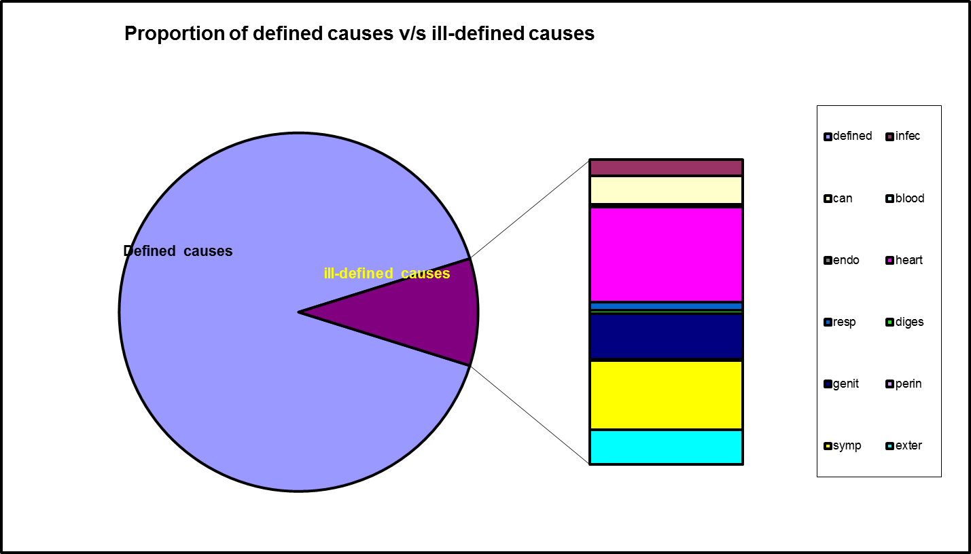
ANACoD - PART III: CAUSES OF DEATH ANALYSIS
Step 10: Ill-defined causes of death
Specific causes among ill-defined causes can be used to target improvement efforts.
Notes:
ANACoD also automatically generates a pie chart showing a break down of the specific causes for deaths assigned to ill-defined causes. This chart can be used to target improvement efforts and retraining for medical certification and coding of cause of death.

Slide 47
ANACoD Wrap up
The “Summary” sheet provides a summary report of findings
With ANACoD, the user is able to:
Derive the mortality profile of the country/area analysed
Develop a critical view on the quality of mortality data
Understand further cause-of-death statistics
Limitations of ANACoD include:
Partial data are not adjusted for incompleteness by the tool
The tool cannot improve the quality of poor data, but it can provide insights on medical certification or coding problems
Currently only data coded to ICD-10 three or four characters can be analysed

