Slide 1
Evaluating & Improving
Civil Registration and Vital
Statistics Systems

Slide 2
Outline
Previous international efforts to strengthen CRVS systems
Evaluating CRVS systems
  Models for evaluating the system
  Adequacy of government provisions
  Flexibility
Improving CRVS systems
SOURCES: NCHS, Unit 18.
Notes:
Notes:
A country’s vital statistics system should be periodically evaluated to see whether the needs of the system are being adequately met. Two major aspects should be examined: the quality of the resulting vital statistics and an evaluation of the overall CR/VS system. We’ll look at different models that have been proposed for evaluation. As well, we’ll discuss the importance of evaluating the adequacy of government provisions for the CR/VS system and the importance of system flexibility.

Slide 3


Previous International Efforts to
Strengthen CRVS Systems
Focused on:
Standards to improve comparability
  UN Principles & Recommendations for a Vital Statistics System
  WHO definitions for live birth and fetal death
  ICD system
  International Form of Medical Certification of Cause of Death
  Physician and coder training
  Verbal autopsy
International collection and publication of data
Strengthening national statistical systems
SOURCES: Mahapatra.
Notes:
Notes: [This is a good time for a class break or exercise]
We’ll now discuss evaluating and improving CR/VS systems. We’ll start by taking a look at what has been done in the past.
In the 1960s and 70s, there was a focus on improving CR/VS systems with support by international, bilateral organizations. Multiple conferences and improvement projects were conducted, and efforts to establish national committees for vital and health statistics were made.
In the past 60 years, international efforts to strengthen CR/VS systems have focused on…
-Setting standards:
The UN Statistics Division published the Principles and Recommendations for a Vital Statistics System in 1953 (revised in 1973 and 2001) to bring about uniformity of data acquisition through civil registration systems and comparability of notions for vital statistics. Such principles have successfully improved the comparability of vital statistics by standardising fundamental ideas in vital statistics, including date and place of events.
WHO has been instrumental in providing definitions to improve comparability of infant mortality and stillbirth rates.
International efforts to develop a uniform nomenclature and classification of cause of death, which is essential for comparability, began as early as 1851. WHO continued this work, adopting the sixth revision of the International Classification of Disease system in 1948. WHO has guided all subsequent revisions. The ICD is a major achievement in enhancing the comparability of medically-certified causes of death and is one of the earliest (if not the earliest) examples of an international classification for statistical use.
Another important achievement towards comparability of cause-of-death statistics has been the development of the International Form of Medical Certification of cause of death and a set of rules for classification in the ICD, including the notion of underlying cause of death. However, only about 80 member countries, representing 27% of the world’s population, have reported useable cause of death data to WHO in the past decade.
Another major difficulty in achieving comparable results for certified causes of death is the scarcity of interest from the medical profession, especially in developing countries where doctors do not attend most deaths and have no professional incentive to ascertain their cause. Physicians in all countries should be provided with training in the proper completion of the medical certification form. Detailed training for coders is also essential.
More than half of the world’s population live in countries where medical attention at death, or medical certification of its cause, is rare. Many of these countries use verbal autopsy to ascertain cause of death. Verbal autopsy procedures have been developed by various scientific studies, usually as part of a health/demographic surveillance site. However, procedures vary widely. Efforts to improve the comparability of causes of death from verbal autopsy, led by WHO, have only recently begun.
-Collection and publication of data:
A problem in officially reported statistics is the absence of external validation and correction of known bias. Since 2000, WHO has published mortality estimates by adjusting for known biases and using disease models and extrapolations to make estimates to ensure internal consistency and improve comparability over time. Since discrepancies exist between figures reported by countries and estimates produced by WHO, it is important to add transparency by making original data and adjustment processes publicly available.
-Strengthening national systems: [see next slide]

Slide 4
Previous International Efforts to
Strengthen CRVS Systems
Setting standards to improve VS comparability
International collection and publication of data
Strengthening national statistical systems
  Not a government priority
  Lack of recognition by development partners as key component of development infrastructure
SOURCES: Mahapatra.
Notes:
Notes: While international efforts have led to some success in the first two areas, there has been a collective inability to make or sustain improvements at the country level. This failure has been attributed to first, governments not making civil registration systems a priority, and second, development partners not recognizing these systems as key components of development infrastructure. Most of the country projects financed by development partners up to now have focused on poverty measurement and economic statistics, rather than CR systems and what is needed to develop and sustain them. Of the few projects focused on developing CR systems in developing countries, most have not been maintained by the relevant government agency after the outside funding ended.

Slide 5
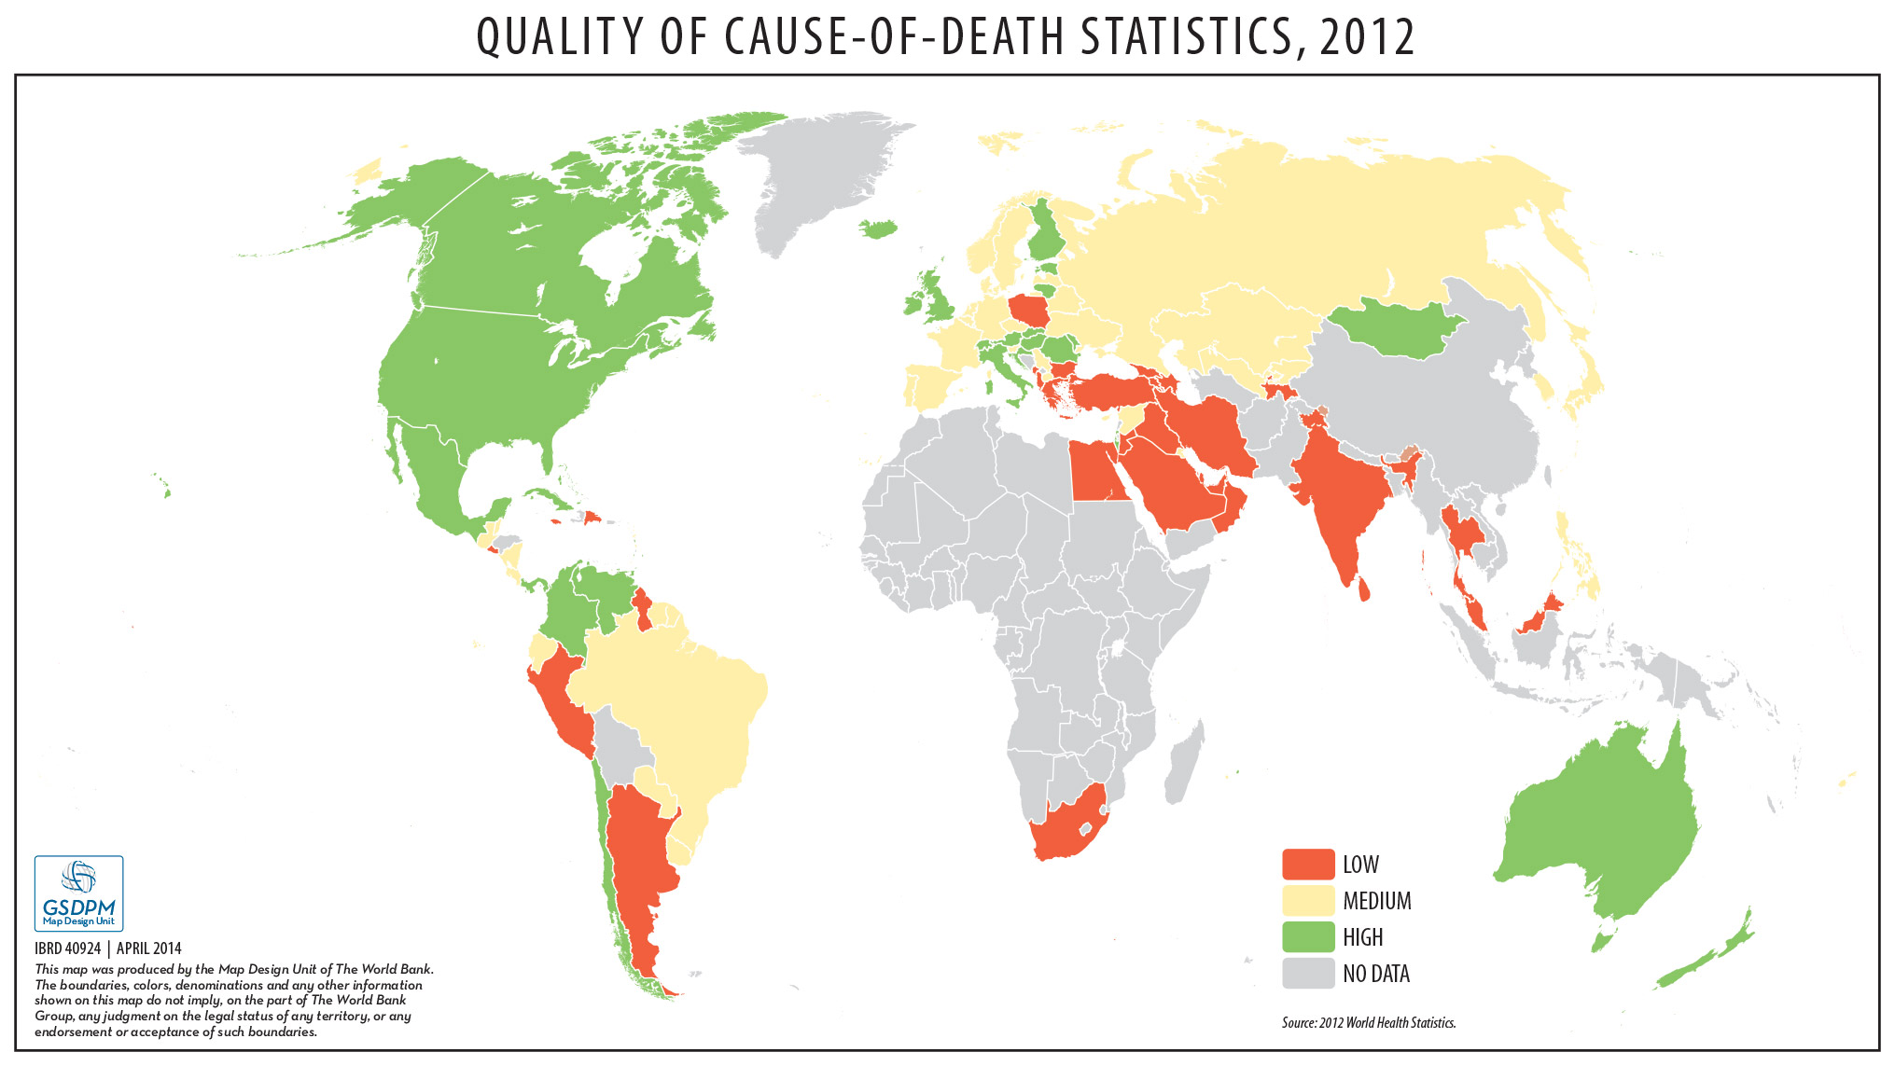
Notes:
Notes: Here’s a map depicting the quality of globally available information on causes of death…

Slide 6
Evaluating CRVS Systems
The need for periodic evaluation:
Civil registers not able to meet information needs of various programs, yet new needs arise
Separation of function requires coordination
Organizational tendency towards status quo
Cost should be appraised to economize methods & procedures, including costs for:
  Collecting raw data
  Processing raw data
  Disseminating statistics to users
SOURCES: NCHS, Unit 18.
Notes:
Notes:
The civil registers, by virtue of their original purposes, are often limited in their ability to meet the information needs of various social, economic, and public health programs management and planning efforts. Moreover, new needs arise as each country moves toward its economic and social development goals.
The statistical compilation of vital events is most often carried out by the central statistical office, which is located in a different ministry from the ministry in which the vital events were registered. Thus, careful coordination is needed to ensure a responsive approach to the requirements of the statistical program.
As any organizational arrangement has a tendency to maintain the status quo, without proper attention to the purposes and the efficiency of the system, the whole system needs to be evaluated periodically. The cost of any vital statistics system should also be appraised periodically- to economize the methods and procedures. The cost can be broken down into three major elements: (1) the cost of collecting the raw data, (2) the cost of processing the raw data, and (3) the cost of disseminating the statistics to users. In most countries, the raw data are simply by-products of the legal registration of vital events, so the collection cost may not be a major concern. However, the processing and dissemination costs require careful scrutiny. It is especially important when a decision is necessary for the choice of specific new equipment and procedures.

Slide 7
Evaluating CRVS Systems
Purpose:
To provide evidence to guide the development of improvement plans
Designed to:
  Identify structural weaknesses in system
  Provide a basis for correcting biases in data
  Plan improvements
SOURCES: WHO/UQ, Introduction; Mahapatra.
Notes:
Notes:
The provision of appropriate procedures for evaluating various facets of the system is an important function of the officers responsible for vital statistics. The purpose of reviewing existing systems is not to hold individuals accountable for problems in the system, but rather to provide evidence that countries can use to guide the development of improvement plans. Such evidence can be used, for example, in discussions with donors, governments, and development partners, when seeking funding for the strengthening of the national civil registration system.
System assessments are designed to identify structural weaknesses in the system, provide an empirical basis to correct observed biases in the data it generates, and plan improvements (emphasize this point!). We emphasize this last point- as no amount of assessment or evaluation is helpful if action is not taken to correct the problems that have been identified.

Slide 8
Discuss
Why is a periodic evaluation of a CRVS system necessary?
Notes:
To provide evidence to guide the development of improvement plans
To identify structural weaknesses in system; a system can deteriorate over time, though personnel/budget/procedural changes
To provide a basis for correcting biases in data
To plan improvements

Slide 9
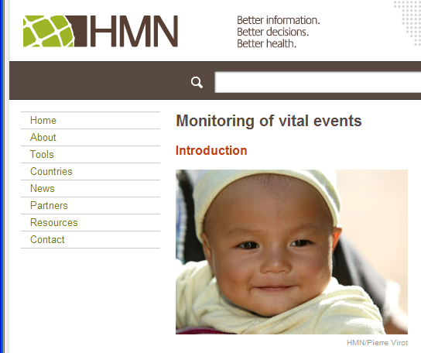
Evaluating CRVS Systems
WHO Guidance Tool (Health Metrics Network)
  Promotes international standards and practices
  Does NOT prescribe measures
  Targeted for countries (or regions within countries) where civil registration is established but subject to inadequacies
SOURCES: WHO/UQ, Executive Summary, Introduction.
Notes:
Notes:
As part of efforts by the WHO Health Metrics Network to strengthen national health information, the WHO Guidance Tool was developed to provide guidance for a standards-based review of country practices in civil registration and vital statistics.
The tool promotes international standards and practices, but does not prescribe what measures countries should adopt to achieve fully functioning systems. Such measures and practices are best determined locally, because much will depend on the local context, capacity, resources and traditions.
This tool is largely directed to countries where civil registration is established but is subject to inadequacies in terms of coverage, quality, or both.

Slide 10
WHO Guidance Tool
Rapid assessment tool
  Provide evidence for the need of a detailed review
  Group discussion
  Quick evaluation (25 questions)
Scoring of scenarios for rapid assessment
Scenario | A | B | C | D
Score | 3 | 2 | 1 | 0
SOURCES: WHO/UQ, Executive Summary, Introduction; WHO/HMN.
Notes:
Notes:
The Guidance Tool consists of two components- the rapid assessment tool and the detailed assessment tool.
The rapid assessment tool provides a tool to quickly evaluate the state of the current system and make the case for a more detailed assessment. It was developed to help provide evidence to senior management to garner support for a detailed review.
The rapid assessment should be completed through a process of discussion among all group members, leading to a common view on the issue. The purpose of the assessment is to engage in discussion on the possible weaknesses and strengths of the system.
The tool consists of 25 questions about how the CR/VS system functions. Each question allows countries to select one of four scenarios (A-D) describing a typical range of hypothetical situations. A value of 0-3 is attached to each scenario, generating a total score.

Slide 11
WHO Guidance Tool
Rapid assessment tool
Scores, ratings and actions required for rapid assessment
Score (%) | Rating | Actions required
<34 | Dysfunctional | System requires substantial improvement in all areas
35–64 | Weak | Many aspects of the system do not function well, and multiple issues require attention
65–84 | Functional but inadequate | System works but some elements function poorly and require attention; specific weaknesses of the system should be identified by completing the comprehensive review
85–100 | Satisfactory | Minor adjustments may be required in an otherwise well functioning system
SOURCES: WHO/HMN.
Notes:
Notes: The total score provides a rating and suggest actions associated with each rating. Countries with ratings below 65 are advised to complete the comprehensive assessment, though the comprehensive review will be useful in identifying specific weaknesses in countries with a rating up to 84.

Slide 12
WHO Guidance Tool
Detailed assessment tool
  Main aspects
    Legal & regulatory framework
    Registration, certification, & coding practices
    Compilation, tabulation, & use of resulting data
  Roadmap: outlines main steps
  Assessment framework: template for review
SOURCES: WHO/UQ, Executive summary, Introduction.
Notes:
Notes:
The Guidance Tool consists of two components- the rapid assessment tool and the detailed assessment tool.
The rapid assessment tool provides a tool to quickly evaluate the state of the current system and make the case for a more detailed assessment. The tool consists of 25 questions about how the CR/VS systems function; It was developed to help provide evidence to senior management to garner support for a detailed review.
The detailed assessment tool reviews the main aspects of the civil registration and vital statistics systems. These include the legal and regulatory framework; registration, certification and coding practices; and the compilation, tabulation and use of the resulting data. The detailed assessment tool comprises both a roadmap, which outlines the main steps in conducting the review, and an assessment framework, which serves as a template for the detailed review.
Note that another important assessment measure not included in the WHO Guidance Tool is a review of certificate services. Aspects of certificate services to review include:
the average time it takes to receive a certificate
the process for applying for a certificate
the appropriateness of the location for where someone applies for a certificate
the existence of government services that require a birth/death certificate.

Slide 13
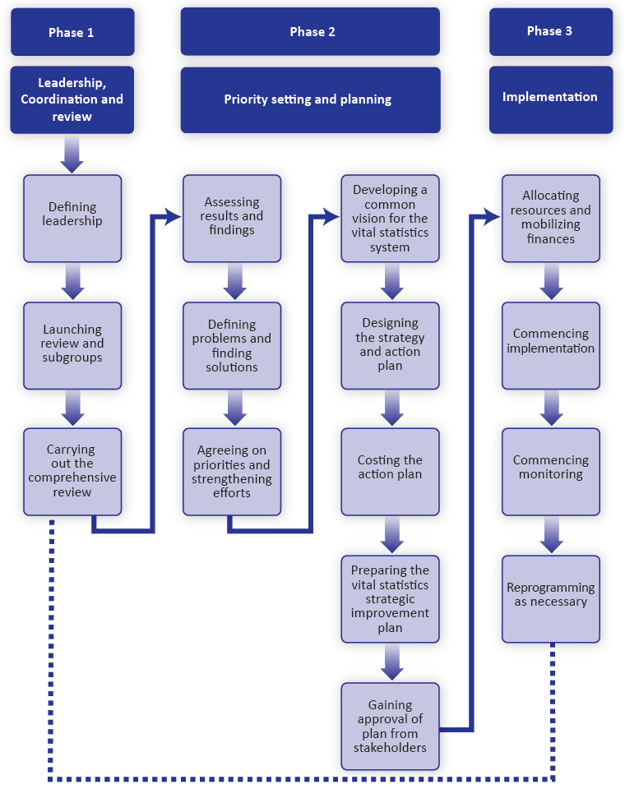
Assessment tool from WHO/University of Queensland, 2010
SOURCES: WHO/UQ, 2, Annex A.
Notes:
Notes:
The detailed assessment tool is accompanied by a roadmap that describes the process for reviewing civil registration and vital statistics systems. The process has three phases:
Phase 1 – Leadership coordination and review – this is preparing for and carrying out the review
Phase 2 – Priority setting and planning – or developing a strategic plan for strengthening the system
And Phase 3 – Implementation of the strategic plan.
The Guidance Tool provides detailed guidance for Phases 1 and 2, while less detail is provided for Phase 3 because the steps are likely to vary for each country.
Under Phase 1 we first identify a lead agency that can initiate the process of forming a review committee. We also identify and invite stakeholders, and make a case to the government of the need to improve the vital statistics system. We then undertake a rapid assessment of the current system to build the case and prepare for the launch of the review. We conduct a launch meeting to raise awareness, expand the committee and form subgroups. We then conduct an initial committee meeting and the thorough review through subgroup work sessions– this process is highlighted in the orange circle.
The results of this process lead to Phase 2, where we conduct a review committee results meeting with the subgroups and develop a strategic plan. Then, we conduct a large stakeholder meeting to present the improvement plan.
Again, these results lead to Phase 3, where the specific actions and the strategic plan are implemented.

Slide 14
Discuss
What would be the functions of a steering committee in carrying out a comprehensive evaluation?
SOURCES: WHO/UQ, Ch 2.
Notes:
Note: a steering committee typically includes representatives from agency leadership and is responsible for overseeing the “big picture” of a project/program (rather than implementing/planning the technical details)
To identify stakeholders and ensure all stakeholders are involved
To build awareness among senior government policy-makers and to gain their support
To engage civil society groups as needed to help mobilize stakeholders
To conduct a rapid assessment and discuss results
To launch the review, develop a workplan, and guide subgroups through formal comprehensive review
To organize a results meeting and review and discuss evaluation results; to guide the development of a list of agreed and prioritized recommendations
To guide the development of a strategic improvement plan, based on the recommendations from the review meeting
To present the strategic improvement plan to stakeholders and oversee its implementation

Slide 15
Assessment tool from WHO/University of Queensland, 2010
SOURCES: WHO/UQ, 2, Annex A.
Notes:
Notes:
We’ll now back up a little and look in more depth at the framework that is used in the comprehensive review process of Phase 1.

Slide 16
The WHO Assessment Framework:
Phase 1 – Comprehensive Review
Inputs
A: Legal basis and resources for civil registration
Processes
B: Registration practices, coverage, and completeness
C: Death certification and cause of death
D: ICD mortality coding practices
Outputs
E: Data access, use, and quality checks
SOURCES: WHO/UQ, 3.
Notes:
Notes:
The WHO assessment framework is used by subgroups in undertaking the detailed review of a country’s civil registration and vital statistics systems. The framework consists of five key components (A-E) of the civil registration and vital statistics systems. These components cover the inputs, processes, and outputs that are crucial aspects to the functioning of a vital statistics system and its review.
These 5 components are further broken down into 16 subcomponents which collectively investigate the specific questions and issues that not only assess coverage or completeness of data produced but also evaluate issues related to the functioning of the system and hence diagnoses potential problem areas. In working through the framework, the inputs and processes of the system are evaluated in order to make lasting improvements to the output of the system.
(Note: As mentioned before, a review of certificate services is another important assessment measure that is not included in the WHO Guidance Tool.)

Slide 17
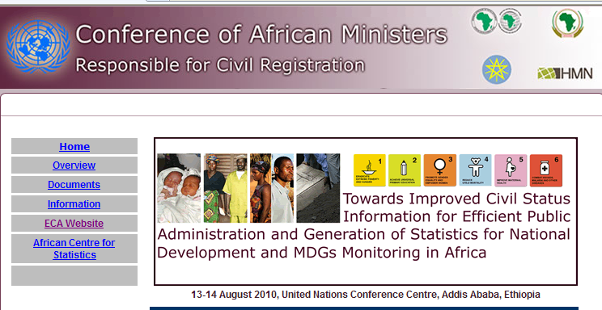
Adequacy of
Government Provisions
Legal provisions
Organization
Government
sponsorship
Procedures of recruitment & training
Adequacy of instructions for recording data
Adequacy of management procedures
SOURCES: NCHS, Unit 18, 19.
Notes:
Notes:
Beyond the WHO proposed evaluation guide, another important aspect of evaluating a vital statistics system is reviewing the various components contributing to the structure of the system- which we have discussed in previous lectures. This includes evaluating the adequacy of government provisions.
Appropriate legislation is an important precondition for a good vital statistics system. vital registration laws differ from country to country, but the most fundamental element is their obligatory or compulsory nature, providing for nationwide, complete coverage (both geographic and ethnic). Current legislation should be critically reviewed and new laws created or existing laws revised as needed.

Slide 18
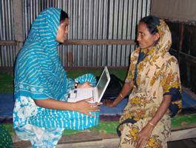
Flexibility of the System
Must accommodate necessary changes & modifications
Must remain responsive to various needs & uses
Population Health Metrics
SOURCES: NCHS, Unit 18.
Notes:
Notes:
As well, any modern system of vital registration and statistics must be flexible enough to accommodate any changes or modifications necessary to make it more responsive to the needs expressed in the various uses of vital records and vital statistics. Evaluating the system’s flexibility is another important aspect of evaluating a CR/VS system.

Slide 19
Review
Previous efforts to improve CRVS systems
Status of CRVS quality
Evaluating the CRVS system
  Purpose
  WHO Guidance Tool
    Rapid assessment tool
    Detailed assessment
      3 phases
      Phase 1 - Comprehensive Review
  Adequacy of government provisions
  Flexibility of the system

Slide 20
Discuss
How might the priorities for improvement be the same or different if in an urban office versus a rural office?
Notes:
Priorities for an urban office may focus on operations to manage workload within the office, while priorities for a rural office may focus on improving access to services and active participation of residents outside of the office.
Note: Even in urban areas, some sections having poorer populations may have problems that are similar to those in rural areas. In that case, the priorities might be to bring all sections of the urban area up to the level of the best sections. Alternatively, there could be a rural area that gets records filed but does not have staff to process them in a timely manner.

Slide 21
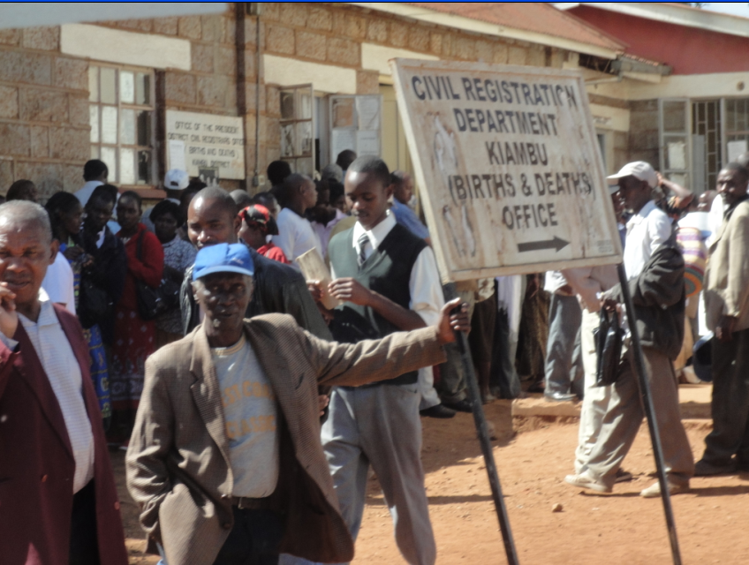
Improving CRVS Systems:
Common Issues
Sharing of costs
Involvement of local authorities
Motivating individuals to register: certificates & incentives
Strategic plan to support long investment (5-10 yrs)
Strong central management for standard approach
Coordination btwn registration function & statistical unit
Use of interim registration points as needed (e.g. schools and health facilities)
SOURCES: WHO/UQ; NCHS, Unit 19; PRVSS2, p 78.
Notes:
Notes: The specific actions for improving a CR/VS system will vary by country-- and these actions are guided by the outcomes of the comprehensive evaluation. However, some common issues for implementing an improvement plan are listed here.
As collecting and producing vital statistics typically involves many departments, it is important to remember that costs can be shared. The information generated by the CR/VS system will support many government functions.
(very important point- emphasize) As local authorities are key players in CR/VS improvement, they must be convinced of the importance of proper birth and death certification. Producing certificates is a service for the people and is essential for sustaining the system, as it generates ongoing participation from the people. Participation in the system can be encouraged by requiring certificates for services (i.e. school enrollment, marriage licenses, or driver’s licenses).
As well, the provision of local vital statistics information should be carefully catered for in improvement implementation.
For all countries, civil registration is a long-term investment and needs to be continually maintained. Thus, a strategic plan that reflects the long term investment is needed.
For data to be useful at the national level, a standardized approach to collecting vital event information is needed. Thus, it is necessary to have careful central management of implementations of changes. As well, any action program should be well coordinated with appropriate public administration functions.
The statistical unit must be well-coordinated with the registration function.
In countries where registration offices and infrastructure are lacking, schools and primary health-care facilities could be used as interim registration points until the government has the resources to extend the registration infrastructure.
Picture: creating demand for certificates by requiring certificates for government services; birth certificates are now required by Ministry of Education in Kenya to sit for exams at end of secondary school.

Slide 22
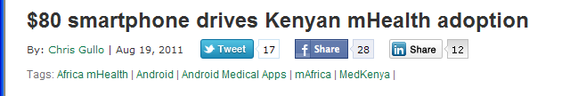
Improving CRVS Systems:
Suggested Activities
Public education campaigns to promote CRVS
Produce small area information as available
Training: internal and external
Pilot/demonstration project
Model registration areas
Use of information technology & automation
SOURCES: PRVSS2, p 77-80; NCHS, Unit 19.
Notes:
Notes:
Efforts should be made to raise awareness of the importance of CR/VS among the general public, representatives of organizations, senior government officials, and CR/VS personnel.
As well, making registration advantageous to individuals, such as requiring birth certificates for school attendance, is an important means for motivating individuals to register. Such actions should be included in an improvement plan. These types of actions will convert the public into advocates for a well-functioning CR system- a system that can provide needed birth/death certificates in timely fashion. It will also convince government leaders of the importance of a CR system.
Training programs provide the knowledge and skills necessary to efficiently carry out the required functions. Internal training should be provided for system staff through seminars and workshops; training should emphasize techniques, methods and skills, and should address issues of professional roles and functions. External training should be designed to inform groups about the needs and functions of CR/VS systems. Periodic training and retraining provides opportunities for feedback from staff and users about problem and possible alternative procedures and solutions.
Various approaches can be tried out in pilot or demonstration projects and later expanded as appropriate. The success of either pilot studies or demonstration areas is dependent on a country’s ability to carry over to the national level the experiences and lessons learned. Thus, there must be sufficient national commitment to provide the resources to sustain the approach. For any pilot or demonstration project to be successful, it is critical that an evaluation plan be developed, implemented, and reviewed.
Similar to demonstration projects, one or more small areas can be selected as model registration areas for registering every vital event, and coverage can be expanded as resources are available.
The level and sophistication of information technology and analysis contributes substantially to timeliness and quality of information. CR/VS systems should routinely monitor new technologies and technique to assess applicability to their current system.
Lastly, we’ll discuss the use of small area information whenever possible. If you have good coverage, even for a small area, you can begin producing reports. This will show others what can be done with CR/VS information and will help increase support for expansion.

Slide 23
Discuss
What are the advantages of setting up a demonstration area?
How would you tailor the scope of activities for a demonstration area?
What would be the functions of a steering committee in carrying out a demonstration project?
What output and by-products would you expect to have at the end of a demonstration project?
Notes:
The advantages of setting up a demonstration area are that it allows the team to try out improvement strategies on a smaller scale- which costs less and is more likely to facilitate success- before trying on a large scale, which will cost more. Demonstration areas help identify successful strategies before money is spent on implementing unsuccessful strategies on a large scale. A demonstration area can be helpful in identifying strategies that are useful for sustainability (i.e. personnel budget).
To tailor the scope of activities for a demonstration area, you need to consider the size of the demonstration area, characteristics of local population, infrastructure and resources available in demonstration area, current procedures, and any planned changes to procedures that might affect project implementation.
Note: a steering committee typically includes representatives from agency leadership and is responsible for overseeing the “big picture” of a project/program (rather than implementing/planning the technical details)
The functions of a steering committee in carrying out a demonstration project would be to:
Ensure that all appropriate stakeholders are engaged
Ensure that demonstration project strategies are compatible with the national system
To ensure adequate coordination of the project across all agencies involved
To ensure adequate provision of resources for the project
Oversee the development and implementation of the project workplan
Oversee an evaluation of the project, review of project results, and development of future recommendations
Liase with partners implementing the scale-up of any successful components of the demonstration project
At the and of a demonstration project, you would expect to have:
Documentation of project, including the original workplan and all modifications
Evaluation results of the project
Project review: description of project strengths, weaknesses, lessons learned, and recommendations
As appropriate, recommendations for scaling up/expanding project strategies
A meeting with stakeholders to review the project and discuss the way forward

Slide 24
Discuss
What preconditions need to be satisfied before we can formulate an action program to develop or improve a national vital statistics system?
How may public education impact a registration system?
Notes:
Preconditions that need to be satisfied before an action program can be formulated are:
Identification of a steering committee
Involvement of all stakeholders and support of government officials
Availability of evaluation results of current system
Need a plan for monitoring and evaluating the action program
Public education may impact a registration system in the following ways (consider positive and negative impacts):
Positive
Increase registration coverage
Increase awareness of and support/advocacy for CR/VS systems
Lead to changes in laws and procedures, requiring registration documents for civil services
Negative
Potential for overwhelming the system

Slide 25

Improving Severely Lacking Systems
& Complementary Sources of VS
Population censuses
Household sample surveys
Sample registration: e.g. SAVVY
Sample Vital Registration with Verbal Autopsy
  Reduced cost
  Improvement in timeliness
  Higher quality data
SOURCES: NCHS, Unit 19; PRVSS2, p 48-49, 90-93.
Notes:
Notes:
Where CR/VS systems are severely lacking and resources are constrained, some alternative and complementary sources of VS can be utilized. We won’t discuss these in depth here, but they include population censuses, household sample surveys (including single-round retrospective household surveys, individual in-depth single-round retrospective surveys, and follow-up household surveys).
Where civil registration systems are not fully developed, sample registration can be used. One technique that has been used to produce useful cause of death information for a manageable registration area is SAVVY- or Sample Vital Registration with Verbal Autopsy. This technique provides nationally, and possibly regionally, representative information on vital events from a sample of the population. If properly conducted and gradually expanded, sample registration can develop into a national civil registration system.
The advantages of sampling in CR/VS systems include reduced cost, improvement in timeliness of statistics, and achievement of higher quality data.

Slide 26
Discuss
What future changes are likely to occur in the vital statistics of developing countries?
What are some implications of those future changes?
What are major obstacles to establishing and improving a vital registration system?
Notes:
Future changes that are likely to occur include:
- Introduction of mHealth (mobile health) applications/technology
- Increasing demands for data
- Improved information technology
- Changes in fraudulent behavior
- Changes in organization of personnel
Legislation changes (e.g. late registration penalties, requirements for certificates/documentation, decentralization/improved accessibility)
Development of national ID systems
Implications of those future changes include the need to review procedures to ensure maximum efficiency, affordability, and security of the system.
Major obstacles to establishing and improving a system include:
Competing priorities
Lack of government awareness of importance of system
Lack of resources
Lack of cooperation among stakeholders involved (i.e. the Ministry of Health working with the Ministry of the Interior)
Lack of technical expertise in some areas
Challenges of obtaining data from every household (i.e. transportation, remote areas, civil strife, etc.)

Slide 27
Monitoring Progress
Establish database of core indicators:
  Relevance
  Measurability
  Understandability
  Responsiveness to change
  Data availability
Plan from the beginning
Measure every 3-4 years
SOURCES: WHO/UQ, Annex C.
Notes:
Notes:
Any improvement process or implementation plan needs to be monitored to ensure that goals will be reached. A list of core performance indicators that are most likely to reflect progress in a country’s specific areas of concern should be created. Indicators should focus on relevance, measurability, understandability, responsiveness to change, and data availability within the areas of system inputs, processes, and outputs. A monitoring plan should be established at the beginning of an improvement process, and progress should be measured every 3-4 years.
[SHARE: a list of suggested indicators can be shared with class; see Table C1, p67/Annex C of the WHO Guidance Tool.]

Slide 28
Other CRVS System Indicators
# of staff trained on vital statistics
# of supportive supervision visits conducted
# of district registrar offices that are fully staffed
# of local/national organizations receiving funding from partners
% of trainees that apply skills to current work
Local/national partners demonstrate responsibility and ownership of program based on identified bench marks
SOURCES: PEPFAR Malawi Strategic Information Proposal: Strengthening Malawi’s Vital Statistics.
Notes:
Notes:
Here are some additional examples of indicators that can be used to track progress of CR/VS system improvement

Slide 29
CRVS System Improvement
Efforts in [COUNTRY]
Describe any efforts that have been taken to improve the CRVS system in [COUNTRY].

Slide 30
Discuss
What are some areas where improvement/action programs are most needed in many countries?
Notes:
Coverage: increasing the number of events reported and registered in the system
Accessibility: improving access of the system’s services for residents living in remote locations
Efficiency: improving flow of information from local to national offices; reducing waiting times, improving access to certificate services anywhere
Security: as IT solutions are applied, ensure protection of information
Storage: providing safe and secure ways to store information, both in paper and electronic forms (easier to locate record)
Data quality: implementing mechanisms for checking data quality and completion
Medical certification of cause of death: implementing mechanisms for improving the number of deaths for which cause of death information is available (including verbal autopsy and physician certification)
Coding: providing training on ICD coding practices
Certificate services
Others….

Slide 31
Review
Improving CRVS Systems
  Common issues
  Suggested activities
  Severely lacking systems & complementary VS sources
Monitoring progress
CRVS System indicators

Slide 32
References
(Mahapatra) Mahapatra P, Shibuya K, Lobez AD, et al. Civil registration systems and vital statistics: successes and missed opportunities. Who Counts? 2. Lancet. 370:1653-63. 2007.
(NCHS) National Center for Health Statistics. Methods of Civil Registration: Modular Course of Instruction.
(PRVSS2) UN. Principles and Recommendations for a Vital Statistics System, Revision 2. New York. 2001.
(WHO/HMN) WHO, University of Queensland. Rapid assessment of national civil registration and vital statistics systems. WHO: Geneva. 2010.
(WHO/UQ) WHO, University of Queensland. Improving the quality and use of birth, death and cause-of-death information: guidance for a standards-based review of country practices. WHO: Geneva. May 2010.

Slide 33
Activity
In small groups, design a registration improvement education program for your assigned target population.
Outline the following details for your event:
  Location
  Agenda (activities and main topics/messages)
  Attendees
  Stakeholder involvement
  How event will be advertised
  Follow-up activities that will be conducted
Discuss the similarities and differences between designs for different target populations.
Notes:
[The amount of detail for this activity will depend on availability of time; students are encouraged to use their lecture material to develop the agenda.]
Distribute target population assignments to small groups. If possible, each population should be given to at least two groups (for comparison in group discussion). Various ideas encouraged with discussion on advantages and disadvantages of different approaches.
Suggested targeted populations include:
urban parents to register births
rural parents to register births
parents to register deaths of children
late registration for older children/adults/elderly

Slide 34
Overall Review
  One explanation for the inability to make CRVS improvements at the country level is that governments have not (funded / prioritized) civil registration systems.
  The WHO Guidance Tool promotes (international / national) standards and practices.
  The WHO Guidance Tool (does / does not) prescribe measures for improvement.
  The five key components of the WHO Guidance Tool framework cover inputs, (processes / measures), and outputs crucial aspects to the functioning of a system.
  While working to improve a system, small area information (should / should not) be produced as available.
Notes:
One explanation for the inability to make CR/VS improvements at the country level is that governments have not (funded / prioritized) civil registration systems.
The WHO Guidance Tool promotes (international / national) standards and practices.
The WHO Guidance Tool (does / does not) prescribe measures for improvement.
The five key components of the WHO Guidance Tool framework cover inputs, (processes / measures), and outputs crucial aspects to the functioning of a system.
While working to improve a system, small area information (should / should not) be produced as available.

