Slide 1
Analysis of Vital Statistics Data
These materials have been developed by the National Center for Health Statistics, International Statistics Program, Hyattsville, Md., as part of the CDC Global Program for Civil Registration and Vital Statistics Improvement.

Slide 2
Outline
Uses, general principles, & standardization of VS data
Types of vital statistics measures
Visualizing data (general)
Natality
Mortality
Linking data

Slide 3
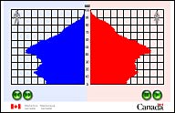
Uses of Vital Statistics
Planning human development
Dynamics of reproduction
Life-tables
Risks of dying
Population growth dynamics
Population projections
Monitoring & evaluating interventions
Population Pyramid, Statistics Canada
SOURCES: PRVSS2, Chapter I.B.; NCHS, Unit 15.
Notes:
NOTE: Cross-reference with I. c. iii. Section of first lecture.
Notes:
Statistical uses of vital records have been recognized in many societies as they confronted the need for planning and evaluation of economic and social development. Today in most countries, vital records are compiled into indispensable statistical information for a variety of uses.

Slide 4
Uses of Vital Statistics
Can facilitate information for:
Provision of services for vulnerable populations (i.e. single mothers & children)
Regional & urban/rural comparisons
Allocation of resources (i.e. health care, education, & social security)
SOURCES: PRVSS2, Chapter I.B.
Notes:
Notes:
Vital statistics are an essential input for the planning of human development.
Single mothers and their children constitute a particularly vulnerable group in most populations. Appropriate provision of services for this group is likely to require adequate information on their number and changes in trends over time, which only a well established civil registration system can provide.
Adequate civil registration data that achieve a high level of coverage at the national level also have the potential of allowing the estimation of differentials at the regional level- thus providing invaluable information for regional planning and the appropriate allocation of resources at the appropriate administrative level. The same is true for small areas, where vital statistics data often are the only source of reliable data.

Slide 5
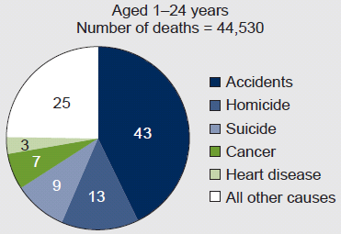
Uses of Vital Statistics
Only nationally representative source for:
Mortality by cause of death
Risks of premature death by sex & age
Relative risks of death among subgroups
Cause-specific risk of dying trends
CDC, NVSS, 2007
SOURCES: PRVSS2, Chapter I.B.
Notes:
Notes:
Vital statistics derived from civil registration are the only nationally representative source of information on mortality by cause of death. The timely recording of deaths by cause can provide early insights into trends in disease prevalence, thus helping to design prevention or intervention strategies. Small area data from vital statistics also can help to identify localized health problems.

Slide 6
General Principles:
Useable Statistics
Clear, explicit, & simple definitions
  Universal acceptance / international standards
  Comparability (geographically & over time)
Continuity
  Setting targets
  Evaluating social & economic plans
Flexibility to adapt
  New methods / requirements
  Computing technology
  Changes described in reporting (titles, footnotes)
SOURCES: PRVSS2, Chapter I.B.; Chapter II.G.3.; NCHS, Unit 15.
Notes:
Notes:
Any attempts to generate vital statistics must strive to meet adequately the needs of statistical uses. The central goal of collecting and compiling vital statistics is to generate useable statistics. [Discuss slide content as a means for generating useable statistics]
Continuity in the availability of vital statistics and their subsequent analysis and interpretation are essential for setting targets and evaluating social and economic plans, including the monitoring of health and population intervention programs, and the measurement of important demographic indicators of levels of living or quality of life (such as the expectation of life at birth and the infant mortality rate).

Slide 7
Standardization of VS Data:
ICD & International Comparison
WHO: International Statistical Classification of Diseases and Related Health Problems
Revisions
  Currently in 10th Revision (1993)
  Recommended every 10 years; getting longer
  Countries are slower to adopt
Ideal source for international comparison
  Universal morbidity & mortality coding
  Only cases seen by physician
SOURCES: WHO ICD-10, Volume 2, Chapter 5; NAPHSIS.
Notes:
Notes:
ICD: an extensive list of alpha-numeric codes used since 1900 to classify diseases, conditions, findings, and causes of injury or disease (this list was developed earlier, in the mid 1800’s). The ICD has become the international standard diagnostic classification for all general epidemiological and health management purposes.
Regarding revisions, as the system becomes more complex, the time interval between revised versions has increased. ICD 11 is likely to be released 25 years after ICD 10.

Slide 8
Standardization of VS Data:
ICD & International Comparison
ICD in (country):
  (current status)
  (future steps)
SOURCES: WHO ICD-10, Volume 2, Chapter 5; NAPHSIS.
Notes:
Notes:
ICD: an extensive list of alpha-numeric codes used since 1900 to classify diseases, conditions, findings, and causes of injury or disease (this list was developed earlier, in the mid 1800’s). The ICD has become the international standard diagnostic classification for all general epidemiological and health management purposes.
Regarding revisions, as the system becomes more complex, the time interval between revised versions has increased. ICD 11 is likely to be released 25 years after ICD 10.

Slide 9
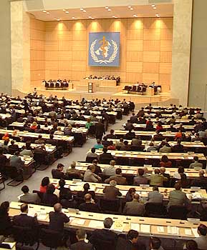
Standard Definitions & Guidelines
Adopted by World Health Assembly
(ICD-10 Volume 1, pp 1233-1238)
Necessary for international comparison
List of definitions
WHO, 1998
  Cause of death
  Live birth
  Fetal death
  Birth weight
  Gestational age
  Pre-term, term, post-term
  Perinatal / neonatal period
  Maternal / late maternal death
  Pregnancy related death
  Direct obstetric deaths
  Indirect obstetric deaths
SOURCES: WHO ICD-10, Volume 1, p 1233-1238; Volume 2, Chapter 5.
Notes:
Notes:
Provide handout: “WHO/ICD Definitions” (See WHO/ICD Definitions – Appendix A in Participant Notes)
[review/compare country definitions if available; ACTIVITY: in small groups, review country versus WHO definition – differences?]

Slide 10
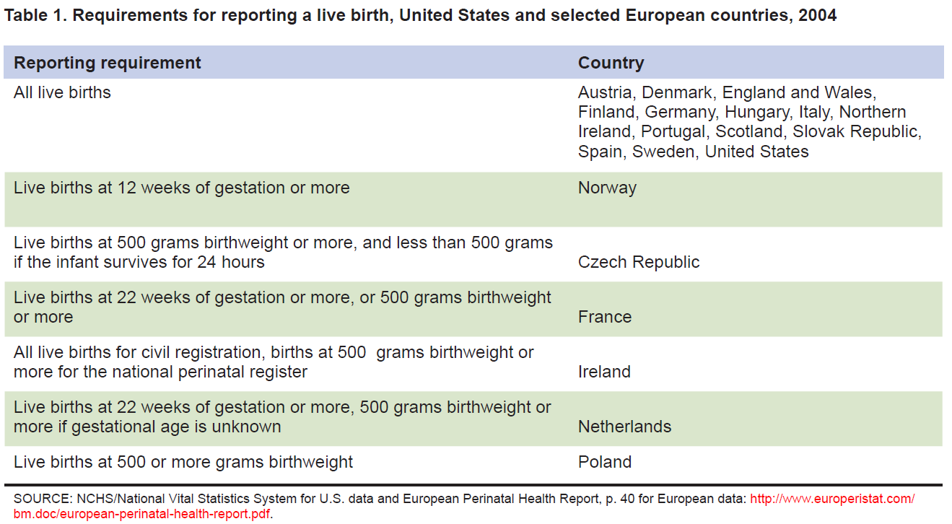
Differences in Reporting Requirements:
“Live Birth”
SOURCES: MacDorman, MF and Mathews TJ. Behind International Rankings of Infant Mortality: How the United States Compares with Europe. NCHS Data Brief No. 23. Nov. 2009. See also: Healy, B. Behind the Baby Count. US News & World Report. 2 Oct 2006.
Notes:
This table shows various definitions of “live birth” used in the US and different European countries. To compare data across countries, these differences in definitions would need to be taken into consideration.

Slide 11
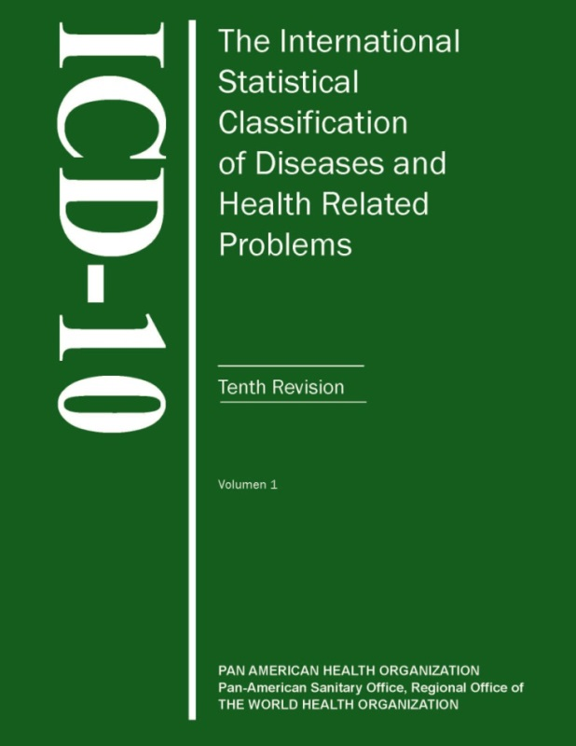
Review: Vital Statistics Data
Uses
  Variety of indicators
  Generate information for services
  Nationally representative data source
General Principles
  Clear, explicit, & simple definitions
  Continuity
  Flexibility to adapt
Standardization
PAHO, 2009

Slide 12
Discuss
How are causes of death classified in your country?
How often are the ICD codes revised? What version is currently used in your country?
If ICD10 is in use, what edition of that revision is being used in your country?
Notes:
Country specific; ICD codes are scheduled to be revised every 10 years. However, the 9th and 10th revisions have not followed that schedule. In the US, the 9th revision was used from 1979-1998 and the 10th revision has been used since 1999 (though it was adopted in 1989; note that the time a version is adopted is not the same as the time a version is used; automated systems take longer to modify).
Before 1989, revisions of the ICD were not modified. Instead, new revisions were produced every 10 years to reflect changes in medical understanding, the appearance of new diseases, and so on. Because the pace of medical understanding and innovation has increased substantially in recent decades, an updating process was put in place as part of the 10th Revision. Under this process updates to the 10th Revision are considered by WHO and approved updates are made every 3 years. For this reason there are various editions of ICD10 and it is important to obtain the most recent edition available.

Slide 13
Types of Vital Statistics Measures:
Absolute versus Relative
Absolute counts
Not comparable over time/geography
Can stratify number of events (count) by:
  Demographics (age, sex, marital status, race/ethnicity)
  Time (month, year)
  Location (district, region)
  Place of occurrence (home vs. health institution)
SOURCES: NAPHSIS; NCHS, Unit 17.
Notes:
[emphasize/discuss what information is available or what calculations are possible in present country]
Notes:
There are times when counts are useful: e.g. using the number of births to determine hospital capacity needs.

Slide 14
Types of Vital Statistics Measures:
Absolute versus Relative
Relative numbers: percentages, ratios, and rates
Relating absolute counts to population at risk: must have denominator information
Place- and time- specific
Comparable
Source of information / denominators:
  Census projections
  Hospital reports (limited to events that take place in a health institution)
SOURCES: NAPHSIS; Kenya; NCHS, Unit 17.
Notes:
[emphasize/discuss what information is available or what calculations are possible in present country]
Notes:
In addition to absolute numbers, certain forms of relative numbers are usually used in order to facilitate better understanding and comparability. The most commonly used relative numbers in vital statistics include percentages, ratios, and rates. These relative numbers are obtained by relating one absolute number to another absolute number.
Note that having small absolute numbers will increase uncertainty of estimates. To avoid this, you can combine groups (i.e. years, regions, ages, causes).

Slide 15
Types of Vital Statistics Measures:
Percentages
Computing by hundredths
Numerator must be part of denominator
Example: % of premature babies
  = number of premature births X 100
  total number of births
Percentages as summary statistics
  Array of subcategories, using total as denominator
  Can obtain percentage distribution
  All percentages should add up to 100 percent
Source: NAPHSIS; NCHS, Unit 17.
Notes:
Notes: [This should be review for fellows; in the next few slides, we review basic principles of percentages, ratios, and rates; relevant measures for natality and mortality statistics are provided in more detail later].
Percentage refers to computing by hundredths. For instance, it will be useful to show what percent of the total births are premature babies. This can be computed by dividing the number of premature births by the total number of births and multiplying by 100.
Sometimes percentages are computed for an array of subcategories using the total number as the base denominator. In this case, a percentage distribution can be obtained, and all percentages should add up to 100 percent. This type of percentage can be used as a summary statistic.

Slide 16
Types of Vital Statistics Measures:
Ratios
Used to indicate relative size of one number compared with another number
Numerator does NOT have to be part of denominator
Example: Sex Ratio at Birth
= number of male live births X 100 (or 1,000)
number of female live births
= number of male live births per 100 (or 1,000) female live births
SOURCES: NAPHSIS; NCHS, Unit 17.
Notes:
Notes: [This should be review for fellows; here, we review basic principles of percentages, ratios, and rates; relevant measures for natality and mortality statistics are provided in more detail later].
A ratio is generally used to indicate the relative size of one number compared with another number. In this sense, the percentage can be a ratio. In computing a percentage, the numerator is a part of the denominator, but a ratio does not have such a requirement. A well-known ratio in vital statistics is the Sex Ratio at Birth, which can be computed by dividing the number of male live births by the number of female live births and multiplying by 100 (or 1,000).

Slide 17
Types of Vital Statistics Measures:
Rates
Describes rapidity of occurrence during a stated period of time
Example: infant mortality rate
= # deaths under 1 yr during given calendar year X 1,000
# live births during same year
Two types of rates
  Based on vital statistics only
  Based on vital statistics and population statistics
SOURCES: NAPHSIS; NCHS, Unit 17.
Notes:
Notes: [This should be review for fellows; here, we review basic principles of percentages, ratios, and rates; relevant measures for natality and mortality statistics are provided in more detail later].
While the percentage and ratio are generally used to describe a static quantity, a rate describes the rapidity with which something is happening during a stated period of time; it describes a dynamic quantity- all rates must have a period of time specified. For example, in vital statistics, a rate is used to describe how fast infant deaths are occurring in a country during a calendar year, or an infant mortality rate. This rate is calculated by dividing the number of deaths in children under one year of age during a given calendar year by the number of live births during the same year and multiplying by 1,000. What is the period of time in this example?
There are two types of rates that are used:
1) Rates that can be computed based on vital statistics only and 2) Rates that can be computed based on both vital statistics and population statistics.
[[Note: All rates are ratios, calculated by dividing a numerator by a denominator. Some rates are proportions, where the numerator is contained within the denominator. Proportion and ratio are not synonyms for rate.]]

Slide 18
Types of Vital Statistics Measures:
Rates
Based on vital statistics only
Infant mortality rate
= # deaths under 1 yr during given calendar year X 1,000
# live births during same year
Based on vital statistics and population statistics
Age-specific (infant) death rate
= # deaths under 1 yr during given calendar year X 1,000
mid-period total population of children under 1 yr
Importance of census data
SOURCES: NAPHSIS; NCHS, Unit 17.
Notes:
Notes:
In the first type of rate, only vital statistics information is used. In the example of infant mortality, the numerator is a count of the number of deaths and the denominator is a count of the number of live births. In the second type of rate, vital statistics and population statistics information is used. In the example of an age-specific death rate, if we look at infants again– instead of using live births in the denominator, we use the mid-period total population of children under 1 year of age. Population statistics are necessary for this information.
Therefore it is desirable to understand the availability and quality of population census data. Since the census is not taken annually in most countries, it is also important to obtain current population estimates or make such estimates. For the purpose of computing vital rates, the mid-year population figure is used.

Slide 19
Discuss
How will percentages help you to summarize statistical data?
Notes:
They are a simple standardized statistic
Help to interpret/understand counts
Allow comparison of subgroups
Show proportion of a specific event out of the total number of events (e.g. percent of deaths from cancer)

Slide 20
Review: Types of Vital Statistics Measures
Absolute versus relative
Percentages
Ratios
Rates

Slide 21
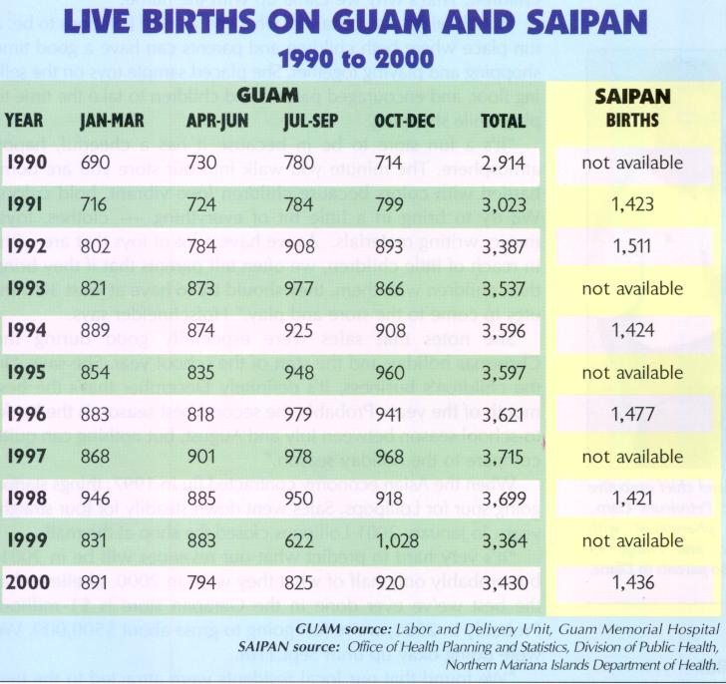
Visualizing Data: Tabulations
Degree of detail
  Cause
  Sex, race
  Age
  Geographical area
Depends on
  Purpose of statistics
  Range/completeness of data
Column and row totals should add up correctly
SOURCES: WHO ICD-10, Volume 2, Chapter 5; NCHS, Unit 17.
Notes:
Notes:
The selection of what categories or groups of categories will be used is dependent upon the purpose of the statistical table. A variety of special groupings can be developed, but certain conventions are useful in guiding the procedures of data summarization and computing basic rates. WHO has provided recommendations on groupings to improve comparability (to be discussed in specific sections below).

Slide 22
Tabulations:
Specify Time Reference
By date of registration
  For provisional tabulations only
  Need to evaluate differences expected
  May be quicker for weekly, monthly, or quarterly summaries
By date of occurrence of event
  Recommended for final tabulations
  Must define “cut-off” date for reporting events
    Legislation
    Organizational structure
SOURCES: WHO ICD-10, Volume 2, Chapter 5; UN Handbook, Module 18, A1.
Notes:
Notes:
For best statistical use, each event must be registered and reported within the time period specified in the civil registration and vital statistics laws. The time periods used for tabulations of vital statistics should be specific calendar periods – month, quarter, year. In preparing tabulations, a decision needs to be made whether to use the date of registration or the date of occurrence of the event. The recommendation is to present final tabulations based on the events that occurred during the time period specified. If it is necessary to prepare provisional tabulations by date of registration, then an evaluation of the degree of difference to be expected between the two types of tabulation should be done. For current weekly, monthly, or quarterly summaries, it may be quicker to compile the data by date of registration.
The recommendation to do final tabulations by date of occurrence brings with it the necessity to establish the “cut-off” date (in the United States, the cut-off date is the end of the first quarter of the following year). Establishing the cut-off date requires considerations of legislatively established time periods for registration and reporting. Another consideration is the organizational structure that determines the number of offices through which the report passes on its way to the national statistical agency.

Slide 23
Tabulations:
Specify Geographic Reference
Goal: complete coverage of country’s total population
May focus on areas of known coverage
  Incentive for lower-quality areas to improve
  Interim measure
  Data not nationally representative; supplement data:
    Statistical adjustment for under-reporting
    Collecting supplementary data by field surveys
SOURCES: WHO ICD-10, Volume 2, Chapter 5; UN Handbook, Module 18, A2.
Notes:
Notes:
Geography is also an influence on tabulation coverage. The basic principle relative to geography is that each vital event occurring within the country must be registered and have a statistical report filed. This allows tabulation of vital statistics for the entire country, intermediate civil divisions, large cities and towns, and sub-population groups.
During the development or improvement of a vital statistics system, countries may decide to do detailed tabulations on geographic areas of known coverage completeness levels.

Slide 24
Tabulations:
Specify Geographic Reference
Normal assumption: little difference between resident population & population present
By place of usual residence
  Use for final tabulations for civil divisions & large cities
  Can present by events of residents versus non-residents
  Must consider legal definition of “residence”
By place of occurrence:
Recommended for subnational areas
SOURCES: WHO ICD-10, Volume 2, Chapter 5; UN Handbook, Module 18, A2.
Notes:
Notes:
There are a number of issues to consider relative to the geographic classifications used in compiling vital statistics. One assumption that is normally made is that there is relatively little difference between a country’s resident population and the population present in the country at any particular time. The presumption is that those involved in international travel or those not at their usual place of residence (e.g. the military, diplomats, tourists) are a very small portion of the total population, and contribute in an even smaller amount to births and deaths.
Final tabulations for geographic civil divisions of the country and for large cities should be done by place of usual residence.
For provisional or advance tabulations on civil divisions within the country, it is not practical to attempt reallocation of the data by usual residence since early release of the data is of the essence. Tabulation by place of occurrence is the recommendation for these data.

Slide 25
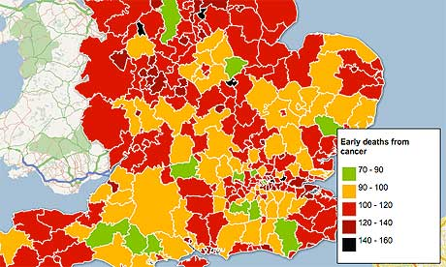
Visualizing Data:
Charts, Graphs & Figures
  Customize for local needs
  Use to expand data interpretation
  Use to explain/justify needs to stakeholders
The Guardian, UK, 2011
Notes:
Notes:
The image illustrates how maps can be used to visualize sub-area information, in this case the number of early deaths due to cancer in small areas of England. In South Africa, where they need to focus on violent deaths, another example of customizing information for local needs would be to stratify deaths by natural versus non-natural causes.

Slide 26
Review: Visualizing Data
Tabulations
  Time reference
  Geographic reference
Charts, graphs, & figures

Slide 27
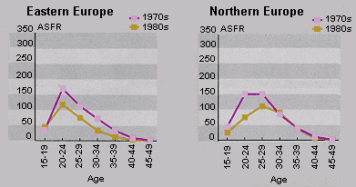
Natality Statistics
Various rates/ratios/percentages
Age specific rates
Fertility rates
Tabulations
Graphs/charts/figures
UN, World Fertility Patterns, 1997
SOURCES: NAPHSIS
Notes:
Notes:
Births form the denominator for the infant mortality rate and maternal mortality ratio (discussed later). Both of these measures are used in measuring progress on the Millennium Development Goals (4 and 5), which helps provide an important rationale for birth registration.

Slide 28
Crude Birth Rate
# resident live births for a specific area during a specified period
divided by total population for that area (usually mid-year)
multiplied by 1,000
Total resident live births X 1,000
Total Population
ON YOUR OWN: What is the birth rate in this area in 2005?
180,000 live births in 2005 among area residents
12,300,000 estimated population in 2005 for area residents
SOURCES: NAPHSIS
Notes:
Notes: Crude Birth Rate (CBR) is a basic measure of fertility. There are other fertility measures that are more population-at-risk specific and more comparable across time and geography (such as the general fertility rate and the total fertility rate).
Crude birth rate is usually calculated for a calendar year.
Note: Birth rate is NOT the same as pregnancy rate, which is the total number of resident pregnancies including live births, induced abortions, and fetal deaths per 1,000 women aged 15-44 years for a specified geographical area (country, state/province, county etc.) during a specified time period.

Slide 29
Crude Birth Rate: Example
180,000 live births in 2005 among area residents
12,300,000 estimated population in 2005 for area residents
180,000 X 1,000 = 14.6
12,300,000
14.6 live births per 1,000 area residents in 2005
SOURCES: NAPHSIS
Notes:
[Remove solution slide from student version].
Notes: Crude Birth Rate (CBR) is a basic measure of fertility. There are other fertility measures that are more population-at-risk specific and more comparable across time and geography (such as the general fertility rate and the total fertility rate).

Slide 30
Sex Ratio at Birth
# resident male live births for a specific area during a specified period
divided by # of resident female live births for that area & period
multiplied by 100 or 1,000
# of resident male live births X 100 (or 1,000)
# of resident female live births
ON YOUR OWN: What is the sex ratio at birth for the area in 2008?
58,000 = male live births in 2008 to area residents
55,000 = female live births in 2008 to area residents
SOURCES: NAPHSIS
Notes:
Note:
The sex ratio at birth is an important demographic indicator used for determining the sex composition of a population. It also affects some critical demographic measures such as the number of years required for a population to double in size given a rate of population growth, which rises as the ratio of males to females at birth increases.

Slide 31
Sex Ratio at Birth: Example
58,000 = male live births in 2008 to area residents
55,000 = female live births in 2008 to area residents
58,000 X 100 = 105.5
55,000
105.5 male births per 100 female live births among area residents in 2008
SOURCES: NAPHSIS
Notes:
[Remove solution slide from student version].
Note:
The sex ratio at birth is an important demographic indicator used for determining the sex composition of a population. It also affects some critical demographic measures such as the number of years required for a population to double in size given a rate of population growth, which rises as the ratio of males to females at birth increases.

Slide 32
% Low (Very Low) Birth Weight
# resident live births for a specific area during a specified period with a birth weight of less than 2,500 (1,500) grams
divided by # of resident live births for that area & period
multiplied by 100 to get a %
# of resident live births < 2,500 (1,500) grams X 100
# of resident live births
ON YOUR OWN: What is the % low birth weight for the area in 2005?
10,500 = live births < 2,500 grams in 2005 among area residents
150,000 = live births in 2005 to area residents
SOURCES: NAPHSIS
Notes:
Notes:
Low and very low birthweight births have been associated with negative birth outcomes, and may be an indicator of problems in access to quality health services and/or the need for prenatal care services.

Slide 33
% Low Birth Weight: Example
10,500 = live births < 2,500 grams in 2005 among area residents
150,000 = live births in 2005 to area residents
_10,500_ X 100 = 7.0
150,000
7.0 % of all live births in 2005 among area residents were low birthweight births
SOURCES: NAPHSIS
Notes:
[Remove solution slide from student version].
Notes:
Low and very low birthweight births have been associated with negative birth outcomes, and may be an indicator of problems in access to quality health services and/or the need for prenatal care services.

Slide 34
% Preterm Live Births
# resident live births for a specific area during a specified period with a gestational age < 37 completed weeks
divided by # of resident live births for that area & period
multiplied by 100 to get a %
# of resident preterm (< 37 weeks) live births X 100
# of resident live births
ON YOUR OWN: What is the % preterm live births in the area in 2008?
15,900 = preterm (< 37 weeks) live births in 2008 among area residents
127,000 = live births in 2008 to area residents
SOURCES: NAPHSIS

Slide 35
% Preterm Live Births: Example
15,900 = preterm (< 37 weeks) live births in 2008 among area residents
127,000 = live births in 2008 to area residents
15,900 X 100 = 12.5
127,000
12.5 % of all live births in 2008 among area residents were preterm births.
SOURCES: NAPHSIS
Notes:
[Remove solution slide from student version].

Slide 36
Age-Specific Birth Rate
# resident live births to women in a specific age group for a specific area during a specified period
divided by the total population of women in the same age group for that area & period
multiplied by 1,000 to get a rate
# resident live births to women in a specific age group X 1,000
# of women in the same age group
ON YOUR OWN: What is the 2008 area birth rate for women 20-24 yrs?
36,000 = live births in 2008 among resident women 20-24 years old
310,000 = area resident women who are 20-24 years old in 2008
SOURCES: NAPHSIS

Slide 37
Age-Specific Birth Rate: Example
36,000 = live births in 2008 among area resident women who are 20-24 years old
310,000 = area resident women who are 20-24 years old in 2008
36,000 X 1,000 = 116.1
310,000
116.1 live births per 1,000 area resident women who are 20-24 years old in 2008
SOURCES: NAPHSIS
Notes:
[Remove solution slide from student version].

Slide 38
General Fertility Rate
# resident live births for a specific area during a specified period
divided by the female population age 15-49 years (usually estimated for a mid-year) for the same area/period
multiplied by 1,000
# of resident live births X 1,000
# of females aged 15-49
ON YOUR OWN: What is the general fertility rate in the area in 2008?
180,000 = live births in 2008 among area residents
2,700,000 = estimated # of area resident females 15-49 yrs in 2008 (estimated for 1 July, 2008)
SOURCES: NAPHSIS
Notes:
Notes: The General Fertility Rate (GFR) is perhaps the most commonly used overall fertility measure because it matches often readily available numerator and denominator data in a broad age range that covers most of the female reproductive years and thus representing the population at greater likelihood of giving birth.

Slide 39
General Fertility Rate: Example
180,000 = live births in 2008 among area residents
2,700,000 = estimated # of area resident females who are 15-44 years old in 2008 (estimated for 1 July, 2008)
180,000 X 1,000 = 66.7
2,700,000
66.7 live births per 1,000 area resident women who are 15-44 years old in 2008
SOURCES: NAPHSIS
Notes:
[Remove solution slide from student version].
Notes: The General Fertility Rate (GFR) is perhaps the most commonly used overall fertility measure because it matches often readily available numerator and denominator data in a broad age range that covers most of the female reproductive years and thus representing the population at greater likelihood of giving birth.

Slide 40
Total Fertility Rate
sum the age-specific birth rates (5-yr age groups between 10 & 49) for female residents of a specific area during a specified period
multiply by 5
(ΣASBR) x 5
where ASBR is each 5-year age-specific birth rate: Bx x 1,000
Px
where Bx is the # live births to mothers age x
Bx age groups: <15, 15-19, 20-24, 25-29, 30-34, 35-39, 40-44, & 45+
Px is the # resident women age x
Px age groups: 10-14, 15-19, 20-24, 25-29, 30-34, 35-39, 40-44 & 45-49
SOURCES: NAPHSIS
Notes:
NOTE: This rate estimates the number of children a hypothetical cohort of 1,000 females in the specified population would bear if they all went through their childbearing years experiencing the same age-specific birth rates for a specified time period.
The Total Fertility Rate (TFR) is perhaps the most commonly used standardized fertility measure because it is ideal for comparative purposes and is a comprehensive summary measure readily understood.
The sum of these ASBRs is multiplied by 5 because each ASBR represents a 5-year cohort of women.

Slide 41
Total Fertility Rate
Determine Bx and Px
  List # live births to moms in each age group (Bx)
  List # resident women in each age group (Px)
Calculate the age-specific birth rates (ASBR)
  Divide Bx by Px
  Multiply by 1,000
Sum the age-specific birth rates (ASBR)
Multiply the total ASBR by 5

Slide 42
Total Fertility Rate for an area for year 2000:
1. Determine Bx and Px (given)
*For groups 10-14 & 45-49, births to ages < 15 and 45+ are used.
Mother’s Age Group | 2000 Live Births (Bx) | 2000 Mid-year Female Population (Px) | ASBR
10-14 | 300* | 165,000
15-19 | 11,000 | 179,000
20-24 | 20,000 | 192,000
25-29 | 22,000 | 222,000
30-34 | 20,000 | 213,000
35-39 | 10,000 | 212,000
40-44 | 2,000 | 210,000
45-49 | 500* | 200,000
SOURCES: NAPHSIS
Notes:
Given Bx, the number of live births to mothers in each age group and Px, the number of resident women in each age group…

Slide 43
Total Fertility Rate for an area for year 2000:
2. Calculate the age-specific birth rate (ASBR)
ASBR = Bx x 1,000
Px
Age Group | 2000 Live Births (Bx) | 2000 Female Population (Px | ASBR rounded)
10-140-14 | 300 | 165,000
SOURCES: NAPHSIS
Notes:
We calculate the age-specific birth rate (ASBR) by dividing Bx by Px and multiplying by 1000.
Let’s look at the 10-14 age group…
[Have class calculate the remaining groups by themselves using the TFR Exercise Worksheet (included in “Activity Materials” section of Participant Notes)].

Slide 44
Total Fertility Rate for an area for year 2000:
2. Calculate the age-specific birth rate (ASBR)
ASBR = Bx x 1,000
Px
ASBR = 300 X 1,000 = 1.8 live births per 1,000
165,000
Mother’s Age Group | 2000 Live Births (Bx) | 2000 Female Population (Px | ASBR rounded)
10-140-14 | 300 | 165,000 | 1.8
SOURCES: NAPHSIS
Notes:
We calculate the age-specific birth rate (ASBR) by dividing Bx by Px and multiplying by 1000.
Let’s look at the 10-14 age group…
[Have class calculate the remaining groups by themselves using the TFR Exercise Worksheet].

Slide 45
Total Fertility Rate for an area for year 2000:
Finish the remaining groups …
*For groups 10-14 & 45-49, births to ages < 15 and 45+ are used.
Mother’s Age Group | 2000 Live Births (Bx) | 2000 Female Population (Px) | ASBR (rounded)
10-14 | 300* | 165,000 | 1.8=300/165,000*1,000
15-19 | 11,000 | 179,000
20-24 | 20,000 | 192,000
25-29 | 22,000 | 222,000
30-34 | 20,000 | 213,000
35-39 | 10,000 | 212,000
40-44 | 2,000 | 210,000
45-49 | 500* | 200,000
SOURCES: NAPHSIS
Notes:
[Have class calculate the remaining groups by themselves using the TFR Exercise Worksheet]. Round to 1 decimal place.

Slide 46
Total Fertility Rate for an area for year 2000:
Finish the remaining groups …
*For groups 10-14 & 45-49, births to ages < 15 and 45+ are used.
Mother’s Age Group | 2000 Live Births (Bx) | 2000 Female Population (Px) | ASBR (rounded)
10-14 | 300* | 165,000 | 1.8
15-19 | 11,000 | 179,000 | 61.5
20-24 | 20,000 | 192,000 | 104.2
25-29 | 22,000 | 222,000 | 99.1
30-34 | 20,000 | 213,000 | 93.9
35-39 | 10,000 | 212,000 | 47.2
40-44 | 2,000 | 210,000 | 9.5
45-49 | 500* | 200,000 | 2.5
SOURCES: NAPHSIS
Notes:
[Remove solution slide from student version].

Slide 47
Total Fertility Rate for an area for year 2000:
3. Sum the age-specific birth rates (ASBR)
Total or Σ of ASBRs _____ live births per 1,000
Age Group | 2000 Live Births (Bx) | 2000 Female Population (Px) | ASBR (rounded)
10-14 | 300* | 165,000 | 1.8
15-19 | 11,000 | 179,000 | ---
20-24 | 20,000 | 192,000 | ---
25-29 | 22,000 | 222,000 | ---
30-34 | 20,000 | 213,000 | ---
35-39 | 10,000 | 212,000 | ---
40-44 | 2,000 | 210,000 | ---
45-49 | 500* | 200,000 | ---
SOURCES: NAPHSIS

Slide 48
Total Fertility Rate for an area for year 2000:
3. Sum the age-specific birth rates (ASBR)
Total or Σ of ASBRs 419.7 live births per 1,000
Age Group | 2000 Live Births (Bx) | 2000 Female Population (Px) | ASBR (rounded)
10-14 | 300* | 165,000 | 1.8
15-19 | 11,000 | 179,000 | 61.5
20-24 | 20,000 | 192,000 | 104.2
25-29 | 22,000 | 222,000 | 99.1
30-34 | 20,000 | 213,000 | 93.9
35-39 | 10,000 | 212,000 | 47.2
40-44 | 2,000 | 210,000 | 9.5
45-49 | 500* | 200,000 | 2.5
SOURCES: NAPHSIS
Notes:
[Remove solution slide from student version].

Slide 49
Total Fertility Rate for an area for year 2000:
4. Multiply the total ASBR by 5
Total or Σ of ASBRs _____ live births per 1,000
TFR = (ΣASBR) x 5
SOURCES: NAPHSIS

Slide 50
Total Fertility Rate for an area for year 2000:
4. Multiply the total ASBR by 5
Total or Σ of ASBRs 419.7 live births per 1,000
TFR = (ΣASBR) x 5
419.7 X 5 = 2,098.5 live births per 1,000 female area residents in 2000 who live through their reproductive yrs
An alternative interpretation:
2,098.5 / 1,000 = 2.1 children per woman during reproductive years
SOURCES: NAPHSIS
Notes:
[Remove solution slide from student version].

Slide 51
Natality Statistics
What types of natality statistics are produced/used in your country?

Slide 52
Review: Natality Statistics
Crude birth rate
Sex ratio at birth
% low (very low) birth weight
% preterm live births
Age-specific birth rates
General fertility rate
Total fertility rate

Slide 53
Natality Statistics:
Tabulations & Figures
Data based on information recorded on birth certificate/registration
Where necessary, use census/projections for denominators
Uses: identify population group with highest # or % of births
Notes:
[The following slides provide some examples of natality statistics tabulations and provide some practice for the students in developing tabulations and figures; use local data whenever possible; have students interpret tables/figures and discuss patterns observed].

Slide 54
Live Births by Age of Mother &
Live Birth Order
Live birth order (child) | All ages | < 15 years | 15-19 years | 20-24 years | 25-29 years | 30-34 years | 35-39 years | 40-44 years | 45-49 years | 50-54 years
1st | 194,990 | 1,245 | 40,367 | 49,976 | 44,294 | 32,894 | 16,928 | 8,289 | 997 | 25
2nd | 164,574 | 53 | 10,944 | 39,678 | 42,028 | 39,288 | 21,934 | 9,427 | 1,183 | 39
3rd | 108,726 | 5 | 2,023 | 17,823 | 35,098 | 27,185 | 17,932 | 7,926 | 715 | 19
4th | 55,737 | - | 589 | 6,023 | 12,377 | 22,047 | 9,022 | 5,078 | 585 | 16
5th | 45,061 | - | 128 | 2,133 | 6,992 | 19,832 | 8,043 | 7,012 | 898 | 23
6th | 10,339 | - | 15 | 849 | 3,514 | 3,349 | 1,970 | 590 | 48 | 4
7th | 5,000 | - | 3 | 195 | 1,364 | 1,802 | 1,210 | 393 | 29 | 4
8th+ | 4,783 | - | 2 | 76 | 788 | 1,645 | 1,573 | 640 | 50 | 9
Not stated | 6,858 | 33 | 1,010 | 2,153 | 1,763 | 1,133 | 588 | 166 | 11 | 1
SOURCES: NVSS Births, p 31.
Notes:
Notes:
-An example of using a table for planning
-Compare number of live births across different age groups of mothers
-Can identify age group with highest number of births
-Can identify teen mothers giving birth to 2nd, 3rd, or higher order birth
-Numbers to add up across rows in “all ages” column
-It may be useful to further break down the 15-19 years to 15, 16, 17, 18, and 19 year categories
-It may be useful to break down by race, region, etc.
-Live birth order refers to the number of children born alive to the mother
- “-” means quantity = 0

Slide 55
Live Births and Fertility Rates
Year | Number of Live Births among women aged 15-44 years | Rate per 1,000 women aged 15-44 years
1996 | 3,928,442 | 61.4
1997 | 3,810,292 | 60.9
1998 | 3,319,013 | 57.6
1999 | 3,421,573 | 56.4
2000 | 3,701,352 | 58.9
2001 | 3,910,102 | 60.2
2002 | 3,892,047 | 61.5
2003 | 4,277,382 | 63.8
2004 | 4,729,100 | 64.2
2005 | 4,779,291 | 64.5
SOURCES: NVSS, p 4.
Notes:
Notes: [insert local table if possible]
-Here, we show an example of building a graph from a table
-We have 10 years of data for the number of live births and fertility rates for women aged 15-44 years

Slide 56
Number of Live Births
Year | Number of Live Births among women aged 15-44 years
1996 | 3,928,442
1997 | 3,810,292
1998 | 3,319,013
1999 | 3,421,573
2000 | 3,701,352
2001 | 3,910,102
2002 | 3,892,047
2003 | 4,277,382
2004 | 4,729,100
2005 | 4,779,291
Notes:
Notes:
First, we take the number of live births

Slide 57
Number of Live Births
Year | Number of Live Births among women aged 15-44 years
1996 | 3,928,442
1997 | 3,810,292
1998 | 3,319,013
1999 | 3,421,573
2000 | 3,701,352
2001 | 3,910,102
2002 | 3,892,047
2003 | 4,277,382
2004 | 4,729,100
2005 | 4,779,291
Notes:
Notes:
And we plot the number of live births for each year
Note: to make the chart easier to read, we made the y-axis in “millions of births,” so “3,928,442” becomes “3.9 million.”

Slide 58
Fertility Rates
Year | Rate per 1,000 women aged 15-44 years
1996 | 61.4
1997 | 60.9
1998 | 57.6
1999 | 56.4
2000 | 58.9
2001 | 60.2
2002 | 61.5
2003 | 63.8
2004 | 64.2
2005 | 64.5
SOURCES: NVSS, p 4.
Notes:
Notes: [insert local graph if possible]
-Then we take the fertility rates

Slide 59
Fertility Rates
Notes:
Notes:
-…And we plot them on a second y-axis– over the live birth numbers.
-Notice we have two different axis labels; we use two different colors to distinguish them.
What do we see?
- We have 10 years of data- so we can look at trends in birth numbers and fertility rates.

Slide 60
Live Births and Fertility Rates
Notes:
Notes:
-…And we plot them on a second y-axis– over the live birth numbers.
-Notice we have two different axis labels; we use two different colors to distinguish them.
What do we see?
- We have 10 years of data- so we can look at trends in birth numbers and fertility rates.

Slide 61
Live Births and Fertility Rates
Notes:
Notes:
- Note that the rate of births does not always change the same as the number of births (i.e. from 1998 to 1999, the number of births increases slightly while the rate decreases)– why? (denominators)
-Discuss interpretation/implications of information

Slide 62
Live Births and Fertility Rates
Notes:
Notes:
-You can use whatever type of graph is most useful. Here, we’ve changed the birth numbers series to a line graph like the fertility rate series.

Slide 63
% Low Birthweight by Age of Mother
Age of Mother | Number Low Birthweight | % low Birthweight
All Ages | 351,974 | 8.3
Under 15 years | 856 | 13.4
15-19 years | 43,369 | 10.0
20-24 years | 89,982 | 8.3
25-29 years | 88,386 | 7.5
30-34 years | 72,524 | 7.6
35-39 years | 43,855 | 8.8
40-44 years | 11,589 | 11.0
45-54 years | 1,413 | 20.3
Sources: NVSS Births, table 35, p 78.
Notes:
Notes: [insert local graph if possible]
-Also shows change by year
-It is useful to break down the 15-19 year category by each year: 15, 16, 17, 18, and 19

Slide 64
Number of Low Weight
Births by Age of Mother
SOURCES: NVSS Births, table 35, p 78.
Notes:
Notes:
-As before, we first plot the number of low birthweight for each age category…

Slide 65
% Low Birthweight by Age of Mother
SOURCES: NVSS Births, table 35, p 78.
Notes:
Notes:
-Then we add the % low birthweight
-Compare trends
-What is highest risk group (very young and very old); how do numbers compare to %? (% accounts for denominator, or the number at risk for low birthweight (the number of live births) in each age category)
-How might we use this information? (target interventions to risk groups)

Slide 66
Total Fertility Rates &
Birth Rates by Age of Mother
Year | Total Fertility Rate | Birth Rates (live births per 1,000 females)
 |  | 10-14 Years | 15-19 years | 20-24 years | 25-29 years | 30-34 years | 35-39 years | 40-44 years | 45-49 years
2006 | 2,100.5 | 0.6 | 41.9 | 105.9 | 116.7 | 97.7 | 47.3 | 9.4 | 0.6
2005 | 2,053.5 | 0.7 | 40.5 | 102.2 | 115.5 | 95.8 | 46.3 | 9.1 | 0.6
2004 | 2,045.5 | 0.7 | 41.1 | 101.7 | 115.5 | 95.3 | 45.4 | 8.9 | 0.5
2003 | 2,042.5 | 0.6 | 41.6 | 102.6 | 115.6 | 95.1 | 43.8 | 8.7 | 0.5
2002 | 2,013.0 | 0.7 | 43.0 | 103.6 | 113.6 | 91.5 | 41.4 | 8.3 | 0.5
2001 | 2,034.0 | 0.8 | 45.3 | 106.2 | 113.4 | 91.9 | 40.6 | 8.1 | 0.5
2000 | 2,056.0 | 0.9 | 47.7 | 109.7 | 113.5 | 91.2 | 39.7 | 8.0 | 0.5
1999 | 2,007.5 | 0.9 | 48.8 | 107.9 | 111.2 | 87.1 | 37.8 | 7.4 | 0.4
1998 | 1,999.0 | 1.0 | 50.3 | 108.4 | 110.2 | 85.2 | 36.9 | 7.4 | 0.4
1999 | 1,971.0 | 1.1 | 51.3 | 107.3 | 108.3 | 83.0 | 35.7 | 7.1 | 0.4
SOURCES: NVSS Births, p 33.
Notes:
Notes:
- Uses age-specific birth rate
- Birth rates are live births per 1,000 women in age group
- Reminder: total fertility rate is: the number of live births per 1,000 female residents in the year who live through their reproductive years
- Shown is 10 years of data; can show over longer period of time to track longer trends
- May be helpful to further split 15-19 year group to 15, 16, 17, 18, and 19 years or 15-17 and 18-19 years.
Show class how to use table:
Which age group has the highest birth rates overall? (25-29 years)
Which age group has the lowest birth rates overall? (45-49)
Which age group has the steadiest birth rate over the ten years (45-49)
Which age group(s) increased in birth rate from 1999 to 2006? (25-29, 30-34, 35-39, 40-44, 45-49)
What do you think this means? (successful interventions in reducing child/teen births/pregnancies; women are delaying pregnancy- e.g. for school, later marriage, etc.)

Slide 67
Exercise: Graph the % of Preterm Live Births
Year | Country | North | Central | South
2002 | 12.8 | 11.7 | 18.5 | 12.2
2003 | 12.7 | 11.7 | 18.4 | 12.1
2004 | 12.5 | 11.5 | 17.9 | 12.0
2005 | 13.2 | 11.3 | 17.8 | 11.9
2006 | 12.1 | 11.0 | 17.7 | 11.6
Bar graph
Over time, by year
Total & by region
SOURCES: NVSS Births
Notes:
Materials: will be helpful to have 4 different color markers for each group; flip chart paper.
Notes: Break into small groups to do exercise.
Review “terms” with class
Give class time to construct graph and “struggle” with any questions
Before showing “answer” on next slide, discuss:
What goes on the X axis? (year)
What goes on the Y axis? (%)
How do we distinguish the country % from the region %s? (by separate bars/data points)

Slide 68
% Preterm Live Births by Region
2002-2006
Notes:
Notes: [Remove this graph from student version].
Discuss Figure
Review: X axis – Year; Y axis- %; each color bar = region/country
Discuss trends:
Highest %: Central
North and South- better than national average
Overall, decreasing % between 2002 and 2006

Slide 69
Exercise: Graph the # of Live Births by Attendant and Place of Delivery
 | Attendant |  |  | Place of Delivery
Year | Physician | Midwife | Other | Clinic/ Hospital | Residence
2002 | 25,487 | 32,864 | 3,477 | 34,862 | 26,786
2003 | 27,855 | 30,893 | 2,796 | 35,489 | 26,001
2004 | 26,783 | 30,455 | 3,711 | 33,786 | 27,163
2005 | 29,325 | 29,861 | 2,421 | 37,104 | 24,503
2006 | 31,499 | 28,471 | 2,468 | 37,949 | 24,489
Bar & Line graph
Over time, by year
By attendant (bar) & place of delivery (line)
SOURCES: NVSS Births
Notes:
Materials: Have 4 different color markers for each group; Use flip-chart paper.
Notes: Break into small groups. This exercise can/should be simplified as necessary.
Review “terms” with class
Give class time to construct graph and “struggle” with any questions
Before showing “answer” on next slide, discuss:
What goes on the X axis? (year)
What goes on the Y axis? (#)
How do we distinguish the attendant type and place of delivery? (by separate bars for attendant and separate lines for place of delivery)
We’ll use the same axis (look at range of numbers; what makes sense?)

Slide 70
Number of Live Births by Attendant &
Place of Delivery
Notes:
Notes: [Remove this graph from student version].
Discuss Figure
Review: X axis – Year; Y axis- #, single axis; each color bar = attendant type; each color line = place of delivery
Discuss trends:
Overall, physician delivered births increased while midwife delivered births decreased
We see a corresponding trend in births taking place in a clinic/hospital (increasing) and births taking place at a residence (decreasing)
And in case anyone asks about what countries still have such a high percentage of home births, you can mention the Netherlands, where approximately one-third of all deliveries still take place at home.

Slide 71
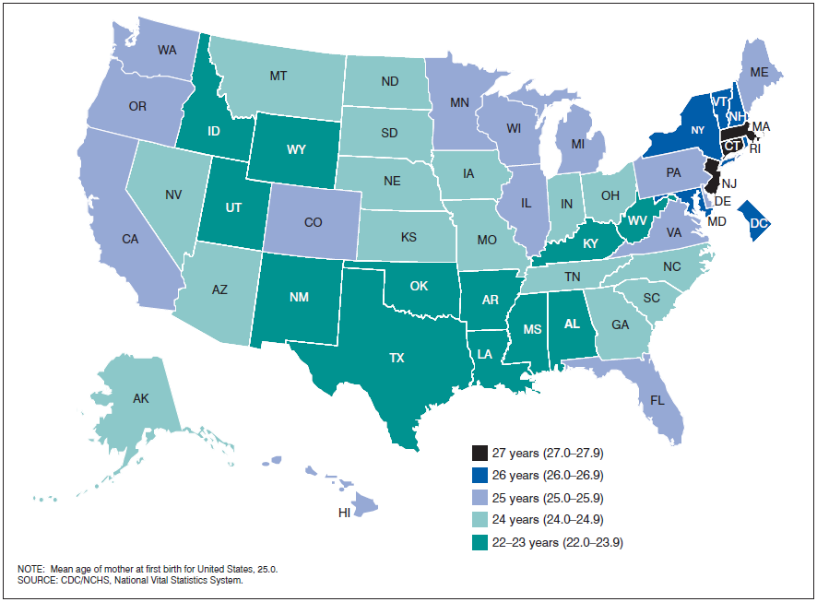
Mean Age of Mother at First Birth By State
Notes:
Notes: Here is an example of how we can use maps to visualize geographic differences.

Slide 72
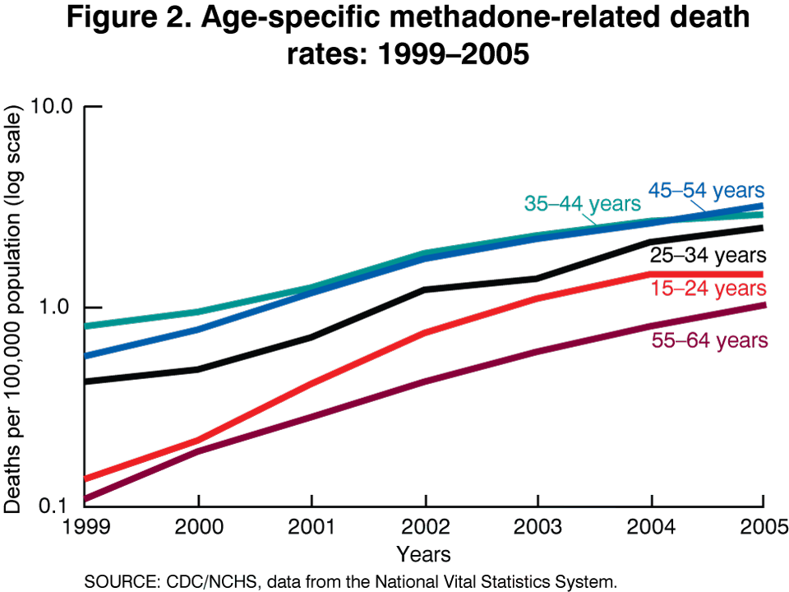
Mortality Statistics
Crude rates
Age specific, cause specific, race specific rates
Age adjusting
Tabulations
Graphs/charts/ figures
SOURCES: NAPHSIS

Slide 73
Crude Death Rate
# resident deaths for a specific area during a specified period
divided by the total population (mid-year estimate) for the same area/period
multiplied by 100,000
# of resident deaths X 100,000
Total Population
ON YOUR OWN: What is the crude death rate in the area in 2006?
15,231 = total deaths in area during 2006
2,010,787 = estimated 2006 mid-year population for area residents
SOURCES: NAPHSIS
Notes:
Notes: The crude death rate is a very general indicator/index of the health status of a geographic area or population.
This type of crude rate is not appropriate for comparison of different populations or areas due to the significant impact of age in mortality data and different age-distributions in different populations. Rather, age-adjusted mortality rates should be used for comparative analysis (more on this later, see below).

Slide 74
Crude Death Rate
15,231 = total deaths in area during 2006
2,010,787 = estimated 2006 mid-year population for area residents
15,231 X 100,000 = 757.5
2,010,787
757.5 resident deaths per 100,000 area population in 2006
SOURCES: NAPHSIS
Notes:
[Remove solution slide from student version].
Notes: The crude death rate is a very general indicator/index of the health status of a geographic area or population.
This type of crude rate is not appropriate for comparison of different populations or areas due to the significant impact of age in mortality data and different age-distributions in different populations. Age-adjusted mortality rates should be used for comparative analysis (see below).

Slide 75
Age Specific Death Rate
# resident deaths for a specific age or age group in a specific area during a specified period
divided by the population (mid-year estimate) of the same age or age group in the same area/period
multiplied by 100,000
# of resident deaths in specified age/group X 100,000
Total population in same specified age/group
ON YOUR OWN: What is the area death rate for children ages 1-14 in 2006?
37 = deaths among area children ages 1 -14 during 2006
381,910 = estimated 2006 mid-year population for area population aged 1-14
SOURCES: NAPHSIS

Slide 76
Age Specific Death Rate
37 = deaths among area children ages 1-14 during 2006
381,910 = estimated 2006 mid-year population for area population aged 1-14
37 X 100,000 = 9.7
381,910
9.7 deaths per 100,000 area population aged 381,910 1-14 in 2006
SOURCES: NAPHSIS
Notes:
[Remove solution slide from student version].

Slide 77
Cause Specific Death Rate
# resident deaths from a specified cause in a specific area during a specified period
divided by the total population at risk (mid-year estimate) in the same area/period
multiplied by 100,000
# of resident deaths from specific cause X 100,000
Total population at risk
ON YOUR OWN: What is the 2006 area death rate for homicide deaths?
137 = homicide deaths among area residents in 2006
2,010,787 = estimated 2006 mid-year population for area
SOURCES: NAPHSIS
Notes:
Notes:
Calculating cause specific death rate is useful for public health planning because it helps determine allocation of resources.

Slide 78
Cause Specific Death Rate
137 = homicide deaths among area residents in 2006
2,010,787 = estimated 2006 mid-year population for area
137 X 100,000 = 6.8
2,010,787
6.8 deaths from homicide per 100,000 area population in 2006
SOURCES: NAPHSIS
Notes:
[Remove solution slide from student version].

Slide 79
Infant Mortality Rate
# resident newborns dying under 1 year of age for a specific area during a specified period
divided by the number of resident live births for the same area/period
multiplied by 1,000
# of resident infant deaths X 1,000
# of resident live births
ON YOUR OWN: What is the area infant mortality rate in 2008?
1,300 = infant deaths in area during 2008
150,000 = live births in 2008 to area residents
SOURCES: NAPHSIS
Notes:
Notes:
An infant mortality rate (IMR) is considered a primary and important indicator of an area’s overall health status or quality of life.
Fetal- / Neonatal-/ Postneonatal- / Perinatal- mortality rates are calculated in a similar way- with the specific populations at risk (see WHO definitions).

Slide 80
Infant Mortality Rate
1,300 = infant deaths in area during 2008
150,000 = live births in 2008 to area residents
1,300 X 1,000 = 8.7
150,000
8.7 infant deaths per 1,000 live births among area residents in 2008
SOURCES: NAPHSIS
Notes:
[Remove solution slide from student version].
Notes:
An infant mortality rate (IMR) is considered a primary and important indicator of an area’s overall health status or quality of life.
Fetal- / Neonatal-/ Postneonatal- / Perinatal- mortality rates are calculated in a similar way- with the specific populations at risk (see WHO definitions).

Slide 81
Maternal Mortality Rate
# resident maternal deaths within 42 days of pregnancy termination due to complications of pregnancy, childbirth, and the puerperium in a specific area during a specified period
divided by total resident live births for the same area/period
multiplied by 100,000
__# of resident maternal deaths X 100,000
# of resident live births
ON YOUR OWN: What is the 2008 area maternal mortality rate?
84 = maternal deaths in area during 2008
130,000 = live births in 2008 to area residents
SOURCES: NAPHSIS
Notes:
Notes:
A maternal mortality rate is considered a primary and important indicator of an area’s overall health status or quality of life. Maternal mortality rate can be used as an indicator of access to prenatal and obstetrics care (where additional resources may be needed).

Slide 82
Maternal Mortality Rate
84 = maternal deaths in area during 2008
130,000 = live births in 2008 to area residents
84 X 100,000 = 64.6
130,000
64.6 maternal deaths per 100,000 live births among area residents in 2008
SOURCES: NAPHSIS
Notes:
[Remove solution slide from student version].
Notes:
A maternal mortality rate is considered a primary and important indicator of an area’s overall health status or quality of life.

Slide 83
Pregnancy-Related Mortality Rate
# resident deaths of individuals within 42 days of pregnancy termination due to any cause in a specific area during a specified period
divided by total resident live births for the same area/period
multiplied by 100,000
# of resident pregnancy-related deaths X 100,000
# of resident live births
ON YOUR OWN: What is the 2008 area pregnancy-related mortality rate?
91 = pregnancy-related deaths among area during 2008
130,000 = live births in 2008 to area residents
SOURCES: NAPHSIS
Notes:
Notes:
Distinguish pregnancy-related mortality rates from maternal mortality rates. Pregnancy-related deaths differ from maternal deaths, as defined by the World Health Organization, in that a pregnancy-related death is defined as “the death of a woman while pregnant or within 42 days of termination of pregnancy, irrespective of the cause of death.” In contrast, a maternal death is restricted to deaths “from any cause related to or aggravated by the pregnancy or its management, but not from accidental or incidental causes.”

Slide 84
Pregnancy-Related Mortality Rate
91 = pregnancy-related deaths among area during 2008
130,000 = live births in 2008 to area residents
91 X 100,000 = 70.0
130,000
70.0 pregnancy-related deaths per 100,000 live births among area residents in 2008
SOURCES: NAPHSIS
Notes:
[Remove solution slide from student version].
Notes:
Distinguish pregnancy-related mortality rates from maternal mortality rates. Pregnancy-related deaths differ from maternal deaths, as defined by the World Health Organization, in that a pregnancy-related death is defined as “the death of a woman while pregnant or within 42 days of termination of pregnancy, irrespective of the cause of death.” In contrast, a maternal death is restricted to deaths “from any cause related to or aggravated by the pregnancy or its management, but not from accidental or incidental causes.”

Slide 85
Life Expectancy at Birth
Derived through life table calculations
Standardized summary measure
Used as an overall gauge of health, based on population’s age-specific mortality experience
Index of the level of mortality within a population
Represent hypothetical # years a newborn would live under prevailing mortality levels
SOURCES: NAPHSIS
Notes:
Notes:
See “Life Expectancy” handout for calculations (Appendix B in Participant Notes).
Life expectancy most often is referenced as at birth and derived through life table calculations, although such calculations allow for estimation of life expectancy at a series of age intervals. Life expectancy at birth is a standardized summary measure, sometimes used as an overall gauge of health, based on a population’s mortality experience. As such, it is an index of the level of mortality within a population, and it represents a hypothetical number of years a newborn would live, on average, if he or she experienced the prevailing or some other set levels of mortality within each age group as he or she aged.

Slide 86
LIFE TABLE FOR STATE RESIDENTS, 1999-2001
 |  | Of 100,000 Born Alive |  |  | Stationary Population
Age at Start of Interval (years) | Probability of Dying During Interval | # Living at Start of Interval | # Dying During Interval |  | # of Person-Years Lived In the Interval | # of Person-Years Lived in Interval & All Years After | Average Years of Remaining Lifetime
x | _{n}q_{x} | lx | _{n}d_{x} |  | _{n}L_{x} | T_{x} | e_{x}
0 | 0.00842 | 100,000 | 842 |  | 99,229 | 7,682,595 | 76.8
1 | 0.00132 | 99,158 | 131 |  | 396,306 | 7,583,366 | 76.5
5 | 0.00072 | 99,027 | 71 |  | 494,956 | 7,187,060 | 72.6
10 | 0.00093 | 98,956 | 92 |  | 494,632 | 6,692,103 | 67.6
15 | 0.00347 | 98,864 | 343 |  | 493,535 | 6,197,472 | 62.7
20 | 0.00499 | 98,521 | 491 |  | 491,374 | 5,703,937 | 57.9
25 | 0.00443 | 98,030 | 434 |  | 489,090 | 5,212,563 | 53.2
30 | 0.00555 | 97,595 | 542 |  | 486,695 | 4,723,473 | 48.4
35 | 0.00760 | 97,054 | 737 |  | 483,565 | 4,236,779 | 43.7
40 | 0.01161 | 96,316 | 1,118 |  | 479,004 | 3,753,214 | 39.0
45 | 0.01766 | 95,199 | 1,681 |  | 472,041 | 3,274,211 | 34.4
50 | 0.02458 | 93,517 | 2,299 |  | 462,316 | 2,802,169 | 30.0
55 | 0.03950 | 91,219 | 3,603 |  | 447,796 | 2,339,853 | 25.7
60 | 0.06192 | 87,615 | 5,425 |  | 425,422 | 1,892,057 | 21.6
65 | 0.09363 | 82,190 | 7,965 |  | 392,871 | 1,466,635 | 17.8
70 | 0.14175 | 74,495 | 10,560 |  | 347,266 | 1,073,764 | 14.4
75 | 0.20809 | 63,935 | 13,304 |  | 287,616 | 726,498 | 11.4
80 | 0.31556 | 50,631 | 15,977 |  | 216,239 | 438,882 | 8.7
85 | 1.00000 | 34,654 | 34,654 |  | 222,643 | 222,643 | 6.4
SOURCES: NAPHSIS
Notes:
This is a life table (reference “Life Expectancy” handout)- the slide is just for an overall reference, students should use handout to look at table). We won’t discuss how to create a life table, but we’ll look at how to determine life expectancy at birth from a life table.
x - the age in years at the start of the interval. The interval implied is the age at the start through to, but not including, the next stated age.
nqx - the probability of dying during the interval.
lx – the number alive at the start of the age interval of a hypothetical birth cohort of 100,000 (or some other arbitrary starting number, called a radix).
ndx – the number dying during the age interval of a hypothetical birth cohort of 100,000 experiencing the nqx values at each interval.
nLx – the number of person-years lived during the age interval of a hypothetical birth cohort of 100,000 experiencing constant rates of mortality, number of births, age structure and size (called the stationary population).
Tx - the total number of person-years lived in the age interval and all subsequent age intervals of the stationary population.
ex - the expectation of life remaining at the start of the age interval. ex is calculated Tx / lx

Slide 87
LIFE TABLE FOR STATE RESIDENTS, 1999-2001
 |  | Of 100,000 Born Alive |  |  | Stationary Population
Age at Start of Interval (years) | Probability of Dying During Interval | # Living at Start of Interval | # Dying During Interval |  | # of Person-Years Lived In the Interval | # of Person-Years Lived in Interval & All Years After | Average Years of Remaining Lifetime
x | _{n}q_{x} | lx | _{n}d_{x} |  | _{n}L_{x} | T_{x} | e_{x}
0 | 0.00842 | 100,000 | 842 |  | 99,229 | 7,682,595 | 76.8
1 | 0.00132 | 99,158 | 131 |  | 396,306 | 7,583,366 | 76.5
5 | 0.00072 | 99,027 | 71 |  | 494,956 | 7,187,060 | 72.6
10 | 0.00093 | 98,956 | 92 |  | 494,632 | 6,692,103 | 67.6
15 | 0.00347 | 98,864 | 343 |  | 493,535 | 6,197,472 | 62.7
20 | 0.00499 | 98,521 | 491 |  | 491,374 | 5,703,937 | 57.9
25 | 0.00443 | 98,030 | 434 |  | 489,090 | 5,212,563 | 53.2
30 | 0.00555 | 97,595 | 542 |  | 486,695 | 4,723,473 | 48.4
35 | 0.00760 | 97,054 | 737 |  | 483,565 | 4,236,779 | 43.7
40 | 0.01161 | 96,316 | 1,118 |  | 479,004 | 3,753,214 | 39.0
45 | 0.01766 | 95,199 | 1,681 |  | 472,041 | 3,274,211 | 34.4
50 | 0.02458 | 93,517 | 2,299 |  | 462,316 | 2,802,169 | 30.0
55 | 0.03950 | 91,219 | 3,603 |  | 447,796 | 2,339,853 | 25.7
60 | 0.06192 | 87,615 | 5,425 |  | 425,422 | 1,892,057 | 21.6
65 | 0.09363 | 82,190 | 7,965 |  | 392,871 | 1,466,635 | 17.8
70 | 0.14175 | 74,495 | 10,560 |  | 347,266 | 1,073,764 | 14.4
75 | 0.20809 | 63,935 | 13,304 |  | 287,616 | 726,498 | 11.4
80 | 0.31556 | 50,631 | 15,977 |  | 216,239 | 438,882 | 8.7
85 | 1.00000 | 34,654 | 34,654 |  | 222,643 | 222,643 | 6.4
SOURCES: NAPHSIS
Notes:
Life expectancies for various ages (listed in the far left column, x) are shown in the corresponding row in the far right column (ex). Life expectancy at birth (beginning of age interval 0) was 76.8 years. The life expectancy at age 1 year was 76.5 years, decreasing only a fraction of a full year of life expectancy compared to age 0. This is often the case because the probability of dying during the first year of life often is much higher than immediate subsequent years. (Where infant mortality rates are high, often the life expectancy at age 1 year is used for comparative purposes.) In the same manner, life expectancy at age 65 years in this example is 17.8 years.
Life tables and life expectancy can be calculated for specific subpopulations, such as by sex, race category, ethnicity, geography, year(s) period, etc. or a combination of such characteristics provided matching mortality and population data are available. Additionally, life expectancy differences can be compared by time period, sex and race category. (i.e. In a state from 1979-1981 to 1999-2001, life expectancy at age 20 years improved 1.1 years for females and 2.6 years for males.)

Slide 88
Years of Potential Life Lost (YPLL)
Difference between a predetermined end point age (usually 75 years) and the age at death for a death or deaths that occurred prior to that end point age
YPLL = (predetermined end point age – age of decedent who died prior to end point age)
ON YOUR OWN: What is the YPLL for a given area resident in 2008?
75 = predetermined end point age
54 = age at death for an area resident in 2008 (who died prior to end point age)
SOURCES: NAPHSIS
Notes:
Notes:
The years of potential life lost for each death (usually to residents of a geographic area for a specific time period) are summed to represent the total years of potential life lost for that area.
The primary use of YPLLs is for summing of the data by leading causes of death and then ranking the results to show the causes with the highest numbers of years of potential life lost for a specific geographic area or specific demographic/s.
YPLL is an important measure of premature mortality. It is very useful for prioritizing public health and health services management since mortality in older age groups is less amenable to health services or public health intervention than among younger age groups. Preventing deaths among younger persons is a major public health goal.

Slide 89
Years of Potential Life Lost (YPLL)
75 = predetermined end point age
54 = age at death for an area resident in 2008 (who died prior to end point age)
75 – 54 = 21
21 years of potential life lost to that resident who died at age 54 in 2008
SOURCES: NAPHSIS
Notes:
[Remove solution slide from student version].
Notes:
The years of potential life lost for each death (usually to residents of a geographic area for a specific time period) are summed to represent the total years of potential life lost for that area.
The primary use of YPLLs is for summing of the data by leading causes of death and then ranking the results to show the causes with the highest numbers of years of potential life lost for a specific geographic area or specific demographic/s.
YPLL is an important measure of premature mortality. It is very useful for prioritizing public health and health services management since mortality in older age groups is less amenable to health services or public health intervention than among younger age groups. Preventing deaths among younger persons is a major public health goal.

Slide 90
Using Years of Potential Life Lost:
YPLL by Cause of Death, USA and Russia, 2000
(per 100,000 population)

Slide 91
Review: Mortality Statistics
Crude death rate
Age specific death rate
Cause specific death rate
Infant mortality rate
Maternal mortality rate
Pregnancy-related mortality rate
Life expectancy at birth
Years of potential life lost

Slide 92
Mortality Statistics: Age Adjusting
Controls for effects of differences in population age distributions
Used to compare relative mortality risks among:
  groups (i.e. geographic areas)
  over time
View as relative indices rather than actual measures of mortality risk
SOURCES: NAPHSIS; NVSS Deaths.
Notes:
In order to make death rates comparable across geographic areas, we need to adjust for different population age distributions…

Slide 93
2011 Deaths per 1,000 Population
Population Reference Bureau, 2011
Notes:
As mentioned before, crude death rates are not appropriate for comparing different populations or areas due to the significant impact of age in mortality data and different age-distributions in different populations. For example: This bar graph shows the crude death rate for four high income countries. Would we expect the death rate for the remaining countries listed to be higher, lower, or about the same as the four high income countries? We would expect it to be higher, or at least the same. BUT….

Slide 94
2011 Deaths per 1,000 Population
Population Reference Bureau, 2011
Notes:
…As we see in this graph, the lower income countries have the same or lower crude death rates. Why? Because they have a younger population/different age-distributions, and age significantly impacts mortality data. This is why this type of crude rate is not appropriate for comparison of different populations or areas. Rather, we need to use age-adjusted death rates.

Slide 95
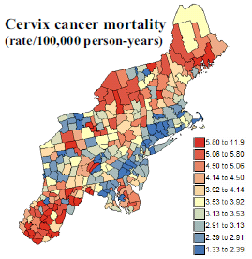
Mortality Statistics:
Age Adjusted Death Rate
A death rate that controls for the effects of differences in population age distributions
Necessary for comparing across geographic areas
Goovaerts, 2005
SOURCES: NAPHSIS; NVSS Deaths.
Notes:
See “Age-Adjusted Death Rate” handout for additional information (Appendix C in Participant Notes).
Notes: Age-adjusted death rate is a death rate that controls for the effects of differences in population or age distributions. When comparing across geographic areas, some method of age-adjusting is typically used to control for the influence that different population age distributions might have on health event rates.

Slide 96
Age-adjusted Death Rate:
Direct Age-Adjustment
Same as calculating weighted average
Applying age-specific death rates in observed pop. to standard pop. age distribution (weights)
Calculation:
  Need standard population weights
    Weight = # of persons in a given age group
      total # of persons in standard population (all ages combined)
  Calculate age-specific rate for each age group
  Multiply age-specific rate for each age group by weight
  Sum the products
SOURCES: NAPHSIS; NVSS Deaths; WHOSIS.
Notes:
Notes:
The weights are the proportions of persons in the corresponding age groups of the standard population.
A variety of standard populations can be used, but the WHO world standard population is recommended.

Slide 97
Exercise - Calculate:
Age-adjusted death rates
from diabetes mellitus
for State A and State B
using data from 2003-2005
Notes:
We’ll walk through the 4 steps to get the age-adjusted death rates for each state.

Slide 98
1. Standard Population Weight
Age Group | Weight | World Average (Proportion, %)
0 | 0.018 | 1.8
1-4 | 0.07 | 7.0
5-14 | 0.173 | 17.3
15-24 | 0.167 | 16.7
25-34 | 0.155 | 15.5
35-44 | 0.138 | 13.8
45-54 | 0.114 | 11.4
55-64 | 0.083 | 8.3
65-74 | 0.052 | 5.2
75-84 | 0.024 | 2.4
85+ | 0.006 | 0.6
All Ages | 1.00 | 100.0
WHO World Standard Population Distribution
World Average: 2000-2025
SOURCES: NAPHSIS; NVSS Deaths; WHOSIS.
Notes:
Notes: WHO World Standard Population available in Appendix D in Participant Notes.
When comparing rates within a country, the country level age distribution can be used if it is accurate and reliable. If a country’s age distribution is not accurate and reliable, or if international comparisons are to be made, the WHO World Standard should be used.
The WHO World Standard Population was based on the average world population structure for the period 2000-2025 as assessed every two years by the United Nations Population Division (UNPD) for each country by age and sex. Estimates from the UNDP 1998 assessment (being the latest one at the time the WHO Standard Population was chosen) based on population censuses and other demographic sources, adjusted for enumeration errors were used. The use of an average world population as well as a time series of observations removes the effects of historical events such as wars and famine on population age composition. WHO Standard Population is defined to reflect the average age structure of the world's population over the next generation, from the year 2000 to 2025.
Data sources: Death registration data for 112 WHO Member States, sample registration systems (India, China), available data on child and adult mortality from censuses and surveys, together with population-based epidemiological studies, disease registers and notifications systems for the estimation of mortality for 21 specific causes of death.
Note that you can combine age groups by summing the weights for groups to combine; e.g. the weight for 0-4 would be 0.018+0.07=0.025.

Slide 99
2. Calculate age-specific rate for each age group

Slide 100
  Rate for Diabetes Mellitus, 2003-2005
 | STATE A |  |  |  |  |  | STATE B
Age Group (years) | # of Deaths |  | Population Counts |  | Age-Specific Rate |  | # of Deaths |  | Population Counts |  | Age-Specific Rate
Under 1 | 0 |  | 84,952 |  |  |  | 0 |  | 350
1-4 | 0 |  | 325,508 |  |  |  | 0 |  | 1,266
5-14 | 2 |  | 828,663 |  |  |  | 0 |  | 4,384
15-24 | 2 |  | 893,809 |  |  |  | 0 |  | 4,526
25-34 | 19 |  | 718,484 |  |  |  | 0 |  | 2,977
35-44 | 61 |  | 810,632 |  |  |  | 1 |  | 4,269
45-54 | 160 |  | 833,948 |  |  |  | 0 |  | 5,581
55-64 | 297 |  | 602,768 |  |  |  | 1 |  | 5,985
65-74 | 443 |  | 381,451 |  |  |  | 11 |  | 5,946
75-84 | 546 |  | 235,030 |  |  |  | 6 |  | 4,086
85 + | 369 |  | 82,660 |  |  |  | 3 |  | 1,584
All Ages | 1,899 |  | 5,797,906 |  |  |  | 22 |  | 40,952
Notes:
Here, we are given the number of deaths from diabetes mellitus and the population counts (for 3 years, 2003-2005) for State A and State B.
How do we calculate the Age-specific death rate from diabetes mellitus?

Slide 101
Death Rate for Diabetes Mellitus, 2003-2005
 | STATE A |  |  |  |  |  | STATE B
Age Group (years) | # of Deaths |  | Population Counts |  | Age-Specific Rate |  | # of Deaths |  | Population Counts |  | Age-Specific Rate
Under 1 | 0 | / | 84,952 | = | 0 |  | 0 |  | 350
1-4 | 0 |  | 325,508 |  |  |  | 0 |  | 1,266
5-14 | 2 |  | 828,663 |  |  |  | 0 |  | 4,384
15-24 | 2 |  | 893,809 |  |  |  | 0 |  | 4,526
25-34 | 19 |  | 718,484 |  |  |  | 0 |  | 2,977
35-44 | 61 |  | 810,632 |  |  |  | 1 |  | 4,269
45-54 | 160 |  | 833,948 |  |  |  | 0 |  | 5,581
55-64 | 297 |  | 602,768 |  |  |  | 1 |  | 5,985
65-74 | 443 |  | 381,451 |  |  |  | 11 |  | 5,946
75-84 | 546 |  | 235,030 |  |  |  | 6 |  | 4,086
85 + | 369 |  | 82,660 |  |  |  | 3 |  | 1,584
All Ages | 1,899 |  | 5,797,906 |  |  |  | 22 |  | 40,952
Notes:
You divide the number of deaths (0) by the population count (84,952). For the Under 1 year age group, the age-specific death rate for diabetes mellitus is 0.
(Use the worksheet provided (included in “Activity Materials” section of Participant Notes). Divide class into two groups. Have group 1 calculate the remaining rates for State A and group 2 calculate the remaining rates for State B. Answers on next slide).
(all rates are per 100,000 persons)

Slide 102
Death Rate for Diabetes Mellitus, 2003-2005
 | STATE A |  |  |  |  |  | STATE B
Age Group (years) | # of Deaths |  | Population Counts |  | Age-Specific Rate |  | # of Deaths |  | Population Counts |  | Age-Specific Rate
Under 1 | 0 | / | 84,952 | = | 0 |  | 0 | / | 350 | = | 0
1-4 | 0 | / | 325,508 | = | 0 |  | 0 | / | 1,266 | = | 0
5-14 | 2 | / | 828,663 | = | 0.24 |  | 0 | / | 4,384 | = | 0
15-24 | 2 | / | 893,809 | = | 0.22 |  | 0 | / | 4,526 | = | 0
25-34 | 19 | / | 718,484 | = | 2.64 |  | 0 | / | 2,977 | = | 0
35-44 | 61 | / | 810,632 | = | 7.52 |  | 1 | / | 4,269 | = | 23.43
45-54 | 160 | / | 833,948 | = | 19.19 |  | 0 | / | 5,581 | = | 0
55-64 | 297 | / | 602,768 | = | 49.27 |  | 1 | / | 5,985 | = | 16.71
65-74 | 443 | / | 381,451 | = | 116.14 |  | 11 | / | 5,946 | = | 185.01
75-84 | 546 | / | 235,030 | = | 232.31 |  | 6 | / | 4,086 | = | 146.85
85 + | 369 | / | 82,660 | = | 446.41 |  | 3 | / | 1,584 | = | 189.45
All Ages | 1,899 | / | 5,797,906 | = | 32.75 |  | 22 | / | 40,952 | = | 53.72
Notes:
[Remove solution slide from student version].
These are crude death rates for diabetes mellitus. Note the rates for all ages: which State has a higher rate? (State B)
Now we’ll see what happens when we adjust for age.
(all rates are per 100,000 persons)

Slide 103
  3. Multiply age-specific rate for each age group by weight

Slide 104
Death Rate for Diabetes Mellitus, 2003-2005
 | STATE A |  |  |  |  |  | STATE B
Age Group (years) | Age-Specific Rate |  | WHO Standard Pop Weight |  | Age Adjusted Rate |  | Age-Specific Rate |  | WHO Standard Pop Weight |  | Age Adjusted Rate
Under 1 | 0 | X | 0.018 | = | 0 |  | 0 |  | 0.018
1-4 | 0 |  | 0.07 |  |  |  | 0 |  | 0.07
5-14 | 0.24 |  | 0.173 |  |  |  | 0 |  | 0.173
15-24 | 0.22 |  | 0.167 |  |  |  | 0 |  | 0.167
25-34 | 2.64 |  | 0.155 |  |  |  | 0 |  | 0.155
35-44 | 7.52 |  | 0.138 |  |  |  | 23.43 |  | 0.138
45-54 | 19.19 |  | 0.114 |  |  |  | 0 |  | 0.114
55-64 | 49.27 |  | 0.083 |  |  |  | 16.71 |  | 0.083
65-74 | 116.14 |  | 0.052 |  |  |  | 185.01 |  | 0.052
75-84 | 232.31 |  | 0.024 |  |  |  | 146.85 |  | 0.024
85 + | 446.41 |  | 0.006 |  |  |  | 189.45 |  | 0.006
Notes:
Now we take the age-specific rates for each age group that we just calculated (second column from the left), and we multiply them by our WHO Standard Population Weight (third column from the left). For the Under 1 age group in State A, we take 0 times 0.018, which equals 0.
Note: we don’t calculate the cross products for the “all ages” category.
(Use worksheet provided (section B). Divide class into two groups. Have group 1 calculate the remaining rates for State A and group 2 calculate the rates for State B. Answers on next slide).
(all rates are per 100,000 persons)

Slide 105
Death Rate for Diabetes Mellitus, 2003-2005
 | STATE A |  |  |  |  |  | STATE B
Age Group (years) | Age-Specific Rate |  | WHO Standard Pop Weight |  | Age Adjusted Rate |  | Age-Specific Rate |  | WHO Standard Pop Weight |  | Age Adjusted Rate
Under 1 | 0 | X | 0.018 | = | 0 |  | 0 | X | 0.018 | = | 0
1-4 | 0 | X | 0.07 | = | 0 |  | 0 | X | 0.07 | = | 0
5-14 | 0.24 | X | 0.173 | = | 0.042 |  | 0 | X | 0.173 | = | 0
15-24 | 0.22 | X | 0.167 | = | 0.037 |  | 0 | X | 0.167 | = | 0
25-34 | 2.64 | X | 0.155 | = | 0.409 |  | 0 | X | 0.155 | = | 0
35-44 | 7.52 | X | 0.138 | = | 1.038 |  | 23.43 | X | 0.138 | = | 3.233
45-54 | 19.19 | X | 0.114 | = | 2.188 |  | 0 | X | 0.114 | = | 0
55-64 | 49.27 | X | 0.083 | = | 4.089 |  | 16.71 | X | 0.083 | = | 1.387
65-74 | 116.14 | X | 0.052 | = | 6.039 |  | 185.01 | X | 0.052 | = | 9.621
75-84 | 232.31 | X | 0.024 | = | 5.575 |  | 146.85 | X | 0.024 | = | 3.524
85 + | 446.41 | X | 0.006 | = | 2.678 |  | 189.45 | X | 0.006 | = | 1.137
Notes:
[Remove solution slide from student version].
These are the age-specific age-adjusted death rates for diabetes mellitus in State A and State B.
(all rates are per 100,000 persons)

Slide 106
4. Sum the products

Slide 107
Death Rate for Diabetes Mellitus, 2003-2005
 | STATE A |  |  |  |  |  | STATE B
Age Group (years) | Age-Specific Rate |  | WHO Standard Pop Weight |  | Age Adjusted Rate |  | Age-Specific Rate |  | WHO Standard Pop Weight |  | Age Adjusted Rate
Under 1 | 0 | X | 0.018 | = | 0 |  | 0 | X | 0.018 | = | 0
1-4 | 0 | X | 0.07 | = | 0 |  | 0 | X | 0.07 | = | 0
5-14 | 0.24 | X | 0.173 | = | 0.042 |  | 0 | X | 0.173 | = | 0
15-24 | 0.22 | X | 0.167 | = | 0.037 |  | 0 | X | 0.167 | = | 0
25-34 | 2.64 | X | 0.155 | = | 0.409 |  | 0 | X | 0.155 | = | 0
35-44 | 7.52 | X | 0.138 | = | 1.038 |  | 23.43 | X | 0.138 | = | 3.233
45-54 | 19.19 | X | 0.114 | = | 2.188 |  | 0 | X | 0.114 | = | 0
55-64 | 49.27 | X | 0.083 | = | 4.089 |  | 16.71 | X | 0.083 | = | 1.387
65-74 | 116.14 | X | 0.052 | = | 6.039 |  | 185.01 | X | 0.052 | = | 9.621
75-84 | 232.31 | X | 0.024 | = | 5.575 |  | 146.85 | X | 0.024 | = | 3.524
85 + | 446.41 | X | 0.006 | = | 2.678 |  | 189.45 | X | 0.006 | = | 1.137
All Ages |  |  |  |  | 22.095 |  |  |  |  |  | 18.902
Notes:
[Remove solution slide from student version].
We sum all of the age-adjusted rates for each state, and we have the age-adjusted death rate for diabetes mellitus for all ages in State A and State B. Which state is higher after age-adjusting? (State A)
(all rates are per 100,000 persons)

Slide 108
Death Rate for Diabetes Mellitus, 2003-2005
 | STATE A |  |  |  |  |  | STATE B
Age Group (years) | Age-Specific Rate |  | WHO Standard Pop Weight |  | Age Adjusted Rate |  | Age-Specific Rate |  | WHO Standard Pop Weight |  | Age Adjusted Rate
Under 1 | 0 | X | 0.018 | = | 0 |  | 0 | X | 0.018 | = | 0
1-4 | 0 | X | 0.07 | = | 0 |  | 0 | X | 0.07 | = | 0
5-14 | 0.24 | X | 0.173 | = | 0.042 |  | 0 | X | 0.173 | = | 0
15-24 | 0.22 | X | 0.167 | = | 0.037 |  | 0 | X | 0.167 | = | 0
25-34 | 2.64 | X | 0.155 | = | 0.409 |  | 0 | X | 0.155 | = | 0
35-44 | 7.52 | X | 0.138 | = | 1.038 |  | 23.43 | X | 0.138 | = | 3.233
45-54 | 19.19 | X | 0.114 | = | 2.188 |  | 0 | X | 0.114 | = | 0
55-64 | 49.27 | X | 0.083 | = | 4.089 |  | 16.71 | X | 0.083 | = | 1.387
65-74 | 116.14 | X | 0.052 | = | 6.039 |  | 185.01 | X | 0.052 | = | 9.621
75-84 | 232.31 | X | 0.024 | = | 5.575 |  | 146.85 | X | 0.024 | = | 3.524
85 + | 446.41 | X | 0.006 | = | 2.678 |  | 189.45 | X | 0.006 | = | 1.137
All Ages |  |  |  |  | 22.095 |  |  |  |  |  | 18.902
Crude Rates |  |  |  |  | 32.75 |  |  |  |  |  | 53.72
Notes:
How do the age-adjusted rates compare to the crude rates? (State B has a higher crude rate, but State A has a higher age-adjusted rate).
Which rate should we use? (age adjusted, when comparing rates for one area to another)
(all rates are per 100,000 persons)

Slide 109
Review: Direct Age-Adjustment
  Need standard population weights
  Calculate age-specific rate for each age group
  Multiply age-specific rate for each age group by weight
  Sum the products

Slide 110
Standardized Mortality Ratio
(Indirect Age-adjusted Death Rate)
To compare the death rates of a study population with those of a standard population
Averages specific rates in a standard population, weighted by the age distribution of the study population
  Need:
    Age-specific death rates for a standard population
    Age distribution of study population
Useful when age-specific # of deaths in the study population are unavailable or small (< 25)
SOURCES: NAPHSIS; NVSS Deaths.
Notes:
Notes:
Standardized mortality ratio is the most common way of presenting the results of indirect age-adjustment of a death rate.
Indirect adjustment averages the specific rates in the standard population, weighted by the distribution of the study population. Indirect adjustment is used less frequently than direct adjustment, but is useful when age-specific numbers of deaths in the study population are either unavailable or small in number (less than 25 events across all age groups).

Slide 111
Calculating a
Standardized Mortality Ratio
Calculate # of expected deaths in population:
Σ (Standard age-specific death rate) X (Study age-specific pop weight)
Calculate the standardized mortality ratio
# observed deaths in population X 100
# expected deaths (step 1)
Notes:
Your standard age-specific death rate may come from a national level (to apply to a regional level calculation), from a regional level (to apply to a local level calculation), or from a neighboring country.
Remember that the age-specific population weight for the study population is just the age-distribution.

Slide 112
Exercise - Calculate:
Standardized Mortality Ratio (SMR)
for District A
using 2004 National death rates
as the standard for comparison
59,153 deaths were observed in District A in 2004
Notes:
We’ll walk through the 2 steps to get the indirect age-adjusted death rate, or standardized mortality ratio.

Slide 113
1. Calculate # of expected deaths in population
Σ (Standard age-specific death rate) X (Study age-specific pop weight)

Slide 114
Example of Calculating Expected Deaths in a Population
Age Group | National (Standard) Population Death Rate per 100,000 |  | District A Population (#) |  |  | Expected Deaths (rounded)
0 | 5.3 |  | 154,585
1-4 | 25.6 |  | 607,984
5-14 | 14.1 |  | 1,585,503
15-24 | 69.2 |  | 1,440,136
25-34 | 83.6 |  | 1,528,427
35-44 | 156.5 |  | 1,616,982
45-54 | 373.2 |  | 1,337,298
55-64 | 770.5 |  | 872,216
65-74 | 1,822.1 |  | 527,629
75-84 | 4,626.5 |  | 365,602
85+ | 11,873.4 |  | 138,471
All Ages
Notes:
Here, we are given the national population death rate per 100,000 persons. We are also given the age distribution for the population of District A. How do we calculate the expected number of deaths in District A, using the national death rate?

Slide 115
Example of Calculating Expected Deaths in a Population
Age Group | National (Standard) Population Death Rate per 100,000 |  | District A Population (#) |  |  | Expected Deaths (rounded)
0 | 5.3 | X | 154,585 | / 100,000 | = | 8
1-4 | 25.6 |  | 607,984
5-14 | 14.1 |  | 1,585,503
15-24 | 69.2 |  | 1,440,136
25-34 | 83.6 |  | 1,528,427
35-44 | 156.5 |  | 1,616,982
45-54 | 373.2 |  | 1,337,298
55-64 | 770.5 |  | 872,216
65-74 | 1,822.1 |  | 527,629
75-84 | 4,626.5 |  | 365,602
85+ | 11,873.4 |  | 138,471
All Ages
Notes:
We multiply the national death rate for each age category by the population in District A. Since our national death rate is “per 100,000”, we have to also divide by 100,000.
For our “0” age group, we take 5.3 times the “0” population in District A, 154,585, and divide by 100,000. This gives us 8.19…. We round this to 8. Using the national population death rate for the “0” age group, we can expect 8 deaths for the “0” age group in District A.
[Have the class calculate the remaining age categories, using worksheet provided (included in “Activity Materials” section of Participant Notes). Answers on next slide.]

Slide 116
Example of Calculating Expected Deaths in a Population
Age Group | National (Standard) Population Death Rate per 100,000 |  | District A Population (#) |  |  | Expected Deaths (rounded)
0 | 5.3 | X | 154,585 | / 100,000 | = | 8
1-4 | 25.6 | X | 607,984 | / 100,000 | = | 156
5-14 | 14.1 | X | 1,585,503 | / 100,000 | = | 224
15-24 | 69.2 | X | 1,440,136 | / 100,000 | = | 997
25-34 | 83.6 | X | 1,528,427 | / 100,000 | = | 1,278
35-44 | 156.5 | X | 1,616,982 | / 100,000 | = | 2,531
45-54 | 373.2 | X | 1,337,298 | / 100,000 | = | 4,991
55-64 | 770.5 | X | 872,216 | / 100,000 | = | 6,720
65-74 | 1,822.1 | X | 527,629 | / 100,000 | = | 9,614
75-84 | 4,626.5 | X | 365,602 | / 100,000 | = | 16,915
85+ | 11,873.4 | X | 138,471 | / 100,000 | = | 16,441
All Ages
Notes:
(Remove solution slide from student version).
Now, to complete step one, we need to sum the expected deaths. (Have the class sum the numbers; answer on next slide).

Slide 117
Example of Calculating Expected Deaths in a Population
Age Group | National (Standard) Population Death Rate per 100,000 |  | District A Population (#) |  |  | Expected Deaths (rounded)
0 | 5.3 | X | 154,585 | / 100,000 | = | 8
1-4 | 25.6 | X | 607,984 | / 100,000 | = | 156
5-14 | 14.1 | X | 1,585,503 | / 100,000 | = | 224
15-24 | 69.2 | X | 1,440,136 | / 100,000 | = | 997
25-34 | 83.6 | X | 1,528,427 | / 100,000 | = | 1,278
35-44 | 156.5 | X | 1,616,982 | / 100,000 | = | 2,531
45-54 | 373.2 | X | 1,337,298 | / 100,000 | = | 4,991
55-64 | 770.5 | X | 872,216 | / 100,000 | = | 6,720
65-74 | 1,822.1 | X | 527,629 | / 100,000 | = | 9,614
75-84 | 4,626.5 | X | 365,602 | / 100,000 | = | 16,915
85+ | 11,873.4 | X | 138,471 | / 100,000 | = | 16,441
All Ages |  |  |  |  |  | 59,875
Notes:
(Remove solution slide from student version).

Slide 118
2. Calculate the standardized mortality ratio
# observed deaths in population X 100
# expected deaths (step 1)
------ observed deaths (given) X 100 = ____
------ expected deaths (step 1)
SMR = _____ deaths per 100,000

Slide 119
2. Calculate the standardized mortality ratio
# observed deaths in population X 100
# expected deaths (step 1)
59,153 observed deaths (given) X 100 = 98.8
59,875 expected deaths (step 1)
SMR = 98.8 deaths per 100,000
Notes:
(Remove solution slide from student version).

Slide 120
How to interpret an SMR
Comparing deaths in study population (District A) to what would be expected if the study population had the same probability of dying as the standard population (National)
SMR > 100.0
# of observed deaths is greater than what would be expected
SMR < 100.0
# of observed deaths is less than what would be expected
Notes:
A SMR of above 100 means the number of observed deaths is greater than what would be expected if the study population had the same probability of dying as the standard population, while a SMR of below 100 means the number of observed deaths is less than expected.

Slide 121
Review: Age Adjusting
Why we adjust
Direct age adjustment
  Uses standard population age distributions
Indirect age adjustment
  Uses standard population age-specific death rate

Slide 122
Mortality Statistics
What types of mortality statistics are produced/used in your country?

Slide 123
Cause of Death Tabulations
Cause of death lists are basis for:
  Leading causes of death
  National cause of death tabulations
WHO death tables by country as a resource:
  http://www.who.int/healthinfo/statistics/mortality/en/index.html
Each country should develop national cause of death tabulation list to meet specific needs
SOURCES: WHO Health Statistics and Health Information Systems, Mortality Data: http://www.who.int/healthinfo/statistics/mortality/en/index.html
Notes:
Notes: Cause of death lists are the basis for leading causes of death and for national cause of death tabulations. The WHO publishes mortality data and cause of death lists for each country (see web link above). These data are a good reference for countries, but ideally, each country should develop a national cause of death tabulation list that meets their specific needs.

Slide 124
Cause-Specific Mortality Tabulations
ICD Recommendations
Coding – various levels of detail available (diagnosis, location of event, contributing conditions, etc.)
Age classifications (vary by indicator)
< 1 yr | < 1 yr | ,< 1 y<< 1 yr
1 yr | 1-4 yrs | 1-14 yrs
2 yrs | 5-14 yrs | 15-44 yrs
3 yrs | 15-24 yrs | 45-64 yrs
4 yrs | 25-34 yrs | > 65 yrs
5-yr groups from 5-84 yrs | 35-44 yrs
> 85 yrs | 45-54 yrs
 | 55-64 yrs
 | 65-74 yrs
 | > 75 yrs
SOURCES: WHO ICD-10, Volume 2, Chapter 5; NCHS, Unit 17.
Notes:
Notes:
The ICD provides recommendations on producing mortality tabulations. The following slides outline these recommendations.
If age groupings are published in greater detail than is suggested by WHO, it is recommended that they be arranged as to allow condensation into the groupings specified by WHO.
The age classifications presented in the middle column is the preferred classification.

Slide 125
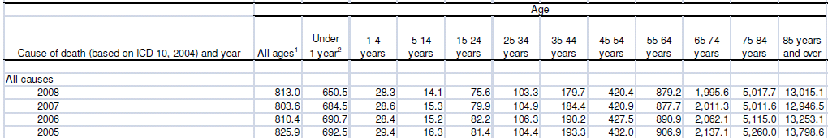
Recommended
Age Classifications
SOURCES: NVSS Deaths, p 77.
Notes:
Notes: example of preferred age classifications.

Slide 126
Cause-Specific
Mortality Tabulations
ICD Recommendations (continued):
Area classifications
  Major civil division (state, province, region, country, etc.)
  Town or conurbation of ≥ 1 million, otherwise largest town with population ≥ 100,000
  National aggregate of urban areas (≥ 100,000 population)
  National aggregate of urban areas (< 100,000 population)
  National aggregate of rural areas
* Include definitions of urban and rural
* Where medical certification of COD is limited to certain areas, separate figures for deaths not medically certified
SOURCES: WHO ICD-10, Volume 2, Chapter 5.
Notes:
Notes:
Also can tabulate by race, gender.

Slide 127
Cause-Specific
Mortality Tabulations
ICD Tabulation Lists:
Lists of causes of mortality
Adopted by World Health Assembly in 1990
4 lists:
  General mortality, condensed list (103 causes)
  General mortality, selected list (80 causes)
  Infant & child mortality, condensed list (67 causes)
  Infant & child mortality, selected list (51 causes)
SOURCES: WHO ICD-10, Volume 1, p 1205-20, Volume 2, Chapter 5.
Notes:
[Example: Statistics South Africa, Mortality and causes of death in South Africa, 2008 Report, Appendix J; Also, Jordan Mortality Report 2005, Tables 4.1-5.3, pp. 9-20, and Table 8.1-3, pp. 25-27 – Distribute example for students to view]
Discuss: what causes should be on the list for the students’ country? Emphasize that it is important to customize the cause of death lists for each country.

Slide 128
Cause-Specific
Mortality Tabulations
ICD Tabulation Lists (continued):
  Which list to use?
  Condensed: Condense full range of ICD (3 character) categories
  Selected: Items significant for monitoring population health status at sub-national, national, and international levels
  Customize for local use (if no international comparison)
SOURCES: WHO ICD-10, Volume 1, p 1205-20, Volume 2, Chapter 5.
Notes:
[Example: Statistics South Africa, Mortality and causes of death in South Africa, 2008 Report, Appendix J
Discuss: what causes should be on the list for the students’ country?

Slide 129
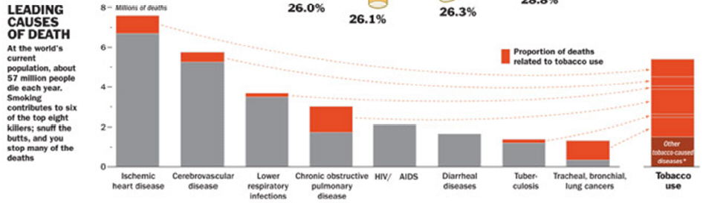
Mortality Statistics:
Tabulations & Figures
Uses:
To identify population group with highest number/percentage of deaths
To rank causes of death, by main groups & underlying cause
Time Inc., 2012
Notes:
[Activity: review tables and discuss usefulness of/points conveyed by information]
[The following slides provide some examples of mortality statistics tabulations- they are for student reference, not a prescribed set of tables/figures that must be memorized. Detailed instructions are not provided for graph/figure types that have already been discussed, e.g. line and bar graphs. Use local data whenever possible. Have students interprets tables/figures and discuss patterns observed].

Slide 130
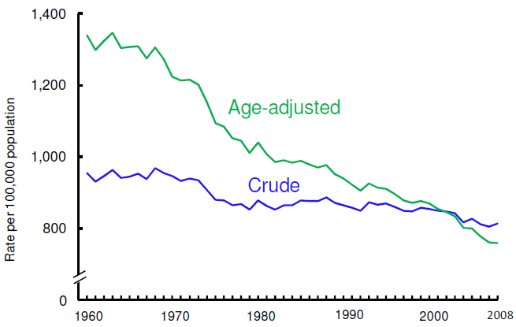
Crude and Age-adjusted Death Rates
SOURCES: NVSS Deaths, p 9.
Notes:
Notes: [use local data if possible] Here is an example of how to graph crude versus age-adjusted death rates over time.
-Line graph
-Rate per 100,000 population
-Change over time
-Note differences in rates.
Remember: Crude death rate is not appropriate for comparison of different populations or areas due to the significant impact of age in mortality data and different age-distributions in different populations. Age-adjusted mortality rates should be used for comparative analysis.

Slide 131
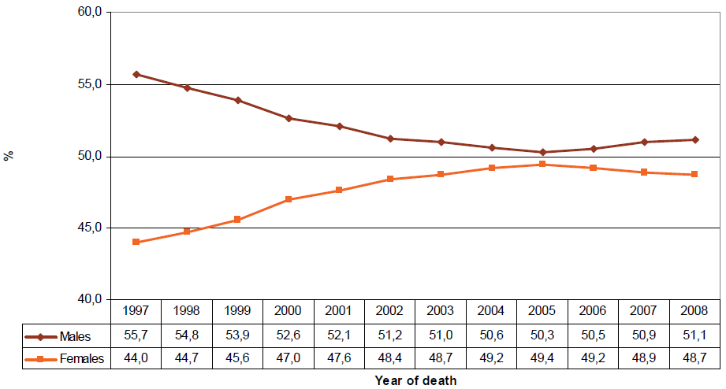
% Distribution of Deaths by Sex and Year of Death
SOURCES: Statistics SA, p 14.
Notes:
Notes: This is a graph from Statistics South Africa, showing trends in % distribution of deaths by sex. Looking at vital statistics data in this manner can provide information on sex differentials in death over time. (Discuss patterns/differences).

Slide 132
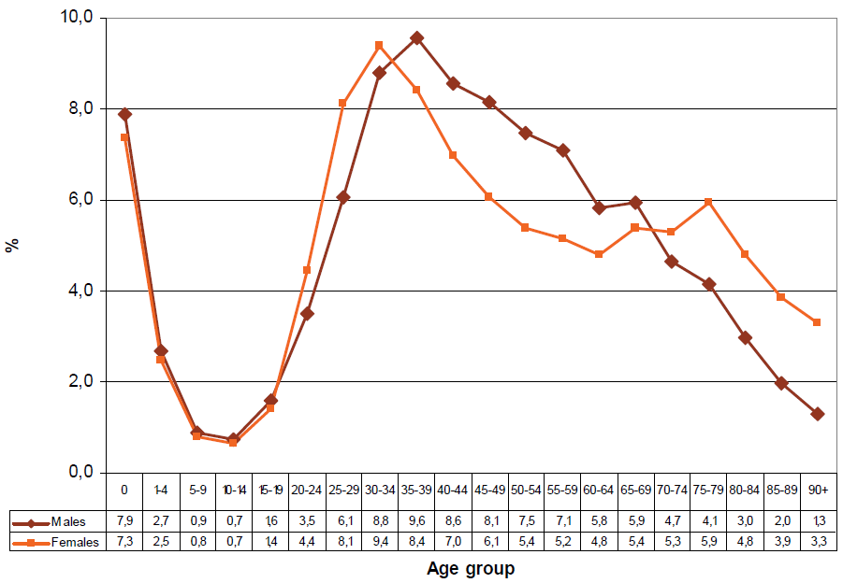
% Distribution of Deaths by Age and Sex, 2008
SOURCES: Statistics SA, p 16.
Notes:
Notes: Similarly, you can graph % distribution of deaths by sex and by age for a single year to examine age and sex differentials (discuss patterns/differences).

Slide 133
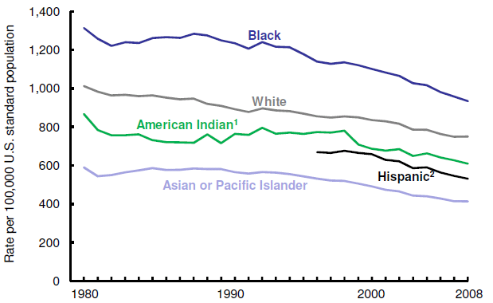
Age-adjusted Death Rates by Sub-population
SOURCES: NVSS Deaths, p 10.
Notes:
Notes: [use local data if possible]
-Here’s an example of comparing death rates (among the US population). Note we are using age-adjusted rates. You can stratify on whatever subgroup is of interest: by race, age, region, country of origin, gender, etc.

Slide 134
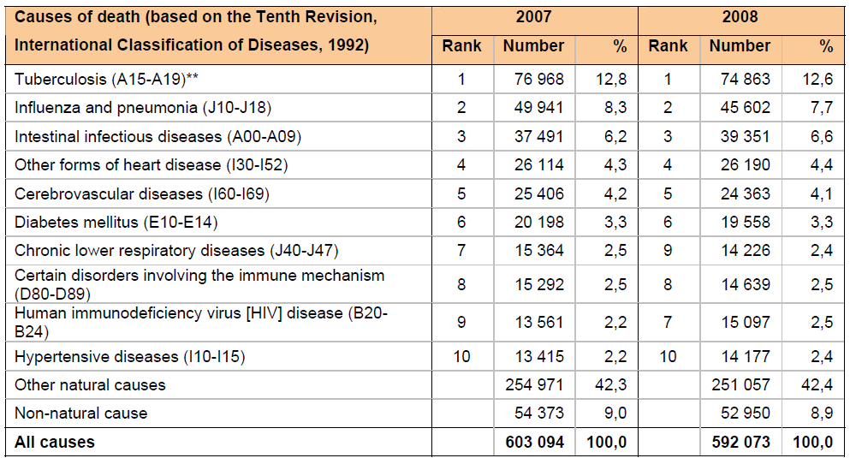
10 Leading Natural Causes of Death
SOURCES: Statistics SA, p 28.
Notes:
Notes: [use local data if possible]
-Tables for leading causes of death often include ranks to show overall patterns over time
-Can look at consistency in leading cause of death over time
-Can look at various stratifications (sex, age, within smaller age groups, by geographic area, by race, etc.)
-Note- unnatural causes of death are not included in this table

Slide 135
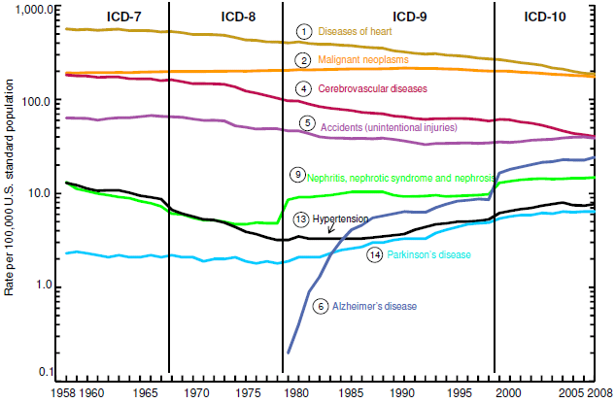
Age-adjusted Death Rates for Leading Causes of Death
SOURCES: NVSS Death, p 22.
Notes:
Notes:
-Log scale Y axis
-Note impact of ICD version; must consider such changes when looking at comparability

Slide 136
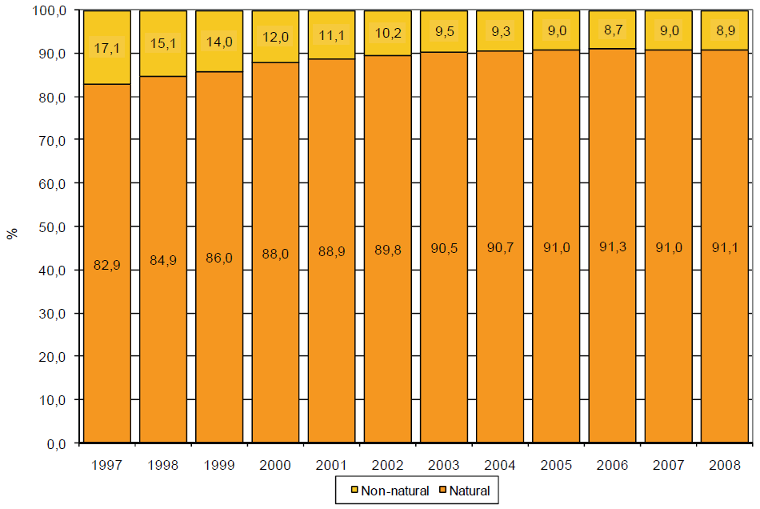
% Distribution of Natural & Non-natural
Causes of Death by Year of Death
SOURCES: Statistics SA, p 26.
Notes:
Notes: Here is a method for comparing natural and non-natural causes of death over time.
-Stacked bar graph; visual comparison

Slide 137
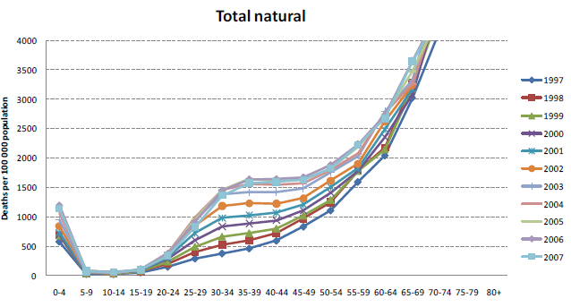
Exercise: Natural versus
External Causes of Death
SOURCES: MRC, p 9.
Notes:
It may be useful to compare natural versus external causes of death across ages. Look at this and the following graph and compare patterns in natural versus non-natural (external) deaths.

Slide 138
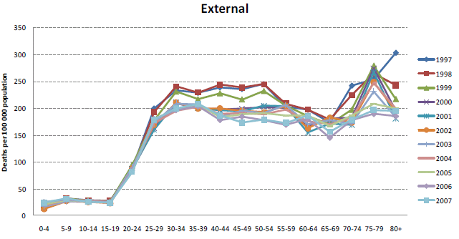
Exercise: Natural versus
External Causes of Death
SOURCES: MRC, p 9.

Slide 139
Exercise: Natural versus External Causes of Death
SOURCES: MRC, p 9.
Notes:
There is a clear difference in the age pattern of deaths due to natural versus external causes.

Slide 140
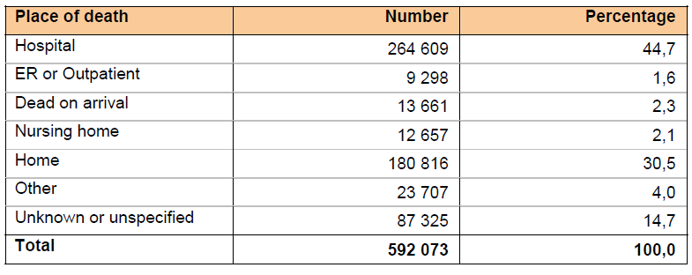
Distribution of Deaths by Place of Death
SOURCES: Statistics SA, p 20.
Notes:
Notes: To understand patterns in mortality, you can create a table that shows the number and percentage distribution of deaths by place of death.

Slide 141
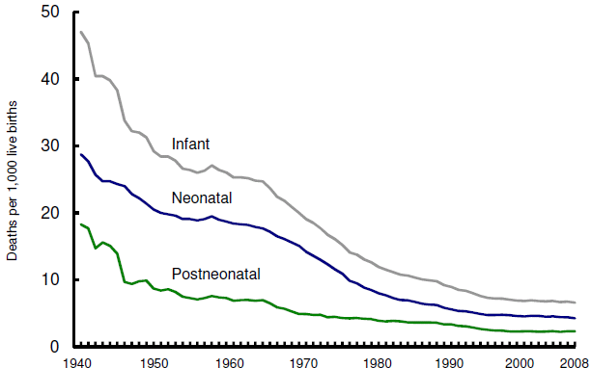
Infant, Neonatal, &
Postneonatal Mortality Rates
SOURCES: NVSS Deaths, p 26.
Notes:
Notes:
Deaths per 1,000 live births

Slide 142
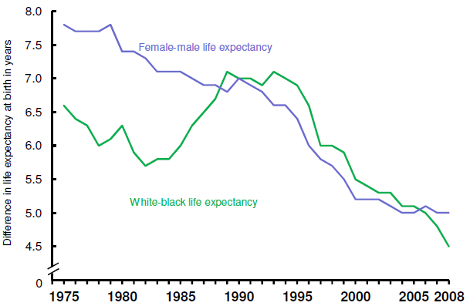
Life Expectancy Differential by Sex and Race
SOURCES: NVSS Deaths, p 14.
Notes:
Notes:
-Based on life table calculations;

Slide 143
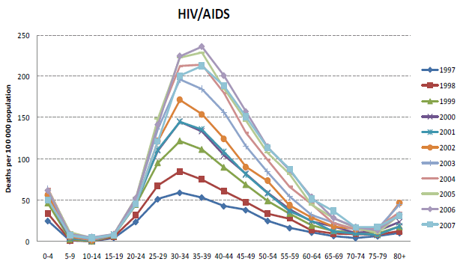
HIV Deaths by Age
SOURCES: MRC, p 11.
Notes:
Notes: Here is a graph of age-specific HIV/AIDS death rates over time. We see that over time, rates have increased dramatically between about 25 and 60 years of age. Overall trends show consistently (i.e. over time) lower rates among older age groups.

Slide 144
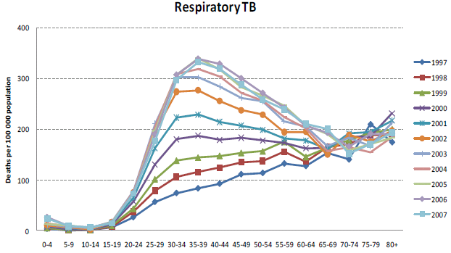
TB Deaths by Age
SOURCES: MRC, p 11.
Notes:
When we look at age-specific death rates for TB in the earlier years, rates steadily increase with age. However, in the later (i.e. more recent) years, rates among 25-60 year olds have dramatically increased and become higher than rates among older ages.

Slide 145
HIV & TB Deaths by Age
In more recent years, TB death patterns look more like HIV/AIDS death patterns
“TB deaths” are more likely deaths due to HIV/AIDS, complicated by TB
SOURCES: MRC, p 11.
Notes:
When we compare the two graphs of HIV/AIDS and TB, we see that what’s happened is that the TB graph has begun to look much more like the HIV/AIDS graph, suggesting HIV/AIDS’ likely role in TB deaths. Really, these are likely deaths due to HIV/AIDS, complicated by TB. These types of graphs provide an example of how graphs can be used to better interpret and understand disease patterns in a population.

Slide 146
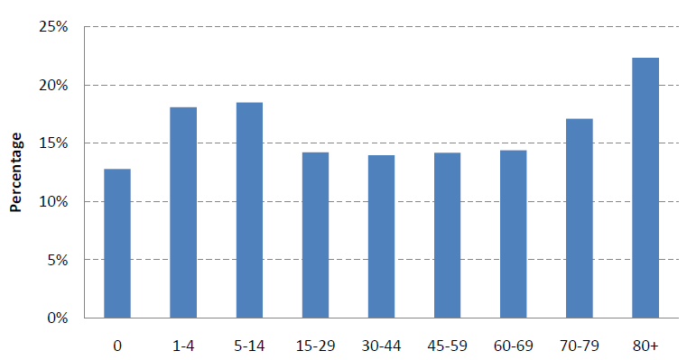
Natural Deaths Due to Ill-defined Causes
SOURCES: MRC, p 7.
Notes:
Notes: [Use local data if possible]
Ill-defined causes provide information on the quality of vital statistics data. Graphing the percentage of ill-defined causes can help identify problems. In this graph, from South Africa in 2007, over 20% of the natural deaths in the elderly (80+years old) were due to ill-defined causes, considerably higher than the national average of 15.2%. This could be a result of multiple conditions associated with old age, making it difficult to diagnose the underlying cause of death, or the deaths occurring out of hospital more frequently.

Slide 147
Analysis Points to Remember
Always specify rate/ratio denominator (e.g. live births)
Analysis of population subgroups must consider size of subgroup
  Use broader groups
    Disease classification
    Age categories
  Aggregate data over a longer period of time
SOURCES: WHO ICD-10, Volume 2, Chapter 5.

Slide 148
Analysis Points to Remember
Small area analysis
  Produce and use statistics in areas with good coverage
  Data more accurate than survey data
  Data used to show usefulness to government
Notes:
Notes:
Where good coverage is not possible for the entire country, it is recommended that countries begin to produce and use statistics in smaller areas with good registration coverage. These data are likely to be more accurate than data collected from sample surveys. The information reported in smaller areas can be used to demonstrate its usefulness to government officials, which will serve to gain support for improving civil registration and vital statistics systems.
Note: Caution must always be taken when analyzing data with small numbers.

Slide 149
Discuss
What would be reasonable goals for collection and compilation of vital statistics?
Notes:
[Country specific]
- Consider timeliness, denominator availability, availability of standard population information, statistical capacity, coverage of registration, and focus on accuracy

Slide 150

Matching/Linking Vital Records
Example: Matching a birth record with a corresponding death record
Purpose
  Statistical / Reporting
    Richer data set
    Outside users
  Administrative
    Improve quality of information
    Prevent fraud
SOURCES: PRVSS2, Chapter III.E.10-11; Freedman, p 5-6.
Notes:
Notes: Matching birth and death records is an important function of the vital registration and statistics operation. The initial matching is best done as part of the civil registration process and should be a routine practice in local registration offices. While it is desirable to attempt to find a matching birth record for all death records, resource constraints often limit the matching process to births and infant deaths.
The matching of birth and death records has several important uses. There are both statistical and administrative purposes for linking records within the registration system. The birth-infant death match helps to ensure the completeness of infant death registration and results in a file that has many important statistical uses. Matching and linking these two kinds of records yields information from the birth record (e.g. birth weight, gestational age, and other characteristics of mother and infant at birth) which can be combined with information from the death record (e.g. age at death, cause(s) of death). This combination of data provides a richer data set. Birth/death linkages can also be used to improve maternal death surveillance.
From an administrative perspective, the quality of the civil registration system may be improved from such linking by identifying unregistered births and finding inconsistencies in reporting of items which appear on both the live-birth and death records. Census information can be linked with death records to improve the reporting of certain variables.
Linking death records to birth records can also be used as a means of preventing fraudulent use of birth records. A person wishing to obtain a false identity might apply for a copy of the birth certificate of a person who died (typically infants) but who would now be about the same age and of the same sex as the fraudulent applicant, had the deceased person lived. To protect against this deceit, vital record offices link death records with corresponding birth records and mark the birth record as “deceased.”

Slide 151
Discuss
What are some non-statistical &
statistical uses of record linkage?
Notes:
Examples [where possible, update for local context]:
Voter registration with death records – update voter list
Social security and other benefit payments with death records – updated recipient list
Cancer registries with death records – cancer surveillance/outcomes
Hospital records with death records – maternal mortality surveillance, birth defects surveillance, etc.
Mark birth records when individual deceased to prevent fraud
Link infant deaths and/or maternal deaths with birth records to study infant and maternal health
Death records with benefit programs (e.g. Medicaid or Medicare in US) to study causes of death in specific population groups
Death records with persons previously employed at a specific company to study occupational diseases

Slide 152
Evaluating the
Quality of Information
Coverage
  Representativeness
  Delays in reporting
Accuracy & completeness
Sufficient detail to reveal relationships
Timeliness
  Availability of information
  Date of event versus date event was registered
Geographic reference
  Place of event versus place of usual residence
SOURCES: PRVSS2, Chapter II.H.3.
Notes:
This topic will be discussed in depth in the lecture on Assessing Vital Statistics.

Slide 153
Discuss
What leads to late registration?
What can be done to eliminate late registration?
Notes:
[Tailor to country/region when possible.]
Factors contributing to late registration:
System inefficiency: misplaced requests, bottlenecks in forwarding requests
Lack of public awareness
Lack of incentives/laws requiring registration
Lack of convenience, presence of barriers (i.e.: the office is far away, restrictions on who can report)
What can be done:
Awareness campaigns
Laws supporting incentives to register

Slide 154
References
(Freedman) Freedman, MA. Improving Civil Registration and Vital Statistics. The World Bank. 2003.
(Kenya) Republic of Kenya. Annual Health Sector Statistics Report, 2008. Division of Health Management Information Systems. July 2009.
(MRC) Medical Research Council. Cause of death statistics for South Africa: Challenges and possibilities for improvement. Burden of Disease Research Unit. Nov 2010.
(NAPHSIS) National Association for Public Health Statistics and Information Systems. Statistical Measures and Definitions.
(NCHS) National Center for Health Statistics. Methods of Civil Registration: Modular Course of Instruction.
(NVSS Births) National Vital Statistics Reports. Births: Final Data for 2006. 57(7). 7 Jan 2009.
(NVSS Deaths) National Vital Statistics Reports. Deaths Final Data for 2008. 59(10) 7 Dec 2011.
(PRVSS2) UN. Principles and Recommendations for a Vital Statistics System, Revision 2. New York. 2001.
(Statistics SA) Statistics South Africa. Mortality and causes of death in South Africa, 2008: Findings from death notification. Statistical release P0309.3. Nov 2010.
(UN Handbook) UN. Handbook on Training in Civil Registration and Vital Statistics Systems. Studies in Methods, Series F, No. 84. UN: New York. 2002.
(WHO ICD-10) WHO. ICD-10, Tenth Revision, Volumes 1 and 2. 1993.
(WHOSIS) WHO Statistical Information Systems. Indicator definitions and metadata, 2008. Age-standardized mortality rates by cause.

Slide 155
Activity
In small groups, based on the data sheet handout, compute and interpret the following summary statistics and rates for (if using South Africa example, use data for 2009):
Discuss how the various defects in basic data would affect the computed statistics.
Crude birth rate | Neonatal mortality rate
Sex ratio at birth | Post-neonatal mort. rate
Percent of premature | Age-specific death rate
births | Age-adjusted death rate
Crude death rate | (using either direct or
Infant mortality rate | indirect method ― see
 | worksheet)
Notes:
This exercise is intended to provide further opportunities for the participants to familiarize themselves with the definitions of basic rates and their meanings and uses. Compile data listed below and provide as a handout. Adjust measures as necessary to fit data availability and desired complexity of the exercise.
Obtain the following data from the country where this course is taught or some neighboring countries:
Tabulations of live births by sex and other characteristics
Tabulations of deaths by age/sex and other characteristics
Tabulations of infant deaths by age at death (neonatal and post-neonatal)
Tabulations of fetal deaths
Mid-year population by age/sex
Can reference Population Reference Bureau for data: http://www.prb.org/Publications/Datasheets/2011/world-population-data-sheet/data-sheet.aspx
[An example exercise using data from South Africa is available for reference or use if data from the participants’ country(ies) is not available. An instructor’s guide for this activity is included in the Course Instructor’s Guide. Participant handouts using the South Africa example are included in the ‘Activity Materials’ section in the Participant Notes].

Slide 156
Activity
In small groups, draft statistical “dummy” tables that you would publish in an annual CRVS report for your country.
  Consider the number/type of categories or groups to be used in the tables
  Consider the types of measures you would present
Share with the class.
Notes:
See report examples; consider relevant subcategories for local context; consider data availability.
For exercise- have groups put their tables on flipchart paper, using markers.
Notes on small cell size:
Need to consider potential breaches of confidentiality that may occur with small cell size.
Also need to consider statistical reliability of cells with small numbers

Slide 157
Activity
Select subgroups & label categories
Label headings
 |  |  |  | TOTAL
TOTAL
Make sure all column and row totals are summed correctly

Slide 158
Overall Review
  Vital statistics (can / cannot) be used for planning human development.
  Vital statistics are (one of many / the only) nationally representative source(s) of mortality by cause of death.
  Useable statistics have (complex / simple) definitions.
  Useable statistics are (able / not able) to be adapted.
  Absolute counts (are / are not) comparable over time/geography.
Notes:
Vital statistics (can / cannot) be used for planning human development.
Vital statistics are (one of many / the only) nationally representative source(s) of mortality by cause of death.
Useable statistics have (complex / simple) definitions.
Useable statistics are (able / not able) to be adapted. (They are flexible)
Absolute counts (are / are not) comparable over time/geography.

Slide 159
Overall Review
  (Absolute / Relative) numbers must have denominator information.
  In a ratio, the numerator (does / does not) have to be part of denominator.
  Final tabulations should be calculated by date of (occurrence / registration) of the event.
  Final tabulations should be calculated by place of (usual residence / occurrence of event).
  Small area analysis data are (less / more) accurate than survey data.
Notes:
(Absolute / Relative) numbers must have denominator information.
In a ratio, the numerator (does / does not) have to be part of denominator.
Final tabulations should be calculated by date of (occurrence / registration) of the event.
Final tabulations should be calculated by place of (usual residence / occurrence of event).
10. Small area analysis data are (less / more) accurate than survey data.

