Slide 1
Civil Registration Systems

Slide 2
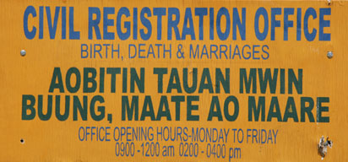
Outline
Characteristics
Structure
Process of Civil Registration
Registered Records Processing
Giacomo Pirozzi/Panos Pictures

Slide 3
Characteristics of Civil
Registration Systems
Legal framework
Full coverage of population
Continuous and permanent
Confidentiality of personal information
SOURCES: Handbook on Training in Civil Registration and Vital Statistics Systems, Series F, No. 84, United Nations, New York, 2002, Modules 2, 3 and 4 and Principles and Recommendations for a Vital Statistics System, Revision 2, United Nations, New York, 2001, Chapter III.
Notes:
Review UN definition or paraphrase.
“the continuous, permanent, compulsory and universal recording of the occurrence and characteristics of vital events pertaining to the population as provided through decree or regulation in accordance with the legal requirements in each country.”
It is important for students to be aware of the civil registration system and laws and regulations for their country. The instructor should have a copy of the civil registration law for the country where the course is being taught for reference purposes.

Slide 4
Characteristics
Legal Framework
  Primary objective of civil registration
    Obtain legal documents required by law
  Legal requirements of ideal civil registration system
    Registration of all vital events
    Identify agency authorized to register vital events
    Specify time period for registration of records
    Penalties for failure to comply with law
    Compilation or publication of vital statistics
SOURCES: Handbook on Training in Civil Registration and Vital Statistics Systems, Series F, No. 84, United Nations, New York, 2002, Modules 2, 3 and 4 and Principles and Recommendations for a Vital Statistics System, Revision 2, United Nations, New York, 2001, Chapter III.
Notes:
Emphasize that Civil Registration is based on a legal framework.
The primary objective is to obtain the legal documents required by law in a country.
Civil Registration Law (in ideal situation):
Should contain requirement that records of all vital events be registered.
Should identify the organization or agency authorized to register vital events.
Should contain a specific time period in which records should be registered
– more on time period later in course.
Provide for penalties on officials or authorities who fail to comply with the law
– no method to enforce requirements of law if penalties are not included.
May contain requirement for compilation or publication of vital statistics
– this is not in civil registration laws for all countries.

Slide 5
Characteristics
Slide to give some specific legal requirements for the country in which the course is being taught or slides could contrast differences in countries if students are from different countries.

Slide 6
Characteristics
Full Coverage of Population
  Ideally should cover entire country
    Not always possible due to economic or cultural conditions
    May only cover certain states or provinces
  May not include all types of vital events
    Priority to births and deaths
SOURCES: Handbook on Training in Civil Registration and Vital Statistics Systems, Series F, No. 84, United Nations, New York, 2002, Module 2 and Principles and Recommendations for a Vital Statistics System, Revision 2, United Nations, New York, 2001, Chapter III.
Notes:
Civil registration should provide full coverage of the population in ideal situation.
Note that this is not always possible in all countries due to economic or cultural conditions.
In some countries, only certain states or provinces have requirements for full coverage of vital events.
Priority may be given to some types of vital events (usually births and deaths) if all vital events cannot be registered for the entire country.

Slide 7
Characteristics
Slide with coverage information for the country where course is being taught or contrast differences in countries.

Slide 8

Characteristics
Continuous and Permanent
  Vital records
    New records continually added
    Must be preserved
    Available when needed
SOURCES: Handbook on Training in Civil Registration and Vital Statistics Systems, Series F, No. 84, United Nations, New York, 2002, Module 1 and Principles and Recommendations for a Vital Statistics System, Revision 2, United Nations, New York, 2001, Chapter III.
Picture from WHO web site.
Notes:
Civil registration should be continuous and permanent.
New records of vital events must be continually added to the system preferably as the events occur.
Since vital records are used over a long period of time, they must be preserved.
Procedures must be established to ensure that records are maintained and available when needed for individual or administrative use in the future.

Slide 9
Characteristics
Confidentiality of Personal Information
  Some details on individuals may be very personal
  Individual information
    Ideally should be confidential
      May improve reporting
      May improve accuracy
    No restrictions in some countries
      Vital records open to public inspection
SOURCES: Handbook on Training in Civil Registration and Vital Statistics Systems, Series F, No. 84, United Nations, New York, 2002, Module 1 and Principles and Recommendations for a Vital Statistics System, Revision 2, United Nations, New York, 2001, Chapter III.
Notes:
Civil registration laws should provide for confidentiality of personal information and limit release of information from the records.
Vital records contain details on individuals some of which could be potentially embarrassing, sensitive, or very personal
– legitimacy status, cause of death.
Ideally safeguards should be available to protect confidentiality of individual information.
Confidentiality of personal information should lead to improved reporting and accuracy of the information on vital records.
However, in some countries vital records are not restricted and are open to public inspection.

Slide 10
Characteristics
Slide with information on legal requirements on confidentiality for the country where the course is being taught or contrast differences in countries.

Slide 11
Discuss
How might confidentiality be breached or cause problems with reporting?
What are some advantages and/or disadvantages to some of the legal requirements related to confidentiality in your country?
Notes:
If students are from different countries, they might discuss advantages and/or disadvantages to some of the legal requirements related to confidentiality in their countries.
Examples of ways to breach confidentiality are:
Individual records handled in ways that might allow unauthorized individuals to look at them
– left in the open where others can see them
– if forwarded to a central unit, not secured properly when sent
– copies of records released to individuals not authorized to have them
Information from individual records released to unauthorized individuals
– employees discussing information in public areas
– employees telling friends or family about specific cases
– computer files not protected
– government employees or researchers who are authorized to obtain information not keeping that information confidential
– too much detail provided in statistical tabulations
– too much detail on public use files for research

Slide 12
Review
Civil Registration
  Based on system of laws
  Primary objective to obtain legal documents required by law
  Should cover entire population of country
  Records should be registered as vital events occur
  Ideally, personal information on vital records should be kept confidential

Slide 13
Activity
In small groups, examine the civil registration laws for your country and compare those requirements with the ideal requirements for civil registration. In particular, does the law specify the following:
  What documents must be registered?
  An agency/organization designated to register vital events?
  A time period for registration?
  Penalties for not complying with the law?
  Requirements for publishing vital statistics?
  Registration requirements that apply to the entire country?
If the laws do not meet the ideal requirements for civil registration, what changes could be made in the existing laws to get closer to the ideal requirements for civil registration?
Notes:
It is important for students to be familiar with the main points in the civil registration laws for their country.
The answers to the questions will depend on the laws of the country. Students could get back together as a large group to compare their answers particularly to the last question about changes that could be made to make their laws more like the ideal requirements for civil registration.

Slide 14
Structure of Civil
Registration Systems
Legal Basis
Centralized/Decentralized
Single/Multiple Administrative Agency(ies)
Advantages/Disadvantages
Differences Between Countries

Slide 15
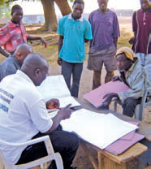
Structure
Legal Basis
  Authority for civil registration system
    Agency specified in law
    Registrar General or Director General
      Provides oversight of civil registration system
  Types of vital records
SOURCES: Handbook on Training in Civil Registration and Vital Statistics Systems, Series F, No. 84, United Nations, New York, 2002, Modules 3 and 4, and Principles and Recommendations for a Vital Statistics System, Revision 2, United Nations, New York, 2001, Chapter III. Picture from WHO web site.
Community volunteer gathering information in the Northern Region of Ghana. Kingsley Asare Addo/BDR.
Notes:
Civil Registration law should specify the agency where the central or national authority for the civil registration system will be located
-- in some countries the central authority may be located in a state or province (more covered in the next slides).
A Registrar General or Director General is generally appointed to provide oversight of the Civil Registration System
-- the general authority and duties of the Registrar General should be specified in the law.
Ideally the civil registration law should also specify:
the types of vital records that have to be reported and when and where they should be reported
the financial basis for the system
if information on vital records is confidential
who may obtain copies of the records or information on those records.

Slide 16
Structure
Legal Basis (continued)
  Method for funding
  Requirements for release of vital records
  Provision for vital statistics system
  Vital events registered at local office or registration unit
SOURCES: Handbook on Training in Civil Registration and Vital Statistics Systems, Series F, No. 84, United Nations, New York, 2002, Modules 3 and 4, and Principles and Recommendations for a Vital Statistics System, Revision 2, United Nations, New York, 2001, Chapter III.
Notes:
The civil registration law may also designate the agency for tabulating and compiling vital statistics which may or may not be the same agency responsible for civil registration.
Civil registration of vital events usually takes place at a local office or registration unit. Smaller secondary registration areas are sometimes established under the primary area to improve the registration process.

Slide 17
Structure
Legal Basis (continued)
  Local Registrar administers local office
    Ensures compliance with civil registration law
    Records information for vital events
    Ensures records are accurate and complete
    Informs public of procedures for registering records
    Completes statistical reports
    Preserves and stores vital records locally
    Issues certified copies of vital records
SOURCES: Handbook on Training in Civil Registration and Vital Statistics Systems, Series F, No. 84, United Nations, New York, 2002, Modules 3 and 4, and Principles and Recommendations for a Vital Statistics System, Revision 2, United Nations, New York, 2001, Chapter III.
Notes:
A Local Registrar is appointed to administer the local office.
Civil registration law usually has provisions for appointment of Local Registrars and establishes their duties and responsibilities.
The local registrar is usually a full time position with responsibility over a primary registration area.
Usually duties of the Local Registrar include:
Ensures compliance with the civil registration law
Records specific information for vital events
-- in many countries the informant goes to the local registration office to provide information about a vital event to the local registrar
Ensures records are accurate and complete
-- the local registrar is usually responsible for following up on questionable or problem items on a vital record (more will be covered on this later under querying)
Informs the public of procedures for registering vital records
In some countries, completes statistical reports and forwards to the statistical agency for compilation in national data
Preserves and stores vital records locally
Issues certified copies of vital records
Note that the last 3 duties listed are not always done in local offices. They may be done only at the national level or at a regional level depending on the laws of the jurisdiction where the vital records are filed.

Slide 18
Structure
Centralized
  Responsibility for civil registration at national government level
Decentralized
  Responsibility for civil registration at state or provincial level
SOURCES: Handbook on Training in Civil Registration and Vital Statistics Systems, Series F, No. 84, United Nations, New York, 2002, Modules 3 and 4, and Principles and Recommendations for a Vital Statistics System, Revision 2, United Nations, New York, 2001, Chapter III.
Notes:
Civil Registration can be centralized or decentralized depending on the country.
Whether the structure is centralized or decentralized, it is important for the civil registration law to specify where the responsibility for civil registration lies.

Slide 19
Structure
Single Agency
  Responsibility for civil registration and vital statistics functions in one agency
Multiple Agency
  Responsibility for civil registration and vital statistics functions in different agencies
SOURCES: Handbook on Training in Civil Registration and Vital Statistics Systems, Series F, No. 84, United Nations, New York, 2002, Module 3 and Principles and Recommendations for a Vital Statistics System, Revision 2, United Nations, New York, 2001, Chapter III.
Notes:
Civil Registration and Vital Statistics functions can be in the same agency or different agencies.
The civil registration law should specify the specific agency that has responsibility for civil registration and the one that has responsibility for vital statistics functions.
Any combination of these types of structures can be found.

Slide 20
Centralized National Level
Single Agency
National Agency
Civil Registration
Vital Statistics
Local Registration Office
Local Registration Office
SOURCES: Handbook on Training in Civil Registration and Vital Statistics Systems, Series F, No. 84, United Nations, New York, 2002, Module 3 and Annex I. C.
Notes:
One agency at the national level with responsibility for both civil registration and vital statistics data. Most countries have local registration offices under the national civil registration office where the vital records are initially filed.

Slide 21
Centralized National
Level Multiple Agency
National Agency A
National Agency B
Civil Registration Office
Vital Statistics Office
Local Registration Office
Local Registration Office
SOURCES: Handbook on Training in Civil Registration and Vital Statistics Systems, Series F, No. 84, United Nations, New York, 2002, Module 3 and Annex I. C.
Notes:
Civil registration and vital statistics are in different government agencies at the national level.

Slide 22
Decentralized Multiple
Agency Example
National Vital Statistics Office
Professional Advisory Committee
National Vital Statistics Office
Professional Advisory Committee
State/Province B
Vital Statistics
Office
State/Province B
Civil Registration Office
State/Province B
Vital Statistics
Office
State/Province A
Civil Registration Office
State/Province A
Vital Statistics
Office
State/Province B
Civil Registration Office
State/Province A
Civil Registration Office
State/Province A
Vital Statistics
Office
Local Registration Office
Local Registration Office
Local Registration Office
Local Registration Office
Local Registration Office
Local Registration Office
SOURCES: Handbook on Training in Civil Registration and Vital Statistics Systems, Series F, No. 84, United Nations, New York, 2002, Module 3 and Annex I. C.
Notes:
Various Types of Decentralized Systems:
Local government units (state, province, district) may operate the civil registration system including establishing laws and regulations.
Or, local government units may operate the civil registration system under national laws and regulations.
Local government units may compile vital statistics locally.
Local government units may pass vital statistics information to a national vital statistics office for compilation of national statistics.
To ensure consistency in data collection and civil registration methods, there should at least be a national/professional advisory committee to promote communication among government units.
This slide shows an example where the local governments (Province A and Province B) are responsible for civil registration and vital statistics. Each province operates under its own civil registration law and the provinces may have different methods for collection of vital statistics. However, both provinces pass vital statistics information to a national office of vital statistics. For coordination purposes, a Professional Advisory Committee has been established to act as a liaison between the national vital statistics office and the offices in the provinces. Note that the system in the United States is similar to this example.

Slide 23
Structure:
Advantages & Disadvantages
System | Advantages | Disadvantages
Centralized System | One central authority manages entire system Consistent laws and regulations Same forms and procedures throughout country Consistent training and technical assistance at local levels Uniform archival practices for maintaining vital records | More difficult to add data items for unique health problems in local areas
Decentralized System | Better in countries with large land areas or large populations Individuals obtain copy of record from area where event registered Easier to include data items relevant to area | Different laws, registration processes, data collection forms, and/or data items Compilation of national statistics more difficult
SOURCES: Handbook on Training in Civil Registration and Vital Statistics Systems, Series F, No. 84, United Nations, New York, 2002, Module 3 and Principles and Recommendations for a Vital Statistics System, Revision 2, United Nations, New York, 2001, Chapter III.
Notes:
Centralized Civil Registration System (continued):
Makes training and technical assistance at local levels more consistent
Keeps vital records under more uniform archival practices
Using the same forms does not allow for local areas to add items to collect data on health problems unique to their areas
Decentralized Civil Registration Systems:
May be more advantageous for countries with large land areas or large populations
Requires individuals to obtain copies of vital records from the state/province where the records were registered. Note that this requirement may also be true in centralized civil registration systems.
May not have consistent laws and regulations, registration processes, data collection forms or data items making compilation of national statistics more difficult
Easier to include data items that are relevant to their area

Slide 24
Structure
Differences Between Countries
  Centralized Systems
    Costa Rica
    Thailand
  Decentralized Systems
    Canada
    Argentina
    Mexico
    United States
SOURCES: Handbook on Civil Registration and Vital Statistics Systems, Management, Operation and Maintenance, United Nations, 1998, Annex II.
Notes:
These are examples of countries with centralized and decentralized systems. Other countries can be added to be more specific to the class.
Centralized Systems:
Costa Rica – Separate agencies for civil registration and vital statistics
-- Civil registration is under the jurisdiction of the Supreme Tribunal of Elections, an independent institution that administers the country’s electoral procedures and preparation of identity cards; vital statistics are compiled by the General Directorate of Statistics and Censuses under the Ministry of Economy, Trade and Industry.
Thailand – Separate agencies for civil registration and vital statistics
-- Civil registration is in the Civil Registration Division of the Department of Local Administration, Ministry of the Interior; vital statistics are compiled by the Health Statistics Division of the Ministry of Public Health.
Decentralized Systems:
Canada – Vital events are registered in the provinces or territories where they occur and data on the vital events are transmitted to the national authority (Statistics Canada) for inclusion in the national data base.
Argentina – The Dirección General de Registro Civil, under the ministry of government in each province, administers civil registration within its jurisdiction.
Mexico – Each of the 32 states has its own civil code and civil registration requirements although all are similar.
United States – The registration of vital events occurs in the 50 states, 2 cities, and 5 territories; statistical information is forwarded to the national government for preparation of national vital statistics.

Slide 25
Structure
Slide with diagram of civil registration structure in country where course is being taught.
Diagram should give the specific names of the agencies where civil registration and vital statistics functions are located.
Additional slides could be added if students are from different countries or just to point out contrasts between countries.

Slide 26
Discuss
When civil registration and vital statistics are in different agencies, it is important that coordination exist between those agencies. What are some areas for coordination between those agencies?
What are some methods that can be used to promote coordination between agencies and between national and local government units that have responsibility for civil registration and vital statistics?
SOURCES: Handbook on Training in Civil Registration and Vital Statistics Systems, Series F, No. 84, United Nations, New York, 2002, Module 5and Principles and Recommendations for a Vital Statistics System, Revision 2, United Nations, New York, 2001, Chapter III.
Notes:
This may be done as a class exercise or have the students work in small groups.
Important that coordination exist between civil registration agency (or unit) and vital statistics agency (or unit).
Areas for coordination:
Design and use of collection forms
Definitions
Use of same personnel to collect both registration and statistical items
Training and education of staff and providers of information
Processing methods
Methods for coordination:
Interagency committees
Workshops, conferences, newsletters, email, web sites
Field consultants or liaisons
Uniform legislation or model law

Slide 27
Review
    Law specifies structure of civil registration system
  Agency with authority for civil registration
  Registrar General to oversee system
  Vital registration takes place at a local office under Local Registrar

Slide 28
Review
Civil Registration System
  Centralized or decentralized
  Single agency or multiple agencies
  All combinations of these structures used in different countries

Slide 29
Process of Civil Registration
Place of registration
Time to register vital event
Person responsible for registering event
Documentation to support registration
Format for registration of vital events
Storage
Issuance of copies

Slide 30
Process
Place of Registration
  Vital events registered
    In local area
    By place of occurrence
      Geographic location where vital event occurred
    Or by place of residence
      Usual residence of person involved in vital event
  Birth – residence of mother
  Fetal death – residence of mother
  Death – residence of decedent
SOURCES: Handbook on Training in Civil Registration and Vital Statistics Systems, Series F, No. 84, United Nations, New York, 2002, Module 8 and Principles and Recommendations for a Vital Statistics System, Revision 2, United Nations, New York, 2001, Chapter III.
Notes:
Registration by place of occurrence is usually easier to accomplish.
Note that the places of residence given above are the ones preferred for statistical tabulations for public health. In some cases the father’s residence may be collected.

Slide 31
Process
Place of Registration (continued)
  Statistical tabulation
    Collect both occurrence and residence data
    Tabulate data according to research needs
  Civil registration law
    Specify where vital event should be registered
    Specify how to handle problem events
SOURCES: Handbook on Training in Civil Registration and Vital Statistics Systems, Series F, No. 84, United Nations, New York, 2002, Module 8 and Principles and Recommendations for a Vital Statistics System, Revision 2, United Nations, New York, 2001, Chapter III.
Notes:
If registration is by place of occurrence, the residence information should be collected as well. Likewise, if registration is by place of residence, the place of occurrence should also be collected. Statistical data can be tabulated by either place of occurrence or place of residence depending on the researchers needs.
Civil registration law should specify for each type of event where that event should be registered.
Laws or regulations should specify how to handle problem events such as:
people with more than one residence
people with no usual residence
events occurring in moving vehicles,
foreign nationals temporarily living in the country
children found with no known parents

Slide 32
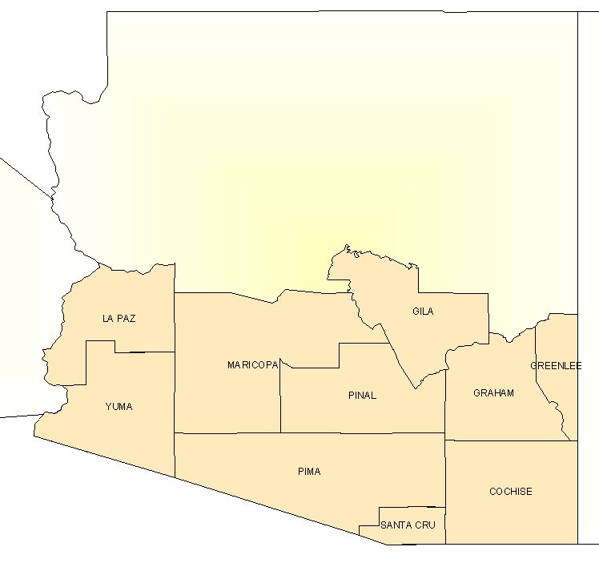
48 motor vehicle crash deaths in Cochise County, State A
Other Counties in State A
2
Other
3
STATE C
3
STATE B
3
4
7
STATE D
1
48
16
Source: Mortality data, NCHS/CDC.
FOREIGN COUNTRY
9
Notes:
Notes: [slide is animated; animation activated by clicking] This slide shows the difference between tabulating by place of occurrence versus place of usual residence.
At first appearance of slide, explain: This slide shows State A. In 2000, there were 48 motor vehicle crash deaths in Cochise County. If we were to report the number of motor vehicle crash deaths in Cochise County by place of occurrence, we would have 48. But what happens when we look at the deaths by place of usual residence?
Click 1: Only 16 motor vehicle crash deaths occurred among Cochise County residents.
Click 2: The remaining 32 deaths took place in other areas, including 7 to residents of other states and 9 to residents of another country.
What can explain this drastic change between 48 and 16? (there is a major interstate highway that runs through Cochise County).

Slide 33
Process
Slide with place of registration requirements for country where course is being taught or comparison if students are from multiple countries.

Slide 34
Discuss
What are some advantages and disadvantages of registering and tabulating vital events by place of occurrence or place of residence?
SOURCES: Handbook on Training in Civil Registration and Vital Statistics Systems, Series F, No. 84, United Nations, New York, 2002, Module 8 and Principles and Recommendations for a Vital Statistics System, Revision 2, United Nations, New York, 2001, Chapter III.
Notes:
This may be done as a class exercise or have the students work in small groups.
Place of occurrence:
Generally easier to do since it is where the event occurred and records are usually registered locally.
May be a problem, especially for a death, if a family member is not available to provide information about the deceased.
If the event occurs in a moving vehicle (train, airplane, ship, etc.) place of occurrence should clearly be specified in civil registration law – often where moving vehicle first stops and infant or decedent removed from vehicle.
Data about place of occurrence can be used to study location of hospital or other medical care facilities.
Place of residence:
May be harder to register event if it occurs away from the place of residence (students, travelers, members of armed forces, refugees) or if someone has more than one residence.
Definition used should be the same as the one used in the national census to have consistent data. Census data are also used as the denominators for calculating many rates used in health analyses.
Data tabulations provide information on health problems in the area where the population resides – particularly important if rural populations go into cities or away from their residences to deliver births or enter medical facilities prior to death.
Tabulations by place of residence are often used because you are more likely to know the denominator.

Slide 35
Process
Time to Register Vital Event
  Law should specify time period to report vital event to local registrar
  Time should be short but reasonable
  Common time periods
    Births One month
    Death Five days
    Fetal deaths Five days
SOURCES: Handbook on Training in Civil Registration and Vital Statistics Systems, Series F, No. 84, United Nations, New York, 2002, Module 8 and Principles and Recommendations for a Vital Statistics System, Revision 2, United Nations, New York, 2001, Chapter III.
Notes:
The time periods given are used in many countries but there is lots of variation around those periods. The situation in the country needs to be considered and the period set to meet most situations.
Note: a time period of one month may be excessive; in the United States, it is 5 days, as for other vital events.

Slide 36
Process
Time to Register Event (continued)
  Delayed or late registrations
    Vital events registered after required time period
    Additional requirements or documentary proof may be needed to register event
    May not be included in vital statistics data if registered more than a year after event occurred
    Number of late or delayed registrations should be limited
      Use of educational programs
      Improve efficiency of vital event registration
SOURCES: Handbook on Training in Civil Registration and Vital Statistics Systems, Series F, No. 84, United Nations, New York, 2002, Module 8 and Principles and Recommendations for a Vital Statistics System, Revision 2, United Nations, New York, 2001, Chapter III.
Notes:
Vital events registered after required time period are called “Late” or “Delayed” registrations.
Civil registration law or regulations may include additional requirements or documentary proof for late or delayed registrations depending on the length of time that the event is registered – in many countries the time period for requiring additional evidence is one year after the event occurred. Documentation for delayed registrations should be checked VERY carefully in order to protect against fraudulent registrations.
Usually a vital event registered more than a year after the event will not be included in vital statistics data.
Attempts should be made to limit the number of late or delayed registrations through educational programs and improving the efficiency of vital event registration.

Slide 37
Process
Slide with time requirements for registering vital events for the country where the course is being taught or comparison if students are from multiple countries.

Slide 38
Discuss
What are some of the problems that might delay registering of vital events?
What are some ways to prevent these problems?
Notes:
This may be done as a class exercise or have the students work in small groups.
Problems that might delay registration:
Lack of knowledge on who is responsible for registering event
Informant not available
Informant does not know all of the required information to register event
Naming child if local or religious customs cause delay
When both legal and statistical information are collected on the same registration form, reporting problems can occur. If the time period is too short some information may not be available within the required period:
Deaths that require autopsies or toxicology testing
Deaths where the medical certifier is not available to provide cause of death information
Follow-up should be done to ensure that the cause of death or other incomplete information is reported at a later time. A method should be available for registering the event without all the information such as listing “pending” for the cause of death. Some countries require that burial permits be obtained before final disposition to get deaths registered in a timely manner. Education and training of persons responsible for registering events is important especially if the event occurs in a medical facility.
Note that generally adding penalties such as fines or other sanctions does not improve timeliness of registration (and may discourage late registration).

Slide 39
Process
Person Responsible for Registering Vital Event
  Informant
    Person stating that vital event occurred
    Civil registration law should specify for each vital event
      May be different for vital events inside or outside of medical facilities
      Alternates if preferred not available
SOURCES: Handbook on Training in Civil Registration and Vital Statistics Systems, Series F, No. 84, United Nations, New York, 2002, Module 7 and Principles and Recommendations for a Vital Statistics System, Revision 2, United Nations, New York, 2001, Chapter III.
Notes:
Note that the informant is the person who declares that the event occurred. (In the United States, the informant provides information on the event, but the attendant is the person who declares that the event occurred).
The civil registration law should state who is responsible (informant) for providing information to the registrar for each type of vital event.
Informants for vital events occurring in medical facilities may be different from those for vital events occurring outside of such facilities.
Alternate informants should be specified if the preferred informant is not available.

Slide 40

Process
Person Responsible for Registering Vital Event (continued)
  Informant (continued)
    Someone who knows parties involved and/or characteristics of the event
    May have to provide oral or written declaration of circumstances of vital event
WHO/Evelyn Hockstein
SOURCES: Handbook on Training in Civil Registration and Vital Statistics Systems, Series F, No. 84, United Nations, New York, 2002, Module 7 and Principles and Recommendations for a Vital Statistics System, Revision 2, United Nations, New York, 2001, Chapter III.
Notes:
The informant should be someone who knows the parties involved and/or the characteristics of the event.
The informant may have to provide an oral or written declaration of the circumstances of the event.

Slide 41
Suggested Informants for Vital Events
Vital Event | Occurs in Medical Facility | Occurs Outside of Medical Facility
Birth | Head of medical facility Other person representing medical facility | Mother Father Attendant at delivery Nearest relative of mother Other adult person who knows facts of birth
Death | Head of medical facility Other person representing medical facility | Surviving spouse of decedent Mother/father of decedent (particularly for child or infant) Other relative of decedent Other adult person who knows facts of death
SOURCES: Handbook on Training in Civil Registration and Vital Statistics Systems, Series F, No. 84, United Nations, New York, 2002, Module 7 and Principles and Recommendations for a Vital Statistics System, Revision 2, United Nations, New York, 2001, Chapter III.

Slide 42
Process
Person Responsible for Registering Vital Event (continued)
  Others having responsibility for vital events
    Funeral director
      Collects information from informant and registers death
    Medical certifier for death
      Provides cause of death information
      Part of registration of death or supplemental statistical item
SOURCES: Handbook on Training in Civil Registration and Vital Statistics Systems, Series F, No. 84, United Nations, New York, 2002, Module 7 and Principles and Recommendations for a Vital Statistics System, Revision 2, United Nations, New York, 2001, Chapter III.
Notes:
In some countries the informant provides information for death records to the funeral director who is responsible for providing the information to the registrar. The cause of death may be part of the registration of the vital event or it may be collected as a supplemental statistical item.
Cause of death information is best obtained from the physician or medical attendant or the coroner or medical examiner who handled the death.

Slide 43
Process
Person Responsible for Registering Vital Event (continued)
  Others having responsibility for vital events (continued)
    Medical attendant at birth
      Provides supplementary medical information
      Part of registration of birth or supplemental statistical item
SOURCES: Handbook on Training in Civil Registration and Vital Statistics Systems, Series F, No. 84, United Nations, New York, 2002, Module 7 and Principles and Recommendations for a Vital Statistics System, Revision 2, United Nations, New York, 2001, Chapter III.
Notes:
Supplementary medical information may also be collected for births which may also be part of the registration of birth or collected as a supplemental statistical item. Medical information for births is best obtained from the physician or medical attendant.
Note that there will be additional discussions on obtaining the cause of death and on other information on birth, death, and fetal death records later in the course.

Slide 44
Process
Slide with required informant for registering vital event for the country where the course is being taught or comparison if students are from different countries.

Slide 45
Process
Documentation to Support Registration
  May be required to prevent fraudulent registration of vital events
  Minimal requirements for timely registration
  Late or delayed registration
    Usually after one year
    May require multiple documents
  SOURCES: Handbook on Training in Civil Registration and Vital Statistics Systems, Series F, No. 84, United Nations, New York, 2002, Module 8 and Principles and Recommendations for a Vital Statistics System, Revision 2, United Nations, New York, 2001, Chapter III.
Notes:
Civil registrars must be familiar with all types of legal documents to prevent fraudulent registrations of vital events.
In many countries if the vital event is registered within the time period specified in the civil registration law, minimal documentation is required.
Registration of a vital event after one year (late or delayed registration) generally requires multiple documents.

Slide 46
Process
Documentation to Support Registration (continued)
  Types of documents required
    Statement from medical attendant
    Witness statements
    Legal documents
    Baptismal certificate
    Vaccination or other health records
  SOURCES: Handbook on Training in Civil Registration and Vital Statistics Systems, Series F, No. 84, United Nations, New York, 2002, Module 8 and Principles and Recommendations for a Vital Statistics System, Revision 2, United Nations, New York, 2001, Chapter III.
Notes:
Types of documents required may include (note different countries accept different types of documents based on the legal requirements in the civil registration law):
Certification from medical attendant
Witness statements
Legal documents
Baptismal certificate
Vaccination or other health records
Other documents acceptable under the law
Efforts should be taken to decrease late or delayed registrations.

Slide 47
Process
Slide showing documentation requirements for country where course is being taught or comparison if students are from different countries.

Slide 48
Process
Format for Registration of Vital Events
  Various formats
  Depends on development of the country
  Educational and technical level of employees
  Resources available
  Different formats for registration of different types of vital events
  May change over time
SOURCES: Handbook on Training in Civil Registration and Vital Statistics Systems, Series F, No. 84, United Nations, New York, 2002, Module 9 and Principles and Recommendations for a Vital Statistics System, Revision 2, United Nations, New York, 2001, Chapter III.

Slide 49
Examples of Formats
Book Register | Bound book of preprinted forms with entry by hand Events entered as they are registered Usually just legal information Separate registers for each vital event
Card Register | Preprinted card with entry by hand or typewriter Cards can be sorted by date or surname for storage Late or delayed events can be added Cards can be lost of misfiled
Paper Record | Preprinted form on paper with entry by hand or typewriter Statistical information may be collected with legal information Records can easily be photocopied Records can be lost or misfiled
Electronic Record | Preparation of record on computer Statistical information may be collected with legal information Electronic storage Information easily sorted and tabulated High cost of equipment and software Need qualified technical staff
SOURCES: Handbook on Training in Civil Registration and Vital Statistics Systems, Series F, No. 84, United Nations, New York, 2002, Module 9 and Principles and Recommendations for a Vital Statistics System, Revision 2, United Nations, New York, 2001, Chapter III.
Notes:
Book Register -- Usually a hard bound book of preprinted forms with events entered by hand as they are registered:
Information entered usually just relates to legal requirements for vital event with statistical information gathered separately
Separate registers are used for each type of vital event
A back up system must be kept
Card Register --A preprinted card is used to enter the information by hand or with a typewriter:
Cards can be easily sorted by date or by surname for storage
Late or delayed events can be added
Cards can be lost or filed out of order making records hard to find
Paper Record -- Similar to card system, but on paper with a preprinted form used to enter the information:
Statistical information can be gathered along with the legal information
Records can be easily photocopied
Paper records can be lost or filed out of order making records hard to find
Electronic Records -- New method since introduction of computers:
Preparation of record on computer allowing for collection of legal and statistical information
Storage of record electronically eliminating the need for storage of paper or books
Information can easily be sorted and tabulated
Records can be easily located making issuance of certified copies much faster
Backups of files can easily be made
High cost for equipment and software
Need for qualified technical staff – programmers and system management
Need for electronic backup

Slide 50
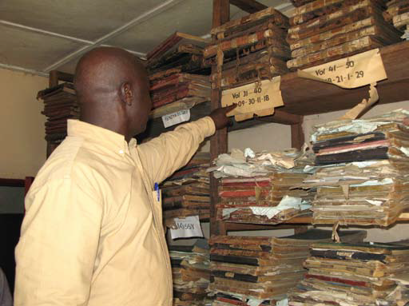
Process
Format for Registration of Vital Events (continued)
  Combinations of all formats
    Used in some countries
    Harder to store, preserve and issue certified copies
SOURCES: Handbook on Training in Civil Registration and Vital Statistics Systems, Series F, No. 84, United Nations, New York, 2002, Module 9 and Principles and Recommendations for a Vital Statistics System, Revision 2, United Nations, New York, 2001, Chapter III.
In Freetown, registered deaths are archived without being entered into a database and analyzed. PHOTO: WHO/David Lubinski
Picture from WHO web site
Notes:
Some countries have used combinations of all of the above formats.
Use of multiple formats in a country may make storage, preservation and issuance of certified copies more difficult to manage – some countries are attempting to convert older records in books or on cards or paper into electronic format for ease of management and issuance of copies.

Slide 51
Process
Format for Registration of Vital Events (continued)
  Electronic records
    Just coming into use
    Local paper records converted to electronic format at national or regional office
    Older formats converted to electronic format
SOURCES: Handbook on Training in Civil Registration and Vital Statistics Systems, Series F, No. 84, United Nations, New York, 2002, Module 9 and Principles and Recommendations for a Vital Statistics System, Revision 2, United Nations, New York, 2001, Chapter III.
Notes:
Often the format changes over time with electronic records just recently coming into use.
In some cases paper records are used locally to collect information on vital events with information from the paper records entered into electronic format at a national or regional office.

Slide 52
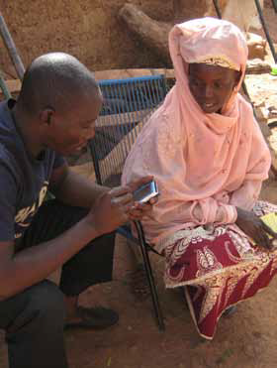
Process
Format for Registration of Vital Events (continued)
  Electronic records (continued)
    Ideally collect information directly from source
      Medical facility where birth occurs
      Funeral director who handles disposition
SOURCES: Handbook on Training in Civil Registration and Vital Statistics Systems, Series F, No. 84, United Nations, New York, 2002, Module 9 and Principles and Recommendations for a Vital Statistics System, Revision 2, United Nations, New York, 2001, Chapter III.
Devices such as smart phones can provide real-time data access from remote areas. Picture from WHO web site.
Notes:
Note that some countries are beginning to collect information for vital records in electronic format directly from the source such as the medical facility where the birth occurs or the funeral director who handles the disposition.

Slide 53
Process
Slide with type of format for collection of vital event information in country where course is being taught or comparison if students are from different countries.

Slide 54

Process
Storage
  Official government documents with legal value
    Secure
    Permanent
    Protected from catastrophic events such as fires, floods or other weather related issues
      Vault with fire protection features
      Backup methods to preserve records
  Records can be stored both centrally and locally
Picture from WHO web site
SOURCES: Handbook on Training in Civil Registration and Vital Statistics Systems, Series F, No. 84, United Nations, New York, 2002, Module 9 and Principles and Recommendations for a Vital Statistics System, Revision 2, United Nations, New York, 2001, Chapter III.
Notes:
Since vital records are official government documents that have legal value, they must be kept in a secure, permanent way. Records can be stored both centrally and locally. Care must be taken to ensure that the records are secure and protected from catastrophic events such as fires, floods or other weather related issues. Many countries store records in a vault with fire protection features. Backup methods must also be used to ensure that the records are preserved. Backup copies should be stored in a safe, remote location.

Slide 55
Examples of Storage & Backup Methods
Format | Storage Methods | Backup Methods
Book Register | Stored on shelves | Difficult to backup Information copied into other books or other formats
Card Register | File drawers | Information copied to other cards Microfilm
Paper Record | Bound volumes Loose leaf binders Stored on shelves | Microfilm Electronic images
Electronic Record | Electronic format | Electronic copies Copies should be stored offsite Must migrate to new systems with changing technology
SOURCES: Handbook on Training in Civil Registration and Vital Statistics Systems, Series F, No. 84, United Nations, New York, 2002, Module 9 and Principles and Recommendations for a Vital Statistics System, Revision 2, United Nations, New York, 2001, Chapter III.
Notes:
The storage method depends on the format used to collect vital event information:
Book registers are usually stored on open shelves
Card registers are kept in file drawers
Paper records are either permanently bound or placed in loose leaf binders and stored on open shelves
Electronic records are stored electronically
Backup methods must also be used to ensure that the records are preserved.
Microfilm is one method that is frequently used especially for paper records with a backup copy of the film stored offsite.
If electronic records are used, backup copies of files must also be kept offsite and care must be taken to migrate records to new systems as technology changes.

Slide 56
Process
Slide with type of storage used for vital events in country where course is being taught or comparison if students are from different countries.

Slide 57
Process
Issuance of Copies
  Key function of civil registration
  How copies are issued
    Specified in civil registration law
    Full copy of original vital record or excerpt of record
    Handwritten, photocopied, or computer generated
    On safety paper to prevent fraud
    With certification and/or seal of Registrar General or local registrar who issued copy
SOURCES: Handbook on Training in Civil Registration and Vital Statistics Systems, Series F, No. 84, United Nations, New York, 2002, Module 11 and Principles and Recommendations for a Vital Statistics System, Revision 2, United Nations, New York, 2001, Chapter III.
Notes:
Issuance of certified copies of vital records is a key function of civil registration. Civil registration law should specify how copies should be issued and who may obtain them. Copies may be full copies of the original record or they may just contain excerpts from the original record – if statistical information is collected along with the legal information, the statistical information may not be shown on certified copies of the record. Copies may be handwritten, photocopied, or computer generated. For prevention against fraud, many countries use special safety paper to make alteration of copies difficult. Generally the copy contains a certification statement that often includes a seal of the Registrar General or local registrar who issued the copy.

Slide 58
Process
Issuance of Copies (continued)
  Who may obtain copies of records
    Most countries restrict issuance
    Usually strictest requirements on birth records
  Where copies are issued
    National level
    Local level
    Both
SOURCES: Handbook on Training in Civil Registration and Vital Statistics Systems, Series F, No. 84, United Nations, New York, 2002, Module 11 and Principles and Recommendations for a Vital Statistics System, Revision 2, United Nations, New York, 2001, Chapter III.
Notes:
Most countries have restrictions on who may obtain copies of records:
only authorized individuals may obtain copies
– for a birth record often registrant or mother or father (or their legal representatives)
– for a death record next of kin or family member (or their legal representatives)
law should specify who is authorized to obtain each type of vital record
strictest requirements are usually on birth records which may be used fraudulently
Copies may be issued at the national level, the local level or both depending on the country.

Slide 59
Process
Issuance of Copies (continued)
  Ways to obtain copies of vital records
    In person
    By mail
    By telephone
    Over the Internet
SOURCES: Handbook on Training in Civil Registration and Vital Statistics Systems, Series F, No. 84, United Nations, New York, 2002, Module 11 and Principles and Recommendations for a Vital Statistics System, Revision 2, United Nations, New York, 2001, Chapter III.
Notes:
Some countries require that copies of vital records (particularly births) be obtained in person. Other countries accept mail requests for copies.
Some countries allow copies to be ordered over the phone or over the internet with proper security requirements if release of records is restricted.
If records are restricted, applicants may need to provide identity documentation to show that they are entitled to obtain the copies they are requesting. Requirements for identity documents to obtain copies of records vary from country to country.

Slide 60
Process
Slide with brief description on issuance of certified copies for country where course is being taught or comparison if students are from different countries.
Examples of certified copies of records from the country where the course is taught may also be shown.

Slide 61
Discuss
What are some of the ways that birth and death records might be used for fraudulent purposes, especially if release of those records is not restricted or if security measures are not used on certified copies?
Notes:
This may be done as a class exercise or have the students work in small groups.
Birth records:
Using someone else’s record to create a new identity
Altering the record to change information – date of birth, name, parents, etc.
Death records:
Falsely declaring someone dead to collect benefits such as insurance or other benefits
Altering the record to change information – name, date of death, surviving spouse, residence, cause of death, etc.
Falsely claiming to be surviving spouse to collect benefits or an heir to the estate

Slide 62
Review
Vital events usually registered at local units
Vital event registered
  By place of occurrence or by place of residence
  Both should be collected for statistical tabulation
Time to register vital event
  Should be reasonable
  Late or delayed records
    May not be in annual statistical tabulations
    May require documentation for registration

Slide 63
Review
Informant
  Person responsible for registering vital event
  Should be designated in civil registration law
Formats for registration
  Book or card registers
  Paper records
  Electronic records

Slide 64
Review
Vital records must
  Be preserved
  Be stored in secure manner
  Have backup copies available
Issuance of certified copies of vital records is a key function of civil registration
Most countries
  Restrict who may obtain certified copies
  Take precautions to prevent use of vital records for fraudulent purposes

Slide 65

Registered Records
Processing
Numbering
Coding Data
Computerizing
Editing
Querying
Correcting Errors
Picture from WHO web site; Health Metrics Network

Slide 66
Basic Record Flow
Registration
Add Certificate Number
Problem on Record
Review Record
Query Record
OK
Coding/data entry
Make Correction
Computerize
Fails
Legal Info
Edit Record
Stat
Data
Notes:
Summary of basic record flow. Most countries use some variation of this scheme.
This slide gives an overview of the general record flow used in processing vital records that have been registered. Each step will be discussed in the next few slides.

Slide 67
Basic Record Flow
Registration
Add Certificate Number
Problem on Record
Review Record
Query Record
OK
Coding/data entry
Make Correction
Computerize
Fails
Legal Info
Edit Record
Stat
Data
Notes:
The first step is adding the certificate number to the record.

Slide 68
Registered Records
Numbering
  Unique number for each type of vital record
    Assigned at local or national registration office
    Specific criteria so numbers not duplicated
  Some countries use personal identification number from population registry on vital records
SOURCES: Handbook on Training in Civil Registration and Vital Statistics Systems, Series F, No. 84, United Nations, New York, 2002, Module 10 and Principles and Recommendations for a Vital Statistics System, Revision 2, United Nations, New York, 2001, Chapter III.
Notes:
Each type of vital record registered is given a unique number.
The number may be assigned at the local registration office or at the national office.
All numbers assigned should follow an established scheme with specific criteria so they are not duplicated.
Some countries that have population registries assign a unique personal identification number to each individual at birth and use this number on vital records.

Slide 69
Registered Records
Numbering (continued)
  Common methods for assigning numbers
    Year of event followed by sequential number for each type of vital record in calendar year – 2011-000001
    Date of event followed by sequential number – 19910810-0001 for 10 August 1991
SOURCES: Handbook on Training in Civil Registration and Vital Statistics Systems, Series F, No. 84, United Nations, New York, 2002, Module 10 and Principles and Recommendations for a Vital Statistics System, Revision 2, United Nations, New York, 2001, Chapter III.
Notes:
One common method for assigning numbers is numbering each vital record sequentially within each calendar year by each type of event:
The first event of each type is 000001 continuing until all events for that year are numbered.
To be unique for computerization, the year must be included such as 2011-000001.
Another method is to use the date of the event followed by a sequential number:
For an event on 10 August 1991 the number would be 910810-0001 or 19910810-0001.

Slide 70
Basic Record Flow
Registration
Add Certificate Number
Problem on Record
Review Record
Query Record
OK
Coding/data entry
Make Correction
Computerize
Fails
Legal Info
Edit Record
Stat
Data
Notes:
The record should be reviewed early in the process to get any errors or missing information corrected as soon as possible. We will discuss this in more detail as part of editing.

Slide 71
Basic Record Flow
Registration
Add Certificate Number
Problem on Record
Review Record
Query Record
OK
Coding/data entry
Make Correction
Computerize
Fails
Legal Info
Edit Record
Stat
Data
Notes:
If there are no problems on the record it is forwarded for coding and data entry.

Slide 72
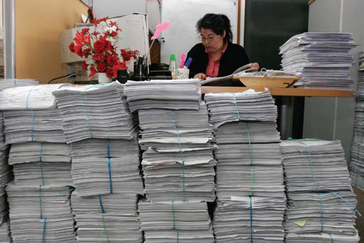
Registered Records
Coding Data
  Some items on vital records are “coded”
    Changed to numerical format for computer entry and data tabulation
    Examples of coded items
      Sex
      Geographic location
      Marital status
      Education level
      Cause of death
      Occupation
Picture from WHO web site.
SOURCES: Handbook on Training in Civil Registration and Vital Statistics Systems, Series F, No. 84, United Nations, New York, 2002, Module 13 and Principles and Recommendations for a Vital Statistics System, Revision 2, United Nations, New York, 2001, Chapter III.
In Santiago, Chile, Alejandra Landabur enters information from death certificates
into a database. Photo: WHO/Aliosha Marquez

Slide 73
Registered Records
Coding Data (continued)
  Coding standards
    Follow international statistical classifications for data comparisons
    Allow for comparison of items over time
    Simple for items with limited number of entries
    Strict rules for items with many possible entries
    Verification of coding
  Coders must be well trained to prevent errors
SOURCES: Handbook on Training in Civil Registration and Vital Statistics Systems, Series F, No. 84, United Nations, New York, 2002, Module 13 and Principles and Recommendations for a Vital Statistics System, Revision 2, United Nations, New York, 2001, Chapter III.
Notes:
Standards for coding items must be established and should follow international statistical classifications where possible to allow for data comparisons.
Coding standards must also allow for comparison of items over time. Items such as sex or marital status have a limited number of entries, so coding is relatively simple. Items such as geographic location, occupation or cause of death may have many possible entries and must have strict rules for converting to coded data.
Coded data should be verified to check that the coding has been done correctly. This is particularly important for the application of codes to items with many possible entries (and thus codes). In some cases, a sample of records is re-coded by a different person to verify that the appropriate codes have been applied.
Coders must be well trained in the requirements for coding particular items so errors do not occur.
More detail on coding information, particularly cause of death, will be covered later in the course.

Slide 74
Basic Record Flow
Registration
Add Certificate Number
Problem on Record
Review Record
Query Record
OK
Coding/data entry
Make Correction
Computerize
Fails
Legal Info
Edit Record
Stat
Data
Notes:
After coding, the information is data entered into the computer.

Slide 75
Registered Records
Computerizing
  Method depends on technology available
    Paper records forwarded to national office for data entry
    Data entry at a local level and electronic information forwarded
  Ideal system
    Informant responsible for entering information into electronic vital record
    Or entered by someone obtaining information from informant
SOURCES: Handbook on Training in Civil Registration and Vital Statistics Systems, Series F, No. 84, United Nations, New York, 2002, Module 13 and Principles and Recommendations for a Vital Statistics System, Revision 2, United Nations, New York, 2001, Chapter III.
Notes:
The method used for computerization of vital event information depends on the technology available.
In some cases, paper records are forwarded to the national office for data entry while in others, data entry may be at a local level and the electronic information is forwarded.
The ideal system is to have the information entered into an electronic vital record by the informant or the person responsible for providing the information (such as the physician or medical examiner for a death) or by someone (clerk in a medical facility, funeral director, or local registrar) obtaining the information from that person.

Slide 76
Registered Records
Computerizing (continued)
  Usually done by civil registration authority
    Vital statistics data should be collected during civil registration process
    Statistical files passed to vital statistics agency
    Need agreements to protect individually identifiable information
  Computerization process
    Include ways to prevent inadvertent keying errors
    Capture both legal and statistical information in computer entry programs
SOURCES: Handbook on Training in Civil Registration and Vital Statistics Systems, Series F, No. 84, United Nations, New York, 2002, Module 13 and Principles and Recommendations for a Vital Statistics System, Revision 2, United Nations, New York, 2001, Chapter III.
Notes:
In countries where the civil registration and vital statistics functions are in separate agencies, computerization is usually done by the civil registration authority rather than the vital statistics agency. In this case, all vital statistics data should be collected during the civil registration process.
Statistical files are passed to the vital statistics agency with appropriate agreements for protection of individually identifiable information
-- Students need to understand the importance of protecting information on individuals in the statistical agency – sometimes publishing detailed statistical information can identify individuals if the information is unusual.
Note: There are variations on this process. In South Africa, the civil registration office lends registration forms to the statistical agency for data entry and preparation of vital statistics.
Programs for entry of information should be designed to capture all of the information necessary for both legal and statistical purposes
If records are data entered, there must be a process in place to prevent inadvertent keying errors – double entry, built-in edits.

Slide 77
Registered Records
Slide with information status of computerization in country where course is being taught. Include how records are numbered and coded. Or, if students are from different countries, show a comparison of countries .

Slide 78
Basic Record Flow
Registration
Add Certificate Number
Problem on Record
Review Record
Query Record
OK
Coding/data entry
Make Correction
Computerize
Fails
Legal Info
Edit Record
Stat
Data
Notes:
After the information from the vital record is entered into the computer, it should be edited.
The initial review of the record is also part of the editing process.

Slide 79
Registered Records
Editing
  Early in registration process
    Paper records
      Reviewed when received
      Preferably in local registration area
      Find obvious errors and missing information
    Electronic records
      Include edits in source programs
        Prevent entry errors
        Disallow missing information
SOURCES: Handbook on Training in Civil Registration and Vital Statistics Systems, Series F, No. 84, United Nations, New York, 2002, Module 13 and Principles and Recommendations for a Vital Statistics System, Revision 2, United Nations, New York, 2001, Chapter III.
Notes:
Editing should be done as early in the registration process as possible. When paper records are presented to the local registrar, they should be reviewed for missing information and obvious errors. The local registrar should try to obtain any missing information or correct any obvious errors before forwarding the record to the central office.
When electronic records are used to register vital events, edits should be built into the entry programs. The programs should be designed to alert the person entering information if items are left blank or obvious or inconsistent errors are made. The programs should also be designed to prevent impossible entries (for example, impossible dates such as February 30). Edits could also be designed to question entries that are possible, but not likely such as a mother whose age is 50 years old.

Slide 80
Registered Records
Editing (continued)
  Records in electronic format
    Check electronically for inconsistent, inappropriate or unusual entries
    Mark records for review if entry outside standard range
    Check for errors during electronic conversion of paper records
  Statistical agency should also check data for inconsistent or unusual trends
SOURCES: Handbook on Training in Civil Registration and Vital Statistics Systems, Series F, No. 84, United Nations, New York, 2002, Module 13 and Principles and Recommendations for a Vital Statistics System, Revision 2, United Nations, New York, 2001, Chapter III.
Notes:
Records in electronic format can be checked electronically for inconsistent, inappropriate, unusual entries, etc.
If paper records are converted to electronic format they should be checked as they are converted with edits built into the programs used for data entry. Records can also be “flagged” or marked for further review if the entry is outside of a standard range.
If records are collected electronically at the source, edits should be included in the programs to prevent as many errors as possible. Statisticians in the statistical agency should also check the data for inconsistent or unusual trends.

Slide 81
Basic Record Flow
Registration
Add Certificate Number
Problem on Record
Review Record
Query Record
OK
Coding/data entry
Make Correction
Computerize
Fails
Legal Info
Edit Record
Stat
Data

Slide 82
Registered Records
Querying
  Follow-up of problems
    Missing, inconsistent or inappropriate entries
    Contact person responsible for providing information
    Query as soon as questionable or missing entry found
    Needed for high quality statistical data
  Often done by local registration office
    National office sends queries to local office
    Corrected or missing information sent back to national office
SOURCES: Handbook on Training in Civil Registration and Vital Statistics Systems, Series F, No. 84, United Nations, New York, 2002, Module 13 and Principles and Recommendations for a Vital Statistics System, Revision 2, United Nations, New York, 2001, Chapter III.
Notes:
Items found to have missing, incomplete, inconsistent or inappropriate entries should be followed up by contacting or “querying” the person responsible for providing the information.
Querying should be done as soon as the questionable or missing entry is found. The earlier querying is done in the registration process, the more likely it will be that the correct or missing information can be obtained. To have useful data for assessing health problems, it is very important that complete and accurate information be entered on vital records.
In some national offices, queries are sent back to the local office for contacting the person responsible for providing the information. A procedure must also be established to forward the corrected or missing information to the national office. Registration offices should have an ongoing query program to ensure high quality statistical data.

Slide 83
Registered Records
Slide with information on editing and querying vital records in country where course is being taught or comparison if students are from different countries.

Slide 84
Discuss
In what ways can computerization of vital records be expanded in your country? What benefits might be gained? What problems or issues might be incurred with an expansion of computerization?
Notes:
This question may be out of the frame of reference for non-MOH/civil registration audiences.
This may be done as a class exercise or have the students work in small groups.
(If no computerization is used in the country, have students discuss benefits and ways in which computerization might improve vital record processing. They should also discuss problems and issues that might be incurred as computerization is implemented.)
Discussion will be specific to country.
Many countries are expanding computerization to have vital records entered into the computer directly at the source using laptops, tablets, and now smart phones. Built in edits point out problems as the data are being entered, and the data can be transmitted to the central office speeding up processing. Having the data computerized at the source also means that it is readily available for public health analyses and other health program uses.
Problems and issues involve the level of technical expertise required to maintain the hardware and the software needed. The cost is also an issue since technical personnel usually are higher paid than clerical staff. There is also the issue of maintaining the system as new technology emerges and the old technology becomes obsolete.

Slide 85
Basic Record Flow
Registration
Add Certificate Number
Problem on Record
Review Record
Query Record
OK
Coding/data entry
Make Correction
Computerize
Fails
Legal Info
Edit Record
Stat
Data

Slide 86
Registered Records
Correcting Errors
  For both legal and statistical items
  Method depends on type of error and data item
  Duplicate records at both national and local level must be corrected
  Correcting legal items (Amendments)
    Method should be specified in civil registration law
    “Evidence” or documentation usually required to support correction
    Obvious clerical errors generally require little evidence
    Some corrections may require court action
SOURCES: Handbook on Training in Civil Registration and Vital Statistics Systems, Series F, No. 84, United Nations, New York, 2002, Module 11 and 13 and Principles and Recommendations for a Vital Statistics System, Revision 2, United Nations, New York, 2001, Chapter III.
Notes:
A process needs to be in place to correct errors found through edits and other consistency checks.
How the errors are corrected depends on the type of error and the data item.
If duplicate records are kept at both national and local level, corrections must be made in both locations.
Corrections can be made to both legal and statistical items.
The civil registration law and regulations should specify how corrections (amendments) can be made to errors in legal items:
“Evidence” or documentation is usually required to support the correction
Obvious clerical errors generally require little evidence
Some corrections may require court action

Slide 87
Registered Records
Correcting Errors (continued)
  Time for correction of error
    Legal items
      Can be made at any time
      Often errors not found until copy of record is issued
      Corrections may not be included on statistical file
    Statistical items
      As soon as possible after error is found
      Prior to preparation of annual tabulations
SOURCES: Handbook on Training in Civil Registration and Vital Statistics Systems, Series F, No. 84, United Nations, New York, 2002, Modules 11 and 13, and Principles and Recommendations for a Vital Statistics System, Revision 2, United Nations, New York, 2001, Chapter III.
Notes:
Corrections to legal items (amendments) can be made at any time. Many times errors are not found until a copy of a record is first issued. Some corrections to legal items may not be included on the statistical file.
Corrections to statistical items should be made as soon as possible after the error is found and prior to preparation of annual tabulations.

Slide 88
Methods for Correcting Errors
Type of Error | Method Used to Correct
Item Left Blank | Correct information inserted into blank space Notation may be added to record to note addition
Minor Clerical Error | May be lined through with correct information written above on paper record New record may be prepared with correct information Notation may be added to record to note correction
Wrong Information Entered on Paper Record | May be lined through with correct information written above on paper record Affidavit with correct information may be attached to original record Notation usually added to record to note correction
Wrong Information Entered on Electronic Record | New record may be prepared with correct information Statement may be added to indicate what was originally entered on record Notation usually added to record to note correction
SOURCES: Handbook on Training in Civil Registration and Vital Statistics Systems, Series F, No. 84, United Nations, New York, 2002, Modules 11 and 13, and Principles and Recommendations for a Vital Statistics System, Revision 2, United Nations, New York, 2001, Chapter III.
Notes:
The methods shown are common methods used.
Various methods are used to make corrections to vital records:
If an item is left blank, the correct information may just be inserted in the space with no indication it was added, or a notation may be placed on the record stating the information was added to the record.
Information in error may be lined through with a single line (so it is still readable) with the correct information written above and a notation about the correction may or may not be added to the record. An entirely new record may be prepared with the corrected information shown and a notation may or may not be added stating that a correction was made. If a new record is prepared it may replace the old record or the old record may be voided and the new record added to the system.
The method for correcting electronic records can be similar to those for paper records with notations added to the computer file regarding the corrections.
Corrections to statistical information not shown on certified copies may just be corrected on statistical file without any indication that the information was corrected.

Slide 89
Registered Records
Correcting Errors (continued)
  Countries may use several methods
    Depends on age of the record
    Depends on item to be corrected
  Certified copies of record should include
    Corrected information
    Notations added to the record
SOURCES: Handbook on Training in Civil Registration and Vital Statistics Systems, Series F, No. 84, United Nations, New York, 2002, Modules 11 and 13, and Principles and Recommendations for a Vital Statistics System, Revision 2, United Nations, New York, 2001, Chapter III.
Notes:
In some countries all of these methods are used depending on the age of the record and/or the item to be corrected.
When copies of corrected or amended records are issued, the corrected information and any notations added to the record should appear on those copies.

Slide 90
Registered Records
Correcting Errors (continued)
  Birth records also can be changed based on civil registration law
    Adoption
    Legitimation
    Recognition
    Paternity determination
SOURCES: Handbook on Training in Civil Registration and Vital Statistics Systems, Series F, No. 84, United Nations, New York, 2002, Modules 11 and 13, and Principles and Recommendations for a Vital Statistics System, Revision 2, United Nations, New York, 2001, Chapter III.
Notes:
Although not corrections of errors, the civil registration law also provides the authority to process changes to birth records due to adoption, legitimation, recognition or paternity determination – usually new birth records are prepared after one of these legal actions and the new record may not indicate that any change was made to the record to protect the child -- more detail can be provided on these if appropriate for country or if questions are raised.
Adoption: the legal and voluntary taking and treating of the child of other parents as one’s own, in so far as provided by the laws of each country.
Legitimation: the formal investing of a person with the status and rights of a person born in wedlock, according to the laws of each country.
Recognition: the legal acknowledgment, either voluntarily or compulsorily, of the paternity of a child born out of wedlock.

Slide 91
Registered Records
Slide with information on correction of records in country where course is being taught or comparison if students are from different countries.

Slide 92
Discuss
What type of documentation or evidence is needed to:
Correct the spelling of a name on a birth or death record?
Change the name on a birth record?
Add a father to a birth record?
Change the age of the mother or father on a birth record?
Change the age on a death record?
Change the cause of death on a death record?
Notes:
This question may be out of the frame of reference for non-MOH/civil registration audiences.
This may be done as a class exercise or have the students work in small groups.
Spelling of a name on birth record:
Name of registrant: Minor misspelling shortly after birth, may accept statement of mother or father or person who registered record that an error was made; Major error in name done years after birth may require legal documentation to prove correct name for registrant
Name of mother or father: May require legal document to prove correct spelling of name
Spelling of a name on a death record:
Name of registrant: May require copy of birth certificate, documentation from population registry or other legal document
Other name:
Spouse may require copy of marriage record or other legal document
Parents may require copy of birth record
Add a father to a birth record:
May require legal determination through the court system to determine father (possibly need DNA evidence)
Change age of mother or father on birth or on death record:
Copy of birth record to prove age
Change cause of death:
Statement from medical certifier with correct information or legal determination of cause of death

Slide 93
Registered Records
Slide with flow chart for processing records in country where course is being taught or slides with information on some of the processes.
If students are from multiple countries, maybe contrast some differences in ways records are processed in those countries.

Slide 94
Review
Civil registration process
  Record given unique number
  Items coded for data entry and statistical tabulation
    Codes should follow international statistical standards
  Computerization may be done in various ways
    Ideal system has informant entering information into software

Slide 95
Review
Civil registration process (continued)
  Editing
    Detect errors, missing values, and inconsistent, inappropriate or unusual entries
    Early in registration process
    Ideally in source programs for electronic records
  Querying problems on records
    Contact person responsible for providing information
    May be done at local registration office

Slide 96
Review
Civil registration process (continued)
  Correction of errors
    Errors in both legal and statistical items should be corrected
    Methods for correction vary depending on item to be corrected and length of time after the event
    Documentation or evidence required for some corrections

Slide 97
Activity
In small groups draft a detailed flow chart for registration and processing of a birth (or death) record in your country.
Draft the flow from the time the record is created until a data file is produced.
Show how a birth (or death) record is registered and handled locally, forwarded to the central office (if that is the case), and the steps for processing the record at the central office.
Compare charts. Identify and discuss organizational aspects of the system that need improvement.
Notes:
This activity will depend on the information available for the particular country where the course is being taught. Some of the information needed for the diagram should have already been presented to the students in earlier slides. However, additional descriptions of the country’s system in the form of operational guides or processing manuals may need to be made available to the students. Alternatively, a written handout with a description of the process could be prepared for the students, or if the information is not available for the country where the course is being taught, the process from another country could be described for the students to use.
Students should consider the flow of the birth record from the hospital if a birth occurs there, or how the family registers the birth if it occurs at home. Included should be how the birth record is handled in the local registration office, any processing done there, and then how it is forwarded to the central registration office. If students have already been given copies of a flow chart for processing the record at the central office, they could reference that briefly, but should show how the statistical information gets to the agency that prepares statistical data for the country. Students should consider all the elements involved in handling the birth record including centralized vs. decentralized systems, single vs. multiple agencies, and the structure of the local registration systems.
Two example flowcharts follow.

Slide 98
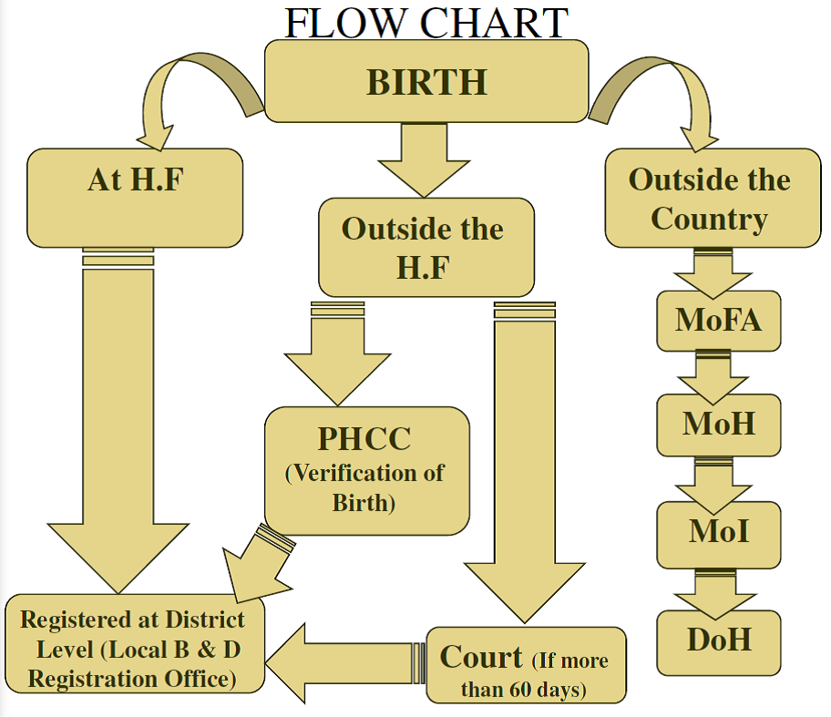
Flowchart Example - Iraq

Slide 99
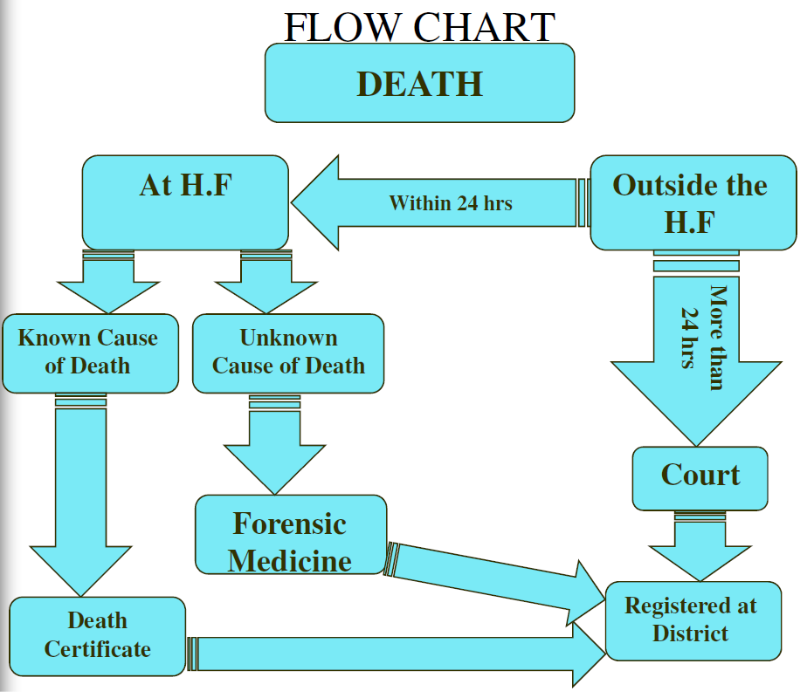
Flowchart Example - Iraq

Slide 100
Word Choice Questions
1. Primary objective of a civil registration system is to obtain (census data/legal documents) as required by law.
2. Ideally, the civil registration system should cover (large population centers/the entire country).
3. Vital records (may/may not) be destroyed after data are tabulated.
Ideally, information from vital records should be (available to anyone/confidential).
The structure of a civil registration system is specified by (law/the Registrar General).
Notes:
These questions should be used as a review prior to starting the next section. Have students choose the best word or group of words.
Legal documents – Civil registration collects legal documents on vital events occurring in the population of the country such as births and deaths.
The entire country – The ideal civil registration should cover all parts of the country. If all parts are not covered, then vital records from some parts of a country may be collected. Often collection of vital records is better in large population centers than in rural areas.
May not – Vital records are permanent and must be preserved for use in the future when individuals and/or government agencies need them for legal purposes.
Confidential – Keeping information on vital records confidential may prevent embarrassing information from being made public and may help improve reporting. However, not all countries have restrictions on vital record information.

Slide 101
Word Choice Questions
Actual registration of vital events generally takes place at the (national/local) level.
The structure of civil registration systems is (the same/different) from country to country.
When responsibility for civil registration is at the local level the system is (centralized/decentralized) while when responsibility is at the national level the system is (centralized/decentralized).
In [country where course is being taught] civil registration and vital statistics functions are in (the same/multiple) agency(ies).
Notes:
Law – The law specifies how civil registration is structured in a country. The Registrar General is given the authority to oversee the system and perform the duties specified in the law.
Local – Vital events are registered at the local level under the direction of a Local Registrar.
Different – Various types of structures are used throughout the world for civil registration systems.
Decentralized; centralized -- Civil registration at the local level is called decentralized since responsibility is in multiple locations. Civil registration at the national level is called centralized since responsibility is in one location.
A question should be added related to the country where the course is being taught. Students should know the structure of the civil registration in their country.

Slide 102
Word Choice Questions
(Either/both) place of occurrence (or/and) place of residence should be collected for statistical purposes.
The time required for registration of vital events (should/should not) be specified in civil registration law.
Annual statistical tabulations (may/may not) include vital events that are registered late.
Civil registration law (should/should not) designate the person responsible for registering each type of vital event.
Notes:
These questions should be used as a review prior to starting the next section. Have students choose the best word or group of words.
Both, and – It is important to be able to tabulate data by both where the event occurred and where the individual involved in the event lived. Occurrence data are used for planning and determining the need for health facilities and residence data are used for examining health problems and trends in the population in specific geographic areas.
Local – Most countries have local registration areas where vital events are registered.
Should – The time required to register each type of vital event should be specified in the civil registration law.
May not – If vital events are registered after the required time period they may not be processed in time to be included in the annual data files. Some vital events may not be registered for a long time (years) after the event occurs.

Slide 103
Word Choice Questions
Vital records must be (securely preserved/discarded after use).
A key function of civil registration is issuing (lists/certified copies) of vital records.
Most countries (have/do not have) restrictions on who may obtain certified copies of vital records.
Vital records registered in the civil registration process should have (duplicate/unique) numbers.
Notes:
Should – The informant or person responsible for registering each type of vital event should be specified in the civil registration law and should be someone with knowledge of the event and/or the person involved in the event. An alternate informant should be allowed and specified in the event that the primary informant is not available.
Securely preserved – Vital records should be stored in a secure manner with backup copies made to insure that they are available for future use.
Certified copies – Issuing certified copies of vital records is one of the main functions of a civil registration system.
Have – Release of certified copies of vital records is limited in most countries to only certain individuals who need those records for legal purposes. Most countries also take precautions to prevent the fraudulent use of vital records.

Slide 104
Word Choice Questions
Items on vital records coded for statistical tabulation should follow (local/international) statistical standards.
Ideally, detection of errors, inappropriate entries, or missing values on vital records should be done (at the end of/early in) the registration process.
Querying problems on birth or death records involves contacting the (informant/local registrar) to obtain the correct information.
Notes:
These questions should be used as a review prior to starting the next section. Have students choose the best word or group of words.
Unique – Vital records are given unique numbers so they can be located using that number. Unique numbers are also necessary for computerizing vital records.
International – International statistical standards should be used to code vital records so that tabulations of data will be comparable to tabulations from other countries.
Early in – The sooner errors are found and corrected, the better. Ideally edits to catch errors are in source programs for electronic records to catch errors during the initial entry of information.
Informant – The informant (person who provided the information for the birth or death record) should be contacted as soon as the error is found.

Slide 105
Word Choice Questions
Errors in (statistical/legal/both statistical and legal) items on vital records should be corrected.
The method used for correction of errors on vital records may vary depending on the (informant who provided the information/item to be corrected), the type of error made and the length of time after the event occurred.
Notes:
Both statistical and legal – Errors should be corrected in both statistical and legal items. The correct information is needed for legal purposes and also to have accurate statistical tabulations.
Item to be corrected – The method used for correction of errors varies depending on the item to be corrected, the type of error made and the time elapsed after the event has occurred. Methods used for correction include entering missing information in the blank space on the form, lining through information and adding the correction above, adding an attachment to the record with the new information shown, or preparing an entirely new record. In some cases documentation or legal action is required prior to making the corrections.

