Slide 1
Healthy People 2020 Progress Review: Violence Across the Lifespan
April 18, 2013

Slide 2
Howard K. Koh, MD, MPH
Assistant Secretary for Health
U.S. Department of Health and Human Services

Slide 3
Progress Review Overview
Summarize the impact of violence across the lifespan, including the in effects on health and workplace
Provide an update on the progress of Healthy People 2020 objectives
Examine what is being done to achieve the Healthy People 2020 objectives
Notes:
Dr. Koh:
Today’s presentation will focus on violence across the lifespan.
You will learn more about the public health impact of violence in all age group and progress of where we are as a nation in meeting important Healthy People objectives. These objectives can be found in the Injury and Violence Prevention and Occupational Safety and Health topic areas.
You will also hear from HHS officials who will talk about how their research and programs are moving the nation toward achieving the Healthy People 2020 targets.
We will also hear from a community-based organization who has played a major role in workplace violence.
And we are also joined by a number of our colleagues from the Department of Justice, the Department of Labor and the Department of Education who will join us to field questions from the audience.

Slide 4
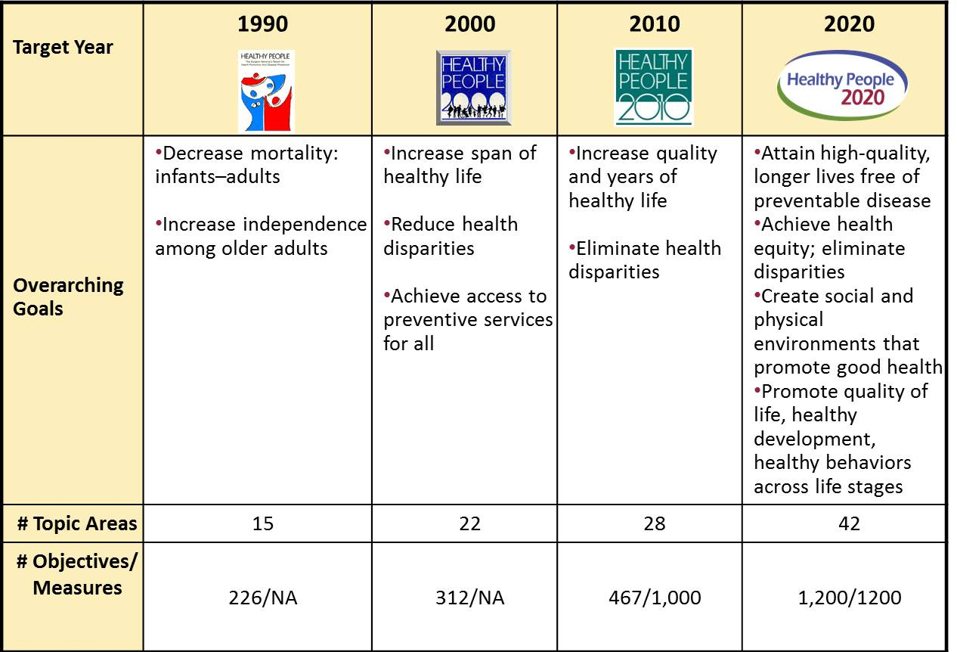

Evolution of Healthy People
Notes:
Dr. Koh:
Entering into its fourth decade, Healthy People continues to be at the forefront of public health, health promotion and disease prevention. It has evolved over time to include the most current topics and issues and has grown in strength and stature in so doing. Healthy People has extended its reach and concern for the health and well-being of our citizens. From the 15 areas covered by Healthy People 1990, the initiative expanded to 22 areas in Healthy People 2000, then to 28 in Healthy People 2010. Now, with the launch of HP2020, we have 42 Topic Areas, including such newcomers as Preparedness, Sleep Health, Global Health, LGBT Health, and Social Determinants of Health.
The growth of Healthy People topic areas presents a challenge in updating all of the data. More data on all of the objectives can be found on www dot healthy people dot gov

Slide 5
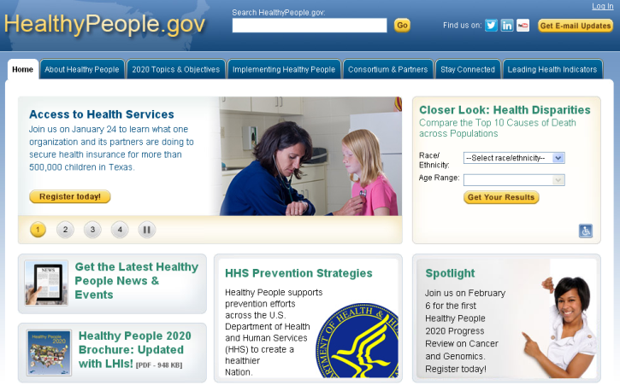
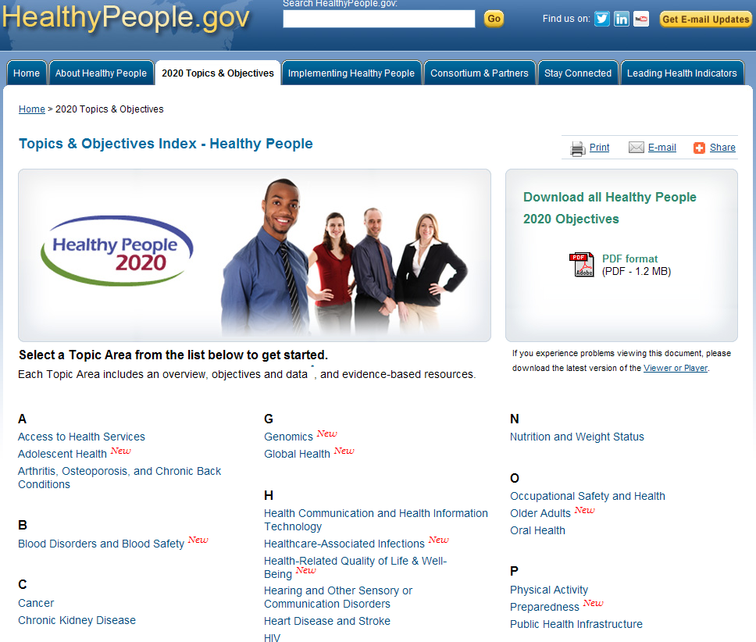

Healthy People 2020
  42 topic areas and 1200 objectives
  Source for reliable, science-based, public health measures
  Can be customized to meet needs of diverse users
  Guided by collaborative stakeholder-driven process
Notes:
Dr. Koh:
To access these objectives and view the Topic Areas, simply go to healthy people dot gov
Healthy People is still a source of reliable, science-based, public health measures because it has adapted over time to address changing health needs. Furthermore, Healthy People is an exceptional initiative in that it demonstrates the importance of collaboration across the Department of Health and Human Services and stakeholder input.
Included here is a screen capture of both the Healthy People landing page and the topic area page where you can access all of the Injury and Violence Prevention and Occupational Safety and Health objectives and data updates. The two topic areas circled on this slide are the focus of today’s progress review.

Slide 6
Public Health Impact:
Injury and Violence
Leading causes of death for ages 1-44
Affects all ages
  181,000 deaths in 2010 – one death every 3 minutes
  5,600 homicide deaths for ages 0-24, including 1,500 deaths from child abuse and neglect
  36,600 poisoning deaths for ages 25-64
  22,000 fall deaths for ages 65 and older
  33,700 motor vehicle traffic deaths for all ages
Costs more than $500 billion annually in medical care and lost productivity
Notes:
Dr. Koh:
Let’s take a look at public health impact of injury and violence. Unintentional injuries, suicides, and homicides are the leading causes of death for ages 1-44 (2010 data).
As you can see by the slide, this affects all ages. And results in:
30,024,936 emergency department visits for nonfatal unintentional injuries for all ages (IVP-29)
1,693,551 emergency department visits for nonfatal physical assault injuries for all ages (IVP-32)
The cost is more than $500 billion annually in medical care and lost of productivity.
[Data source: The most recent nonfatal injury data in NEISS-AIP (WISQARS http://webappa.cdc.gov/sasweb/ncipc/nfirates2001.html) are from 2011]

Slide 7
Public Health Impact:
Occupational Safety and Health
49,000 deaths from work-related illnesses (e.g., respiratory disease, cancer) in 2010
2.9 million workers injured in 2010
    110,000 hospitalized
    4,690 died
137,400 work-related assaults seen in emergency departments in 2009
Each year, work-related deaths, injuries, and illnesses cost $250 billion
  Work-related homicides cost nearly $3 billion in
  2003-2006
Notes:
Dr. Koh:
154 million civilian workers spend 40% of their waking hours at work (2012).
In 2010, there were 49,000 deaths from work-related illnesses (e.g. respiratory disease, cancer)
Also in 2010, there were 2.9 million workers injured, you can see the figures for those that were hospitalized and those that resulted in deaths.
In 2009, there were 137,000 work-related assaults seen in emergency departments.
Each year, work-related deaths, injuries, and illnesses cost $250 billion dollars.
[Source: Bureau of Labor Statistics and Steenland K, Burnett C, Lalich N, Ward E, Hurrell J. Dying for work: the magnitude of
US mortality from selected causes of death associated with occupation. Am J Ind Med 2003;43:461–82.
http://www.cdc.gov/mmwr/preview/mmwrhtml/mm6116a1.htm?s_cid=mm6116a1_w ]

Slide 8
Presenters
Chair
Howard K Koh, MD, MPH
Assistant Secretary for Health, HHS
Data Presentation
Edward Sondik, PhD Director, National Center for Health Statistics, CDC
Injury and Violence Prevention Topic Area
Linda Degutis, DrPH, MSN
Director, National Center for Injury Prevention and Control, CDC
Occupational Safety and Health Topic Area
Dawn Castillo, MPH
Director of the Division of Safety Research
National Institute for Occupational Safety and Health
Community Highlight
Matt London, MS
Health and Safety Specialist
New York State Public Employees Federation
Notes:
Dr. Koh:
Each Healthy People 2020 Topic Area is led by team of subject matter experts from across the Federal Government. For the Injury and Violence topic area, I’d like to welcome Dr. Linda Degutis, the Director of the National Center for Injury Prevention and Control, CDC. From the Occupational Safety and Health Topic Area I would like to welcome Dawn Castillo the Director of the Division of Safety Research of CDC’s National Institute for Occupational Safety and Health.
We are also joined by Matt London a Health and Safety Specialist at the New York State Public Employees-Federation, who will share their experience in reducing workplace violence.
As I mentioned earlier, we have a number of federal partners joining us. They will be on hand to answer your questions during the Q and A portion of the webinar. I’d like to welcome:
Paul Kesner, Director of the Safe Supportive Schools Program at the U.S. Department of Education
Thomas Feucht, Executive Senior Science Advisor at the National Institute of Justice, at the U.S. Department of Justice, and
William Wiatrowski, Associate Commissioner for Compensation and Working Conditions, Bureau of Labor Statistics, U.S. Department of Labor
Before we come to those presentations and the Q and A, we will hear from the CDC’s National Center for Health Statistics (NCHS) about the state of the data that are the underpinning of the whole Healthy People enterprise. Without supporting data for the 2020 objectives, we would not be able to assess the progress towards achievement of the targets for any of those objectives. NCHS is the compiler, oftentimes the collector, and the official analyst of data associated with and essential for Healthy People.
[Special remarks about Dr. Sondik’s retirement.]
At this time, I’d like to turn the rest of the meeting over to the very capable hand of Don Wright the Director of the Office of Disease Prevention and Health Promotion.
[Transitions to Dr. Wright]
Dr. Wright:
Thank you so much Dr. Koh. Here to bring us up to date on the progress of key Healthy People 2020 objectives is a wonderful colleague and long time supporter of Healthy People, Dr. Edward Sondik. Over to you, Ed.

Slide 9
Edward J. Sondik, PhD
Director, National Center for Health Statistics
Centers for Disease Control and Prevention

Slide 10
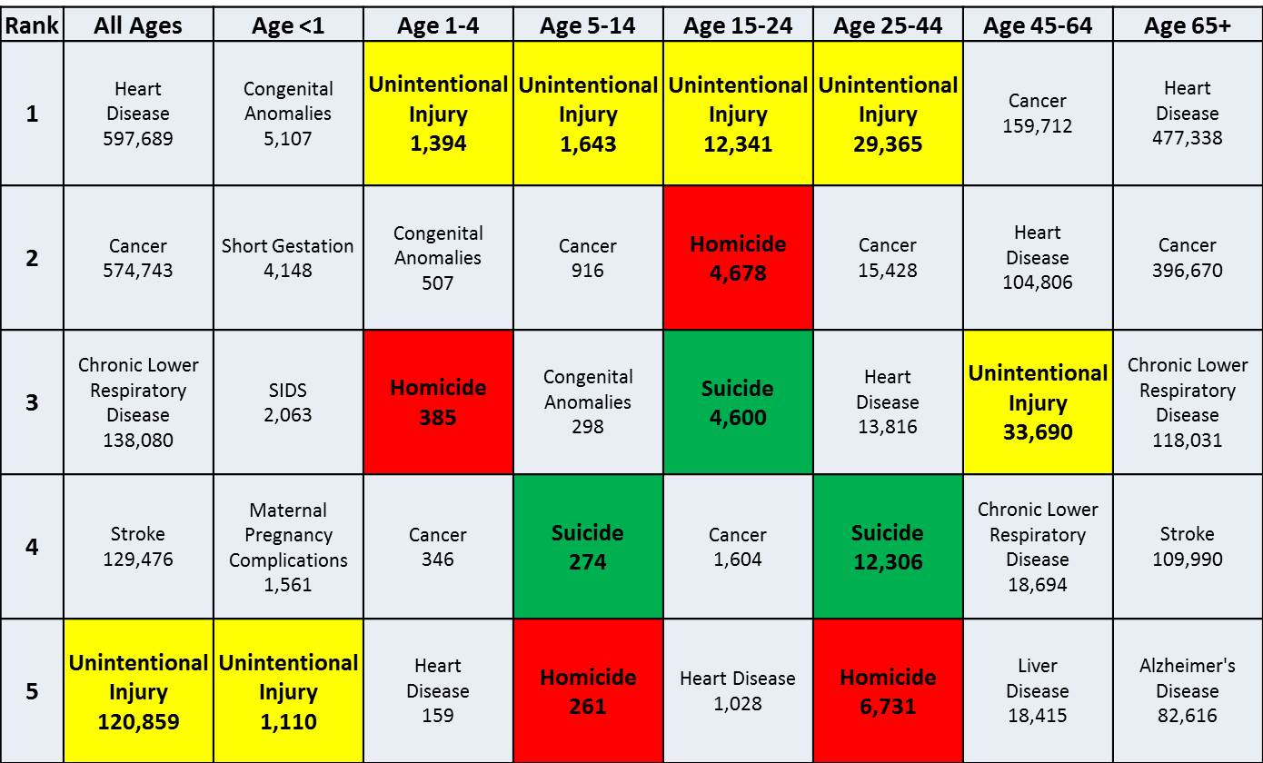
Leading Causes of Death, 2010
SOURCE: National Vital Statistics System–Mortality (NVSS-M), CDC/NCHS.

Slide 11
Injury in the United States, 2010
Deaths
Hospital discharges
Initial
emergency department
visits
35 million
episodes of medically consulted injuries were reported in a national household survey
SOURCES: National Vital Statistics System–Mortality (NVSS-M), National Hospital Discharge Survey (NHDS), National Hospital Ambulatory Medical Care Survey (NHAMCS), and National Health Interview Survey (NHIS), CDC/NCHS.

Slide 12
Injury Deaths by Cause, 1999-2010
Rate per 100,000 (age-adjusted)
MV Traffic
2020 Target = 13.1
Poisoning
Firearm
2020 Target = 12.4
2020 Target = 9.2
Fall
Obj. IVP-9.1, 13.1, 23.1*, 30
Decrease desired
  *IVP-23.1 tracks only unintentional fall deaths, which constitute the majority of fall deaths. IVP-23.1 does not include fall deaths that are of intentional or of undetermined intentso the HP2020 target is not shown. Data for all fall deaths are shown here.
  Data are age adjusted to the 2000 standard population.
SOURCE: National Vital Statistics System–Mortality (NVSS-M), CDC/NCHS.

Slide 13
Injury Deaths by Cause and Age, 2009-2010
Rate per 100,000
203.0
Fall
Poisoning
Firearm
MV Traffic
Obj. IVP-9.1, 13.1, 23.1*, 30
Decrease desired
*IVP-23.1 tracks only unintentional fall deaths, which constitute the majority of fall deaths. IVP-23.1 does not include fall deaths that are of intentional or of undetermined intent. Data for all fall deaths are shown here.
SOURCE: National Vital Statistics System–Mortality (NVSS-M), CDC/NCHS.

Slide 14
Nonfatal Injuries by Cause and Age, 2011
Rate per 100,000
14,159
Fall
Struck by/Against
MV Traffic
Overexertion
85+
SOURCE: National Electronic Injury Surveillance System–All Injury Program (NEISS-AIP), CDC/NCIPC and CPSC.

Slide 15
Work-related Injuries

Slide 16
Work-related Injuries
Ages 16+, 2004–2010
Rate per 100 full-time equivalent workers
2020 Target = 3.8
Obj. OSH-2.1
Decrease desired
SOURCE: Survey of Occupational Injuries and Illnesses (SOII), BLS.

Slide 17
Work-related Injuries Treated in
Emergency Departments, 2009
Rate per 100 full-time equivalent workers
Age (years)
Obj. OSH-2.2
Decrease desired
I = 95% confidence interval.
Total and sex-specific rates include ages 16+.
SOURCE: National Electronic Injury Surveillance System–Work Supplement (NEISS-Work), CDC/NIOSH and CPSC.

Slide 18
Work-related Injury Deaths
Ages 16+, 2010
Rate per 100,000 full-time equivalent workers
Total deaths: 4,690
2020 Target = 3.6
Obj. OSH-1.1
Decrease desired
Race groups exclude persons of Hispanic or Latino origin. Persons identified as Hispanic or Latino may be of any race.
I = 95% confidence interval.
SOURCE: Census of Fatal Occupational Injuries (CFOI), BLS.

Slide 19
Work-related Injury Deaths by Age, 2010
Rate per 100,000 full-time equivalent workers
2020 Target = 3.6
Obj. OSH-1.1
Decrease desired
I = 95% confidence interval.
SOURCE: Census of Fatal Occupational Injuries (CFOI), BLS.

Slide 20
Work-related Injury Deaths by Industry
Ages 16+, 2004–2010
Rate per 100,000 full-time equivalent workers
Agriculture/Forestry/Fishing
Mining
Transportation
Construction
All Industry
Obj. OSH-1.1 to OSH-1.5
Decrease desired
SOURCE: Census of Fatal Occupational Injuries (CFOI), BLS.

Slide 21
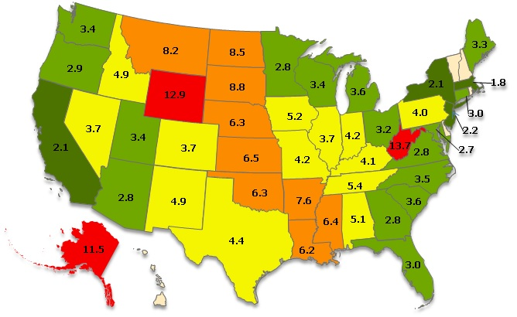

Work-related Injury Deaths, 2010
Highest rates
  West Virginia
  Wyoming
  Alaska
Lowest rates
  Massachusetts
  California
  New York
  New Jersey
8.9 – 13.7
5.7 – 8.8
3.7 – 5.6
2.3 – 3.6
2020 Target = 3.6 per 100,000, ages 16+
States in green have met the target.
0.9 – 2.2
Obj. OSH-1.1
Decrease desired
Rate not reliable
Rates are displayed by a modified Jenks classification for U.S. states, for full-time equivalent workers.
SOURCE: Census of Fatal Occupational Injuries (CFOI), BLS.

Slide 22
Violence-related Injuries:
Assaults and Homicides

Slide 23
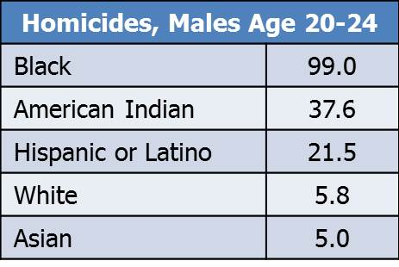
Homicides by Sex and Age, 2010
Rate per 100,000
Male
Female
85+
Obj. IVP-29
Decrease desired
Data are for ICD-10 codes *U01-*U02, X85-Y09, Y87.1 reported as underlying cause of death.
Race groups exclude persons of Hispanic or Latino origin. Persons of Hispanic or Latino origin may be of any race.
SOURCE: National Vital Statistics System–Mortality (NVSS-M), CDC/NCHS.

Slide 24
Percent Distribution of Homicides by Method
Ages 15-24, 2010
Firearm
Cut/pierce
Suffocation
Other/unspecified
Males, N=4,067
Females, N=611
SOURCE: National Vital Statistics System–Mortality (NVSS-M), CDC/NCHS.

Slide 25
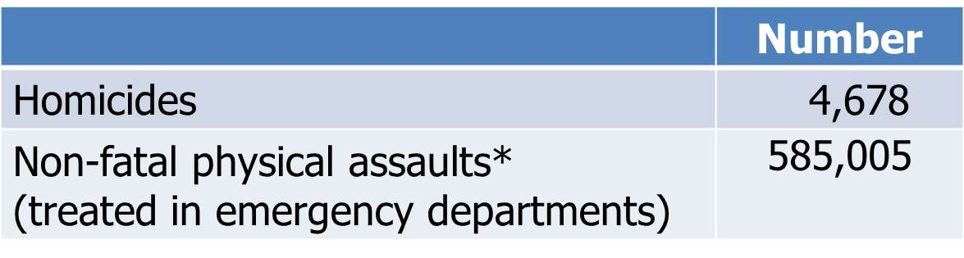
The Burden of Violence
Ages 15-24, 2010
Obj. IVP-29 and 32
Decrease desired
*Physical assaults include all confirmed or suspected cases of injuries and poisonings intentionally or purposefully inflicted by one person on another person with the aim of injuring or killing, with the exception of sexual assault.
SOURCES: National Electronic Injury Surveillance System–All Injury Program (NEISS-AIP), CDC/NCIPC and CPSC; National Vital Statistics System–Mortality (NVSS-M), CDC/NCHS.

Slide 26
Physical Assault Injuries Treated in
Emergency Departments, 2011
Rate per 100,000
2020 Target = 461.2
Age (years)
Obj. IVP-32
Decrease desired
I = 95% confidence interval.
Data for the total population are age adjusted to the 2000 standard population.
SOURCE: National Electronic Injury Surveillance System–All Injury Program (NEISS-AIP), CDC/NCIPC and CPSC.

Slide 27
Violence Against Children and Adolescents

Slide 28
Children’s Exposure to Violence, 2011
2020 Target: 52.9
Total
Male
Female
0-4 years
5-11 years
12-17 years
Black
White
Hispanic or Latino
Obj. IVP-42
Decrease desired
Proportion of children aged 17 years and under who have been exposed in the past year to any of 44 types of violence such as: conventional crime, child maltreatment, peer and sibling victimization, sexual victimization, witnessing and indirect victimization, school violence and threat, internet harassment and threats.
Race groups exclude persons of Hispanic or Latino origin. Persons of Hispanic or Latino origin may be of any race.
I = 95% confidence interval.
SOURCE: National Survey of Children’s Exposure to Violence (NatSCEV), DOJ/OJJDP.

Slide 29
Bullying On School Property, Grades 9-12, 2011
2020 Target: 17.9
Total
Female
Male
9th grade
10th grade
11th grade
12th grade
Obj. IVP-35
Decrease desired
Proportion of students in grades 9–12 who report being bullied on school property in the past 12 months.
I = 95% confidence interval.
SOURCE: Youth Risk Behavior Surveillance System (YRBSS), CDC/NCCDPHP.

Slide 30
Physical Fighting, Grades 9-12, 2011
2020 Target: 28.4
Total
Male
Female
9th grade
10th grade
11th grade
12th grade
Obj. IVP-34
Decrease desired
Proportion of students in grades 9–12 who report that they engaged in physical fighting in the previous 12 months.
I = 95% confidence interval.
SOURCE: Youth Risk Behavior Surveillance System (YRBSS), CDC/NCCDPHP.

Slide 31
Physical Fighting by Race and Ethnicity,
Grades 9-12, 2011
2020 Target: 28.4
Total
Two or more races
Nat. Hawaiian or Pacific Isl.
Am. Indian/AK Native
Black
Hispanic or Latino
White
Asian
Obj. IVP-34
Decrease desired
Proportion of students in grades 9–12 who report that they engaged in physical fighting in the previous 12 months. Respondents were asked to select one or more races. The single race categories listed include persons who reported only one racial group. Race groups exclude persons of Hispanic or Latino origin. Persons of Hispanic or Latino origin may be of any race.
I = 95% confidence interval.
SOURCE: Youth Risk Behavior Surveillance System (YRBSS), CDC/NCCDPHP.

Slide 32
Work-related Violence:
Assaults and Homicides

Slide 33
Work-related Assault Injuries Treated in Emergency Departments by Industry , 2007
Rate per 10,000 full-time equivalent workers
2020 Target = 7.6
Industry Sector
Obj. OSH-6
Decrease desired
I = 95% confidence interval.
SOURCE: National Electronic Injury Surveillance System–Work Supplement (NEISS-Work), CDC, NIOSH and CPSC.

Slide 34
Percent Distribution of Work-related Homicides by Perpetrator Type, 1997-2010
Robbers
Relatives
Customers
Co-workers
Male = 7,008
Female = 1,658
Robbers includes “other assailants”, Relatives includes “other personal acquaintances”, Customers includes “client”, Co-workers includes “former co-workers”.
SOURCE: Census of Fatal Occupational Injuries (CFOI), BLS.

Slide 35
Work-related Homicides, 2003-2010
Total (Number)
Work Setting
Obj. OSH-5
Decrease desired
SOURCE: Census of Fatal Occupational Injuries (CFOI), BLS.

Slide 36
Key Points
Younger age groups are disproportionately impacted by non-fatal injuries in both work and non-work environments
Over half of all children and adolescents have been exposed to violence
The burden of violence extends beyond homicides to include nonfatal physical assaults and bullying
Patterns of violence differ by age, settings, and race suggesting the need for targeted prevention strategies

Slide 37
Appendix

Slide 38
Objective Status: Injury Prevention
  IVP-1.1 Injury deaths
  IVP-1.2 Nonfatal injury hospitalizations
  IVP-1.3 Emergency department visits for nonfatal injuries
  IVP–2.1 Traumatic brain injury deaths
  IVP-2.2 Nonfatal traumatic brain injury hospitalizations
  IVP-2.3 Emergency department visits for nonfatal traumatic brain injuries
  IVP-3.1 Spinal cord injury deaths
  IVP-3.2 Nonfatal spinal cord injury hospitalizations
  IVP-4 State-level child fatality review
  IVP-5 State-level SIDS review
  IVP-6 Emergency department surveillance of external causes of injury
  IVP-7 Hospital discharge surveillance of external causes of injury
  IVP-8.1 Trauma center access, by population
  IVP-8.2 Trauma center access, by land mass
  IVP-9.1 Poisoning deaths
  IVP-9.2 Poisoning deaths: adults 35–54 years
  IVP-9.3 Poisoning deaths, unintentional or undetermined
  IVP-9.4 Poisoning deaths, unintentional or undetermined: 35–54 years
  IVP-10 Emergency department visits for nonfatal poisonings
Target met Improving Little/No change Getting worse Baseline only Developmental
Notes:
Definitions
Target met: Target met or exceeded
Improving - Movement is in the desired direction:
Change in objective is statistically significant*, OR
Objective has achieved 10% or more of the targeted change
Little/No change:
Objective has achieved less than 10% of the targeted change (and is not statistically significant*)
Objective has a deficit of less than 10% relative to its baseline which it needs to regain before starting to move toward the target (and is not statistically significant*)
Getting worse - Movement is not in the desired direction:
Change in objective is statistically significant*, OR
Objective has a deficit of 10% or more (relative to its baseline), which it needs to regain before starting to move toward the target
Baseline only: Baseline data only; progress cannot be assessed
Developmental: Objective is developmental (does not have baseline data)
Informational: Objective is informational (does not have a target)
Notes
*Statistical significance is only assessed when estimates of variability are available
Percent of targeted change achieved = 100 × (Most recent value – Baseline value) / (HP2020 target – Baseline value)
Percent in deficit = 100 × |Most recent value – Baseline value| / (Baseline value)

Slide 39
Objective Status: Unintentional Injury Prevention
  IVP-11 Unintentional injury deaths
  IVP-12 Emergency department visits for nonfatal unintentional injuries
  IVP-13.1 Motor vehicle crash deaths (per 100,000 population)
  IVP-13.2 Motor vehicle crash deaths (per 100 million vehicle miles)
  IVP–14 Nonfatal motor vehicle crash injuries
  IVP–15 Safety belt use
  IVP–16.1 Age-appropriate child restraint use (0-12 months)
  IVP–16.2 Age-appropriate child restraint use (1-3 years)
  IVP-16.3 Age-appropriate child restraint use (4-7 years)
  IVP-16.4 Age-appropriate child restraint use (8-12 years)
  IVP-17 "Good" graduated driver licensing laws
  IVP-18 Pedestrian deaths
  IVP-19 Nonfatal pedestrian injuries
  IVP-20 Pedalcyclist deaths
  IVP-21 Bicycle helmet laws
  IVP-22 Motorcycle helmet use
  IVP-23.1 Deaths from unintentional falls
  IVP-23.2 Deaths from unintentional falls (≥65 years)
  IVP-24.1 Unintentional suffocation deaths
  IVP-24.2 Unintentional suffocation deaths (0-12 months)
  IVP-24.3 Unintentional suffocation deaths (≥65 years)
  IVP-25 Drowning deaths
  IVP-26 Medically consulted sports and recreation injuries
  IVP-27.1 Protective gear in physical education
  IVP-27.2 Protective gear in intramural activities and physical activity clubs
  IVP-28 Residentail fire deaths
Target met Improving Little/No change Getting worse Baseline only Developmental
Notes:
Definitions
Target met: Target met or exceeded
Improving - Movement is in the desired direction:
Change in objective is statistically significant*, OR
Objective has achieved 10% or more of the targeted change
Little/No change:
Objective has achieved less than 10% of the targeted change (and is not statistically significant*)
Objective has a deficit of less than 10% relative to its baseline which it needs to regain before starting to move toward the target (and is not statistically significant*)
Getting worse - Movement is not in the desired direction:
Change in objective is statistically significant*, OR
Objective has a deficit of 10% or more (relative to its baseline), which it needs to regain before starting to move toward the target
Baseline only: Baseline data only; progress cannot be assessed
Developmental: Objective is developmental (does not have baseline data)
Informational: Objective is informational (does not have a target)
Notes
*Statistical significance is only assessed when estimates of variability are available
Percent of targeted change achieved = 100 × (Most recent value – Baseline value) / (HP2020 target – Baseline value)
Percent in deficit = 100 × |Most recent value – Baseline value| / (Baseline value)

Slide 40
Objective Status: Violence Prevention
  IVP-29 Homicides
  IVP-30 Firearm-related deaths
  IVP-31 Emergency department visits for nonfatal firearm-related injuries
  IVP-32 Emergency department visits for nonfatal physical assault injuries
  IVP-33 Physical assaults
  IVP-34 Physical fighting among adolescents
  IVP-35 Bullying among adolescents
  IVP-36 Weapon carrying by adolescents on school property
  IVP-37 Child maltreatment deaths
  IVP-38 Nonfatal child maltreatment
  IVP-39.1 Physical violence by intimate partners
  IVP-39.2 Sexual violence by intimate partners
  IVP-39.3 Psychological abuse by intimate partners
  IVP-39.4 Stalking by intimate partners
  IVP-40.1 Rape or attempted rape
  IVP-40.2 Abusive sexual contact other than rape
  IVP-40.3 Non-contact sexual abuse
  IVP-41 Emergency department visits for nonfatal intentional self-harm injuries
  IVP-42 Children exposed to violence
  IVP-43 State linkage of violent death data
Target met Improving Little/No change Getting worse Baseline only Developmental
Notes:
Definitions
Target met: Target met or exceeded
Improving - Movement is in the desired direction:
Change in objective is statistically significant*, OR
Objective has achieved 10% or more of the targeted change
Little/No change:
Objective has achieved less than 10% of the targeted change (and is not statistically significant*)
Objective has a deficit of less than 10% relative to its baseline which it needs to regain before starting to move toward the target (and is not statistically significant*)
Getting worse - Movement is not in the desired direction:
Change in objective is statistically significant*, OR
Objective has a deficit of 10% or more (relative to its baseline), which it needs to regain before starting to move toward the target
Baseline only: Baseline data only; progress cannot be assessed
Developmental: Objective is developmental (does not have baseline data)
Informational: Objective is informational (does not have a target)
Notes
*Statistical significance is only assessed when estimates of variability are available
Percent of targeted change achieved = 100 × (Most recent value – Baseline value) / (HP2020 target – Baseline value)
Percent in deficit = 100 × |Most recent value – Baseline value| / (Baseline value)

Slide 41
Current HP2020 Objective Status:
Injury and Violence Prevention
Total number of objectives: 65
Target met
Improving
Little/No change
Getting worse
Baseline only
Developmental
Notes:
Definitions
Target met: Target met or exceeded
Improving - Movement is in the desired direction:
Change in objective is statistically significant*, OR
Objective has achieved 10% or more of the targeted change
Little/No change:
Objective has achieved less than 10% of the targeted change (and is not statistically significant*)
Objective has a deficit of less than 10% relative to its baseline which it needs to regain before starting to move toward the target (and is not statistically significant*)
Getting worse - Movement is not in the desired direction:
Change in objective is statistically significant*, OR
Objective has a deficit of 10% or more (relative to its baseline), which it needs to regain before starting to move toward the target
Baseline only: Baseline data only; progress cannot be assessed
Developmental: Objective is developmental (does not have baseline data)
Informational: Objective is informational (does not have a target)
Notes
*Statistical significance is only assessed when estimates of variability are available
Percent of targeted change achieved = 100 × (Most recent value – Baseline value) / (HP2020 target – Baseline value)
Percent in deficit = 100 × |Most recent value – Baseline value| / (Baseline value)

Slide 42
Objective Status: Occupational Safety and Health
  OSH-1.1 Reduce deaths from work-related injuries (All industry).
  OSH-1.2 Reduce deaths from work-related injuries (Mining).
  OSH-1.3 Reduce deaths from work-related injuries (Construction).
  OSH-1.4 Reduce deaths from work-related injuries (Transportation and warehousing).
  OSH-1.5 Reduce deaths from work-related injuries (Agriculture, forestry, fishing, and hunting).
  OSH-2.1 Injuries resulting in medical treatment, lost time from work, or restricted work activity
  OSH-2.2 Injuries treated in emergency departments.
  OSH-2.3 Reduce nonfatal work-related injuries among adolescent (15-19 years) workers.
  OSH-3 Reduce injury and illness due to overexertion or repetitive motion.
  OSH-4 Reduce pneumoconiosis deaths.
  OSH-5 Reduce deaths from work-related homicides.
  OSH-6 Reduce work-related assaults .
  OSH-7 Reduce the proportion of persons who have elevated blood lead concentrations from work exposures injuries
  OSH-8 Reduce occupational skin diseases or disorders.
  OSH-9 Increase the proportion of employees who have access to workplace programs that prevent or reduce employee stress.
  OSH-10 Reduce new cases of work-related, noise- induced hearing loss
Target met Improving Little/No change Getting worse Baseline only Developmental
Notes:
Definitions
Target met: Target met or exceeded
Improving - Movement is in the desired direction:
Change in objective is statistically significant*, OR
Objective has achieved 10% or more of the targeted change
Little/No change:
Objective has achieved less than 10% of the targeted change (and is not statistically significant*)
Objective has a deficit of less than 10% relative to its baseline which it needs to regain before starting to move toward the target (and is not statistically significant*)
Getting worse - Movement is not in the desired direction:
Change in objective is statistically significant*, OR
Objective has a deficit of 10% or more (relative to its baseline), which it needs to regain before starting to move toward the target
Baseline only: Baseline data only; progress cannot be assessed
Developmental: Objective is developmental (does not have baseline data)
Informational: Objective is informational (does not have a target)
Notes
*Statistical significance is only assessed when estimates of variability are available
Percent of targeted change achieved = 100 × (Most recent value – Baseline value) / (HP2020 target – Baseline value)
Percent in deficit = 100 × |Most recent value – Baseline value| / (Baseline value)

Slide 43
Current HP2020 Objective Status:
Occupational Safety and Health
Total number of objectives: 16
Target met
Improving
Little/No change
Getting worse
Baseline only
Developmental
Notes:
Definitions
Target met: Target met or exceeded
Improving - Movement is in the desired direction:
Change in objective is statistically significant*, OR
Objective has achieved 10% or more of the targeted change
Little/No change:
Objective has achieved less than 10% of the targeted change (and is not statistically significant*)
Objective has a deficit of less than 10% relative to its baseline which it needs to regain before starting to move toward the target (and is not statistically significant*)
Getting worse - Movement is not in the desired direction:
Change in objective is statistically significant*, OR
Objective has a deficit of 10% or more (relative to its baseline), which it needs to regain before starting to move toward the target
Baseline only: Baseline data only; progress cannot be assessed
Developmental: Objective is developmental (does not have baseline data)
Informational: Objective is informational (does not have a target)
Notes
*Statistical significance is only assessed when estimates of variability are available
Percent of targeted change achieved = 100 × (Most recent value – Baseline value) / (HP2020 target – Baseline value)
Percent in deficit = 100 × |Most recent value – Baseline value| / (Baseline value)

Slide 44
Public Health Impact:
Injury and Violence
Leading causes of death for ages 1-44
Affects all ages
  181,000 deaths in 2010 – one death every 3 minutes
  5,600 homicide deaths for ages 0-24, including 1,500 deaths from child abuse and neglect
  36,600 poisoning deaths for ages 25-64
  22,000 fall deaths for ages 65 and older
  33,700 motor vehicle traffic deaths for all ages
Costs more than $500 billion annually in medical care and lost productivity

Slide 45
Public Health Impact:
Occupational Safety and Health
49,000 deaths from work-related illnesses (e.g., respiratory disease, cancer) in 2010
2.9 million workers injured in 2010
    110,000 hospitalized
    4,690 died
137,400 work-related assaults seen in emergency departments in 2009
Each year, work-related deaths, injuries, and illnesses cost $250 billion
  Work-related homicides cost nearly $3 billion in
  2003-2006

Slide 46
Linda C. Degutis, DrPH, MSN
Director, National Center for Injury Prevention and Control
Centers for Disease Control and Prevention

Slide 47
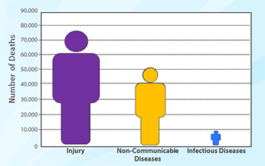
National Center for Injury Prevention and Control (NCIPC)
Mission: To prevent violence and injuries, and reduce their consequences
Injury: Leading cause of death, ages 1-44
Notes:
Committed to saving lives, preventing violence and injuries; lowering health and societal costs of violence and injuries.
Leading cause of death among children, youth, and adults ages 1-44; 180,000 deaths/year.
> 20 years, Injury Center uses science to create real-world solutions
Work across sectors; many diverse federal and non-federal partners — to make people safer (all environments)

Slide 48
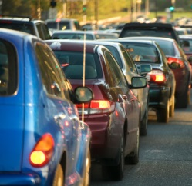

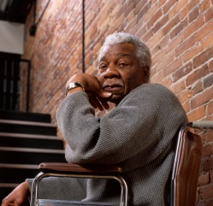

NCIPC Focus Areas
    Motor Vehicle-Related Injury
    Prescription Painkiller Overdose
    Traumatic Brain Injury
    Violence Against Children and Youth
Notes:
4 focus areas:
Motor Vehicle-Related Injury Prevention
Prevention of Prescription Painkiller Overdose
Prevention of Traumatic Brain Injury
Prevention of Violence Against Children and Youth
Intent: address high burden issues where promising and proven practices are available; be more flexible and nimble in responding to emerging issues.
All are critical priorities associated with HP2020 objectives.
Today - talk about violence prevention work

Slide 49
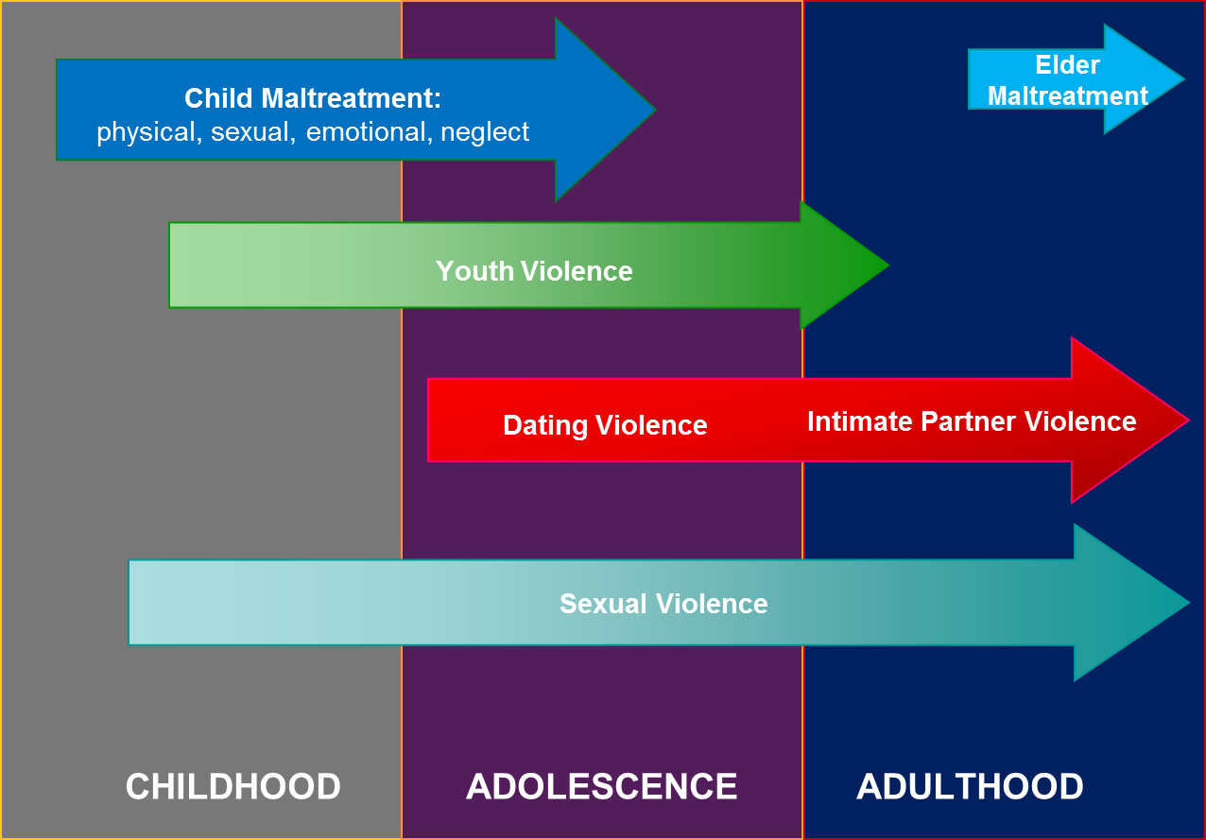
Violence Across the Lifespan
Notes:
Risk for violence starts at birth and continues across the lifespan. Supporting work in each area
Recently released Essentials for childhood
National Intimate Partner and Sexual Violence Survey – first ongoing survey of its kind in over 10 years.
Data from 2010: 1 in 5 women and 1 in 71 men raped in their lifetime.
RPE Program provide funding to strengthen sexual violence prevention efforts in all 50 states, the District of Columbia, Puerto Rico, and six U.S. territories.

Slide 50
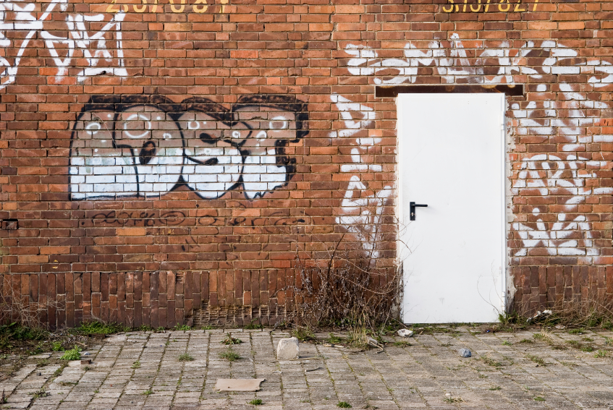
Violence Against Children and Youth
Injury or death
Life-long consequences
Subsequent violence
Linked to chronic diseases
Alcohol/Drug abuse
Obesity
HIV risk
Depression
Asthma
Financial costs
Eating disorders
Notes:
HP2020: > a dozen objectives that relate to reducing violence experienced by children and youth.
Progress on these objectives is critical - as we saw in Dr. Sondik’s presentation, violence contributes to substantial public health burden for young people.
Youth who are victims of violence at greater risk for subsequent violence, including later perpetration and victimization.
Young victims of violence at increased risk for a range of life-long health consequences, including obesity, chronic diseases, depression, alcohol and drug abuse, and eating disorders.
Substantial financial burden - for child maltreatment alone, total lifetime costs—health care, child welfare, criminal justice, and the value of lost future productivity and earnings—are $124 billion each year.
Focused on putting science into action prevent violence.
Share a few examples of current programmatic, research and surveillance activities moving us toward the HP2020 objectives.

Slide 51
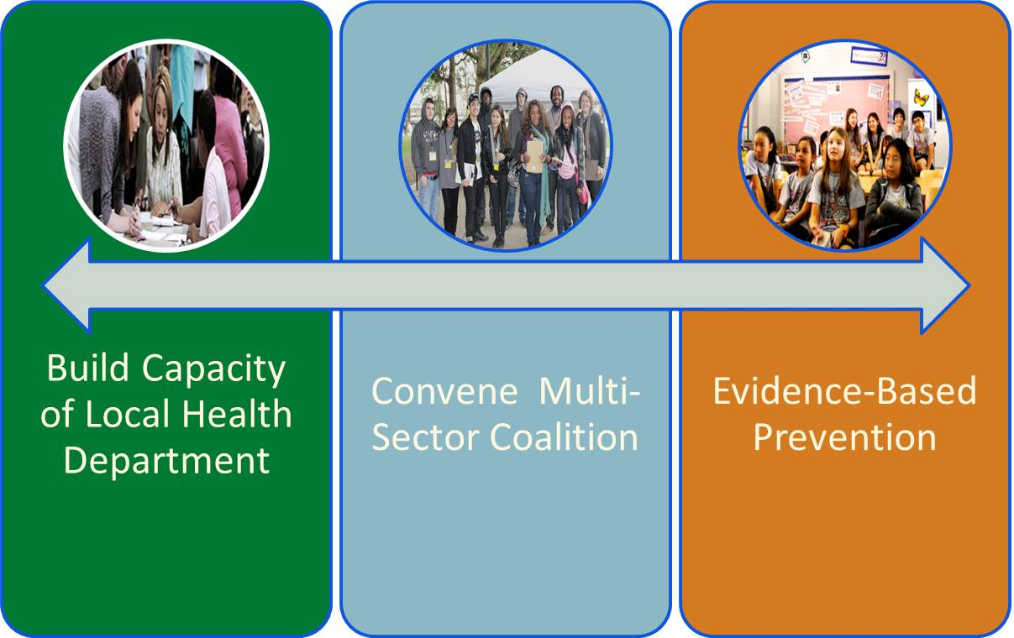

Striving to Reduce Youth Violence Everywhere (STRYVE)
STRYVE Online: www.VetoViolence.org/STRYVE
Objectives: IVP-33 reduce physical assaults, IVP- 34 reduce physical fighting among adolescents, IVP-29 reduce homicides
Notes:
Have learned a great deal about what works. For example, the Blueprints for Violence Prevention program at the University of CO has identified over 30 programs that have been rigorously evaluated and shown to be effective.
Challenge - many communities are either not aware of these strategies or lack the capacity to implement them.
Our youth violence prevention initiative STRYVE is working to provide the help that communities are seeking.
Two prongs to the STRYVE initiative:
Funding four local health departments to implement STRYVE. Sites are working with a coalition of folks from across sectors, including education, law enforcement, and public policy, to
Create a comprehensive plan
implement based on best available evidence
track and measure improvement.
Providing virtual training and technical assistance through STRYVE online to help communities nationwide. Includes information on what has worked and guidance on how to select, implement, and sustain an integrated approach.
Note: funds totaling $4.5 million over a five-year project period.
Sites are: Boston, Salinas, Portland, Houston

Slide 52
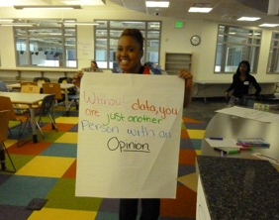
Academic Centers of Excellence in Youth Violence Prevention
  Assessing community-wide impact of data-driven approaches to prevention
Objectives: IVP-33 reduce physical assaults, IVP- 34 reduce physical fighting among adolescents, IVP-29 reduce homicides
Notes:
Learned a great deal but research is still needed. Need to understand how to help high risk communities.
Research activity - Academic Centers of Excellence or ACES.
Purpose: reduce youth violence in defined high–risk communities by connecting academic and community resources to implement and evaluate prevention strategies.
Centers take best available research evidence (peer, family, and community), implement strategies as part of a comprehensive approach in neighborhoods, and assess impact on a range of youth violence outcomes.
Photo was taken at a community celebration with the ACE site in Colorado. The ACE team was explaining the importance of having good data to drive decisions. The young woman in the photo is holding up a sign that says “without data, you are just another person with an opinion."
Nationwide and in the STRYVE and ACEs communities, young people of color are disproportionately affected by youth violence. All of the STRYVE and ACE grantees are working in communities with a high proportion of minority youth. For example, ACE communities are 85-95% minority; rates of poverty and unemployment range from 40% to 80%. The lessons that we learn from working with these communities will allow us to better understand the partnerships and capacity required for successful implementation and the effects of comprehensive prevention strategies - in the communities where these efforts are needed most.
Notes:
Currently-funded ACEs
University of Chicago (Humboldt Park, Chicago)
Virginia Commonwealth University (Richmond, VA)
University of North Carolina, Chapel Hill (Robeson County, NC)
University of Michigan (Flint, MI)
University of Colorado, Boulder (Denver, CO)
Johns Hopkins University (Baltimore, MD)

Slide 53
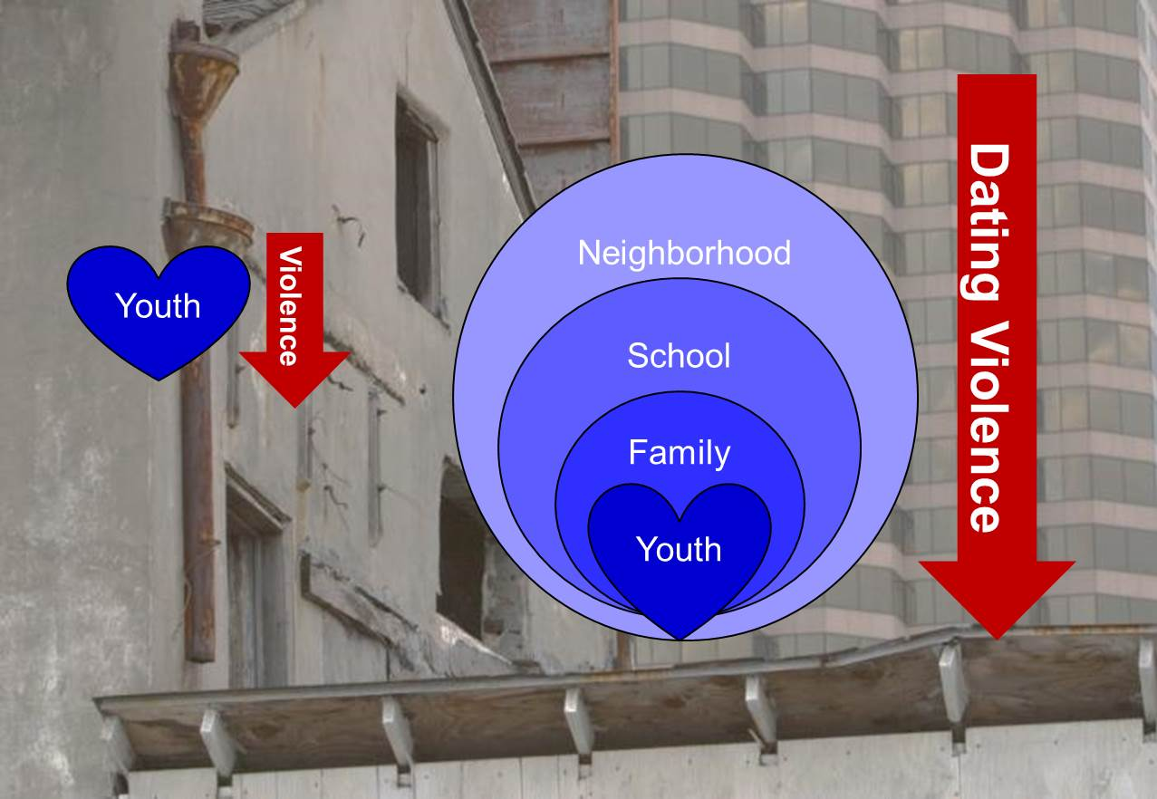
Dating Matters™ to Promote Healthy Teen Relationships
Objective: IVP-39 reduce violence by current or former intimate partners
Notes:
Past CDC funded research in North Carolina showed that school-based TDV prevention programming can result in significant and sustained reductions in physical and sexual teen dating violence. This program is currently being widely disseminated around the country.
Challenge - we do not know what works to prevent TDV in high risk urban communities.
Dating Matters™: program designed specifically for youth in high risk urban communities to promote healthy, nonviolent relationships. Includes:
school-based strategies aimed at building youths’ skills that support healthy relationships
programs to enhance parenting skills and communication;
training to enable teachers to recognize and respond to the risk factors of dating violence
tools for working with organizations and neighborhoods to keep youth safe.
Conducting a rigorous cross-site evaluation comparing Dating Matters approach to standard school-based practice (Safe Dates implemented in 8th grade). Over 5 years, programming will be delivered to tens of thousands of youth, parents, educators, and community members.
Lessons learned will guide future TDV prevention work in high risk communities.
Note: Funded sites:
Alameda County, CA
Baltimore, MD
Fort Lauderdale, FL
Chicago, IL

Slide 54
School Associated Violent Death Surveillance System (SAVD)
Objectives: IVP-29 reduce homicides, IVP- 42 reduce children’s exposure to violence
Notes:
Surveillance data essential for guiding prevention and monitoring results.
CDC’s School Associated Violence Death Surveillance System (SAVD) - partnership with the Departments of Education and Justice (if appropriate, can indicate that two of our partners, Thomas Feucht from NIJ and Paul Kesner from Department of Education are on the webinar – we have collaborated with both agencies on SAVD and multiple other projects over the years).
Information collected each year from media databases, police, and school officials about all school-associated violent deaths in public and private elementary, middle and senior high schools throughout the U.S.
SAVD data:
Between 14 and 34 school-age children are victims of homicide on school grounds or on their way to and from school—each and every year.
Most school-associated violent deaths occur during transition times – immediately before and after the school day and during lunch.
Homicide is the second leading cause of death among youth aged 5-18. Data from this study indicate that between 1% and 2% of these deaths happen on school grounds or on the way to or from school.
Summarize SAVD results each year in the Department of Education’s Indicators of School Crime and Safety Document.

Slide 55
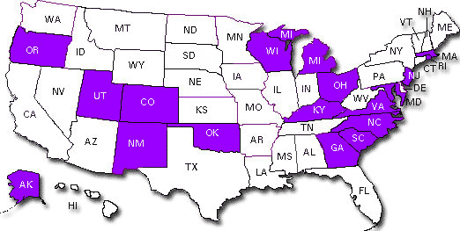
National Violent Death
Reporting System (NVDRS)
Objective: IVP-43 increase number of states that link data on violent deaths
Notes:
Last activity - NVDRS
Although we have extensive data on violent deaths, the information is not integrated.
Since 2003, NVDRS has linked data from death certificates, coroner/medical examiner reports, law enforcement reports and laboratory reports at incident level. For all violent deaths in participating states.
NVDRS states have more complete information on local deaths, including
circumstances that contributed to a violent death
relationship of the victim to the suspect
link deaths within an incident to examine multiple victim homicides and homicides followed by suicide.
NVDRS provides comprehensive data and functionality that no other system offers in a fast, efficient manner that can be used to inform decision-making on violence prevention strategies at the state and local levels.
NVDRS is currently in the 18 states shown in purple.
These states are actively using NVDRS data to inform their violence prevention activities, for example:
Former New Jersey Governor Jon Corzine’s office used NVDRS data to help standardize how gang-related activity was defined and measured. This was used as part of the Governor’s anti-crime strategy to plan interventions to reduce gang violence, such as providing alternative programs for youth to reduce gang membership and helping convicts adjust as they leave prison.
Recently issued President’s Plan to Protect our Children and our Communities by Reducing Gun Violence calls for expansion of NVDRS to all 50 states to help inform future research and prevention strategies.
Goal is consistent with the HP2020 objective and we are taking steps to prepare for expansion.

Slide 56



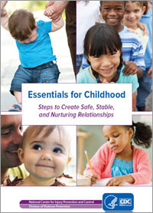




NCIPC Resources for Preventing Violence Across the Lifespan
www.cdc.gov/injury
Notes:
In conclusion,
Injury Center is committed to preventing violence across the lifespan, including child maltreatment, youth violence, IPV, SV, elder maltreatment, and suicide.
have shared just a few activities of the work being done to reduce violence against children and youth, and to reach our HP objectives for 2020.
Activities can have life-long benefits for children by reducing burden from violence and by changing their trajectory for subsequent violence and related health consequences.
More details about these and other activities are available on our website.

Slide 57
Dawn N. Castillo, MPH
Director, Division of Safety Research
National Institute for Occupational Safety & Health

Slide 58

Work, Injuries, Violence and Prevention
> 154M workers typically spend 40% of waking hours at work
Workplace injuries, violence and illness impact workers, employers and society
Employers, workers and governments can take steps to improve the safety and health of workers

Slide 59
National Institute for Occupational Safety and Health (NIOSH)
Mission: Improve worker safety and well-being by
  Generating new knowledge
  Transferring that knowledge into practice
Approach
  Conducting scientific research
  Developing guidance and authoritative recommendations
  Conducting outreach
  Responding to requests for technical assistance and evaluations of work hazards

Slide 60
Advancing Occupational Safety and Health HP 2020 Objectives
16 Objectives
  Reducing injuries generally and by industry sector
    2 workplace violence objectives
  Health related outcomes
Engage Partners in Research-to-Practice
  Employers and trade organizations
  Unions and worker organizations
  Government agencies
  Manufacturers

Slide 61
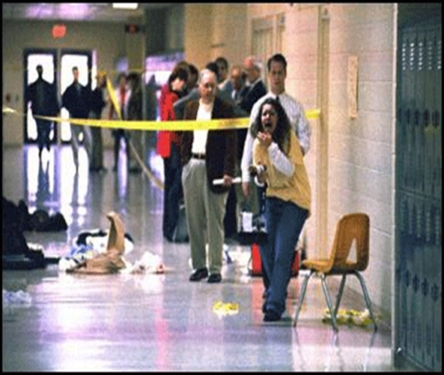
Workplace Violence is Pervasive
Average of 619 homicides (1997-2010)
>137,000 emergency-department treated assaults (2009)
41,000 workers missed > 1 day of work (2009)
Many injuries and assaults not counted
Psychological impacts unmeasured

Slide 62
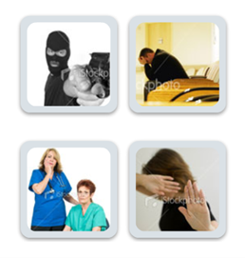
Workplace Violence is Complex
Risks and Prevention Strategies Vary by
Violence Type and Industry

Slide 63

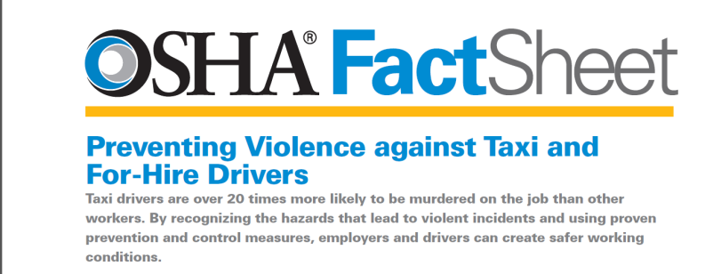
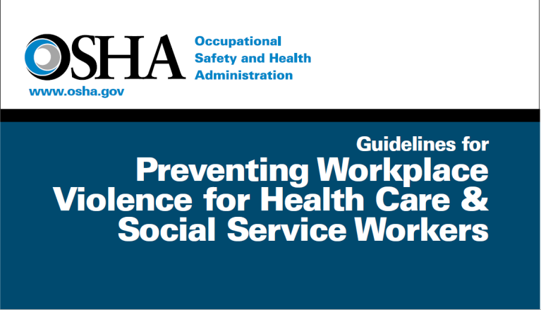
Realizing HP 2020 Objectives: Research to Practice
Approx. 150 scientific articles and publications supported by NIOSH
Research has influenced:
  Employer practices
  State and municipal regulations
  OSHA guidelines
Objectives OSH-5 and OSH-6: Reduce work-related homicides and assaults

Slide 64
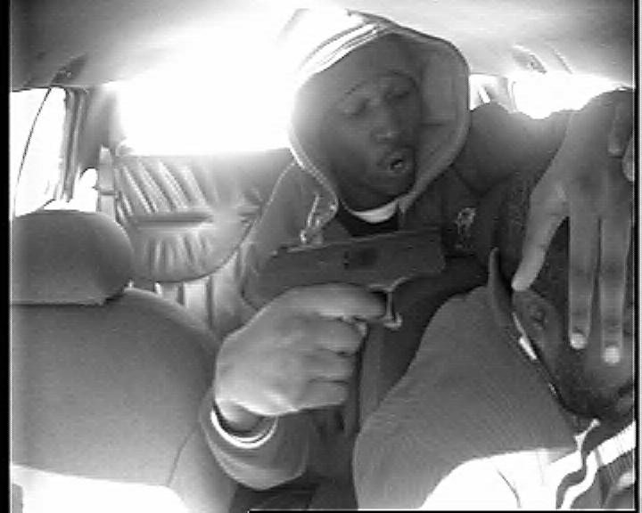
Preventing Workplace Violence in the Taxicab Industry
Example of current research project:
  Multi-city evaluation of security cameras and driver/passenger partitions
Partners:
  International Association of Transportation Regulators
  Taxicab, Limousine and Paratransit Association
Objectives OSH-5 and OSH-6: Reduce work-related homicides and assaults

Slide 65

Preventing Workplace Violence in Healthcare
Partners:
  Veteran’s Health Administration
  Extramural scientists
  Associations
  Vida Health Communications
Examples of current research projects:
  Evaluation of psychiatric facilities intervention
  Evaluation of state legislation
  Development and evaluation of an online course for healthcare personnel
Objectives OSH-6 and OSH-5: Reduce work-related assaults and homicides

Slide 66
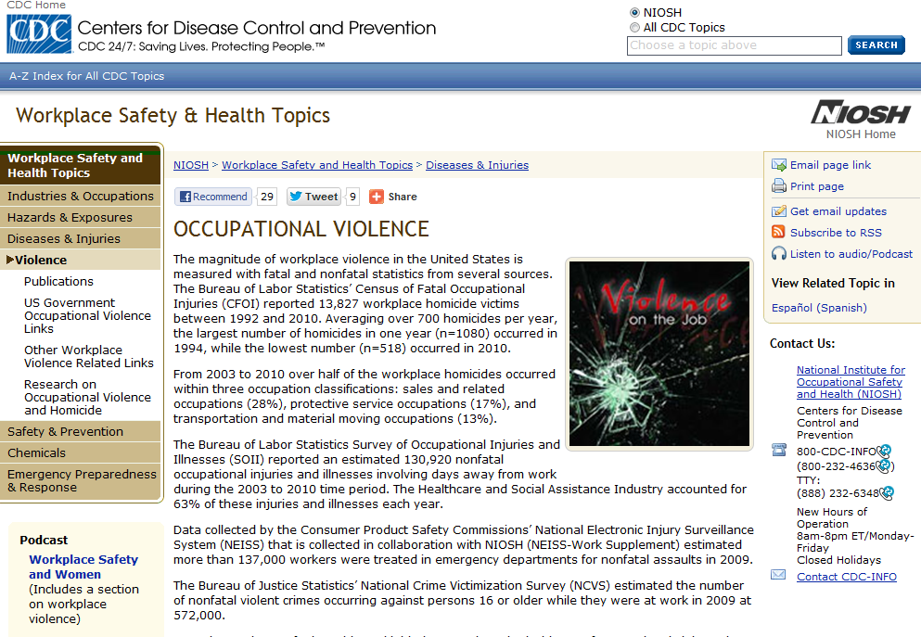
NIOSH Resources for HP 2020 Workplace Violence Objectives
www.cdc.gov/niosh/topics/violence/
Objectives OSH-5 and OSH-6: Reduce work-related homicides and assaults

Slide 67

Violence Across the Lifespan: The Workplace
Matt London
New York State
Public Employees Federation
April 18, 2013
Notes:
Thank you for the opportunity to briefly describe the importance of violence in the workplace, and some of the things that our union has been able to do.
Suggested alt-text for graphic: picture of poster urging “Stop Workplace Violence”, with the image of an assaulted worker within an octagonal stop sign.

Slide 68
NYS Public Employees Federation (PEF)
Union representing 55,000 NYS government employees
Professional, scientific, and technical jobs
Nurses, counselors, teachers, social workers, engineers, researchers
High-risk settings
Extensive exposure to vulnerable sectors of the public
Notes:
I work for PEF, a public sector union that represents many professionals who work for New York State government agencies. Our members provide vital services to the community, including to citizens who may pose a significant risk of violence. Ms. Castillo described many of these work settings.
The union’s role is to, not only bargain over salaries and other aspects of compensation, but also over working conditions, including workplace health and safety.

Slide 69
Patient-related Injuries
NYS Office of Mental Health - FY 2006
Occ Group FTEs # Incid. Rate
Therapy Aides 2890 1052 36.4%
Secure Aides 939 778 82.9%
Nurses 1616 379 23.5%
Overall 5445 2209 40.6%
Notes:
This table describes the high annual incidence rates for direct care workers in the state’s Office of Mental Health. The aides have virtually full-time contact with patients. Secure aides work in forensic hospitals.

Slide 70
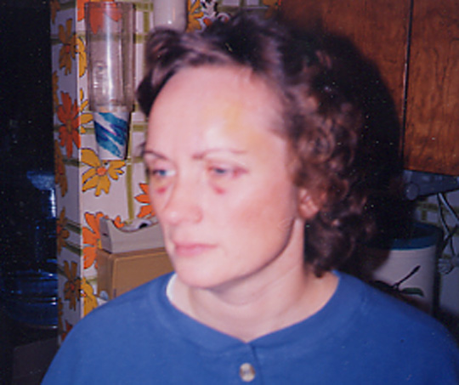
Jill D., RN – Psychiatric Nurse
November 1996
Notes:
Jill is a psychiatric nurse who was working at a state-run psychiatric center. She was brutally assaulted by a patient who had a long history of violence.
Jill was working alone, and it wasn’t until another patient heard Jill’s head being bashed against a wall that a call for assistance was made. Jill’s boss callously told her that the patient had nowhere else to go, and would remain there. The local police informed her “You knew that it was risky when you took the job.”
Jill missed two months’ work, but the trauma remains to this day.
Suggested alt-text for graphic: Picture of a psychiatric nurse who was assaulted in 1996.

Slide 71

Job Shouldn’t
Kill You
Notes:
It was two years later that another PEF psychiatric nurse was murdered. Judi was working alone, conducting a home visit to a patient. She had not been informed of this patient’s relevant history, and was brutally murdered with a hammer.
Suggested alt-text for graphic: Picture of a button that was created as part of the union’s workplace violence campaign. It includes the image of a psychiatric nurse who was murdered by one of her patients. The button includes the slogans “Your job shouldn’t kill you!” and “Remember Judi Scanlon”

Slide 72
PEF’s Workplace Violence Partnership
Educate and mobilize our members
NIOSH/Univ of MD School of Nursing grants
  Mental Health
  Social Service
Partner with other unions
Work with employers
Develop and assess best practices
Notes:
As a result of the statistical toll, as well as the human impact personified by Jill and Judi, PEF began to focus on workplace violence prevention in the late 1990s.
Our first priorities were to provide support to our injured members and to learn more about the problem. We joined with the Univ of Maryland School of Nursing to obtain a NIOSH research grant looking at workplace violence in psychiatric settings. We were later able to parlay that into a similar grant studying the problem in social service settings. The goals were to document the problem of WV in those settings, identify risk factors, and to begin to develop prevention strategies.
Our first step was to partner with our sister unions and management in those agencies. We used Participatory Action Research methods, believing that the frontline workers themselves had valuable information to provide.

Slide 73
PEF’s Stop Workplace Violence Campaign (2005-06)
10 regionally-based day-long mobilization/trainings of >300 members
Development of booklet and DVD
Successful legislative campaign
Notes:
After getting increasingly immersed in this work for 6-7 years, we decided that we needed to launch a public health-style campaign to tackle the problem of workplace violence.
Using the knowledge that we had obtained, we convened a series of day-long sessions around the state. We targeted our members who worked in high-risk settings, as well as those who were already on a union H&S committee or in a leadership position. The goals were to educate them on the issue, and to mobilize them into taking action.
We worked with legislators to draft legislation, and launched a campaign. This included telling our story to the press, testifying at hearings, and holding rallies.

Slide 74
Human face
Notes:
While we utilized injury and cost statistics, we also wanted to put a human face on this problem. We developed a booklet that included photos of ten of our members, post-assault, as well as the victims telling the story of what happened and the impact of their assault.
Many of these brave members participated in the trainings and the lobbying. Their personal testimony was very powerful.
Suggested alt-text for graphic: Picture of the cover of a booklet created as part of the union’s campaign to gain workplace violence prevention legislation. The partial faces of three assault victims are included. The title is “The human face of workplace violence: the pain and suffering caused by workplace violence in state facilities, and how we can stop it.”

Slide 75
Campaign Follow-up
Post-training Actions
Spoke with co-workers – 91.3%
Spoke with management – 75.7%
Committee deal w/ issue – 68.7%
Formed new committee – 16.5%
Participate in legisl. camp. – 80.9%
data from followup questionnaire survey – 115 respondents
Notes:
The daylong trainings were very successful. Virtually all of the attendees became engaged in this issue, both raising the topic in their workplace and also participating in the legislative campaign.

Slide 76
NYS Workplace Violence Regulations
12 NYCRR Part 800.6
Ensure the risk of WV is evaluated by affected public employers and their employees
Design and implement protective programs to minimize the hazard of WV to employees
  Incident reporting and recordkeeping
  Identify and evaluate risk factors – ALL types of WV
  Risk-reduction measures
Union reps and employees must be included
Regulations took effect 2009
Notes:
With the assistance of our members and our partners, our law was passed in 2006. This comprehensive statute covers virtually all public employers in NYS. It is administered by the state OSHA plan thru the NYS Department of Labor.
Employers are required to assess the risk of workplace violence, and identify and implement risk reduction strategies. It requires that a system be utilized for recording all workplace violence incidents. And it requires that all employees be trained in the various elements of their employer’s program.
Unlike all other workplace H&S regulations, the concept of workers as experts is recognized, and union representatives and frontline employees must be included in the development and implementation of the program. The regulations took effect in 2009.

Slide 77
Violence Prevention Programs
Core Elements
Management Commitment and Employee Involvement
Worksite Risk Evaluation & Determination
Hazard Prevention and Control
Safety and Health Training
Recordkeeping and Program Evaluation
Notes:
The regulations draw heavily on NIOSH and OSHA’s research and guidance documents.
They state that successful workplace violence prevention programs start with the commitment of top management and with extensive employee involvement.
The risk evaluation is critical to ensure that prevention efforts are effective and appropriate for that particular workplace.

Slide 78
Impact of the NYS Law
Little reliable data
  Recency of law
  No single database
  Presumed increase in reporting due to law
Dramatic increase in program development and prevention efforts
Notes:
At this time, we have little reliable data demonstrating a specific reduction in workplace assaults. This is due to the recency of the law, non-uniformity in data collection methods and formats, and a presumed increase in reporting due to the requirements of the law itself and to increased awareness.
However, we know that there has been a dramatic increase in workplace violence prevention efforts. Our advocacy and education, and the power of the Law, have resulted in most public employers focusing on this issue, many for the first time.

Slide 79
Co-Worker Conflict/Bullying
Goals
  NIOSH grant obtained to study the prevalence, severity, and impact of co-worker conflict and bullying in NYS agencies
  Next step is to develop “state-of-the-art” prevention and response programs
Notes:
NIOSH has described the various sources of workplace violence. In addition to patient/client perpetrated incidents, we have also begun focusing on coworker conflict and workplace bullying.
Partnering again with the UMB School of Nursing, we obtained a NIOSH research grant focusing on coworker conflict and bullying.
As with our other work, we’ve partnered with our sister unions and employers.

Slide 80
Co-Worker Conflict/Bullying Study
Survey Response:
  Most surveys completed electronically
  Anonymous and confidential
  Secure website
  12,966 completed overall
  72% response rate
Notes:
Working with five state agencies, we offered a survey to all of their employees. We obtained almost 13,000 completed surveys, with an overall response rate of 72%.

Slide 81
Co-Worker Conflict/Bullying Study
Negative Acts/Bullying in Prior 6 Mos.
  Reported at least one negative act - 44%
        ignored or shunned
        insulting/offensive remarks made
        humiliated or ridiculed
        shouted or raged at
        excessive teasing/sarcasm
        intimidated/threatening behavior
  Bullying - 10%
  (repeated abuse w/ difficulty defending self)
Notes:
Using a battery of questions derived from the work of other leading researchers, just under half of all respondents reported experiencing at least one of these six negative acts at work during the prior six months.
Using a standard definition, 10% indicated that they had been bullied during that period.

Slide 82
Co-Worker Conflict/Bullying Study
Impact on individuals who were bullied
Negatively affected you personally - 52%
Negatively affected your work - 48%
Influenced intention to remain in job - 45%
Impact is related to the frequency of the behaviors experienced
Notes:
Those who had been bullied were severely impacted, both at work and at home. The more frequent the bullying, the more serious the impact.

Slide 83
Co-worker Conflict and Bullying
Prevention & Response
Clear norms of behavior
System for reporting and investigating complaints
  No retaliation for reporting
  Prompt, fair investigation
  Threat assessment, conflict resolution, peer mediation, etc.
Reduce organizational stressors
Select, train, and evaluate supervisors
Notes:
How do we reduce coworker conflict and bullying? While there are measures that individuals should take, we are also trying to identify organizational causes and responses.
We recommend that employers develop policies with clear norms of behavior. An explicit system for reporting and investigating complaints should be created. Some elements of that system are described here.
Additionally, the organization should reduce stressors, to the extent feasible. These include job insecurity, mandatory overtime, etc.
Finally, supervisors play an important role. In most organizations, supervisors are NOT selected for their abilities to manage people. Nor are they trained, or evaluated on that ability.
This, we believe, contributes to many of the problems, both from bullying bosses, but also from managers who are incapable of managing.

Slide 84
Lessons Learned
Working in partnership gets results
Regulations result in action
Workplace violence programs need to be dynamic and regularly updated
Workplace violence is not “part of the job”
Notes:
So what have we learned?
We have been able to accomplish what we have by working in coalition. The enactment of strong regulations has resulted in a significant increase in worksite-based violence prevention activities.
This problem will likely never be fully solved – the programs need to be evaluated and updated on a regular basis.
No matter where you work, workplace violence should never be accepted as “part of the job”.

Slide 85
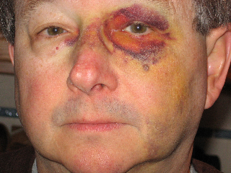
Mark G - teacher
Notes:
Unfortunately, the problem continues.
Not long ago, Mark, a teacher in a youth detention facility for girls, was assaulted by one of his students.
Suggested alt-text for graphic: Picture of a male assault victim, a teacher in a youth detention facility for girls who was assaulted by one of his students.

Slide 86
Next Steps
Continue to assist our members and their employers in having a robust program.
Increase efforts to evaluate the impact of the law, and of various prevention strategies.
Increase public awareness of the problem, and partner with more community stakeholders.
Notes:
Where do we go from here?
Only with ongoing attention to the problem will significant improvements occur.
Though difficult to do rigorously because of myriad confounders, evaluation studies are critical.
Worker safety is inextricably linked to the safety of the individuals being served by our members, and of the public at large.
Thank you

Slide 87

Please submit your questions through the chat function.

Slide 88
Healthy People 2020
HEALTHY PEOPLE 2020 Progress Review
Federal Core Planning Group
  Annie Archbold (CDC)
  Tom Simon (NCIPC)
  Gwen Cattledge (NCIPC)
  Jane Bigham (NIOSH)
  DeKeely Hartsfield (NIOSH)
  John R. Myers (NIOSH)
  Rebecca Hines (NCHS)
  Holly Hedegaard (NCHS)
  Leda Gurley (NCHS)
  Jeff Pearcy (NCHS)
  Kimberly Hurvitz (NCHS)
  Deepthi Kandi (NCHS)
  Timothy McManus (NCHS)
  Yen Luong (ODPHP)
  Ellis Davis (ODPHP)
  Debbie Hoyer (ODPHP)
Notes:
Dr. Wright:
Thank you to all of our presenters today for sharing their expertise and knowledge. For our webinar audience, especially, I hope this has been a rewarding experience and that you will join us again in June for our next Progress Review, in which we will focus on the Topic Area Immunization and Infectious Diseases paired with the Global Health Topic Area. I hope that joining us for Progress Reviews will become a habit.
I would be remiss if I did not mention the workgroup members from the Injury and Violence Prevention and Occupational Safety and Health of Healthy People, as well as the team from ODPHP and NCHS who have worked tirelessly to update the data and pull this information together.
Together, we CAN make Healthy People come alive for all Americans. Thank you for all that you do.

Slide 89





Stay Connected
Web healthypeople.gov
Email hp2020@hhs.gov
Twitter @gohealthypeople
LinkedIn Healthy People 2020
YouTube ODPHP(search “healthy people”)
Join the Healthy People Listserv & Consortium
Notes:
Dr. Wright:
For more information about Healthy People or the upcoming Progress Reviews and a complete listing of all the data updates for the Occupational Safety and Health and Injury and Violence Prevention Topic Areas, please visit, www.healthypeople.gov.
[Transition to close session]
[Break until 2 PM]
89

