Slide 1
Role of Artificial Intelligence (AI) and
Machine Learning (ML) in NCHS Programs
Board of Scientific Counselors
09/14/2023
Travis Hoppe, PhD, qrd5@cdc.gov
Associate Director of Data Science and Analytics, Office of the Director
National Center for Health Statistics,
Centers for Disease Control,
Health and Human Services (HHS/CDC/NCHS)
The findings and conclusions in this report are those of the author and do not necessarily represent the official position of the National Center for Health Statistics, Centers for Disease Control and Prevention

Slide 2

NCHS AI activities, per EO 13960 (Trustworthy AI)
Developed in house
SANDS: Semi-automated non-response detection, live model release
MedCoder: Coding cause of death information to ICD-10
Detecting Stimulant and Opioid Misuse and Illicit Use in EHRs
Commercial-off-the-shelf or open-source implementation
Whisper: Speech to text (CCQDER) improvement, 20x improvement
Private AI: PII detection model used for FOIA requests
Governance, policy, and strategic planning
Utility and Risks to CDC of Conversational Artificial Intelligence

Slide 3
(Generative) AI at across the Federal government
NCHS → CDC → HHS → USG
  NCHS led the development of a generative AI whitepaper
  NCHS is helping lead a new CDC AI Community of Practice
  OPHDST is developing a FedRamp approved ChatGPT interface
  CDC is drafting an AI strategy, including generative AI
  HHS published the 2023 AI inventory
  Guiding Frameworks: NIST AI RMF, HHS Trustworthy AI Playbook, and upcoming OMB guidance on generative AI

Slide 4
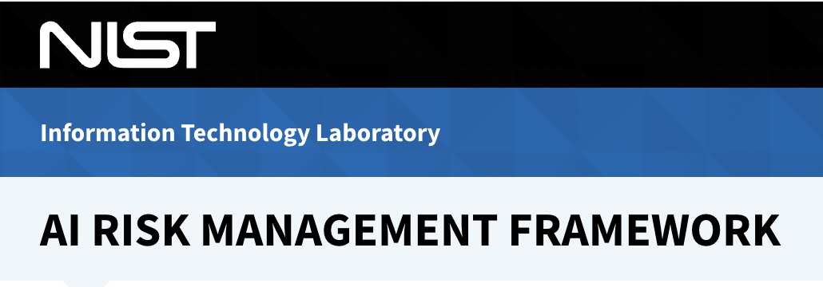

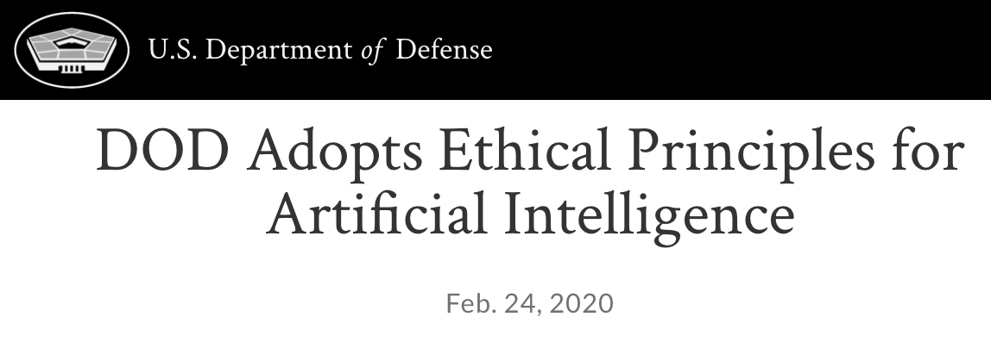

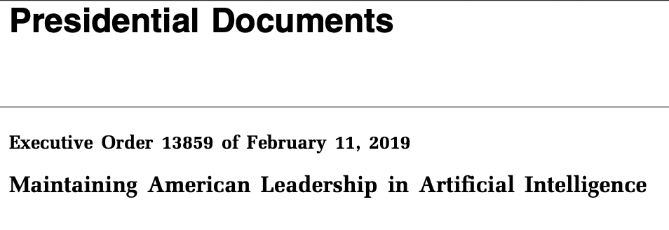

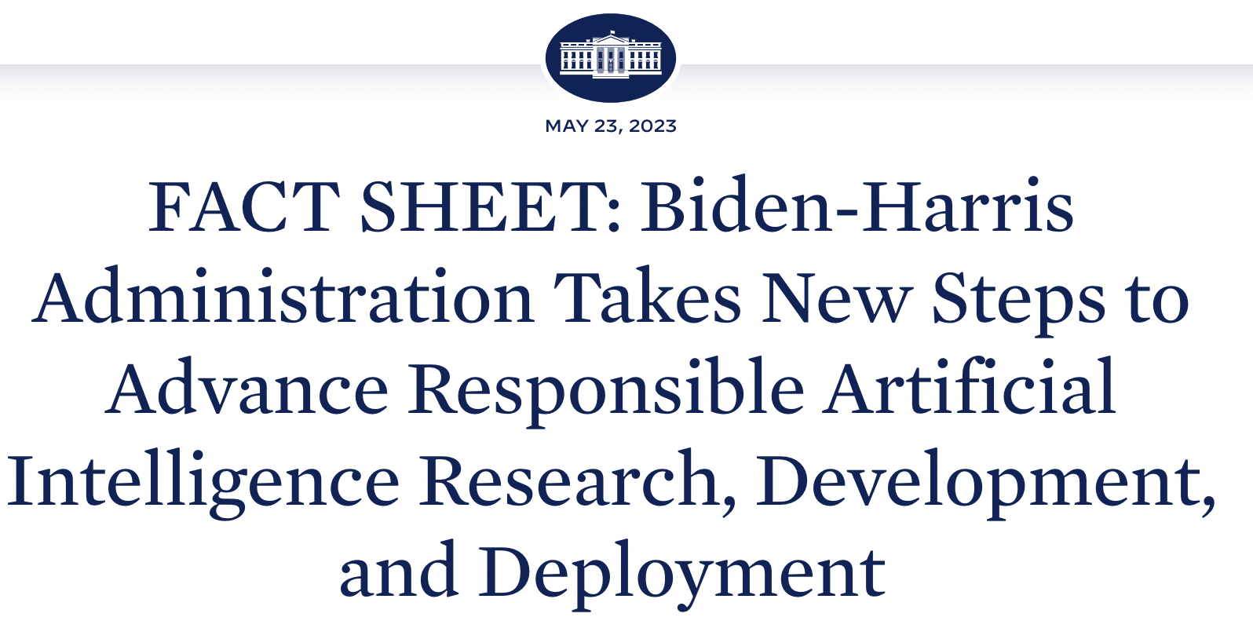
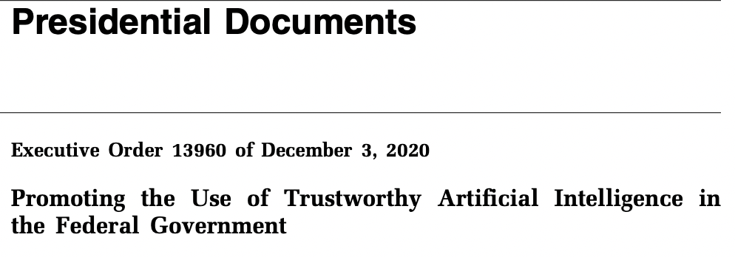
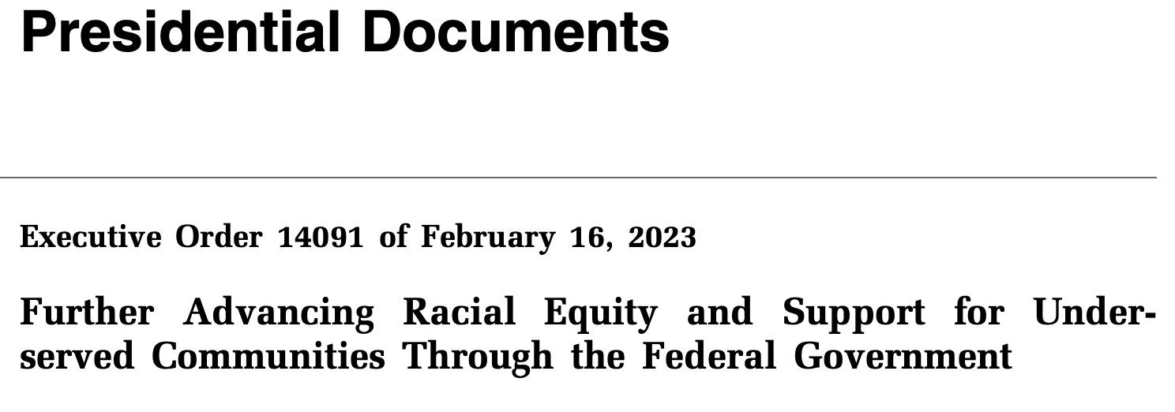
Trustworthy AI initiatives in the federal government
2019
2020
2021
2022
2023

Slide 5
Potential benefits of generative AI for CDC
Potential benefit to CDC | Examples
Save resources: Automate or accelerate certain tasks and processes | Draft an executive summary of a written report from talking points Draft a chart abstraction questionnaire Draft a scope of work for a contract Draft a position description for a vacant job
Increase efficiency: Accelerate manual or repetitive tasks that do not require a high level of expertise or using structured formats | Draft or edit scientific products including abstracts and manuscripts Create resumes or other structured documents Create or edit code and documentation Translate code between programming languages
Synthesize and summarize information | Summarize written material Describe methodological options, with references, for conducting multiple imputation at scale
Communicate: Adapting text to various reading levels, platforms, audiences | Draft communications messages Translate websites or other written materials between spoken languages Draft tweets from a list of talking points.
Personalize responses | Draft responses to public inquiries with references to relevant CDC guidance
CDC Tiger Team, "Utility and Risks to CDC of Conversational Artificial Intelligence (AI) Technologies Like ChatGPT"

Slide 6
Potential risks of generative AI for CDC
Potential harm to CDC | Examples
Failure to meet ethical or regulatory standards | Relevant regulations and policies that could be threatened by AI use include those addressing data accuracy, data security and privacy/confidentiality, intellectual property, health equity, discrimination, and scientific integrity.
Fabrication | Conversational AI may “hallucinate” or fabricate information including data and references has been reported widely. Fabrication, falsification, and plagiarism are included in the federal definition of reportable research misconduct.
Bias and discrimination | Conversational AI technology is trained on vast amounts of data from undisclosed sources, and tone and content may include biases, misconceptions, or outdated information regarding specific populations
Lack of privacy and data security | Cloud-based models rely on external infrastructure, which may not always be compliant with the strict security standards required in the healthcare sector or by federal assurances.
Other legal or ethical risks, including risks to agency credibility | Transparency, oversight, and accountability for AI-generated material can be unclear.
CDC Tiger Team, "Utility and Risks to CDC of Conversational Artificial Intelligence (AI) Technologies Like ChatGPT"

Slide 7
CDC should anticipate malicious use by external actors
    …
Potential action | Examples
Generating misinformation | External actors might generate large volumes of text-based communications that include unintentional errors or propagate misinformation. Misinformation may use various strategies to appear credible, such as using scientific language or citing references.
Impersonating CDC | External actors might use ChatGPT to imitate CDC or other public health authorities (“deepfakes”) or hallucinated written material falsely attributed to CDC. CDC may need to expend resources explaining or debunking information falsely attributed to CDC, including requests to verify statements, publications, or guidance.
Spamming CDC | In platforms for public communication where CDC is required or obligated to respond, external actors might spam CDC with large volumes of credible inquiries. This includes public comments (including on government documents or at open government meetings), public inquiries to CDC (including CDC-Info and NIP-Info), social media comments and inquiries, and media or other requests for CDC response. Recently, volume of public comments at a CDC ACIP in late 2022 increased from an anticipated 600 comments to 127,000 comments (unknown proportion AI).
CDC Tiger Team, "Utility and Risks to CDC of Conversational Artificial Intelligence (AI) Technologies Like ChatGPT"

Slide 8
State of AI: How we got here and current capabilities
Board of Scientific Counselors
09/14/2023
Ben Rogers, MS, qtw4@cdc.gov
Data Scientist, Division of Research and Methodology
National Center for Health Statistics,
Centers for Disease Control,
Health and Human Services (HHS/CDC/NCHS)
The findings and conclusions in this report are those of the author and do not necessarily represent the official position of the National Center for Health Statistics, Centers for Disease Control and Prevention

Slide 9
Considerations for the BSC:
  How can NCHS and other statistical agencies benefit from AI/ML?
  What role should federal agencies take in the AI/ML research space given the rapid innovation?

Slide 10
State of AI key take aways:
  Recent innovations in technology and data have spurred massive growth in the capabilities of AI
  Existing text/audio/images workflows can be augmented with AI
  Advances in AI/Machine Learning are not slowing down
    Emergent capabilities in larger models not present in smaller models
  Open source models and data help AI adoption and innovation

Slide 11
Using definitions of AI and Machine Learning from NIST:
  AI: Interdisciplinary field, usually regarded as a branch of computer science, dealing with models and systems for the performance of functions generally associated with human intelligence, such as reasoning and learning. *
  Machine Learning: The study of computer algorithms that improve automatically through experience.*
* National Institute of Standards and Technology Language of Trustworthy AI: In-Depth Glossary of Terms

Slide 12
AI, How did we get here?

Slide 13
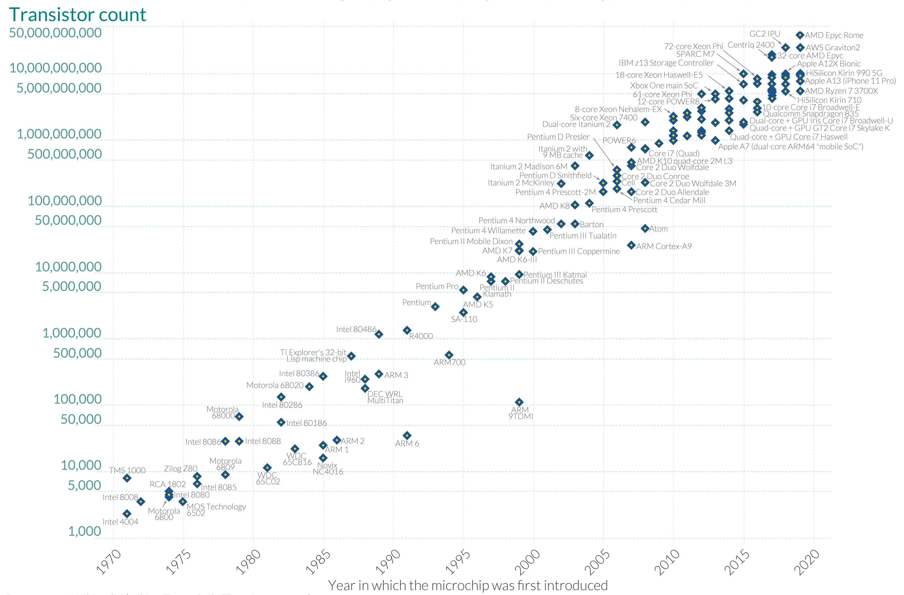
It starts with Moore’s Law
What is Moore’s Law? - Our World in Data
Graphic created by Hannah Ritchie and Max Roser available on Our World in Data.

Slide 14
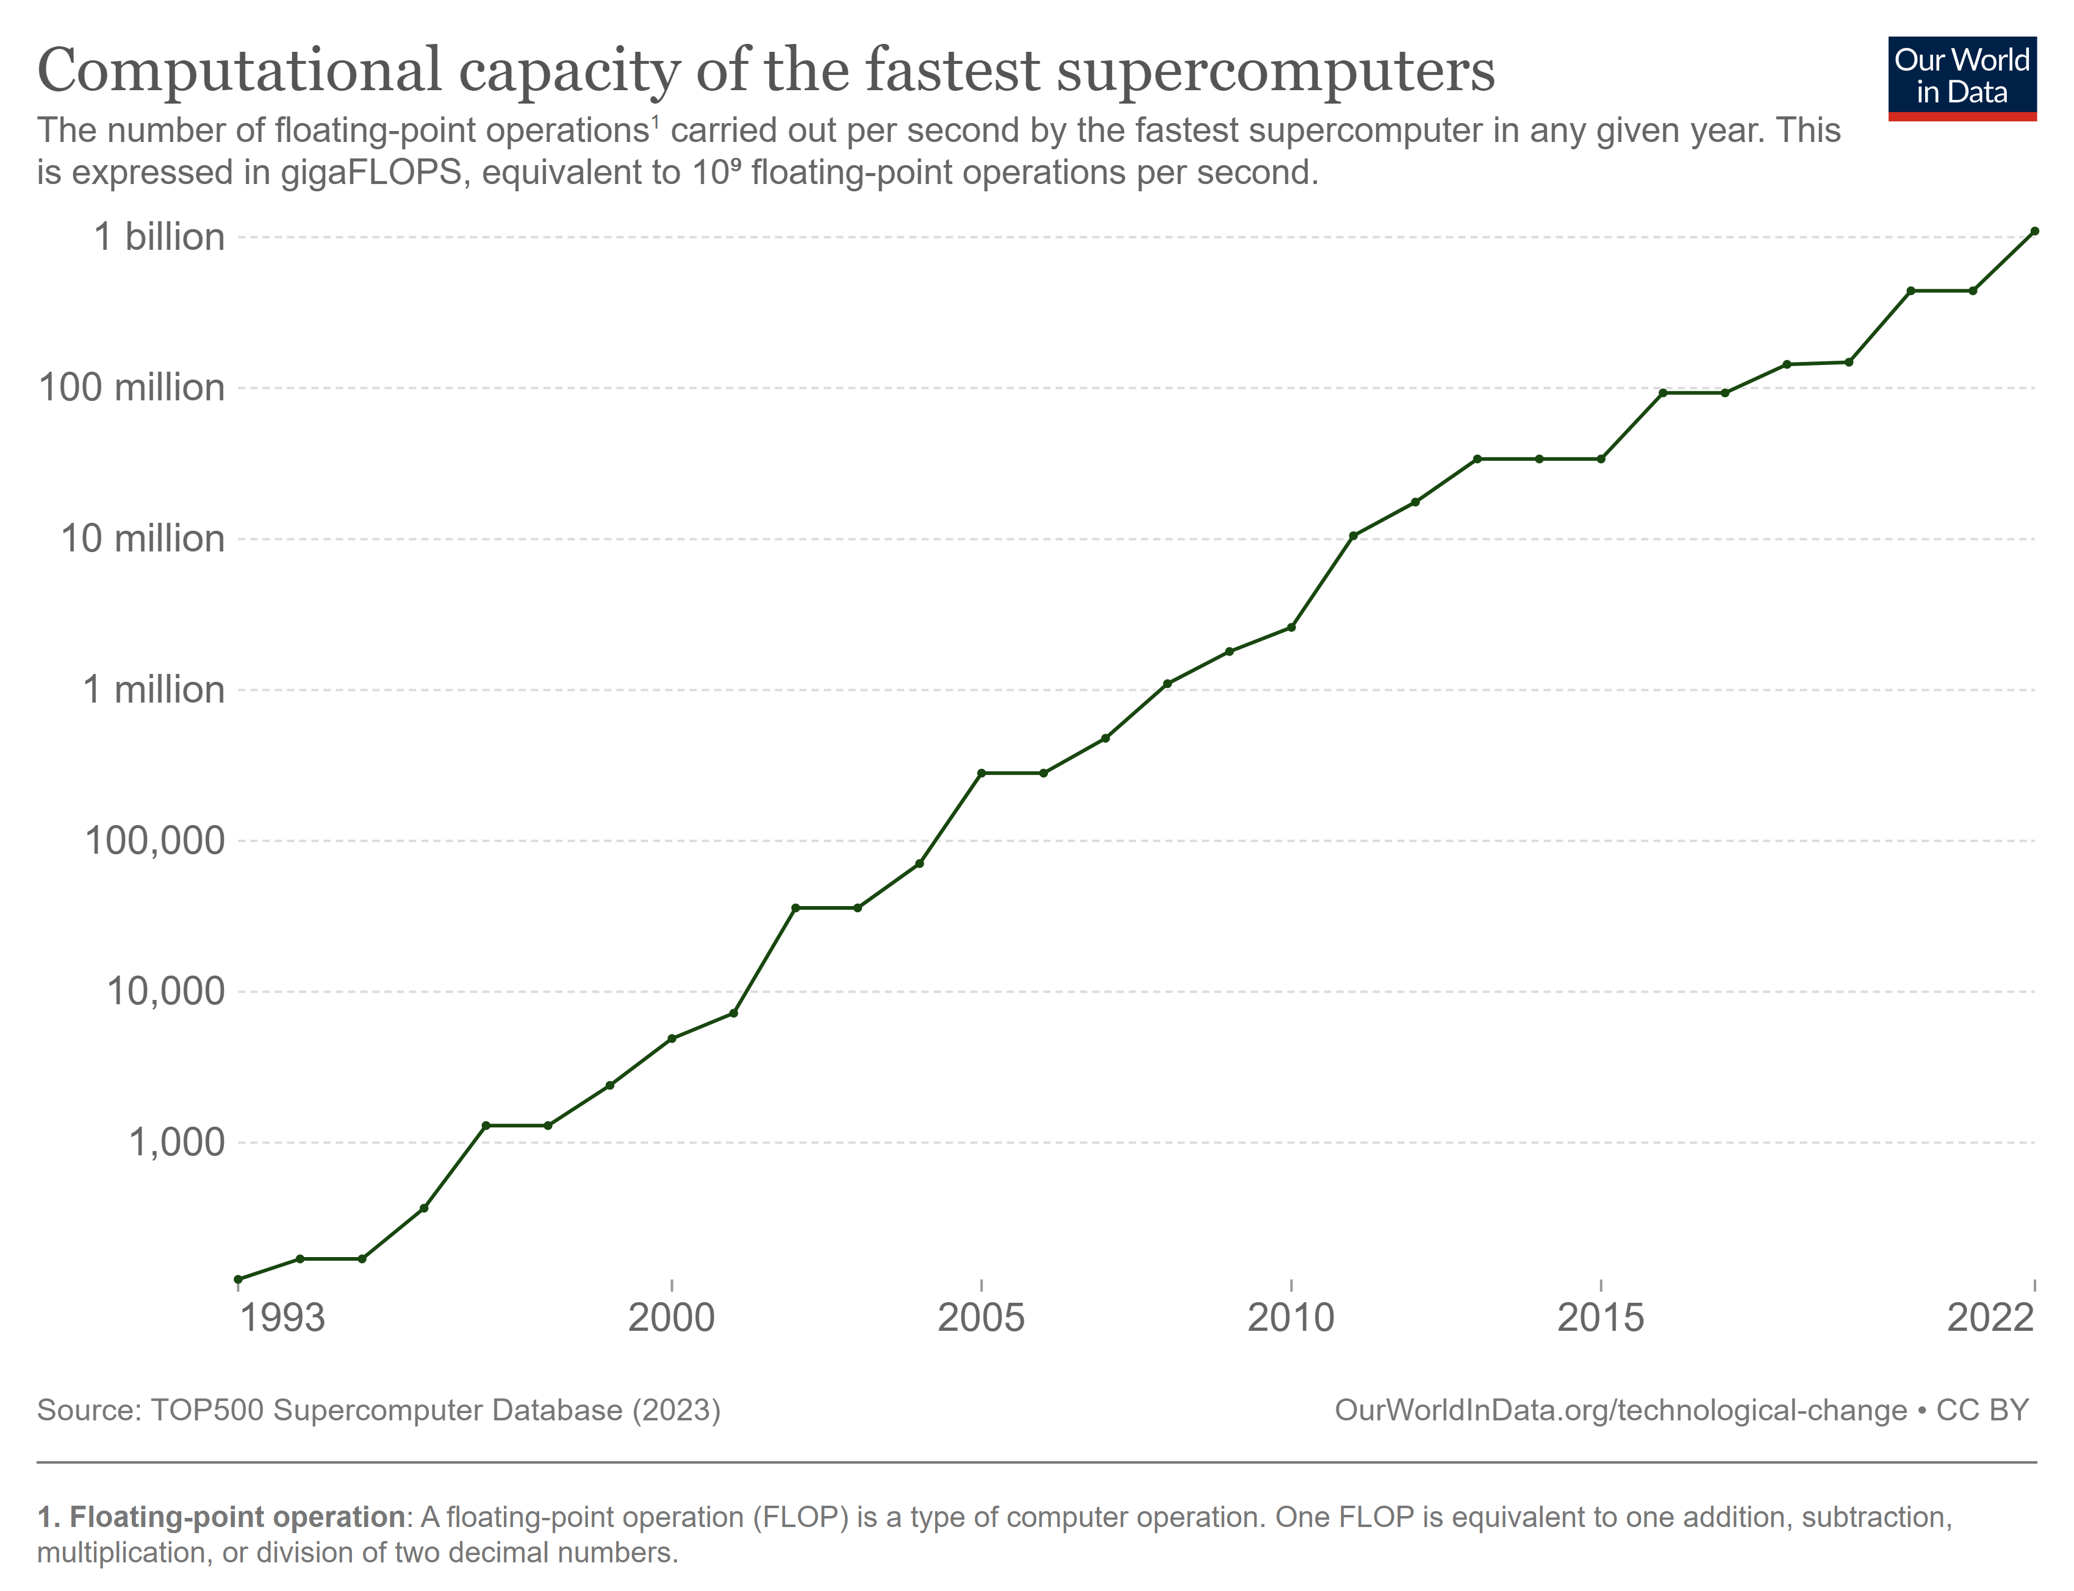
Implication: Exponential growth in computing power
Computational capacity of the fastest supercomputers (ourworldindata.org)

Slide 15
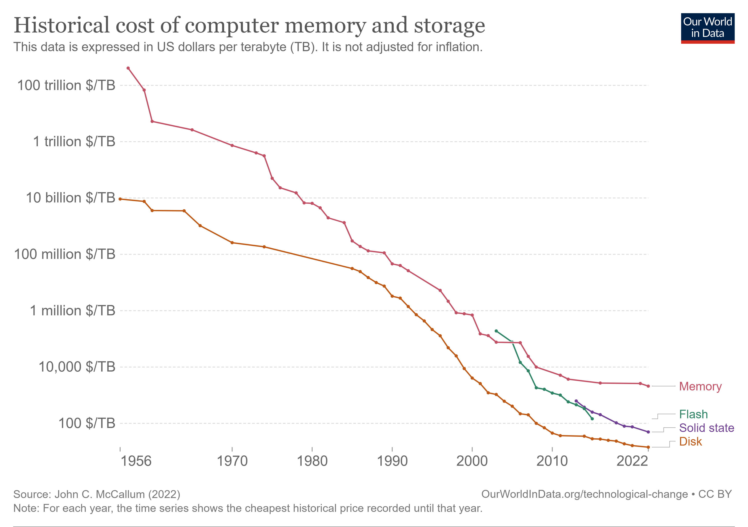
Implication: Large availability of affordable data storage
Historical cost of computer memory and storage (ourworldindata.org)

Slide 16
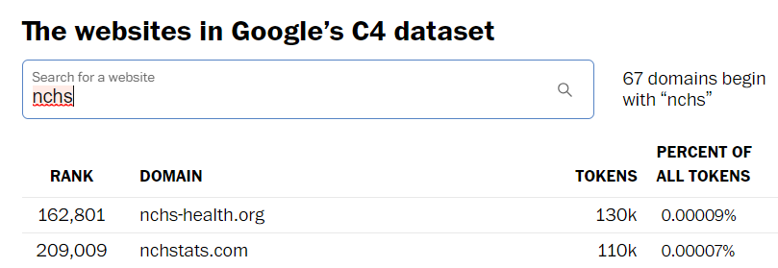
Implication: Increased data availability
  Data are available through web-scraping, research article platforms, etc.
  This includes any text, image, audio, video in the public domain
    Anything available on CDC.gov, NCHS’s discontinued blog nchstats.com, etc.
Google’s Colossal Clean Crawled Corpus introduced in https://arxiv.org/abs/1910.10683v3
https://www.washingtonpost.com/technology/interactive/2023/ai-chatbot-learning/

Slide 17
Application: Foundational AI models
  Example: LLaMa 2 family of Large Language Models
    Trained on Meta’s Research SuperCluster
    Estimated cost of computing with Microsoft Azure ~$4.5 Million**
    Chat GPT and other famous Conversational AI models assumed to be on the same magnitude of computational cost
  Training foundational AI models at this scale requires thousands of data-center grade GPUs which are rare and in high demand internationally
*[2307.09288] Llama 2: Open Foundation and Fine-Tuned Chat Models (arxiv.org)
**Using cost of $1.3631 per hour of A100 GPU on Azure platform where LLaMa2 used 3,311,616 GPU hours

Slide 18
Application: open source foundational models available for data scientists
  Foundational models are available to fine tune either through open-source (LLaMa2*) or paid access (Chat GPT**)
    Vastly cheaper to fine tune these pre-trained models
    OpenAI FedRAMP authorized through Microsoft Azure***
  Zero-shot/Few-shot classification from transfer learning enable high-performance on classification tasks with off-the-shelf models
*https://ai.meta.com/llama/
**https://platform.openai.com/docs/guides/fine-tuning
***https://devblogs.microsoft.com/azuregov/azure-openai-service-achieves-fedramp-high-authorization/

Slide 19
Potential AI tasks considered by NCHS staff
  Text:
    Translation, code generation, summarization, conversational text generation, classification, named entity recognition, PII detection, topic modeling
  Vision:
    Classification, generation, segmentation
  Audio:
    Transcription, translation, generation, speaker identification

Slide 20
Current CDC/NCHS projects leveraging AI

Slide 21
Use of machine learning for “nowcasting” suicide fatalities in the U.S.
  CDC’s National Center for Injury Prevention and Control has leveraged machine learning and artificial neural networks to integrate several streams of information to estimate weekly suicide fatalities in the U.S. in near real time.
  The ensemble machine learning framework reduces the error for suicide rate estimation, establishes a novel approach for tracking suicide fatalities in near real time, and provides the potential for an effective public health response and interventions to prevent suicides in the U.S.
Development of a Machine Learning Model Using Multiple, Heterogeneous Data Sources to Estimate Weekly US Suicide Fatalities - PubMed (nih.gov)

Slide 22
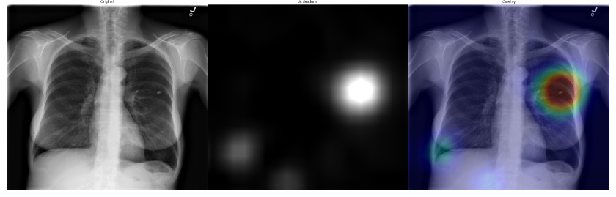
HaMLET: Harnessing Machine Learning to Eliminate Tuberculosis
  At CDC, data scientists are exploring ways to use machine learning to leverage chest x-ray and tuberculosis data from overseas immigration visa screening examinations of immigrants and refugees to enhance programs to detect and treat tuberculosis (TB) to prevent TB importation.
  The computer vision model detects abnormal findings suggestive of TB in chest x-rays and can identify results that are discordant with the radiologist’s findings
https://github.com/scotthlee/hamlet

Slide 23
Transcribing cognitive interviews
  Transcriptions have had a 69.8% decrease in errors in 2 years
    Previous CCQDER Transcription software has a word error rate of 68.4 on Cognitive interviews
    *2020 state-of-the-art transcription model Wav2Vec2-large-960h had a word error rate on FLEURS.en_us is 14.6
    *2022 state-of-the-art transcription model Whisper word error rate on FLEURS.en_us is 4.4
  Transcription errors dropped from 1 in 2 words to 1 in 25 when applied to cognitive interviews conducted by NCHS staff
* Robust Speech Recognition via Large-Scale Weak Supervision

Slide 24
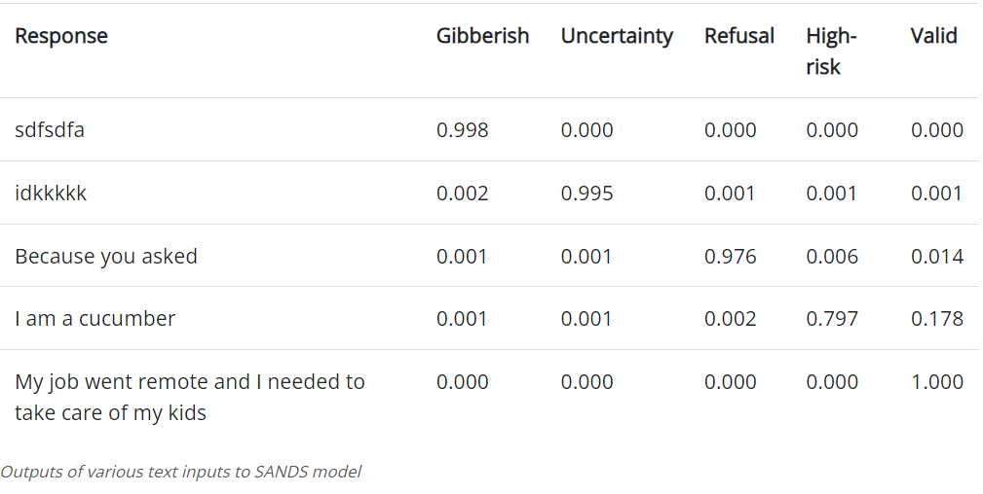
Semi-Automated Non-response Detection for Surveys
  SANDS is a non-response detection AI model designed to be used for data cleaning for open-ended survey text in conjunction with human reviewers.
NCHS/SANDS · Hugging Face
Semi-Automated Non-response Detection for Surveys (cdc.gov)

