Slide 1
Understanding NHANES Response Rates During Data Collection in a Pandemic
Ryne Paulose, Ph.D., Acting Director, NHANES
Board of Scientific Counselors Meeting
February 10, 2022

Slide 2
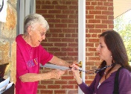
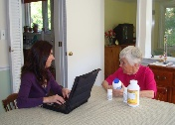
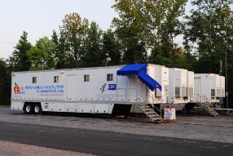
NHANES Data Collection Stages
Examination at Mobile Examination Center (MEC)
Screening
In-home interview

Slide 3
Trends in Response Rates: NHANES 1999‒2018

Slide 4
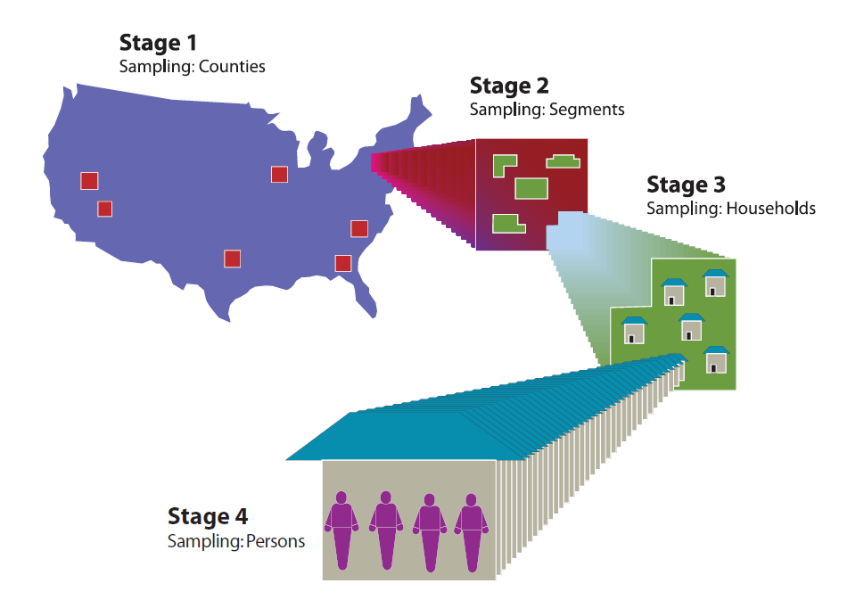
Multistage Probability Sampling Design
24 segments selected within each PSU (Census blocks or groups of census blocks)
15 PSUs selected across US each year (Single counties, multiple counties, or parts of counties; Stratified by state-level healthiness, region, urbanicity)
Dwelling units (DUs) selected within each segment
Select participant(s) per occupied DU

Slide 5
NHANES August 2021 – August 2023 Sample Design
Sampling change: no oversampling by race/ethnicity, income
Select at least one person per occupied DU
  All children (0-19 years) and older adults (60+) are selected
  1-2 persons 20-59 years, depending on number of persons in HH 20-59

Slide 6
Interview Response Rate (among those identified) and Examined Response Rate (among Interviewed)
Conditional
Exam RR = 89.0%
Cumulative
Exam RR = 73%
Interview RR = 58.1%
Interview RR = 56%
2019

Slide 7
Interview Response Rate (among those identified) and Examined Response Rate (among Interviewed) - continued
Conditional
Exam RR = 89.0%
Cumulative
Exam RR = 73%
Interview RR = 58.1%
Interview RR = 55.8%
2019
2021

Slide 8
Interview Response Rate (among those identified) and Examined Response Rate (among Interviewed) – continued 2
Conditional
Exam RR = 89.0%
Conditional
Exam RR = 70.5%
Interview RR = 58.1%
Interview RR = 55.8%
2021

Slide 9
Interviewed Participants who are Appointed to the MEC

Slide 10

Exam Participation among those Interviewed and MEC Appointed

Slide 11
Exam Participation among those Interviewed and MEC Appointed - continued
 | % Exams Rescheduled | % Exams Rescheduled 2 times or more
2017-2018 | 15.2% | 4.2%
2019-Mar 2022 | 18.7% | 5.2%
2021 (5 PSUs) | 27.9% | 7.0%

Slide 12
Exam Non-Response Among Interviewed and MEC appointed
 | Cancelled / No Show Later Examined
2017-2018 | 71%
2019-Mar 2022 | 66%
2021 (5 PSUs) | 32%

Slide 13
Characteristics associated with exam nonresponse among interviewed participants
Examined differences by sociodemographic characteristics (age, race/ethnicity, education, income) and other factors (# SPs in HH, interview mode)
Patterns by age were noted but not others
The greatest difference from pre-pandemic rates is for children 0-5 years
Age Categories | Exam RR 2017-2018 | Exam RR 2021
0-5 years | 93% | 62%
6-11 years | 93% | 66%
12-19 years | 95% | 70%
20-39 years | 94% | 68%
40-59 years | 96% | 75%
60-79 years | 95% | 77%
80+ years | 90% | 65%

Slide 14
Characteristics associated with exam nonresponse among interviewed participants - continued
COVID-19 vaccination status, a new variable collected in the home interview, was the only other notable predictor of nonresponse (no difference by COVID-19 illness history)
Lower MEC examination rate among adults not vaccinated for COVID-19.
COVID-19 Vaccine Status, Age 20+ | Proportion Interviewed | Exam RR among Interviewed
Vaccinated | 75% | 76%
Unvaccinated | 25% | 65%
Ever had COVID-19 | Proportion Interviewed | Exam RR among Interviewed
Yes, tested positive | 17% | 70%
No | 81% | 70%

Slide 15
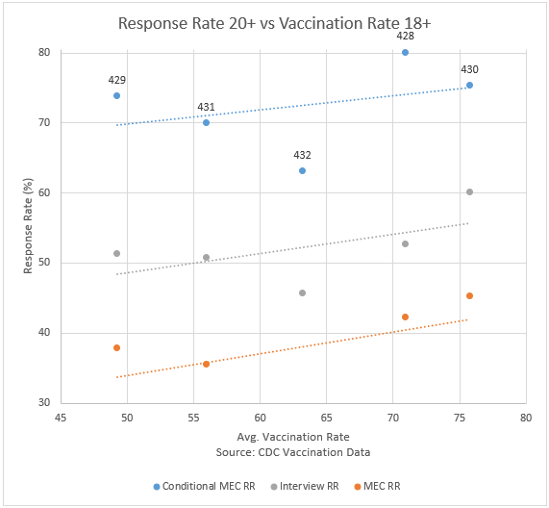
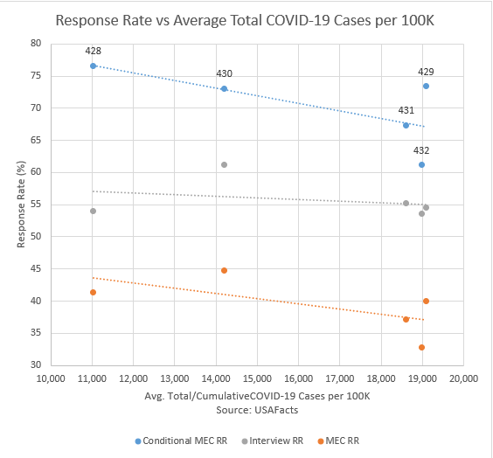
Correlation between Vaccination and COVID Case Rates with Response Rates

Slide 16
Approaches to Address MEC Participation
MEC incentive increase for adults from $85 to $125 (experiment for 5 PSUs)
Offering options to participant for receipt of transportation incentive
MEC clinician contact:
  Clinician address participant concerns for those who missed exam or are reluctant to make appointments
Study ambassadors:
  Enthusiastic exam participants are used to help convert reluctant potential participant
Paradata:
  Identify characteristics of exam participation & cancel/no show; Develop targeted recontact strategies & messaging
Implementing shortly:
Conduct Survey of MEC Nonrespondents:
  Follow up questionnaires mailed (with telephone follow-up) to participants who refused exam to better understand reasons for declining.
Overbooking MEC appointment slots
  Within COVID safety protocols, book extra SP in session with other appointed SPs who have characteristics associated with cancellation/no show

Slide 17
Examination Response Rates - Summary
Willingness of persons to be interviewed by phone but not examined in person
Examination rates much lower since returning to the field
Fewer people willing to visit a medical center during a pandemic
    Greater percentage not even scheduling an appointment
    More cancellations and no shows
    Greater level of effort per completed exam
New non-random patterns of nonresponse have likely emerged during pandemic
Vaccination status most significant factor related to exam response

Slide 18
Questions to the BSC
In addition to the strategies already implemented, are there interventions that could be implemented in real time to address exam nonresponse?
Are there specific steps to take that could mitigate potential nonresponse bias while data are still being collected?
  (e.g., are there examples of more effective messaging that could be used or important paradata to consider?)
NHANES is a unique survey with an extra survey stage (exam) not included in other national surveys. Are there any other examples to compare the recent NHANES exam response rate experience?

Slide 19
Questions?

