Slide 1
Reporting on the Nation’s Health in Health, United States
Renee Gindi, PhD, Chief
Sheila Franco, MS, Health Statistician
Population Health Research and Dissemination Branch Division of Analysis and Epidemiology
Board of Scientific Counselors Meeting September 14, 2023

Slide 2
Motivating issue
Feedback is requested on (1) the new HUS products and
(2) next steps for the program.

Slide 3
Outline
What is Health, United States?
New design for Health, United States products
Examining health disparities with the new Health, United States, 2020–2021: Annual Perspective
What’s next for Health, United States?

Slide 4
Health, United States: Background
Published by the National Center for Health Statistics since 1975
Congressionally mandated report from the Secretary of Health and Human Services to the President and Congress
Educate and inform policymakers and the public about key health topics
Health status and determinants
Healthcare utilization
Healthcare resources
Health expenditures and payers
Draws from NCHS, CDC, HHS, other federal, and non-government sources

Slide 5
Health, United States: Redesign Process
Web user survey
Literature review
Audience research
Stakeholder interviews
Web analytics

Slide 6
Introducing the Redesigned Health, United States
New website:
23 topic pages
Released August 2022
Highlight program focus on
Trends
Health disparities
https://www.cdc.gov/nchs/hus/index.htm

Slide 7
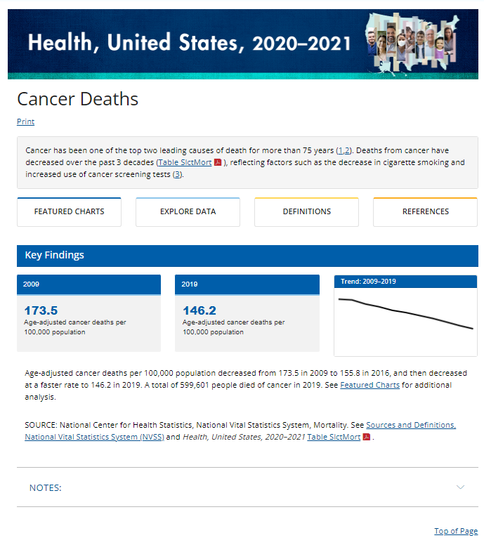
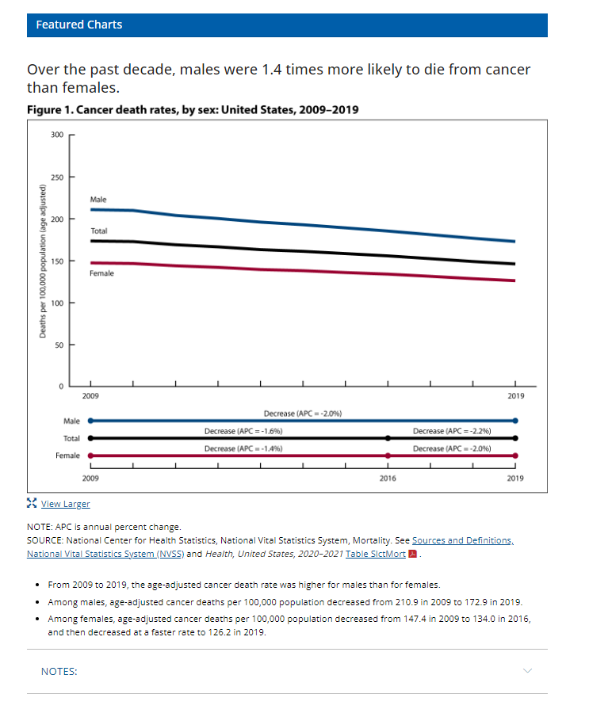
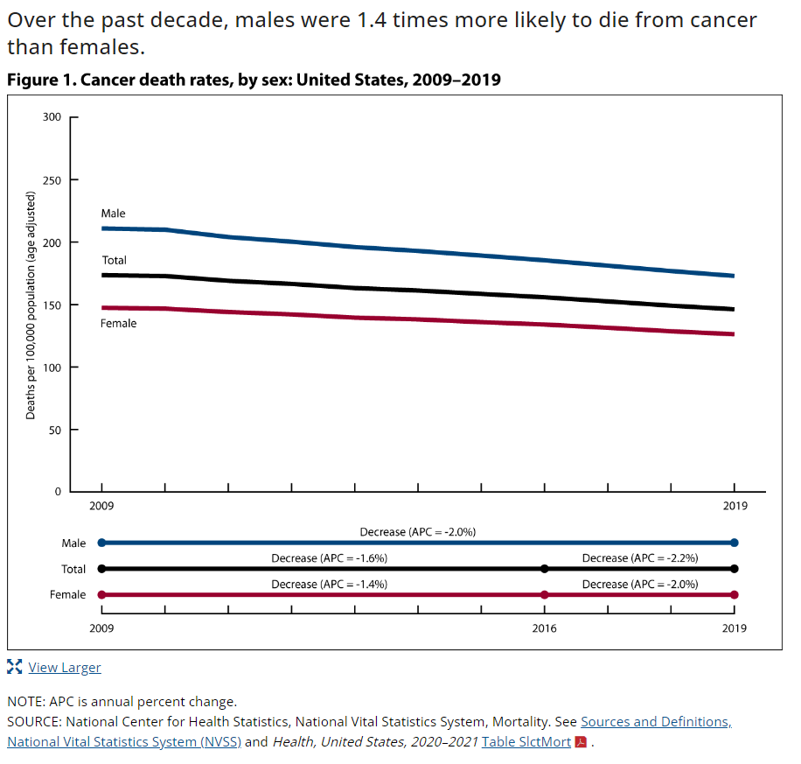
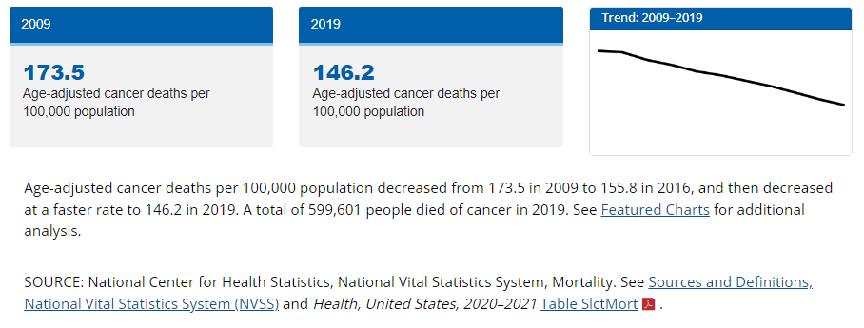
New: National trends and trends by selected groups
https://www.cdc.gov/nchs/hus/topics/cancer-deaths.htm

Slide 8
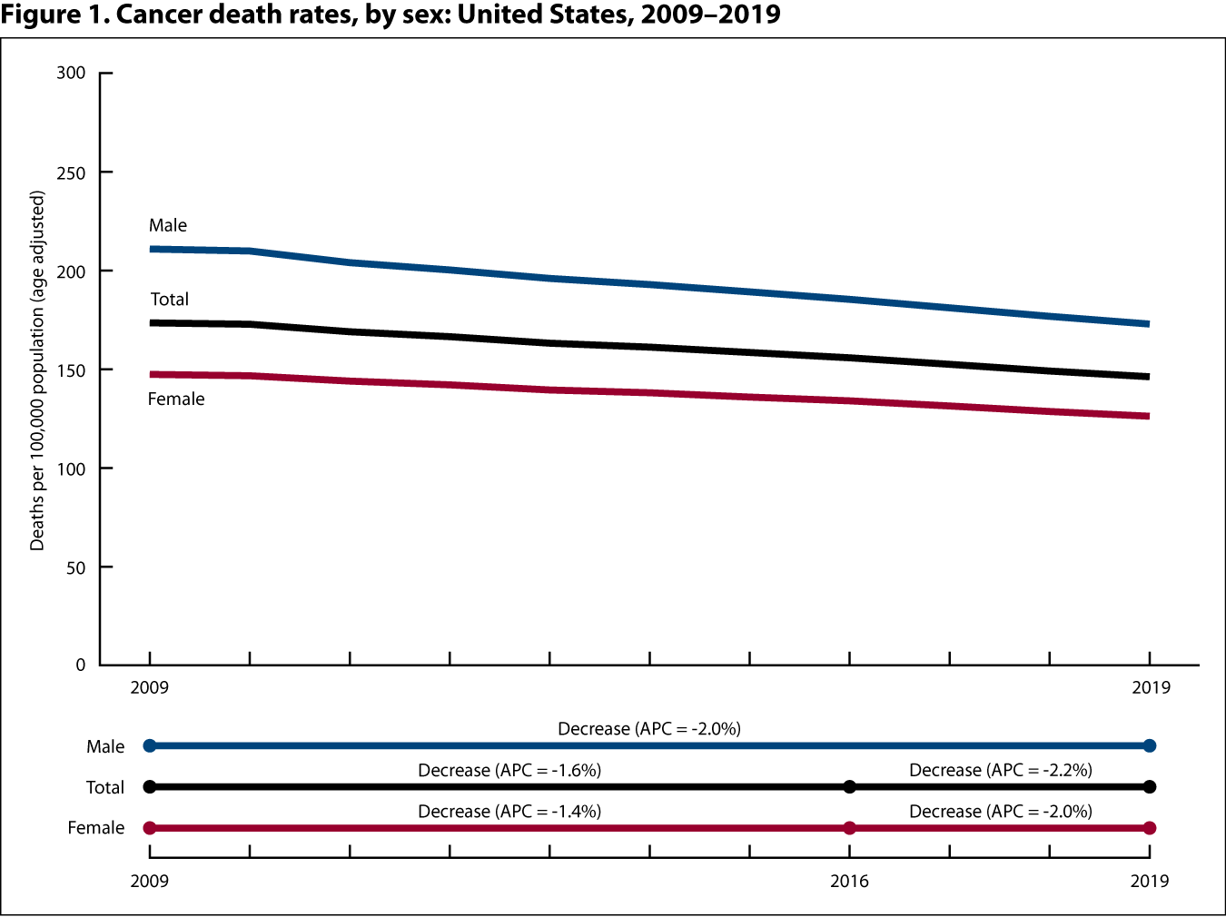
New: Visual Trend Summary

Slide 9
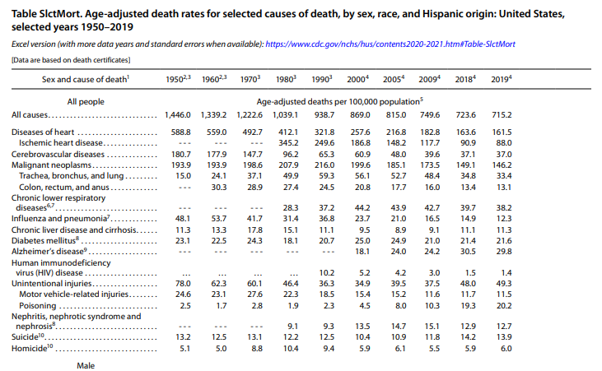
New: Links to trend tables and definitions

Slide 10
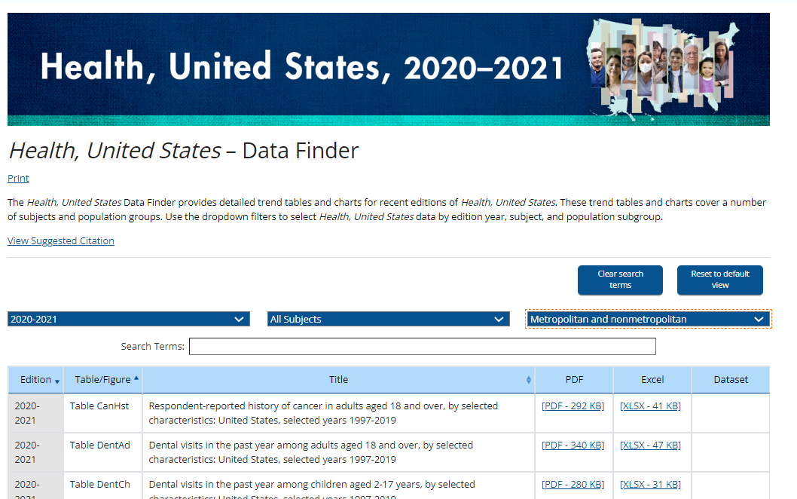
New: Browse Health, United States Tables
Browse 90+ health topics and 20+ population subgroups
Trend tables available in Excel and PDF formats
https://www.cdc.gov/nchs/hus/data-finder.htm

Slide 11
Health, United States, 2020–2021: Annual Perspective
Integrates selected analyses from the Health, United States topics presented in the online topic pages
Explores one theme across multiple health topics and data sources
The theme of the 2020–2021 edition is health disparities
Released January 2023

Slide 12
Health, United States: Dissemination Activities
Adobe Campaign email went to 29,000 listserv addresses
Hill Alert email to legislative staffers
Social media blog posts and Twitter campaign
Webinar with 280 attendees
National Library of Medicine cross-posting of report on the Bookshelf

Slide 13
Health, United States, 2020–2021: Annual Perspective health areas covered
Heart disease
Hospital utilization
Heart disease
HIV and sexually transmitted diseases
Substance use
Cancer
Oral health
Health insurance and access
Risk factors and mortality

Slide 14
Health, United States, 2020–2021: Annual Perspective health disparities covered
Heart disease
Hospital utilization
Socioeconomic characteristics
HIV and sexually transmitted diseases
Substance use
Cancer
Oral health
Health insurance and access
Risk factors and mortality
Race and Hispanic origin
Sex

Slide 15
Health, United States, 2020–2021: Annual Perspective health areas covered (2)
Heart disease
Hospital utilization
Heart disease
HIV and sexually transmitted diseases
Substance use
Cancer
Oral health
Health insurance and access
Risk factors and mortality

Slide 16
Heart Disease: Disparities by race and Hispanic origin
Heart disease
Mortality
National Vital Statistics System (NVSS)
Prevalence
National Health Interview Survey (NHIS)
National Health Interview Survey (NHIS)
Risk factors
National Survey on Drug Use and Health (NSDUH)
National Health and Nutrition Examination Survey (NHANES)

Slide 17
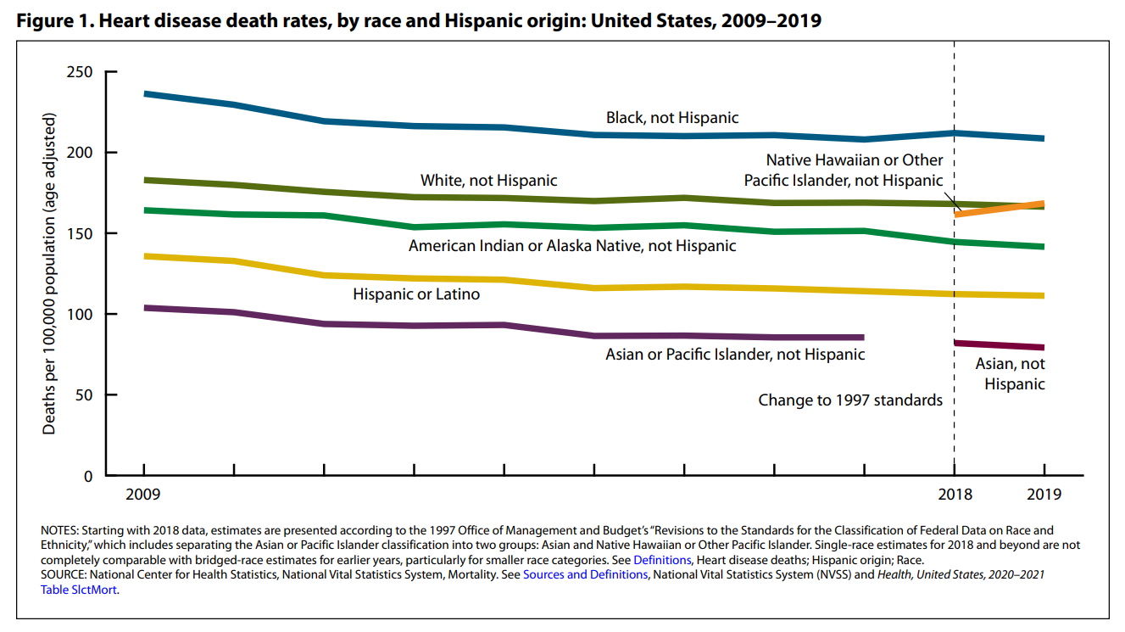
Non-Hispanic Black people are more likely than people in other racial and ethnic groups to die of heart disease.

Slide 18
Heart Disease: Findings on prevalence and risk factors by race and Hispanic origin
Non-Hispanic Black, non-Hispanic White, and Hispanic adults had similar heart disease prevalence in 2019. (Table HDPrev)
Non-Hispanic White and non-Hispanic Black adults are more likely to be current smokers than Hispanic adults. (Table Smok)
Non-Hispanic Asian people are less likely to report binge drinking than people in other racial and ethnic groups. (Table Subuse)
Saturated fat consumption has increased over the last two decades. (Table McrNutr)

Slide 19
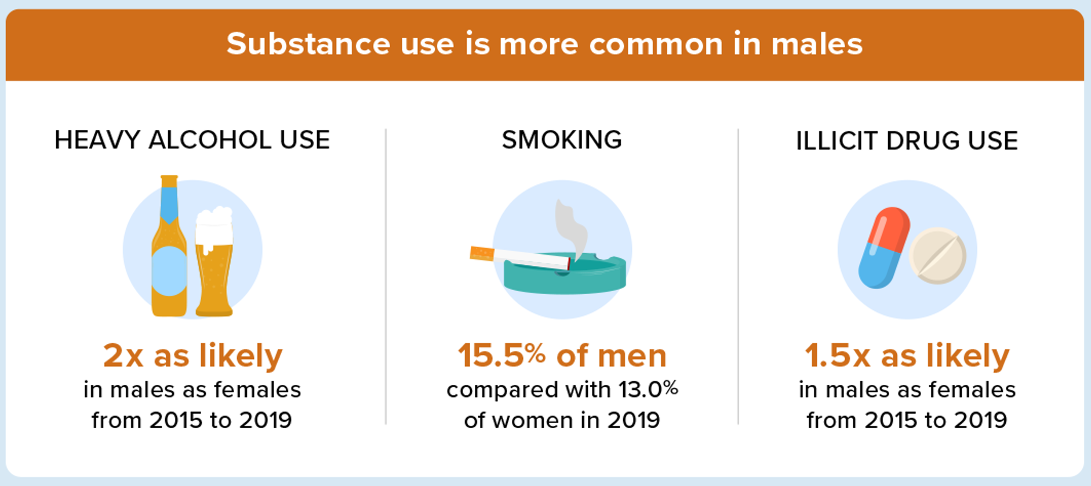
Health, United States, 2020–2021: Infographics

Slide 20
Takeaways: The redesigned Health, United States
Presents trend tables and analyses in a suite of products designed to meet the needs of a variety of users
Integrates multiple topics and data sources in the Annual Perspective and other Health, United States products to offer users more context for health trends
Continues to focus on trend analysis, while developing innovative ways to communicate findings

Slide 21
Health, United States: What’s next
Updating more trend tables
Adding more topic pages
Publishing topic pages and trend tables throughout the year
Developing machine-readable files will allow users to create customized visualizations

Slide 22
Thank you!
PHRDB Staff and Contractors | NCHS | Partners
Shilpa Bengeri La-Tonya Curl Barnali Das Sheila Franco Renee Gindi Nancy Han Liz Heitz Ji-Eun Kim Florence Lee Fen Li Michelle Liu Zakia Nelson (CTR) Ashley Woodall | Division of Analysis and Epidemiology Division of Health Care Statistics Division of Health Examination and Nutrition Examination Statistics Division of Health Interview Statistics Division of Vital Statistics Office of the Director Office of Information Services Office of Planning Budget and Legislation | American Dental Association American Hospital Association Bureau of Economic Analysis Bureau of Labor Statistics CDC, Division of Health Informatics and Surveillance CDC, National Center for HIV/AIDS, Viral Hepatitis, STD, and TB Prevention Centers for Medicare & Medicaid Services Health Resources and Services Administration National Center for Immunization and Respiratory Diseases National Institutes of Health Substance Abuse and Mental Health Services Administration

Slide 23
Contacts
Renee Gindi
Sheila Franco
Population Health Reporting and Dissemination Branch
healthus@cdc.gov
www.cdc.gov/nchs/hus

Slide 24
Returning to the motivating issue
Feedback is requested on (1) the new HUS products and
(2) next steps for the program.

