Slide 1
The NCHS Data Query and Visualization System:
Development and Next Steps
National Center for Health Statistics
Renee Gindi, PhD
Chief, Population Health Reporting and Dissemination Branch
BSC Meeting
May 26, 2022
Zoom

Slide 2
Feedback and Questions
What non-NCHS tabulated data sources would you recommend prioritizing for inclusion in the DQS?
What query and visualization features would you recommend prioritizing for inclusion in the DQS?
What user groups can we work with to promote use/feedback of early DQS products?

Slide 3







NCHS DMI Goals: Data Query System
Data users seamlessly connect to data assets with the
least amount of required prior knowledge about
individual data systems.
National Vital Statistics System
National Survey of Family Growth
National Health Interview Survey
National Health and Nutrition Examination Survey
National Health Care Surveys
Data Linkage
Non-NCHS Data Sources

Slide 4
Building the NCHS Data Query System
Multiple (NCHS, CDC) data systems
Harmonized approach to indicators
Wide variety of health topics
Existing staff resources

Slide 5
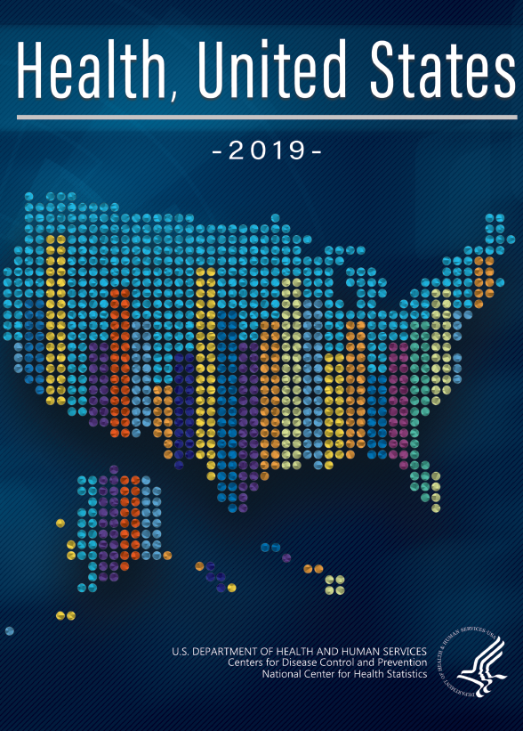
Health, United States: A Brief Detour
A Congressionally mandated report from the Secretary of Health and Human Services to the President and Congress and flagship publication from the National Center for Health Statistics since 1974
Uses NCHS and non-NCHS data sources to create national-level estimates for multiple population groups
Digital first and interactive product redesign based on formative research with data users and other partners

Slide 6
Building the NCHS Data Query System (2)
Health,
United States
Multiple (NCHS, CDC) data systems
Harmonized approach to indicators
Wide variety of health topics
Existing staff resources

Slide 7

NCHS Partnerships: NCHS DQS Advisory Group
Goals and Activities:
Use the data query / data dashboard experiences from around NCHS to develop a set of critical features for inclusion in a single system.
Provide feedback on the pilot version of the DQS that uses Health, United States tables.
Develop a scope of work for the future NCHS DQS contract, including critical data needs and features.
Think ahead to further innovations that could be built with or on the NCHS DQS.

Slide 8

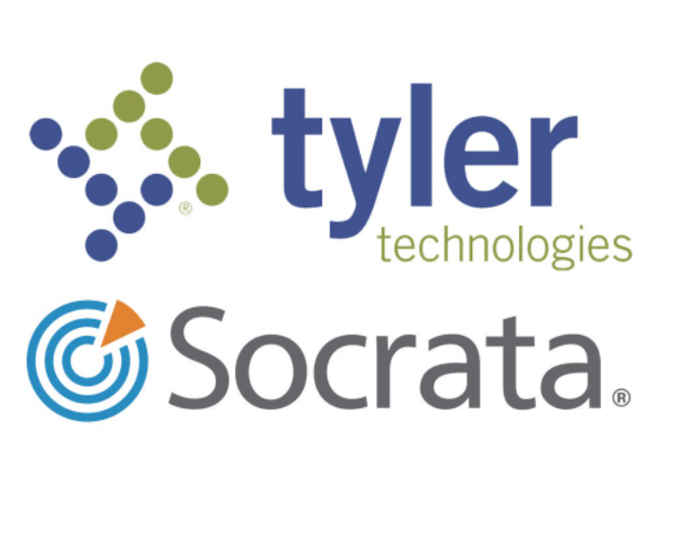
Enterprise Partnerships: GRASP and Socrata
Worked with CDC/ATSDR/GRASP to award a contract for system development
  Geospatial Research, Analysis, and Services Program team with expertise in public health and geospatial science, technology, visualization, and analysis
Worked with existing agency license for Socrata (data.cdc.gov)
  Manage and store machine readable files
  Uses metadata to optimize search and organization
  Provides multiple download formats and API endpoints

Slide 9




External Partnerships: AcademyHealth
Expand NCHS’ relevance and external engagement through a data challenge
Test usability of new Data Query System data files for visualization
Data Viz
SEP NOV DEC FEB MAY
2021 | 2022
https://academyhealth.org/NCHSData

Slide 10
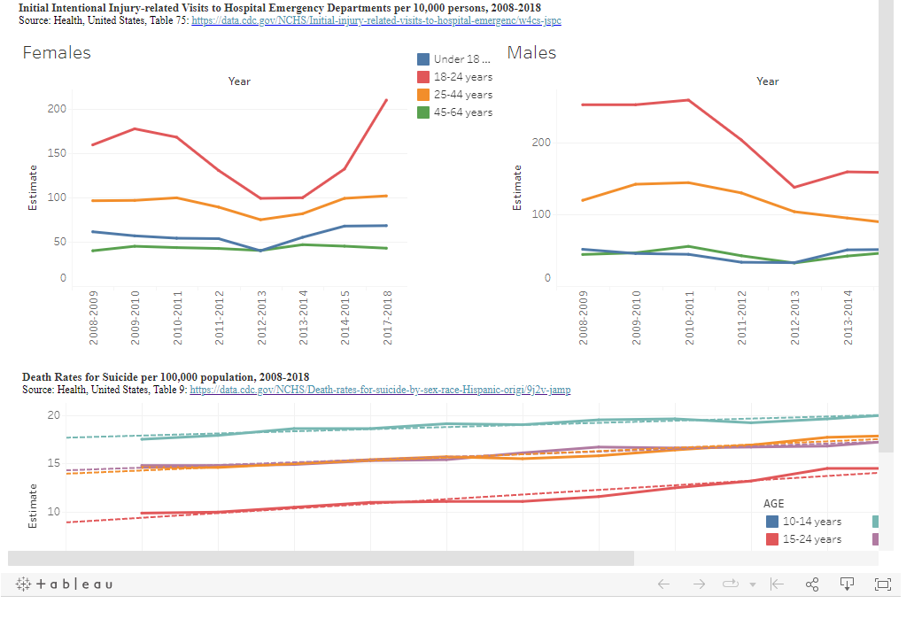
1st Place Winner
Sound the Alarm: Large Inequities in Rates of Gun Deaths Among Young People
Used DQS files for overarching trends
Drilled down using WONDER queries
Constructed a narrative using multiple visualizations
Made methods information easy to find
https://public.tableau.com/app/profile/lauren.russell/viz/shared/FDRKC7NHC

Slide 11
What We Learned
Refined processes to transform legacy print-friendly tables into machine-readable data files
  Developed distinct steps in processing and quality control
Learning from users about file strengths and weaknesses
  More “cohesion” between data files
  More accessible methodological information

Slide 12
DQS Key Requirements
Timely
Roll out new tabulations through existing channels
Provide tabulations in machine-readable formats to support modeling and forecasting
Leverages Enterprise Resources
Providing users with a consistent experience across CDC and NCHS
Encourage interoperability across NCHS (and non-NCHS) data sources
Customizable
Customized and interactive data visualization tools (tables, charts, maps)
Visualizing reliability of estimates; rotating content; redesign and standards changes; bringing together experimental, preliminary, and final data

Slide 13
DQS Key Data Decisions
Software platform –custom application approach to solving existing NCHS statistical / display challenges
Desktop and mobile consumers
Custom application
data.hhs.gov
Socrata API
Data file location –Socrata (data.cdc.gov) to use enterprise services for federated data
data.cdc.gov
Socrata Federation
Dataset, metadata, footnotes
Data file types –aggregated, pre-tabulated estimates
Data creator/steward

Slide 14
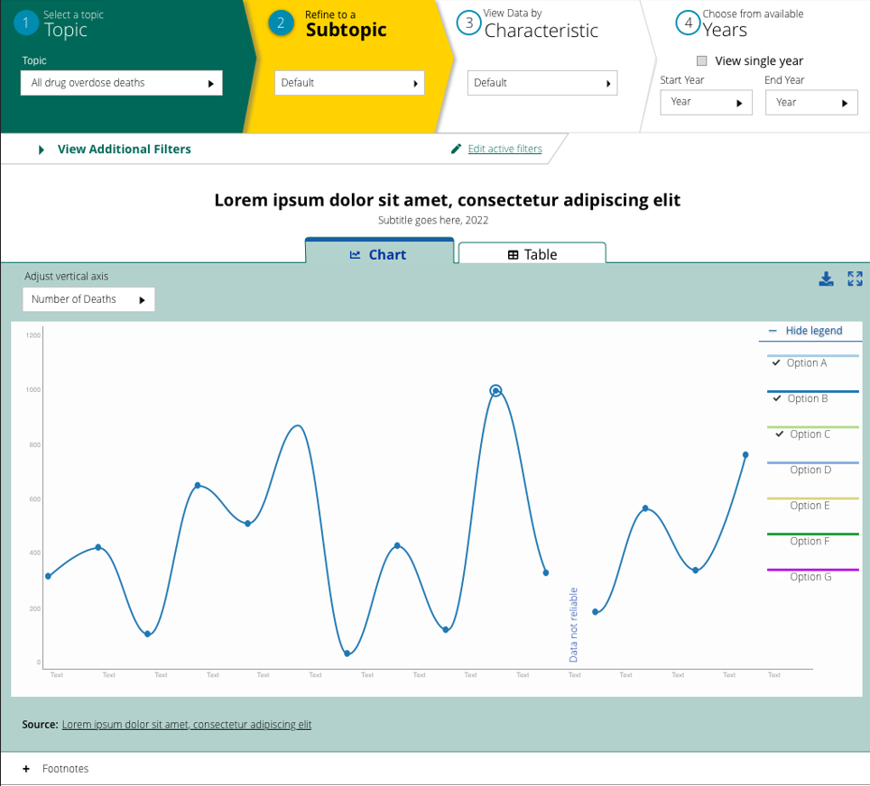
Mockup/Demo

Slide 15
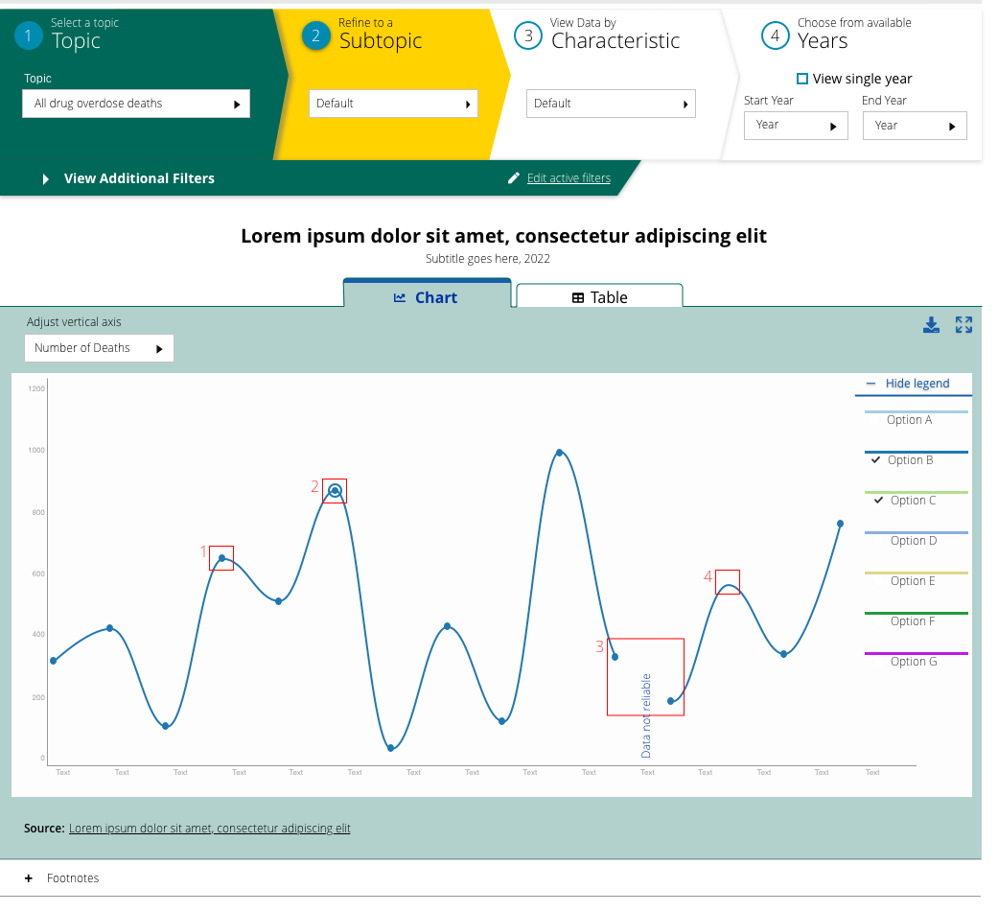
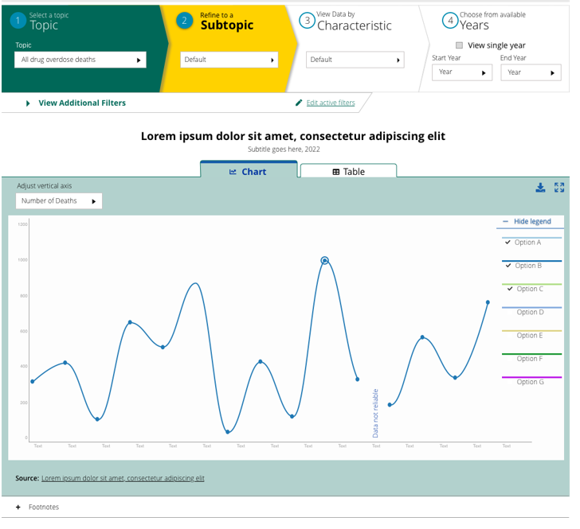
Mockup/Demo (2)

Slide 16
Future Thinking
Proof of Concept
DQS (Pilot) with Health US content
NCHS content development and harmonization
NCHS DQS Releases
2022 2023 2024

Slide 17
Acknowledgments
Project Team | NCHS | Partners
DAE Irma Arispe* Shilpa Bengeri Matt Branner (CTR) Jim Brittain* La-Tonya Curl Barnali Das* Sheila Franco Renee Gindi* Nancy Han Liz Heitz Ji-Eun Kim Florence Lee* Fen Li Michelle Liu Jessica Morgan (CTR) Zakia Nelson (CTR) Keith Toussant (CTR) Ashley Woodall | NCHS OD Jim Craver OIS/OIT Latria Dolberry John Dolinka William Johnson* Anthony Lipphardt Dorothy Roper Sherry Brown-Scoggins DHCS Kathy O’Connor Carol DeFrances NCHS DQS Advisory Group NCHS DataViz Group | AcademyHealth CDC/ATSDR/GRASP TylerTechnologies (Socrata) * Project owners/stewards and core support
17

Slide 18
Feedback and Questions (2)
What non-NCHS tabulated data sources would you recommend prioritizing for inclusion in the DQS?
What query and visualization features would you recommend prioritizing for inclusion in the DQS?
What user groups can we work with to promote use/feedback of early DQS products?

