Slide 1
National Vital Statistics System (NVSS) Updates
Paul D. Sutton, Ph.D.
Deputy Director, Division of Vital Statistics
Board of Scientific Counselors | October 24, 2022

Slide 2
NVSS Statistical Products and Reports Released Since the last Board Meeting on May 26, 2022
Weekly Update of Provisional Death Counts of Coronavirus Disease (COVID-19)
Quarterly Provisional Estimates for Infant Mortality: 2019 – Q2 2021
Monthly Provisional Drug Overdose Death Counts (thru January 2022)
Maternal Characteristics and Infant Outcomes of Women Born in and Outside the United States: United States, 2020
Quarterly Provisional Estimates for Selected Birth Indicators: Q1 2021 – Q1 2022
Changes in primary and repeat cesarean delivery: United States 2016-2021
Monthly Provisional Drug Overdose Death Counts (thru February 2022)
Changes in Births by Month: United States, 2021

Slide 3
NVSS Statistical Products and Reports Released Since the last Board Meeting on May 26, 2022 (continued)
Trends and Characteristics in Gestational Diabetes: United States, 2016-2020
Quarterly Provisional Estimates for Selected Causes of Death: 2019 – Q4 2021
Urban-Rural Differences in Drug Overdose Deaths
Fetal Mortality: United States, 2020
United States Life Tables, 2020
Monthly Provisional Drug Overdose Death Counts (thru March 2022)
U.S. State Life Tables, 2020
Births in the United States, 2021
Quarterly Provisional Estimates of Infant Mortality: 2016 – Q3 2021

Slide 4
NVSS Statistical Products and Reports Released Since the last Board Meeting on May 26, 2022 (continued)
Provisional Life Expectancy Estimates for 2021
Monthly Provisional Drug Overdose Death Counts (thru April 2022)
Infant Mortality in the United States, 2020: Data From the Period Linked Birth/Infant Death File
Provisional Numbers and Rates of Suicide by Month and Demographic Characteristics: United States, 2021
Quarterly Provisional Estimates for Selected Birth Indicators: Q2 2021 – Q2 2022
Monthly Provisional Drug Overdose Death Counts (thru May 2022)
COVID-19 Mortality Among Adults Aged 65 years and Over: United States, 2020
Cause-of-Death Data from the Fetal Death File, 2018–2020

Slide 5
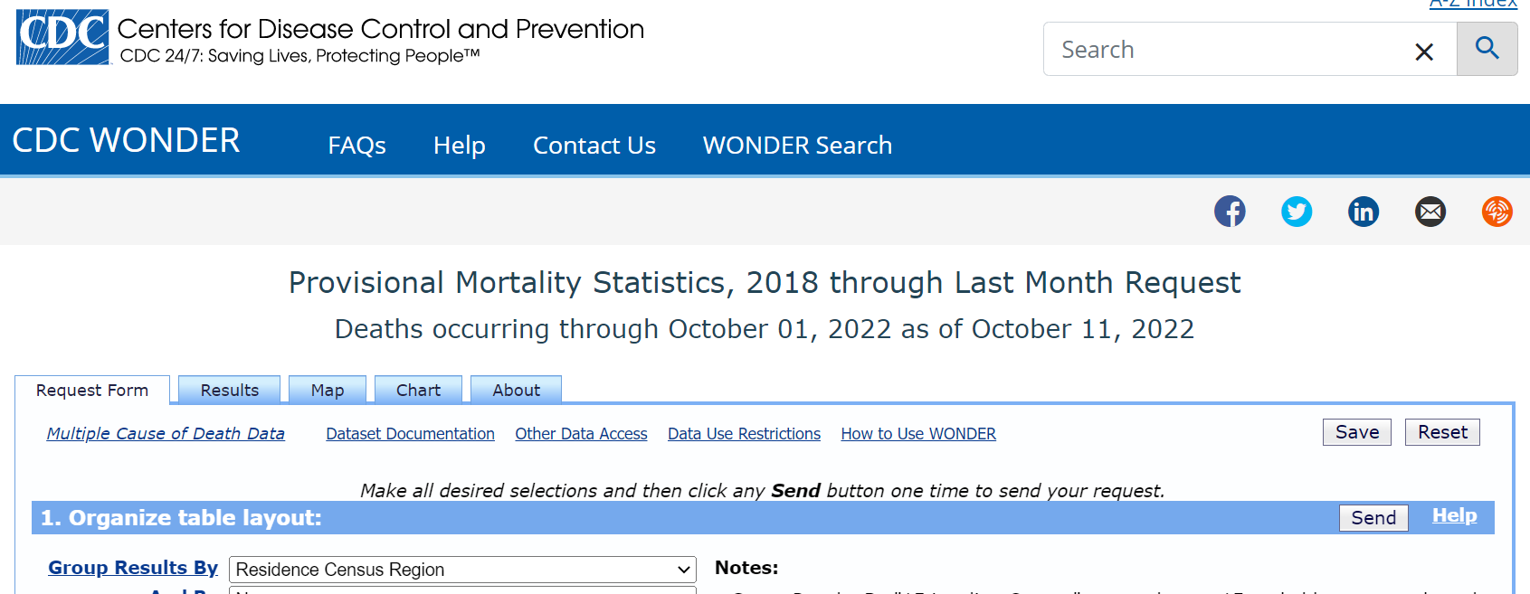
CDC WONDER: Provisional Mortality Data
(over 400,000 data queries since December 6, 2021)
https://wonder.cdc.gov/mcd-icd10-provisional.html

Slide 6
Successful MedCoder Implementation in June
MedCoder is a new NCHS system for coding causes of death literal text from death certificates to ICD-10 codes.
Implementation
Cause of death coding of 2022 data was paused for 2 weeks beginning June 6th
During the pause, all 2022 data received prior to June 6th was reprocessed through MedCoder
Impact
Since implementation 86% of records have been auto-coded (compared to about 70% in the legacy coding system)

Slide 7


Vital Statistics Modernization Community of Practice
Celebrating 2nd Anniversary (launched in October 2020)
The Vital Statistics Modernization Community of Practice is a virtual forum for sharing ideas, technical tools, resources, and promising practices to improve birth and death data. We welcome all jurisdictions and partners interested in modernizing the vital records system, at any level of experience.
https://www.cdc.gov/nchs/nvss/modernization/cop.htm

Slide 8
NCHS Hosted Interoperability Testing Events in 2022
Date | Jurisdictions Testing | Jurisdictions Observing | Jurisdictions Participating
January 24-25, 2022 | 5 | 11 | 16
June 27-28, 2022 | 8 | 12 | 20
October 17-18, 2022 | 18 | 12 | 30
In October 11 of 18 testing jurisdictions were testing for the first time.
Final NCHS hosted testing event of 2022 is scheduled for December 5-6.

Slide 9
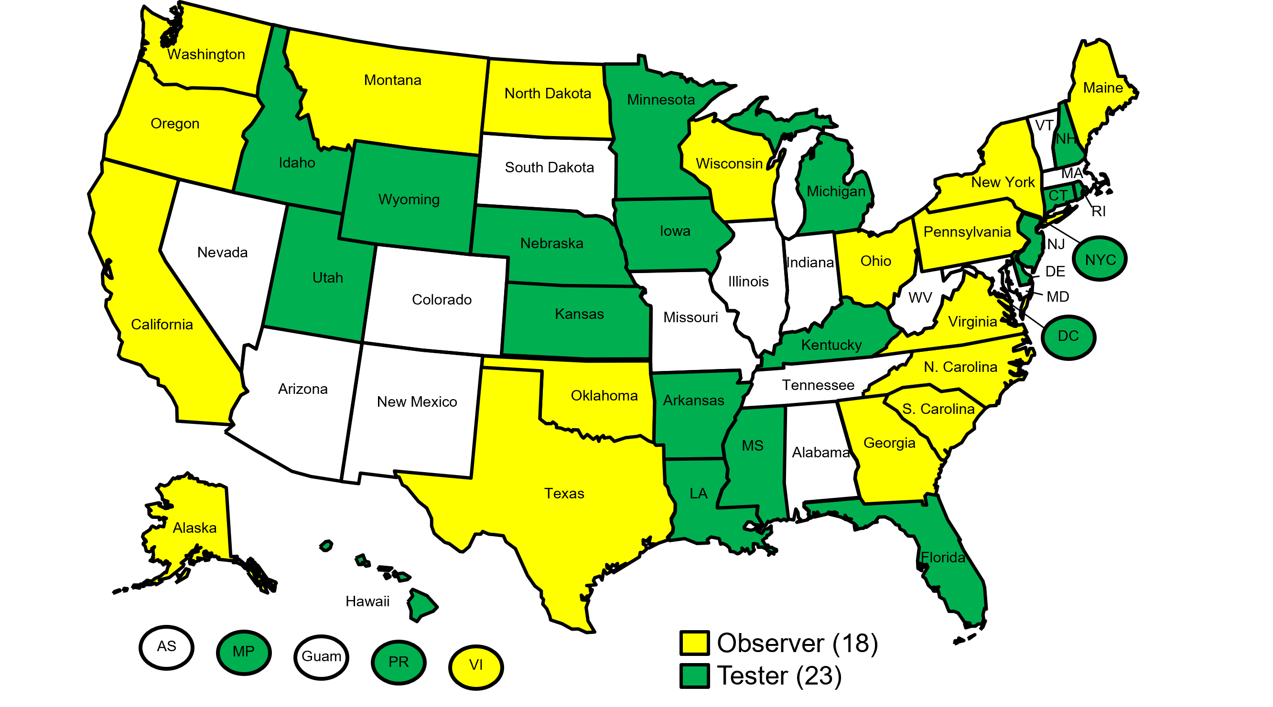
41 Jurisdictions have Participated in NCHS Hosted Interoperability Testing Events since January 2022

Slide 10
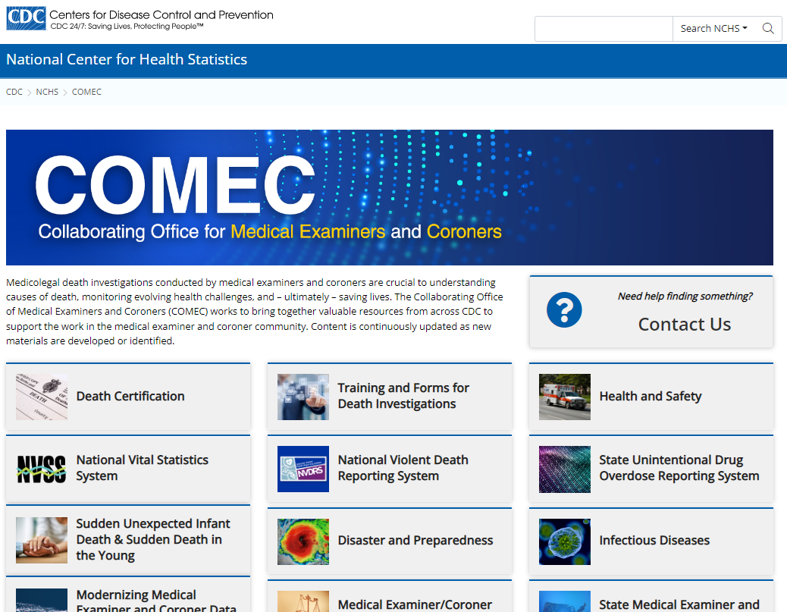
https://www.cdc.gov/nchs/comec/index.htm

