Slide 1
Advancing the Data Modernization Initiative through Data Linkages
Lisa B. Mirel
NCHS Board of Scientific Counselors
May 26, 2022

Slide 2
Overview
NCHS Data Linkage Program
Data Modernization Initiative
  Linking to New Sources of Data
  Evaluating Linkage Methodologies
  Implementing Privacy Preserving Techniques
    Privacy Preserving Record Linkage
    Synthetic Data
Summary
Questions for the Board

Slide 3


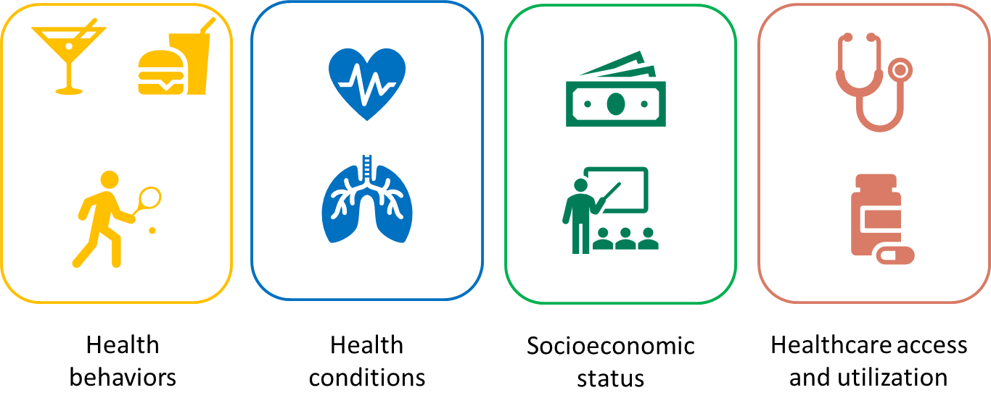







NCHS Data Linkage Program: Sources
Survey Data
Sampling frame
Known inference
Administrative Data
Program participation/vital status
Not meant for research purposes
Housing and Urban Development
Medicare and Medicaid
Mortality
Geocoded Addresses
End Stage Renal Disease
Department of Veterans Affairs

Slide 4
Linking NCHS Survey Data to Two New Sources of Data
Veterans Affairs (VA) data
Transformed Medicaid Statistical Information System (T-MSIS)
Both of these new data sources:
Use enhanced linkage methodologies
Will be available for researchers in summer 2022
Can be used to answer key policy questions, such as:
  VA: What are the health characteristics, outcomes, and health care utilization for Veterans within and outside the VA health system?
  T-MSIS: How do health policy changes affect the health of Medicaid recipients?
T-MSIS PII data quality assessment will be included in linkage documentation.

Slide 5
Evaluating Linkage Methodologies
NCHS Data Linkage Program developed state-of-the-art methodologies to link data (including machine learning)
Comparison of NCHS enhanced algorithm to open-source linkage software
  Exploring Match*Pro
  Could be utilized enterprise wide

Slide 6
Initial Match*Pro Comparison to Standard Methods
Random sample was compared
Preliminary results are promising for total number of possible pairs
  P(>0.95)→ concordance 87%
  P(>0.85)→ concordance 89%
 |  | Gold Standard
Match*Pro P(>0.95) |  | Did not link | Linked | Total
 | Did not link | n/a | 988 | 988
 | Linked | 10 | 6,908 | 6,918
 | Total | 10 | 7,896 | 7,916
 |  | Gold Standard
Match*Pro P(>0.85) |  | Did not link | Linked | Total
 | Did not link | n/a | 792 | 792
 | Linked | 22 | 7,104 | 7,126
 | Total | 22 | 7,896 | 7,918

Slide 7
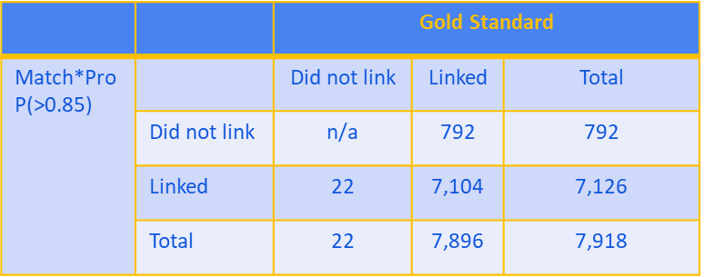
Next Steps for Comparison Analysis and Future Use
Explore off diagonals
Assess impact on secondary analysis
Resolve computing capacity issues for larger datasets

Slide 8
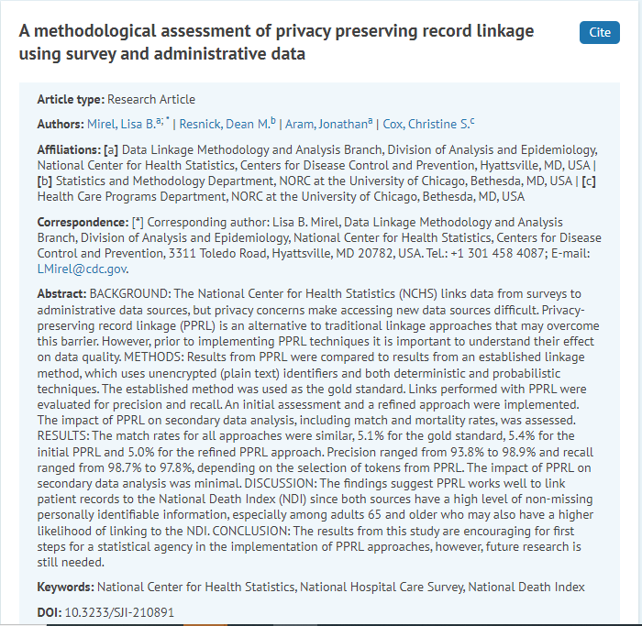
Implementing Privacy Preserving Techniques:
Evaluating Privacy Preserving Record Linkage (PPRL)
PPRL could expand linkage opportunities to new sources of data
Assessed how PPRL compared to standard linkage methodologies (using NHCS-NDI linkage for comparison)
  Precision ranged from 93.8% to 98.9%
  Recall ranged from 98.7% to 97.8%
Journal IAOS: DOI 10.3233/SJI-210891

Slide 9
Implementing Privacy Preserving Techniques: PPRL Next Steps
Assess different PPRL tools, using NCHS linked data as gold standard
  Supported with OS-PCORTF FY 22 funding
  Open source and commercial products
  Evaluating sub-populations and linkage quality
Collaborate with ASPE to inform other HHS OPDIVs considering PPRL implementation going forward
Participate in CDC’s PPRL Community of Practice

Slide 10
Implementing Privacy Preserving Techniques: Synthetic Linked Data
Piloting innovative methods to create public-use linked files that increase data accessibility while maintaining analytic utility and protecting privacy
File Development
Conducted expert interviews: 9 federal partners, 3 non-federal
Focus on health equity and SDOH
Selected variables, now testing
Three proposed files
  NHIS linked to HUD, CMS Medicare (two files: one for ages 18+, one for ages 65+)
  NHCS linked to HUD and NDI (all ages)
File Dissemination
Data will be available for researchers in summer 2023
Creation of a validation service
  Analyses will be run on synthetic data and then validated on the true linked data
  Homomorphic encryption vs. manual validation
Interactive data tables

Slide 11
Summary: DMI and Data Linkages
Strengthening the exploration of new technologies for data linkage
Creating opportunities to:
  Expand linkages beyond traditional federal data sources
  Create files that protect privacy and increase data accessibility
Developing new resources to address emerging public health issues
Supporting the objectives of the Foundations Evidence Building for Policymaking Act of 2018 and for CDC to respond to public health emergencies

Slide 12
Questions for the Board:
What are some innovative strategies we should consider for outreach about the new linked files?
Are there concerns with synthesizing variables that have been brought in at the zip code level (e.g., percent of zip code residents that are uninsured) for a person level file?
Do you have suggestions on how to set up a sustainable validation service for the synthetic data?

Slide 13
Questions?
Thank you!

