Slide 1
National Center for Health Statistics (NCHS)
Director’s Update:
NCHS Board of Scientific Counselors
Brian C. Moyer, Ph.D., NCHS Director
September 14, 2023

Slide 2
Advancing Knowledge About Health Equity
Welcome and Thank you to our Board Members!

Slide 3
Thank you for your service!
Kennon R. Copeland, Ph.D.
Scott H. Holan, Ph.D.
Sally C. Morton, Ph.D.

Slide 4
New CDC Director, Mandy Cohen, MD, MPH
Strong focus on equity, data accountability, and transparent communication.
Immediate priorities include:
Readiness and Execution for Fall and Winter Respiratory Illnesses
Improving Mental Health and Combatting Opioid Crises
Supporting Young Families

Slide 5
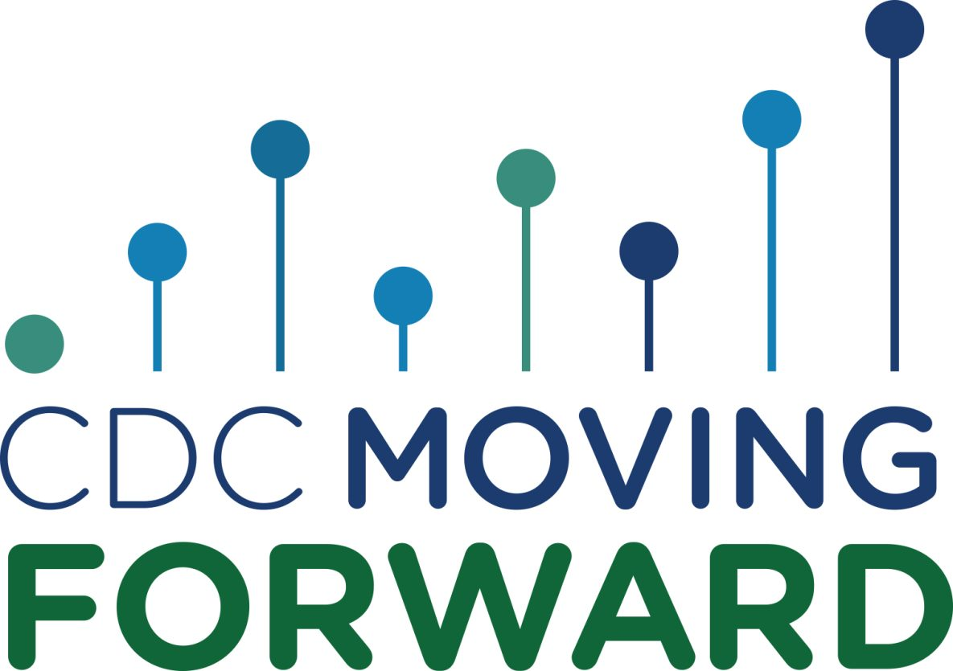
CDC Moving Forward
Share science and data faster
Translate science into practical policy
Prioritize public health communications, with a focus on the American public
Develop a CDC workforce ready to respond to future threats
Promote partnerships

Slide 6
NCHS Re-Organization
Goal: To position CDC to better respond to and tackle future public health threats, while we continue our important day-to-day work of disease control and prevention.
Establish: The Office of Public Health Surveillance, Data, and Technology (OPHDST)
Key NCHS Changes
Establish the Office of Deputy Director for Programs
Establish the Office of Science
Establish the Collaborating Office of Medical Examiners and Coroners (COMEC)

Slide 7
Welcoming our Deputy Director for Programs
Carolyn Greene, M.D.
Principal Deputy Director, NCHS

Slide 8
National Center for Health Statistics (NCHS)
Office of Public Health Surveillance, Data, and Technology (OPHDST)
Jennifer Layden, MD, PhD, Director

Slide 9
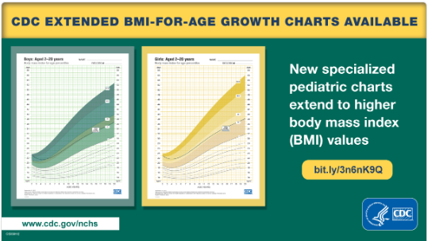
Highlights from NCHS

Slide 10
New Report on America’s Children
Purpose
To update well-being indicators and trends across economic, health, education, and other domains
Upcoming report to be published
September 27, 2023
2023 Report Highlights
Increase in the percentage of children ages 0–17 living with at least one parent employed year-round, full-time
Increase in the percentage of children ages 3–5 who were read to 3 or more times in the last week
Decrease in the percentage of children ages 5–17 with a dental visit in the past year
Go to childstats.gov to access the report when it is released later this month.

Slide 11
NCHS Strategic Plan – Highlights and Accomplishments
Goal 1
Expand NCHS’s relevance
and external engagement
Goal 2
Accelerate NCHS’s health
data capabilities
Goal 3
Build on NCHS’s workforce
and operational excellence
Conducted Health Data User Survey to understand user needs/ interests to inform strategy; June 2023 with N=2,600+ respondents
Developed a Strategic Partnership Engagement Plan draft to engage new and existing NCHS Partners
Evaluating ways to improve the timeliness and quality of pregnancy mortality data (Div. of Vital Stats and the Div. of Reproductive Health)
Initiated plan for new Health Equity Data Webinar Series to launch Dec 2023
Launched Collaborating Office for Medical Examiners and Coroners (COMEC)
46 jurisdictions participated in quarterly testing events focused on interoperability between jurisdictions’ electronic death reporting systems (EDRS) and NCHS
Released 66 experimental, preliminary, provisional, model-based, or early estimates in FY23 as of Q3 end
Conducting IT systems assessment in preparation for cloud based EHR data receipt and processing
Led FYQ4 Cross-cutting program meeting on NCHS’s data needs and potential data linkages.
Finalizing Enterprise Data Analytics and Visualization (EDAV) rules of behavior to process, store, and analyze data now that a EDAV CIPSEA zone has been created and tested
Completed review of Disclosure Review Board assessment & initiating pilot to expand the board and increase review frequency by January 2024
Developed NCHS DEAIB plan
Revised Key Performance Indicators for DEIAB, workforce planning, and professional development
Delivered 41 trainings in CY2022 on leadership, technical, and DEIAB topics to NCHS staff
Notes:
Released 66 experimental, preliminary, provisional, model-based, or early estimates FY23 as of Q3 end
# of early estimates: in line with CDCMF objective of getting data out quickly for public health action.
Enterprise Data Analytics and Visualization (EDAV) is a critical part of CDC’s Data Modernization Initiative efforts
FIHR: Fast Healthcare Interoperability Resources is a next-generation interoperability standard created by the standards development organization Health Level 7 (HL7®). FHIR is designed to enable health data, including clinical and administrative data, to be quickly and efficiently exchanged.

Slide 12
NCHS FY 2023-FY2024 Priorities
NCHS is …
Releasing data faster—continuing aggressive early and provisional data release schedules and improving DRB capacity to review faster
Leveraging emerging technology to improve the quality and timeliness of data—increasing use of new analytic techniques to develop experimental and model-based estimates and ML/NLP uses
Modernizing systems to enhance data access—migrating CIPSEA-protected data to the cloud, exploring a cross-agency National Secure Data Service, assessing IT systems in support of CDC’s Data Modernization Initiative, and advancing Web platforms and data query tools.
Maximizing partnerships and collaborations – implementing results from Health User Survey to guide engagement with state/local gov and academia; developing a strategic partnership engagement plan
Cultivating belonging in the workforce – developing a Workforce Development Strategy, leading CDC’s Data Science Happy Hour

Slide 13
Modernizing Data
Data modernization continues to be an implementation priority for CDC.
To improve the timeliness and accuracy of its data reporting, CDC is modernizing data by adopting innovative data systems that get information to CDC and the public quickly and accurately.
Data Modernization Initiative modernizes core data and surveillance infrastructure across the federal and state public health landscape to shift from siloed and brittle public health data systems to connected, resilient, adaptable, and sustainable ‘response-ready’ systems inside and outside CDC (OPHDST)
Notes:
The Data Modernization Initiative at CDC has been a focused effort to identify the key areas of improvement in the public health data ecosystem that the COVID pandemic exposed and that have been long standing needs for the agency to better serve the Nation.
Key among many areas is the need to improve the timeliness of data access while preserving the high quality and accuracy of these data.
The vision of DMI is a public health data system that is well connected, resilient, adaptable, and sustainable to respond quickly to public health emergencies while conducting the day-to-day core operations of the CDC.

Slide 14
Data Modernization at NCHS
DMI Portfolio Review
NCHS has a strong array of projects that increase the quality and timeliness of data and improve access to data.
These projects were greatly enhanced by COVID related funding: CDC’s DMI Budget, the CARES Act, and the American Rescue Plan.
Rescission of COVID Related Funding
All acquisitions not fully obligated by May 31, 2023 were put on pause.
Looking Ahead: Sustaining and Building on Progress
The deep cuts have impacted the DMI projects but we have worked to preserve many gains.
We are reviewing existing programs and prioritizing activities to build on our progress.
Notes:
Data Modernization Initiative Update
DMI Portfolio Review
To recap, NCHS has received very generous funds from CDC’s annual DMI budgets, the CARES Act, and the American Rescue Plan.
We’ve allocated these funds to several high priority projects, including these few:
Establishing the Rapid Surveys System, a quarterly web panel survey program.
Creating a cloud-based data environment to receive and process EHR data, and to expand the use of these data supporting the National Health Care Surveys.
Implementing various efforts to modernize the National Vital Statistics System, including the creation of FHIR Implementation Guide and API resulting in substantially reduced lag time in data exchange with jurisdictions and increased data quality, among other improvements.
Creating the Virtual Data Enclave for accessing restricted data files at lower researcher cost and increased continuity of operations.
Exploring methodological advances with Model-Based Early Estimates, allowing for finer data granularity.
Developing the Data Query System for improved access to pre-tabulated data and to support the transition to a digital first Health, United States, along with extensive revisions to the NCHS website.
Rescission of COVID Related Funding
This past May, Congress passed, and the President signed the Fiscal Responsibility Act.
Among other things, this law clawed back unobligated funding that had been intended for COVID-19 spending, including DMI projects established to address the infrastructure and other modernization needs that the pandemic had placed in high relief.
As of May 31, 2023, all acquisition items not yet full obligated were placed on pause while we awaited direction from CDC’s Office of Financial Resources, and they in turn awaited guidance from the Office of management and Budget.
We created various working scenarios on how to best reallocate non-COVID-19 related dollars and preserve, and possibly continue to build on, the many successes of our DMI portfolio.
In late June, we received OMB guidance and approval of our revised spend plans for the COVID related funded projects.
While available funds for DMI projects were reduced by about $10M, and these cuts are deep, careful management of funds has allowed us preserve improvements.
Looking Ahead: Sustaining and Building on Progress
The NCHS Data Modernization Initiative portfolio remains strong and committed to our goals, the CDC Moving Forward goals, and the Public Health Data Strategy goals.
These include increasing the timeliness and relevance of data, and improving access to data, among other goals.
For example, we were able to distribute an additional $1.3M to each NVSS jurisdiction for their continued modernization progress.
We will be able to complete the infrastructure developments needed to receive EHR data.
And the VDE is now up and running, with 10 CDC projects actively onboarding.
The COVID related funding provided a significant boost in these and other areas, and we’re proud of what we’ve accomplished.
Looking ahead, we continue to prioritize internal efficiencies and data timeliness gains with the resources we do have.
Sustaining our progress, and building on it, remains important. By evaluating existing programs and processes, we are engaging in the difficult task of prioritizing activities as the resources return to level or near leve

Slide 15
NCHS Budget Updates
NCHS Budget Updates

Slide 16
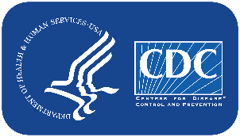
Questions?
www.cdc.gov/nchs

