Slide 1
Model-Based Early Estimates Update:
NCHS Board of Scientific Counselors
National Center for Health Statistics (NCHS)
Lauren Rossen, Ph.D., Senior Scientific Advisor
Division of Research and Methodology
September 14, 2023

Slide 2
Model-Based Early Estimates: Goals
Improve the timeliness and granularity of data
Enable data to action
Predicted data
Reported data
Notes:
Provide fast and detailed estimates for small groups or areas
Reduce manual processes for modeling and analysis
Provide relevant data for evidence-based decision-making
Track public health priorities and health equity in near-real time

Slide 3




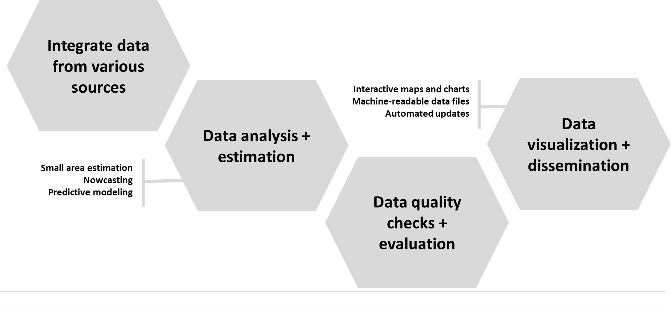



Model-Based Early Estimates: Design
NCHS Data Systems
+
Auxiliary Data
Notes:
Automated statistical modeling to produce early, small area/domain estimates

Slide 4
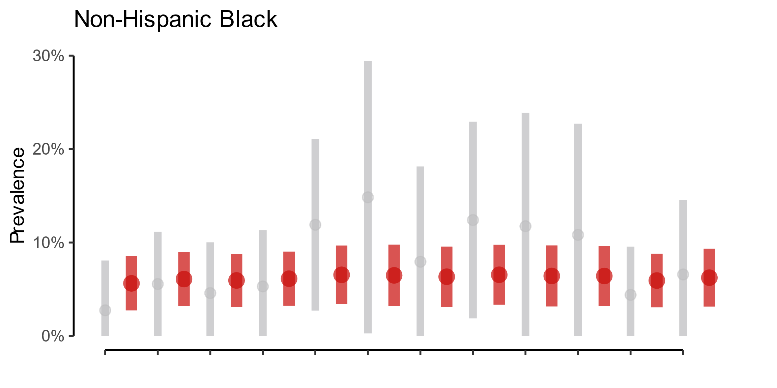
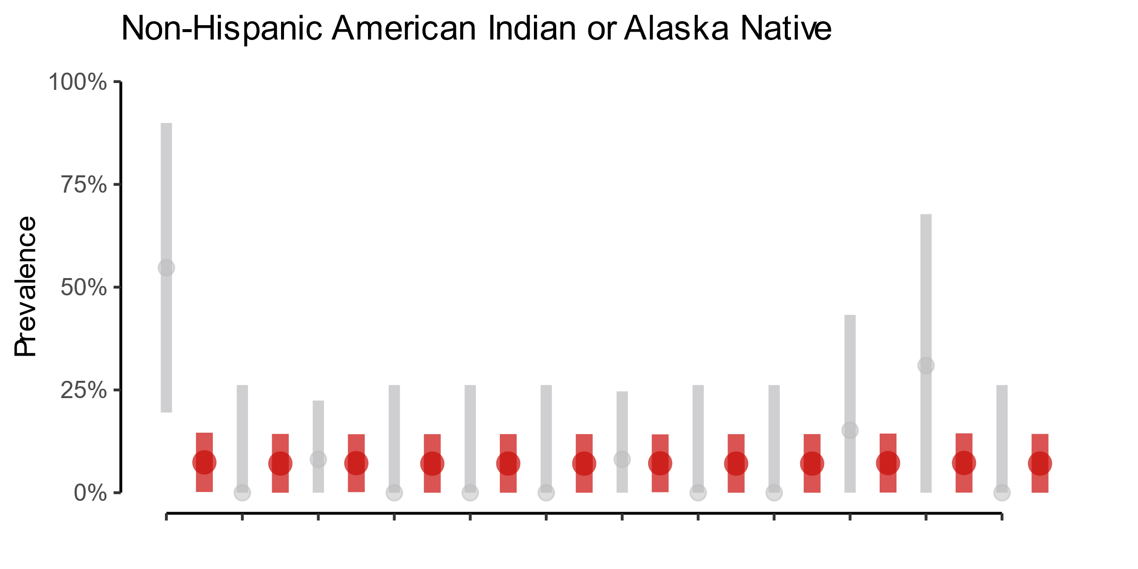
Model-Based Early Estimates: First Product
■ = Direct survey estimate
■ = Model-based estimate
Goal: Evaluate methods to produce and disseminate estimates for small subgroups
      Publish estimates where data are often suppressed
      Assist measurement and tracking of disparities
Solution: Enhancements to an existing small domain modeling approach/tool
      Added functionality
      Improved transparency
      Evaluations underway
Can use this tool to generate model-based estimates for small subpopulations using NCHS data systems
Time

Slide 5
Model-Based Early Estimates: Timeline
Implementation and
Production
Analytic tool for small domain estimation
County-level estimates of deaths, births
State-level estimates from NHIS
Analytic pipelines for other data systems
Evaluation of methods for combining non-probability and probability data
Ongoing Research and Development
Continuous evaluation of estimates and methods
Analytic support to data divisions and data users
Research on new and emerging data science methods
September 2023
January 2024
September 2024

Slide 6

Questions?
www.cdc.gov/nchs

