Slide 1
NCHS and Gender Identity Data Collection
Amy Branum
Associate Director for Science
NCHS

Slide 2
The importance of gender identity
“Only when questions about sexual orientation and gender identity are included in national surveys, such as those conducted by the Department of Health and Human Services, can researchers identify health disparities within or across groups who identify as lesbian, gay, bisexual, or transgender”¹
¹Collect Data on Sexual Orientation and Gender Identity in Health Surveys | RAND

Slide 3
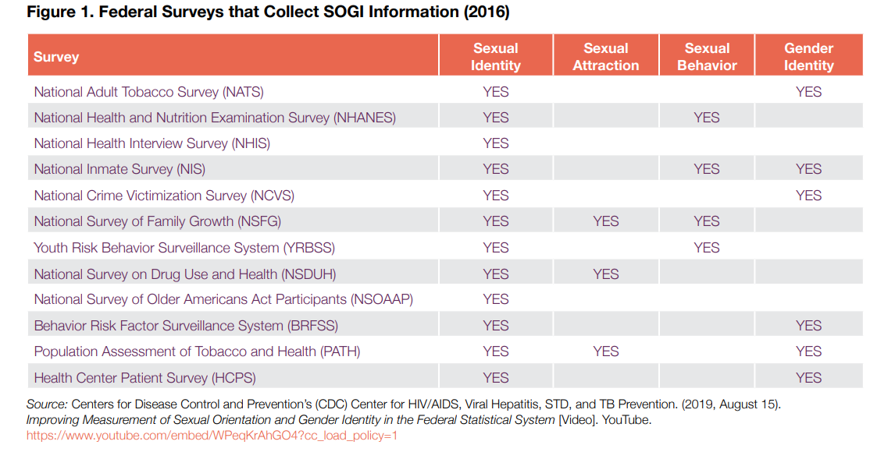

Slide 4
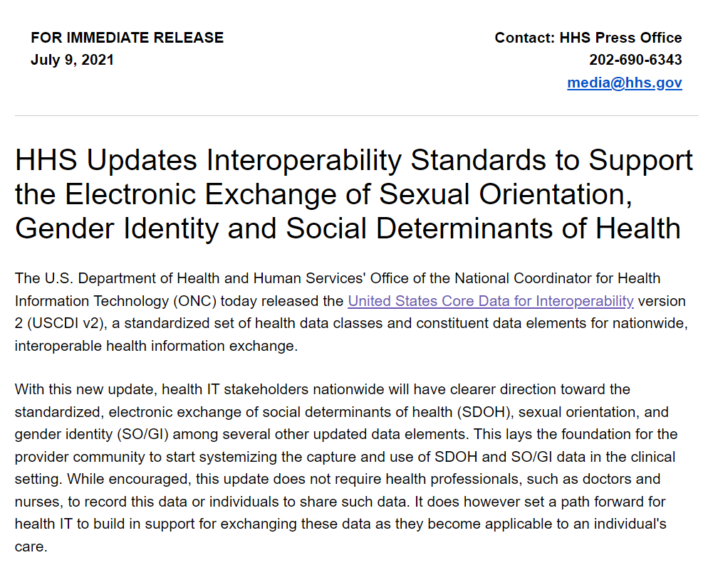

Slide 5
NCHS gender identity activities
NCHS Health Equity CORE Goal: By July 2023, using a range of methodologies, NCHS will identify and evaluate various question sets related to health equity, including approaches that most accurately assess gender identity.
  Beginning on January 1, 2022, NCHS will collect information on gender identity among sample adults in the NHIS
  In 2023, NHANES will also add gender identity questions
  First year in NHIS will be experimental, testing various question approaches
SOGI Interoperability Standards: NCHS involved in discussions with others within CDC around approaches to USCDI standards
Cognitive interviewing and question testing

Slide 6
Gender Identity Measure Development
Kristen Miller
Collaborating Center for Question Design and Evaluation Research (CCQDER)

Slide 7
Organization of Discussion
  Overview of CCQDER Program
  Gender Identity Question Design
    Features
    Data quality issues
  CCQDER Gender Identity-Related Projects

Slide 8
Activities
Methodological Research Program
  Study of meaning and question response in relation to data quality
  Development of design and evaluation methods
Questionnaire Design Research Lab
  Question Development and Testing Projects
  For NCHS, CDC, HHS, and others
Question Evaluation Applications
  Q-Notes: Data entry and analysis tool for cognitive interviewing studies
  Q-Video: Cognitive Interview/Data Storage
  Q-Bank: Online library of question evaluation findings

Slide 9

NCHS Evaluation Methods
Cognitive Interviewing
Experimental Design and Embedded Probing with the Research and Development Survey (RANDS)
Ethnographic Methods: In-depth interviewing, Free Lists, Card Sorts
Focus Groups
Interviewer Debriefing
Usability Testing

Slide 10

Cognitive Interviewing at NCHS
First cognitive laboratory, 1980s
Scientific study
  Systematic analysis
  Data quality
  Maintenance of data
  Transparency
  Documentation
Cognitive interviewing as validation
Ensuring Comparability and Measurement Equity (AAPOR Webinar)
Research and Development Survey (RANDS): Mixed Method

Slide 11
Analytic Goals of Cognitive Interviewing Studies
Cognitive Testing: Conducting interviews to “look for problems.”
Construct Validity Study: Identifying the constructs captured by individual questions by identifying the specific phenomena that account for respondents’ answers.
Comparability Study: Determining whether constructs are consistently captured across salient respondent groups.

Slide 12
Research and Development Survey (RANDS)
Mixed Method:
  Cognitive Interviewing + Web Panel Survey Data
  How much error? In what demographic groups?
Embedded Construct and Error Probes
  ‘When answering the last question, were you thinking about X, Y or Z?’
Experimental Design:
  To test different versions of questions

Slide 13
Gender Identity Measurement
Notes:
Goal is to collect data to understand disparities of gender minorities; but it is also about understanding how conceptualizations of gender and sex have changed over time, and understanding how we should ask it now--- given key variable

Slide 14
External Collaborations
CDC coordination of data collection systems
NCVHS Workgroup on SOGI & SDOH Data (ASPE)
NASEM Workgroup
OMB, Domestic Policy Council, State Dept
FCSM SOGI Workgroup
Interagency Response Error Group
Community Groups

Slide 15
Gender Identity, Census PULSE, July 2021
SEX: What sex were you assigned at birth, on your original birth certificate?
  Male
  Female
  Refused
  Don’t know
GENDER: How do you describe yourself?
  Male
  Female
  Transgender
  None of these
CONFIRM: Just to confirm, you were assigned {FILL} at birth and now you describe yourself as {FILL}. Is that correct?
  Yes
  No
  Refused
  Don’t know
Notes:
Question design features

Slide 16
Gender Identity, Census PULSE, Week 34, 2021
Total Sample (unweighted) | 64,562
Cis-gender (M/M; F/F) | 96.75%
Gender minority (M/F; F/M) | .2%
Selected "transgender" | .3%
Selected "none of these" | 1.16%
Missing | 1.57%
Very small transgender population; no room for error
Question design goal: Get everyone in the right bucket
False positives = bad for understanding disparities
False negatives = bad for population estimates
For this data:
  Confirmation question false positives = 22% (corrected)
  Cases not corrected = ?
  “None of these” false positive/negative = ?
Percentages are weighted.

Slide 17
Question Design Goals
Capture complexity and range of sex and gender identities
  Asking both SAB and Gender
  Mark all that apply
Reduce false positive and false negative error
  Why is error occurring? What is the reason?
  Privacy = false negative; Misunderstanding = false positive
Research activities: To understand the various question design features,
  Response categories
  Order
  Wording and phrase choices
  …. and how they relate to performance (in allowing for complexity and generating error)

Slide 18
2021 NCHS Gender Identity Question Design and Evaluation Studies
Cognitive interviewing NIOSH/YRBSS, ACES, NAMCS, NSVIS, NSFG
  Constructs captured: Sex and Gender questions
  Changing terms/understanding differences between gender minorities/non-minorities
  Adults vs. Teens: Different interpretive processes
  Proxy: What contexts are appropriate?
Usability testing
Gender X marker passport application form (for US State Dept) – 100 in-depth interviews conducted
Split sample with embedded probes
RANDS with NISVS Questionnaire
RANDS with NSFG Questionnaire

Slide 19
RANDS Split Sample with Embedded Probes
(Experiment: Order and Gender/Sex Categories)
1. What sex were you assigned at birth, on your original birth certificate?
Male
Female
[Don’t know]
2a. How do you describe yourself? Select all that apply.
Male
Female
Transgender
Something else: _____________
2b. Do you describe yourself as a man, a woman, or in some other way? Select all that apply.
Man
Woman
In some other way: _________________ [text box]
3. Just to confirm, you were assigned {FILL} at birth and describe yourself as {FILL}. Is that correct?
Yes
No
4. [PROBE]. You didn’t answer “what sex were you assigned at birth, on your original birth certificate?” Can you tell us why? Select all that apply.
I don’t understand what the question is asking
I’ve never seen my birth certificate
I don’t want to answer this question
This was a mistake, I meant to say: ___________ [text box]
Other, specify: ____________ [text box]

Slide 20
QBank: wwwn.cdc.gov/qbank
Miller, K., Willson, S., Ryan, V. (2021). An Initial Cognitive Evaluation of a 2-Step Gender Identity Measure. National Center for Health Statistics - CCQDER. Hyattsville, MD https://wwwn.cdc.gov/QBank/Report.
For questions, email Kristen Miller: ksmiller@cdc.gov
https://www.cdc.gov/nchs/ccqder
https://www.cdc.gov/nchs/rands

