Slide 1

NCHS Data Presentation Standards for Rates and Counts
Jennifer D. Parker
Director, Division of Research and Methodology
National Center for Health Statistics
Meeting of the NCHS Board of Scientific Counselors
February 10, 2022

Slide 2
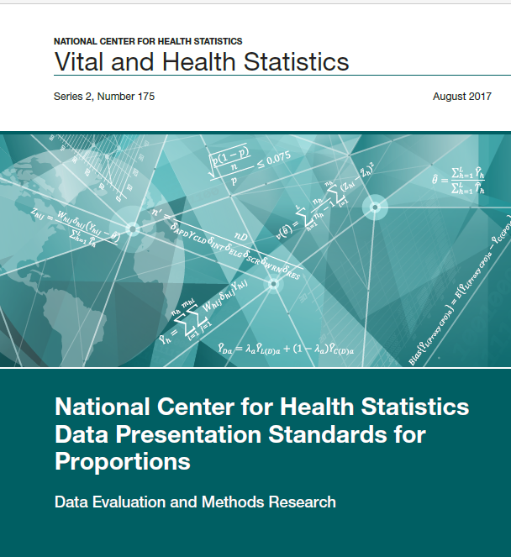
NCHS Data Presentation Standards for Proportions released August 2017
Standard
  Criteria based on minimum sample size and absolute and relative width of exact confidence interval
  Estimated proportions with few degrees of freedom or with suppressed complementary proportions are to be evaluated individually
Implementation generally, although not always, led to more estimates presented compared to prior criteria
NCHS Vital and Health Statistics, Series 2, Number 175, August 2017 (cdc.gov)

Slide 3
NCHS Data Presentation Standards for Rates (and Counts) workgroup formed 2018
Workgroup was formed in 2018 and includes representatives from DRM, DAE, DVS, DHCS, OCD and DRM contractors (mathematical statisticians)
Objective
  Identify current practices for data suppression of rates and counts
  Review and examine statistical principles, particularly properties of intervals calculated for rates and counts
  Create and evaluate presentation standards for rates and counts

Slide 4
Provisional guidance for vital rates and counts presented to BSC January 2020
Rates with (assumed) constant numerators and non-constant denominators from vital statistics, including:
  national and state death rates, birth and fertility rates, age-adjusted death rates; rates for subpopulations
Strategy
  Identify and compare current presentation guidelines, methods of interval estimation, relative standard errors

Slide 5
Structure of Standards
National Vital Statistics System
  Counts
  Crude rates with denominator assumed constant
  Age-adjusted death rates with denominator assumed constant
  Rates with non-constant denominator (e.g., from ACS)
Population Health Surveys
  Counts
  Rates with denominator assumed constant
  Rates with non-constant denominator

Slide 6
Presentation Criteria
Minimum sample size or effective sample size
  Minimum sample size and effective sample size (when applicable) of 10 in the numerator (rates and counts) and in the denominator (rates only)
Maximum relative width of confidence interval
  If the sample size criteria are met, calculate a 95% two-sided confidence interval using the appropriate method and obtain its relative width. Estimated rates should have a relative confidence interval width of 160% or lower
Minimum degrees of freedom
  When applicable, if the degrees of freedom are fewer than 8 then flag for statistical review

Slide 7
Presentation Criteria – Confidence Intervals for Rates from NVSS (1 of 2)
Denominators assumed constant
  Calculate gamma interval where the lower limit is the 0.025 quantile of the standard gamma with α=x and β=1 and the upper limit is the 0.975 quantile of the standard gamma with α=x+1 and β=1.
  The adjustment used by Fay-Feuer should be applied for age-adjusted vital rates.
Denominators assumed non-constant
  Calculate a Student’s t interval for the logarithm of the rates with variance estimated using method supplied by source. Parameters for age-adjusted intervals can be formed using weighted combinations of age-specific estimates.

Slide 8
Presentation Criteria – Confidence Intervals for Rates from NVSS (2 of 2)
Denominators from other population surveys and assumed nonconstant
  Calculate a Student's t interval for the logarithm of the rate. Parameters for intervals for age-adjusted intervals can be formed using weighted combination of age-specific intervals.
Denominator from births file, which is subject to random variation and assumed non-constant*
  Calculate a Student’s t confidence interval for the logarithm of the rate
  * e.g., period-linked, cohort-linked infant mortality files

Slide 9
Presentation Criteria – Confidence Intervals for Rates from Population Health Surveys
Denominator assumed constant
  Calculate a Student's t confidence interval for the logarithm of the rate
Denominator assumed non-constant
  Calculate a Student’s t confidence interval for the logarithm of the rate
  The interval accounts for the sampling variability of the denominator

Slide 10
Evaluations for Vital Statistics
Distributional assumptions: comparison of ‘exact’ gamma interval width thresholds, relative standard errors (RSE), and counts
Age-adjusted death rates: simulation-based comparison of Anderson-Rosenberg method, used at NCHS and in CDC WONDER, with approaches by Fay/Feuer and Tiwari et al, used in U.S. Cancer registries.
Simulation to examine proposed and previous standards for county-level data by race/Hispanic origin and cause of death
Simulations evaluating log Student’s t interval for non-constant denominator, including correlation assumptions for numerator and denominator

Slide 11
Evaluations for National Health Care Surveys
Simulations based on NAMCS data structure
  Evaluation of confidence intervals when the denominator is constant
  Evaluation of confidence intervals by nominal and effective sample sizes and survey years when the denominator is constant
  Evaluation of the design effect using row proportions and using totals or counts when the denominator is constant
  Evaluation of rates and age-adjusted rates when both the numerator and the denominator are non-constant
Simulations based on sampling small samples from a large combined file of multiple years of NAMCS
  Evaluation estimates presented using proposed and prior standards, interval coverage, effective sample size, design effect, RSE
    Focus on detailed age groups, race/ethnicity groups, reason for visit

Slide 12
NCHS Data Presentation Standard for Rates and Counts
Review by the workgroup
Review by the NCHS ADS from each division
Review by additional mathematical statisticians
Next Steps
  Consolidate comments and prepare for official NCHS clearance
  Three presentations to NCHS: Overview (February), Technical Development and Evaluations (April), and Implementation (late spring/summer)

Slide 13
Data Presentation Standards Workgroup
Division of Research and Methodology
  Jennifer Parker
  Katherine Irimata
  Don Malec (retired)
  Guangyu Zhang
  Makram Talih (SIS)
  Frances McCarty (SIS, Virginia Tech)
Office of Center Director
  Amy Branum
Division of Vital Statistics
  Brady Hamilton
  Ken Kochanek
Division of Health Care Statistics
  Alex Strashny
  Danielle Davis
Division of Analysis and Epidemiology
  Barnali Das

Slide 14
Questions?

