Slide 1
National Center for Health Statistics
Increasing Availability of Social Determinants of Health (SDOH) Data at HHS
Irma Arispe, PhD
Director, Division of Analysis and Epidemiology
NCHS Board of Scientific Counselors Meeting May 26, 2022
Zoom

Slide 2
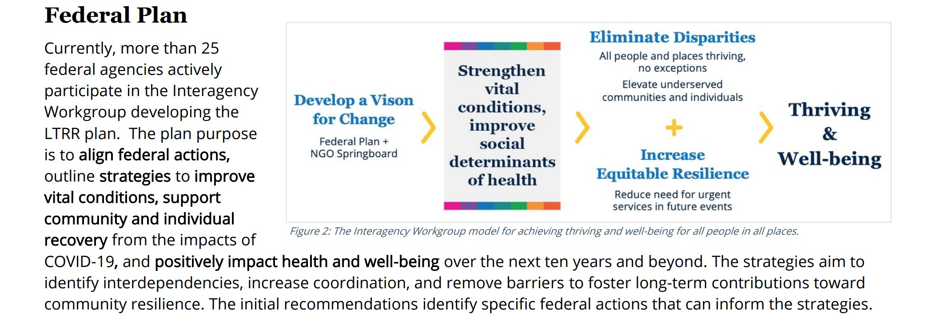
Signaling the Importance of Social Determinants of Health
Reaching people, many of whom are experiencing grief and sometimes stigma from the loss of a loved one to COVID-19, may require multiple, varied forms of outreach over a long period of time. And, while COVID-19 has affected the entire country, there have been notable regional and demographic variations in the severity of its health impacts, both because of social determinants of health and, more recently, varied vaccination rates.

Slide 3
Selected Evidence-Building Questions
How do HHS programs and policies expand equitable access to comprehensive, community- based, innovative, and culturally-competent healthcare services while addressing social determinants of health?
To what extent do HHS programs and policies strengthen and expand access to mental health and substance use disorder treatment and recovery services for individuals and families?
How do HHS policies and programs enhance promotion of healthy lifestyle behaviors to reduce occurrence and disparities in preventable injury, illness, and death
What improvements are needed to HHS programs and policies for data collection, use, and evaluation to increase evidence-based knowledge that leads to better health outcomes, reduced health disparities, and improved social well-being, equity, and economic resilience?
FY 2023-2026 HHS Evidence-Building Plan | ASPE

Slide 4
Questions for the BSC
How can NCHS be more strategic in engaging on this broad set of topics so that our work is most effective?
Are there specific SDOH that should be prioritized across the agency?

Slide 5
HHS SDOH Action Plan

Slide 6
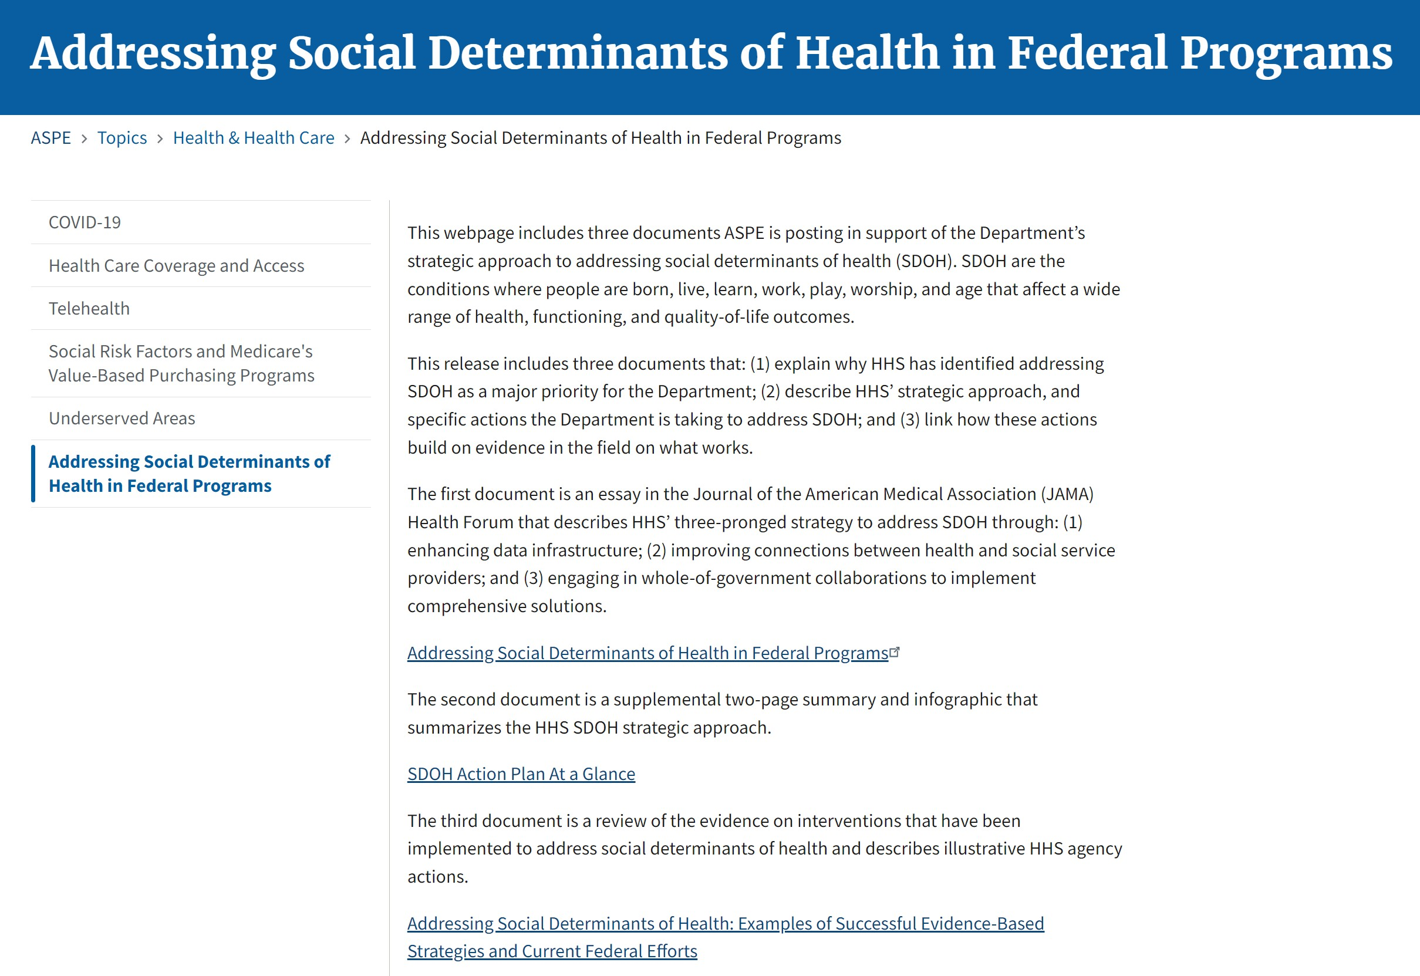
Addressing Social Determinants of Health in Federal Programs | ASPE (hhs.gov)

Slide 7
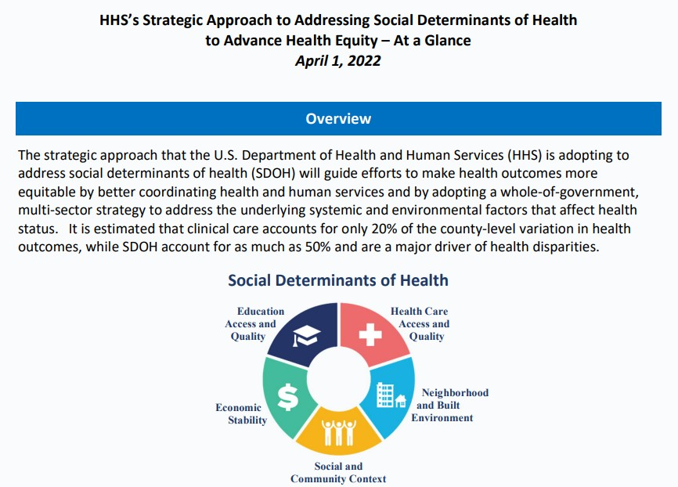
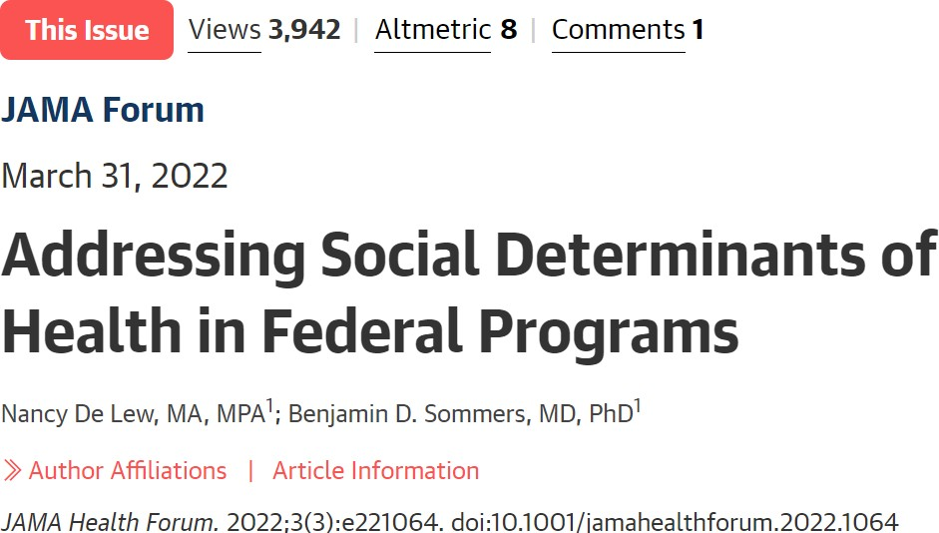
SDOH-Action-Plan-At-a-Glance.pdf (hhs.gov)
Social Determinants of Health - Healthy People 2030 | health.gov

Slide 8
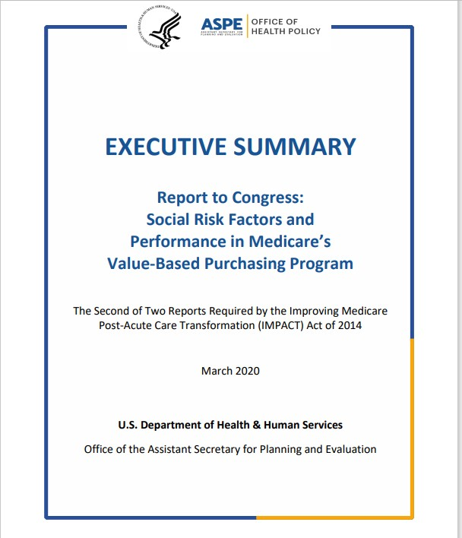
Section 2(d) of the Improving Medicare Post-Acute Care Transformation (IMPACT) Act of 2014 (P.L. 113-183) called for the Secretary of Health and Human Services (HHS) to study the effect of individuals’ socioeconomic status (SES) on quality measures and measures of resource use under the Medicare program.
Three policy questions:
Should some or all of Medicare’s value-based purchasing programs account for social risk by adjusting measures and/or payment based on those measures?
Should HHS routinely collect more extensive and detailed data on beneficiaries’ social risk factors than is currently available?
How can HHS achieve better outcomes for all Medicare beneficiaries by facilitating the ability of providers and communities to address social risk factors and integrate health and social services?

Slide 9
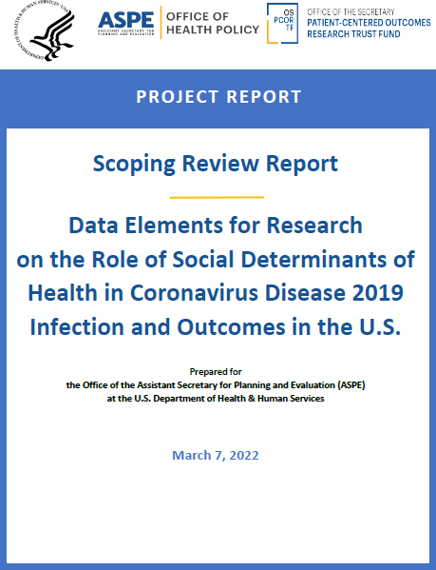
ASPE Office of Health Policy
Existing data sources from federal agencies such as the Centers for Disease Control and Prevention (CDC) Social Vulnerability Index (SVI), Housing and Urban Development data, Centers for Medicare and Medicaid Services (CMS) claims data, as well as local data from EHRs and health information exchanges, are important for understanding disparities and effectiveness of
interventions.
However, they may not include standardized
SDOH data elements for comparability and linkages across that
could be the possible reason for finding only very limited (a
few) examples in the scoping review where these data were
linked.

Slide 10
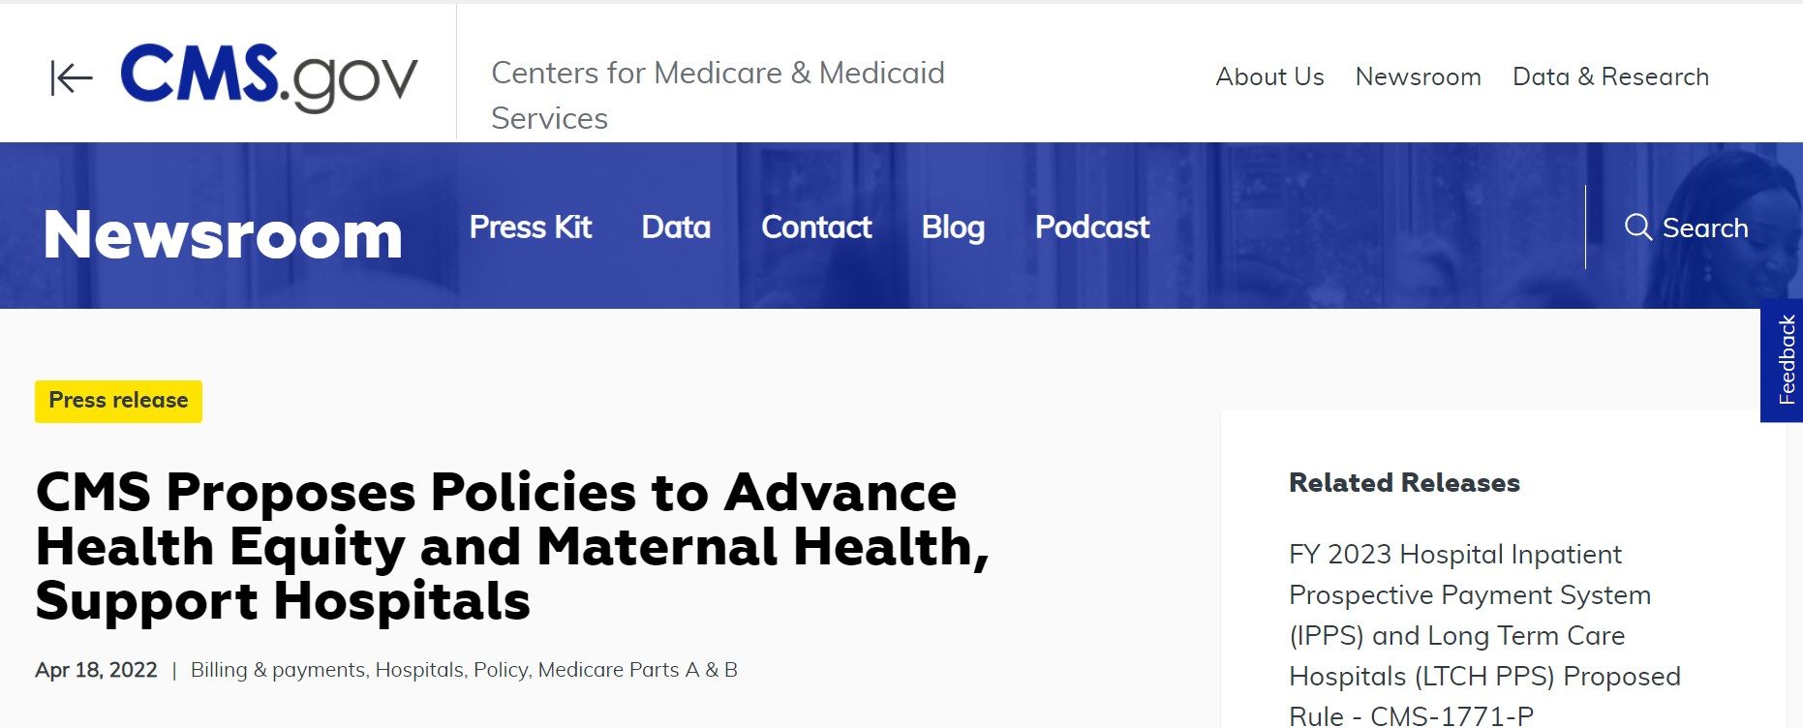
Centers for Medicare & Medicaid Services
CMS Proposes Policies to Advance Health Equity and Maternal Health, Support Hospitals | CMS

Slide 11
CDC SDOH Task Force

Slide 12
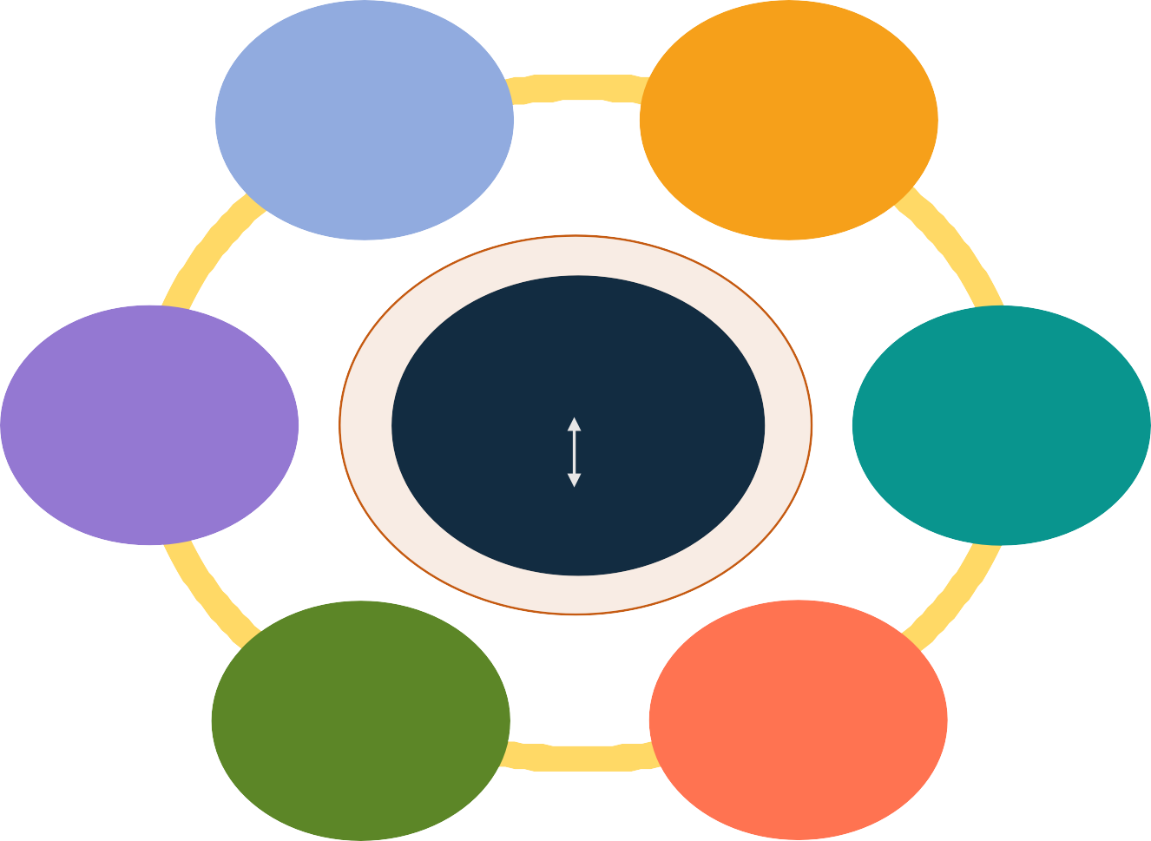
Describing the Value of Public Health Investment in SDOH
CDC SDOH Task Force
Policy and law
Data and surveillance
Six cross-CIO subcommittees
Share information about ongoing activities
Shape SDOH cross-cutting work
Develop SDOH goals
Promote whole of government approach
Support the field (funding, technical assistance
Develop workforce capacity
Equity
SDOH
Social conditions
Infrastructure and capacity
Evaluation and evidence building
Structural conditions
Community engagement
Partnerships and collaborations

Slide 13
Fostering Communication with Other SDOH- Related Initiatives Within CDC
Data Modernization Initiative (Alignment Groups)
Standards Development Activities
Data Standards Management and Harmonization Workgroup
Health Equity Data Elements and Standards Group
CDC SDOH Public Health Use Case Workgroup

Slide 14
NCHS SDOH-related Activities

Slide 15
NCHS Activities to Support SDOH

Slide 16
Social Determinants of Health
“Social determinants of health are conditions in the places where people live, learn, work, and play that affect a wide range of health and quality-of life-risks and outcomes.”
:
NHIS 2020: Perceptions of the Neighborhood Environment
NHIS 2020: Chemical Exposures at Work
NHIS 2013-18: Neighborhood Social Capital
NHANES 1999-2016: Noise
Exposure at Work
NHANES 2005-6: Household Allergens
NHANES: 2011-2016 Occupation- based physical activity
NCHS-HUD linked files
Live
Work
Vitals: Births at home
Vitals: Deaths at work
Learn
Play
NHIS 2020: Perceptions of the Neighborhood Environment
NHANES: School meals, school physical education, recess
NHIS 2020: Injuries while playing sports or other physical activities
NHIS 2020: Injuries while at school
NHANES: 1999-2016 Leisure-time physical activity
Examples from NCHS Data Systems

Slide 17
Promoting Harmonization in Interagency Health Monitoring
Healthy People Initiative
Health, United States
America’s Children Key National Indicators of Well-Being
Older Americans Key Indicators of Well-Being

Slide 18
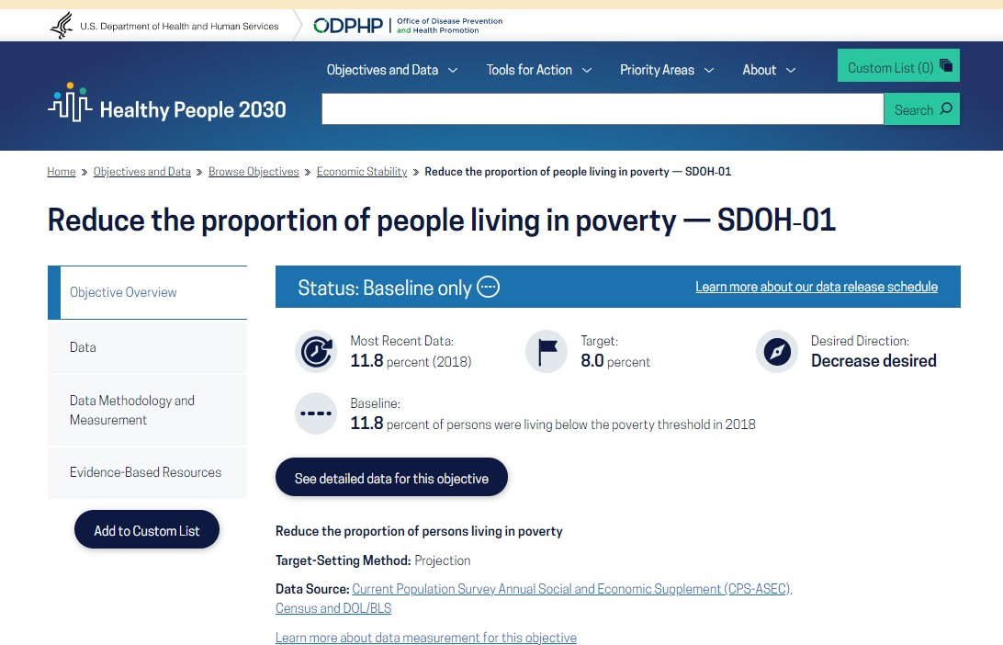
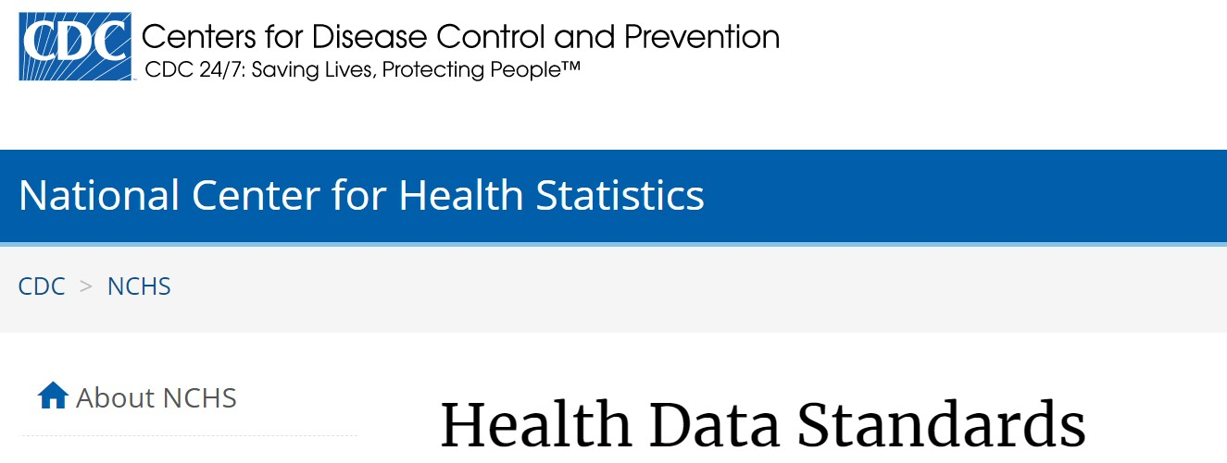
Standardizing Measures

Slide 19
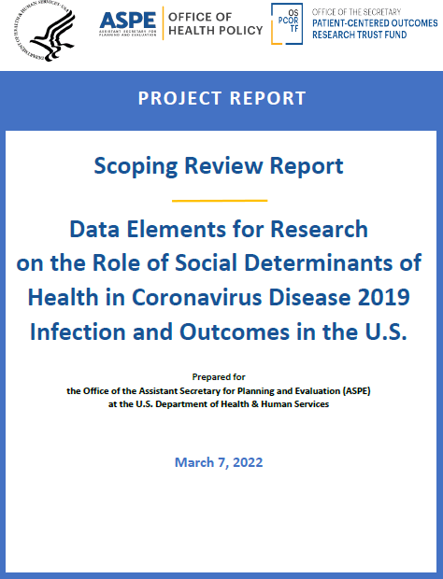
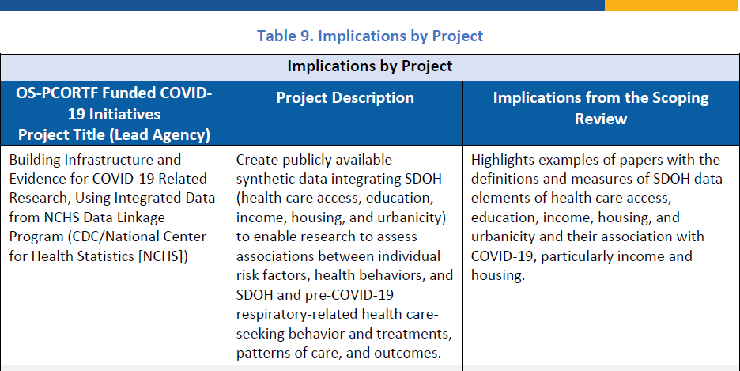
Supporting Data Infrastructure through Data Linkage

Slide 20
What should be NCHS’ goal in SDOH?
An important emphasis of the HHS Action Plan is on the Medicare program, data infrastructure, data sharing, interoperability
Translates into capturing SDOH in the clinical encounter
Data linkage also plays an important role
Standardization and data quality issues will challenge these efforts
Public health dimensions are not yet addressed
NCHS has a unique opportunity through its multiple programs to contribute to improvements in data infrastructure for SDOH
A more strategic approach can strengthen our contribution

