Slide 1
Upcoming Changes to the National Hospital Ambulatory Medical Care Survey (NHAMCS) and Update on the National Ambulatory Medical Care Survey (NAMCS)
Carol DeFrances, Ph.D., Brian Ward, Ph.D.
Division of Health Care Statistics
NCHS Board of Scientific Counselors Meeting
October 24, 2022

Slide 2
Questions for the Board
In addition to preparing to collect ambulatory visit data from provider groups and FQHCS, we are also interested in potential sources that may be used to supplement any primary data collection. Would the BSC members be aware of any sources of data that would be worth exploring?
DHCS will soon seek to recruit two large provider groups (50+ individuals) and an individual FQHC for participation in our FHIR IG pilot. Any suggestions on providers groups or health centers who may be interested or willing to participate?
2

Slide 3
Agenda
Provide an overview of the National Health Care Surveys.
Review the National Hospital Ambulatory Medical Care Survey.
  Provide an overview of NHAMCS.
  Discuss the future of NHAMCS.
Review the National Ambulatory Medical Care Survey.
  Provide an overview of NAMCS.
  Update on the future of the NAMCS Physician/Provider Component.
  Update on the future of the NAMCS Health Center Component.
3

Slide 4
Overview of the National Health Care Surveys

Slide 5
National Health Care Surveys
  Produce accurate objective, nationally-representative statistics on health care to inform health care policy and serve a variety of research needs.
  Are establishment surveys, not household surveys.
  Provide estimates about the universe of encounters with providers, not the population.
  Historically, patient-level data largely abstracted from medical or administrative data.
  Include health care provider surveys to understand this population's experience providing care.
5

Slide 6
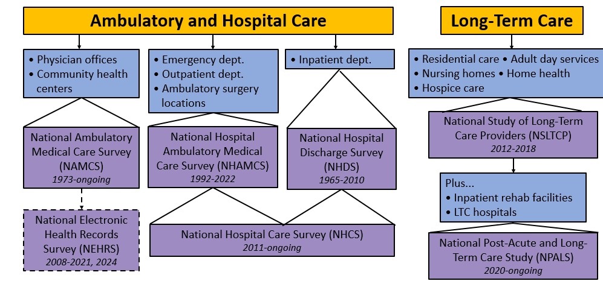
National Health Care Surveys Spectrum of Care
6

Slide 7
Changing Health Care Systems
Settings where ambulatory care is provided have changed
Electronic health record adoption
Data security and confidentiality
Increased mandatory reporting requirements
Increase in use of telemedicine and e-health
7

Slide 8
National Hospital Ambulatory Medical Care Survey (NHAMCS)

Slide 9
National Hospital Ambulatory Medical Care Survey (NHAMCS)
Purpose: Collect data on the utilization and provision of ambulatory care services in hospital emergency departments (EDs), outpatient departments, and ambulatory surgery locations. Beginning in 2018, only ED data are collected.
Sample: Noninstitutional, general and short-stay hospitals located in the 50 U.S. states and the District of Columbia, excluding Federal, institutional, military, and VA hospitals. Hospitals must have 6+ staffed inpatient beds and an EDs must be open 24/7.
Mode: In-person data collection; CAPI for facility interviews, computer-assisted manual abstraction of medical records; remote abstraction can be utilized.
Questionnaire: Hospital and emergency service area interviews collect data about hospital and ED characteristics.
Data collection: Annually (4-week reporting period); public and restricted use files.
Linkage capability: None.
9

Slide 10
NHAMCS Data Elements Collected for Hospital Ambulatory Visits
Patients
Encounters
Demographics
Insurance status
Residential Zip
Medical Conditions
Reason for Visit
Diagnosis
Procedures and services
Medications or immunizations
Injuries
Triage
Disposition
10

Slide 11

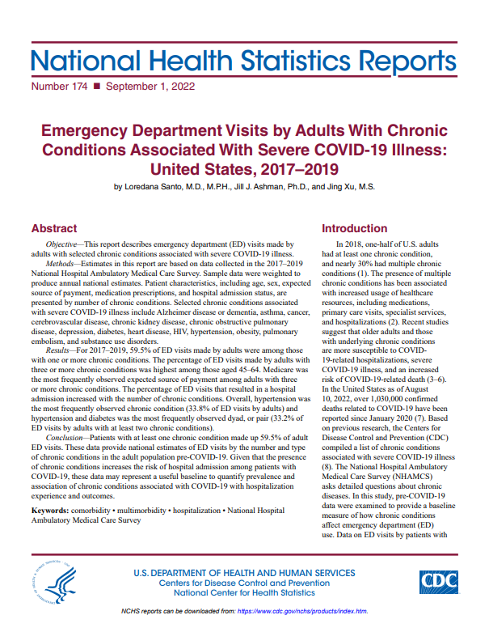
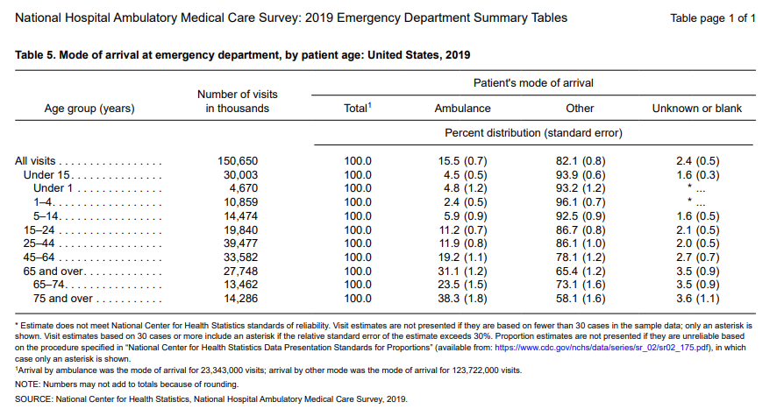
NHAMCS: Available Data Files and Products
Data files:
  Public-use data files for ED visits are available for 1992-2020
  2021 data file is currently in process
Publications:
  NCHS reports
  Peer-reviewed journal articles
  Official government reports
Web tables:
  Available for the years 2007-2019
  2020 web tables are in progress
11

Slide 12
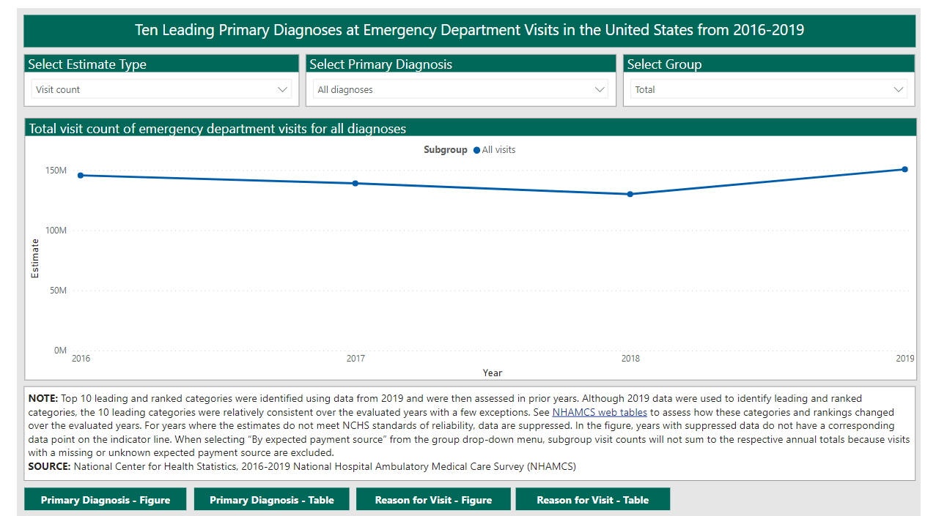
NHAMCS Online Dashboard: Estimates of Emergency Department visits in the United States, 2016-2019
https://www.cdc.gov/nchs/dhcs/ed-visits/index.htm
12

Slide 13
NHAMCS: Challenges to Fielding and Operations
Using manual, in-person data collection presents several challenges:
  Increased competition with other hospital data collections/reporting systems
  Increased security and legal concerns
  Decreasing response rates
  Increased cost of operations
  COVID-19 and challenges of in-person data collection
  Timeliness of data collection and preparation
  Lack of PII and no data linkage capability
13

Slide 14
Upcoming Changes to NHAMCS

Slide 15
NHAMCS: End of Fielding
After 30 years of fielding, NHAMCS data collection will cease
    2022 will be the final year of NHAMCS data collection
    Fielding of 2022 scheduled to end in spring/summer 2023
    The National Hospital Care Survey (NHCS) collects data on ED visits and will be used to provide national estimates of ED visits, after 2022.
Plan to convey the change via:
    NHAMCS Website
    NAMCS/NHAMCS Monthly Newsletter
    Friends of NCHS Newsletter
    Email/phone calls sent to regular/reoccurring NHAMCS data users
15

Slide 16
NHAMCS: Schedule for Remaining Data Releases
2021 NHAMCS
Data collection finished/processing underway
PUF - anticipated release in summer 2023
2022 NHAMCS
Data collection ongoing through spring/summer 2023
PUF – anticipated release in summer 2024
16

Slide 17
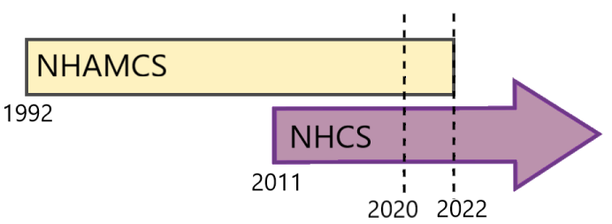
NHAMCS and Transition to the National Hospital Care Survey (NHCS)
Beginning in 2023, the NHCS will be the sole source of hospital data collected by NCHS.
  NHCS uses electronic health care data to collect all annual visits from inpatient departments and EDs.
  Collection of PII allows for data linkage to external sources.
  Currently DHCS and DRM are working with NORC to use modeling to develop nationally representative weights for the 2020 NHCS.
Three years of overlap between NHAMCS and NHCS will allow for a comparison of ED estimates.
17

Slide 18
Thank you…
  To the numerous NCHS staff who worked on the planning, operations, and dissemination of the NHAMCS data over the years.
  To the U.S. Census Headquarters and Regional Office staff who managed the NHAMCS data collections.
  To the countless Census Field Representatives who have diligently collected and cared for the NHAMCS data for 30 years.
18

Slide 19
National Ambulatory Medical Care Survey (NAMCS) – Physician/Provider Component

Slide 20
National Ambulatory Medical Care Survey (NAMCS) – Traditional Physician Survey (1973-2021)
Purpose: Designed to meet the need for objective, reliable information about the provision and use of ambulatory medical care services in the United States.
Sample: Physicians classified by the AMA/AOA and physician; not federally employed and not in the specialties of anesthesiology, radiology or pathology.
Mode: In-person data collection; CAPI for physician interviews, computer-assisted manual abstraction of medical records; remote abstraction can be utilized.
Questionnaire: Obtains data about characteristics of the physician and practice, EHR use/adoption.
Data collection: Annually from 1989-2021 (1-week reporting period), public and restricted use files. No visit data collected in 2020-2021. Not fielded in 2022.
Sample size: Most recently - 3,000 physicians.
Linkage capability: None.
20

Slide 21
NAMCS Data Elements Collected for Physician Ambulatory Visits
Patients
Encounters
Demographics
Insurance status
Residential Zip
Medical Conditions
Smoking history
Reason for Visit
Diagnosis
Procedures and services
Medications or immunizations
Laboratory and other diagnostic tests
Types of providers seen
21

Slide 22
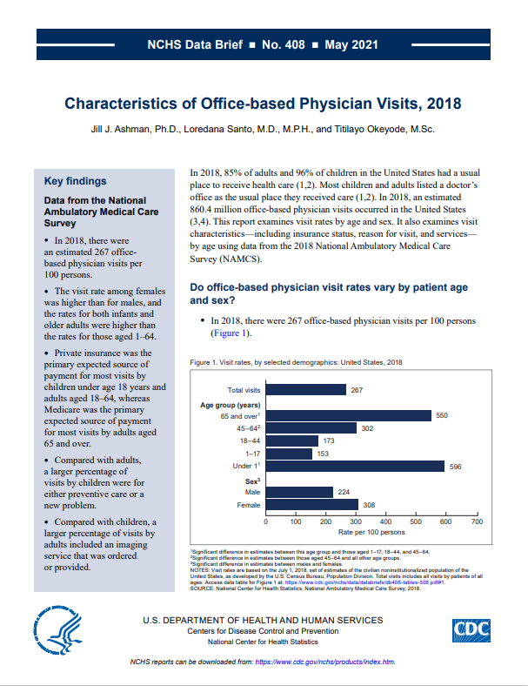
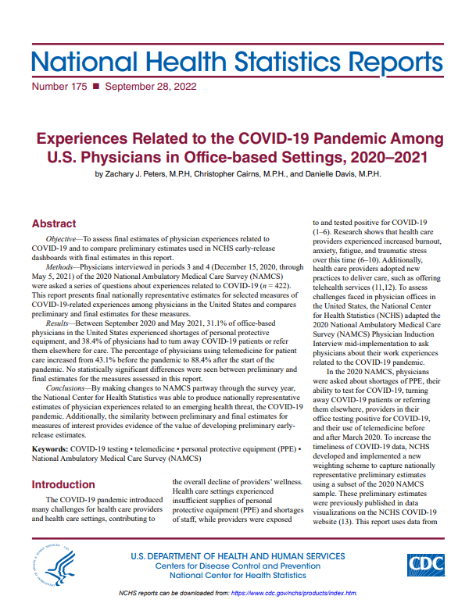
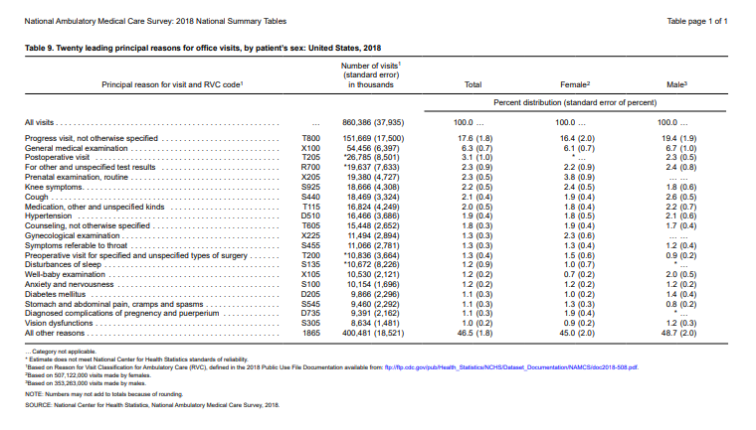
NAMCS: Available Data Files and Products
Data files:
  Public-use data files for physician visits are available for the years 1973-2018.
  2020 physician interview data file available in the RDC
  2019 expected by the end of 2021
  2021 data currently being processed; expected early 2023
Publications:
  NCHS reports
  Peer-reviewed journal articles
  Official government reports
Web tables:
  Available for the years 2007-2018
  2019 web tables are in progress
22

Slide 23
NAMCS Online Dashboard:
Physician Experiences Related to COVID-19
Online, interactive dashboard using preliminary NAMCS physician data to examine physician experiences during the COVID-19 pandemic
  First time preliminary estimates on NAMCS have been released
Includes 2020 P3/P4 and 2021 P1/P2 data
Topics include:
  Shortages of Personal Protective Equipment (PPE)
  Experiences Related to COVID-19 at Physician Offices
  Physician Telemedicine or Telehealth Technology Use
Ability to stratify by various physician characteristics
  Specialty, office type, owner type, MSA
Website: https://www.cdc.gov/nchs/covid19/namcs.htm
23

Slide 24
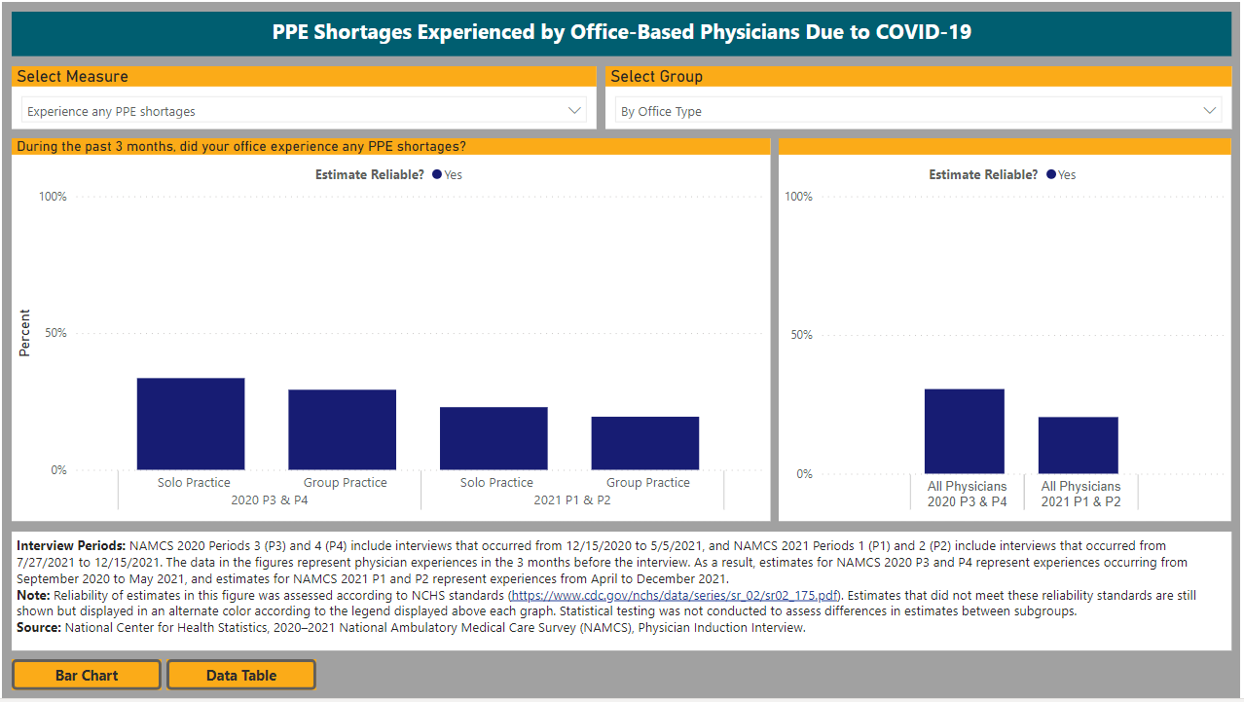
NAMCS Online Dashboard (cont.):
Physician Experiences Related to COVID-19
24

Slide 25
NAMCS: Challenges to Fielding and Operations
Using manual, in-person data collection presents several challenges
COVID-19 created additional challenges
Settings where ambulatory care is provided have changed
Systems used to provide ambulatory care have also changed
25

Slide 26
Update on NAMCS – Physician/Provider Component

Slide 27
National Ambulatory Medical Care Survey (NAMCS) –
Provider Component
Purpose: Designed to meet the need for objective, reliable information about the provision and use of ambulatory medical care services in the United States.
Sample: Physicians classified by the AMA/AOA and physician assistants/associates classified by the AAPA as providing office-based care; not federally employed and not in the specialties of radiology or pathology.
Mode: Mixed-mode (web and mail), self-administered survey collected by the U.S. Census Bureau, with tracing performed to increase accuracy of contact information.
Questionnaire: Obtains data about characteristics of the physician and practice, as well as relevant/timely topics such as telemedicine, CLAS standards, knowledge of opioid guidelines (physicians), and autonomy (PAs).
Data collection: No data collected in 2022. Provider data only collected in early/mid 2023, public and restricted use files.
Sample size: 5,000 physicians, 5,000 physician assistants/associates.
Linkage capability: None.
27

Slide 28
NAMCS – Provider Component: Changes Underway
In 2023, numerous changes will occur:
    Pilot a mixed mode (web and mail) provider survey conducted by U.S. Census Bureau
    Scope will be expanded to include physicians and PAs
    Potential for additional advanced practice providers in the future
    No visit data collection will be included for 2023
Survey content to include more timely/relevant topics such as:
    Provider and practice characteristics
    Telemedicine
    CLAS standards
    Knowledge of opioid guidelines (physicians)
    Autonomy (PAs)
28

Slide 29
NAMCS – Provider Component: Future Plans
Continue fielding the Provider Interview
  Pending a successful 2023 pilot, continue fielding this component in the future, looking to expand the sample and allow for more flexibility with questions.
Reinstating collection of ambulatory care visits made to providers
  Developmental work is underway with RTI International in determining the feasibility of drawing a nationally representative sample of provider groups.
  Exploring how to leverage EHR submission to collect annual visits from provider groups.
Fast Healthcare Interoperability Resources (FHIR): HL7 Health Care Surveys Content Implementation Guide (IG)
  Highly aligned with the United States Core Data for Interoperability (USCDI) standard.
  This content IG uses the technical infrastructure of the HL7 MedMorph Reference Architecture IG, most notably the MedMorph app, which is also used in CDC elsewhere.
29

Slide 30
National Ambulatory Medical Care Survey (NAMCS) – Health Center Component

Slide 31
National Ambulatory Medical Care Survey (NAMCS) –
Health Center Component
Purpose: Designed to meet the need for objective, reliable information about the provision and use of ambulatory medical care services in the United States.
Sample: Federally qualified health centers (FQHCs) and FQHC look-alikes as classified by the Health Resources and Services Administration (HRSA).
Mode: Electronic health record (EHR) data transmitted electronically to NCHS or its data collection agent.
Questionnaire: Facility Interview collects HC information needed for statistical weighting.
Data collection: January-December annually, restricted-use files (public use files if feasible).
Sample size: 50 HCs in 2021; +50 HCs in 2022 (total of up to 100); +50 HCs in 2023 (total of up to 150).
Linkage capability: PII collected that could allow linkage to other data sources.
31

Slide 32
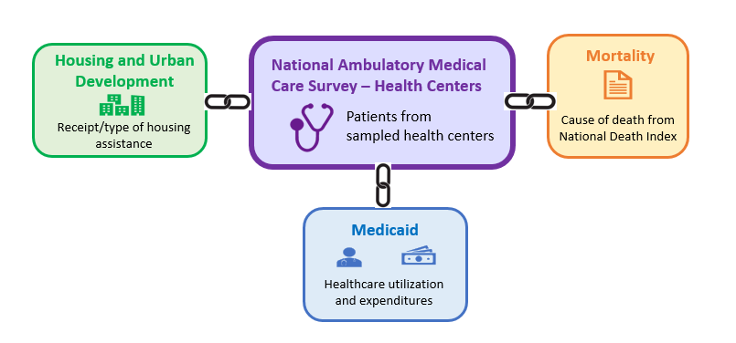
Linkage of NAMCS Health Center Data: Proposed/Planned
32

Slide 33

NAMCS - Health Center Component:
Redesigned Participant Site
33

Slide 34


Thank you!
34

