Slide 1
Healthy People 2030: Health Disparities Feature
David T. Huang, PhD, MPH, CPH (ihw4@cdc.gov)
CDR, US Public Health Service
Chief, Health Promotion Statistics Branch
Division of Analysis and Epidemiology
NCHS Board of Scientific Counselors
September 14, 2023

Slide 2
Background

Slide 3
What is Healthy People?
Provides a strategic framework for a national prevention agenda that communicates a vision for improving health and achieving health equity
Identifies science-based, measurable objectives with targets to be achieved by the end of the decade
Requires tracking of data-driven outcomes to monitor progress and to motivate, guide, and focus action
Offers model for international, state, and local program planning
3
Notes:
3

Slide 4
Role of NCHS within Healthy People
Statistical methods and measure development
Healthy People databases
Analysis and presentation of data
Expertise and technical assistance
4

Slide 5
History
1985: HHS Report of the Secretary’s Task Force on Black & Minority Health (Heckler Report)
Healthy People Overarching Goals:
HP2000: Reduce health disparities
HP2010: Eliminate health disparities
HP2020: Achieve health equity, eliminate disparities, and improve the health of all groups
HP2030: Eliminate health disparities, achieve health equity, and attain health literacy to improve the health and well-being of all
5

Slide 6
Measurement

Slide 7
Healthy People 2030 Data Template
Total
Sex
Male
Female
Race/Ethnicity
American Indian/Alaska Native only
Asian only
Native Hawaiian/Pacific Islander only
Black or African American only
White only
2 or more races
Hispanic or Latino
Not Hispanic or Latino
American Indian/Alaska Native only, not Hispanic or Latino
Asian only, not Hispanic or Latino
Native Hawaiian/Pacific Islander only, not Hispanic or Latino
Black only, not Hispanic or Latino
White only, not Hispanic or Latino
2 or more races not Hispanic or Latino
Age
[Standard groups by data system]
Educational Attainment
< High school
High school
Some college or Associates degree
4-year college degree or more
Family Income (percent poverty threshold)
<100
100-199
200-399
>=400
Health Insurance Status
Insured
Private
Public
Uninsured
Geographic Location or Region
Metropolitan
Nonmetropolitan
Marital Status
Married/Cohabiting partner
Divorced or Separated/Widowed
Never married
Country of Birth
US
Outside US
Veteran Status
Veteran
Non-Veteran
Disability Status
People with disabilities
People without disabilities
Sexual Orientation
Straight
Straight, Male
Straight, Female
Gay/Lesbian
Gay, Male
Gay/Lesbian, Female
Bisexual
Bisexual, Male
Bisexual, Female
Gender Identity
[Standard groups by data system]
Notes:
If data are not collected, analyzed, or available (or need to be suppressed) for a particular demographic group by a data source, the demographic label will still be shown and a symbol or acronym will be displayed to indicate the reason data are not shown.
With justification by the workgroup and approval by NCHS, additional population categories and subcategories may be included on a case-by-case basis.
7

Slide 8
Disparities: Evolution of Measurement
 | HP2000 | HP2010 | HP2020 | HP2030
Overarching Goal | Reduce health disparities | Eliminate health disparities | Achieve health equity, eliminate disparities, and improve the health of all groups | Eliminate health disparities, achieve health equity, and attain health literacy to improve the health and well-being of all
Disparity Targets | Separate targets were set designed to narrow the gap with the total population | No separate disparities targets, but use of “better than the best” target-setting method | No separate disparities targets, but we do consider progress by population group | No separate disparities targets, but we do consider progress by population group
Measurement | Absolute disparity: Not assessed Relative disparity: Not assessed Change in disparity over time: ratio of percent change for reference group to percent change for group of interest Reference point: Total population | Absolute disparity: Not assessed Relative disparity: Percentage difference Index of disparity Change in disparity over time: absolute difference for measures above Reference point: Most favorable group rate | Absolute disparity: Maximal rate difference Relative disparity: Rate ratio Maximal rate ratio Summary rate ratio Change in disparity over time: absolute and relative difference for maximal and summary rate ratio Reference point: Most favorable group rate | Absolute disparity: Rate difference* Maximal rate difference Summary rate difference* Relative disparity: Rate ratio Maximal rate ratio Summary rate ratio Change in disparity over time: absolute and relative difference for measures above Reference point: Most favorable group rate
8
*Proposed new measures for HP2030

Slide 9
Absolute vs. Relative Measures
Absolute disparity: simple difference between two rates (also referred to as the rate difference or absolute difference)
Absolute disparities may be easier to visualize than relative disparities.
Example: The maximal rate difference is the difference between the highest and the lowest group rates.
Relative disparity: disparity measured relative to the group with the best rate
Examples include the percent difference between rates or the ratio between rates.
Relative disparities are unit-free and can be used to compare objectives with different units of measure.
Example: The maximal rate ratio is the ratio of the highest to the lowest group rates.
9

Slide 10
Between-Group Measures
Between-group measures consider disparities between exactly two group rates. For Healthy People purposes, the group rates used are:
$R_{f}$ = rate for the most favorable group (reference point)
$R_{g}$ = rate for a group of interest
Examples
Absolute: The rate difference is the absolute value of the simple difference: $\left|R_{f}−R_{g}\right|$
Relative: The rate ratio is defined as:
$\frac{R_{f}}{R_{g}}$, if an increase is desired
$\frac{R_{g}}{R_{f}}$, if a decrease is desired
10

Slide 11
Overall (Across-Group) Measures
Overall (across-group) measures consider the data across multiple group rates, although their calculation may or may not incorporate more than two group rates.
Examples
Given
$R_{f}$ = rate for the most favorable group (reference point)
$R_{a}$ = the average of the rates for all other groups
Absolute: The summary rate difference is $\left|R_{f}−R_{a}\right|$
Relative: The summary rate ratio is $\frac{R_{f}}{R_{a}}$, if an increase is desired; or $\frac{R_{a}}{R_{f}}$, if a decrease is desired.
When there are only two groups, these measures reduce to the maximal rate difference and maximal rate ratio, respectively.
The maximal rate difference and maximal rate ratio are also examples of overall (across-group) disparities measures that incorporate the smallest and largest rates in their calculation.
11

Slide 12
Demonstration

Slide 13
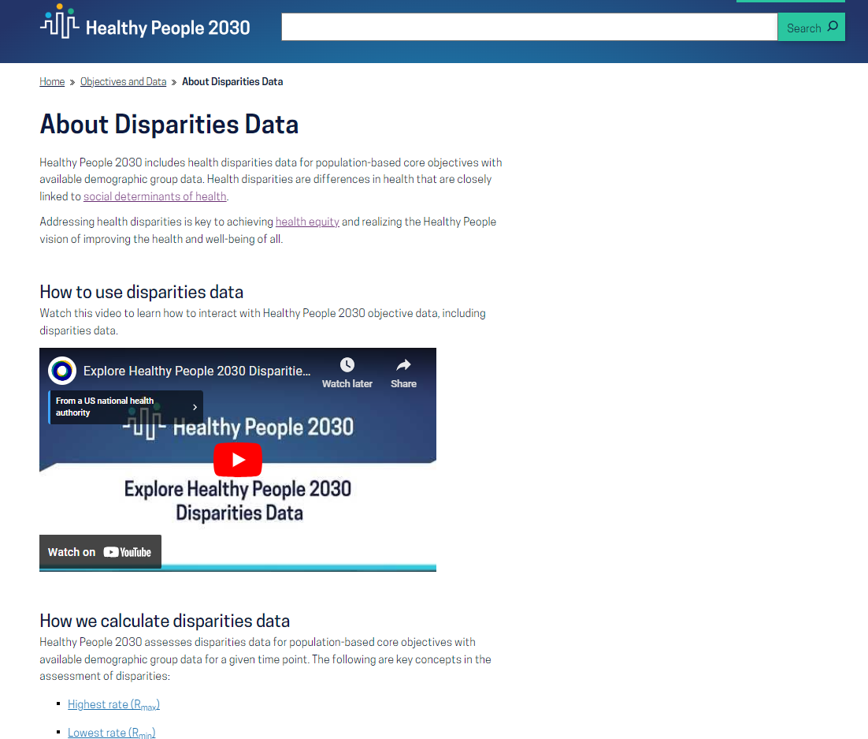
13
13

Slide 14
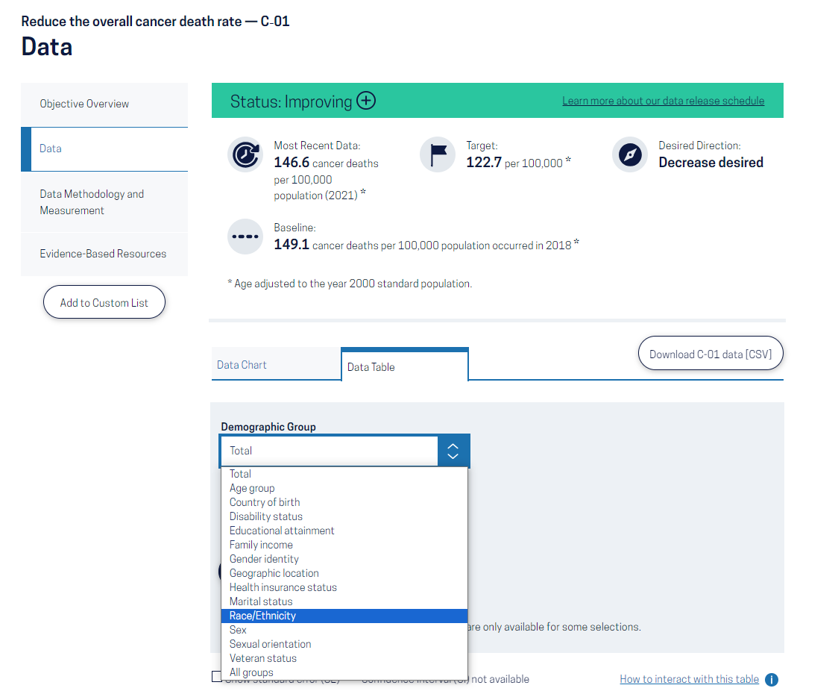
14
14

Slide 15
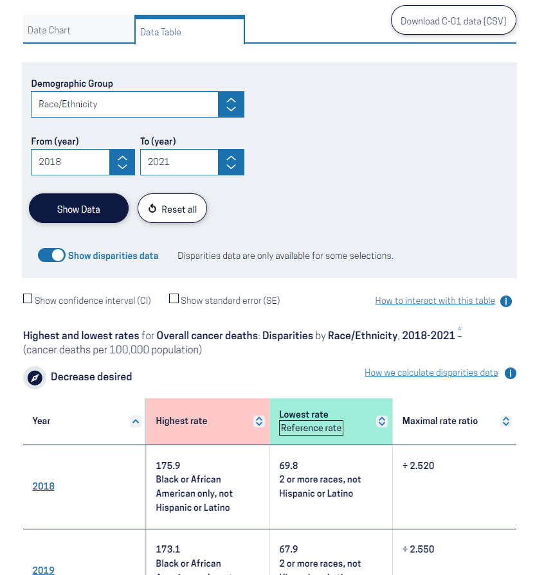
15
15

Slide 16
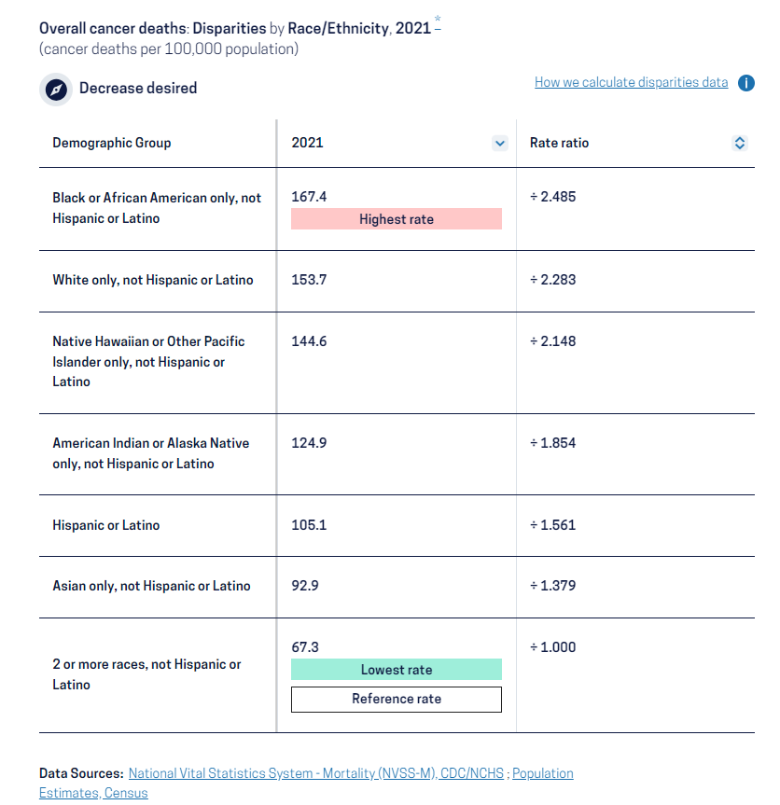
16
16

Slide 17
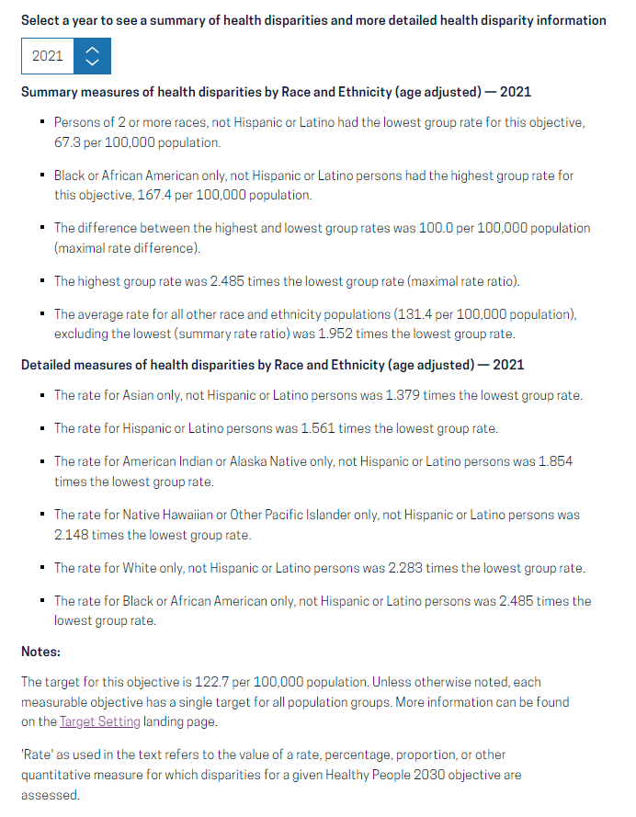
17
17

Slide 18
Conclusion

Slide 19
Next Steps and Takeaways
As there is no single gold standard in health disparities measurement, considering multiple measures can provide a fuller context of health disparities.
A forthcoming NCHS Series 2 report will document HP2030 disparities measures and expand further on their strengths and limitations.
The HP2030 disparities feature provides a starting point for health disparities data and content for HP2030 objectives. Future enhancements:
increased functionality
additional measures
disparities charts
19

Slide 20
References
Websites:
Healthy People 2030 (Main): https://health.gov/healthypeople
Healthy People 2030 (Disparities): https://health.gov/healthypeople/objectives-and-data/about-disparities-data
NCHS Healthy People: http://www.cdc.gov/nchs/healthy_people.htm
Health Disparities Calculator (NCI): https://seer.cancer.gov/hdcalc/
Manuscripts:
Braveman P. Health disparities and health equity: concepts and measurement. Annu Rev Public Health. 2006;27:167-194. https://doi.org/10.1146/annurev.publhealth.27.021405.102103
Harper et al. Implicit value judgments in the measurement of health inequalities. Milbank Q. 2010;88(1):4–29. https://doi.org/10.1111/j.1468-0009.2010.00587.x
Huang DT, Bassig BA, Hubbard K, Klein RJ, Talih M. Examining progress toward elimination of racial and ethnic health disparities for Healthy People 2020 objectives using three measures of overall disparity. National Center for Health Statistics. Vital Health Stat 2(195). 2022. DOI: https://dx.doi.org/10.15620/cdc:121266
Keppel K, Pamuk E, Lynch J, et al. Methodological issues in measuring health disparities. National Center for Health Statistics. Vital Health Stat 2(141). 2005. https://www.cdc.gov/nchs/data/series/sr_02/sr02_141.pdf
Penman-Aguilar A, Talih M, Huang D, et al. Measurement of health disparities, health inequities, and social determinants of health to support the advancement of health equity. J Public Health Management Practice. 2016; 22(1 Supp):S33-S42. https://doi.org/10.1097/phh.0000000000000373
Talih M, Huang DT. Measuring progress toward target attainment and the elimination of health disparities in Healthy People 2020. Healthy People Statistical Notes, no 27. Hyattsville, MD: National Center for Health Statistics. 2016. https://www.cdc.gov/nchs/data/statnt/statnt27.pdf
20

Slide 21
Thank You!
HPSB Staff |  | HPSB Contractors
Johanna Alfier Jonathan Aram Lesley Dobrzynski Robert Francis Leda Gurley LaJeana Hawkins Kimberly Hurvitz Elizabeth Jackson Sibeso Joyner | Deepthi Kandi Mark Montgomery Cheryl Rose Asel Ryskulova Rashmi Tandon Ritu Tuteja Allan Uribe Jean Williams | Rashid Aminou Makram Talih
21

Slide 22
22

