Slide 1


CDC’s Data Modernization Initiative...
Changing the Way We Work
Daniel B. Jernigan, MD, MPH
CDC Deputy Director for Public Health Science and Surveillance
NCHS Board of Scientific Counselors
May 26, 2022
Notes:
I want to thank you for having me here again. It’s been a year since I met with all of you, but I did have a chance recently to travel up and meet with NCHS leadership and to hear about all the critical work around:
interoperability,
survey modernization/accessing and using EHRs,
health equity,
privacy preserving record linkages,
and more.
NCHS exemplifies DMI, and I’m excited about what’s been done so far and about the work being shared here today.

Slide 2
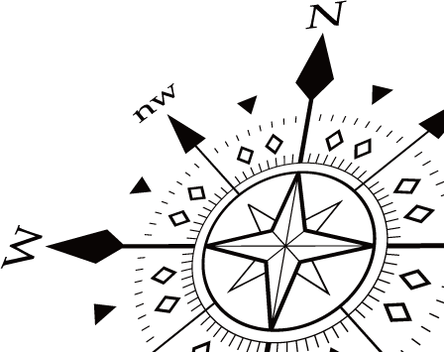
Our Ultimate Goal
To move from siloed and brittle public health data systems to connected, resilient, adaptable, and sustainable ‘response-ready’ systems that can help us solve problems before they happen and reduce the harm caused by the problems that do happen.
Better, Faster, Actionable Intelligence for Decision-Making at All Levels of Public Health
Notes:
I want to give an update on a few things that have been happening recently with DMI.
As a reminder and to set the stage here, our ultimate goal for DMI is to:
move our nation from siloed and brittle public health data systems
to connected, resilient, adaptable, and sustainable ‘response-ready’ systems that can help us solve problems before they happen and reduce the harm caused by the problems that do happen.
Overall, DMI is helping to get BETTER, FASTER, ACTIONABLE INTELLIGENCE FOR DECISION-MAKING

Slide 3

What are the problems we are trying to solve?
Siloed information:
Disconnected and/or proprietary disease systems driven by disease-specific budget lines keep us from seeing the complete picture
Older technologies:
Most systems at health departments are not flexible, do not use cloud, and are not scalable
Outdated skills:
The public health workforce needs training to use today's technologies more effectively
Outdated technologies:
Public health is not a part of the healthcare data ecosystem
Older systems at health departments are not flexible, do not use cloud, and are not scalable
Public health got left behind as federal incentives and regulations helped healthcare systems to be able to easily share data automatically in the Electronic Health Record.
Heavy burdens for Providers:
Providers in healthcare and at health departments are burdened with sending data to many places in many ways
Notes:
All of our work is aimed at solving longstanding problems faced by public health.
Siloes information caused by one-off, proprietary systems tracking multiple individual diseases.
Outdated skills due to long-standing workforce neglect
Heavy burdens for providers, who have to share data with any number of systems in any number of ways.
Older technologies at health departments are not flexible, do not use cloud, and are not scalable
And, finally, the fact that federal incentives for modernizing healthcare records did not address public health.
These technological, funding, policy, and workforce challenges are what we are trying to address though DMI with a strategic approach.

Slide 4
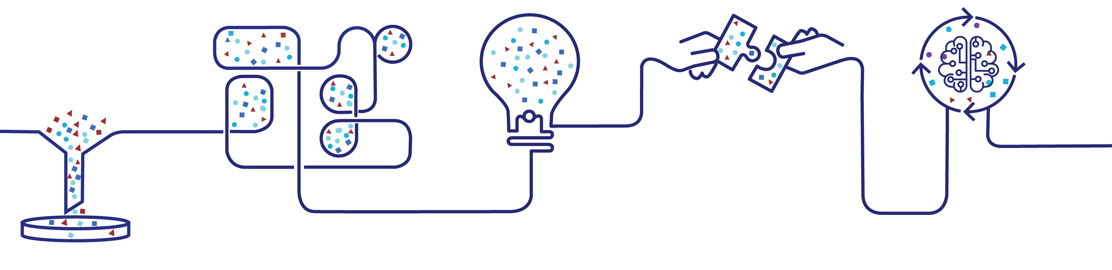
DMI Priorities
Develop a
state-of the-art workforce
Support
+ extend partnerships
Manage change + governance
Build the right foundation
Accelerate data into action
Decreased burden on reporters
Free up staff time to focus on prevention and control
Faster data for detecting emerging threats at all levels of public health
Better data integration, visualization
Robust forecasting / modeling
Response-ready platform
Identify, recruit, and retain experts to generate meaningful public health insights
Better / more timely access to data within and across ecosystem
Common tools to support STLT partners
Adaptive, agile approaches
Collaboration
Improved acquisition
DMI Strategic Implementation Plan (cdc.gov)
Notes:
Last fall, we published our DMI strategic implementation plan that is guiding our vision for solving these issues.
Right now, we’re investing a big bolus of funds from the CARES Act and the American Rescue Plan both at CDC and in jurisdictions.
And our goal is to create scalable, flexible systems that will last beyond the current crisis and work for any disease or condition.
What we’ve landed on are five big areas that will move us toward this vision and will ensure we never find ourselves so far behind again.
Here you see our five DMI priority areas of work and what we plan to get from them.
.

Slide 5
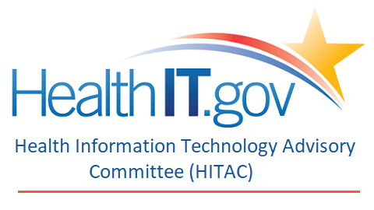




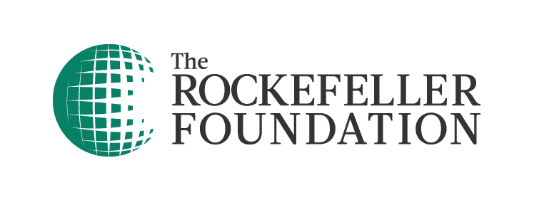


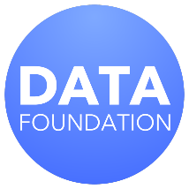

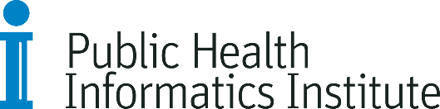


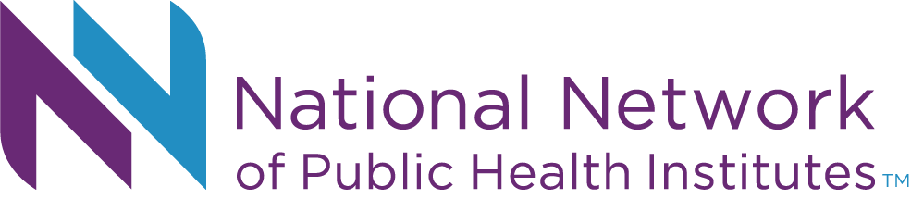



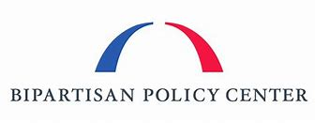



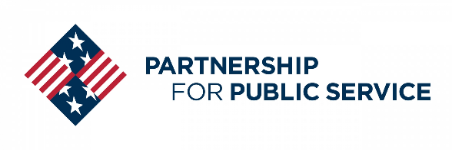



We are listening and connecting
Notes:
Perhaps the biggest strength of DMI is that it's unifying us in ways we've never had before.
Partners from across public health, research, academia, private industry, and this community have been with us every step of the way, supporting DMI with valuable recommendations and a shared vision for what public health can be. ​
You can see here a snapshot of just some of our partners, like APHL, ONC, CSTE, RWJ and many others who have provided thoughtful input and support
​

Slide 6


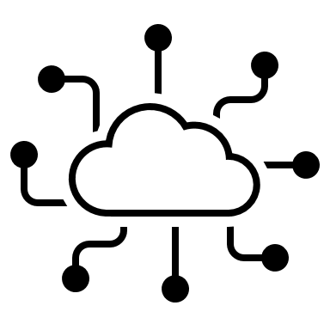


WHAT WE'RE DOING
DMI is changing how we work.
Changing how we work with each other and share data inside CDC...
And also changing
how we work and share data with others...
Which changes the data we have and can use...
… to change the future of health. ​
Notes:
Taken together, what this means is that DMI is:
Changing how we work with each other and share data inside CDC...
And changing how we work and share data with others...
Which changes the data we have and can use...
To change the future of health.
I'll give you a few brief examples of how that's translating on the ground.

Slide 7
We’re changing the way we work at CDC.
CURRENT CDC STRUCTURE
DMI IMPLEMENTATION APPROACH
Infectious Diseases
Change Management
Non-infectious Diseases
Partnerships
Partnerships
Workforce
Partnerships
Science & Surveillance
WITH DMI
DMI
Coordination
DMI
Coordination
DMI
Coordination
Service & Implement-ation Science
Build the Right Foundation
Accelerating Data to Action
Build the Right Foundation
Accelerating Data to Action
Accelerating Data to Action
Notes:
As my colleague Jen Layden mentioned at your last meeting, we’ve redefined how we work across the agency by standing up DMI implementation teams.
Implementation teams are cross-agency teams that will allow us to find shared solutions to shared problems,
The unique thing about these teams is that we’ve set up a structure that’s guided by our DMI priorities and objectives, and not dictated or limited by center or even who’s funded or isn’t
This will ensure we’re serving the greater needs of the agency and that our investments are available and reusable across the enterprise.
This work was just launching back in February. and these teams how now been actively working together for several months.
At this stage, the teams are:
Developing definitions and identifying barriers and risks
As well as prioritizing problem statements and refining their objectives and key results
We want to use these teams to unlock the answers to large public health challenges by using all data we can, across program areas.
This is a big shift that will have really meaningful implications for what we’re able to do in the future.

Slide 8

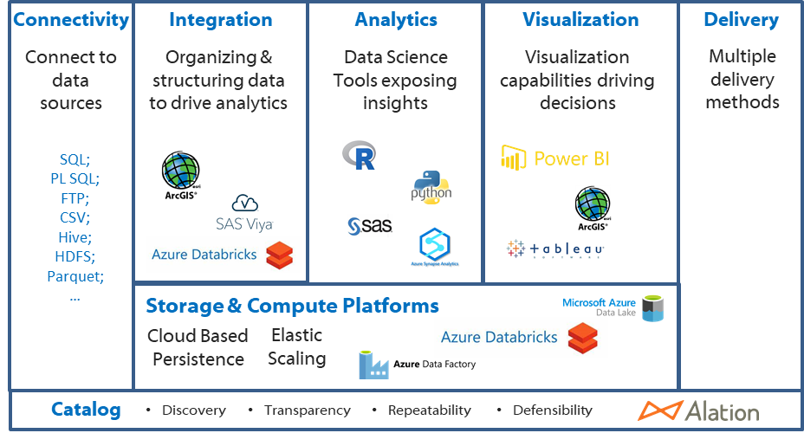







We're establishing cloud environments for managing and analyzing big data
External Data
HHS / CDC Systems
DCIPHER
Cerner
Health Data Lab
IQVIA
E360 Ambulatory EMR; SMART Pharmacy Data
Consolidated Statistical Platform
CMS Data
Chronic Conditions Data Warehouse
BD MedMined
EDAV Curated Data Sets
CDC Program Special Studies Data Lake
NCEH
HHS Protect
APHL AIMS
Case Surveillance Data Lake
CSEL
Others (NSSP, NBS, etc.)
Genomics Data Lake
STLT Data Hub
Notes:
Another big thing we've done inside the agency is to stand up a cloud-based enterprise data, analytics, and visualization platform, called “EDAV.”
EDAV provides the means for breaking down data silos in favor of a centralized data ecosystem that allows CDC scientists to catalogue, analyze, and publish findings faster than previously possible.
This is changing what we can do with our data and how fast we can do it. For example, the EDAV so far has been used to:
Quickly develop a contact tracing solution that allows travelers to submit information through any device, anywhere in the world, and then make that data available to jurisdictions for localized action.
It was also used to streamline a manual reporting process for our Pertussis program, reducing a 20+ page report with repeated copying and pasting to just a “couple of clicks,” resulting in a 95% decrease in reporting time.
A combination of Azure Cloud and EDAV core services is also being deployed to re-architect CDC’s ArboNET surveillance systems with more streamlined data collection and reporting

Slide 9
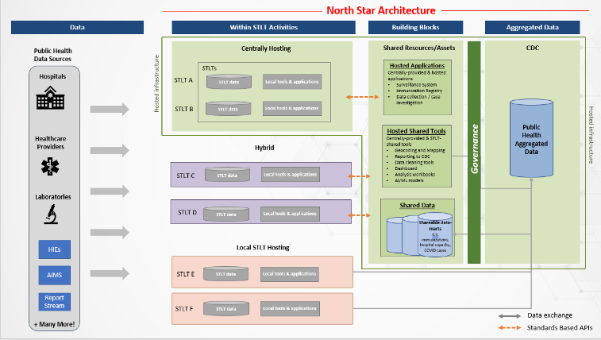
We're developing a "North Star" Architecture
The North Star Architecture is a joint ONC-CDC effort to help articulate a shared vision of a public health data infrastructure for STLTs to share data with each other and CDC.
Key ideas:
Flexible but standardized: Offers a range of support levels to our STLT partners, depending on their needs
Secure cloud environment: Offers more efficient sharing of infrastructure, applications, tools, and data
Collaboration and transparency: Rules and products will be developed through joint CDC/STLT governance
Time and planning: We will work on this with partners over the next two years
In Development…
Notes:
We're also reimagining how data flows from our external data providers to CDC's door. We're working closely with partners to develop a "North Star Architecture" that describes the who, what, and how of a future state public health ecosystem where data flows and information systems are coordinated, connected, and interoperable across healthcare and public health at all levels of government.
It is founded on the lessons learned from the COVID-19 pandemic, and draws inspiration from and builds on the successes of COVID electronic lab reporting, the efforts to modernize NSSP, and the increased scalability of NNDSS, which now receives 10 times the usual case volume due to COVID-19, among others.
We will work on this over next two years.
This is going to take time and planning. That’s what we’re doing now.

Slide 10


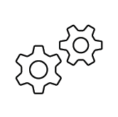

We're changing how we engage with partners
Consortium
for Data
Modernization
Data and
Surveillance
Workgroup
Industry Listening Sessions
Notes:
We've also put some new structures in place that will allow us to listen to, learn from, and work more effectively with both private and public partners.
FIRST: We’ve just recently stood up a new Consortium for Data Modernization, the goal of which is to seek individual perspectives and experiences to inform our planning, engagement, and strategies.
This multi-sector group is facilitated by CDC and ONC, and brings in public health associations, STLT representatives, industry, and academia
So, for example, this group has been:
Providing use cases in which privacy preserving record linkage (PPRL) would improve data quality or completeness
Gathering input as we develop the north star architecture and improve our data pipelines
SECOND we’re forming a new Data and Surveillance Workgroup to support the Advisory Committee to the Director and look at agency-wide activities related to DMI.
We'll bring together a balanced group of subject matter experts from inside and outside the government space to
identify innovative and promising modernization practices,
Find opportunities to advance modern, harmonized data policies
and, overall, look at our existing challenges from a more holistic perspective and find solutions.
The THIRD thing I want to mention today is that we’re leveraging our longstanding collaboration with the CDC Foundation to extend our partner engagements into the private sector and reach a broader group of stakeholders through facilitated industry listening sessions.
Thus far, we’ve started a discussion with major EHR vendors, and we are actively expanding outreach to a broader group.
We are also planning to work with CDCF to reach out to State Health IT Coordinators, the National Governor’s Association, and possibly state legislators.
One very near-term effort is emerging from a combination of our DMI consortium together with our CDC Foundation effort called DMI-P3 on Private-Public Partnerships, which is developing tools to help under-resourced local health departments to connect their case data to a vast array of geospatial, SDOH, and non-traditional data sources.

Slide 11
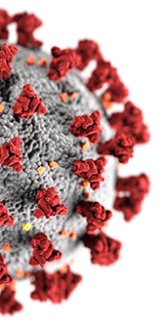
We are in a different place than we were before the pandemic
Monitoring Disease Burden | DATA COLLECTED
Electronic Lab Reports | 813M COVID-19 Tests
Case-Based Disease Surveillance | 79M Case Reports
Emergency Department Visits | 7.4M COVID-19 ED Encounters
Immunization Records | 551M vaccinations administered
Virus Genomics Data | 2.1M published sequences
Healthcare Data | 140TB of clinical and administrative data
Hospitalization Data | 4.6M total admissions
CDC COVID Data Tracker covid.cdc.gov/covid-data-tracker
Notes:
DMI is already making a difference. Overall, the data and analytic needs of the response have led to the unparalleled generation and release of public health data, including some kinds of data collected that we have never had before. We have a lot of this data now in real-time or near-real-time because of our DMI and modernization efforts.
For example:
Case surveillance data comes from electronic case reporting. We had just 187 healthcare facilities using this before the pandemic and now that number exceeds 11,000.
We built new pipelines to handle the increased volume and velocity of immunization records, with new privacy protections and an unprecedented number of data sources delivering daily data.
We opened a new pathway for lab reports to come directly from jurisdictions to CDC that has handled an average of 1.5 million test results per day
And new cloud and computational capabilities have allowed us to handle millions of unique SARS-CoV2 genome sequences. These capabilities are foundational for expanding our platforms for “pandemic-prone” diseases.
A lot of this work will be our bridge as we move forward with DMI. We are building on this foundation even now with as we work to face new challenges like the current outbreaks of hepatitis and monkeypox.

Slide 12

What will be different overall because of DMI?
Success means we will:
Decrease burden on doctors and hospitals by replacing faxes and phone calls with automated reporting directly from electronic health records
Free up public health staff by providing them the infrastructure, tools, and training to use data for more targeted interventions for their communities
Have awareness of emerging threats across the U.S. to inform forecasting and to direct resources to prevent or mitigate public health impacts
Notes:
I've spent a lot of time talking about how DMI is different, I want to close out with what will be different BECAUSE of DMI.
If DMI is successful, we will:
Decrease burden on doctors and hospitals by replacing faxes and phone calls with automated reporting directly from electronic health records
Free up public health staff by providing them the infrastructure, tools, and training to use data for more targeted interventions for their communities
Have awareness of emerging threats across the U.S. to inform forecasting and to direct resources to prevent or mitigate public health impacts
What we’ve been able to prove during the COVID response is that all of this is possible.
That we can see these capabilities in a not-too-far-off future, and importantly -- that we know how to get there.
NCHS has been an example of modernization in action, and I look forward to continuing to work with you to get this done.

Slide 13

Discussion
CDC Logo

