Slide 1
DMI Update: Division of Health Care Statistics Electronic Health Record (EHR) Activities
National Center for Health Statistics
Carol DeFrances, Ph.D., Brian Ward, Ph.D. and Askari Rizvi, M.S.
NCHS Board of Scientific Counselors Meeting
May 26, 2022

Slide 2
Overview of the National Health Care Surveys
2

Slide 3
National Health Care Surveys
  Produce accurate objective, nationally-representative statistics on health care to inform health care policy and serve a variety of research needs.
  Are establishment surveys, not household surveys.
  Provide estimates about the universe of encounters with providers, not the population.
  Historically, patient-level data largely abstracted from medical or administrative data.
  Include health care provider surveys to understand this population's experience providing care.
3

Slide 4
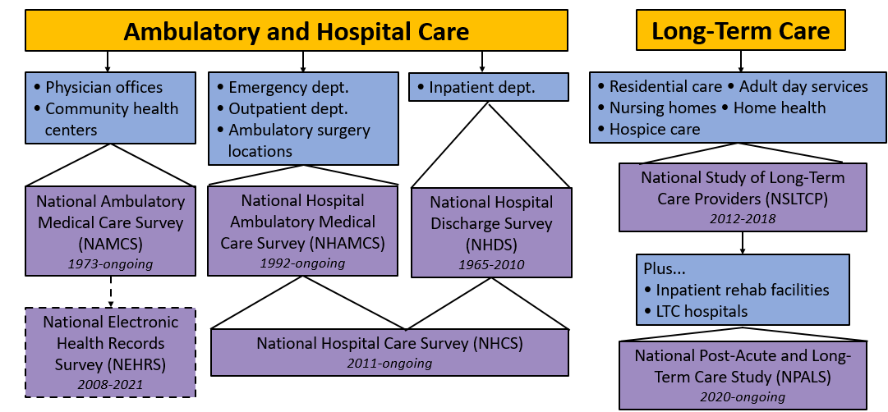
National Health Care Surveys Spectrum of Care
4
4

Slide 5
Questions for BSC
Any additional supplemental data sources of hospital or ambulatory visits that may be worth DHCS investigating? Physician or provider groups/networks would be of particular interest.
Are there any recommendations for managing CIPSEA-protected data on the cloud?
DHCS is migrating HEHR to the EDAV cloud, which currently does not support SAS. Instead, EDAV supports DataBricks. Do any BSC members have familiarity or experience with DataBricks? Any lessons learned or recommendations for migrating from SAS to DataBricks?
5

Slide 6
Moving to EHR Data Collection
6

Slide 7
Leveraging Healthcare Data & Interoperability Standards to Enable EHR Data Collection
  Consolidated Document Architecture (CDA): HL7 CDA National Health Care Surveys Implementation Guide (IG)
    Early releases aligned with older data element lists and added all medications, lab results, and procedures.
    Latest Release is streamlined by dropping lower importance data elements but most EHRs already implemented earlier releases and are unable to move to latest release.
  Fast Healthcare Interoperability Resources (FHIR): HL7 Health Care Surveys Content Implementation Guide (IG)
    Highly aligned with the United States Core Data for Interoperability (USCDI) standard.
    This content IG uses the technical infrastructure of the HL7 MedMorph Reference Architecture IG most notably the MedMorph app, which is also used by:
      electronic Case Reporting (eCR)
      Centralized Cancer Registry Reporting
      Other public health and research use cases.
7

Slide 8
DMI Funds for FHIR Application Pilot in 2022-2023
Pilot tasks:
Select Providers
  2 Ambulatory Physician Groups
  1 Federally Qualified Health Center
  1 Hospital
With each Provider, Co-implement
  MedMorph Reference Architecture IG
    MedMorph App inside provider’s firewall
  Health Care Surveys Content IG
    USCDI/ 17 HL7 FHIR US Core Profiles
Build data lake on EDAV to process and store EHR data collected.
Build data governance structure to allow sharing of EHR data with other CDC CIOs.
8

Slide 9
Leveraging Healthcare Interoperability Regulations to Enable EHR Data Collection
  CMS Promoting Interoperability (PI) Program
    Provider participation (data submission via Certified EHR Technology) in the National Health Care Surveys fulfills a Public Health Reporting measure.
    Approximately 105,000 providers and 365 hospitals have registered their intent to send EHR data to NCHS in the National Health Care Surveys Registry.
    100+ EHR products are certified to the PI health care surveys measure.
  ONC’s Cures Act Final Rule (2020)
    HL7 National Health Care Surveys CDA IG – standard/format named as part of the EHR Certification Program Criteria in the rule.
    CSELS Policy Team working with other CDC Programs to name Public Health FHIR IGs, including the Health Care Surveys (FHIR) Content IG, in near-term future regulations for inclusion in PI.
9

Slide 10
EHR Data Collection for NHCS and NAMCS
10

Slide 11
National Hospital Care Survey (NHCS)
Purpose: Provide reliable and timely health care utilization data for hospital-based settings.
Sample: Non-federal, non-institutional hospitals with 6+ staffed inpatient beds.
Mode: Administrative claims data and electronic health record (EHR) data transmitted electronically to NCHS or its data collection agent.
Questionnaire: Annual Hospital Interview collects facility information needed for statistical weighting.
Data collection: January-December annually, restricted-use files.
Sample size: 608 hospitals in sample; all inpatient and ED encounters (i.e., entire calendar year) requested; 150-200 hospital respondents per year.
Linkage capability: Personally-identifiable information (PII) is collected, which allows data linkage across hospital settings and to external data sources such as the NDI, CMS, and HUD data.
11

Slide 12
National Hospital Care Survey: Modernization
DMI funds used for purchase of data to supplement data collection
American College of Emergency Physicians (ACEP)
Premier
DMI funds to be used to conduct new methodological work
Use data collected directly from hospitals and purchased data for modelling of national estimates.
Explore use of synthetic data for public use and RDC files.
Data linkage work
NHCS data have been linked to the NDI, various CMS data sets, HUD data and VA data is now in progress.
Natural Language Processing (NLP) Work
Using EHR clinical notes to identify opioid-involved hospitalizations.
12

Slide 13
National Ambulatory Medical Care Survey (NAMCS) - Health Center Component
Purpose: Designed to meet the need for objective, reliable information about the provision and use of ambulatory medical care services in the United States.
Sample: Federally qualified health centers (FQHCs) and FQHC look-alikes as classified by the Health Resources and Services Administration (HRSA).
Mode: Electronic health record (EHR) data transmitted electronically to NCHS or its data collection agent.
Questionnaire: Facility Interview collects HC information needed for statistical weighting.
Data collection: January-December annually, restricted-use files.
Sample size: 50 HCs in 2021; +50 HCs in 2022 (total of up to 100); +50 HCs in 2023 (total of up to 150).
Linkage capability: PII is collected which allows linkage to NDI, HUD and Medicaid data
13

Slide 14
NAMCS – Health Center Component: Modernization
Transition from abstraction to EHR data collection
Working with HRSA to recruit up to 50 FQHCs or FQHC-LALs to transmit EHR data in IG 1.2 format or customized report to NCHS for 2021 and 2022 data collections.
Additional recruitment and data availability
DMI funds will be used for 2023 data collection to increase the sample for an additional 50 FQHCs or FQHC-LALs to bring total sample up to 150 and build interactive dashboard for preliminary and final national estimates.
Incentivize participation
Provide up to $10,000 for set-up to activate module on their system or have vendor send customized report to NCHS.
14

Slide 15
Building Infrastructure for EHR Data Collection
15

Slide 16
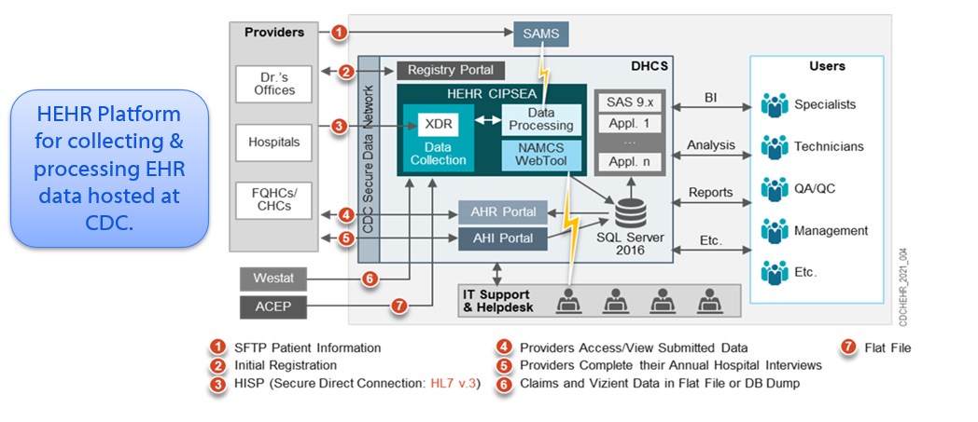
Healthcare Electronic Health Record (HEHR) Architecture – On-premise
16

Slide 17
DMI Funds for HEHR Cloud Migration
HEHR supports NHCS and NAMCS for collecting, integrating, harmonizing, storing, and processing of EHR and administrative claims data.
Imperative to streamline the processes while minimizing costs of maintaining a large infrastructure.
Adhere to all applicable privacy and security standards and compliance with Confidential Information Protection and Statistical Efficiency Act (CIPSEA).
  Advantages:
  Increase processing time.
  Sharing of data across CDC will be easier on the cloud.
  Leverage all OCIO’s EDAV enterprise cloud capabilities minimizing any unnecessary HEHR development/configuration.
  Offer HEHR’s use of DIRECT data transport mechanism solution as an enterprise solution for others to use at CDC within EDAV.
17

Slide 18
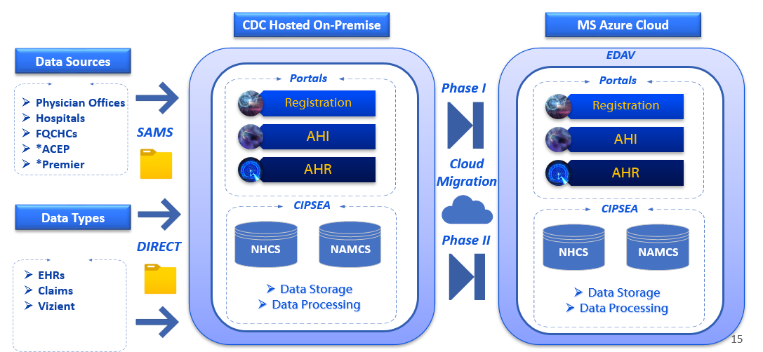
HEHR Cloud Migration Overview
18

Slide 19


Thank you!
19

