Slide 1
NCHS Board of Scientific Counselors Meeting: Director’s Update
Centers for Disease Control and Prevention
Brian C. Moyer, Ph.D., NCHS Director
October 24, 2022

Slide 2
Board of Scientific Counselors Meeting (BSC)
Agenda
Using NCHS Surveys to Measure Discrimination
Long COVID Tracking at NCHS
Upcoming Changes to NHAMCS and NAMCS
NCHS Website Modernization
Program Updates: NHANES, Rapid Surveys, NVSS

Slide 3
Board Membership
Thank You to our committed board members for extending their time on the BSC and service on the Workgroup!
Kristen Olson, Ph.D.
Helen Levy, Ph.D.
BSC Member Search
We are interested in your suggestions for candidates for nomination

Slide 4
NCHS Staff Updates
John Halter, J.D.
Alan Simon, M.D.
Director, Office of Planning, Budget and Legislation
Director, Division of Health and Nutrition Examination Surveys

Slide 5
CDC Moving Forward Initiative
Share scientific findings and data faster
Translate science into practical, easy to understand policy
Prioritize public
health
communications
Promote
results-based partnerships
Develop a workforce prepared for future emergencies
Release scientific findings and data more quickly in response to the need for information and action as well as being transparent about the agency’s current level of understanding
As we share our scientific findings and data faster, implement a standardized policy development process for implementation guidance documents and other public health communications
Prioritize and enhance public-facing health communication practices and staff expertise
Work more effectively with our public health partners to accomplish results-oriented goals and work to address the limitations of a siloed approach to solving major public health problems
With a focus on DEIA, strengthen the CDC workforce in responding to infectious and non-infectious public health emergencies, including new skills, training, and capabilities, and aligning incentives for commitment to these efforts

Slide 6
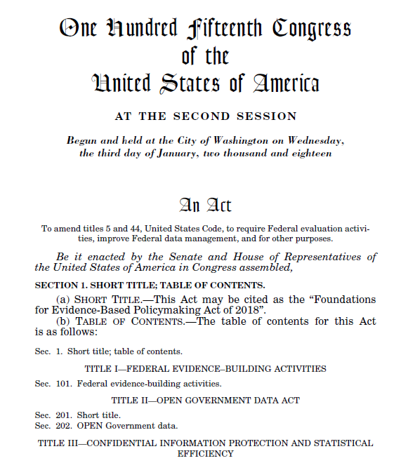
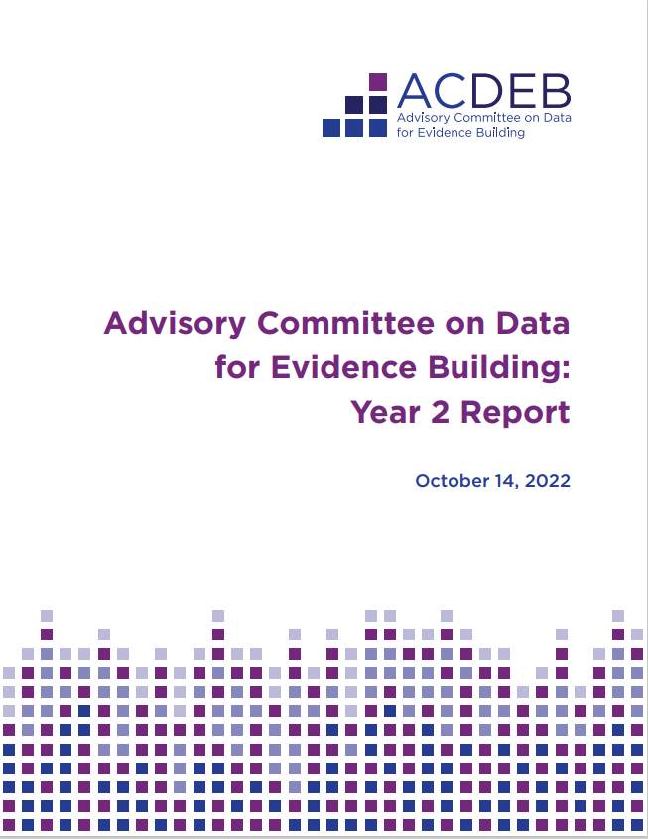
Evidence Act Implementation

Slide 7
Advisory Committee on Data for Evidence Building – Year 2
The Committee’s Year 2 Report lays out recommendations for carrying out the Evidence Act, including that OMB:
Adopt a risk-utility framework as part of securing access to CIPSEA data assets
Promote use of privacy-preserving technologies within government in coordination with the Interagency Council on Statistical Policy (ICSP)
Adopt a clear statement of purpose for the National Secure Data Service (NSDS) including recommendations to define its core functions:
Coordination
Communication
Research and Development
Data Standardization

Slide 8
NCHS Budget Update
Additional Resources in FY23, TBD: includes Data Modernization Initiative funding and collaborative initiatives across CDC and other agencies. NCHS will receive a portion of DMI funding dedicated to CDC.

Slide 9
NCHS New Reports and Data
High Visibility Reports
New Data Releases
This
Week’s
Highlights
Provisional Numbers and Rates of Suicide by Month and Demographic Characteristics: United States, 2021 (9/30)
Cause-of-Death Data From the Fetal Death File, 2018–2020 (10/19)
Telemedicine Use Among Adults: United States, 2021 (10/13)
COVID-19 Mortality Among Adults Aged 65 years and Over: United States, 2020 (10/14)
COVID-19 Death Rates in Urban and Rural Areas: United States, 2020 (10/25)
Quarterly Provisional Estimates for Selected Causes of Death: Q1 2019 – Q1 2022 (10/26)
COVID-19 Mortality by Usual Occupation and Industry: 46 States and New York City, United States, 2020 (10/28)

Slide 10
Phases of the DMI Strategic Roadmap
Notes:
DMI Strategic Implementation Plan (cdc.gov)
Last fall, we published our DMI strategic implementation plan that is guiding our vision for solving these issues.
Right now, we’re investing a big bolus of funds from the CARES Act and the American Rescue Plan both at CDC and in jurisdictions.
And our goal is to create scalable, flexible systems that will last beyond the current crisis and work for any disease or condition.
What we’ve landed on are five big areas that will move us toward this vision and will ensure we never find ourselves so far behind again.
Here you see our five DMI priority areas of work and what we plan to get from them.

Slide 11
NCHS Data Linkage Program: Sources
Survey Data
Sampling frame
Known inference
Administrative Data
Program participation/vital status
Not meant for research purposes
Housing and Urban Development
Medicare and Medicaid
Mortality
Health Behaviors
Health Conditions
Socioeconomic Status
Healthcare Access & Utilization
Geocoded Addresses
End Stage Renal Disease
Department of Veterans Affairs

Slide 12
DMI: Linking NCHS Data to New Sources
The linkage of NCHS survey data to Department of Veterans Affairs (VA) administrative data was funded through DMI
The linkage utilized state-of-the-art methodologies to link data (including machine learning techniques)
First time NCHS survey data were linked to VA data
Invaluable resource on this population
Marks the beginning of on-going collaboration between the agencies
Can be used to answer key policy questions, such as:
What are the health characteristics and outcomes for Veterans within and outside the VA health system?

Slide 13
NCHS Metadata Updates
Centers for Disease Control and Prevention
Travis Hoppe
Associate Director for Data Science and Analytics
NCHS Board of Scientific Counselors
October 24, 2022

Slide 14
NCHS Metadata
F.A.I.R.
NCHS
Strategic Plan
Data Modernization Initiative
Discoverability
Findability
Accessibility
Interoperability
Reuse
Maintain and enhance core data systems and improve integration of data
Move from siloed and brittle public health data systems to connected, resilient, adaptable, and sustainable systems
Improve discoverability as data “federates” to external locations

Slide 15
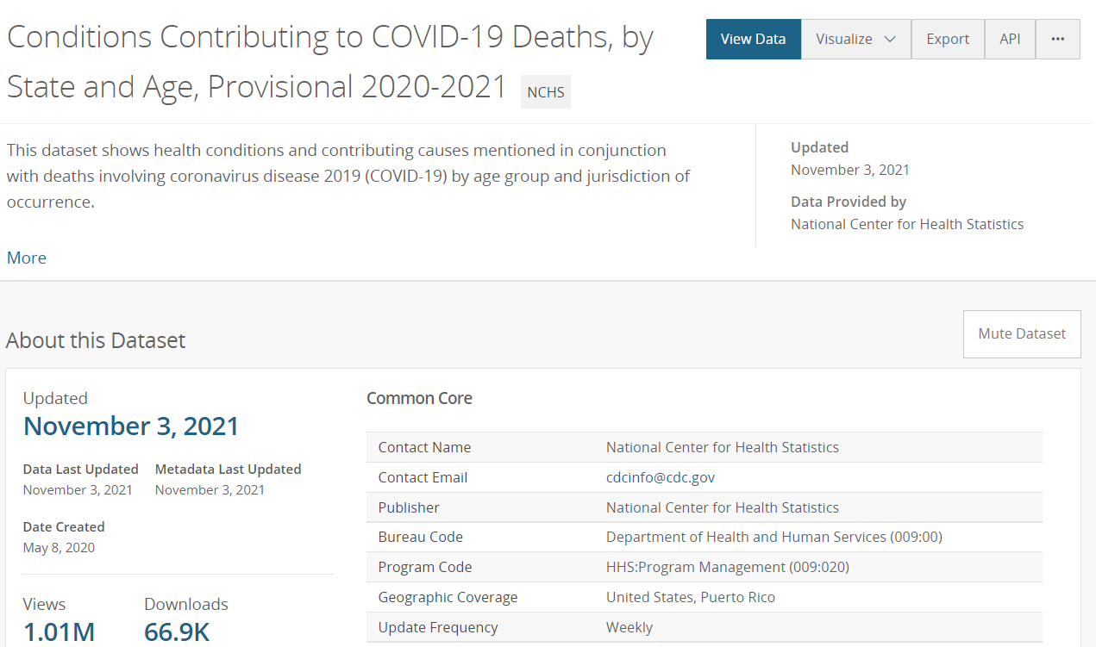
NCHS Metadata Examples
Metadata Website
Machine Readable Output
healthdata.gov, data.gov, Google, Kaggle...

Slide 16
NCHS Metadata Standards
Establish a consistent set of dataset level standards for data.cdc.gov
Consistent with CDC and Federal standards
Started with 820 CDC / 88 Federal errors
Currently at zero validation errors
Formalize two projects with metadata
Restricted datasets / Standard Application Process
Social Determinants of Health tags (in progress)

Slide 17
Restricted Metadata
Response to Standard Application Process (SAP), a catalog for all restricted datasets from federal statistical agencies
NCHS catalog for major restricted access datasets available on the Research Data Center (RDC)
RDC
NCHS Survey Data Linked to Centers for Medicare & Medicaid Services (CMS) Medicare Data Files
Example 1
NCHS Survey Data Linked to National Death Index (NDI) Mortality Files
Example 2
Notes:
https://data.cdc.gov/browse?tags=research-data-center

Slide 18
Social Determinants of Health (SDoH) Tags
Create dataset level tags centered around SDoH
Use Healthy People 2030 as a starting framework for tags
Improve discoverability through “catalogs” of SDoH topics
Coordinate with CDC CIOs for agency adoption and beyond
Education
Neighborhood and Built Environment
Social and Community Context
SDoH
Economic Stability
Health and Health Care

Slide 19
Discussion and Questions

