Slide 1
Leadership Update
Brian C. Moyer, Ph.D., NCHS Director
Jen Layden, M.D., Ph.D., Acting Associate Deputy Director for Public Health Science and Surveillance
Jim Craver, Acting Deputy Director for Management and Operations
February 10, 2022

Slide 2
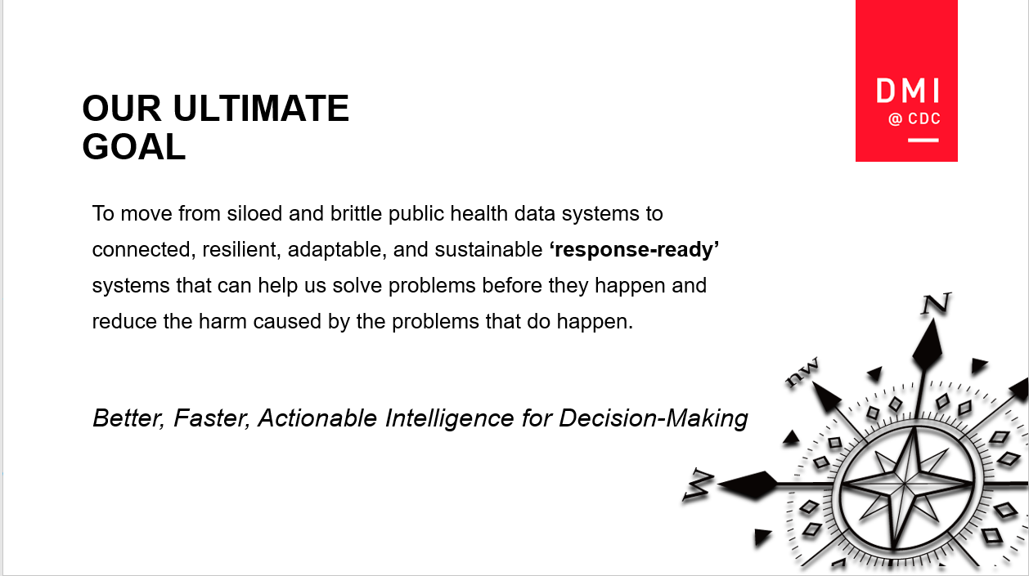
Data Modernization Initiative

Slide 3
Data Modernization Initiative Priorities
NCHS’s DMI activities promote greater data accessibility and data interoperability.
These activities also support the 2018 Foundations for Evidence-Based Policymaking Act.
Electronic Health Records (EHRs)
Healthcare Electronic Health Records (HEHR) Cloud Migration
Microdata Access
Develop partnerships to significantly expand available data through EHRs for enhanced analysis
Cloud-based infrastructure to drive enhanced NCHS survey operations and efficiencies
Model-Based Early Estimates
Standardize NCHS data will provide opportunities for enhancement of reporting, visualization, and advanced analytics
Develop and leverage data science tools and techniques to produce faster, more granular estimates for key health statistics
National Vital Statistics System (NVSS) Modernization
Enhance data interoperability and speed up collection and reporting of vital statistics

Slide 4
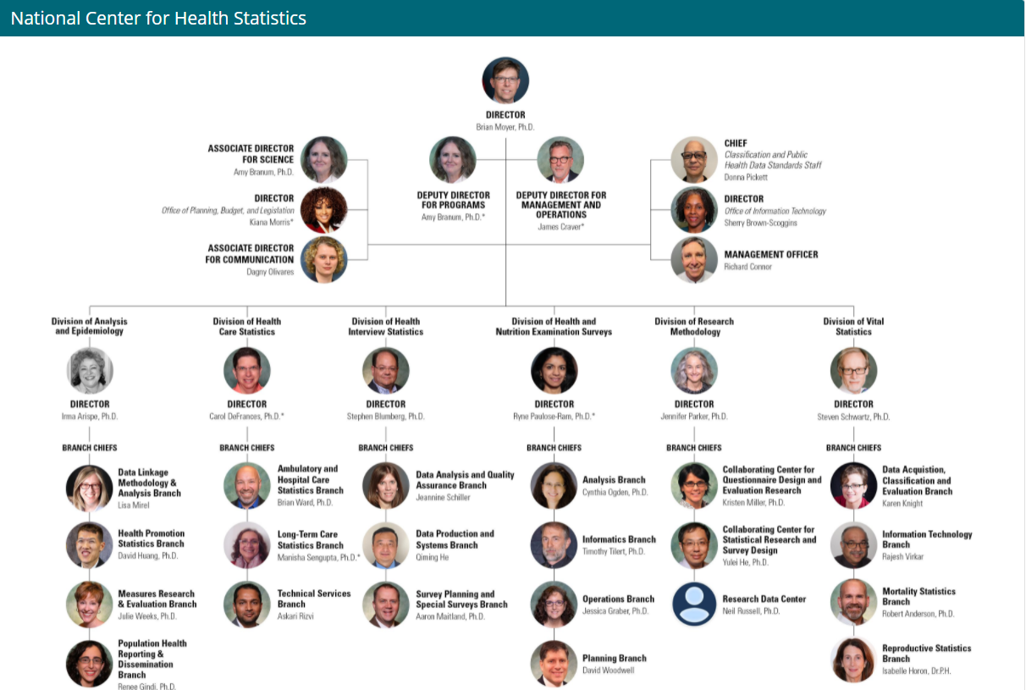
NCHS Organizational Chart

Slide 5
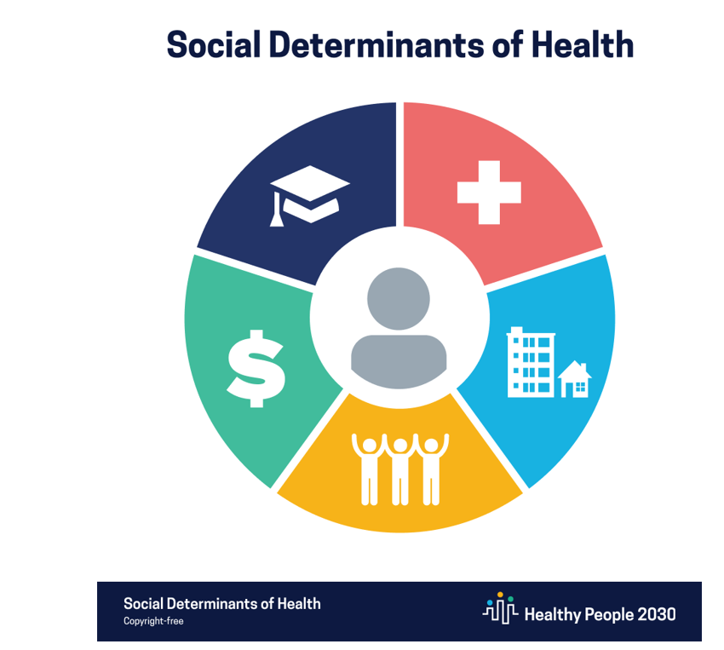
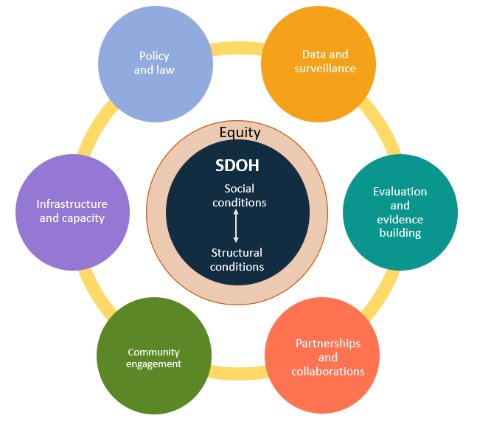
Data are Key to HHS & CDC SDOH-related Initiatives
HHS SDOH Action Plan
CDC Task Force on SDOH
Education Access
and Quality
Health Care Access and Quality
Economic Stability
Neighborhood
and Built
Environment
Social and Community Context

Slide 6
NCHS Activities to Support SDOH
NCHS
Data Development and Modernization Activities
Developing measures & analytic tools for understanding the effect of SDOH on health
Expanding SDOH data through data linkage & use of alternative data sources
Developing model-based estimates at state & local levels
Expanding analysis & dissemination of SDOH data visualizations & tools
Developing new ICD-10-CM codes for social determinants

Slide 7




NCHS Program Updates and New Initiatives
Coordinating Office for
Medical Examiners and Coroners (ME/C)
NCHS Provisional Mortality Data on CDC WONDER database
Advancing Gender
Identity Work
Onboarding CDC Researchers to NCHS Virtual Data Enclave

Slide 8




Medical Examiners and Coroners
Goal of Proposed Office:
To coordinate work and promote collaboration on issues related to Medical Examiners and Coroners (ME/C); to serve as an information hub for ME/C, CDC CIOs, and other stakeholders, including Federal and jurisdictional partners.
Objectives:
- Promote quality and consistency in death investigation and cause-of-death information
- Promote collection, automation, and distribution of medicolegal death investigation data
- Facilitate information sharing within the medicolegal death investigation community
- Coordinate public health surveillance efforts among CDC units and other partners/stakeholders

Slide 9
NCHS Strategic Plan - Fiscal Years 2022–2025
Thank You for Your Input
  NCHS’s strategic plan was a collaborative effort between
  NCHS and partners from the start.
  The BSC’s input focused on:
  Integrating health equity into the plan
  Building on NCHS’s existing programs
  Workforce development and support
Operationalizing the Plan
Tiger Teams are in place to develop an Operational Plan
Three Components:
  Logic Models
  Action Planning Tool
  KPI Performance Scorecard

Slide 10
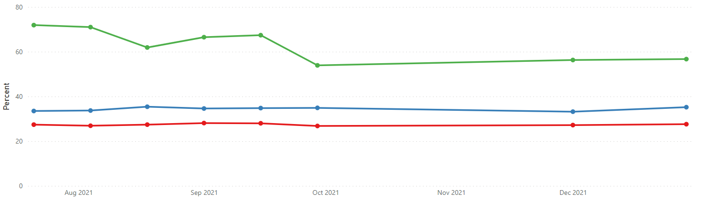
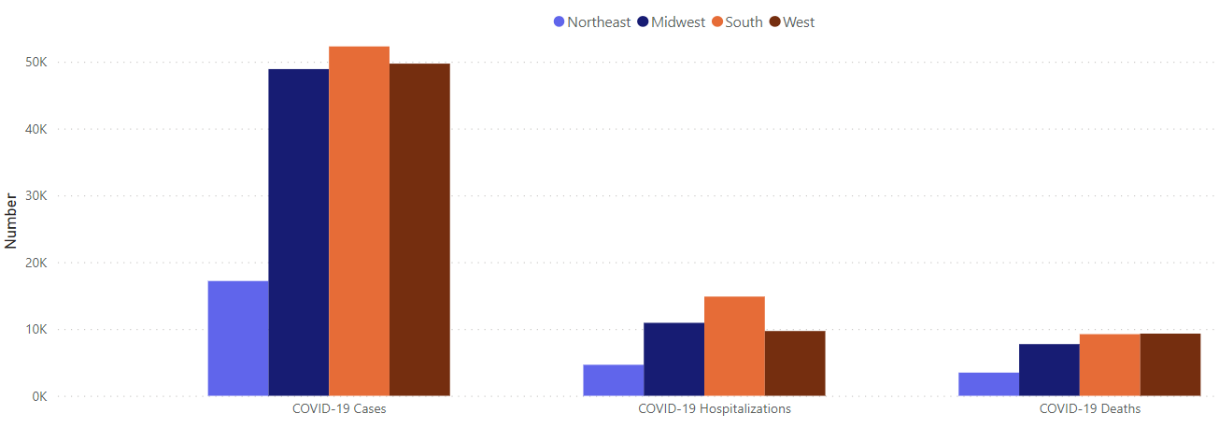
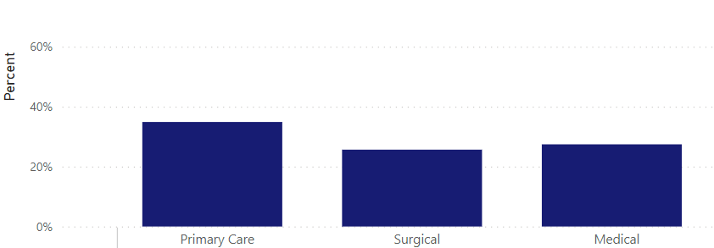
Recent Data Releases on COVID-19
Household Pulse Survey
Symptoms of Anxiety and Depressive Disorder during the COVID-19 Pandemic, by Gender Identity
National Post-Acute and Long-term Care Study
Number of COVID-19 cases, hospitalizations, and deaths among residential care community residents, by U.S. Census Region, Jan 2020 – March 2021
National Ambulatory Medical Care Survey
PPE Shortages Experienced by Office-Based Physicians due to COVID-19, by specialty type
https://www.cdc.gov/nchs/covid19/index.htm

Slide 11
Recently Published Reports Dec 2021 and Jan 2022
Upcoming Reports
Feb 2022
Births: Final Data for 2020
Maternal and Infant Characteristics and Outcomes Among Women with Confirmed or Presumed COVID-19 During Pregnancy: 14 states and DC
Mortality in the United States, 2020
Drug Overdose Deaths in the United States, 1999 – 2020
Marriage Rates in the U.S. by State, 1990-2020
Stressful Life Events Among Children Aged 5-17 Years by Disability Status: United States, 2019
Divorce Rates in the U.S. by State, 1990-2020
Demographic Variation in Health Insurance Coverage: United States, 2020
https://www.cdc.gov/nchs/pressroom/calendar/2022_schedule.htm

Slide 12
NCHS Budget Update
Additional Resources in FY22: includes Data Modernization Initiative funding and collaborative initiatives across CDC and other agencies

Slide 13

Discussion/Questions

