Slide 1
NCHS Board of Scientific Counselors Meeting: Director’s Update
Brian C. Moyer, Ph.D., NCHS Director
May 26, 2022

Slide 2
Thank You to Our Committed Board Members!
BSC members extending their time on the Board:
Kristen Olson, Ph.D.
Helen Levy, Ph.D.

Slide 3
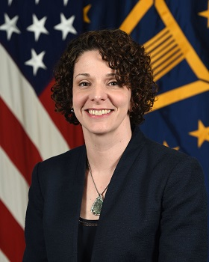
Staffing Updates
Karin Orvis, Ph.D., named OMB’s Chief Statistician of the United States

Slide 4
Return to the Workplace
Staff return to the office!
NCHS maintains flexible work schedules
Office renovations complete to improve ventilation and other amenities

Slide 5
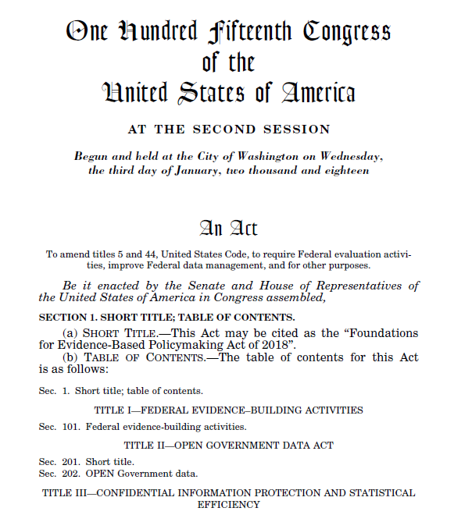
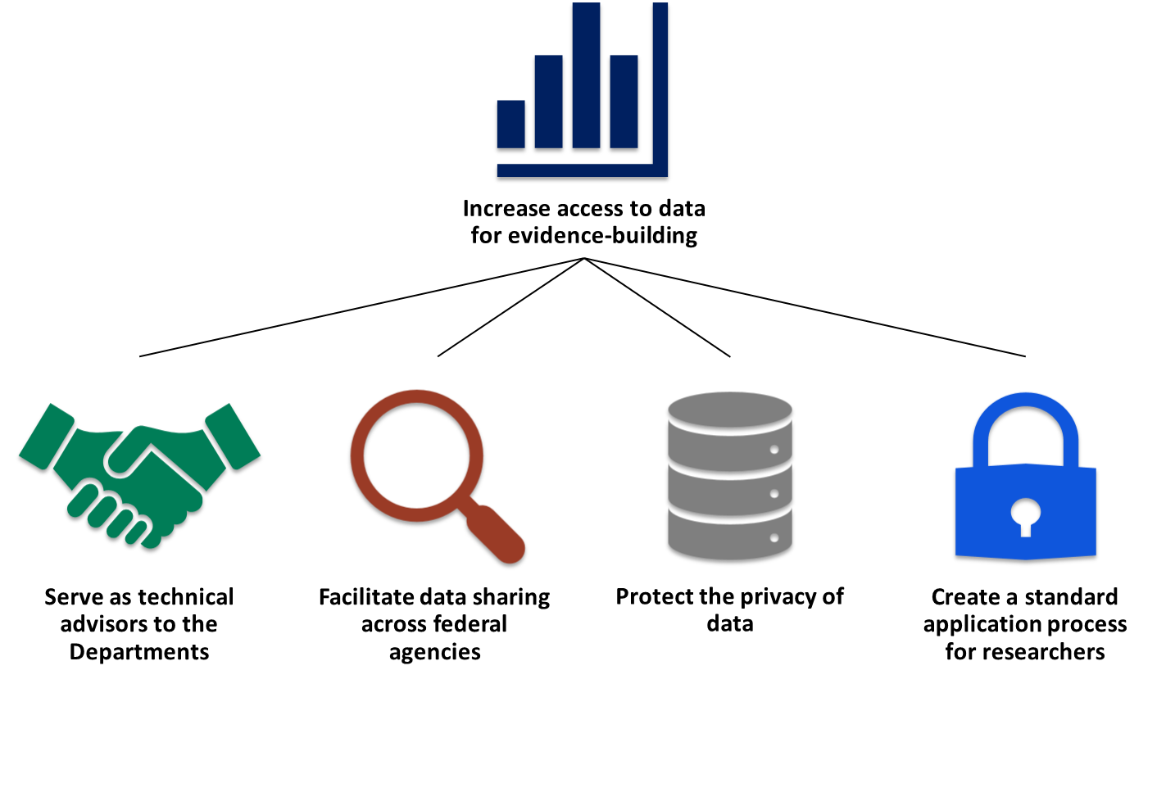
Evidence Act Implementation
Statistical Agencies and Title III

Slide 6
Advisory Committee on Data for Evidence Building: Use Case on Health
Possibilities of a National Secure Data Service
Value of health data access, linking, and analysis for evidence building
Better communication and collaboration among the federal, state, and local levels
Role of communities of practice, training, and resource sharing
Data governance frameworks to facilitate access to and linking of health data
This Photo by Unknown Author is licensed under CC BY-SA

Slide 7
NCHS Budget Update
FY 2023 President’s Budget request includes a $6.54 million increase

Slide 8
Select NCHS Program Updates
Collaboration with Dept. of State to add Gender “X” Marker to U.S. Passport applications
Data4Health Initiative Launched the 2022 WHO Verbal Autopsy Instrument
Collaboration with U.S. Census Bureau on a Retail Health Clinic Project
Onboarding CDC Researchers to NCHS Virtual Data Enclave

Slide 9
Coordinating Office for Medical Examiners and Coroners (COMEC)
GOALS
OBJECTIVES
1
Promote collaboration and coordination on issues related to Medical Examiners and Coroners
2
Serve as a resource for Medical Examiners and Coroners
Promote quality and consistency in Medicolegal Death Investigation (MDI)
Promote collection, automation, and distribution of MDI data
Facilitate information sharing
Coordinate public health surveillance efforts
Analyze and compile information about MDI infrastructure
3
Assist public health researchers and practitioners engaging with Medical Examiners and Coroners

Slide 10
New Reports & Data from NCHS
High-Visibility Reports
Maternal Mortality Rates in the United States, 2020
Health Insurance Coverage: Early Release of Estimates from the National Health Interview Survey, 2021
New Data Releases
Monthly Provisional Drug Overdose Death Counts (thru December 2021)
Just this week…
Births: Provisional Data for 2021 — May 24th
Sexual Orientation Differences in Access to Care and Health Status, Behaviors, and Beliefs — May 25th
2021 National EHR Survey public use data file

Slide 11
NCHS & AcademyHealth 2021 Data Visualization Challenge: Winners Announced!
First Place Winners: Johns Hopkins University’s “Sound the Alarm: Data Show Large Inequities in Rates of Gun Deaths Among Young People”
Second Place Winners: University of Wisconsin-Madison “Investigating Temporal Trends in Preventable Death: Suicide and Drug Overdose”

Slide 12
A free 1-week STEM camp for rising 6th and 7th graders.
Campers will be introduced to statistical concepts such as comparisons, predictions and distributions in a child-friendly format.
Find the application online on NCHS’s webpage.

Slide 13
Discussion/Questions

