Slide 1
Long COVID Content in the National Health Interview Survey & the Household Pulse Survey
Anjel Vahratian, Ph.D., M.P.H.
Associate Director for Science, Division of Health Interview Statistics
NCHS Board of Scientific Counselors
October 24, 2022
Notes:
Hello everyone. For those new to the group, my name is Anjel Vahratian, and I’m the Associate Director for Science in the Division of Health Interview Statistics at NCHS. I am part of a small team at NCHS that has partnered with the Census Bureau on the Household Pulse Survey. Today, I am presenting the first set of estimates on activity limitation due to long COVID. Please note that these estimates are embargoed until 10am tomorrow (10/5).

Slide 2

National Health Interview Survey
Purpose: To monitor the health of the US population through the collection and analysis of data on a broad range of health topics
Sample: Address-based, clustered sample of housing units from every state, to be representative of the civilian noninstitutionalized US population
Mode: In-person interviews by Census interviewers, with follow-up by telephone if needed
Questionnaire: Includes sample adult and sample child sections
Data collection: Continuous, with quarterly and annual data files
Sample size: Complete interviews for 27,000+ sample adults and 9,000+ sample children annually
Notes:
Before I delve right into the estimates, I’d like to provide the audience with an overview of the two surveys.

Slide 3
National Health Interview Survey
Long COVID Questions
Beginning in January 2022, the following questions were asked of both the sample adult and the sample child respondent:
Did [you/child’s name] have any symptoms lasting 3 months or longer that you did not have prior to having coronavirus or COVID-19?
  Read if necessary: Long term symptoms may include tiredness or fatigue, difficulty thinking, concentrating, forgetfulness or memory problems, sometimes referred to as "brain fog," difficulty breathing or shortness of breath, joint or muscle pain, fast-beating or pounding heart (also known as heart palpitations), chest pain, dizziness on standing, depression, anxiety or mood changes.
Do [you/child’s name] have symptoms now?

Slide 4
National Health Interview Survey
Long COVID Questions
Beginning in January 2023, the following question will be added to this series (baring last-minute edits):
Do these long-term symptoms reduce your ability to carry out day-to-day activities compared with the time before you had COVID-19?
  Answer Choices: Yes, a lot; Yes, a little; Not at all
Long COVID estimates based on data from the 2022 NHIS will be available in 2023.

Slide 5

Household Pulse Survey
Census Bureau
Purpose: To monitor how the coronavirus pandemic is impacting households across the country from a social and economic perspective.
Sample: Email and cell-phone contact frames matched to Census Bureau’s Master Address File (MAF) records
Mode: Online
Questionnaire: Adults only
Data collection: Began April 23, 2020, and is ongoing (currently two weeks on / two weeks off)
Sample size: 50,000+

Slide 6
Household Pulse Survey
Long COVID Questions
The NHIS questions on long COVID were added to the Household Pulse Survey at the start of Phase 3.5 (on June 1, 2022).
Beginning in Phase 3.6 (September 14, 2022), the following question was added to the survey:
  Do these long-term symptoms reduce your ability to carry out day-to-day activities compared with the time before you had COVID-19?
    Answer Choices: Yes, a lot; Yes, a little; Not at all

Slide 7

Household Pulse Survey
Long COVID Estimates
September 14-26, 2022 (Week 49)
Sample size: 50,258
Response rate: 4.7%
Estimates:
Ever/current long COVID
Any/significant activity limitation from long COVID
Universe:
All adults in the U.S.
Among adults who had COVID
Notes:
Some basic information on Pulse. Week 49 was administered from September 14-26, 2022. The response rate was 4.7% and for the questions on long COVID, we worked with an unweighted sample size of around 50,000.

Slide 8
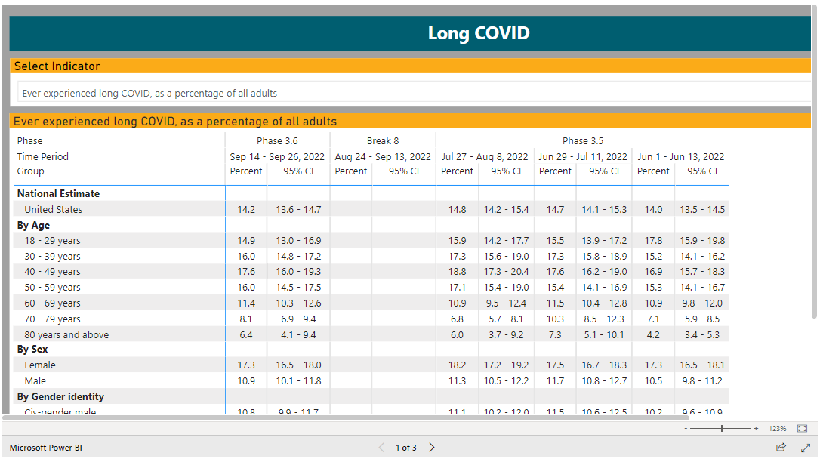
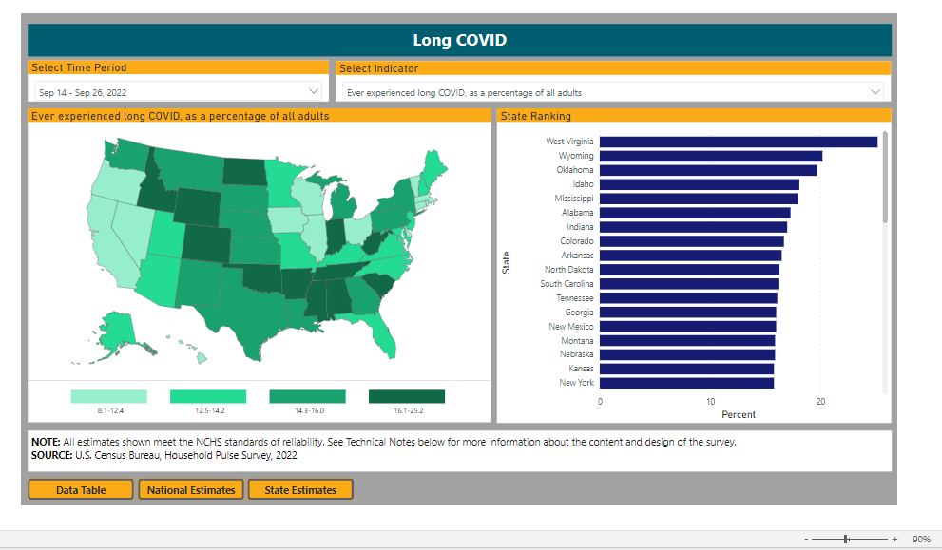
Household Pulse Survey
Long COVID Estimates
https://www.cdc.gov/nchs/covid19/pulse/long-covid.htm

Slide 9
Household Pulse Survey
Long COVID Estimates
Among all U.S. adults
  Percentage who ever had COVID: 48.2%
  Percentage who ever had long COVID: 14.2%
  Percentage who currently have long COVID: 7.2%
Among adults who have had COVID
  Percentage who ever had long COVID: 29.6%
  Percentage who currently have long COVID: 15.0%

Slide 10
Household Pulse Survey
Long COVID Estimates
Among all U.S. adults
Percentage who have long COVID that impacts their day-to-day activities
  at least a little (any) 5.9%
  a lot (significant) 1.8%
Among adults who currently have long COVID
Percentage who have long COVID that impacts their day-to-day activities
  at least a little (any) 81.4%
  a lot (significant) 25.1%

Slide 11
Household Pulse Survey
Long COVID Estimates
Our dashboards include estimates by the following covariates:
  Age
  Sex
  Sexual orientation
  Gender identity
  Race and Hispanic origin
  Educational attainment
  Disability status
  State

Slide 12

Upcoming Household Pulse Survey Releases
Week 50: October 26
Week 51: November 29
NCHS: https://www.cdc.gov/nchs/covid19/health-care-access-and-mental-health.htm
Census: https://www.census.gov/data/experimental-data-products/household-pulse-survey.html

Slide 13
CDC Information Slide

