Slide 1
National Survey of Family Growth Update: Resuming Data Collection with a New Multi-mode Design
Anjani Chandra, Ph.D.
NSFG Team Lead & Principal Investigator
NCHS Board of Scientific Counselors Meeting
February 10, 2022

Slide 2
NSFG Team
At NCHS:
NSFG Team within Division of Vital Statistics/Reproductive Statistics Branch:
Anjani Chandra, Team Lead/Principal Investigator
Joyce Abma, Contract Officer’s Representative
Gladys Martinez
Kim Daniels
Colleen Nugent
Jennifer Sayers
Hee-Choon Shin, Mathematical Statistician, Division of Research & Methodology
At RTI:
Andy Peytchev, Principal Investigator
Susan Kinsey, Project Director
Emilia Peytcheva, Instrumentation and Methodology Reports Task Leader
Taylor Lewis, Sample Design, Weighting, and Imputation Task Leader
Lilia Filippenko, Systems Development, Data Processing, Documentation, and Delivery Task Leader
William Savage, Information Security and Confidentiality Task Leader
Milton Cahoon, Preparation for Data Collection and Data Collection Task Leader

Slide 3
Overview of presentation
NSFG background
Progress since last BSC presentation in January 2020
  Closeout of previous contract and final data release (2017-2019 NSFG)
  Award of new contract September 2020 and preparation for data collection launch
  Instrument development work – including adaptations for online mode
  Multi-mode survey design envisioned for Year 1 data collection
Resumption of data collection in January 2022
  Revisions made for Year 1, Quarter 1 due to COVID-19
  Plans under review/consideration for Quarter 2+
Feedback and discussion

Slide 4
NSFG Background

Slide 5
NSFG Purpose and Uses
Address Section 306 of the Public Health Service Act, stipulating “NCHS shall collect statistics on… family formation, growth, and dissolution”
Help explain variations in birth rates using intermediate or “proximate” determinants of fertility
Assess factors that affect timing and consequences of sexual activity and pregnancy
Describe relationships and families
Measure receipt of family planning and other medical services
Monitor risk of HIV and STIs in general household population

Slide 6
NSFG Background (1973-2019)
Each survey provides a nationally representative, cross-sectional snapshot of the U.S. household “reproductive-age” population
Key changes since “Cycle 1” in 1973:
  1982 – Inclusion of never-married women
  1988 & 1995 - linked to NHIS sampling frame from several years prior
  1995 – Conversion to CAPI and ACASI and 1st use of incentives
  2002 – Inclusion of men (independent sample) & expansion of ACASI
  2006 – Transition to continuous fieldwork design
  2015 – Expansion of age range from 15-44 to 15-49
Public-use files have been released with every periodic survey 1973-2002 (Cycles 1-6) and roughly every 2 years since 2006 (under continuous fieldwork design)

Slide 7
NSFG Years
Year | Scope | N | Over Samples | Response Rates | Incentive | OMB Approved Intvw Length
1973 | Ever-Married Women 15-44 | 9,797 | Black women | 90.2% | None | 60 min
1976 | Ever-Married Women 15-44 | 8,611 | Black women | 82.7% | None | 60 min
1982 | All Women 15-44 | 7,969 | Black women & teens 15-19 | 79.4% | None | 60 min
1988 | All Women 15-44 | 8,450 | Black women | 82.5% | None | 70 min
1995 | All Women 15-44 | 10,847 | Black & Hispanic women | 78.7% | $20 | 100 min
2002 | All Women & Men | 12,571 W = 7,643 M = 4,928 | Black people, Hispanic people, People 15-19 | All - 79% W – 80% M – 78% | $40 | W – 85 min M – 60 min
2006-2010 | All Women & Men 15-44 | 22,682 W=12,279 M=10,403 | Black people, Hispanic people, People 15-19 | All - 77% W – 78% M – 75% | $40 | W – 85 min M – 60 min
2011-2013 | All Women & Men 15-44 | 10,416 W=5,601 M=5,815 | Black people, Hispanic people, People 15-19 | All – 72.8% W – 73.4% M – 72.1% | $40 | W – 80 min M – 60 min
2013-2015 | All Women & Men 15-44 | 10,205 W=5,699 M=4,506 | Black people, Hispanic people, People 15-19 | All – 69.3% W – 71.2% M – 67.1% | $40 | W – 80 min M – 60 min
2015-2017 | All Women & Men now 15-49 | 10,094 W=5,554 M=4,540 | Black people, Hispanic people, People 15-19 | All – 65.3% W – 66.7% M – 63.6% | $40 | W – 80 min M – 60 min
2017-2019 | All Women & Men 15-49 | 11,347 W=6,141 M=5,206 | Black people, Hispanic people, People 15-19 | All – 63.4% W – 65.2% M – 61.4% | $40 | W – 80 min M – 60 min

Slide 8
Current NSFG Cosponsors (all within DHHS)
National Center for Health Statistics (NCHS)
Eunice Kennedy Shriver National Institute of Child Health and Human Development (NICHD)
Office of Population Affairs (OPA)
Administration for Children & Families (ACF)/ Children’s Bureau
Administration for Children & Families (ACF)/ Office of Planning, Research, & Evaluation (OPRE)
Office on Women’s Health
CDC/NCHHSTP/Division of HIV Prevention
CDC/NCHHSTP/Division of STD Prevention
CDC/NCHHSTP/Division of Adolescent & School Health
CDC/NCCDPHP/Division of Reproductive Health
CDC/NCCDPHP/Division of Cancer Prevention & Control
CDC/NCIPC/Division of Violence Prevention

Slide 9
Progress since last BSC update in January 2020

Slide 10
Closeout of previous contract and final data release (2017-2019 NSFG)
Previous 10-year contract with University of Michigan ended Dec 2020
  Final public-use files for 2017-2019 NSFG released in October 2020
  Restricted-use files made available through Research Data Center (RDC):
    Contextual, interviewer observations, and paradata files
    Additional data, formerly included on PUF, but now only available in RDC due to disclosure risk
Analyses with latest NSFG data:
  Data Brief on current contraceptive status released with 2017-2019 PUF in October 2020
  NSFG Key Statistics page updated with 2017-2019 data in November 2021
  Several QuickStats with 2017-2019 data published in 2021, but most other analyses delayed due to staff size and competing demands of new contract and 3 staff COVID deployments
    Teen report using data for 2015-2017
    Menarche report using data through 2017

Slide 11
Award of new contract to RTI and preparations for Year 1 (2022) data collection
New 10-year contract awarded to RTI in September 2020, with plans to resume data collection with a multi-mode survey design in January 2022
Oversight, review, and collaboration with contractor on:
  Sample design and establishing quarterly sample areas
  Interviewer training materials and other preparation for multi-mode data collection
  Onboarding of contractor staff, hiring interviewers
  Establishing IT systems that meet CDC security requirements
  Modification of contract to move web survey mode earlier (to 1st year of data collection) due to COVID
  Obtaining clearances for OMB and ERB

Slide 12
Instrument development work
Producing programmer-ready full specifications based on “capi-lite” questionnaires in RFP
  Streamlining and restructuring of content to reduce complexity and respondent burden
  Improvements to accommodate respondents in same-sex marriages and cohabitations
  Incorporation of new items from cosponsors and revisions prompted by CCQDER work***
  Adapting survey instruments and interview aids to work for both FTF and online modes
  Translating new or revised items into Spanish
Developing web screener to manage multiple survey tasks accomplished in FTF mode
Developing an electronic life history calendar for female survey
Extensive instrument testing in English and Spanish
***Collaboration with CCQDER on selected instrument issues:
  Cognitive interviews to assess Life History Calendar, as well as selected question series
  RANDS panel (in progress) to do split-panel testing of specific questions or series

Slide 13
Survey design envisioned for Year 1
Continuing to interview 1 person aged 15-49 per sample household
Building off success of continuous FTF survey design used 2006-2019:
  Responsive survey design using paradata in real time with subsampling for nonresponse allowed for nonresponse bias mitigation with cost control
Prior FTF design
  Fieldwork organized into 4 12-week quarters/year
  2-Phase design:
    Phase 1 (weeks 1-10):
      All sample worked
      $0 screener, $40 main incentive
    Phase 2 (weeks 11-12):
    30% subsample of non-respondents
    $5 prepaid screener; $40 prepaid for main, and $40 at end for main
Current Multi-mode design
  Fieldwork organized into 4 16-week quarters/year
  3-Phase design:
    Phase 1 (weeks 1-4): Web
      $2 screener, $40 main incentive
    Phase 2 (weeks 5-12): Web & FTF
      No change in incentive
    Phase 3 (weeks 13-16): Web & FTF
      Up to 50% subsample of non-respondents
      $5 prepaid screener; $40 prepaid for main, and $40 at end for main

Slide 14
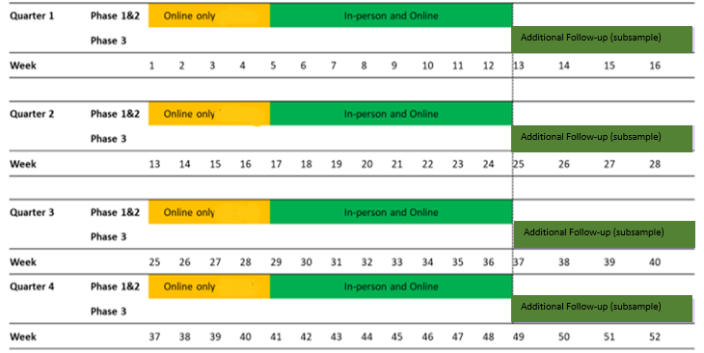
Multi-mode, multi-phase survey design for Year 1:
4 overlapping quarters

Slide 15
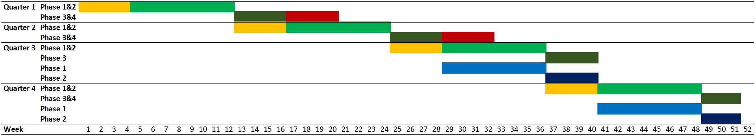


Multi-mode Comparison Study (originally planned for Q1/2, but shifted to Q3/4)
New Multi-mode Design: Face to Face, as used 2006-2019:
Web (CAWI) (Phase 1) Face to Face (Phase 1)
Face to Face (and Web continued) (Phase 2)
Face to Face, increased incentives (Phase 3) Face to Face, increased incentives (Phase 2)
Mail eligibility or NRFU survey (Phase 4)

Slide 16
Resumption of data collection in January 2022

Slide 17
Quarter 1 changes and challenges
The surge in COVID-19 rates, national staffing shortages, and contractor policy precluded FTF interviewing in most NSFG sample areas at start of Q1; policy changed as of 2/3/22 to allow some FTF during Q1.
As a result, for Quarter 1:
  Only CAWI data collection in Phases 1 and 2
  Field staff will conduct Phase 3 interviews with higher incentives, for a subsample of non-respondents from Phases 1 & 2, as originally planned, and will follow up 100% of breakoffs.
  Seeking OMB and ERB approval for further changes in Quarter 2

Slide 18
Changes being considered for Quarter 2+ (1 of 2)
Mailed paper screener to augment CAWI screener
  Most nonresponse in HH surveys relying on mailed invitations to a web survey is at screener stage. Even if FTF interviewing can resume to originally intended levels in Q2, mailed screeners could reduce reliance on in-person follow-up.
  Paper screener would be mailed around week 2 (on 3rd mailing, approx. 1 week after 1st mailing)
  Would only be used to select adult respondents, given complexity of parental permission and minor assent process for teens 15-17
  We would evaluate impact on response rates, demographic composition, & cost indicators.
Conducting telephone prompting calls to complete the web main survey

Slide 19
Changes being considered for Quarter 2+ (2 of 2)
Experiment to test accelerated delivery of Phase 3’s higher incentives
  Phase 3 protocol already approved by OMB & ERB:
    $5 prepaid incentive for screener; $40 prepaid incentive before main and $40 upon completion
  Experimental condition would be assigned 50-50 at sample address level – half receiving higher incentives at standard Phase 3 timing (weeks 13-16) and half receiving up front in Phase 1.
  Higher incentives have potential to increase response rates and decrease nonresponse bias
  Incentivizing participation from the beginning could be cost-efficient overall:
    In areas where FTF is not possible, can reduce # of mailings needed per case
    In areas where FTF is possible, can reduce # of sample addresses needing FTF
  Some increased challenge for field staff juggling different incentive protocols

Slide 20
Feedback and Discussion

