Slide 1
Long COVID-19 Data Collection at NCHS
Amy M. Branum, PhD
NCHS, Associate Director for Science
Board of Scientific Counselors Meeting
October 24, 2022

Slide 2
What is long COVID?
A term with many names - long COVID, long-haul COVID, post-acute COVID-19, post-acute sequelae of SARS CoV-2 infection (PASC), long-term effects of COVID, and chronic COVID
Wide range of new, returning, or ongoing health problems that are experienced after being infected with the virus that causes COVID-19
Conditions can last weeks, months, or longer
  Has been defined at both 3 months after infection and 4 weeks post-infection
Anyone infected with the virus that causes COVID-19 can experience long COVID

Slide 3
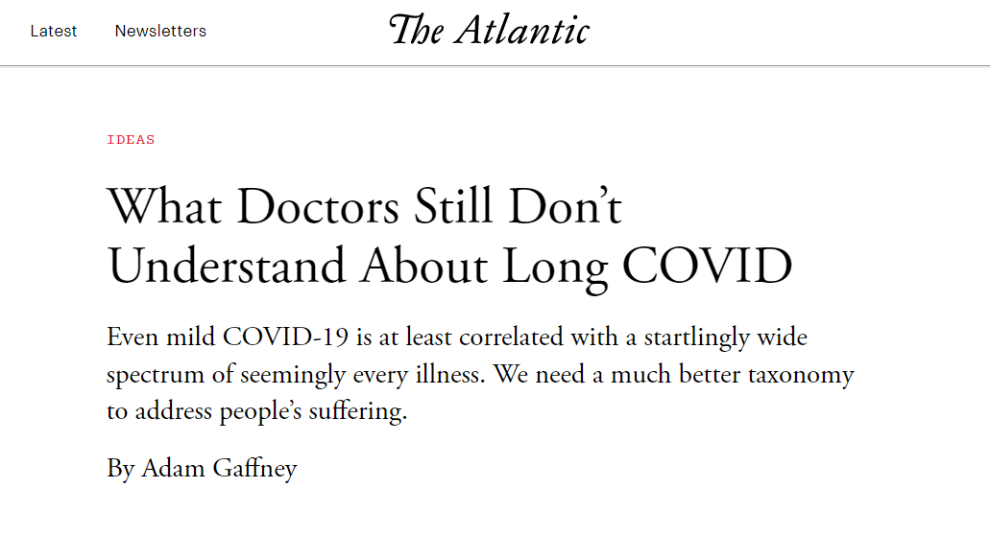
But what is long COVID, really?
“Doctors and scientists still have much to learn about symptoms that continue—or first turn up—months or weeks after an initial COVID infection. What’s clear today is that long COVID can be many different things.”
What Doctors Still Don’t Understand About Long COVID - The Atlantic

Slide 4
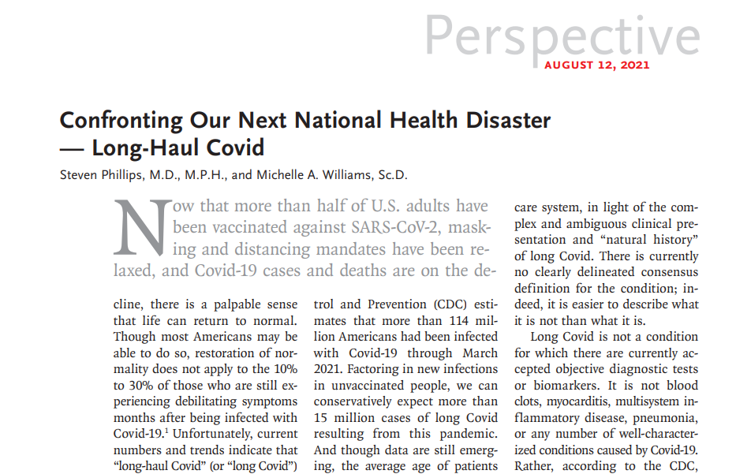
“Our next national health disaster”
“Long Covid is not a condition for which there are currently accepted objective diagnostic tests or biomarkers”
Confronting Our Next National Health Disaster — Long-Haul Covid (nejm.org)

Slide 5
Measurement challenges… and opportunities
Given the lack of clinical and diagnostic criteria, how do we measure long COVID?
NCHS data collection systems may help fill some gaps:
  National Health Interview Survey and National Health and Nutrition Examination Survey
  National Vital Statistics Mortality data
  Collaborating Center for Questionnaire Design, Evaluation, and Research

Slide 6
Panel Presentations

Slide 7
Input for further consideration
Is there additional information we should examine when considering:
  Issuing death certificate guidance for long COVID deaths?
  Implementing the ICD-10 code U09.9 in NVSS cause of death coding?
What should CCQDER focus on in the upcoming rounds of testing?
What should be considered as the potential analytic priorities? With the long COVID questions and other related data in our survey, what are the research questions we should address first?
Given that the characterization of the post-COVID conditions is still evolving, are there areas of Long COVID that you think we are missing and could be added?

