Slide 1
Guide to Efficiently Plan and Organize KAP Survey Activities
Notes:
This material was produced under a cooperative agreement (No. 1 NU2HGH000047-01-00) between the US Centers for Disease Control and Prevention (US CDC) and RTI International, 2022. It is offered free of charge for use in community-based analysis and research, with credit to the US CDC and RTI International as the original authors of the guide, survey questionnaires, and all Excel templates and data dictionary.
This guide was developed in collaboration with the Ministry of Public Health, Hygiene and Prevention, through the National Program of Communication for Health Promotion (PNCPS) and the Health Communication Task Force under the coordination of Mr. Raoul Kamanda Mangamfu, National Director of PNCPS and National Coordinator of the Task Force. The dissemination of this guide for its implementation and use will be ensured by the PNCPS and CDC to other structures and user services of the Ministry of Public Health, Hygiene and Prevention as well as organizations and projects operating in the health sector.

Slide 2
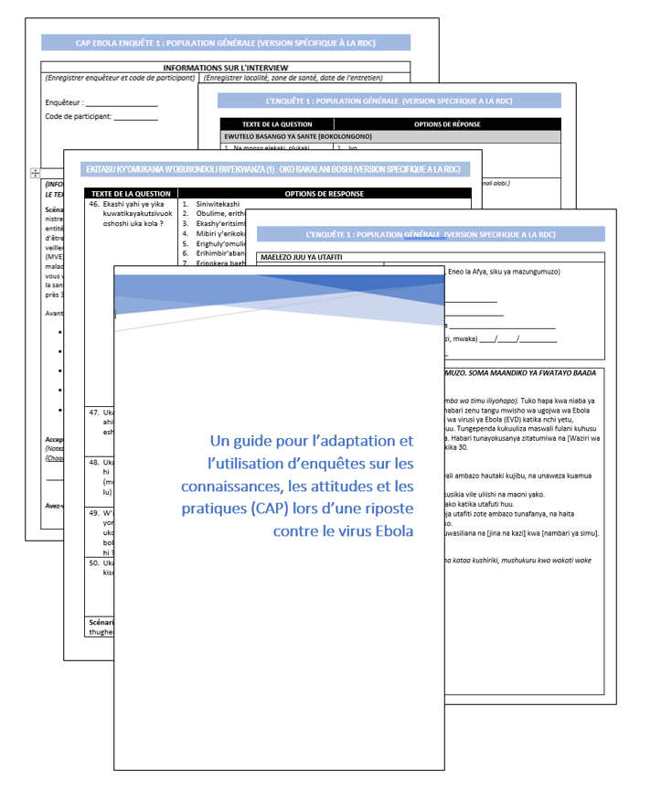
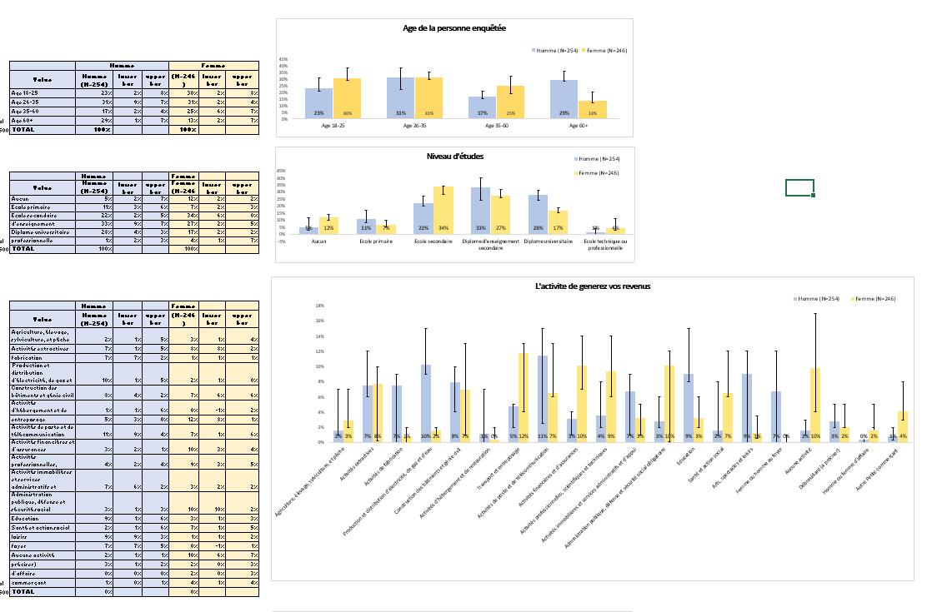
Objectives
  Successfully planning and implementing a KAP investigation during an Ebola Outbreak.
  Development and testing process of survey questionnaires.
  Personalizing your KAP survey and planning for data collection and analysis.
  Using EPI-Info for Data analysis.
Notes:
This document helps you plan and implement a KAP survey during an Ebola outbreak
Today, I will briefly review why we undertook the project to create this two community survey guide in four languages,
how we carried out the development work and how we
I will then spend more time reviewing the survey questionnaires, a guide we wrote to accompany the questionnaires, and a few other useful files for analyzing the survey data.

Slide 3
Resource Planning for a Successful KAP Survey (Section 2)
Notes:
The second objective of my TDY was to assist with the COVID 19 RCCE CARE Acts project.
In my next slide, I am going to give you a quick overview of the project:

Slide 4
Understanding the Essential Steps Prior to Initiating a KAP Study
  Resource planning
  Identify the resource requirements for the study.
  Determine the necessary resources, such as personnel, funding, and time.
  Human Resources
  Assess the personnel needed for the study.
  Consider the expertise and roles required for effective implementation.
Notes:
Human Resources-Personnel
Several people are involved in the planning and implementation of a KAP survey.
Establish a timeline for planning KAP survey activities and stakeholders for each step
Financial Resources- Financing/ Budget
budget to cover the costs of hiring and training data collectors and any items or services needed for the survey.

Slide 5
Understanding the Essential Steps Prior to Initiating a KAP Study
  Timeline for Planning Activities and Stakeholders:
  Develop a timeline outlining the activities at each stage of the study.
  Identify the stakeholders involved and their roles throughout the process.
  Financial Resources:
  Consider the financial aspects of the study.
  Develop a financing plan and budget to ensure adequate resources are available.
Notes:
Human Resources-Personnel
Several people are involved in the planning and implementation of a KAP survey.
Establish a timeline for planning KAP survey activities and stakeholders for each step
Financial Resources- Financing/ Budget
budget to cover the costs of hiring and training data collectors and any items or services needed for the survey.

Slide 6

  Human Resources: Key Personnel for a Successful KAP Study
Recruit local SBS specialists, community leaders - Project Manager
Select/adapt KAP surveys - Project manager, technical team
Identify a sample for the KAP survey Project manager, SBS specialist epidemiologist or statistician.
Translate the survey into local languages - Hire translators, possibly field coordinators and teams.
Pilot testing of the survey - Field coordinators, supervisors
Create the final version of the survey - Project manager, technical team
Electronic Data Collection Program Survey - Data Manager
Recruitment of data collectors - Project manager, technical team
Train data collectors - Project manager, field coordinators, field supervisors, data collectors.
Collect data and oversee quality control - Field coordinators, field supervisors, data collectors.
Clean up data - Data Manager
Analyze Data - Data Manager
Developing presentations - Project Manager
Share results with stakeholders - Project Manager
Steps in the preparation and implementation of a KAP survey
Notes:
Project Manager - This person is responsible for the overall success of the survey. The role of the project manager is to:
Work with collaborators (such as local researchers, community leaders, and local officials) and Ebola response officials to define the objectives of the KAP survey and ensure that the survey is adequately funded and staffed.
Plan the survey, ensuring that there are sufficient staff and time for data collection and analysis.
Share survey results with partners who can use them to take action.
Ebola response teams, local and regional government structures, and other information users - These individuals play an important role early in the process. Their role is to:
Help define the objectives of the KAP survey
Contribute to the adaptation of the instrument to the local context
Receive the results of the survey and apply them to their work in the intervention
Behavioral scientists, epidemiologists, and statisticians - These technical experts can help you review the survey questionnaires in the toolbox. Whenever possible, the survey team should have access to behavioral science and statistical experts, even if they are not part of your full-time staff.
Technical Team - Within this team, some members have several different roles. A person can fill more than one role:
Survey adaptor/designer - This person works with the project manager to make any revisions to the survey instruments (including translations into local languages), creates the strategy, identifies the sample size and type for the KAP survey, and helps recruit data collectors.
Data Manager - Once the survey is complete, this person programs the data entry software. The data manager manages the mobile data collection platform and cleans and codes the data for analysis. This person will lead the analysis of the data.
Field Coordinator - This person is responsible for training the survey data collectors, supervising the field supervisors, and supporting the survey data collectors as needed. This person also creates field files that tell the data collectors where to start their survey, what process to use to go from house to house, and how to record refusals.
Field Supervisor - Field supervisors go into the field during data collection to support the data collectors and resolve any problems that may arise. They ensure that data collectors follow protocols, particularly protocols for obtaining informed consent and asking questions as written.
Survey data collectors - These team members conduct surveys of the population. If possible, they should be recruited from the local population and speak the same language, and teams should include both men and women.

Slide 7
Establishing a Timeline for Planning KAP Surveys: A Practical Model
 | Weeks (divided into 3-day halves)
KAP Survey steps | Wk. 1 |  | Wk. 2 |  | Wk. 3 |  | Wk. 4 |  | Wk. 5
1. Recruit local social scientists, community leaders, others to collaborate on defining KAP goals and implementation - Project lead
2. Select/adapt KAP surveys - Project lead, technical team
3. Identify a KAP survey sample (size and characteristics) - Project lead, behavioral scientist, epidemiologist or statistician
4. Translate the survey into local languages - Contract translators, possibly field coordinators and team
5. Pilot test the survey - Field coordinators, supervisors
6. Create final version of the survey - Project lead, technical team
7. Program survey for electronic data collection - Data manager
8. Recruit data collectors - Project lead, technical team
9. Train data collectors - Project lead, field coordinators, field supervisors, data collectors
10. Collect the data and oversee quality control - Field coordinators, field supervisors, data collectors
11. Clean the data - Data manager
12. Analyze the data - Data manager
13. Develop presentations - Project lead
14. Share results with stakeholders - Project lead
Notes:
The following timeline shows the sequence of steps for preparing and conducting a KAP survey. Although the time required to complete each step may vary, it is important to take each step in order and not skip any. This timeline assumes that financial support for the survey has already been secured within a budget described in Section 2.3.

Slide 8
Funding and Budgeting for a KAP Study
  Allocate sufficient funds for recruiting and training interviewers, as well as for purchasing necessary materials.
  Create a budget by considering the required number of interviewers and the prevailing pay rates.
  Utilize the provided budget to effectively plan the costs associated with your KAP survey.
Notes:
Before undertaking KAP surveys, it is important to understand the time and resources that will be required and to ensure that you have an adequate budget. Using the sample timeline above and one of the sample surveys (and with funding already in place), it took about 5 weeks to complete all 14 steps.
In addition to the time spent by your regular staff adapting and using the KAP surveys we have provided, you will need a budget to pay for the recruitment and training of local KAP survey data collectors, as well as for any materials or services not provided by your agency. To develop this budget, you will need to make some calculations about the number of data collectors you will need, the prevailing wage rate for these workers, and transportation costs (and meals if they are usually provided).
Below is a basic budget sheet to help you plan for the costs associated with a KAP survey. If you need to request these funds, you should do so well in advance of undertaking the KAP survey. The table below will help you think about what should be included in a budget request for KAP survey funding.
This example uses an estimate of 600 surveys with data collected over 5 days, using 12 data collectors and two field supervisors. You will need to determine local pay rates and local food and transportation costs to develop your budget estimate.

Slide 9
Funding and budgeting for a KAP Study: Example Sample budget
 | Cost per unit |  | Number required | Cost
Field supervisors (if not already part of your staff) |  |  | 2
5 days of data collection plus 2 additional days for training and pilot testing
daily pay x 7 days | $ |  |  | $
food x 7 days | $ |  |  | $
transportation x 7 days | $ |  |  | $
 |  |  | subtotal | $
Data collectors |  |  | 12
12 data collectors [teams of 2] = 30 interviews per day [5 days of collection]
2 additional days for training (1 day) and final pilot testing (1 day)
daily pay x 7 days | $ |  |  | $
food x 7 days | $ |  |  | $
transportation x 7 days | $ |  |  | $
 |  |  | subtotal | $
Translators |  |  | 2
2 translators, 2 days [assuming the survey is no more than 35 questions, translated into two local languages; 1 day for translation, 1 day for review by native speaker]
daily pay x 2 days | $ |  |  | $
food x 2 days | $ |  |  | $
transportation x 2 days | $ |  |  | $
Office supplies, printing and photocopying of materials | $ |  | 300 | $
Or
8 data collection tablets (1 for each team, and 1 for each field supervisor) | $ |  | 8 | $
Contractors [If you have to contract for any of the work or include additional paid staff for: data collection training, field visits for planning data collection, creation of data collector field packets, and any programming of tablets or printing of surveys are done by regular staff and don't need to be contracted out.] |  |  |  | $
 |  | Budget total |  | $
Notes:
This example uses an estimate of 600 surveys with data collected over 5 days, using 12 data collectors and two field supervisors. You will need to determine local pay rates and local food and transportation costs to develop your budget estimate.

Slide 10
Establishing Survey Goals, Questionnaire Selection and Adaptation, Audience Pilot Testing, and Choosing Data Collection Method (Sections 3, 4, 5)
Notes:
The second objective of my TDY was to assist with the COVID 19 RCCE CARE Acts project.
In my next slide, I am going to give you a quick overview of the project:

Slide 11

Establish Clear Survey Objectives
Define your needs - what do you need to know?
  Clearly define the objectives of the survey.
  Identify the key areas or topics that the survey aims to explore.
  Establish specific goals and outcomes for the survey.
Notes:
In this section of the guide, we explain how to define the purpose of the survey, and then, if you need to add questions, how to create well-designed survey questions and how to test them.
It is important to define the need for your survey so that you know whether the two questionnaires provide the information you need before using them.

Slide 12
Choose and Customize KAP Survey Questionnaires
Review the two questionnaires to determine if they are appropriate
  Survey 1. Social factors that may contribute to the spread of Ebola, opportunities for community engagement for behavior change.
    Administer early in the epidemic
  Survey 2. People's experiences with the different infection control measures of the Ebola response, how experiences influence support and participation in the response.
    Administer after the Ebola response is well underway
Notes:
In this section of the guide, we explain how to define the purpose of the survey and then, if you need to add questions, how to create well-designed survey questions and how to test them.
It is important to define the need for your survey so that you know whether the two questionnaires provide the information you need before using them.

Slide 13
KAP Survey Questionnaire #1
Provides information on:
  Knowledge, beliefs and attitudes about Ebola
  How people perceive Ebola compared to other problems
  Social environment in which Ebola takes place
Useful for measuring changes in attitudes and behaviors over time
Identify trusted leaders for community engagement
Notes:
The main objective of CAP Survey #1 is to:
Provide information on knowledge, attitudes and practices related to Ebola transmission
Identify trusted leaders who participate in community engagement activities
If the survey is conducted periodically over time, it may be useful for measuring changes in attitudes and behaviors related to Ebola.
The data collected through the survey will provide information on:
knowledge, beliefs, and attitudes that contribute to the spread of Ebola
Assists in understanding the social environment and identifying needs and opportunities for community engagement.

Slide 14
Content of the KAP survey questionnaire n° 1
59 questions
Protective measures (5)
Ebola symptoms, medical care (5)
Community involvement in the response (4)
Perceptions of the response to Ebola (4)
Respondent demographics (8)
Knowledge, concern about Ebola (13)*.
Health Information Sources (4)
Confidence in health/disease information (14)
Health problems in the community (1)
Ebola transmission (1)
* The numbers in parentheses indicate the number of questions on this topic.
Notes:
The CAP 1 survey has a total of 59 questions and takes about 45 minutes to complete.
It includes a mix of multiple choice and open-ended questions.
The themes addressed in Survey 1 are as follows
Key sources of health information in the community
Does the community trust the health information it receives
What are the main health problems in the community,
knowledge and concerns about Ebola virus disease, its transmission, and protective measures.

Slide 15
KAP Survey Questionnaire #2
Respondents' experiences with the Ebola response and levels of confidence
Provides information on:
  Levels of participation in response activities
  Opinions on the response
  Community Support Opportunities
Useful for understanding the differences in support for the Ebola response among different communities.
Notes:
The CAP 2 survey focused on community interaction and response confidence.
The data collected through the survey will provide information on
What are community members' observations, experiences, and impressions of the response teams?
What is the community's support or involvement in response efforts?
Do these experiences build or break trust?
What do response teams need to do differently?
What are examples of positive experiences or unintended consequences of intervention activities?
May be useful to better understand communities with low levels of support for the epidemic response, or to understand differences in support for the Ebola response between different communities.

Slide 16
Content of the KAP survey questionnaire n° 2
65 questions
Knowledge of the epidemic and Ebola control activities (2)
Experiences with Ebola response pillars/teams:
  Ebola virus surveillance (8)
  Ebola treatment centers (8)
  Search for contacts (13)
  Vaccination (15)
  Safe and dignified burials (12)
  Respondent demographics (7)

Slide 17
Choose and Customize KAP Survey Questionnaires
Use the questionnaires as they are (still need to pilot test).
Delete or add questions
If questions are added, it is important to follow best practices for designing survey questions (Section 3.4.1).
  Introduce the question
  Formulation of the question
  Answer options: yes/no, choose from a list, free text, etc.
  Skip patterns
Notes:
You can use one or both questionnaires depending on your needs
You may not need all the questions, in which case it is best to take only the questions you really need.
On the other hand, there may be some information you need that is not included in the two questionnaires, so you can add the questions you need.
Or you may decide that the survey questionnaires provide exactly what you need, and use them as is.
Whatever your decision, it is important that you take the time to think about it so that you don't ask unnecessary questions or miss the opportunity to get all the information you need.
For more details on this topic, see section 3.4.1 of the guide, which discusses key concepts in survey design.

Slide 18
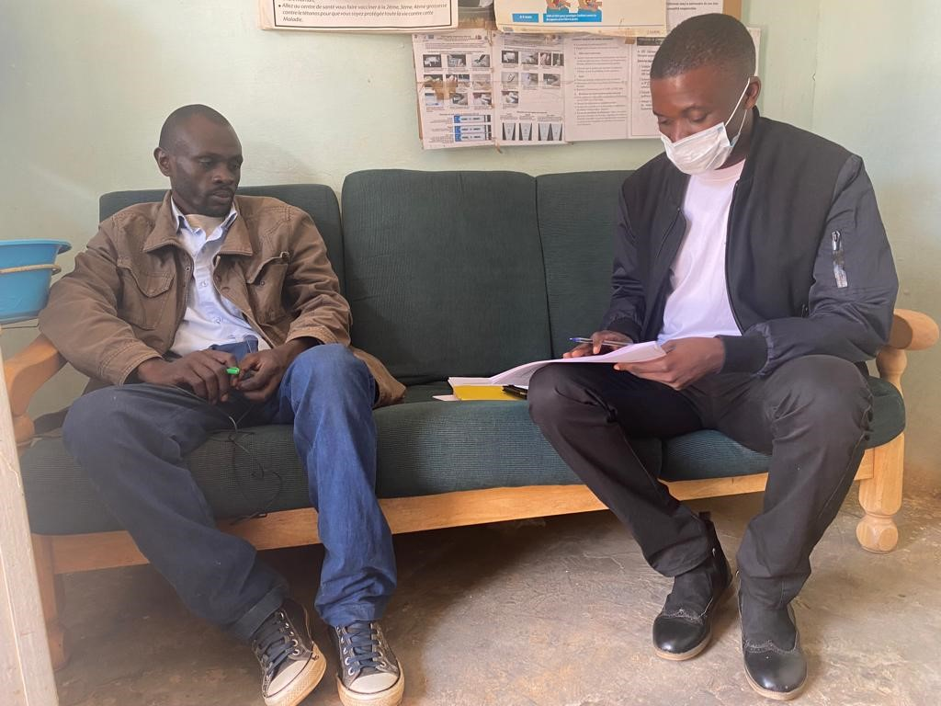
Pilot the Survey with Intended Audience
Use the respondents' native language
Pilot test: test the survey with the intended audience. Check it out:
  Any new question is well understood and easily answered.
  Important Ebola terms are understood
  Common answers are included in the answer options
  The estimated duration of the survey is precise
  The process for recording refusals is clear
The pilot tests both the clarity of the new questions, possible local variations in common responses, and the duration of data collection. Photo credit RTI.
Notes:
Here are some important points about using the KAP survey in the toolbox:
Limit survey questions to priority information needs
There is a temptation to add unnecessary information because it may be interesting. We must be respectful of people's time. Adding more questions will add fatigue and may reduce the quality of the answer.
Use survey questions written in the respondent's native language:
Survey questions should be written in a language with which respondents are most comfortable.
Test all survey questions:
The pilot tests will be an opportunity for investigators to practice using the survey, understand the time it takes, and practice recording responses.
Includes a method of follow-up when individuals refuse to participate or are not at home:
Tracking this information is important because you need it to calculate survey participation rates.

Slide 19

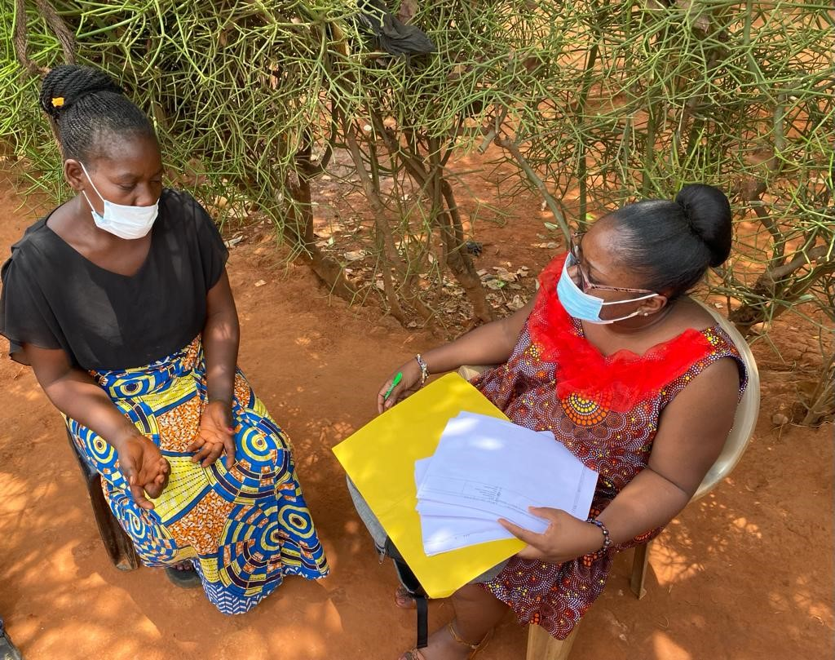
Plan for survey data collection: choose tablet or paper (section 5)
  Add Chris' photo of a person doing an interview with a tablet.
Survey data collection, tablet data collection
(Photo credit: Research Triangle Institute)
Survey data collection, paper questionnaires
(Photo credit: Research Triangle Institute)
Notes:
Data can be collected orally by an interviewer.
Data can be entered on a tablet or recorded on paper survey forms. Both methods work well. The main difference is that with the paper survey, data collectors will need to enter the survey responses into a computer afterwards. Also, with the paper-based data collection, data collectors will need to keep a list of survey refusals and people who were not home when the interview was attempted. This information will be important for
The table is then uploaded to the online program
Easy to use and faster, but requires a budget for tablets
ormation for the calculation of the participation rate.
Print these surveys, the interviewer fills them out by hand
Low cost, low security risk
It is important to keep complete forms secure until they are entered.
Need a system to record refulsals and not at home

Slide 20
Survey data collection: paper questionnaires (section 10)
Printed surveys, completed by the investigator
Low cost, low security risk
It is important to keep complete forms secure until they are entered.
Need for a refusal registration system
Once the data is collected, it must be entered into the database.
Toolbox: Excel file for formatting surveys on Kobo.org
Survey data collection, paper questionnaires
(Photo credit: Research Triangle Institute)
Notes:
You can also collect survey data using paper questionnaires. This is not a problem. You will need to check the surveys daily to ensure that the forms are completely filled out and legible.
Data can be entered on a tablet or recorded on paper survey forms. Both methods work well. The main difference is that with the paper survey, data collectors will need to enter the survey responses into a computer afterwards.
In addition, with paper-based data collection, data collectors will need to keep a list of survey refusals and people who were not home when the interview was attempted. This information will be important for calculating the participation rate.
We recommend that you enter it in KOBo. This way, you will

Slide 21

Survey Data Collection: Tablet (Section 10)
  Add Chris' photo of a person doing an interview with a tablet.
The data collector asks questions and then enters the data on a tablet.
The table is then uploaded to the online program
Relatively simple, fast
More expensive, security can be an issue
Toolbox: Excel file for formatting surveys on Kobo.org
Survey data collection, tablet data collection
(Photo credit: Research Triangle Institute)
Notes:
Data can be collected orally by an interviewer.
Data can be entered on a tablet or recorded on paper survey forms. Both methods work well. The main difference is that with the paper survey, data collectors will need to enter the survey responses into a computer afterwards. Also, with the paper-based data collection, data collectors will need to keep a list of survey refusals and people who were not home when the interview was attempted. This information will be important for calculating the participation rate.
If you are using a tablet, you will need to program it with the questions. We've made it easy for you by creating a format file for each questionnaire that can be used with the free, open-source survey program Kobo. Kobo is a survey tool created for free use by anyone, with support from the U.S. Agency for International Development. However, if you are using another survey tool, you may be able to use this format file, or you can create your own.
You must download the survey questionnaire to the tablet.
We make it easy for you by providing a survey format file for each questionnaire that can be downloaded from kobo.org, a widely used free survey tool.

Slide 22
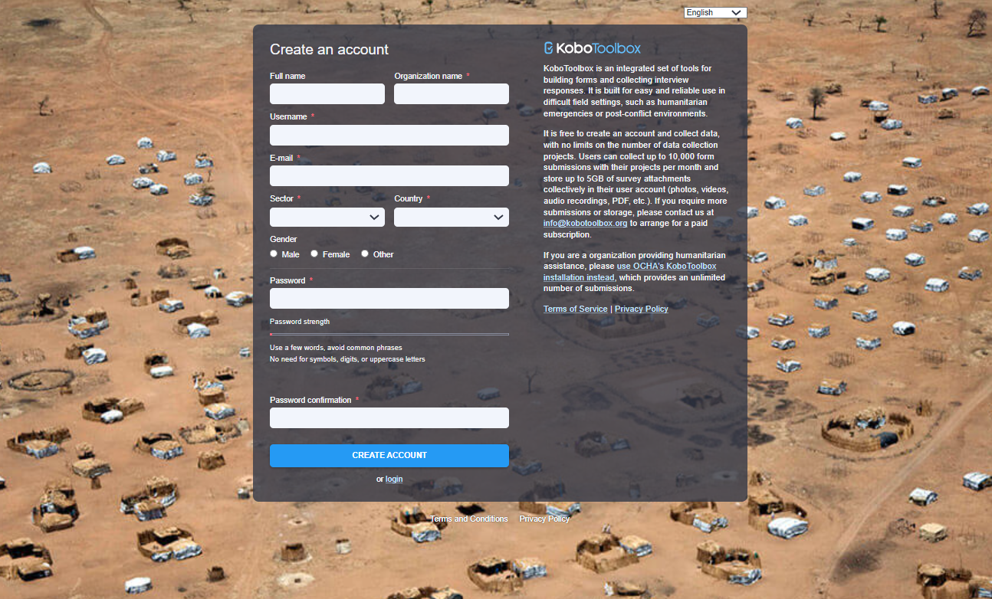
Step 1. On a computer, go to KoBo (https://www.KoBotoolbox.org/), and create an account. This account will contain your survey data.
Notes:
Whether you are using tablets to collect data or collecting data using paper forms, you will want to enter your data into a computer program for data management. KOBO.org is the free online tool we use in this guide, but you can use another program if you prefer. We do not endorse this product, it is simply an example of a freely available tool.
For teams that have been collecting data using paper forms, you will need to establish a procedure for entering the data into a computer program. Data collectors or the data supervisor can enter the data into a form that looks like the survey on a computer using KoBo.
This screen shows a screenshot of the kobo.org registration screen. Here you must register your survey. A person must create an account where the survey data will be stored.
The guide shows how to create an account, how to log in and how to activate your survey.

Slide 23
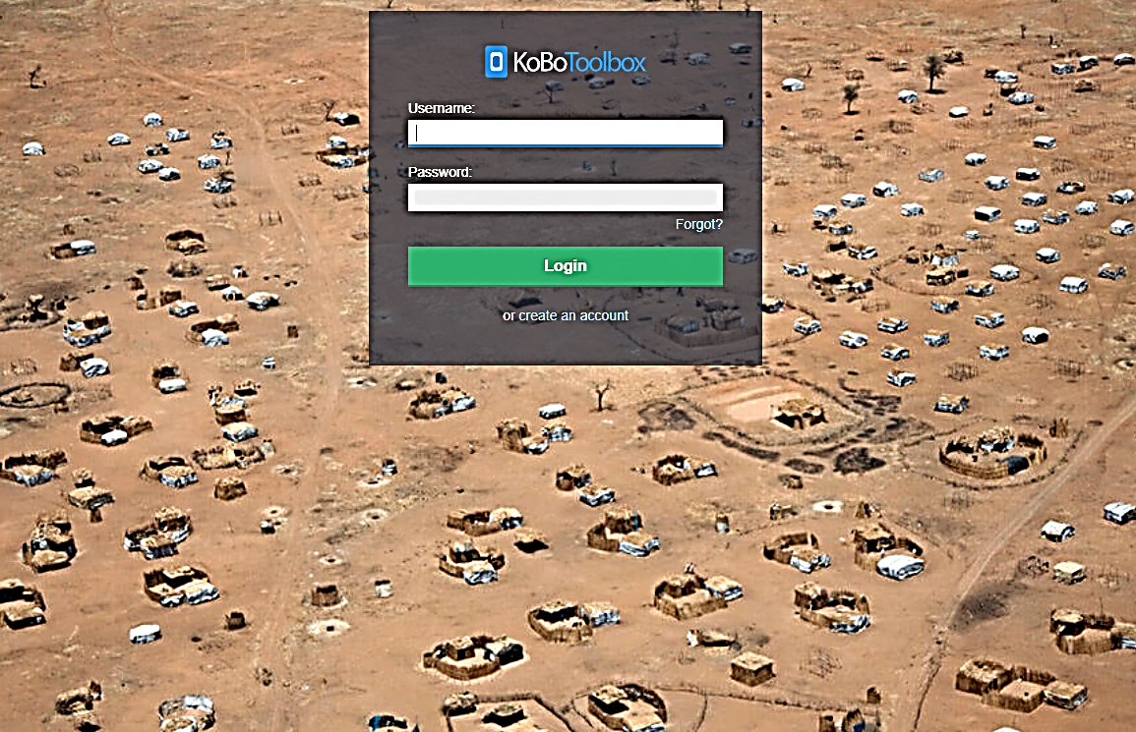
You will receive an email to activate your account.
Notes:
Click on the "New" button

Slide 24
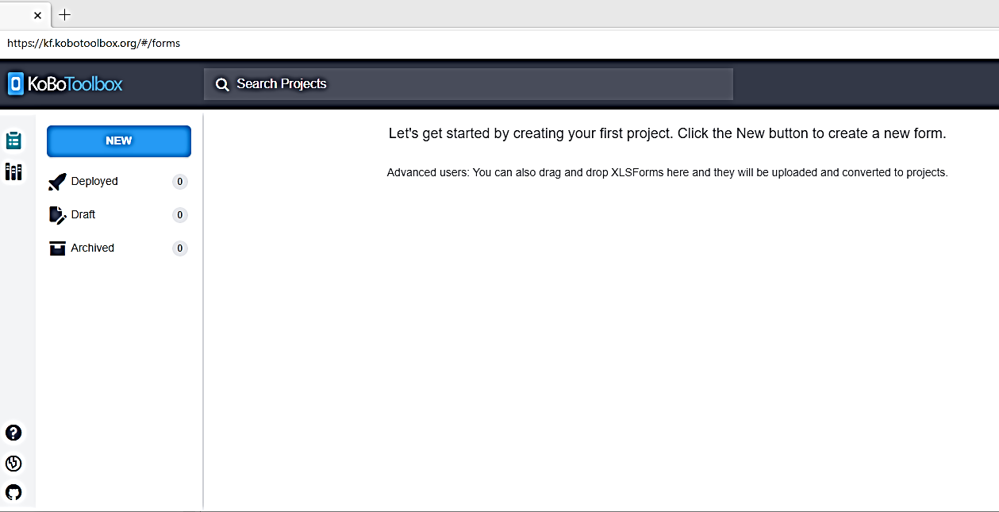
Step 2. Select "New" your screen will look like the page below
Notes:
Click on the "New" button

Slide 25
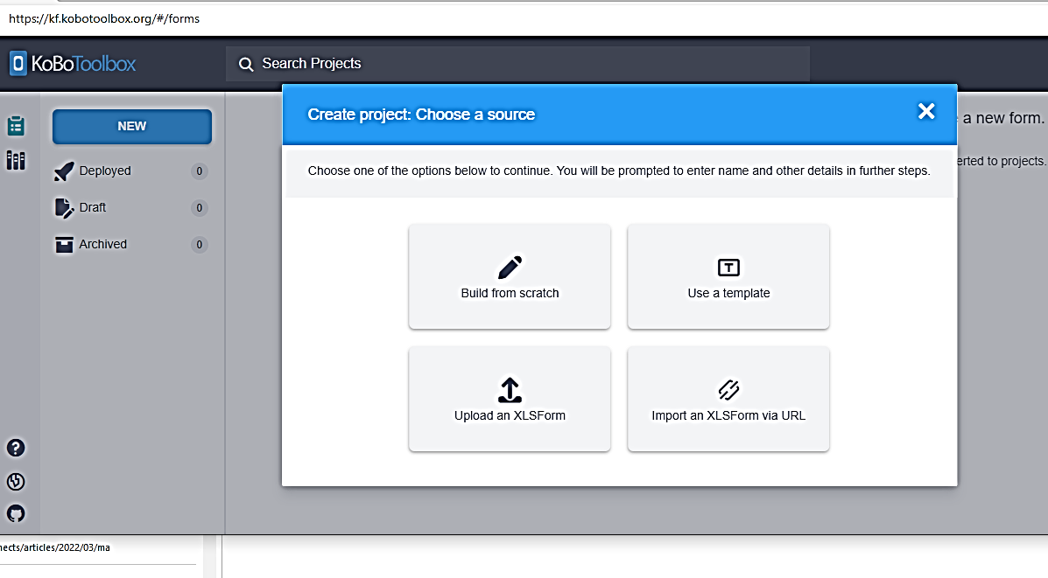
Then "Download an XLSForm".
Notes:
Click on the "New" button

Slide 26
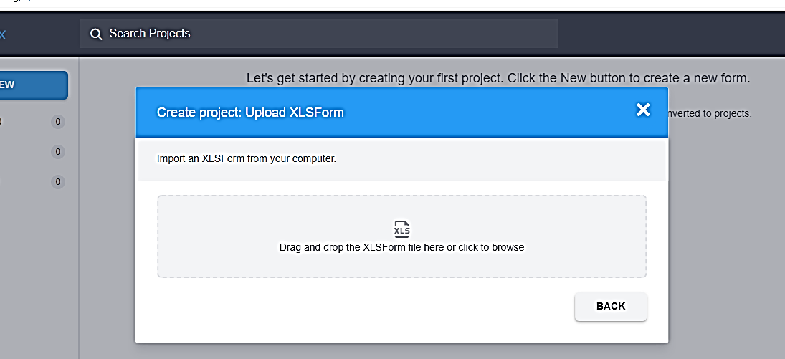
Step Three. Copy the Excel file from the toolbox that contains the KoBo format for the survey you are using (survey 1 or 2) to your desktop
Notes:
Step Three. Copy the Excel file from the Toolbox that contains the KoBo format for the survey you are using (Survey 1 or Survey 2) to your desktop. The files are named: "Survey Format File 1", and "Survey Format File 2".
When the following screen appears (below), you upload the file to the box, either by dragging it or by clicking on the XLS icon and selecting the Excel file on your desktop. This will create your electronic version of the survey questionnaire.

Slide 27
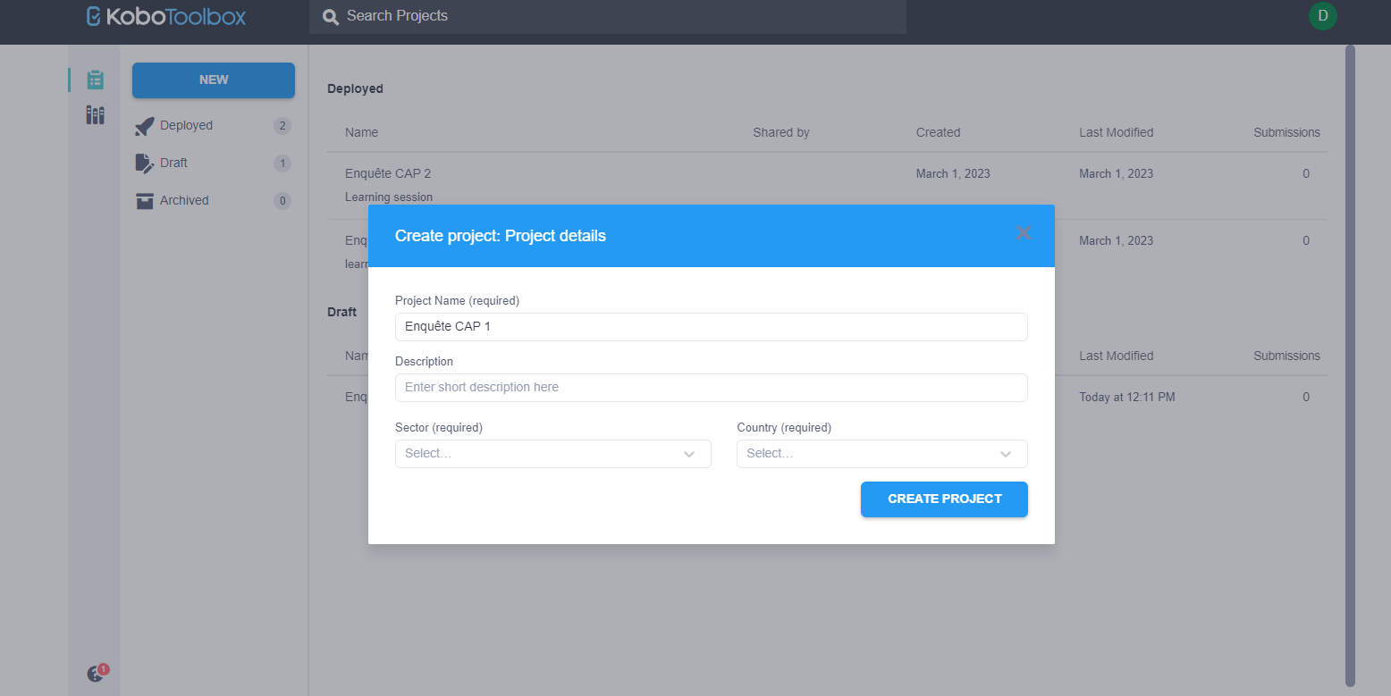
Fill in the information about your project and click "create project".
Notes:
Step Three. Copy the Excel file from the toolbox that contains the KoBo format for the survey you are using (Survey 1 or Survey 2) to your desktop. The files are named: "Survey Format File 1", and "Survey Format File 2".
When the following screen appears (below), you upload the file to the box, either by dragging it or by clicking on the XLS icon and selecting the Excel file on your desktop. This will create your electronic version of the survey questionnaire.

Slide 28
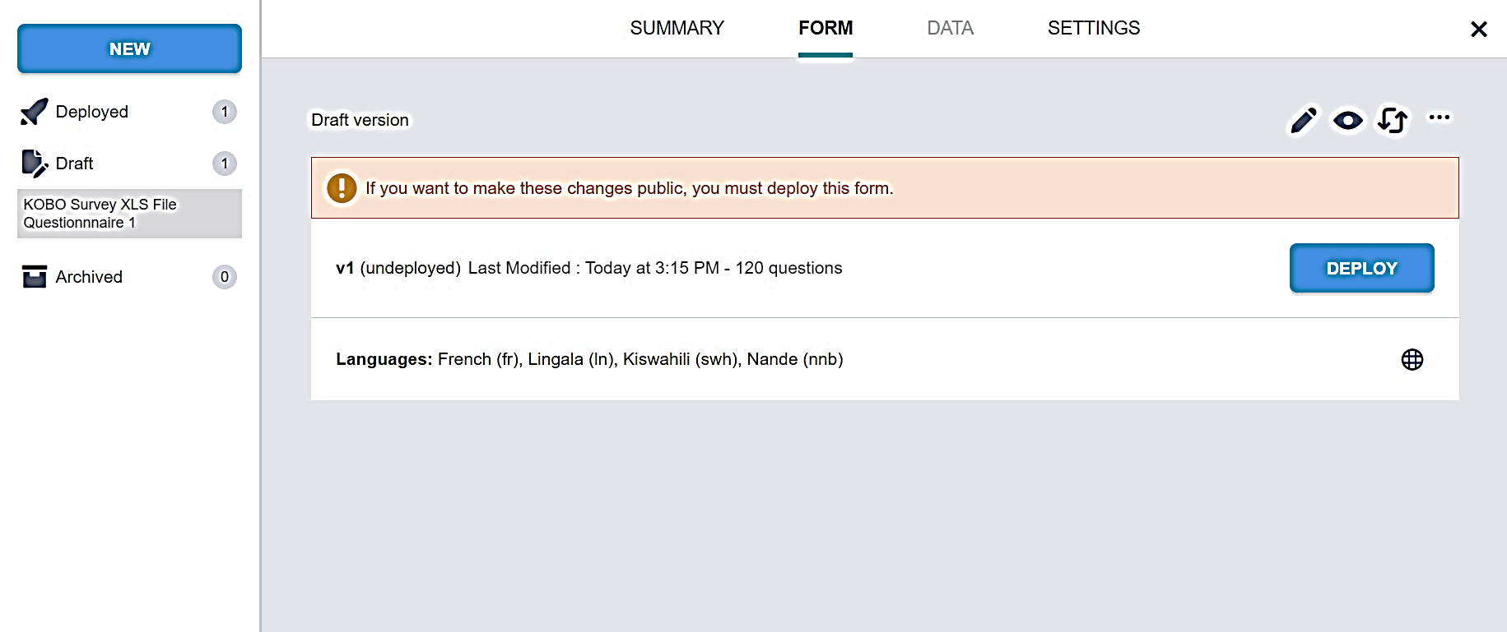
Step Four. In the upper right corner, select the eye icon, which will allow you to preview the survey
Notes:
Step 4. You will see the screen below. In the upper right corner, select the eye icon, which will allow you to preview the survey. If there are any errors in the survey formatting, you will get an error message. If this happens, you will need to change the format of the Excel file and upload it again (is there a link in the tips on how to change this file? The Excel file formats provided in the toolkit have been tested and there should be no errors.
Once you have checked the "preview" box, you will close this viewing tab by looking at the top ribbon and closing the tab by clicking the "x". You should then see this screen again.

Slide 29
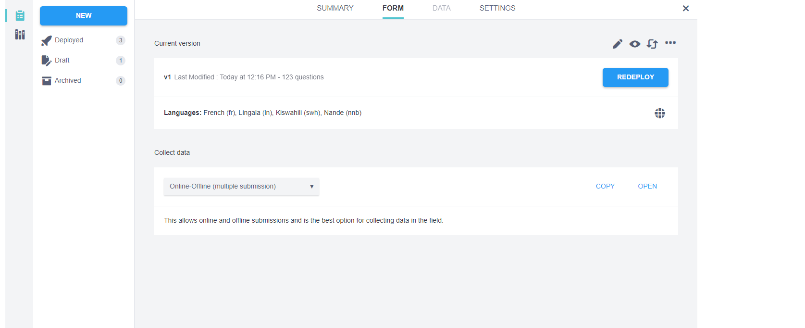
Step 5. Next, click the "deploy" button. If the survey deploys successfully, a brief message will appear at the bottom of your screen indicating that the survey has been deployed.

Slide 30
Step 6. Click the "Open" button in the lower right part of the screen to start entering data
Notes:
Step 6. In the lower right part of the screen you will see the "Open" button. If you click on it, you can start entering data into the empty dataset. If you set up this survey in KoBo to capture data from paper questionnaires, you can open the file in this way. If you want to access the dataset from a tablet or other computer, you must select the "copy" button. This will copy a link to the dataset that you can then send to anyone who wants to access your dataset. Here you will also make sure that the "online/offline" data entry option is selected, so that data collectors can use the form even when the Internet is not available. The master file will be updated as soon as the tablet is back in an area with wifi.
Note: With this method, one person will create an account for the entire team, and then the data collectors will send the data to this single account using the Internet link. Data collectors do not need to create KoBo accounts themselves.

Slide 31
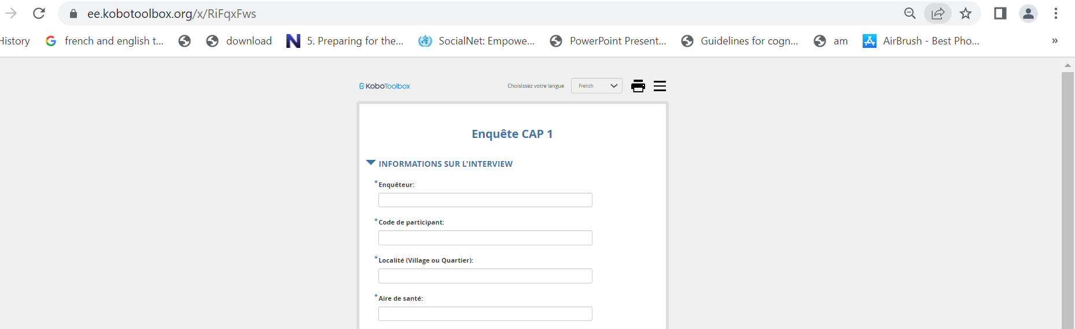
Step Seven. For a tablet, open the survey, select "bookmark" or "favorite" in your browser options. This allows you to easily open the survey if needed in the future
Notes:
NOTE: If you are using paper surveys, open this same survey to manually enter data from paper forms.

Slide 32
Participants Sampling, Data Collector Recruitment and Training, and Final Data Collection Planning (Sections 6, 7, 8, 9)
Notes:
The second objective of my TDY was to assist with the COVID 19 RCCE CARE Acts project.
In my next slide, I am going to give you a quick overview of the project:

Slide 33

Basic Sampling Concepts
Population
Notes:
Definition of some concepts :
Population
Sampling

Slide 34

Basic Sampling Concepts
Sampling
Notes:
sampling - or polling - refers to methods of selecting a subset of individuals within a population to estimate the characteristics of the whole population

Slide 35
Basic Sampling Concepts
Sampling methods
Recruit
Number
Select
Notes:
Once you have calculated the sample size for the survey, you will also need to design methods for numbering, selecting and recruiting respondents. Ideally, participant selection is done by obtaining a list of all members of the population of interest and then selecting participants at random from that list. Contact the local public health unit to obtain a list of all households in the area.
Once you have a list of all residents in the population of interest, identifying individuals to recruit for the interview is a simple matter of random selection from the list. You have several options:
You can assign a number to each individual and then use a random number generator such as this one (Stat Trek Sample Size Calculator: https://stattrek.com/survey-sampling/sample-size-calculator.aspx) to select individuals at random.
In more remote environments, you can simply put all the numbers in a bowl and select them at random.
If it is not possible to obtain or create a list of every member of the population, alternative methods such as stratified sampling (sometimes also called representative sampling) can be used.

Slide 36
Stratified random sampling
Employ alternative methods when random sampling is not feasible.
Randomly select samples at various stages of the process.
Ensure that specific characteristics of the sample align with those of the underlying population.
Notes:
When random sampling of the entire population is not possible, we can use alternative methods, such as randomly selecting villages, then neighborhoods within villages, then houses within neighborhoods, then individuals within selected households.
As long as selections are made randomly throughout the process, this is also an acceptable method for selecting respondents.
This method also allows you to ensure that certain characteristics of your sample are consistent with the underlying population

Slide 37
Sample Size Estimation (Beni SZ illustration)
 | Total N (%) | Men N (%) | Women N (%)
Population of the health zone of Beni | 260,000 (100%) | 127,400 (100%) | 132,600 (100%)
Population of the city of Beni (urban population) | 120,640 (46%) | 59,114 (46%) | 61,526 (46%)
Population of medium-sized villages | 91,978 (35%) | 32,192 (35%) | 46,909 (35%)
Small village population | 45,989 (18%) | 22,535 (18%) | 23,454 (18%)
Notes:
We estimated the numbers in the above table from four numbers obtained online:
The population of the Beni health zone: (https://www.watercharity.org/book/beni-biosand-training-democratic-republic-of-congo-2/)
Percentage of women in the total population of the DRC and percentage of children under 15 years of age: https://africa.unwomen.org/en/where-we-are/west-and-central-africa/democratic-republic-of-congo)
The population of the city of Beni, the only major urban center in the health zone: (https://www.cidrap.umn.edu/news-perspective/2018/07/news-scan-jul-31-2018#:~:text=The%20Ministry%20of%20health%20of%20the%20DRC%20has%20urged%20the%20health%20workers%20in%20Beni%2C%20which%20has%20a%20population%20of%20232%2C000.)

Slide 38

Sample size estimation
Use an online sample size estimator such as Stat Trek Sample Size Calculator to begin the estimation process (https://stattrek.com/survey-sampling/sample-size-calculator.aspx).

Slide 39
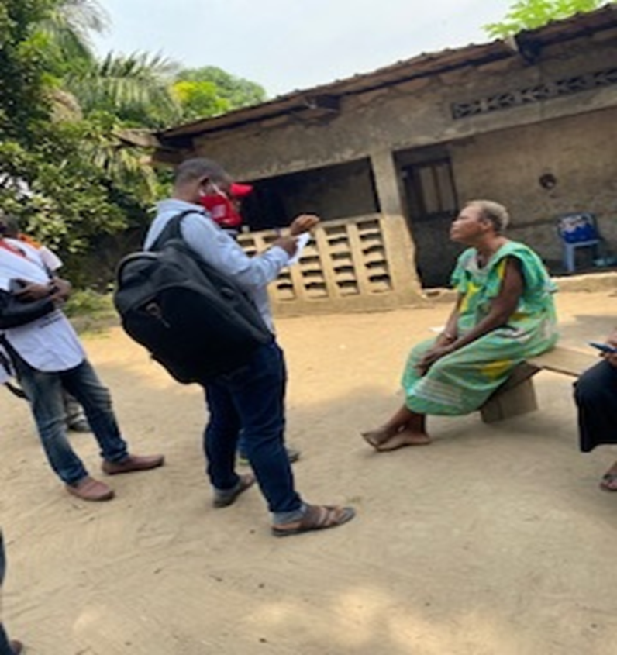
Recruitment of survey data collectors
Involve community members as data collectors.
Ensure the recruitment of a local supervisor with community knowledge.
Collaborate with local authorities to select investigators.
Data collectors Collecting Information in their Community.
(Photo credit: Centers for Disease Control and Prevention)
Notes:
The number of data collectors required will be determined by the geographic scope and sample size of the population to be surveyed. In general, you want to hire enough data collectors to travel to the community in teams of two (ideally one male and one female) and to be able to complete all surveys in about a week. The number of surveys that can be completed in a day will depend on the distance between health facilities (or other survey locations) and how often respondents refuse to participate or stop the survey midway through. If you don't have a sense of timing, you can send your team out to do a day of practice surveys, and you will see how many surveys can be completed in one day.
The data collectors are from the communities to be surveyed. They have experience conducting KAP surveys and are fluent in local languages and French;
It is important to hire a local supervisor who knows the community and has a good reputation.

Slide 40
Training of survey data collectors
Ensure that the training is conducted in a language understood by all participants.
Cover the following content during the training session:
  Clearly explain the objective of the survey.
  Discuss the respondent selection protocol.
  Describe the informed consent process.
  Review the survey questions in detail.
  Provide guidance on processing and recording refusals.
  Emphasize effective interpersonal communication techniques.
  Highlight the importance of avoiding bias when asking questions.
  Address data backup and transmission procedures.
  Incorporate role-playing games for practical learning.
  Conduct field tests to assess survey implementation.
Notes:
The following section reviews each of the training components, and provides instructions on what should be presented and discussed.

Slide 41
Training of survey data collectors: Clearly explain the objective of the survey
Understand the purpose of the survey and how the results will be used.
Familiarize with the sampling protocol employed.
Understand the process for selecting households and interviewees.
Notes:
It is essential that all team members understand why the KAP survey is being undertaken and how the results will be used to assist in Ebola responses. Data collectors will be better able to deal with unexpected situations if they understand why they are conducting the survey. Data collectors also need to understand the purpose so they can explain it to respondents.
Survey data collectors must understand the sampling protocol. All data collectors must have written and verbal guidance on how households are selected and who to interview. These documents should be developed and provided by the field supervisor. If the protocol calls for alternating interviews with men and women, this should be discussed and planned for if a man or woman is not present when it is his or her turn to be invited to participate.
Understand why the KAP survey is being undertaken and how the results will be used

Slide 42

Training Survey Data Collectors: Describing the Informed
Consent Process
    Ensure investigators fully comprehend the content and purpose of the introductory script for the survey.
    Clearly communicate the purpose of the survey and its expected duration.
    Emphasize the importance of maintaining confidentiality throughout the investigation.
Notes:
Data collectors should be shown the introductory survey script, which they can read to quickly explain the purpose of the survey, its duration, its confidentiality, and the fact that respondents can refuse to participate, refuse to answer any question, and end the survey at any time without any negative consequences.

Slide 43
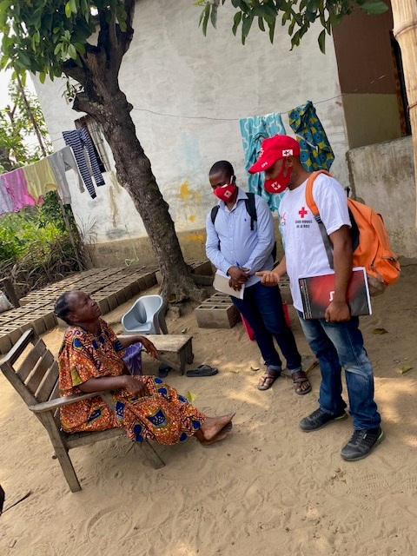
Training Survey Data Collectors in Interpersonal Communication
Introduce yourself by stating your name and agency.
Communicate the survey objectives and assure. participants of the confidentiality of their responses.
Provide an opportunity for respondents to ask questions.
Seek verbal consent from participants.
Conduct the interview following the informed consent process.
Data Collectors Introducing Themselves to a Community Member. (Photo credit: Centers for Disease Control and Prevention)
Notes:
Data collectors should be aware that good communication with respondents is essential to avoid biases that could affect the survey results. Data collectors should seek to build trust by being polite, respectful, and patient. Before beginning an interview, they should
Introduce yourself by indicating your name and agency
Present the objectives of the survey and assure participants that their responses will be anonymous and confidential
Allow the respondent to ask questions
Obtain verbal consent from the participant and record it on the questionnaire.
Conducting the interview
In addition, data collectors should be aware that respondents may respond differently to questions depending on whether they are surrounded by others who are listening to their responses. Every effort should be made to allow the respondent to complete the survey in private.

Slide 44
Familiarize Interviewers with Questionnaires and Ensure Data Transmission Security
Familiarize Interviewers with Questionnaires and Ensure Data Transmission Security
Familiarize Interviewers with Questionnaires and Ensure Data Transmission Security
Familiarize Interviewers with Questionnaires and Ensure Data Transmission Security
Familiarize Data Collectors with Questionnaires and Ensure Data Transmission Security
Ensure interviewers understand the survey questions and how to ask them.
Conduct survey data collection using paper questionnaires.
  Verify that all questions on the questionnaire are answered.
  Submit the completed questionnaires to the supervisor at the end of the day.
Conduct survey data collection using tablet.
  Allow interviewers to practice recording and submitting data.
Notes:
Make sure that the interviewers understand all the questions and that they should be asked in the order they are written.
the data collector should have the opportunity to practice submitting records using the tablet.

Slide 45
Daily Data Collection Planning
Key Elements to Consider:
  Number of Surveys per Day:
    Determine the feasible number of surveys based on field setting and survey duration.
  Geographic Proximity:
    Assign interviews based on geographic proximity to optimize efficiency.
  Team Relocation:
    Maximize supervision opportunities by strategically relocating teams.
  Familiarity with the Area:
    Consider the familiarity of each team with the investigation area for effective data collection.
Notes:
To plan for daily data collection, a schedule must be developed for each team. Here are some things to consider when planning:
The number of surveys that can realistically be conducted in one day given the field context (distance, accessibility, availability of transportation) and the duration of the survey.
Assignment of interviews based on geographic proximity
Moving the team to maximize supervision opportunities
The familiarity of each team with the area to be surveyed (it is imperative to send data collectors who know the communities and speak the local language).

Slide 46
Example of a General Population Data Collection Plan
Team | Health zone | Village | Interviews (men) | Interviews (women)
Team 1 (person A, person B) | Katwa | Kihumulire | 4 | 4
Team 1 | Katwa | Matanda | 3 | 3
Team 2 (person C, person D) | Butembo | Bwinyole | 5 | 5
Etc... | Etc... | Etc... | Etc... | Etc...
Notes:
Official censuses and lists of health facilities may not be up-to-date. If it is discovered in the field that a house in the sample no longer exists, data collectors will be instructed to survey one of the relief houses that have been selected for this purpose.

Slide 47
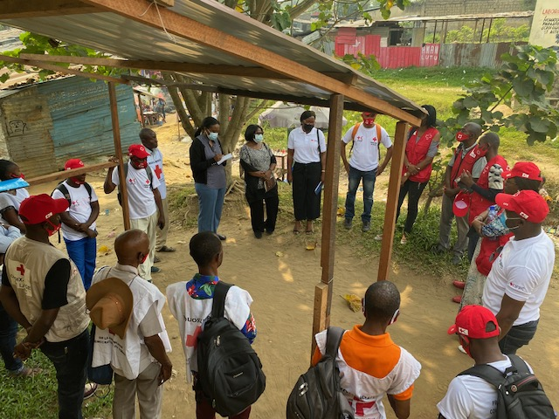
Estimating the Required Number of Data Collectors for a Survey
Determine the number of investigators based on the geographic extent and the number of units to be visited.
Assess the accessibility of households to ensure efficient data collection within the available time.
Plan to deploy data collectors in teams of two or more to enhance effectiveness and support collaboration.
Pre-Deployment Meeting with Data Collectors (Photo credit: Centers for Disease Control and Prevention)
Notes:
Depends on the geographical extent and the number of units to be visited
Consider the accessibility of households to determine the number of data collectors needed to complete the data collection in the allotted time.
Plan to send data collectors in teams of two or more.
When assigning teams, it is a good idea to put a more experienced interviewer with a less experienced one.

Slide 48
Data Collection Materials for Survey (Tablets or Paper Surveys)
A written plan provided by the supervisor for data collection, regardless of using tablets or paper surveys.
  The plan includes instructions on survey areas, home selection, and respondent criteria.
Provide a designated space on the survey list to record visited locations and survey completion status.
Note refusals for paper surveys, while tablets allow for noting refusals at the beginning of the survey.
Include a logbook for recording refusals with paper surveys.
Notes:
Data collectors will follow a written plan given to them by their supervisor that will indicate the areas to be surveyed and provide specific instructions on how to select households to be surveyed and who to survey in each household
Planning for data collection should take into account the security situation. Before conducting the pilot test or survey data collection, check the security situation with local health authorities and identify safe areas for data collection.
It is also very important to meet with local political leaders at the city, village, or neighborhood level, both to gain their support for data collection and to receive information about the local security situation.
Security will also be enhanced by hiring local data collectors who know the community and are known to it.

Slide 49
Data Collection Materials for Survey (Tablets or Paper Surveys) (Cont.)
The data collection plan should specify the daily target number of interviews and provide instructions for handling forms or tablets at the end of each day.
Consider reporting the daily number of completed surveys to ensure timely completion within the allocated time.
Store the forms and tablets securely at the project office to safeguard completed survey data.
Maintain the completed survey data in a safe and well-organized manner.
Notes:
Data collectors will follow a written plan given to them by their supervisor that will indicate the areas to be surveyed and provide specific instructions on how to select households to be surveyed and who to survey in each household
Planning for data collection should take into account the security situation. Before conducting the pilot test or survey data collection, check the security situation with local health authorities and identify safe areas for data collection.
It is also very important to meet with local political leaders at the city, village, or neighborhood level, both to gain their support for data collection and to receive information about the local security situation.
Security will also be enhanced by hiring local data collectors who know the community and are known to it.

Slide 50
Data Collection Supervision
A team of field supervisors:
  Provide daily supervision and support to data collectors.
  Assist in case of difficulties.
  Communicate with the field coordinator regarding significant changes or concerns.
  The field coordinator:
  Supervises the supervisors.
  Provides information including team names, contact numbers, and the daily data collection plan.
  Offers support to field supervisors or data collectors in case of major problems.
Notes:
Data collection must be supervised by a team of field supervisors. They are essential to ensure the quality of the data. Their role is to:
Provide daily supervision of survey data collectors. Supervisors observe the administration of a survey for each team on a daily basis to provide feedback and an opportunity for them to ask questions. They must also review the surveys or tablet data at the end of each day for completeness and legibility.
Be available when difficulties arise. If a team member encounters difficulties in the field, the supervisor is available to find solutions.
Contact the field coordinator if there are any significant changes or concerns. The Field Coordinator will develop a daily plan to observe and support each data collection team at least once during data collection. It is important to be in the field at all times and to rotate between teams to provide as much support as possible.

Slide 51
Data Download, Cleaning, and Analysis (Sections 10, 11, 12, 13)
Notes:
The second objective of my TDY was to assist with the COVID 19 RCCE CARE Acts project.
In my next slide, I am going to give you a quick overview of the project:

Slide 52
Data Entry, Download, and Verification
Ensure the data is stored in KoBo or another survey database.
Follow these steps for data entry and analysis:
  Download the data into an Excel spreadsheet (sections 11.1, 11.2).
  Review the data to identify and correct any problems or download errors (section 11.3).
  Load the cleaned spreadsheet into the data analysis program, such as Epi Info (section 11.4).
    Epi Info data analysis program (11.4)
    Other data program of your choice (R, SPSS, SAS)
Notes:
Whether you have collected data manually or online, you will always go through the same next step: uploading your data into an Excel spreadsheet.
I won't go into detail about all the steps involved in downloading and cleaning the data, but here is a brief overview, with references to the sections in the guide.
These steps will be the same whether you collected the data using tablets or paper forms.

Slide 53
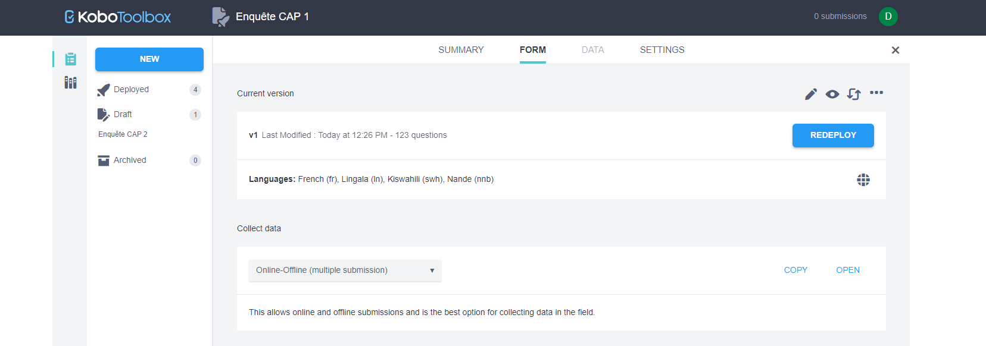
Entering Questionnaire Data in KoBo: Logging In and Survey Selection
Notes:
If you collected the survey data by entering the data directly on a tablet or computer, you can skip this section and go directly to Section 11.2.
If you collected survey data by recording responses on paper questionnaires, you will need to enter the data from the paper forms into the KoBo survey form to use the cleaning and analysis tools.
If you have not yet created an electronic dataset for your survey data, go to section 5.1 above, Creating Your Online Survey Form, and follow the instructions to create a KoBo account, and download the Excel sheet from Survey Toolbox #1 or #2 to create an online version of your survey. Once created, you will be able to open the survey and manually enter your responses into the data set.
We recommend that you try this process with a few records until you have a system that works for you before entering a large number of records.

Slide 54
Select "FORM" at the top of the screen then "OPEN" at the bottom right of the screen after the last question,
Notes:
Login to your account
select the survey you have deployed
then select "FORM at the top of the screen
then "OPEN" at the bottom right of the screen After the last question, you will have the choice between two buttons, "save" and "submit". You can save if you don't have an internet connection or if it is not good

Slide 55
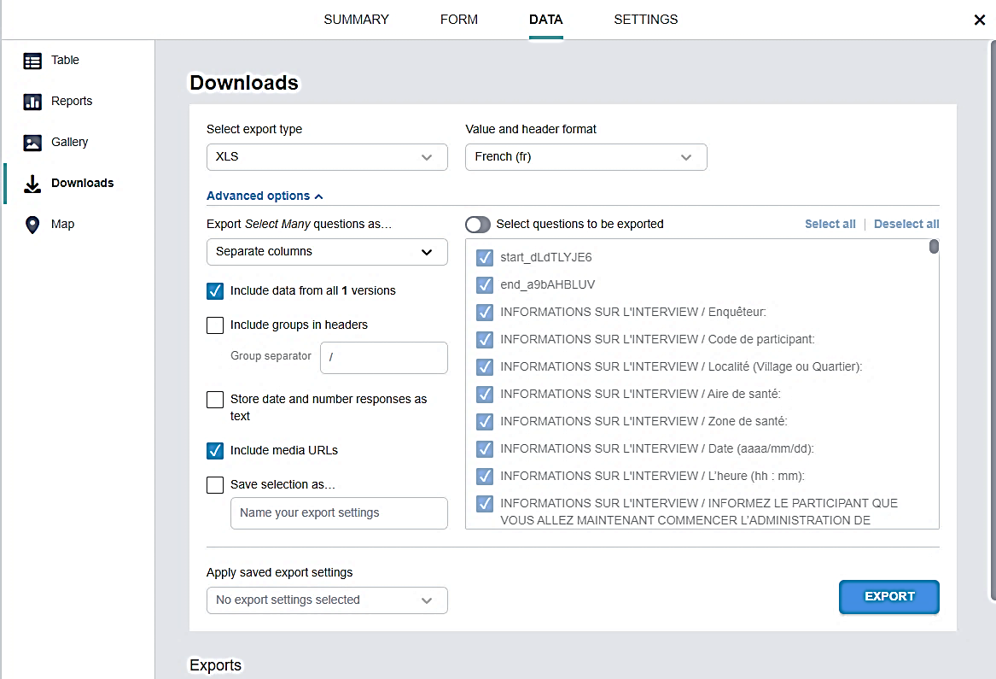
Download Data from KoBo
Notes:
Step 1: In KoBo's data viewer, select the "DATA" tab at the top, then the "Downloads" button on the left side. Then select the following options (see image below):
Export type: "XLS".
Value and header format: "Français (fr)" (This is the default format).
Click on "Advanced Options", then under "Export multiple questions as...", choose "Separate columns":
Then select "Export". A line will appear at the bottom of your screen (you may have to scroll to see it).
At the far right of the line, select the "Download" button. Save this file as "Survey Data".

Slide 56
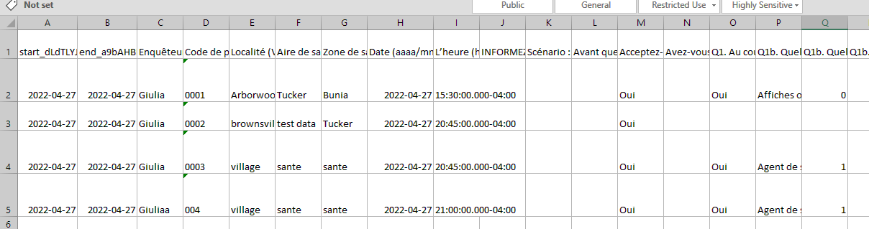
Unsuitability of KoBo Data Import for Statistical Analysis due to Free Text Columns and Lengthy Variable Names
Notes:
The way the data is imported from KoBo is not suitable for analysis in statistical analysis software, because it includes all the free text sections of the survey as individual columns, and the variable names are too long. The following image is an example of what you will see:

Slide 57
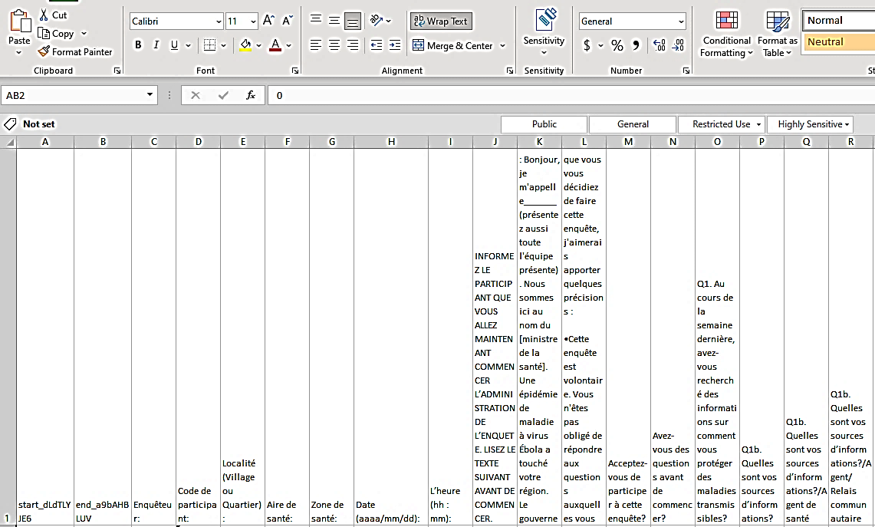
Use the "wrap text" option in KoBo to view the full text of each question in row 1 of the dataset.

Slide 58
Clean the data from unnecessary columns
Uploaded a descriptive text in your survey in a separate column in your dataset.
Review your dataset and remove these columns
CAP 1
  Delete the following columns to clean up your dataset
    Columns J-L
    DR column
    Column IQ
    LG column
    LO-LP column
    LU column
    MI-MR columns
Notes:
Uploaded descriptive text to your survey (for example, explanatory text to be read aloud to the participant), this will be uploaded to a separate column in your dataset. Review your dataset and delete these columns

Slide 59
Clean data from unnecessary columns
CAP 2
  Delete the following columns to clean up your dataset
  Columns J-L
  Column Q
  AT column
  BI column
  DC column
  Column FH
  Column GW
  IA column
  JD column
  JR-KC Columns
Notes:
Uploaded descriptive text to your survey (for example, explanatory text to be read aloud to the participant), this will be uploaded to a separate column in your dataset. Review your dataset and delete these columns

Slide 60
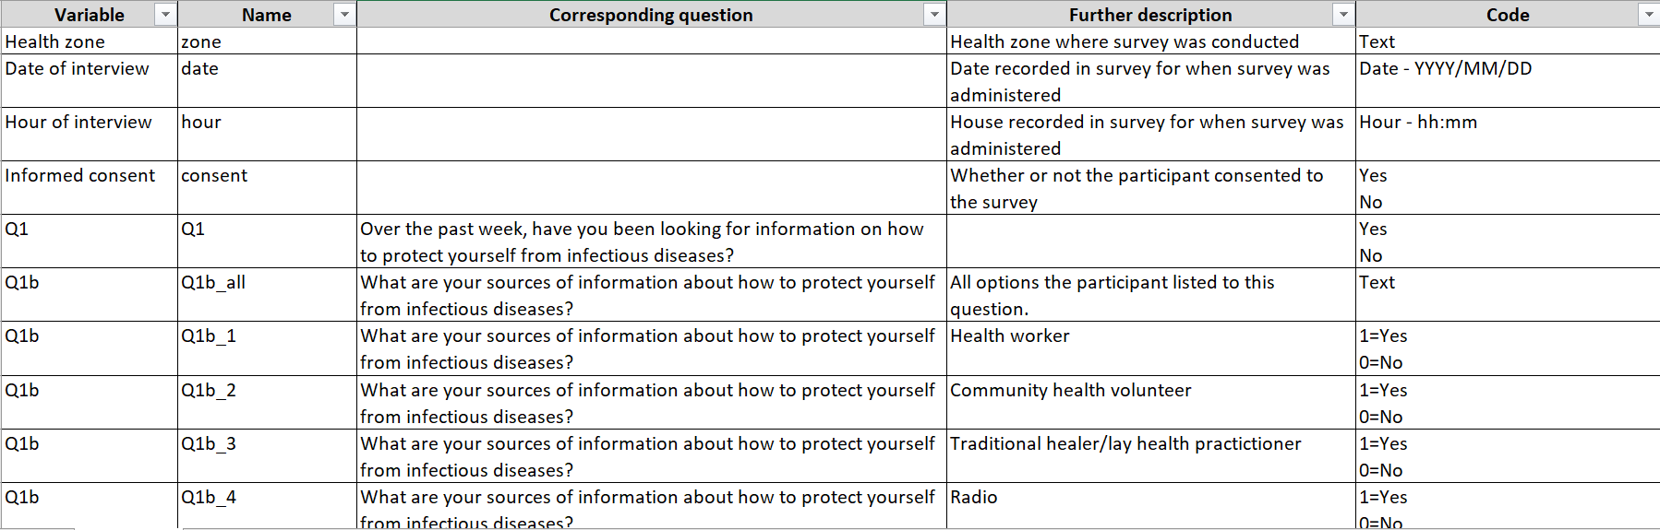
Step 3. Create the codebook
Notes:
Once you have eliminated all unnecessary columns from the data set, you need to create a codebook, or a file that documents what each variable in your data set represents. Two codebooks have been provided to you - "Survey 1 codebook.xlsx" and "Survey 2 codebook.xlsx". If you are using the original surveys without modification, you can use them as your codebook. If you have made changes to the survey, you will need to either modify the codebooks provided or create your own using them as an example.
Your codebook will serve as a guide to understanding your data set. It should include the following: Variable, Variable Name, Variable Description, and Code used to provide information about the variable. When naming variables, the names should be relatively short and intuitive. In addition, the name should not include any special characters (e.g., &, !, $, #, @, etc.), it should not include spaces, and it should not begin with a number.

Slide 61
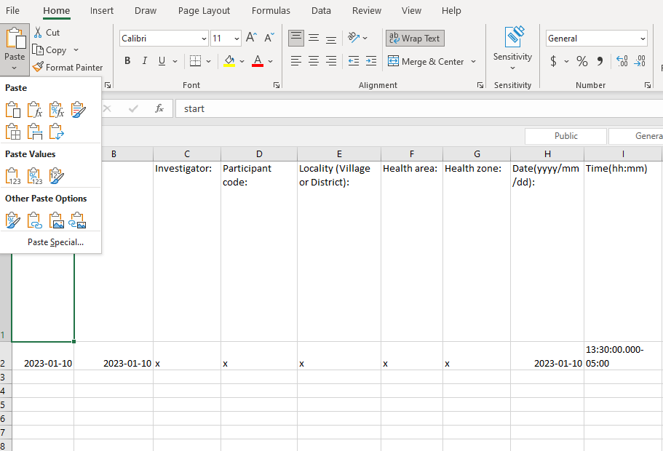
Step 4. Rename the Variables in the Dataset
Notes:
Once you have removed all the descriptive text columns from your data set and have a codebook with the new names to assign to the variables in the data set, you can proceed to rename all the variables in your data set. You can do this in statistical software or directly in Excel. For this example, we will do it directly in Excel.
If you have deleted all the columns that are not included in your codebook and generated a codebook with all the variable names in the same order as the survey was administered, you can use the following method to quickly change all the variable names. You need to highlight all the variable names in your codebook in the column labeled "Name" (Column B), right-click and select "Copy". From there, open your data set, click on the first variable name listed in Row 1, Column A. Go to the upper left corner of the ribbon where the "Paste" icon is located. Click on the small arrow below it and select the icon with the two arrows to transpose the column to your row of variable names in your data set (see the circled icon below). Once this selection is made, all variable names should be replaced with the new variables. It is very important to verify that the variables have been copied correctly and that the variable names match the correct columns.

Slide 62
Step 5. Verify the Accuracy of the Data Entry
Paper questionnaires :
  Ensure that the data set is complete
  Ensure that there are no completely duplicate records in the data set.
  Ensure that each record has an identification number
  Ensure that there are no unexpected missing data
  Correct, remove or isolate errors and missing data cells
Notes:
Once you have removed all the descriptive text columns from your data set and have a codebook with the new names to assign to the variables in the data set, you can proceed to rename all the variables in your data set. You can do this in statistical software or directly in Excel. For this example, we will do it directly in Excel.
If you have deleted all the columns that are not included in your codebook and generated a codebook with all the variable names in the same order as the survey was administered, you can use the following method to quickly change all the variable names. You need to highlight all the variable names in your codebook in the column labeled "Name" (Column B), right-click and select "Copy". From there, open your data set, click on the first variable name listed in Row 1, Column A. Go to the upper left corner of the ribbon where the "Paste" icon is located. Click on the small arrow below it and select the icon with the two arrows to transpose the column to your row of variable names in your data set (see the circled icon below). Once this selection is made, all variable names should be replaced with the new variables. It is very important to verify that the variables have been copied correctly and that the variable names match the correct columns.

Slide 63
Data Analysis and Reporting
Split dataset
Install and open Epi Info
Run the programs provided with this guide
Additional Information - Run your dataset manually

Slide 64
Split Dataset
Split the data set in two
EPI Info cannot process data sets with more than 255 variables
Before deleting variables, be sure to make two copies of the data set
Notes:
Once your dataset has been cleaned and a codebook has been created, you can import it into any statistical analysis software for data analysis. Although KoBo has the ability to display survey results stratified by gender, we recommend that you use a data analysis application, such as R, SAS, EpiInfo, SPSS, or another program to produce frequency tables and 95% confidence intervals. If you do not have access to any type of data analysis software, frequencies can be tabulated manually in Excel, but this is time consuming and we do not recommend using this process. In this guide, we will provide a program for a sample of data to be analyzed in Epi Info, as well as tips on how to analyze your data using this software.
If you decide to use EpiInfo, you will need to divide the data set from Survey 1 and Survey 2 into two parts. This is because EpiInfo can only analyze a maximum of 255 variables, and the surveys contain more than 255 variables.
Split the data set in two
EPI Info cannot process data sets with more than 255 variables
Ensure that both parts contain the first 11 variables (survey data collection information), the gender of the participant and the weighting variables (if applicable)
Before deleting variables, be sure to make two copies of the data set

Slide 65
Survey 1
Divide Survey 1 into two data sets.
  The first data set will include the first 11 variables and questions 1-22b.
  The second data set will include the first 11 variables and questions 22c through 50.
Notes:
The first data set will include the first 11 variables (Columns A-K), questions 1-22b (Columns L-FM), and question 44 (Column LO). Delete all other variables. Save this data set with "_1" at the end of the name as an .xls file.
The second data set will include the first 11 variables (columns A-K) and questions 22c through 50 (columns FN-LZ). Delete all other variables. Save this data set with "_2" at the end of the name as an .xls file.

Slide 66
Survey 2
Divide Survey 2 into two data sets
  The first data set will include the first 11 variables, questions 1-29 and question 53 .
  The second data set will include the first 11 variables and questions 30-59.

Slide 67
Splitting of a Modified Data Set
Count the number of variables in your cleaned dataset
Split your dataset into two datasets with less than 255 variables
Each data set should include the first 11 variables of your data set
Split your data set in two
Make sure that the gender variable is included in both data sets.
Notes:
Each dataset should include the survey start and end time, investigator name, participant code, locality, health region, health zone, survey date, survey time, survey consent, and all participant questions (the first 11 variables in your dataset)

Slide 68
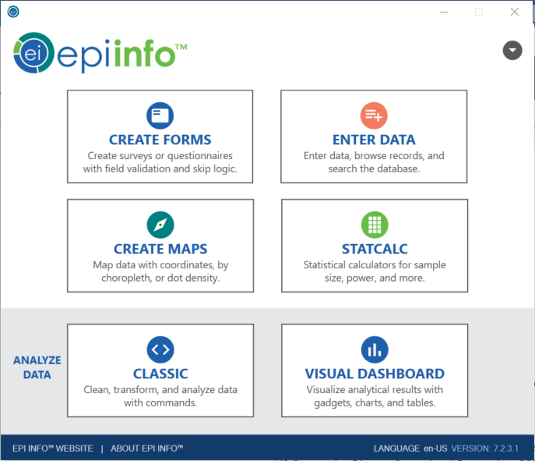
Install Epi Info by following the instructions provided in this link: Windows | Epi Info™ | CDC. Open the classic view for data analysis.

Slide 69
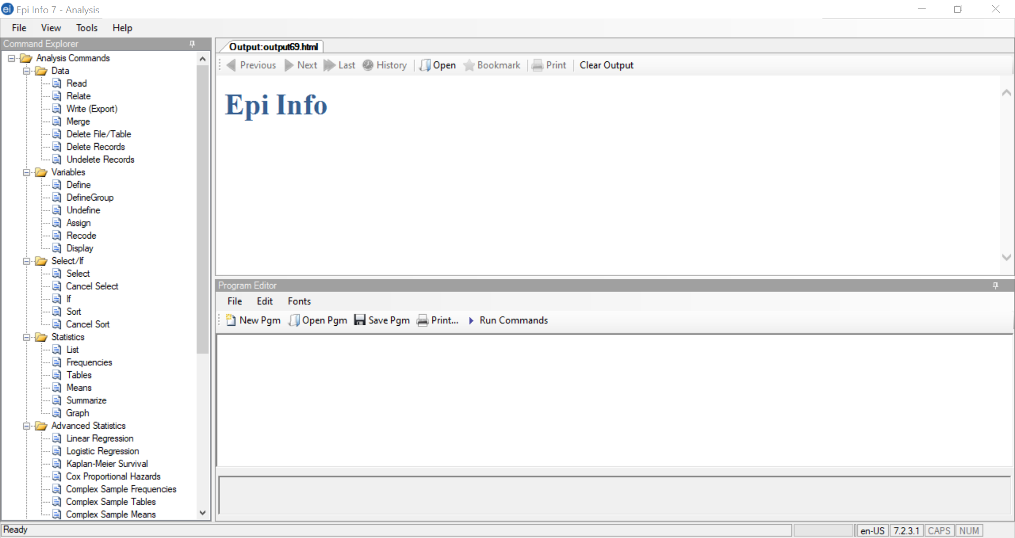
In "Classic Analysis" mode, in the program editor click on "Open Pgm".
Notes:
To open the program in Epi Info
you must be in "Classic Analysis" mode on
Then, in the program editor, you will click on "Open Pgm".

Slide 70
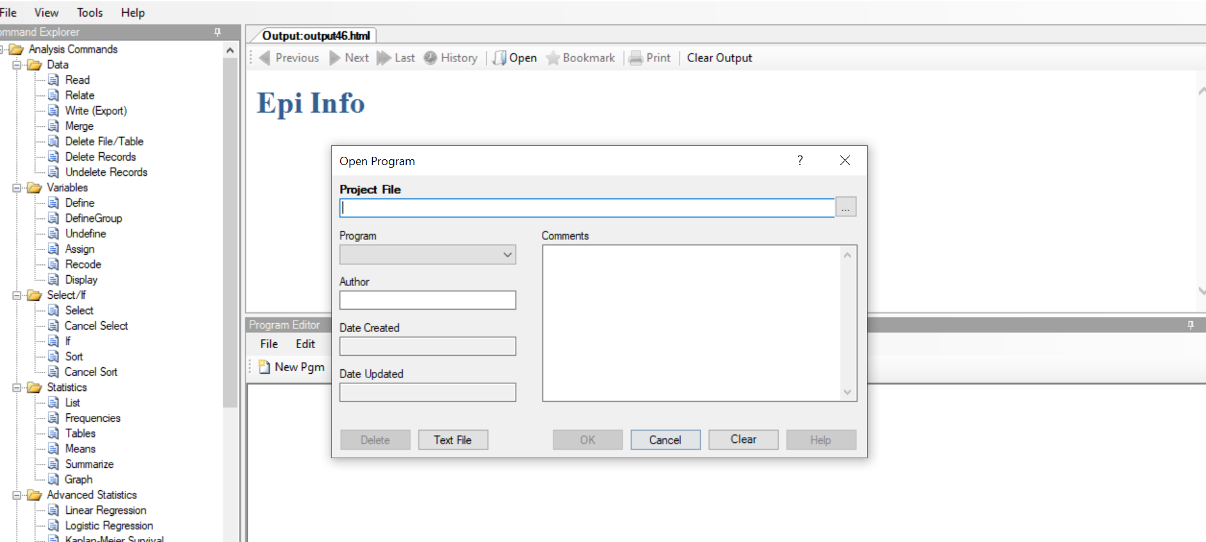
A window will open, click on "Text File" in the lower left corner, which will open the file finder. select the program where you saved it
Notes:
Next, a window will open in which you will be asked to select the program file. Click on "Text File" in the lower left corner, which will open the file finder
From here you can select the program wherever you have saved it
you can click OK and it will open the program code, and the script should be in the bottom "Program Editor" box.

Slide 71
Adjust the first line of the program script so that Epi Info reads the correct file path for where your data set is stored on your computer
For example, the first line of code in Survey Code 1_Q1-Q22.pgm7 reads as follows: READ {C:\Users\toj0\Desktop\Data\testset1_s1_1.xls}:[CAP Survey 1 - English incl###$]
  Change the path to the file (highlighted in red)
  This will take you to the location where the data set for questions 1-22 of Survey 1 is saved.
  If you have changed the name of the Excel sheet in your dataset, replace the text highlighted in brown with the new sheet name.

Slide 72
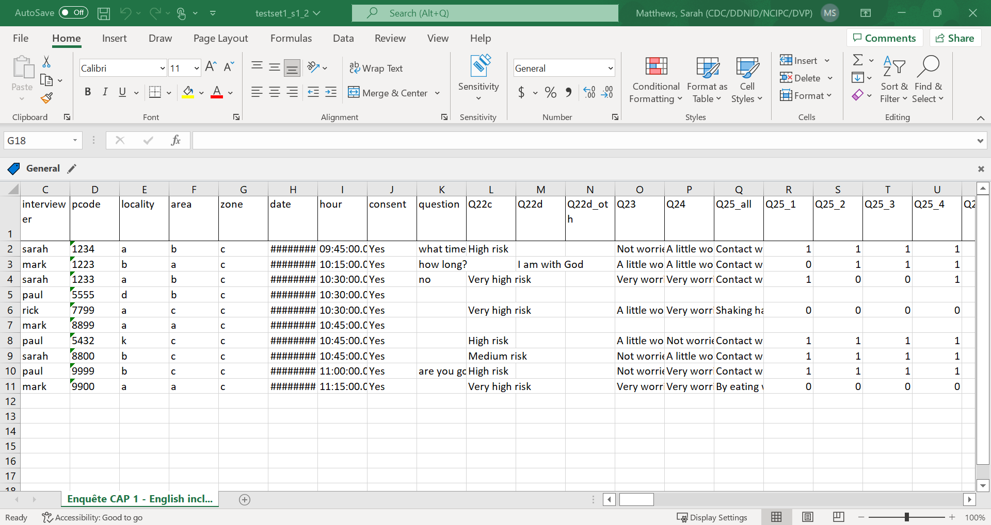
How to find and replace the file path?
Notes:
The file path is where your dataset is saved. To get the file path written for your dataset, open the dataset in Excel.
Make sure it is the correct dataset for the correct .pgm7 file. Once you have opened your dataset, go to the upper left corner of the screen and click on "File" (see below).

Slide 73
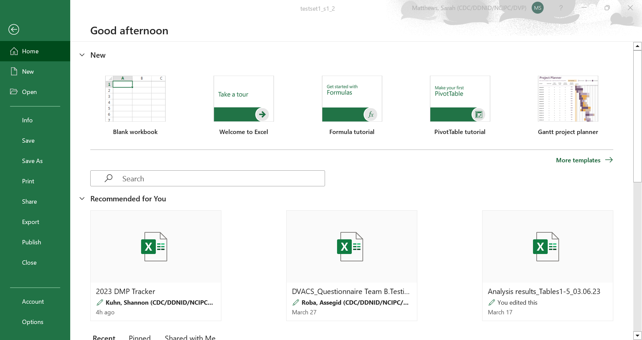
The screen below appears. Click on " Info ".

Slide 74
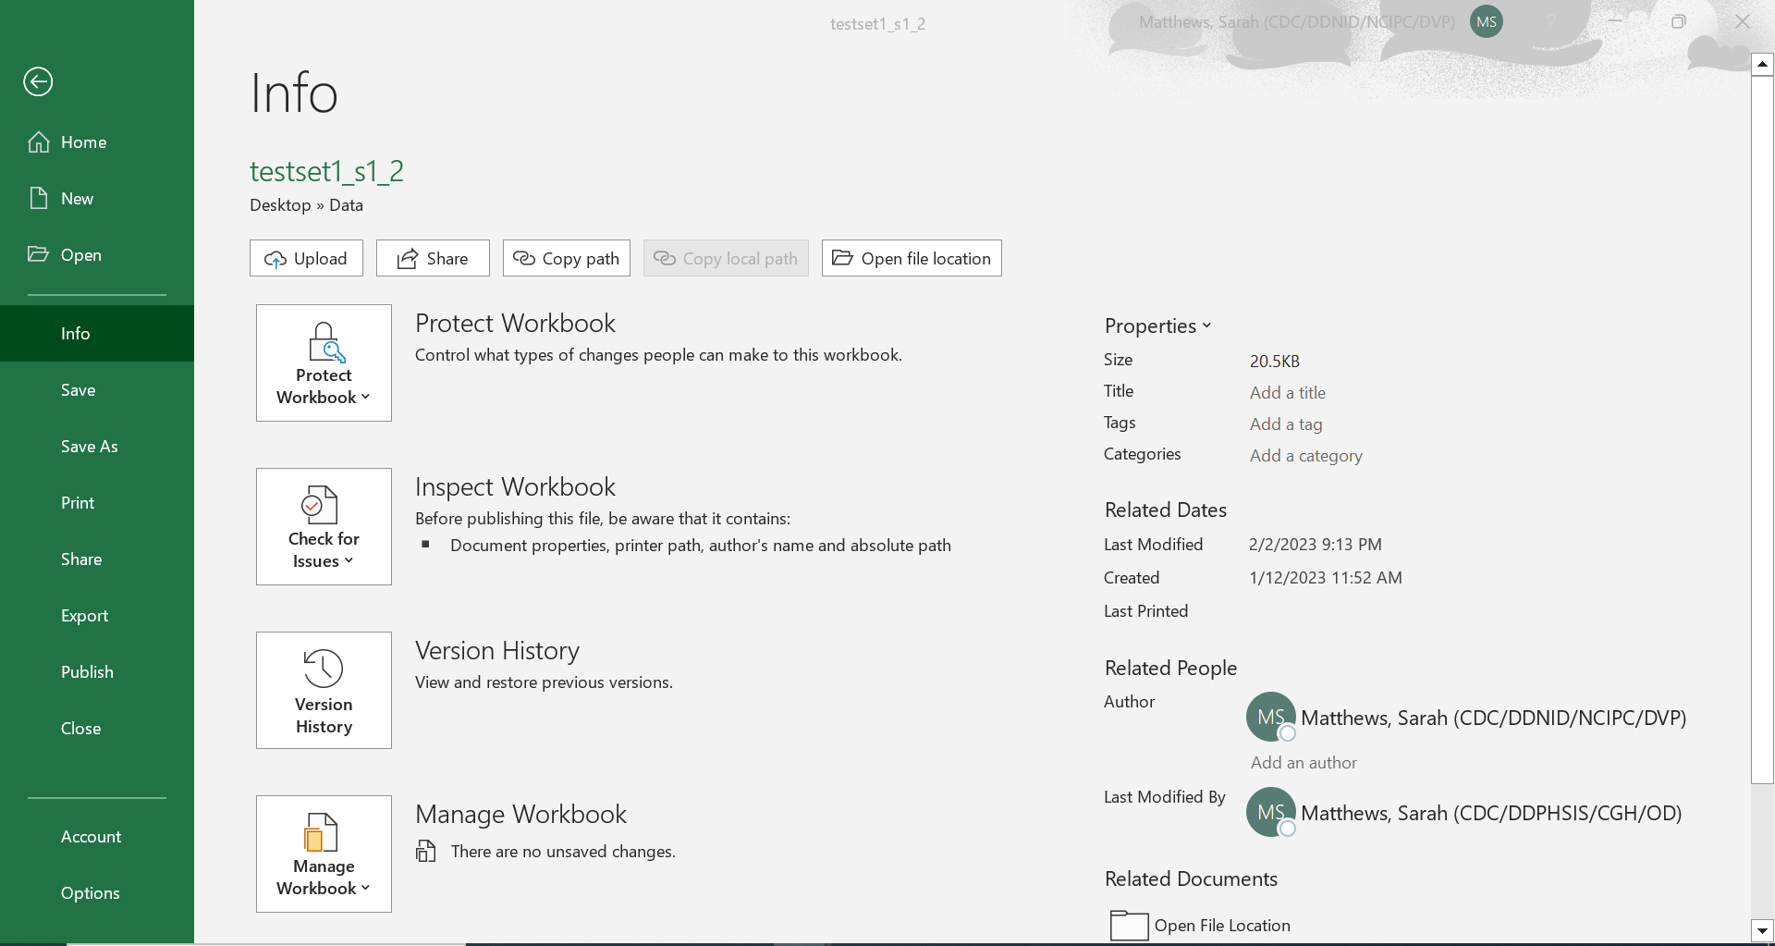
You will then see the following screen. Click on the "Copy Path" button
Notes:
Once you have copied the file path, return to your .pgm7 file. The first line in this file will be the read statement. You will erase the file path that is in the first set of brackets (highlighted in red) and paste the new file path into your .pgm7 file. EpiInfo will include quotation marks around this - make sure to delete the quotation marks around the file path before running the commands.
READ {C:\Users\toj0\Desktop\Data\testset1_s1_1.xls}:[CAP Survey 1 - English incl###$]

Slide 75

How to find and replace the name of the sheet?
Notes:
The name of the sheet is the next piece of information you will need to read in your dataset. To find your sheet name, open your dataset and look at the sheet name (see below).
Enter this name exactly as it is written in the second set of parentheses in your read instruction (see the purple text below).
READ {C:\Users\toj0\Desktop\Data\testset1_s1_1.xls} : [CAP 1 Survey - English incl####$]
Once you have finished modifying your read instruction, be sure to close your dataset before executing the commands.

Slide 76
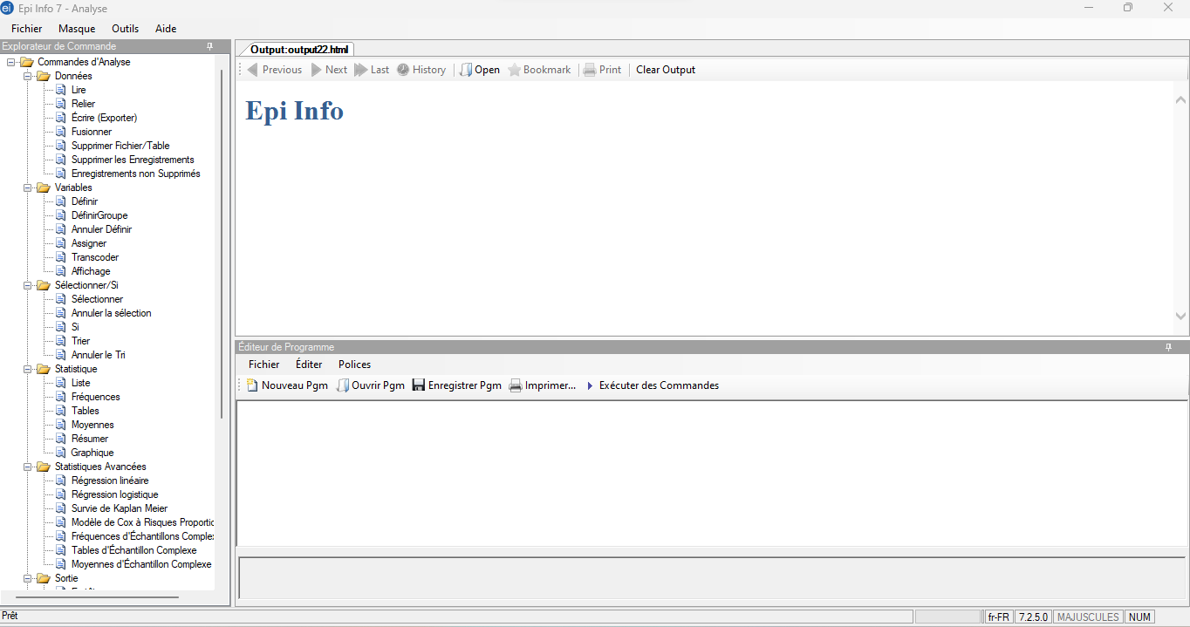
Running the program
you have to click on the button "Execute commands" in the program editor
This will run a frequency of each survey question in your dataset in numerical order, excluding the first 11 variables (these are only survey description variables, not survey responses).

Slide 77
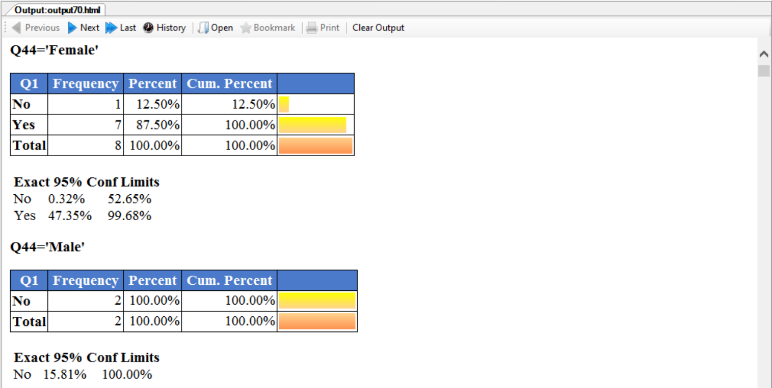
For questions with only one answer option: Epi info will provide the frequencies for each option of the question in a table along with the %.
Notes:
For questions where the participant can only choose one option, Epi Info will produce two tables: one for women and one for men.
It will provide the frequencies for each option in the question in the table and the percentage of female or male participants who chose that option.
Below the table, Epi Info shows the 95% confidence intervals for the frequencies and percentages in the table. See the example output from question 1 below:

Slide 78
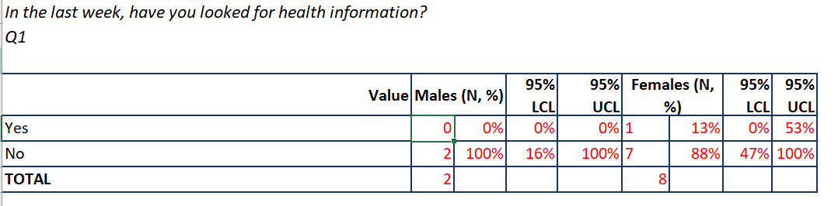
This table shows how to enter information into Epi Info.
Notes:
For this table, you can interpret that all male participants (2) chose "No" for this question. Among women, 1 chose "Yes" (13%) and 7 chose "No" (88%).
In this example, you would enter this data in the table on the far left of the sheet below Q1, where the data is highlighted in red.

Slide 79
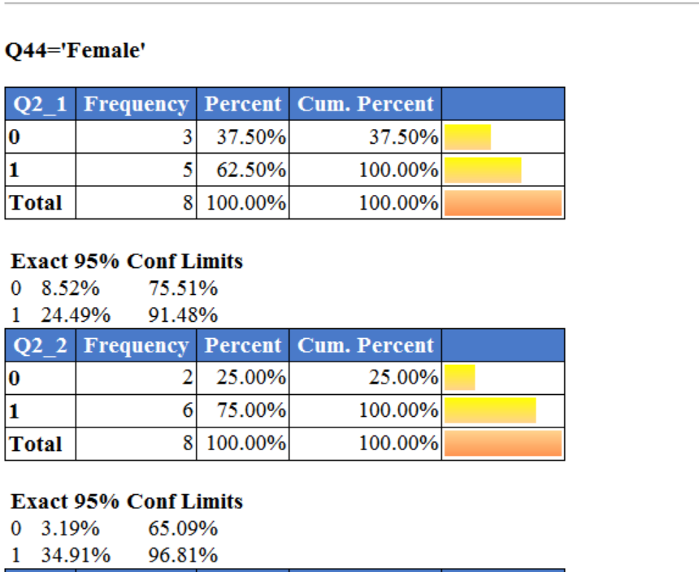
For questions with multiple answer options, each option in that question is displayed as an individual question
Notes:
To complete the survey results template for question Q2 "What are your general sources of information?" you will need to display the results for each response option (Q2_1 through Q2_20). Using the provided script, Epi Info will display the results for Q2_1 through Q2_20 for women first, and then the results for men. Here is an example of the results for women:
Each frequency will be the percentage of respondents who chose that option among all respondents who answered that question

Slide 80
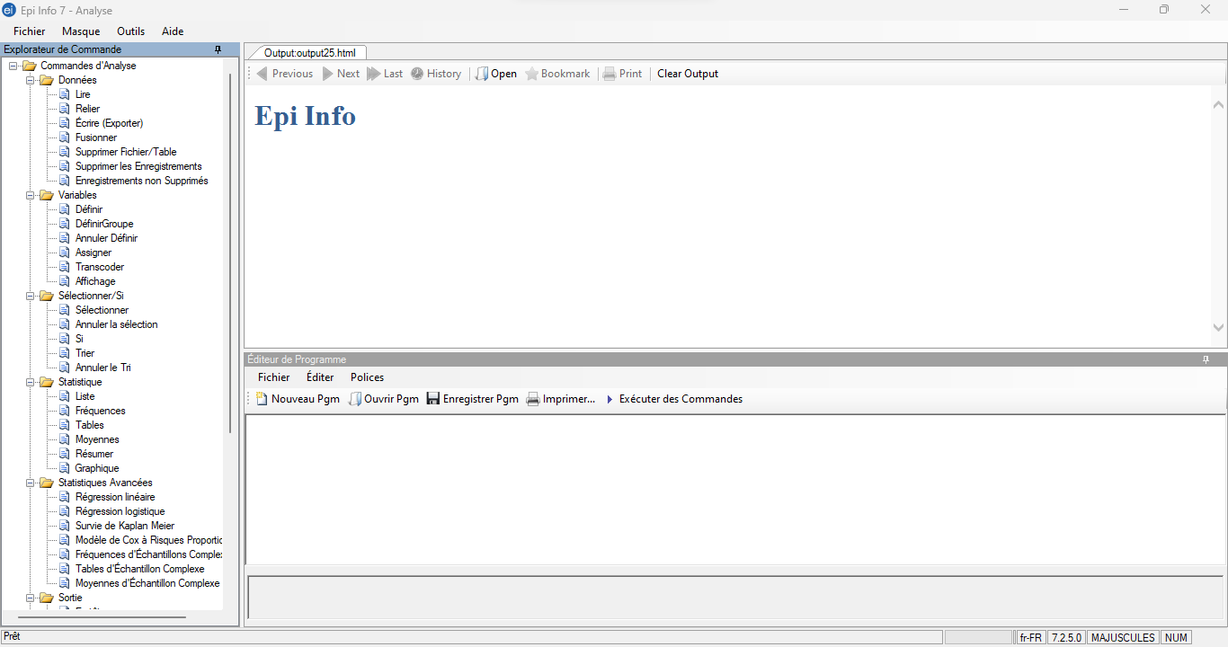
How to import data into Epi Info? :
1. Click on "Read" under the "Data" folder.
Notes:
To read your dataset in EpiInfo, go to the Command Explorer on the left side of the screen and click on "Read" under the "Data" folder.
Select your dataset type. If you used Microsoft Excel to create your dataset, click on the "(.xls)" option.

Slide 81
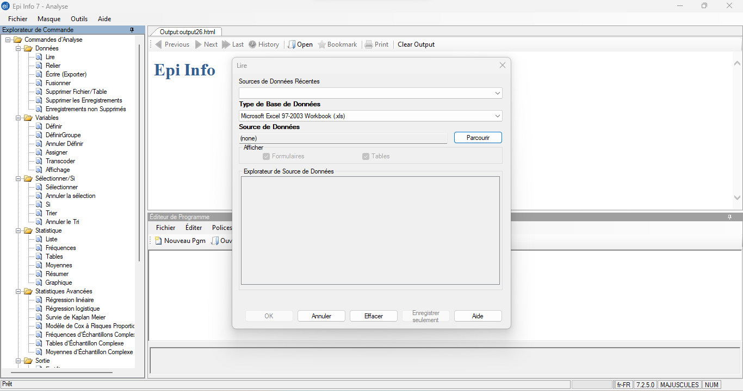
How do I import data into Epi Info?
2. Select your dataset type
Notes:
Select your dataset type. If you used Microsoft Excel to create your dataset, click on the "(.xls)" option.

Slide 82
How do I import data into Epi Info?
3. Select "Browse", and this will open another window
Notes:
From there, you will select "Browse", and it will open another window.

Slide 83
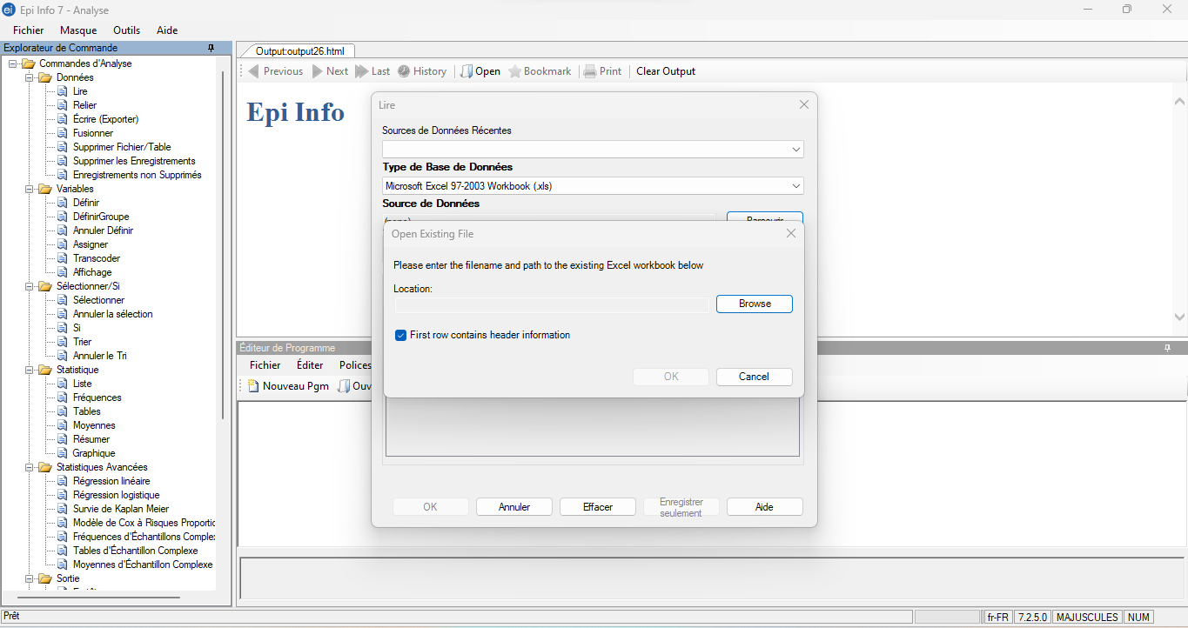
4. Then select "Browse" in this window and it will open the file storage of your computer
Notes:
Navigate to the location where you saved your data sets.

Slide 84
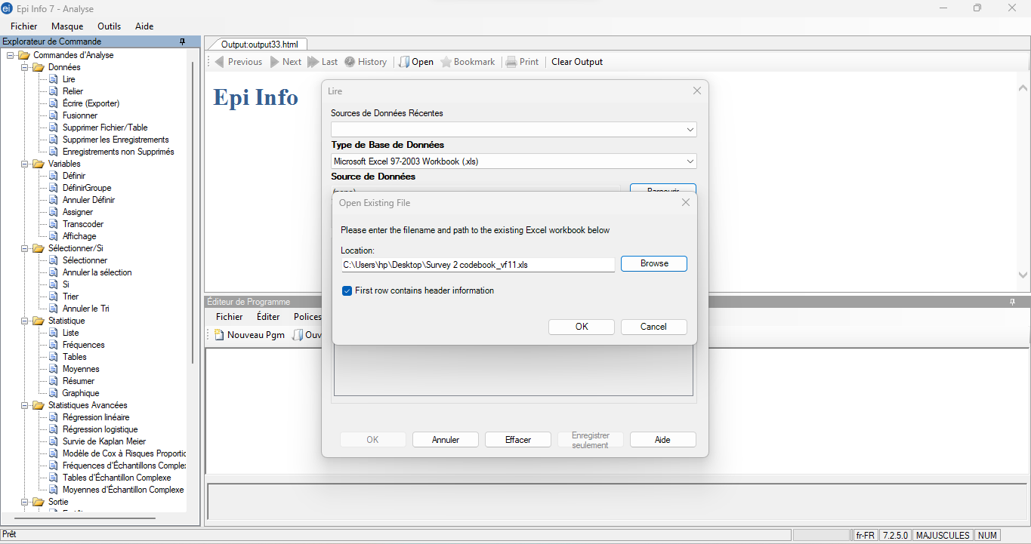
Notes:
To begin, click on your first data set (labeled _1). This will bring you back to your initial reading window, where you will select the dataset in the Data Source Explorer.

Slide 85
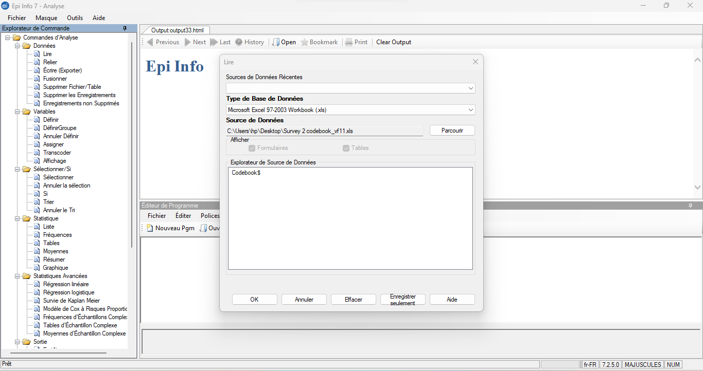
Click on the codebook, then on Ok
Notes:
Click on the codebook$, then on Ok

Slide 86
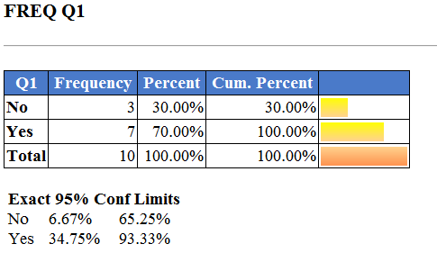
Frequency calculation in Epi Info
Find the statistics folder (in the Command Explorer box on the left), and under it, locate "frequencies".
A box will appear, with the "*" symbol pre-populated in the "Frequency of" box in . The "*" symbol, tells Epi Info to produce a frequency statistic for each variable in your data set.
Click on "OK". (Note: to examine a single variable, click on the arrow and select the variable from the list)
Notes:
Once you have read your data set, you can begin the analysis. Find the statistics folder (in the Command Explorer box on the left), and under it, locate "frequencies". A box will appear, with the "*" symbol pre-populated in the "Frequency of" box. The "*" symbol tells Epi Info to produce a frequency statistic for each variable in your data set. Click on "OK. (Note: to examine a single variable, click on the arrow and select the variable from the list.) Your output for the variables will look like this:

Slide 87
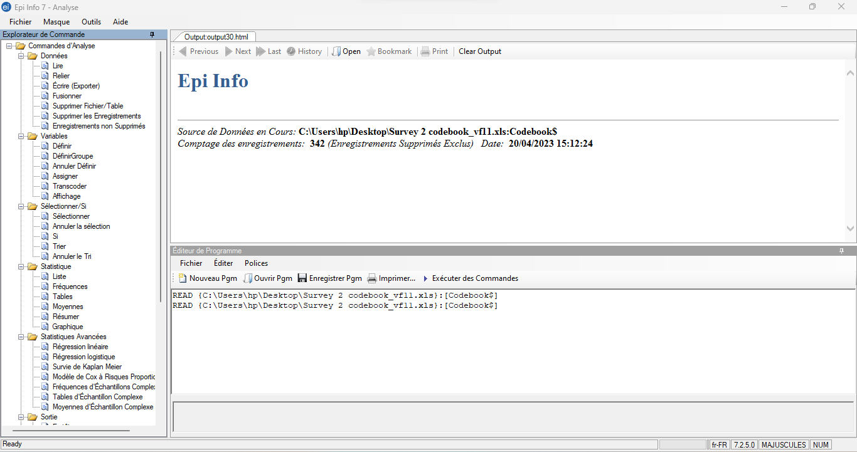
Frequency calculation in Epi Info
1. locate "frequencies".
Notes:
Find the statistics folder (in the Command Explorer box on the left), and under it, locate "frequencies".

Slide 88
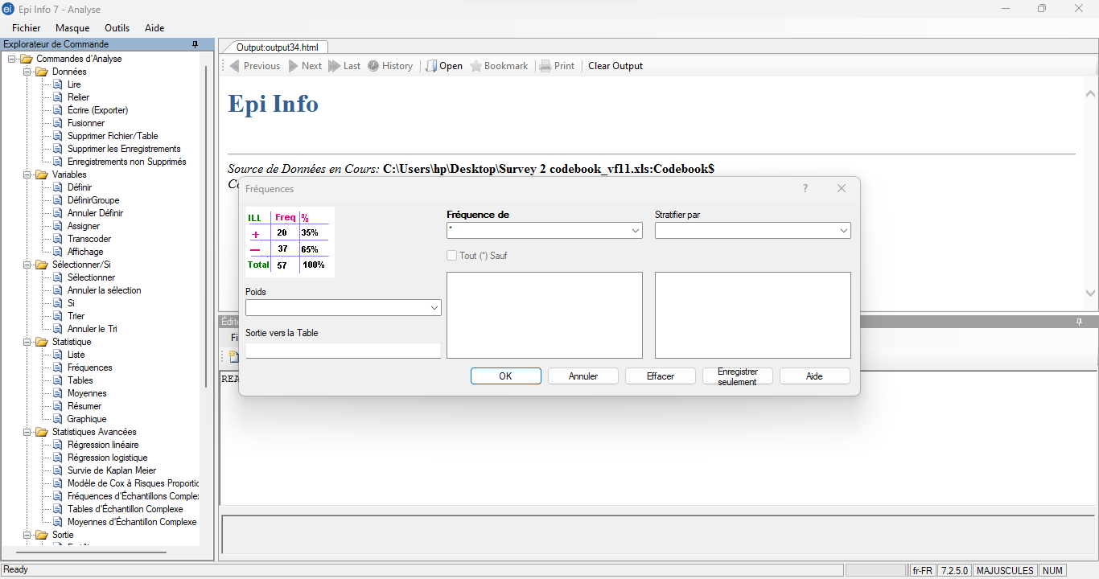
Frequency calculation in Epi Info
2. Identify the frequency and stratify
Notes:
A box will appear, with the "*" symbol pre-populated in the "Frequency of" box in . The "*" symbol, tells Epi Info to produce a frequency statistic for each variable in your data set.

Slide 89
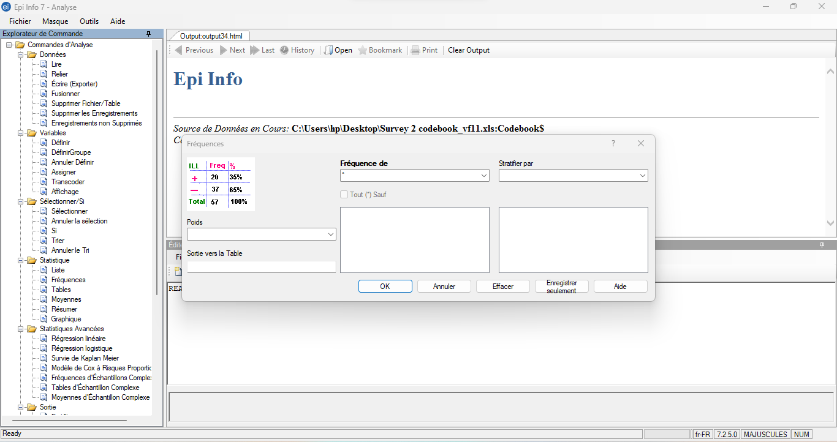
Frequency calculation in Epi Info
3. Click on "OK".
Notes:
Click on "OK". (Note: to examine a single variable, click on the arrow and select the variable from the list)

Slide 90
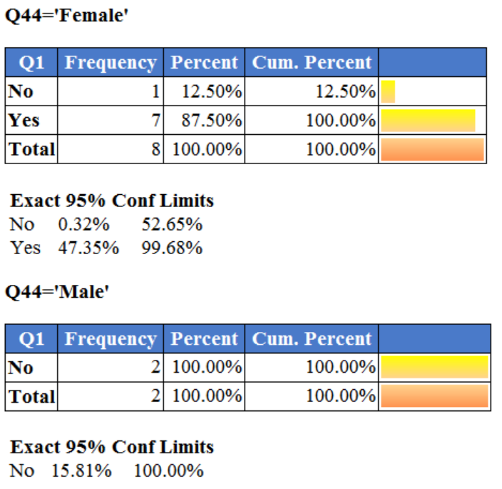
Frequency calculation in Epi Info (continued)
If you want to stratify the results, in the Frequencies window, click on the "Stratify by" drop-down menu and select the variable you want to stratify (for example, gender - Q44 in our example data).
Your results will then be presented by gender

Slide 91
Display the missing percentage for each variable
Click on "Set" under the Options folder in the Command Browser. Check the "Include missing values" box and click OK.
Now, when you produce a frequency, there will be a line for missing data.
It is important to note the number of missing data in your data set.
However, when we calculate percentages, it is common not to include missing data in these percentages.
So, before entering your data into the results template, be sure to repeat this step and uncheck the "Include missing values" box.
Notes:
If you want to include the missing data in your frequencies, you'll need to change Epi Info's programming to display the missing data. To do this, click on "Set" under the Options folder in the Command Browser. Check the "Include missing values" box and click OK. Now, when you produce a frequency, there will be a line for missing data. It is important to note the number of missing data in your data set. However, when we calculate percentages, it is common to not include missing data in those percentages. So, before you enter your data into the results template, be sure to repeat this step and uncheck the "Include missing values" box.

Slide 92
Grouping of variables for analysis
Define a new variable in Epi Info that will represent the categorized age variable. To do this, click on "Define" under the Variables folder in the Command Browser.
Enter the variable name and select the variable type ("Text" is recommended for a categorized variable), then select OK.
For example, we define the variable AGECAT as a Text variable. Once you have defined your new variable, you will select "Recode" under the Variables folder.
Select the numeric variable you want to group from the "From" drop-down list and select the new variable from the "To" drop-down list.
Enter the range of values you want to create in your age groups in "Value" and "To Value". Then, name this group in the "Recoded Value" column
Notes:
In the survey results template, we have grouped the numeric variable Age into different categories. The following tips explain how to recode a numeric variable into separate categories in Epi Info using the example of the variable Age.
First, you must define a new variable in Epi Info that will represent the categorized age variable. To do this, click on "Define" under the Variables folder in the Command Browser. Enter the name of the variable (as described above) and select the variable type ("Text" is recommended for a categorized variable), then select OK. For example, we define the variable AGECAT as a Text variable. Once you have defined your new variable, you will select "Recode" under the Variables folder. Select the numeric variable you want to group from the "From" drop-down list and select the new variable from the "To" drop-down list. Enter the range of values you want to create in your age groups in "Value" and "To Value". Then name that group in the "Recoded Value" column. See the example below:

Slide 93
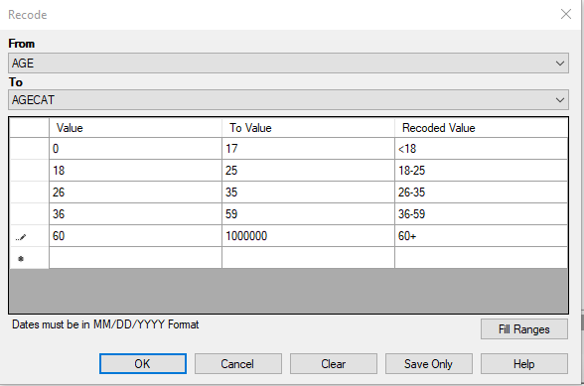
Once this configuration is done, click on OK and you can now run a frequency on this new variable.

Slide 94
Registering a new program code
Click "Save Pgm" in the program editor if you have created your own code to save it.
Click "Text File" in the lower left corner to save this code as a text file
the file finder will open, enter the name under which you want to save this code and click on Save.

Slide 95
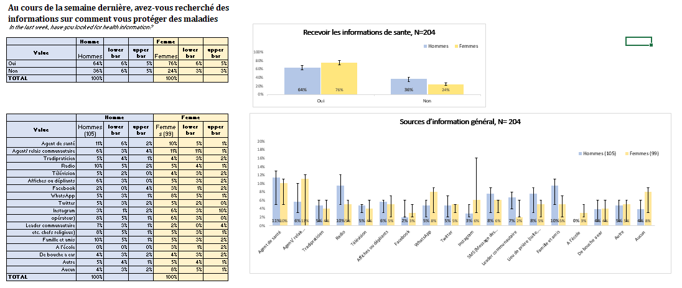
KAP Toolbox results display file
Notes:
In addition to the Excel DataAnalyzer tool, the KAP toolkit contains two Excel files that allow you to quickly make charts once you have results. Currently, we are looking for a way to have KoBo's Excel DataAnalyzer program create tables containing frequencies so that people who want to can use our Excel results files to generate charts. In this program, when you paste your results into the table on the left, the charts are automatically generated on the right.
If you analyze your data in R or another program of this type, you can easily use these tools.

Slide 96
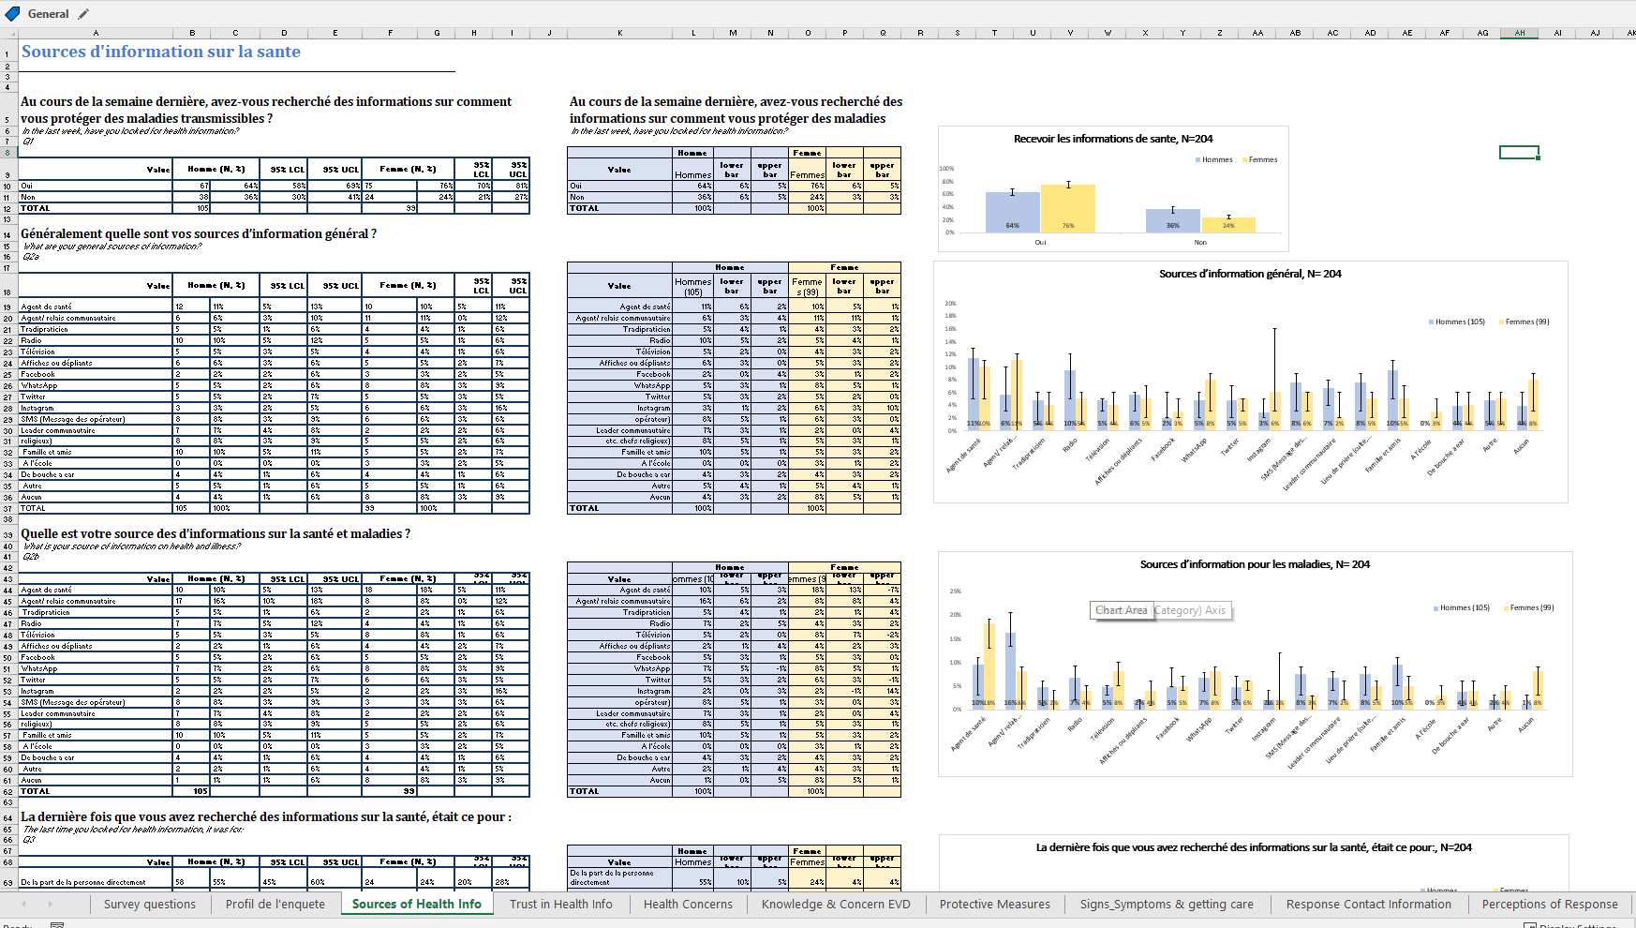
Notes:
Another important feature of these Excel files is the way we organized the questions into categories, so that similar questions are grouped together.
I've enlarged the tabs at the bottom of the spreadsheet so you can see how the file is divided.
The Excel file for Survey #1, top, includes worksheets for the following topics: participant demographics, sources of health information, confidence in health information, health concerns, knowledge and concerns about Ebola, [read more].

Slide 97
Documentation and storage
For each KAP survey, be sure to save the following documents in the appropriate electronic folder:
  The questionnaire (MS Word or KoBo file)
  Raw database (Excel)
  Cleaned database (Excel)
  Results of the analysis (Excel)
  General report and PowerPoint presentation
Notes:
Documentation and storage
As you develop your questionnaire, plan and implement your survey, keep copies of all the documents you use throughout the process. This will help you describe your work later. Archiving could also be very useful for future social science work. For each KAP survey, be sure to save the following documents in the appropriate electronic folder:
The questionnaire (MS Word or KoBo file)
Raw database (Excel)
Cleaned database (Excel)
Results of the analysis (Excel)
General report and PowerPoint presentation

