Slide 1



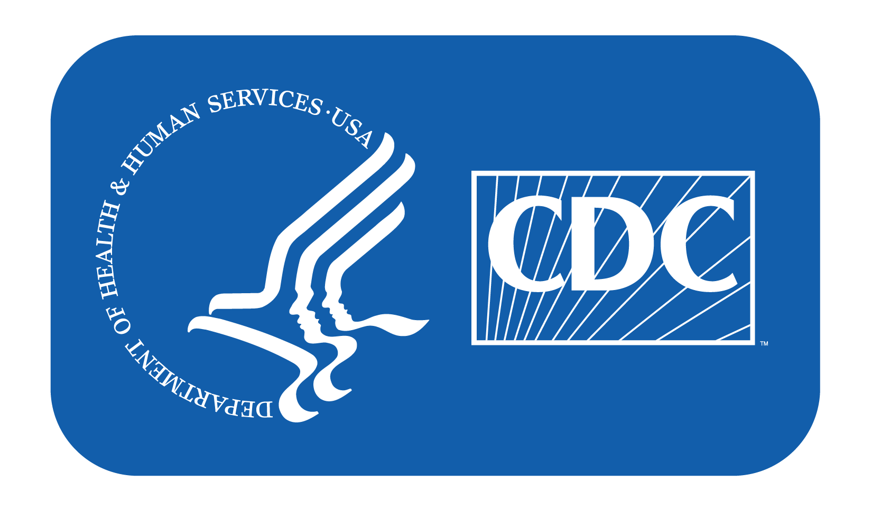
Opioid Epidemic
Notes:
Drug overdose deaths have been increasing in the United States since the 1990’s, mostly due to the use of opioids. More than 500,000 people in the United States have died from an overdose involving opioids since 1999, including both prescription and illegal forms.
Note: These slides are made possible by the David J. Sencer CDC Museum Public Health Academy. https://www.cdc.gov/museum/education/lessons/

Slide 2
Terms to Know
 | an increase in the number of cases of a disease above what is normally expected in that area
 | injury to the body (poisoning) that happens when a drug is taken in excessive amounts
 | when a person’s use of drugs or alcohol results in health issues or problems in their work, school, or home life; commonly called addiction
 | adaptation to a drug that produces symptoms of withdrawal when it is stopped
 | humanmade; in this context, drugs that are made in a laboratory or illegally
 | the science of protecting and improving the health of people and communities
 | the nonmedical use of a variety of drugs that are prohibited by law
 | reduced response to a drug with repeated use
Word Bank
Dependence
Epidemic
Illicit drugs
Overdose
Public health
Substance Use Disorder
Synthetic
Tolerance
Notes:
Terms to Know
Dependence - adaptation to a drug that produces symptoms of withdrawal when it is stopped
Epidemic - an increase in the number of cases of a disease above what is normally expected in that area
Illicit drugs - a variety of drugs that are prohibited by law for nonmedical use
Overdose - injury to the body (poisoning) that happens when a drug is taken in excessive amounts; can be fatal or nonfatal
Public health - science of protecting and improving the health of people and communities
Substance Use Disorder - when a person’s use of drugs or alcohol results in health issues or problems in their work, school, or home life; commonly called addiction
Synthetic - human-made; in this context, drugs that are made in a laboratory or illegally
Tolerance - reduced response to a drug with repeated use

Slide 3
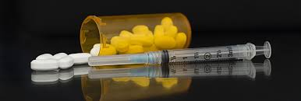
Understanding Opioids
Opioids are drugs that
interact with opioid
receptors on nerve
cells in the body and brain
Common opioids:
  Prescription drugs like oxycodone, hydrocodone, codeine, morphine
  Heroin
  Synthetic opioids like fentanyl and carfentanil
Opioids have high potential for addiction and overdose
Notes:
Background on Opioids
Opioids are natural, synthetic, or semi-synthetic chemicals that interact with opioid receptors on nerve cells in the body and brain, reducing the intensity of pain signals and feelings of pain. This class of drugs includes the illegal drug heroin, synthetic opioids such as fentanyl, and pain medications available legally by prescription, such as oxycodone, hydrocodone, codeine, morphine, and many others. Prescription opioids are generally safe when taken for a short time and as directed by a doctor, but because they produce euphoria in addition to pain relief, they can be misused and have addiction potential.

Slide 4

Think About It
Why do you think people are dying from opioid overdoses?
What are some reasons why people use opioids?
The U.S. Food and Drug Administration (FDA) monitors drug quality and safety. Why is it important to monitor medications?

Slide 5
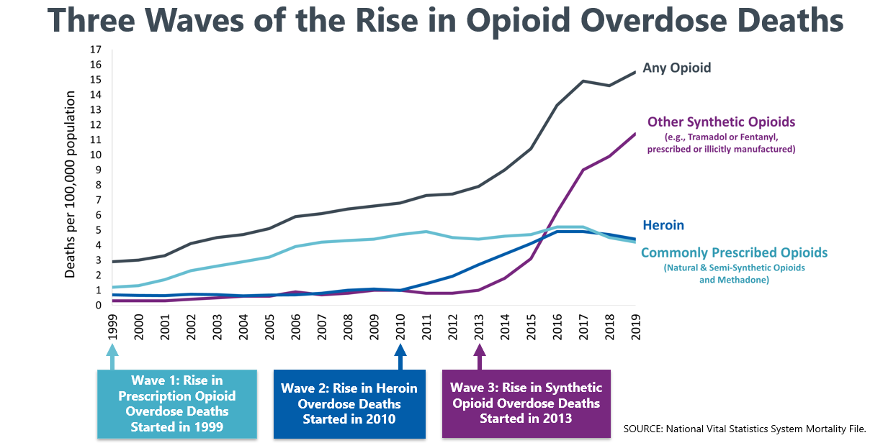
Opioids and CDC
Long-term use of prescription or illicit opioids can lead to an opioid use disorder, commonly known as addiction
Opioid overdose deaths have been increasing steadily since 1999
Notes:
Opioids and the Centers for Disease Control and Prevention (CDC)
Opioid tolerance occurs when a person using opioids begins to experience a reduced response to medication, requiring more opioids to experience the same effect. Opioid dependence occurs when the body adjusts its normal functioning around regular opioid use. Unpleasant physical symptoms occur when medication is stopped. Opioid addiction occurs when attempts to cut down or control use are unsuccessful or when use results in social problems and a failure to fulfill obligations at work, school, and home. Opioid addiction often comes after the person has developed opioid tolerance and dependence, making it physically challenging to stop opioid use and increasing the risk of withdrawal. Addiction is also known as opioid use disorder (OUD).
From 1999–2019, nearly 500,000 people died from an overdose involving prescription and illicit opioids. The first wave of overdose deaths began with increased prescribing of opioids in the 1990s, with overdose deaths involving prescription opioids increasing since at least 1999. Synthetic opioids, including illicitly manufactured fentanyls, were involved in 64% of >100,000 estimated U.S. drug overdose deaths during May 2020–April 2021.
Prescription opioids are used to treat moderate-to-severe pain following surgery or injury or for health conditions such as cancer. Common examples include oxycodone, hydrocodone, morphine, codeine, and methadone. While these medications are prescribed by a doctor, it can be very hard for some people to stop taking them. Anyone can become addicted. For patients receiving long-term opioid therapy, as many as one in four will struggle with addiction.
The second wave began in 2010, with rapid increases in overdose deaths involving heroin. Heroin is an illegal, highly addictive opioid drug. Heroin is typically injected but can also be smoked or snorted. When people inject heroin, they are at risk of serious, long-term viral infections such as HIV, hepatitis C, and hepatitis B, as well as bacterial infections of the skin, bloodstream, and heart.
The third wave began in 2013, with significant increases in overdose deaths involving synthetic opioids. More than 150 people die every day from overdoses related to synthetic opioids like fentanyl. Pharmaceutical fentanyl is a synthetic opioid, usually used for treating advanced cancer pain. However, most recent cases of fentanyl-related harm, overdose, and death are linked to illicitly made fentanyl. It is 50 to 100 times more powerful than morphine and is commonly mixed with other illegal drugs like heroin, cocaine, and methamphetamine. Drugs may contain deadly levels of fentanyl, and you can’t see it, taste it, or smell it. Only 2 mg of fentanyl (the size of three grains of salt) can be lethal, depending on body size and drug tolerance.

Slide 6
Opioid Use Disorder and CDC
How can we reduce deaths due to opioid overdose?
  Recognize signs of overdose
    Small, constricted “pinpoint pupils”
    Falling asleep or loss of consciousness
    Slow, shallow breathing
    Choking or gurgling sounds
    Limp body
    Pale, blue, or cold skin
  Passing 911 Good Samaritan Laws
  Using naloxone to reverse overdoses
  Medication-assisted treatment (MAT)
  Syringe service programs
Notes:
Many victims of drug overdose have bystanders nearby who could have helped. Recognizing an opioid overdose can be difficult. If you aren’t sure, it is best to treat the situation like an overdose - you could save a life. Call 911 or seek medical care for the individual. Do not leave the person alone. Signs of an overdose may include:
Small, constricted “pinpoint pupils”
Falling asleep or loss of consciousness
Slow, shallow breathing
Choking or gurgling sounds
Limp body
Pale, blue, or cold skin
Since the start of the opioid epidemic, nearly every state has legislated some form of a 911 Good Samaritan Law to reduce barriers to calling 911 in the event of an overdose. This type of legislation may provide overdose victims and/or bystanders with limited immunity from drug-related criminal charges and other criminal or judicial consequences that may otherwise result from calling first responders to the scene to treat an overdose victim.
A medication called naloxone (brand name Narcan®) can reverse an overdose from opioids. Anyone can carry naloxone, give it to someone experiencing an overdose, and potentially save a life. Targeted naloxone distribution programs seek to train and equip individuals who are most likely to encounter or witness an overdose - especially people who use drugs and first responders -with naloxone kits, which they can use in an emergency to save a life.
In addition to interventions designed to reduce the occurrence of overdoses, other interventions treat the root cause: opioid use disorder. Medication-assisted treatment (MAT) is a proven treatment for OUD. Medications are administered to people with OUD to treat addiction. The drugs methadone and buprenorphine activate opioid receptors in the brain, preventing painful opioid withdrawal symptoms without causing euphoria; the drug naltrexone blocks the effects of opioids to prevent future use. In addition to medications to manage dependency, MAT also includes behavioral therapy to promote long-term success with overcoming addiction.
Other interventions strive to make drug use safer while also connecting people who use drugs with support services. Syringe services programs are community-based prevention programs that can provide a range of services, including linkage to substance use disorder treatment; access to and disposal of sterile syringes and injection equipment; testing; treatment for infectious diseases; and linkage to medical, mental health, and social services.
The Substance Abuse and Mental Health Services Administration’s National Helpline is a free, confidential, 24/7, 365-day-a-year treatment referral and information service (in English and Spanish) for individuals and families facing mental and/or substance use disorders. Call 1-800-662-HELP (4357). You can also visit the online treatment locator for more information.
English: https://www.samhsa.gov/find-help/national-helpline
Spanish: https://www.samhsa.gov/linea-nacional-ayuda
Online Treatment Locator: https://findtreatment.samhsa.gov

Slide 7
Think About It
Why is fentanyl causing such a dramatic increase in drug overdose deaths?
How do 911 Good Samaritan Laws help save lives?
What responsibility do doctors have in ensuring their patients do not become addicted to the opioids prescribed to them?

Slide 8
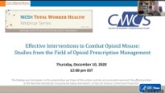
From the Expert
https://youtu.be/ogTXanWuwUk
Notes:
From the Expert:
The National Institute of Occupational Safety and Health (NIOSH) is the part of CDC that works to reduce worker illness and injury. They hosted a recent webinar event focused on effective interventions to combat opioid misuse. The first 8 minutes and 45 seconds of the video summarizes the state of the opioid epidemic and how it relates to work. https://youtu.be/ogTXanWuwUk
Workplaces are a critical point of contact for Americans struggling with or recovering from a substance use disorder. NIOSH has created the Workplace Supported Recovery Program to help employers proactively prevent substance misuse, reduce stigma, and encourage treatment and sustained recovery from addiction. https://www.cdc.gov/niosh/topics/opioids/wsrp
Why Participate? A Message from CDC
One in 14 Americans reports experiencing a substance use disorder. There is not one single driving factor that leads to addiction. Some people may use drugs to help cope with stress, trauma, or to help with mental health issues. Some may even develop opioid use disorder after misusing opioids they are prescribed by doctors. In any case, using drugs over time makes it easier to become addicted. When people take drugs, the brain is flooded with chemicals that take over the brain’s reward system and cause them to repeat behaviors that feel good but aren’t healthy. Addiction is a disease, not a character flaw. People suffering from substance use disorders have trouble controlling their drug use even though they know drugs are harmful. Building awareness about the realities of substance use disorders will help you recognize the signs and get help for those suffering its effects, without stigma or judgement.

Slide 9
Think About It
Why should workplaces care about the health and safety of their workers?
What are the effects of opioid use disorder on the friends, family, and surrounding community of people who are affected by it?
During the COVID-19 pandemic, many of the support services for people with OUD were shut down. How do you think that affected rates of drug overdose?

Slide 10
Give it a Try
Call to Action!
Build empathy for people with opioid use disorders (OUD).
Design an intervention for opioid use disorder (OUD).
Share your findings.
Why do you think participation is important?
Notes:
Call to Action
In order to understand opioid use disorder it is essential that people understand why people use opioids and how to treat addiction. You can help people by following these three steps:
Build empathy for people with opioid use disorders (OUD). People are often quick to judge people who are suffering with opioid use disorder. Your first task is to explore some of their stories so that you can better understand the epidemic and those affected.
Design an intervention for opioid use disorder (OUD). Use the public health approach to analyze data and put together a plan to get resources to the communities and people who most need them.
Share your findings. One of the ways CDC communicates information is through social media. Your work can help CDC communicate the work they have done and are doing to reduce cases of opioid use disorder.

Slide 11
Use the
Public Health Approach
Surveillance
What is the problem?
Risk Factor Identification
What is the cause?
Intervention
What works?
Implementation
How did we do it?
Surveillance
What is the problem?
Risk Factor Identification
What is the cause?
Intervention
What works?
Implementation
How did we do it?

Slide 12
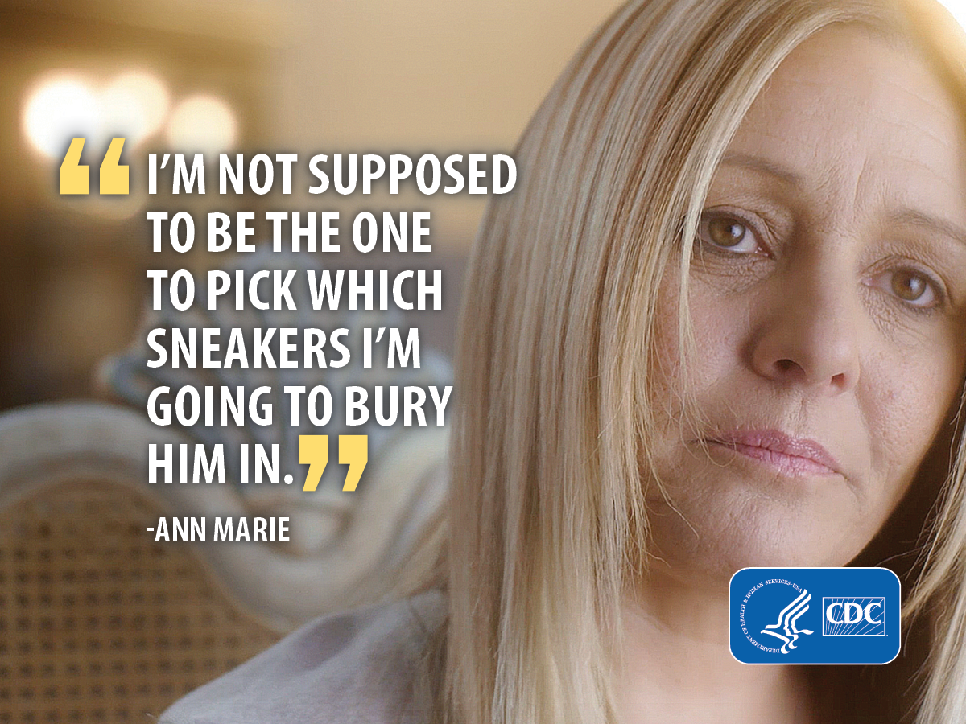
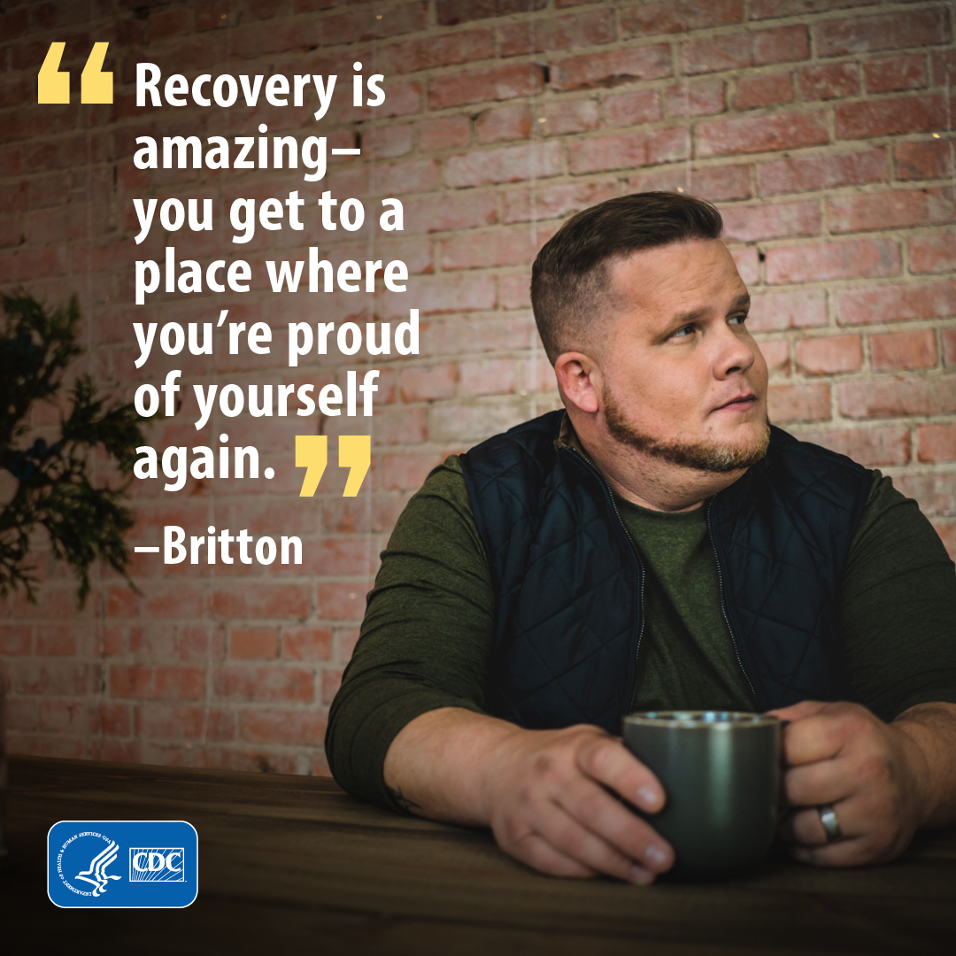
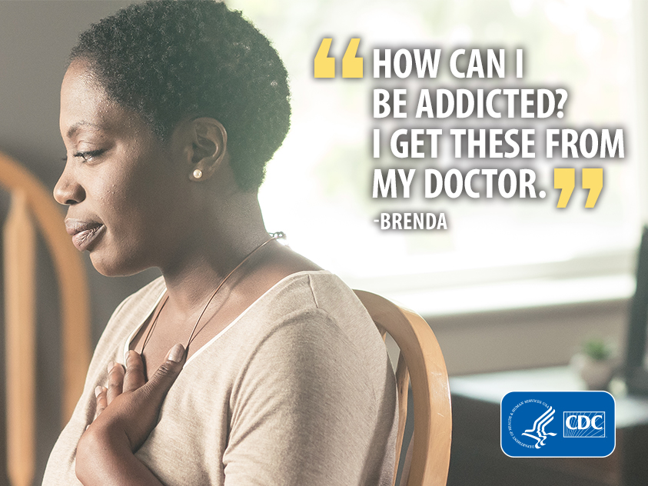
Give it a Try
1. Build Empathy for People with Opioid Use Disorders (OUD)
Watch and read stories from CDC’s Rx awareness campaign, which focuses on people affected by opioid use disorder
Rx Awareness
Notes:
Build Empathy for People with Opioid Use Disorders (OUD)
Public health is “the science and art of preventing disease, prolonging life, and promoting health through the organized efforts and informed choices of society, organizations, public and private communities, and individuals.” — Charles-Edward Amory Winslow
Oftentimes, people use dehumanizing language to describe conditions or circumstances. This is especially true for conversations around subjects like drug use. Health equity requires that all people be addressed inclusively, with respect, using non-stigmatizing, bias-free language. Before you move further into this lesson, take a minute and think about the power of language.
Remember the person! It is important when addressing health issues in communities to always remember the person behind the condition and treat them with respect and dignity. The person always comes first.
diabetic → person with diabetes
disabled → person with a disability
homeless → person experiencing unstable housing
drug user → person who uses drugs
CDC’s Rx Awareness campaign tells the stories of people whose lives were impacted by prescription opioids. The goals of the campaign are to increase awareness that prescription opioids can be addictive and dangerous; to reinforce that help is available for those suffering from an opioid use disorder; and to encourage those struggling with prescription opioids to visit the campaign website to locate help and resources. Visit the campaign site and explore some of the stories. Most videos are 30 seconds long, but the first six have full length videos available that tell a longer story. https://www.cdc.gov/rxawareness/stories/index.html

Slide 13
Give it a Try
2. Design an Intervention for Opioid Use Disorder (OUD)
Surveillance:
What does the data show about opioid overdose deaths?
Risk Factor Identification:
Which populations are most at risk?
Intervention:
What has worked in the past to address the problem?
Implementation:
What intervention will you implement and how?
Notes:
Design an Intervention for Opioid Use Disorder (OUD)
There are overarching principles that serve as a guide for the design and implementation of effective overdose prevention strategies. The four guiding principles below are lessons learned from previous public health emergencies.
Know your epidemic, know your response. Opioid overdose is driven by many different mechanisms and human experiences, and people may follow a variety of paths toward opioid misuse and overdose.
Make collaboration your strategy. Effectively responding to the opioid overdose epidemic requires that all partners be at the table. Make collaboration your strategy.
Nothing about us without us. Prevention strategies need to consider the realities, experiences, and perspectives of those at risk of overdose. Those affected by opioid use and overdose risk should be involved in developing the solutions.
Meet people where they are. The guiding principle of “meeting people where they are” means more than showing compassion or tolerance to people in crisis. This principle also asks us to acknowledge that all people we meet are at different stages of behavior change.
Use the four steps of the public health approach to design an intervention for this epidemic
1. Surveillance: What is the problem?
Use the links below to explore data related to drug overdose deaths and fentanyl and answer the questions on the next page.
Fatal Injury Data Visualization Tool: https://wisqars.cdc.gov/data/explore-data
Provisional Drug Overdose Deaths: https://www.cdc.gov/nchs/nvss/vsrr/drug-overdose-data.html
Drug Overdose Death Maps: https://www.cdc.gov/drugoverdose/deaths
Fentanyl Encounters Data: https://www.cdc.gov/drugoverdose/deaths/fentanyl-encounters
Causes of death, 1981-2019: https://www.cdc.gov/injury/wisqars/animated-leading-causes.html
What trends are you noticing in the data? Before you can solve a problem, you must be able to clearly articulate the problem.
2. Risk Factor Identification: What is the cause?
Who is being affected by drug overdoses? How old are they? Where do they live? What races or ethnicities are most affected? Is one sex more affected than another?
3. Intervention: What works?
For this section, you will be exploring three interventions that are known to be effective in treating and preventing opioid use disorders. You will evaluate the pros and cons of each in order to decide which will work best given the populations and risk factors you have identified.
You can use knowledge gained from this lesson or you can conduct further research on the internet. Just make sure you are using reputable sites to find credible information. Sources that end in .gov or .org are generally reliable, as are sites from medical journals and universities.
4. Implementation: How do we do it?
Which intervention will you implement? How? Where will you get the resources? Describe your plan.

Slide 14
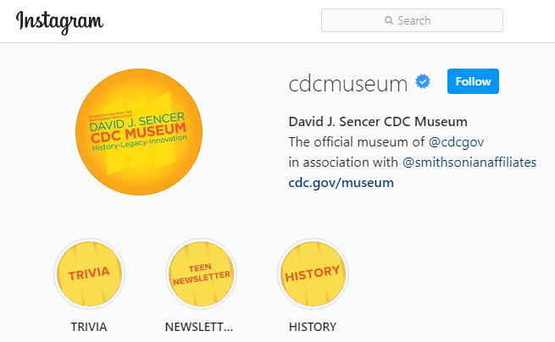
Give it a Try
3. Share Your Findings
Instagram @CDCmuseum
Notes:
Share Your Findings
The David J. Sencer CDC Museum uses award-winning exhibits and innovative programming to educate visitors about the value of public health and presents the rich heritage and vast accomplishments of CDC. Your work could be a valuable contribution! Share your research with the CDC Museum on Instagram using @CDCmuseum.

Slide 15
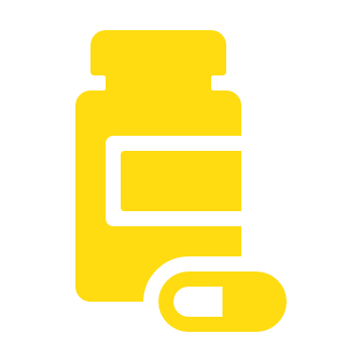
Questions?

