Slide 1
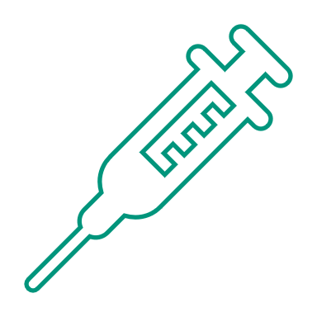



Polio Eradication
Notes:
Hook Sentences
Note: These slides are made possible by the David J. Sencer CDC Museum Public Health Academy. https://www.cdc.gov/museum/education/lessons/

Slide 2
 | a substance used to stimulate the production of antibodies and provide immunity against disease
 | the reduction to zero of an infectious disease's presence in the global host population
 | type of microbe that causes infectious diseases; has a core of genetic material but no way to reproduce on its own
 | the regular presence of a disease or infectious agent in a population
 | the loss of the ability to move (and sometimes to feel anything) part or most of the body; caused by illness, poison, or injury
Word Bank
endemic
vaccine
paralysis
eradication
virus
Notes:
Terms to Know
Vaccine/ Vaccination: a substance used to stimulate the production of antibodies and provide immunity against disease
Virus: type of microbe (organisms too small to be visible to the naked eye) that causes infectious diseases; has a core of genetic material but no way to reproduce on its own; uses infected cells’ reproductive machinery
Paralysis/Paralyzed: the loss of the ability to move (and sometimes to feel anything) part or most of the body; caused by illness, poison, or injury
Endemic: the regular presence of a disease or infectious agent in a population
Eradicate/Eradication: the reduction to zero of an infectious disease's presence in the global host population

Slide 3
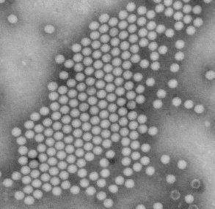
Understanding Polio
Polio (aka poliomyelitis) is:
  a disabling and life-threatening disease
  caused by the poliovirus
Polio can be spread through:
  Contact with the feces (poop) of an infected person
  Droplets from a sneeze or cough of an infected person
  People who are infected even without symptoms
Symptoms of Infection:
  1 out of 4: flu-like symptoms (sore throat, fever)
  1 out of 25: meningitis infection of brain or spinal cord
  1 out of 200: paralysis/weakness in arms, legs, or both
Notes:
Polio is a crippling and potentially fatal infectious disease caused by the poliovirus. Poliovirus is very contagious and spreads through person-to-person contact. The virus enters the human body through the mouth and exits via the digestive system. For most, this virus passes through undetected, but for others, the virus can cause nerve damage, resulting in paralysis. It enters the body through the mouth and spreads through contact with the feces (poop) of an infected person or droplets from a sneeze or cough of an infected person. Polio can contaminate food and water in unsanitary conditions where access to proper sanitation is unavailable.

Slide 4

Think About It
How does the poliovirus’s choice of host make it an easy target for eradication?
What jobs and skills would be needed to stop a disease from spreading?
Polio mainly affects children. How does that affect the public’s interest in stopping the spread of the poliovirus?

Slide 5
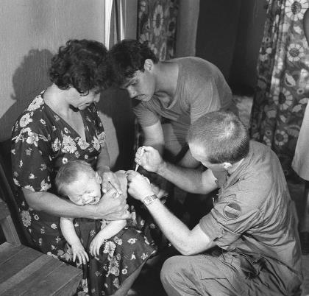
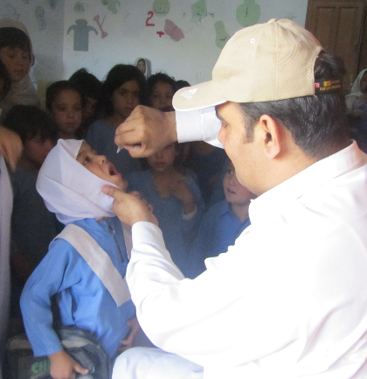
Polio and CDC
Inactivated polio vaccine (IPV)
  Developed by Jonas Salk in 1950s
  Uses killed poliovirus
  Given through injection
  U.S. only uses IPV for safety reasons
Oral polio vaccine (OPV)
  Developed by Albert Sabin in 1960
  Uses weakened live virus
  Given as drops in the mouth
  OPV preferred in places where administration is difficult, particularly remote places
Notes:
Polio and the Centers for Disease Control and Prevention (CDC)
Dr. Jonas Salk created the first polio vaccine in the early 1950s. Children who participated in the first polio vaccine trials in 1954 received Polio Pioneer pins from the National Foundation for Infantile Paralysis. The highly successful vaccine trial led to the vaccine’s implementation the following year. One of CDC’s greatest disease detectives, the late Dr. Stephen B. Thacker, was part of the vaccine trial and remembered receiving his Polio Pioneer pin.
Today, the U.S. Food and Drug Administration (FDA) oversees vaccine licensing, a process that requires significant funding and years to complete. In 1955, no such agency existed. A small federal agency, the Laboratory of Biologics Control, had the power to approve production of vaccine. Eager to meet public demand, the polio vaccine was licensed in just two hours, and state and local health departments began campaigns to vaccinate millions. Shortly after the program was implemented in the U.S., 40,000 cases of polio in children who were recently vaccinated were detected by health departments and reported to CDC. In the subsequent weeks, 260 children were paralyzed, and 10 children died. Epidemic Intelligence Service Officers (EIS) at CDC used epidemiology to trace the outbreak to a few batches of vaccines from California’s Cutter Laboratories that used poliovirus which was not properly killed. The vaccine therefore caused polio instead of protecting against it. The investigation resulted in the establishment of rigid production controls to ensure the vaccine’s safety and the public’s confidence in the vaccine was restored in a matter of weeks. The Cutter Incident, as it came to be called, also put CDC and the EIS disease detectives in the national spotlight as a valuable disease-investigating program.
There is no cure for polio. Infection prevention through the polio vaccine is the only protection available. Two main types exist. The oral polio vaccine (OPV) contains weakened live virus and is administered by mouth. The inactivated polio vaccine (IPV) is given by injection and needs to be administered by a trained health worker. While OPV is much easier to administer, particularly in remote locations, it does carry a very small risk of developing vaccine derived poliovirus if the weakened virus is reactivated by the digestive system. These cases are closely tracked by CDC and other global health organizations.

Slide 6


Polio and CDC
In 1955, CDC Epidemic Intelligence Service
(EIS) Officers responded to an incident at
Cutter Laboratories where 40,000 children
being accidentally injected with live poliovirus
  260 children were paralyzed
  10 children were killed
  Led to increased vaccine safety regulations
CDC partnering with other agencies through Global Polio Eradication Initiative (GPEI) to eradicate polio globally
  Cases of polio down over 99% globally
  Last endemic case in U.S. was in 1979
  Polio only endemic in Pakistan and Afghanistan
Notes:
The last endemic case of polio in the United States occurred in 1979. Today, CDC is partnering with other agencies through the Global Polio Eradication Initiative (GPEI) across the world to eradicate polio globally. Organizations like GPEI carry out disease surveillance activities in countries around the world by going door-to-door to identify polio cases and vaccinate children. Polio has three main strands: poliovirus type 1, type 2, and type 3. Globally, wild types 2 and 3 were declared eradicated in 2015 and 2019. As of 2021, wild type 1 poliovirus remains endemic in only two countries: Pakistan and Afghanistan. Though cases of vaccine derived polioviruses still occur in many countries, the world is close to fully eradicating polio through the concentrated efforts of public health officials.

Slide 7
Think About It
Why might people be reluctant to be vaccinated?
How many years have passed since the disease was endemic in the U.S.?
How does vaccination help limit the spread of polio?

Slide 8
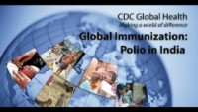
From the Expert
https://youtu.be/uPGhmLzUGec
Notes:
Listen to Dr. Stephen L. Cochi, part of the Global Immunization Division of CDC, speak about the strategy to eliminate endemic polio in India through vaccination and surveillance. Find out how this strategy has been applied globally to reduce polio cases.

Slide 9
Think About It
What role does global politics play in public health?
Explain the important role communication plays in vaccination initiatives.
How can your efforts support the efforts of CDC and GPEI?

Slide 10
Give it a Try
Call to Action!
Design and build a polio vaccine carrier.
Test your prototype.
Share your designs.
Why do you think participation is important?
Notes:
Call to Action
In order to fully eradicate polio, it is essential that children get fully vaccinated, even in remote areas of the world. You can help the eradication efforts by following these three steps:
Design and build a polio vaccine carrier. One of the big challenges with the polio vaccine is that it must be kept between 35-46°F (2-8°C) to remain effective. This can be difficult to do in remote areas. Design a cost-effective portable carrier that will allow healthcare workers to preserve the vaccine’s safety in the field.
Test your prototype. Use the design you developed to build a prototype. Conduct field tests to see how effective your device is at maintaining a consistent temperature.
Share your designs. One of the ways CDC communicates information is through social media. Your designs can help CDC communicate the work they have done and are doing to improve access to polio vaccinations across the globe.
Why Participate? A Message from CDC
The eradication of polio is an important priority for CDC. On December 2, 2011, CDC activated its Emergency Operations Center (EOC) to strengthen the agency’s partnership engagement through the Global Polio Eradication Initiative (GPEI), which is committed to completing the eradication of polio. On December 14, 2011, the support of the entire CDC community was enlisted to become active participants in an intensified effort to eradicate polio worldwide. Efforts to eradicate polio over the last few decades means that over 18 million cases of paralysis have been averted.
Success in eradicating polio will mean that no child will have to experience the devastating effects of the disease again. Failure to eradicate polio could cause poliovirus to reappear around the world with up to 200,000 new cases expected every year within 10 years. We are so close to eradicating the virus, but we need to finish the job now, once and for all.

Slide 11
Use the Engineering Design Process
Define
Define the problem
Research
Do background research
Requirements
Specify requirements
Brainstorm
Develop solutions
Build
Build a prototype
Test and redesign
Test
Share
Communicate results
Notes:
The engineering design process allows engineers to develop and test solutions to problems. You can use the process to help determine the best way to make a portable vaccine carrier that is capable of maintaining low temperatures for long time periods.

Slide 12
Give it a Try
1. Design and Build the Vaccine Carrier
Design a vaccine cooler that can maintain temperature between 35-46°F (2-8°C)
Build a prototype of your design
Notes:
Design and Build the Vaccine Carrier
One of the big challenges with the polio vaccine is that it must be kept between 35-46°F (2-8°C) to remain effective. This can be particularly difficult to do in remote areas. Design a cost-effective portable carrier that will allow healthcare workers to maintain the polio vaccine’s safety in the field. Start by researching the storage and handling concerns of the polio vaccine.
Suggested Materials
You may use any materials to build your cooler. Here are some suggestions:
Container: box, bag, storage container
Insulation: towels, cardboard, bubble wrap, cotton, foam insulation
Cooling: ice, dry ice, gel packs
Temperature monitoring: thermometer or digital temperature probe

Slide 13
Give it a Try
2. Test the Vaccine Carrier
Add a frozen substance to your vaccine carrier and monitor temperature over time
Graph your results
Suggest improvements for design
Notes:
Test the Vaccine Carrier
Use the design you developed to build a prototype. Conduct field tests to see how effective your device is at maintaining a consistent temperature.
As you prepare to test your vaccine carrier, consider the following:
When you open your carrier, heat will enter. Can you measure temperature without opening it?
How often will you collect temperature data? (Every minute? Every 15 minutes? Every hour?)
How does the temperature of the environment surrounding your cooler affect your data?

Slide 14
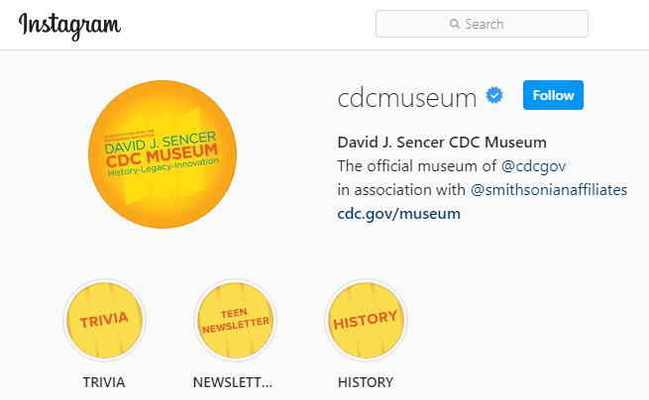
Give it a Try
3. Share Your Findings
Instagram @CDCmuseum
Notes:
Share Your Findings
The David J. Sencer CDC Museum uses award-winning exhibits and innovative programming to educate visitors about the value of public health and presents the rich heritage and vast accomplishments of CDC. Your design could be a valuable contribution! Share your demonstration with the CDC Museum on Instagram using @CDCMuseum.
CDC plays a critical role in eradicating polio by providing scientific leadership and guidance at the global, regional, and country level to implement evidence-based strategies. Since 1988, CDC, ministries of health, and Global Polio Eradication Initiative (GPEI) partners have worked together across these areas to reach every community and vaccinate every last child.
CDC’s Center for Global Health (CGH) works 24/7 around the globe to stop health threats at their source. As a citizen scientist, you can help CDC’s CGH by sharing your design on their Twitter or Facebook pages to show the importance of polio vaccination using @CDCGlobal.

Slide 15
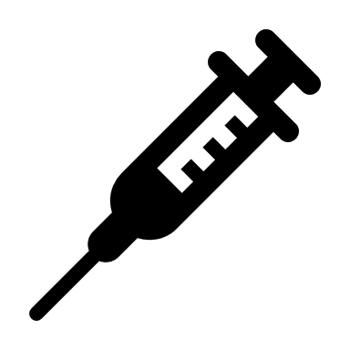
Questions?
Notes:
Share Your Findings
The David J. Sencer CDC Museum uses award-winning exhibits and innovative programming to educate visitors about the value of public health and presents the rich heritage and vast accomplishments of CDC. Your demonstration could be a valuable contribution! Share your demonstration with the CDC Museum on Instagram using @CDCmuseum.

