Slide 1




Pandemic Flu
Notes:
Note: These slides are made possible by the David J. Sencer CDC Museum Public Health Academy. https://www.cdc.gov/museum/education/lessons/

Slide 2
Terms to Know
 | an increase in the number of cases of a disease above what is normally expected
 | science of protecting and improving the health of people and their communities
 | provides a trigger to help the immune system build immunity to a disease
 | an increase in the number of cases of a disease above what is normally expected
 | an event in which a disease spreads across several countries and affects many people
 | ongoing, systematic collection, analysis, and interpretation of health-related data
 | type of microbe that causes infectious diseases
Word Bank
Epidemic
Outbreak
Pandemic
Public Health
Surveillance
Vaccine
Virus
Notes:
Terms to Know
Epidemic - an increase in the number of cases of a disease above what is normally expected in that population in that area
Outbreak - an increase in the number of cases of a disease above what is normally expected
Pandemic - an event in which a disease spreads across several countries and affects a large number of people; occurs when an epidemic spreads to other areas
Public Health - science of protecting and improving the health of people and their communities
Surveillance - ongoing, systematic collection, analysis, and interpretation of health-related data
Vaccine - provides a trigger to help the immune system build immunity to a disease; vaccines allow the immune system to recognize a virus as a threat
Virus - type of microbe (organisms too small to be visible to the naked eye) that causes infectious diseases; has a core of genetic material but no way to reproduce on its own; uses infected cells’ reproductive machinery

Slide 3
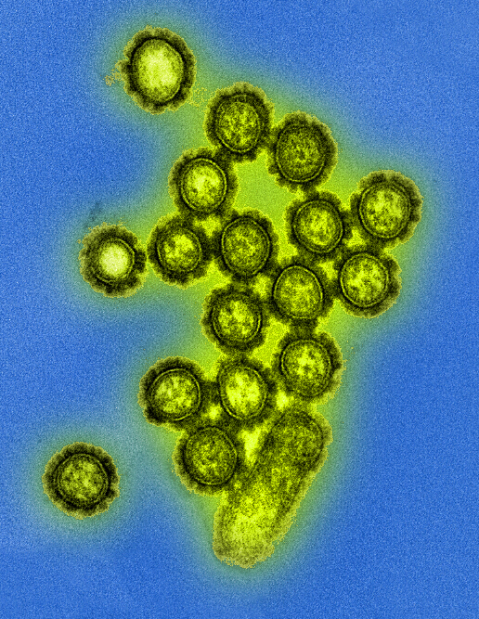
Understanding Flu
Influenza (flu) is a contagious respiratory illness
  Caused by influenza viruses
  Spread by tiny droplets made while coughing, sneezing, or talking or by touching surfaces that have flu virus on them
About 8% of U.S. gets sick from flu annually
Influenza virus particles (digitally colorized transmission electron microscopic image)
Notes:
What is Influenza?
Influenza (flu) is a contagious respiratory illness caused by influenza viruses that infect the nose, throat, and lungs. There are two main types of influenza viruses that cause epidemics: types A and B. These viruses that routinely spread in people (human influenza viruses) are responsible for seasonal flu epidemics each year. About 8% of the U.S. population gets sick from flu each season.
Most experts believe that flu viruses spread mainly by tiny droplets made when people with flu cough, sneeze or talk. These droplets can land in the mouths or noses of people who are nearby. Less often, a person might get flu by touching a surface or object that has flu virus on it and then touching their own mouth, nose or possibly their eyes.

Slide 4

Think About It
How can a disease cause a pandemic?
What groups of people do you think need to be concerned about pandemic flu?
If you were the U.S. president, what would you do to prepare for pandemic flu?

Slide 5
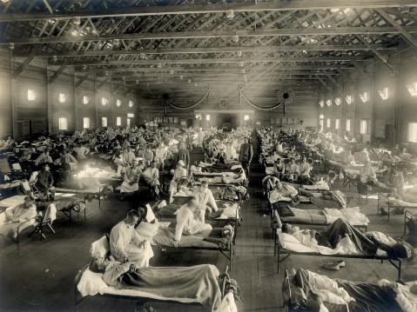
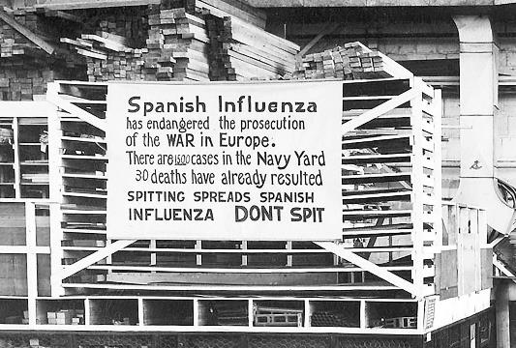
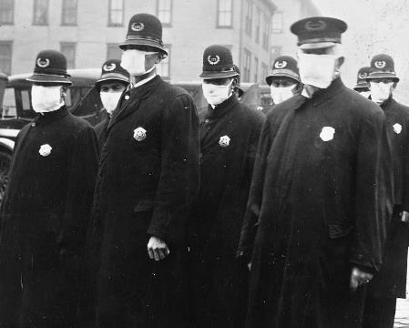
Pandemic Flu and CDC
Seasonal flu occurs annually; pandemic flu only occurs when a novel (new) flu virus infects many people and spread to a wide area
Flu pandemics since 1900:
  1918 H1N1 pandemic flu, ~50 million casualties
  1957 H2N2 pandemic flu, ~1.1 million casualties
  1968 H3N2 pandemic flu, ~1 million casualties
  2009 H1N1 pandemic flu, ~284,000 casualties
Photos from the 1918 pandemic flu
Notes:
Photos (left to right):
Emergency hospital at Camp Funston, Kansas (National Museum of Health and Medicine)
A precautionary sign in a Philadelphia Navy Yard (U.S. Naval History Museum)
Seattle police officers in masks, 1918 (National Archives)
A flu pandemic is a global outbreak of a new influenza virus in people that is very different from current and recently circulating seasonal flu viruses. While seasonal influenza occurs annually, pandemic flu is very rare. There have only been 4 notable flu pandemics since 1900. During a pandemic flu, most people do not have immunity because the novel virus is different from previous ones. Because the case counts are higher, medical care is harder to get once hospitals get overwhelmed. Vaccines will take time to develop, and antiviral medications might also be in short supply. Even healthy people are vulnerable to pandemic flu viruses, so hospitalizations and deaths will increase. Quarantines, travel restrictions, closures, and lockdown restrictions will likely be put in place to prevent further spread.
1918 Pandemic Flu (H1N1): approximately 50 million dead, including 675,000 in the U.S.
The misnamed “Spanish flu” was the deadliest pandemic of the 20th century. It infected roughly 1/3 of the world’s population. It was unusual in that while flu normally is severe for the 65+ age bracket, it caused a very high death rate among healthy adults aged 15-34. Because the world was engaged in fighting World War I, the virus spread particularly quickly. Movement and mobilization of troops placed large numbers of people in close contact, and troop living spaces were overcrowded. There was no vaccine to protect against influenza at the time. Once someone got sick, health services and treatment options were limited. High case counts overburdened a health system that was already low on staff because around 30% of U.S. physicians were deployed to military service. Antibiotics had not yet been discovered, so it was difficult to treat secondary bacterial infections that occurred in lungs that ere weakened by influenza infection. Control efforts worldwide were limited to interventions such as isolation, quarantine, good hygiene, use of disinfectants, and limitations on public gatherings. At the end of the war, more soldiers had died from flu than in combat.
1957 Pandemic Flu (H2N2): approximately 1.1 million dead, including 116,000 in the U.S.
The “Asian flu” was an avian (bird) influenza originally reported in Singapore in 1957. It was formed through antigenic shift as reassortment of human and avian flu virus genes. The virus was somewhat less lethal to healthy young people, and most deaths occurred in people with underlying heart or lung disease. Unlike the 1918 pandemic, disease surveillance measures identified it quickly as a novel influenza virus. An American microbiologist and prolific vaccinologist named Maurice Hilleman identified it as an H2N2 virus; blood samples confirmed that the general population had no immunity to it. He sent off samples to several pharmaceutical companies, and 40 million doses of vaccine were available soon thereafter to prevent infection. This vaccination campaign likely saved hundreds of thousands of lives in the United States.
1968 Pandemic Flu (H3N2): approximately 1 million dead, including 100,000 in the U.S.
The “Hong Kong flu” contained a recombination of the N2 neuraminidase from the 1957 H2N2 flu but also contained a new H3 hemagglutinin from an avian influenza. The pattern of spread and lethality rates varied greatly from place to place, likely because of lingering immunity to the N2 surface protein from the pandemic 11 years prior and improved vaccination campaigns. Most deaths occurred in people 65 and older, a population that is typically vulnerable to influenza complications. The lingering legacy of this pandemic is the continued presence of the H3N2 virus as one of the current dominant seasonal flu types. Because the H3N2 virus undergoes more rapid antigenic changes and demonstrates lower vaccine effectiveness, it is associated with severe illness or death in older individuals.
2009 Pandemic Flu (H1N1pdm09): approximately 284,000 dead, including 12,500 in the U.S.
The “swine flu” was detected in the United States. CDC estimates 151,700 - 575,400 people died during the first year. Though it was an H1N1 virus like the one that caused the 1918 pandemic flu, it contained new genes not previously identified in animals or people. Though many older adults had antibodies against the virus from previous H1N1 infection, the seasonal flu vaccine offered no protection against the disease for others. Globally, 80% of deaths occurred in people under 65 years of age, which is opposite the typical trend for seasonal influenza but is consistent with the pattern for the 1918 H1N1 influenza virus.

Slide 6
Pandemic Flu and CDC
The World Health Organization (WHO) estimates that preparing for a pandemic costs less than 1% the cost of responding to one
Homeland Security Council in 2005 developed the National Strategy for Pandemic Influenza to guide pandemic preparations
Focus areas:
  Gathering timely flu data
  Using nonmedical measures to stop flu
  Using medical measures to stop flu
  Providing training and equipment to health systems
  Improving communication strategies
  Expanding research and lab facilities
  Planning with international partners
Notes:
Preventing Future Pandemics
In 2005, the Homeland Security Council developed the “National Strategy for Pandemic Influenza” to guide our preparedness and response to an influenza pandemic. This plan aims to stop, slow, or otherwise limit the spread of a pandemic to the United States; limit domestic spread, mitigate disease, suffering and death; and sustain infrastructure and lessen the effects on the economy and society as a whole. In 2017, the U.S. Department of Health and Human Services updated this plan by identifying these seven areas of focus for flu pandemic prevention:
Surveillance, Epidemiology, and Laboratory Activities: gathering timely flu data
Community Mitigation Measures: using nonmedical measures to slow the spread of flu
Medical Countermeasures: using medical measures to stop or treat flu
Health Care System Preparedness and Response Activities: using training and equipment to help healthcare systems and workers prepare for high number of patients
Communications and Public Outreach: improving communication channels
Scientific Infrastructure and Preparedness: expanding research and lab facilities
Domestic and International Response Policy, Incident Management, and Global Partnerships and Capacity Building: working with partners to build international response
The World Health Organization (WHO) estimates that preparing for a pandemic costs less than 1% of the cost of responding to one. The next flu pandemic is always just around the corner. By putting resources towards preparedness, we can prevent or lessen the overall impact of the disease.

Slide 7
Think About It
The World Health Organization monitors which influenza viruses are currently circulating to make vaccines that protect against those specific viruses. Sometimes the vaccines are not a good match to the outbreaks. What do you think that means for the immunity of the population? How will it affect cases and deaths?
In recent pandemics, the World Health Organization has opted for more generic names for diseases and infectious agents rather than the typical place-based options. Rather than calling it Spanish flu, 1918 pandemic flu is generally used. Why is this change important from a social equality perspective?
How has our experience with pandemic flu helped us to prepare for the COVID-19 pandemic?

Slide 8
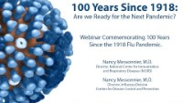
From the Expert
https://youtu.be/4czg3aKmfXs
Notes:
From the Expert:
Because of a convergence of many factors, the 1918 pandemic was exceptionally deadly. A pandemic and a war happening simultaneously led to many negative outcomes. Those lessons were largely forgotten by society by the time the COVID-19 pandemic arrived 101 years later. CDC, however, continued to use those lessons to put emergency plans into place for the next inevitable pandemic. In 2018, CDC commemorated the 100-year anniversary of the 1918 flu pandemic by exploring the events of the period and the lessons it could teach us.
Watch the 1918 Pandemic Partner Webinar featuring former director of the Influenza Division, Daniel B. Jernigan, MD MPH. In this video, he gives an overview of the 1918 flu pandemic and then examines current and future influenza threats. The informational part of this video is about 28 minutes long, but it is well worth a watch! https://youtu.be/4czg3aKmfXs
Why Participate? A Message from CDC
Looking back at the 1918 pandemic flu, we see many similarities to the COVID-19 pandemic a century later. Photos from gatherings in 1918 show masked crowds, streetcar operators arguing with unmasked riders, and hospital wards overflowing with patients. The vaccination mandates of today have a precedent in George Washington’s 1777 smallpox vaccine mandate for the Continental Army. We can apply the mistakes and lessons of our past to improve our future.

Slide 9
Think About It
What are some other pandemics that occurred before the 1900’s that you’ve learned about in the past? How did they change history?
Should epidemiologists consider anything other than direct health effects when responding to pandemics? For instance, if a quarantine due to disease exposure is going to cause someone to lose their job or house, should that be considered?
The response to COVID-19 in the United States was slow at first, due to political divisions. Do you think that pandemics are always inherently political? Why or why not?

Slide 10
Give it a Try
Call to Action!
Stop a flu pandemic.
Prevent a flu pandemic.
Share your findings.
Why do you think participation is important?
Notes:
Call to Action
In order to understand the dangers associated with pandemic influenza, it is essential that people understand how a pandemic occurs and the ways in which it can be slowed, stopped, or even prevented. You can help people by following these three steps:
Stop a flu pandemic. During the 1918 pandemic, the city of Philadelphia had thousands of cases of flu after a huge war fundraiser. Read through the details and decide how you would redesign it to make it safer.
Prevent a flu pandemic. In 1997, an outbreak of H5N1 type A avian influenza in Hong Kong was detected in humans. Learn how thorough disease surveillance detected a potential pandemic early and what measures health officials took to stop it.
Share your findings. One of the ways CDC communicates information is through social media. Your explorations can help CDC communicate the work they have done and are doing to decrease influenza cases, hospitalizations, and deaths worldwide.

Slide 11
Use the
Public Health Approach
Surveillance
What is the problem?
Risk Factor Identification
What is the cause?
Intervention
What works?
Implementation
How did we do it?
Surveillance
What is the problem?
Risk Factor Identification
What is the cause?
Intervention
What works?
Implementation
How did we do it?
Notes:
Public Health Approach
The public health approach below is a general method that can be used to study and solve public health problems. While this is a simplified version, it provides a good general framework. More info: https://www.cdc.gov/training/publichealth101/public-health.html

Slide 12

Give it a Try
1. Stop a flu pandemic
Read some quick info about the 1918 pandemic flu, which claimed the lives of an estimated 50 million people
Explore a case study of a 1918 wartime fundraising parade in Boston
Use the public health approach to develop a plan to raise money for the war effort while also controlling the spread of flu
Notes:
Stop a Flu Pandemic
The flu pandemic of 1918-19 hit the United States in three distinct waves, resulting in an estimated 675,000 deaths. While the origin of the virus isn’t confirmed, the most likely source is Haskell County, Kansas in January 2018. The small town was overwhelmed by an influenza epidemic unlike any the local doctor had ever seen before. Strong, healthy, robust people were being struck down quickly as if they had been shot. The disease burned through the town quickly with high casualty rates but disappeared after only a few weeks. In March, soldiers from Haskell County, Kansas travelled to nearby Camp Funston and brought flu with them. Troop movement to other bases in the U.S. and in Europe efficiently transmitted the virus around the globe. The first wave of the disease was mild compared to what was to come in the fall.
The following example comes from events that occurred along the East Atlantic Coast in September 1918. Use the public health approach to epidemic investigation to propose an intervention.
Surveillance: What is the problem?
In early September, Boston held a “Win the War for Freedom” parade where a few infected individuals spread the disease to many soldiers, seamen, and civilian shipyard workers. The flu quickly spread to the rest of the city with high casualties. Sailors from Boston shipped out for Philadelphia and brought the flu with them. Hundreds of sailors in Philadelphia were sick within days, and dozens died.
Death from this flu was quick and unpleasant. Young, healthy people experienced high fevers, body aches, fatigue, and violent coughing fits as their lungs filled with fluid. Unable to breathe, soldiers turned a dark blue color as they died, choked by their own mucus and blood. The flu was very transmissible from person to person and was more than 25 times deadlier than seasonal flu. Firsthand accounts from the period describe “bodies stacked like cordwood” in the hallways of hospitals and infirmaries.
Risk Factor Identification: What is the cause?
A war bond fundraising parade was planned in Philadelphia for September 28, 1918. The Liberty Loan Drive parade would include floats, community groups, uniformed troops, and even a marching band led by the great John Philip Sousa. Even President Wilson would be attending. The parade was a monumental event, especially during wartime, and was expected to draw tens of thousands of people to the crowded streets of Philadelphia. Wilmer Krusen was the city’s politically appointed public health director at the time. Faced with rising case numbers and objections from local medical experts, Krusen had a decision to make: how will the city fund the war and control the flu? If you were Wilmer Krusen, what concerns would you have about the parade?
Intervention Evaluation: What works?
As health director, Krusen has the duty to protect the health of the people of Philadelphia. It’s time to start thinking about how to slow or stop the spread of this deadly disease using medical knowledge.
Based on what you know about how influenza is transmitted from person to person and the background information provided about Philadelphia, describe a few interventions that will help prevent the flu from spreading.
Implementation: How would you do it?
Knowing the dangers of this flu and the realities of wartime, what should Krusen do? Cancel the parade and give up a huge fundraising opportunity? Let the parade go on knowing that people might get sick? Something else?
From Krusen’s perspective, what are the pros and cons of having the parade? Based on the background information provided, what would you do in Krusen’s position?
Update: What Really Happened: Stop a Flu Pandemic
Wilmer Krusen minimized the threat that flu posed, claiming it was just an old-fashioned flu. Despite many objections and reports of deadly outbreaks nearby, he allowed the parade to go ahead with promises to create an information campaign against coughing, spitting, or sneezing. The politics of wartime won out over public health.
The results were predictable. Within 72 hours, every hospital bed in the city was full. The city went into full lockdown 5 days after the parade, but it was too late to contain the illness. About 2,600 people were dead within a week. More than 12,000 would die in the next few weeks. Hospitals were overwhelmed, and Krusen tried to find more doctors and nurses to treat the abundance of patients. He increased sanitation efforts in the city and hired people to remove bodies from homes, which would later be dumped into mass graves due to a casket shortage. Philadelphia was one of the cities hardest hit by influenza in large part thanks to the deadliest parade ever.
For photos and videos from the parade, watch these videos:
https://youtu.be/6MzoAm6LUZg and https://www.loc.gov/item/mp76000040

Slide 13




Give it a Try
2. Prevent a flu pandemic
Explore a case study involving a 1997 outbreak of flu linked to bird markets
Use the public health approach to develop a plan to stop a flu pandemic before it begins
Notes:
Prevent a Pandemic
Advance planning and preparedness are critical to help reduce the impact of a pandemic. In 1999, the World Health Organization (WHO) publishes a report called “Pandemic Influenza Risk Management” that outlines global needs when responding to pandemic flu. These guidelines were published after cases of a novel H5N1 avian influenza were detected. As a result, the plans put in place using this report guided the response to the 2009 pandemic flu. Read more about an outbreak of novel type A influenza and decide how you would proceed using the public health approach to epidemic investigation.
Surveillance: What is the problem?
In May 1997, a 3-year-old boy in Hong Kong contracted an influenza-like illness and died 12 days later. The virus was identified as an influenza type A and further testing showed it to be a type of H5N1 related to an avian strain that killed thousands of chickens in rural Hong Kong chicken farms in March. No other cases were observed in humans, but because of the transmission from bird to human, disease surveillance capacity was increased to include routine testing for H5 surface proteins. In November, a small cluster of new H5N1 cases were detected. Of the 17 cases identified, 5 were fatal (18% fatality rate for children and 57% in adults 17+).
Risk Factor Identification: What is the cause?
Travelling, eating or preparing poultry products, and recent exposure to those with respiratory infections were not associated with these patients’ illness, but exposure to live poultry in the week before illness was. Those infected had visited live chickens in local marketplaces in the days before illness onset, which suggested direct transmission from bird to humans rather than person-to-person transmission. Blood tests showed that some people who had direct physical contact with infected individuals had H5 antibodies, indicating that some degree of human-to-human transmission had occurred but did not result in illness.
In this outbreak, person-to-person transfer of disease does not appear to be a major concern. With that in mind, what should be your focus areas when designing H5N1 flu interventions?
This outbreak occurred right at the beginning of the normal flu season, so H1N1 and H3N2 flu viruses were already circulating in the population. Why were health officials especially concerned by the emergence of H5N1 flu in humans at the same time as other flu types?
Intervention Evaluation: What works?
Suppose you were a public health official in Hong Kong during this time. Use the background information to come up with a plan that will address the outbreak. In this step of the public health approach to epidemics, you must think about what has worked in the past.
What is causing these infections?
What are three possible things you could do to stop the infections from occurring or spreading? When designing your interventions, be sure to consider social, political, cultural, and economic factors that might impact the effectiveness of your intervention.
Implementation: How would you do it?
From your idea list above, choose the one that you think will be the most effective to end the outbreak and prevent future spread of H5N1 flu.
Describe the intervention you are choosing to implement. Make sure to consider whether this is a long-term or short-term intervention.
What resources will you need to make this happen?
What barriers might make it difficult for you to implement your intervention?
Update: What Really Happened: Prevent a Flu Pandemic
In December 1997, health officials made the decision to slaughter all 1.5 million birds within the farms and markets in the territory. Importation of poultry from other areas was stopped temporarily while markets were cleaned. Once the initial outbreak was contained, other permanent measures were instituted. A 5-day quarantine and H5 infection testing program was put into place for all poultry coming into Hong Kong. New processes require the segregation of chicken from waterfowl. New licensing requirements and increased disease surveillance have been implemented to quickly detect infections in bird imports before they reach the live markets. Health officials also put measures into place to reduce exposure to live birds and have placed restrictions on imported and backyard poultry. This event may be the first example of successful containment of a potential global influenza.
Since then, the Asian H5N1 has been detected in poultry and wild birds in more than 50 countries in Africa, Asia, Europe, and the Middle East. It is considered to be endemic, or naturally occurring, in Bangladesh, China, Egypt, India, Indonesia, and Vietnam. Thorough disease surveillance and less human-bird contact are essential to preventing recombination of different flu genes. Strategic national stockpiles of vaccines, drugs, and medical equipment are also part of the plan to treat infected individuals and stop further spread in the event a flu pandemic occurs.
Read for more info: The Next Influenza Pandemic: Lessons from Hong Kong, 1997 https://wwwnc.cdc.gov/eid/article/5/2/99-0202_article

Slide 14
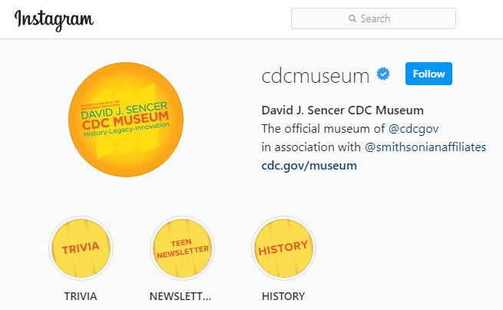
Give it a Try
3. Share Your Findings
Instagram @CDCmuseum
Notes:
Share Your Findings
The David J. Sencer CDC Museum uses award-winning exhibits and innovative programming to educate visitors about the value of public health and presents the rich heritage and vast accomplishments of CDC. Your demonstration could be a valuable contribution! Share your demonstration with the CDC Museum on Instagram using @CDCmuseum.

Slide 15

Questions?

