Slide 1



















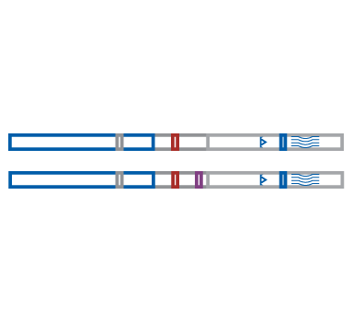

Harm Reduction Iconography
for Your Use
Steps for Downloading an Icon in PowerPoint:
Right-click on any image.
Select “Save as Picture.”
Save icon to your computer.

