Slide 1
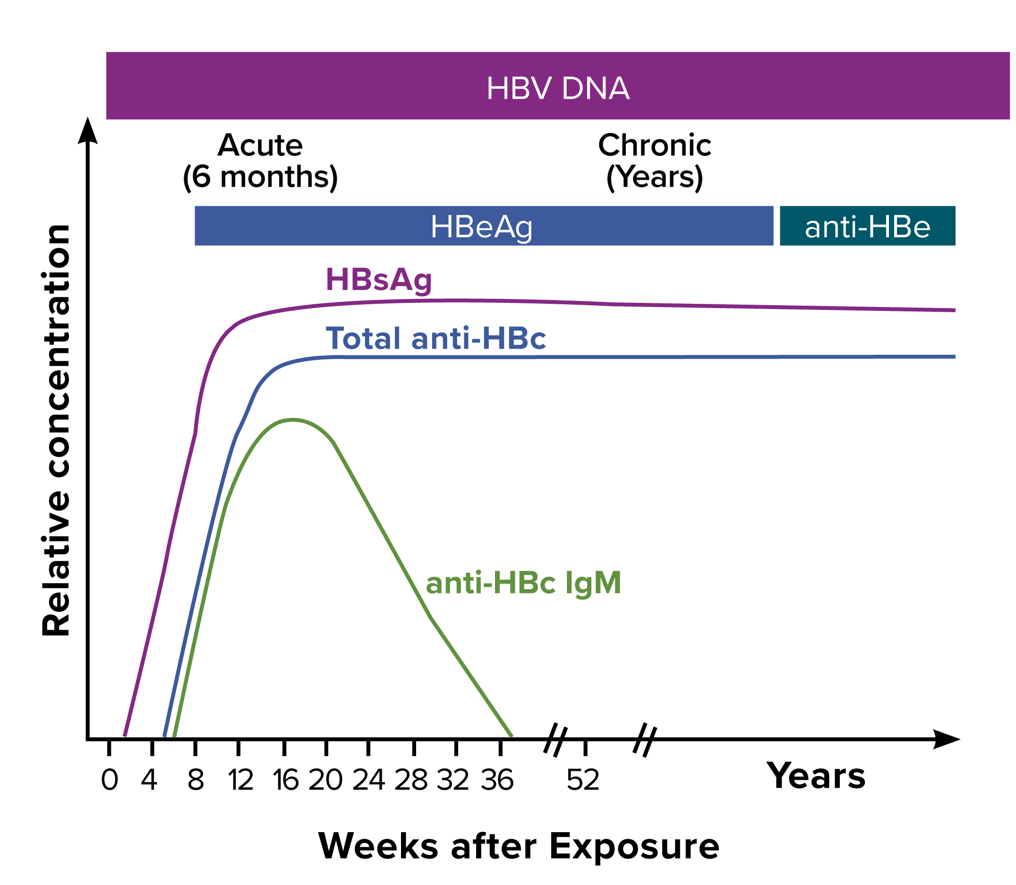
Figure 3-2. Typical serologic course of the progression to chronic hepatitis B
Figure obtained from https://www.cdc.gov/mmwr/preview/mmwrhtml/rr5708a1.htm.
Notes:
Figure 3-2 illustrates the typical biomarker changes of the progression to chronic hepatitis B.

