Slide 1

Childhood Lead Exposure in the United States: CDC’s Role in Prevention, Education, and Surveillance
Environmental Health NEXUS Webinar
August 04, 2021
Madeline Jones, MPH, CHES
Health Communication Fellow
Lead Poisoning Prevention and Surveillance Branch (proposed)
Paul Allwood
Branch Chief
Lead Poisoning Prevention and Surveillance Branch (proposed)

Slide 2
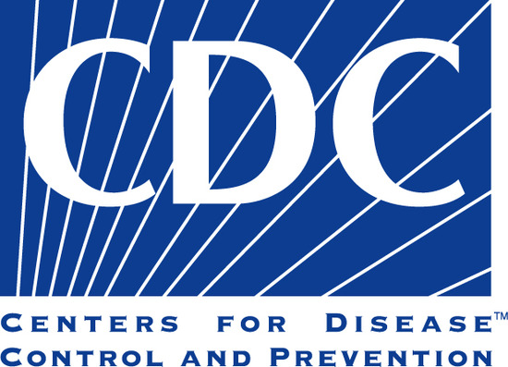
Overview
Introduction to childhood lead exposure
Sources of lead in children’s environments
Description of populations at higher risk
Current trends among children in the United States
Prevention strategies
Current initiatives at CDC

Slide 3

Lead is a toxic (poisonous) metal.
Lead exposure: When a child comes in contact with lead by swallowing or breathing in lead or lead dust.
Even low levels of lead can adversely affect the health of children.

Slide 4

In children, exposure to lead can cause harm.
Damage to the developing brain and nervous system
Learning and behavior problems
Slow growth and development
Hearing and speech problems

Slide 5

Children have the greatest risk of exposure and negative health impacts.
Key routes of lead exposure: inhalation and ingestion
Risk factors include
  Developing body systems and detoxification processes
  Unique behavioral factors such as mouthing and crawling
  Greater lead absorption per body size

Slide 6

Children are primarily exposed to lead from paint, soil, and water.
Lead-based paint in homes and buildings built before 1978
Contaminated soil from exterior lead-based paint, car exhaust, and factories that use lead
Contaminated drinking water delivered through lead plumbing materials

Slide 7

Children can be exposed to lead from other sources.
Take-home lead exposure from certain jobs
Traditional medicines and cosmetics
Remedies used in Ayurvedic medicine
Candy and candy wrappers
Spices
Toys and jewelry
Pottery and ceramic dishes

Slide 8
No safe blood lead level (BLL) has been identified.
The amount of lead in blood is referred to as blood lead level (BLL), which is measured in micrograms of lead per deciliter of blood (μg/dL).
CDC uses a blood reference value of 5 μg/dL to identify children with BLLs that are higher than most children.
  This level is based on the U.S. population of children ages 1-5 years who are in the highest 2.5% of children when tested for lead in their blood based on the National Health and Nutrition Environmental Survey (NHANES).

Slide 9

Testing children for lead exposure
A blood test is the easiest way to determine if a child has been exposed to lead.
  Most children with any lead in their blood show no symptoms.
  Two types of tests may be used: finger prick (capillary test) or venous blood draw.
  Based on the child’s blood lead level, healthcare providers can recommend follow-up actions and care.

Slide 10

What to expect when receiving a blood lead test

Slide 11

Some children are more likely to be exposed to lead.
These include children
  Who live in housing built before 1978
  From low-income households
  From racial or ethnic minority groups
  Who are immigrants, refugees, or recently adopted from outside of the United States
  Whose parents/caregivers may be exposed to lead through their work or hobbies

Slide 12

Lead can pass from a mother to her unborn baby.
Lead in the blood during pregnancy can
  Increase risk for miscarriage
  Cause the baby to be born too early or too small
  Hurt the baby’s brain, kidneys, and nervous system
  Cause the child to have learning or behavior problems
Source: ATSDR Toxicological Profile for Lead, https://www.atsdr.cdc.gov/toxprofiles/tp13.pdf.

Slide 13
Blood lead levels in U.S. children have declined.

Slide 14
Disparities in lead exposure exist.
At-risk children live in neighborhoods characterized by
  Older homes
  Lower family incomes
  Lower housing values
  Higher population densities
  Higher proportions of rental properties
  Higher proportions of minority, immigrant, and refugee residents

Slide 15
Disparities in blood lead levels exist.
Elevated blood lead levels are more prevalent among children
  From racial and ethnic minority groups
  From low-income households
  Children who live in housing built before 1978
Children from racial and ethnic minority groups are more likely to live in conditions where there is greater likelihood of exposure.

Slide 16
There is still more work to be done.
Millions of children are still exposed to lead.
Not all children are tested for blood lead, even when required by law.
Adverse health and developmental effects are being identified at increasingly lower blood lead levels.
Children can be exposed from multiple sources.

Slide 17
A parent’s perspective:
“My son was diagnosed with an elevated blood lead level or 11µg/dL when he was 1 year old. He was tested for ADHD at the age of 8. He exhibited severe symptoms of lead exposure, struggled through school, and required a great deal of academic support from the school. He attempted a year and a half of college, but that experience proved too much. He lacks confidence and knows that any career he chooses will require some form of further education. His fear and lack of self-confidence keeps him from moving forward with hopes.”

Slide 18

Lead exposure is preventable with organized effort.
Several steps can be taken to
  Prevent exposure before it occurs
  Prevent further exposure, if a child has already been exposed
  Mitigate the effects on the child’s health

Slide 19

Preventative actions for parents, caregivers, and others
Parents and caregivers can
  Learn the common sources of lead.
  Test their home for lead.
    Check with your landlord if you rent.
  Renovate and repair safely.
  Take everyday steps to stay healthy.
  Talk to their child’s healthcare provider.

Slide 20

Preventative actions for healthcare providers
Healthcare providers can
  Learn about the causes, symptoms, and effects of childhood lead exposure.
  Talk to their patients about lead exposure.
  Ensure children under the age of 6 receive required blood lead tests.
  Connect exposed children to recommended services.

Slide 21

Preventative actions for public health professionals
Public health professionals can
  Learn about lead hazards and risk factors in their community.
  Create awareness and a sense of urgency to prevent lead exposure.
  Organize and partner.
  Serve as a resource for parents and healthcare providers.

Slide 22

CDC’s Childhood Lead Poisoning Prevention Program (CLPPP)
Vision: To eliminate childhood lead poisoning as a public health problem.
Mission: To reduce blood lead levels in children and differences in average risk based on race and socioeconomic status

Slide 23




CLPPP focuses on strengthening four core strategies.
Blood lead testing and reporting
Surveillance of child blood lead levels
Targeted, population-based interventions
Linkages of lead-exposed children to recommended services

Slide 24
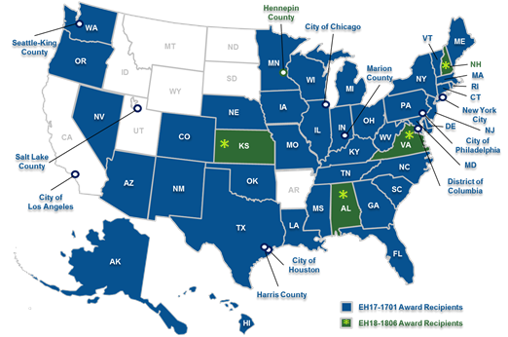
CDC supports prevention activities nationwide.
Figure: Fiscal year (FY) 2018 Childhood Lead Poisoning Prevention Cooperative Agreement Recipients

Slide 25
CDC-funded partners have achieved many successes.
150
200%
3,500+
additional children with elevated blood lead levels identified in Chicago
increase in blood lead testing in one county in Missouri
uses of a new interactive mapping tool in Arizona
330+
17,848
4,000
children given blood lead tests at events in Seattle
referrals made to critical health and development services in Flint, Michigan
pamphlets distributed to parents in Delaware

Slide 26
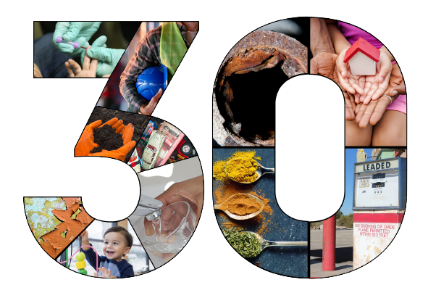
Commemorating 30 years of supporting childhood lead poisoning prevention activities.
CDC began funding state and local childhood lead poisoning prevention programs in 1991.
Theme: Continuing Our Commitment to Eliminate Childhood Lead Exposure

Slide 27
Beginning of a new funding cycle
CDC-RFA-EH21-2102: Childhood Lead Poisoning Prevention and Surveillance of Blood Lead Levels in Children
Project period: September 30, 2021 to September 29, 2026
Eligibility expanded to include public entities such as territories.
62 state and local health departments awarded funding.

Slide 28
Lead Exposure and Prevention Advisory Committee
Consists of 15 Federal and non-Federal experts charged with:
  Reviewing federal programs and services available to lead-exposed individuals and communities.
  Reviewing current research on lead poisoning to identify additional research needs.
  Reviewing and identifying best practices, or the need for best practices, regarding lead screening and prevention of lead poisoning; and
  Identifying effective services for individuals and communities affected by lead exposure.
  More information is available at: https://www.cdc.gov/nceh/lead/advisory/lepac.htm.

Slide 29

Advancing the science of lead exposure prevention
Call for papers: CDC and the American Journal of Public Health (AJPH) Supplement
Title: “Ubiquitous Lead: Risks, Prevention, Mitigation Programs, and Emerging Sources of Exposure.”
Deadline: January 30, 2020

Slide 30
Redesigned Lead Poisoning Prevention Training Center
Audience: public health staff tasked with reducing lead exposure in their communities
Training modules will cover:
  Foundations of lead exposure
  Strategic planning and implementation of key strategies
  Epidemiology and surveillance of lead exposure
  Developing community partners and outreach
  The science of lead exposure: Using data for action
Anticipated launch: October 2021

Slide 31


Join us for National Lead Poisoning Prevention Week!
Annually, the last full week in October.
Hosted by CDC, HUD, and EPA.
Theme: “Get the Facts, Get Your Home Tested, and Get Your Child Tested.”

Slide 32






Resources available at www.cdc.gov/nceh/lead
State and local programs directory
Frequently asked questions
Data and statistics
Laboratory guidance
Publications, guidelines, and policy resources
Communication materials

Slide 33
Resources from our partners
Guidelines for controlling lead-based paint hazards in housing
  https://www.hud.gov/program_offices/healthy_homes/lbp/hudguidelines
Lead disclosure information for homebuyers and renters
  https://www.epa.gov/lead/real-estate-disclosures-about-potential-lead-hazards
Find a certified renovation and lead dust sampling technician firm
  https://cfpub.epa.gov/flpp/pub/index.cfm?do=main.firmSearch
Photos and descriptions of recalled products
  www.cpsc.gov/recalls
Information on lead exposure for adults
  https://www.cdc.gov/niosh/topics/lead/jobs.html

Slide 34
Summary
No safe blood lead level for children has been identified.
Protecting children from lead exposure is important to lifelong good health.
Individuals, public health professionals, and healthcare providers each play a key role.
CDC is committed to eliminating childhood lead exposure as a public health problem.

Slide 35
For more information:
CDC’s Childhood Lead Poisoning Prevention Program
https://www.cdc.gov/nceh/lead/

