Slide 1
Federal Advisory Committee Breast Cancer in Young Women
Sexual Health and Fertility Working Group

Slide 2
Members of Working Group
Anna Crollman
Elissa Thorner, MHS
Myrlene Jeudy, MD
Ellyn Davidson
Lisa Astalos Chism DNP, APRN, BC, CSC, NCMP, FAANP

Slide 3
Statement of Problem
Lack of consistent acknowledgement, assessment, and interventions offered for sexual health concerns among young women with breast cancer
Lack of consistent acknowledgement, assessment, and interventions offered for fertility concerns among young women with breast cancer

Slide 4
Review of NCCN Current Guidelines
Sexual health
Fertility

Slide 5
Sexual Heath
NCCN Guidelines under Survivorship

Slide 6
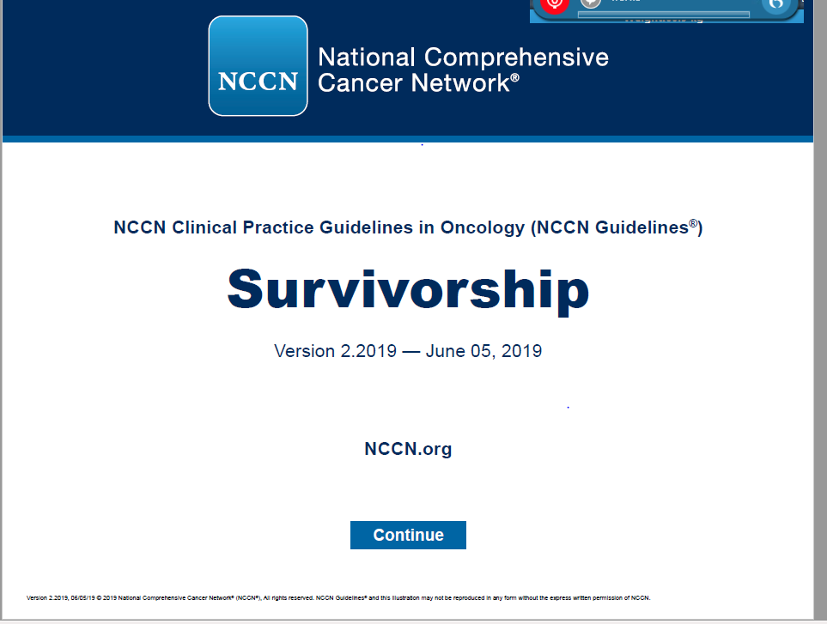

Slide 7
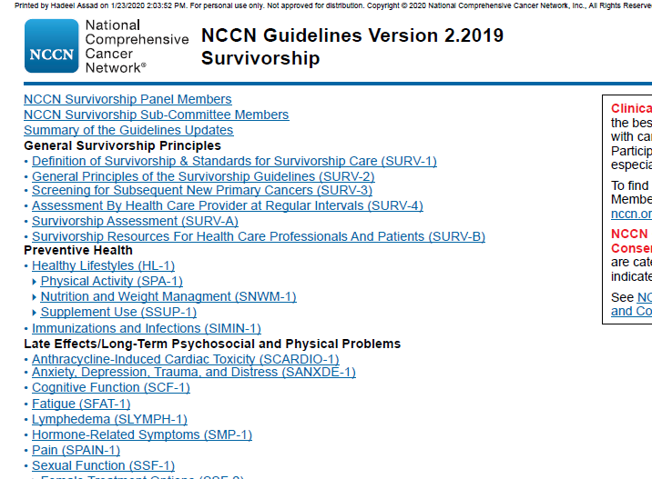

Slide 8
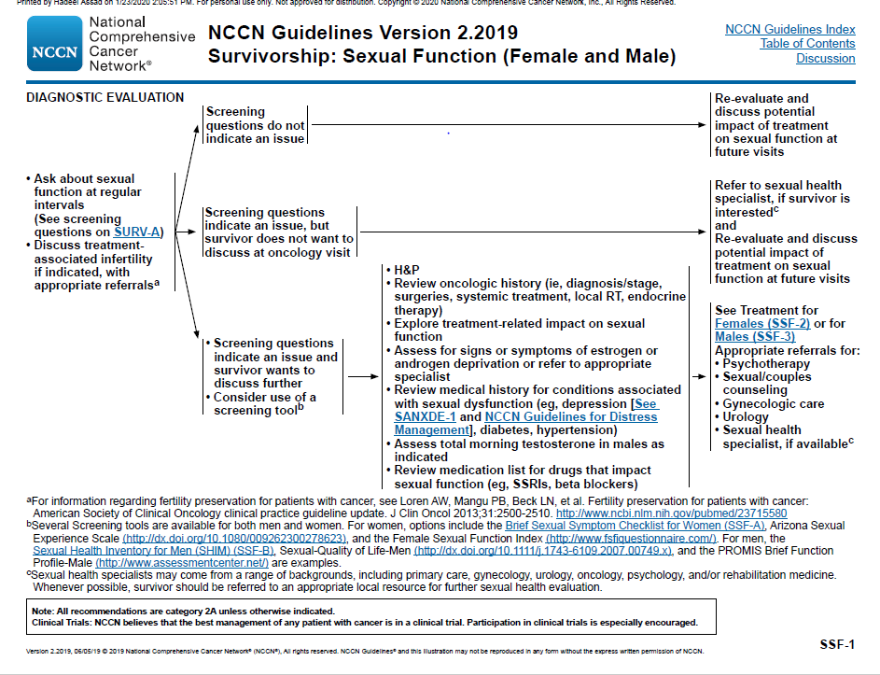

Slide 9
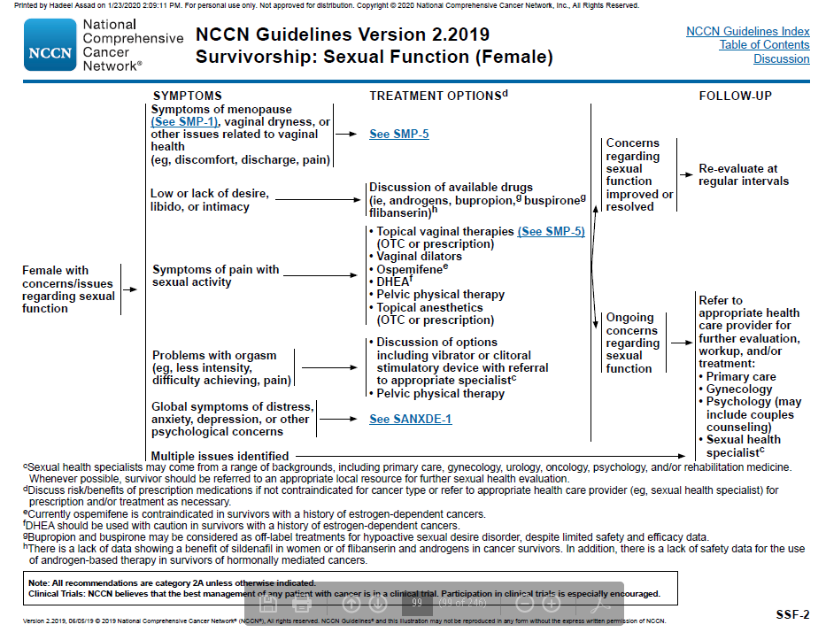

Slide 10
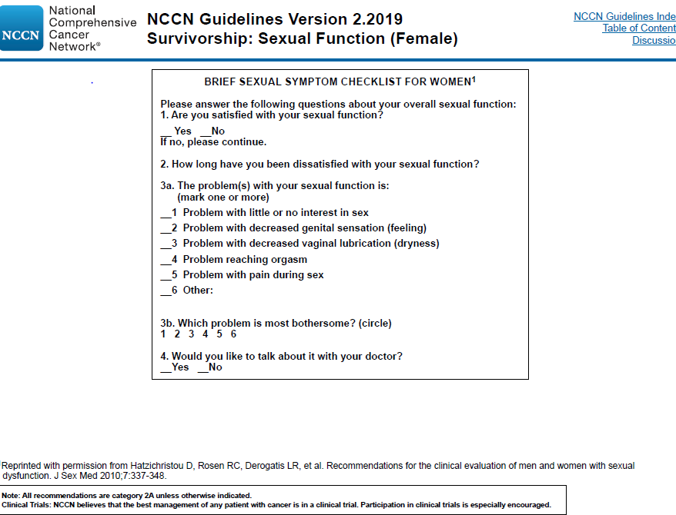

Slide 11
Fertility
NCCN Guidelines under Adolescent and Young Adult Oncology

Slide 12
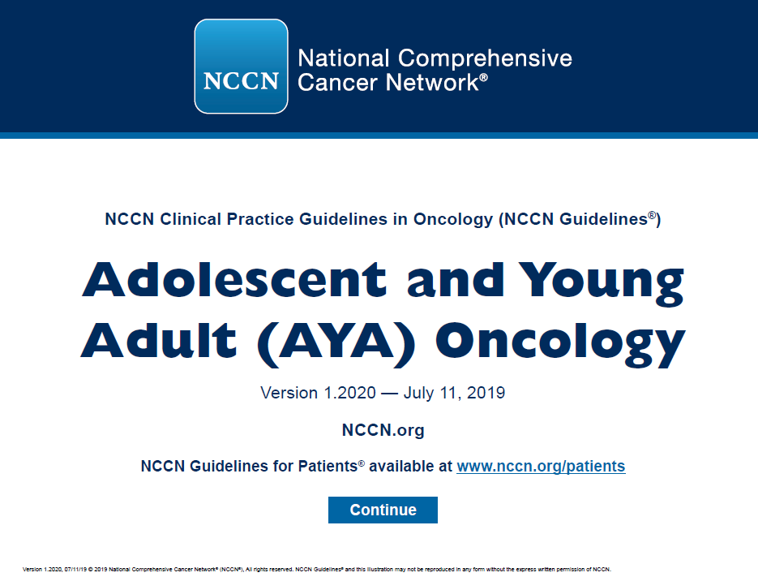

Slide 13
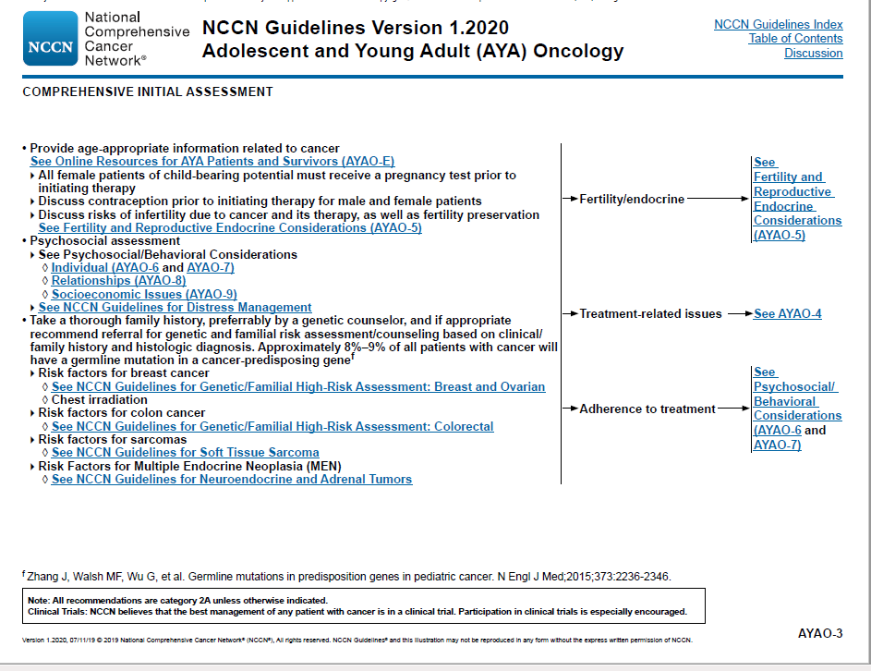

Slide 14
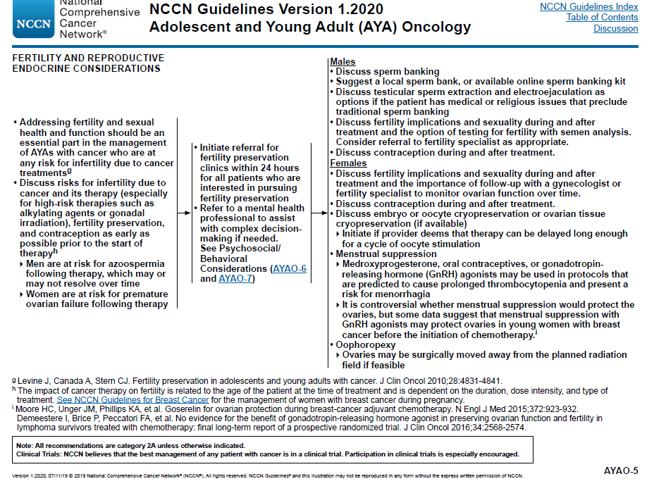

Slide 15
NCCN Guideline Issues:
Sexual Health
  Listed under “survivorship”
  Not specific to young women in breast cancer
  Treatment options not FDA Approved; Requires extensive counseling
  Not consistently used according to the literature/practice
  Sexual minorities not addressed
Fertility
  Listed under “adolescent and young adult”
  Not specific to young women and breast cancer
  Not consistently used according to the literature/practice
  Sexual minorities not addressed

Slide 16
The Literature
Sexual health
2.1 Million breast cancer diagnoses each year worldwide (WHO, 2018)
4-6% are women under age of 40
68% of women treated for BC experience sexual function issues, 45% still experience once treatment done
  Most caused by premature ovarian failure as a result of treatment leading to GSM (genitourinary syndrome of menopause), vaginal dryness, pain with intercourse, decreased desire
  Others self image related (weight gain, loss of breast(s), hair loss)
  Fatigue, pain

Slide 17
The Literature…
Treatments for GSM
Vaginal moisturizers (hyaluronic acid) and lubricants
Local estrogen – requires risk benefit discussion
Local DHEA- requires discussion
Vaginal dilators
Vaginal stimulation
CO2 vaginal laser therapy
Local Lidocaine
*More detail available if needed

Slide 18
The Literature…
Treatments for decreased desire
  Sexual health counseling/therapy
  Flibanserin
  Bremelanotide
  *More details available if needed

Slide 19
The Literature
Fertility
Oncofertility- new branch of medicine
  Embryo cryopreservation
  Cryopreservation of ovarian tissue
  Transplantation of ovarian tissue
  Ovarian suppression
Theresa Woodruff Northwestern University
https://www.youtube.com/watch?v=4G4-38VxrBQ

Slide 20
Future Steps…Based on Feedback from Group
Sexual Health
Fertility

Slide 21
Thank You

