Slide 1

Survivorship Series for Young Women Affected By Breast Cancer
Arin Ahlum Hanson, MPH
Associate Director of Outreach and Partnerships
arin@lbbc.org

Slide 2

Mission: To connect people with trusted breast cancer information and a community of support.

Slide 3




LBBC Programs
Online
In print
By phone
In person
Visit LBBC.ORG to learn more!

Slide 4
Survivorship Series Overview
Trains oncology nurse navigators (Program Leaders) to implement a 4-part group patient education program in their cancer centers.
The series focuses on survivorship concerns for women diagnosed before age 45.
Program is through LBBC’s Young Women’s Initiative, which is funded through a CDC Cooperative Agreement DP14-1408 (2014-2019).
Program will continue with newly awarded CDC Cooperative Agreement DP19-1906 (2019-2024).

Slide 5
Program Objectives
To increase the Program Leaders’ knowledge of the survivorship topics covered in the curriculum and their confidence to implement the program.
To increase the Program Participants’ knowledge of survivorship topics and confidence to make behavioral changes to increase their quality of life after breast cancer.

Slide 6
Survivorship Series Timeline
Development of the program began in 2017, when LBBC engaged Lori Ranallo, RN, MSN, ARNP-BC, to assist in the development of the curriculum.
First Program Leader cohort was trained in April 2018
Second cohort was trained in February 2019

Slide 7
Why the Survivorship Series?
Few cancer centers offer patient education programs that address these survivorship topics for young women.
Some healthcare providers report feeling unprepared to adequately address these patient needs.
Builds off of LBBC’s expertise working with healthcare providers, young women affected by breast cancer and implementing training programs.
Leverages the relationship the patient has with their nurse navigator and cancer center to connect them to LBBC’s tailored resources for young women.
Engages young women who are less likely to seek out LBBC on their own.

Slide 8
Independent External Evaluation
In January 2018, the Survivorship Series Program was selected by the CDC to have an independent external evaluation by Oak Ridge Associated Universities (ORAU).
ORAU Evaluators were tasked to identify and assess the effectiveness of HCP education resources which provide information on early onset breast cancer.
LBBC’s Survivorship Series was one of the only HCP education programs focused on young women affected by breast cancer ORAU could identify in their environmental scan.

Slide 9
Survivorship Series Program Elements
In-person Program Leader training (20 hours), provides in-depth education on the medical and psychosocial content covered in the series, facilitation skill building, and marketing and implementation tools.
Once trained, Program Leaders lead the series at their home cancer centers within five months. These centers also support the marketing and implementation of the sessions.
LBBC provides ongoing support through monthly check-in calls, Online Resource Hub, and a Closed Facebook Group for Program Leaders.
LBBC staff provides ongoing technical assistance through phone and email communication.

Slide 10
Survivorship Series Sessions
Year 1:
Let’s Talk About Sex and Breast Cancer
Hot and Bothered: Coping with Early Menopause
Stay Alert: Managing the Long-Term Side Effects of Breast Cancer Treatment
More You Know: Understanding Your Genetic and Cancer Risk
Year 2:
Hot and Bothered: Coping with Early Menopause
Stay Alert: Managing the Long-Term Side Effects of Breast Cancer Treatment
Let’s Talk About Sex and Breast Cancer
Self Care After Breast Cancer

Slide 11
Materials Provided to Program Leaders
Set of materials for each session include:
  Slide Decks with discussion prompts and online videos
  Worksheets
  LBBC Mailing List Sign Up Forms
  LBBC Care Boxes or gifts
  Marketing templates
  Participant Evaluations
  Program Leader Session Reports

Slide 12
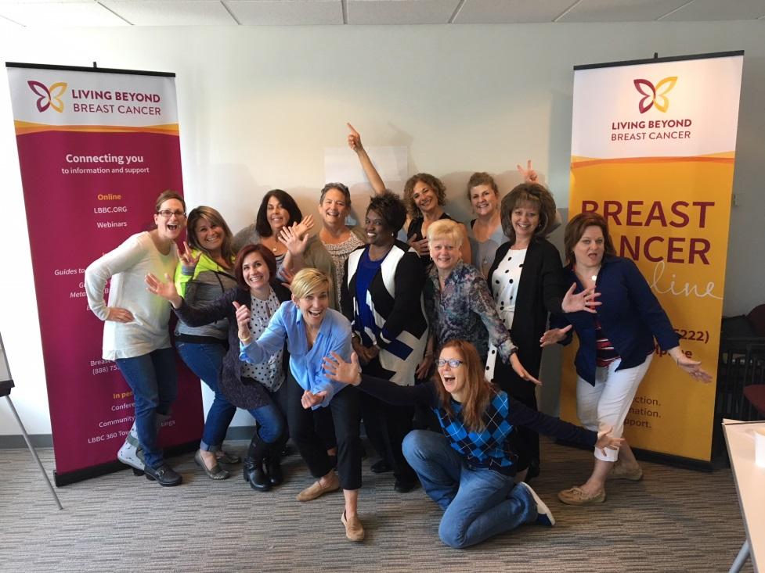
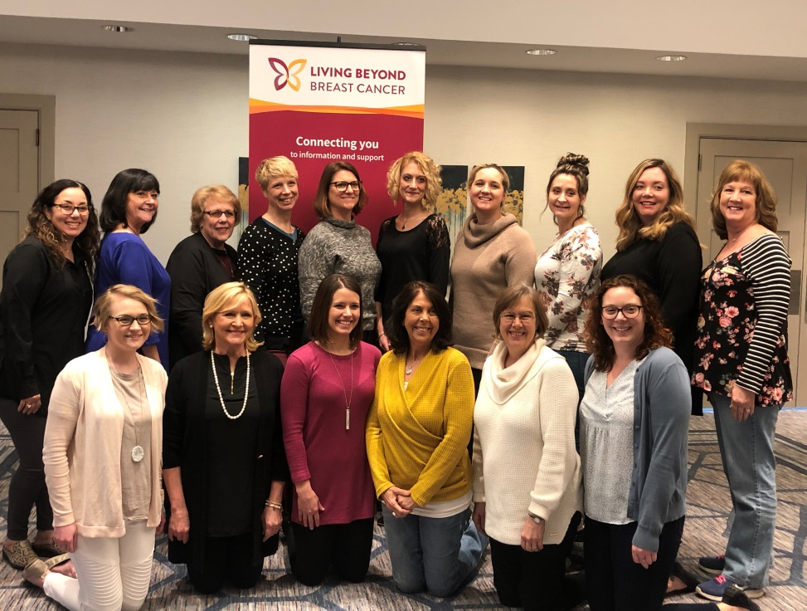
Survivorship Series Program Leaders
26 oncology nurse navigators have been trained and all have successfully implemented the series.

Slide 13
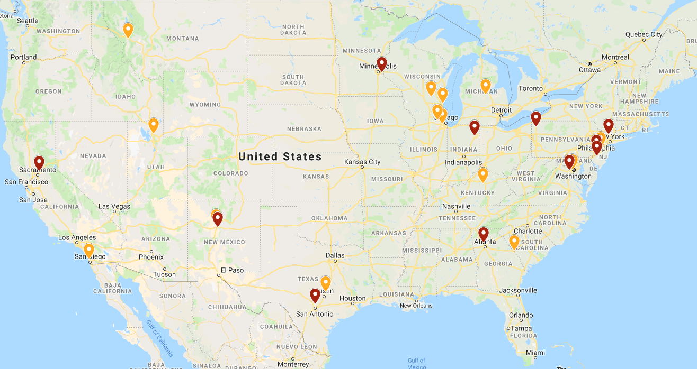
Survivorship Series Program Leaders
Program Leaders represent 26 cancer centers, with the majority of them being community cancer centers.

Slide 14
Adaptable to the Setting and Community
Since the Program Leaders know their patient community best, they are given autonomy to make many programmatic decisions.
Program Leaders select the timing and flow of the program.
Program Leaders can include guest speakers (i.e. yoga instructors, pelvic floor physical therapists, etc.).
Program Leaders create Resource Sheets which list LBBC resources and highlighted local resources specific to the topic.

Slide 15
Evaluation Elements
Program Leaders complete a Pre and Post Training Assessment and Post- Training Evaluation.
Program leaders complete session reports and submitted their modified materials after each session.
Program leaders passed out evaluation forms to each participant to complete by hand at each session.
One-hour interviews were conducted over the phone with all 26 program leaders and a subset of program attendees (33 participants from 20 of the 26 sites).
LBBC staff was also interviewed.

Slide 16
Impact on Program Leaders
Pre and Post assessment showed increase knowledge gains on all survivorship series topics as a result of the in-person training.
Program Leaders reported high levels of satisfaction with the training.
“I'm so very impressed by this training and the program you've put together. As a survivor, I think you've chosen the right topics (I wish I would have known this info way back when!) As an RN, you've created a well-organized, evidence-based program that I think will be the right combination of education and experience sharing.”
– Program Leader

Slide 17
Program Reach
For Year 1, total attendance per session topic ranged from 68 to 111 for the 11 sites.
For Year 2, total attendance per session topic ranged from 81 to 123 for the 15 programs.
Approximately 700 attendees in total over the past 2 years. (This counts attendance, not unique participants.)

Slide 18
Evaluation Highlights
Participants favorably reviewed the content of all four sessions.
The majority of participants strongly agreed with the following statements:
I feel this session was helpful to me (79%)
I feel the length of the session was appropriate (78%)
I feel the instructor showed a thorough knowledge of the topic (76%)
I feel the instructor answered questions effectively (83%)
I feel the materials were easy to understand (84%)
I feel that I am not alone in my experience with breast cancer (79%)

Slide 19
Evaluation Results
Only half of participants reported becoming more familiar with LBBC as a result of the program.
This indicates that LBBC should focus more on training the Program Leaders to serve as more effective “ambassadors” for LBBC and develop a more effective post-program engagement strategy.
Percent of Participants who strongly agreed with the following statements:
I am familiar with Living Beyond Breast Cancer as an organization (53%)
I am familiar with LBBC resources (48%)

Slide 20
Why did Participants Attend?
In the interviews, participants where asked why they attended the program and the majority said they were attracted to the emphasis on young women.
“I was instantly interested…It did not list specific topics but the fact that it was geared to young women was enough for me. “Young Woman with breast cancer – that’s me!”

Slide 21
Participant Interview Findings
Participants indicated they appreciated:
  Connections they made with others
  Information they learned from group
  Listening to others facing similar situations
Many women offered specific examples of information they learned in each session during the interview.
Participants reported “feeling not alone,” “affirmed,” and validated by other participants.

Slide 22
Impacts of the Program Participants
Many women cited specific actions they’ve taken since the series.
Women described the continued networking and connections that came from the experience.
“I got two women’s phone numbers. I still talk to one of them. She is still going through chemo treatment…So I feel like both clinical information and communication with the people I was around in the class is important.”
“I appreciate the PL was open to the idea of bringing in a yoga instructor. As a result, the instructor offered to do free classes for breast cancer survivors. It was a cool connection…It brought people together in a way that something really valuable came out of it. I have been going to that class once a week…I personally had done yoga previously but I had to take a break when I was going through my treatment and it was hard to get back into.”

Slide 23
“Just the very idea of having classes like this is so important. It was such a good help and it made me feel like someone is there to answer our questions or help us …I know this is the first year and they are trying to work on it, but it is amazing.”
Quote from 2018 Survivorship Series Participant

Slide 24
2019 Program Changes
Recruited Program Leaders with more prior experience facilitating in-person programs.
Increased facilitation skill building in the training from 1 hour to 4 hours.
Local Resource Templates for PLs to modify.
Survivorship Series landing page (LBBC.ORG/SURVIVORSHIP)
Multi-touch email engagement strategy
Integration of YWiConnect Text sign up
LBBC name tags

Slide 25
2020 Proposed Changes
Develop a session for young women living metastatic breast cancer. Rename the program to be more inclusive to the metastatic experience.
Increase cancer center buy-in by inviting all key personnel from participating institutions to attend a webinar that provides an overview of the series content and reviews strategies on how to support and promote the program.
Better align program with National Accreditation Program for Breast Centers (NAPBC) accreditation requirements.
Pursue nursing CE accreditation
Modify evaluation plan and evaluate potential institutional change elements of the program.

Slide 26
Conclusion
The pilot evaluation conducted by ORAU showed that the Survivorship Series was an impactful program on Program Leaders and participants.
This program successfully provided a high-touch supportive educational experience to over 300 people.
This model demonstrates that engaged HCPs can be a effective way to deepen LBBC’s reach in areas of the country with little LBBC presence.

Slide 27
Questions?

