Slide 1
2020 Autism and Developmental Disabilities Monitoring (ADDM) Network Surveillance Summaries | Supplemental Slides
Published March 23, 2023

Slide 2
2020 ADDM Surveillance Summary Citations and Links
Maenner MJ, Warren Z, Williams AR, et al. Prevalence and Characteristics of Autism Spectrum Disorder Among Children Aged 8 Years — Autism and Developmental Disabilities Monitoring Network, 11 Sites,
United States, 2020. MMWR Surveill Summ 2023, 72 (No. SS-2): 1-14.
Shaw KA, Bilder DA, McArthur D, et al. Early Identification of Autism Spectrum Disorder Among Children Aged 4 Years — Autism and Developmental Disabilities Monitoring Network, 11 Sites, United States, 2020.
MMWR Surveill Summ 2023, 72 (No. SS-1): 1-15.

Slide 3
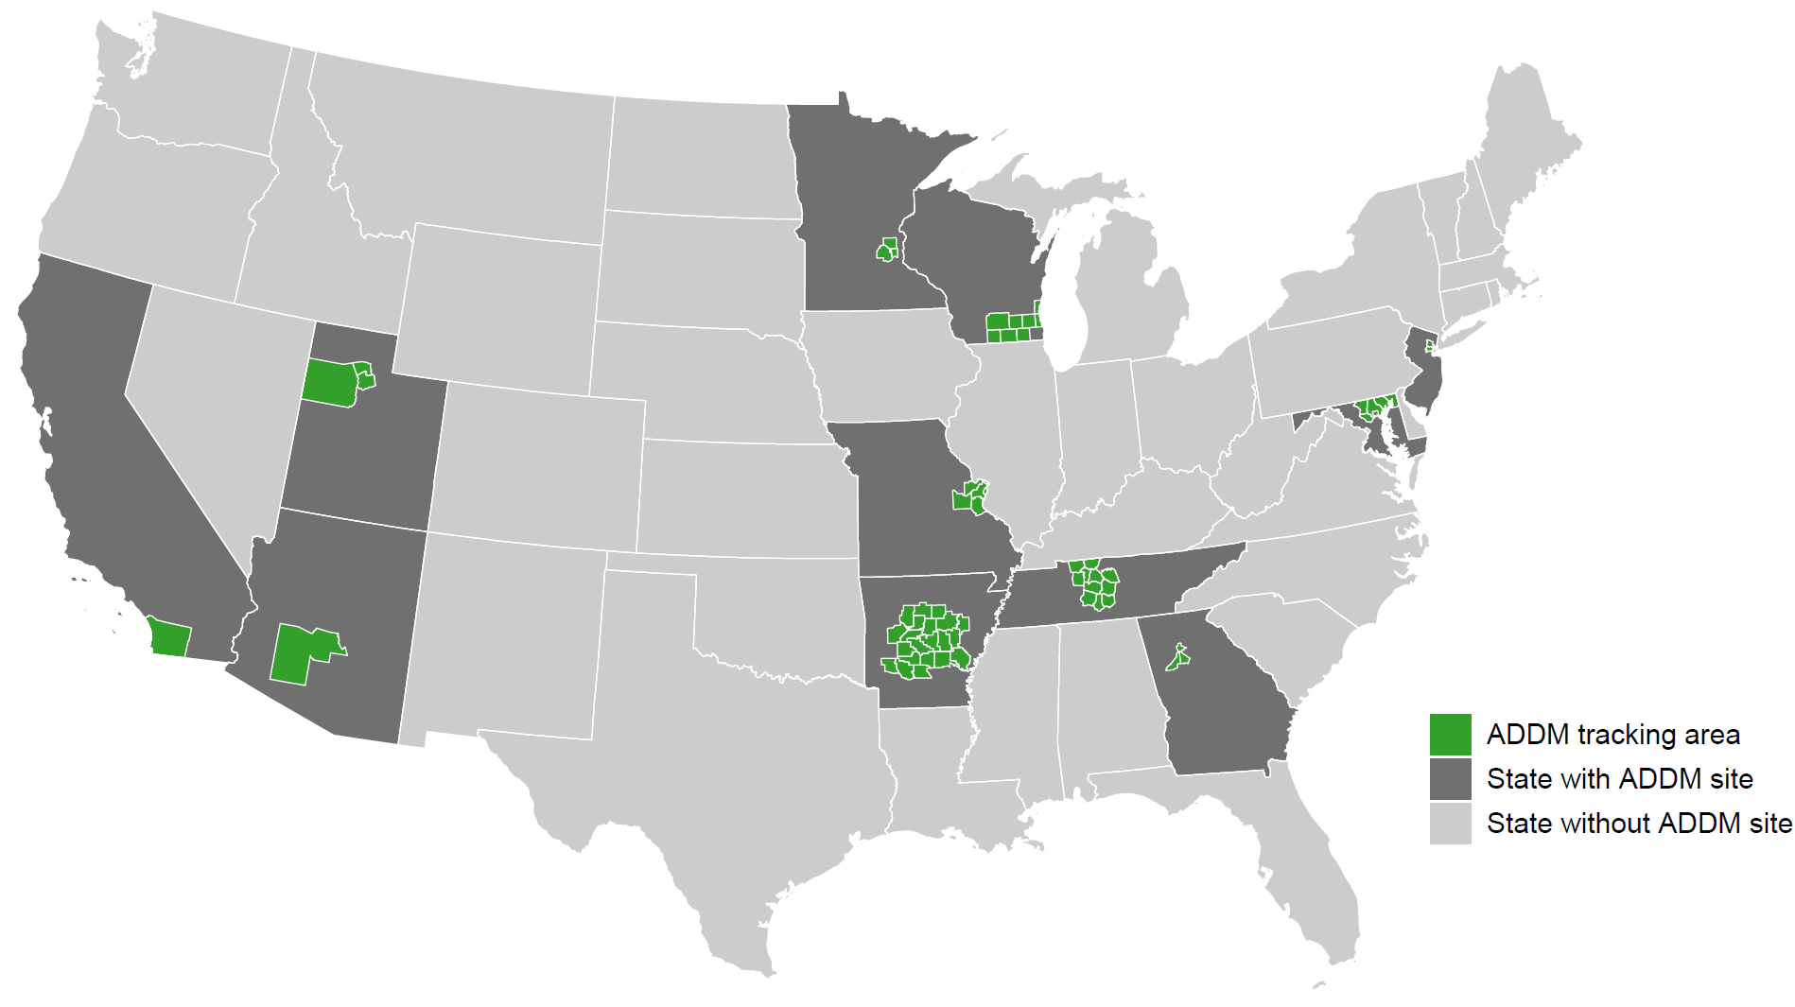
Autism and Developmental Disabilities Monitoring Network, 11 sites, United States, 2020

Slide 4
ADDM Ascertainment and ASD Case Definition
  Records that included various billing codes from the International Classification of Disease, Ninth Revision (ICD-9) or International Classification of Diseases, Tenth Revision (ICD-10) or special education eligibility codes were requested from health and education sources. Children ages 4 or 8 who had a parent or guardian who lived in one of the surveillance areas during 2020 were classified as having ASD or suspected ASD if they met the below criteria.
ASD case definition | Suspected ASD case definition
Child has documentation of ever receiving: a written ASD diagnosis by a qualified professional, a special education classification of autism, OR an ASD ICD code obtained from administrative or billing information | (4-year-old only) Child does not meet criteria of full case definition but there is a qualified examiner’s diagnostic statement that the child is suspected of having ASD

Slide 5
ADDM Intellectual Disability Case Definition
Co-occurring intellectual disability was classified as:
  IQ score ≤70 on most recent test
  examiner’s statement of intellectual disability in a developmental evaluation

Slide 6
ADDM Additional Data Sources and Variable Definitions
  National Center for Health Statistics population estimates for 2020 were used as denominators. Estimates for areas smaller than county level were adjusted using National Center for Education Statistics public school enrollment counts for 2020-2021.
  Sites linked American Community Survey 2020 5-year estimates for median household income (MHI) to records of children using their 2020 address. Census tracts for all sites combined were grouped into low, middle, and high MHI tertiles that included roughly equal populations of children.

Slide 7
ADDM Analytic Methods
  Prevalence was calculated as the number of children with ASD per 1,000 children in the defined population or subgroup.
  Cumulative incidence for children aged 4 years was compared with children aged 8 years in the ADDM Network. Cumulative incidence of ASD diagnosis was calculated per 1,000 children by dividing the total number of children with an ASD diagnosis or special education eligibility at each month of age by the 2020 age 4 or age 8 population denominator.

Slide 8
ADDM Analytic Methods – COVID-19 analysis
  Numbers of evaluations and ages of earliest identification were aggregated by calendar month for children aged 4 and 8 years in 2020.
  To compare the same age windows by calendar month, the numbers of evaluations and incidence of identification from 2012 (year 0) through 2016 (year 4) for children aged 8 years was subtracted from the same months during 2016 (year 0) through 2020 (year 4) for children aged 4 years.

Slide 9
2020 Prevalence of Autism Spectrum Disorder Among Children Aged 8 Years
Autism and Developmental Disabilities Monitoring Network
11 Sites, United States

Slide 10
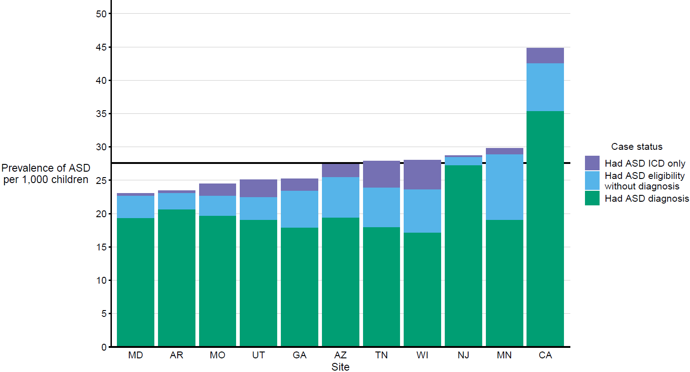
Prevalence* of autism spectrum disorder per 1,000 children aged 8 years, by identification type and site
Autism and Developmental Disabilities Monitoring Network, 11 sites, United States, 2020
* Horizontal line is the overall Autism and Developmental Disabilities Monitoring Network prevalence of 27.6 per 1,000 children aged 8 years. Children with documented ASD statements could also have ASD classifications in special education or ASD ICD codes.

Slide 11
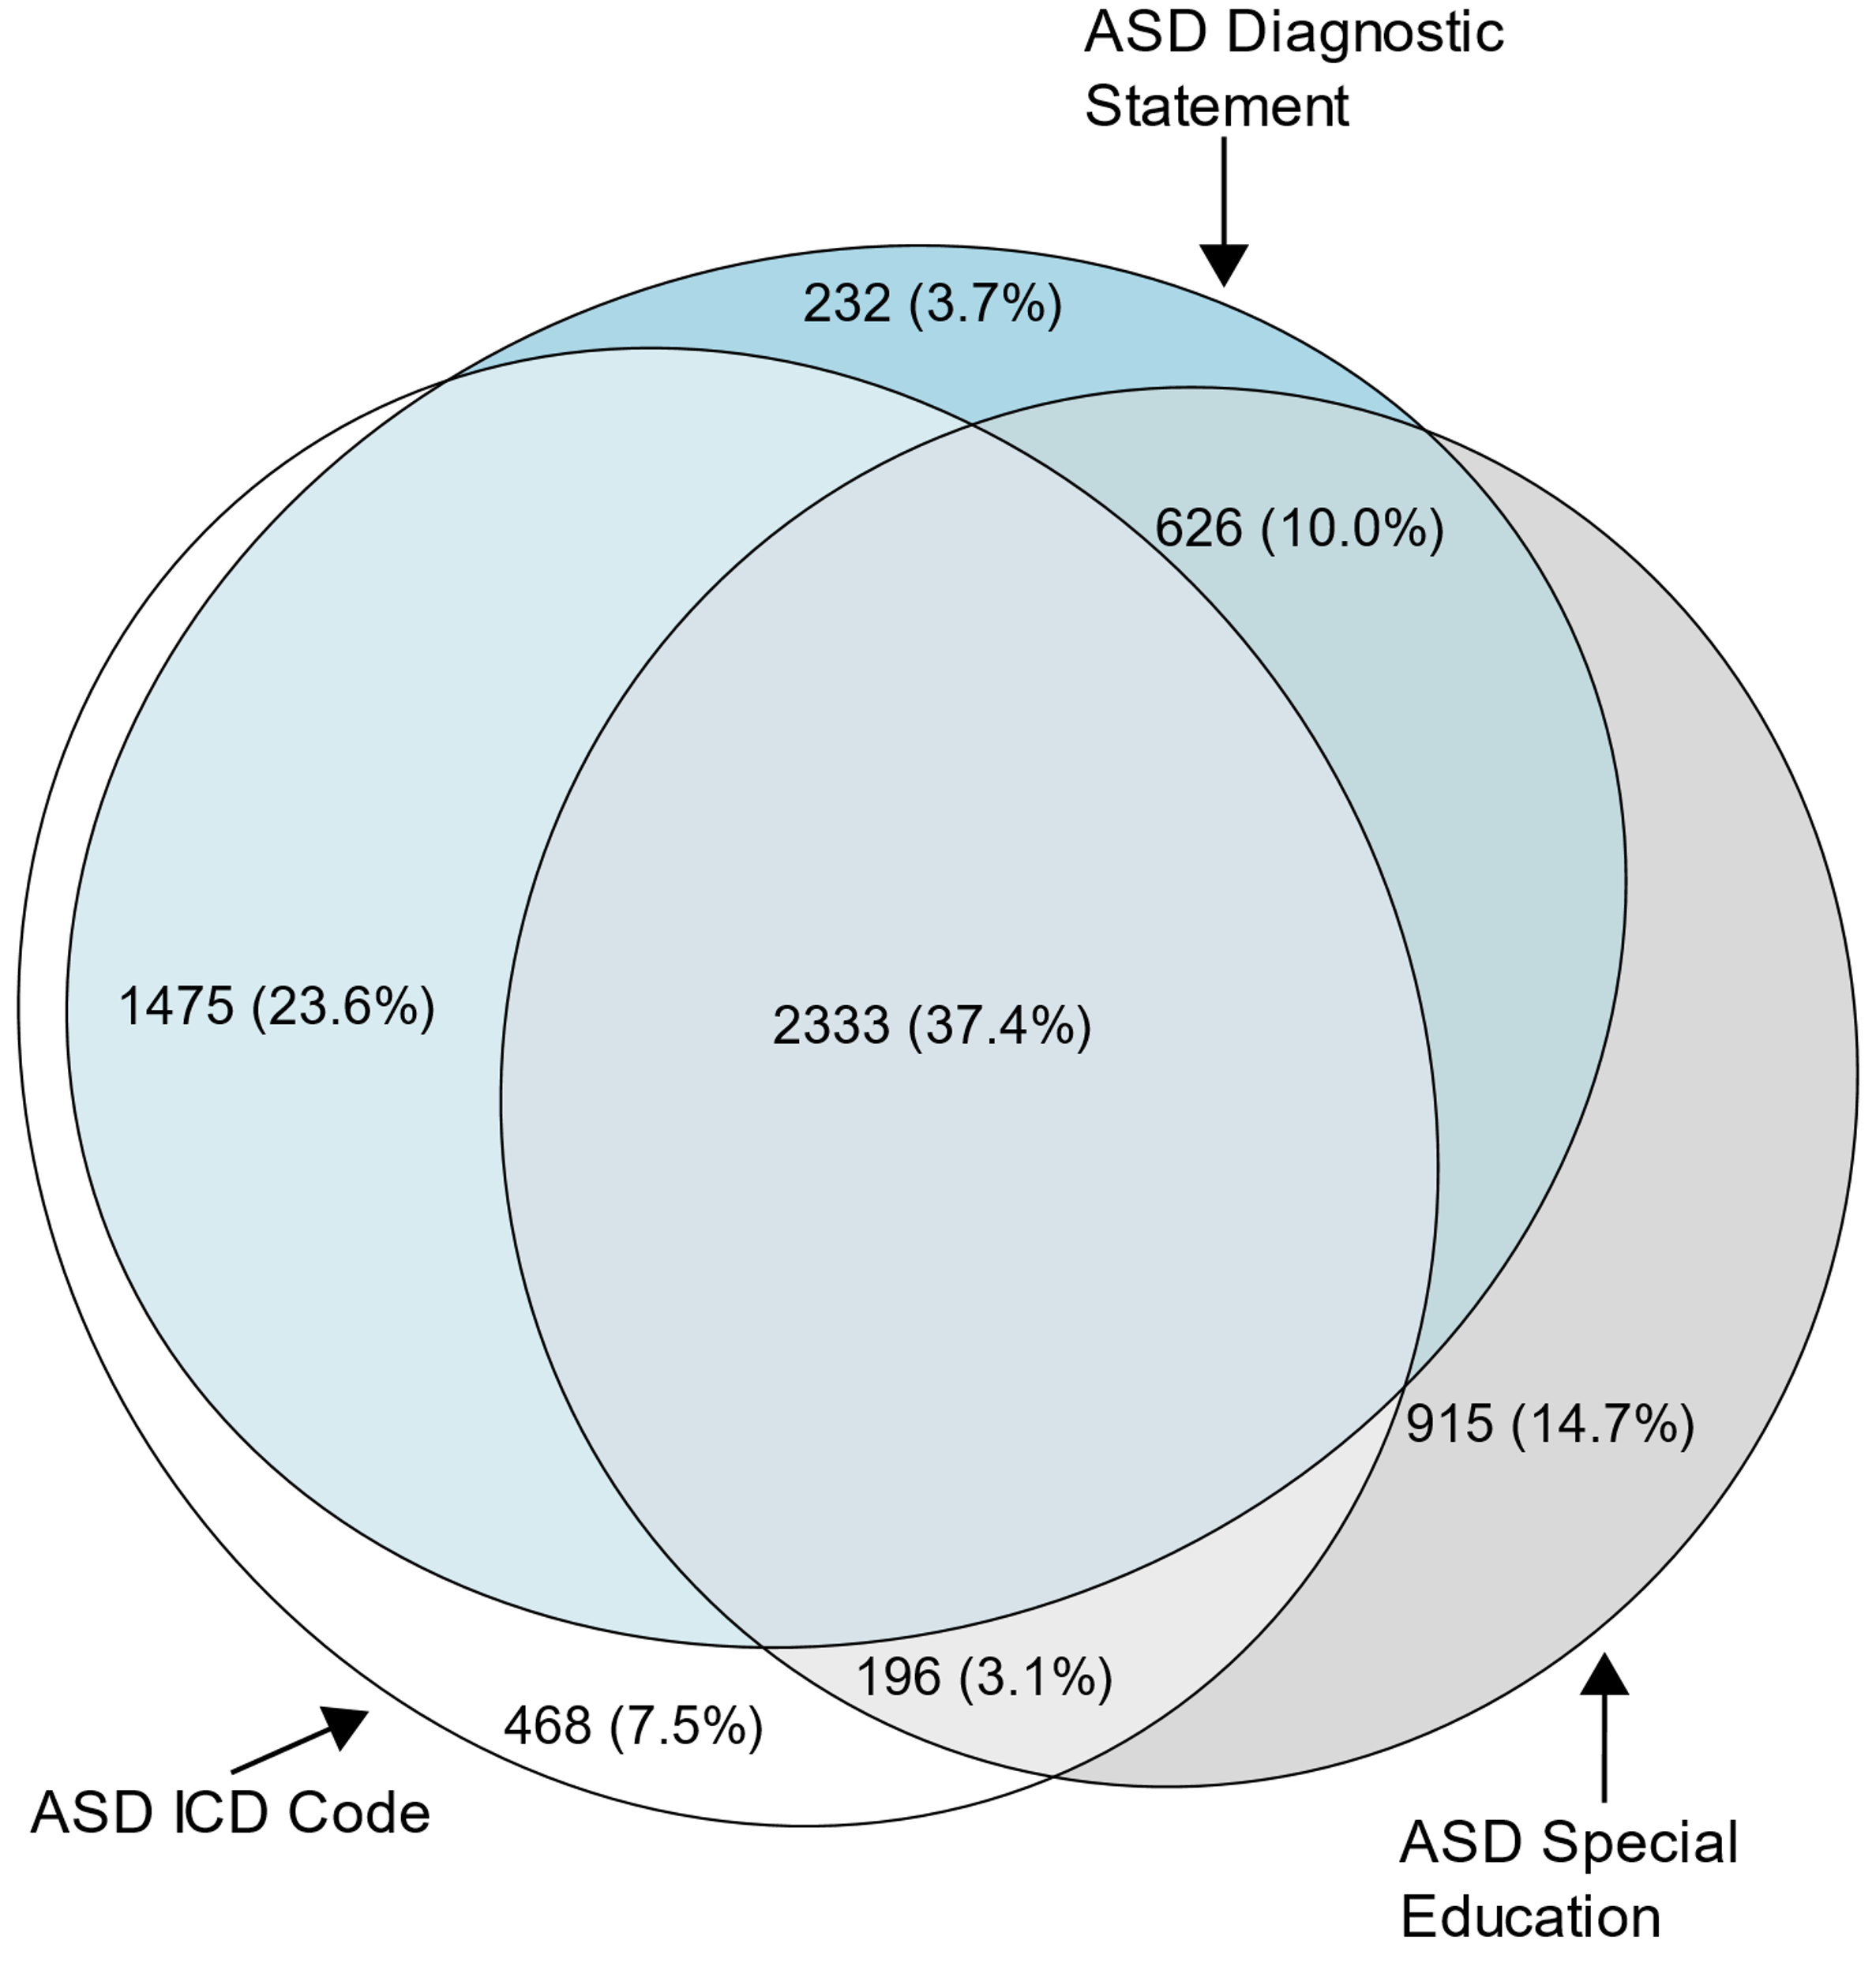
Euler diagram of different types of autism spectrum disorder identification among children aged 8 years with autism spectrum disorder (N=6,245)
Autism and Developmental Disabilities Monitoring Network, 11 sites, United States, 2020

Slide 12
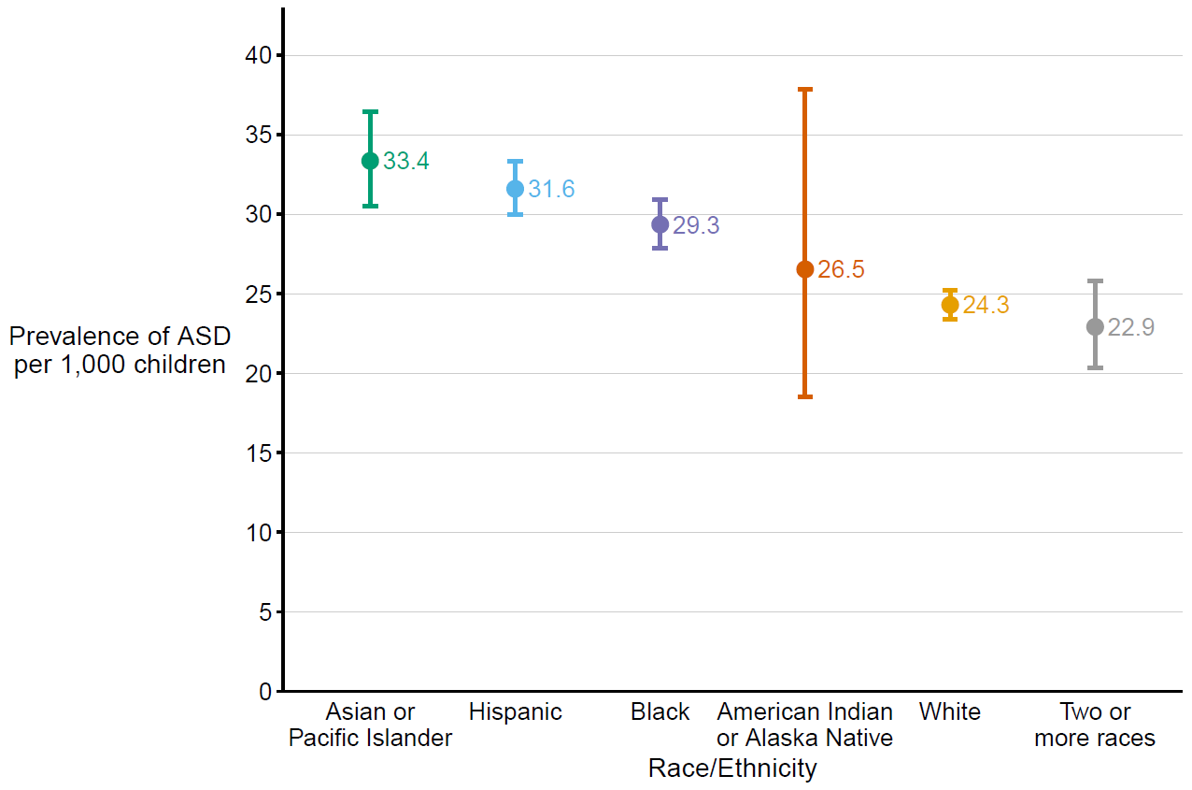
Prevalence of autism spectrum disorder per 1,000 children aged 8 years, by race/ethnicity
Autism and Developmental Disabilities Monitoring Network, 11 sites, United States, 2020

Slide 13
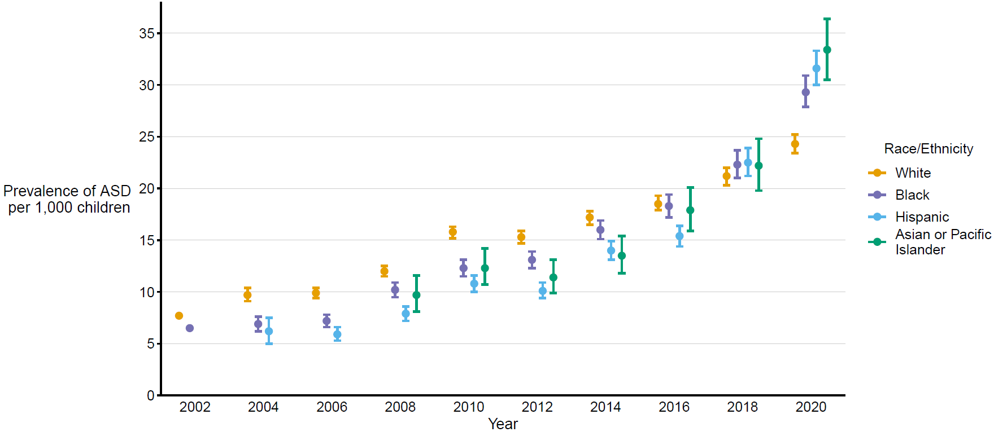
Prevalence of autism spectrum disorder per 1,000 children aged 8 years over time, by race/ethnicity
Autism and Developmental Disabilities Monitoring Network, 11 sites, United States, 2002–2020

Slide 14
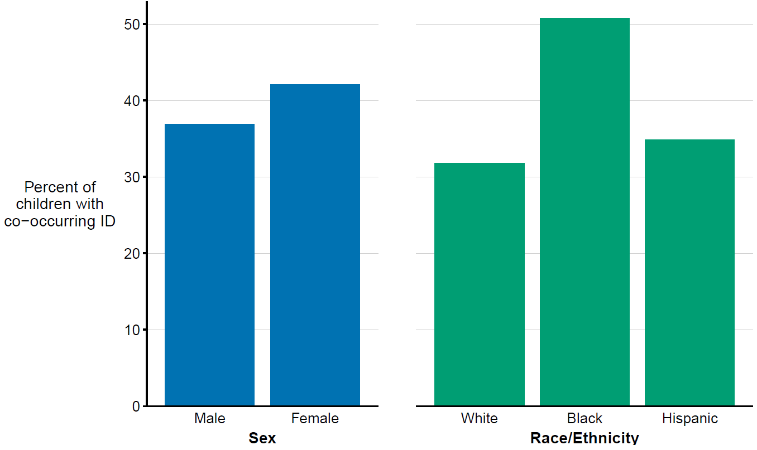
Percent of children aged 8 years with autism spectrum disorder with co-occurring intellectual disability*, by sex and race/ethnicity
Autism and Developmental Disabilities Monitoring Network, 11 sites, United States, 2020
* IQ score ≤70 or examiner statement of intellectual disability in a comprehensive evaluation

Slide 15
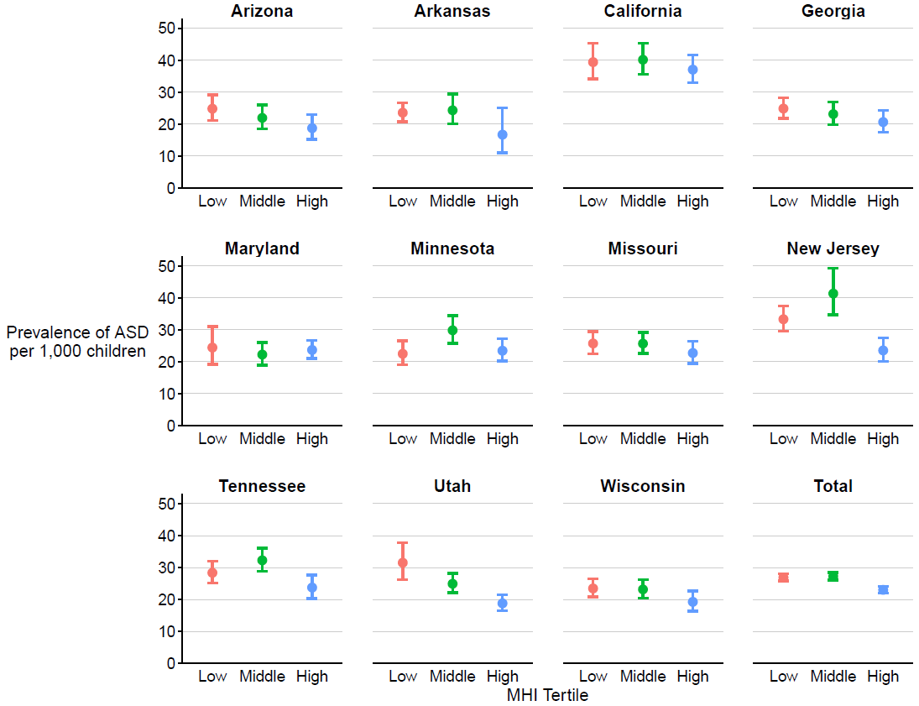
Prevalence* of autism spectrum disorder per 1,000 children aged 8 years,
by median household income tertile and site†
Autism and Developmental Disabilities Monitoring Network, 11 sites, United States, 2020
* Dots are the point estimates and horizontal lines are the 95% confidence intervals.
† Cochran Armitage test of trend results for association between socioeconomic status tertile and ASD prevalence, by site and overall: Arizona p = 0.03; Arkansas p = 0.3; California p = 0.5; Georgia p = 0.08; Maryland p = 0.9; Minnesota p = 0.8; Missouri p = 0.3; New Jersey p<0.01; Tennessee p = 0.1; Utah p<0.01; Wisconsin p = 0.08; Total p<0.01.

Slide 16
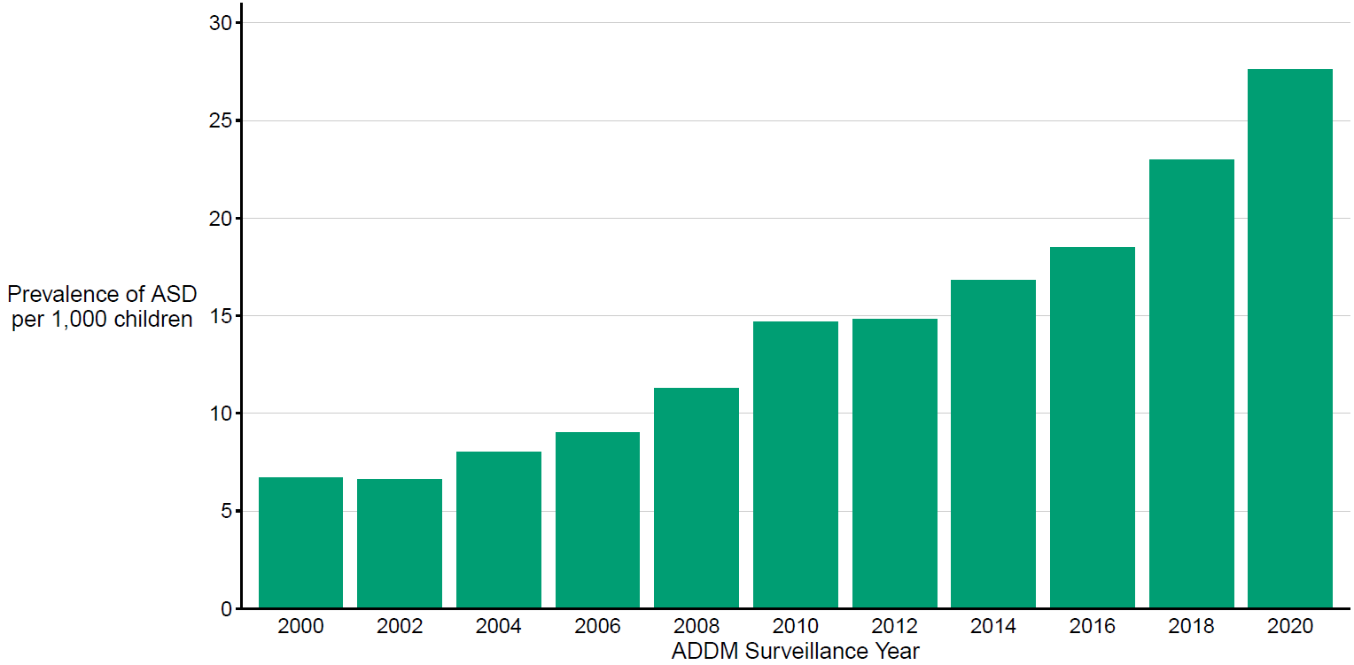
Prevalence of autism spectrum disorder per 1,000 children aged 8 years, by surveillance year
Autism and Developmental Disabilities Monitoring Network, 2000–2020

Slide 17
2020 Early Identification of Autism Spectrum Disorder Among Children Aged 4 Years
Autism and Developmental Disabilities Monitoring Network
11 Sites, United States

Slide 18
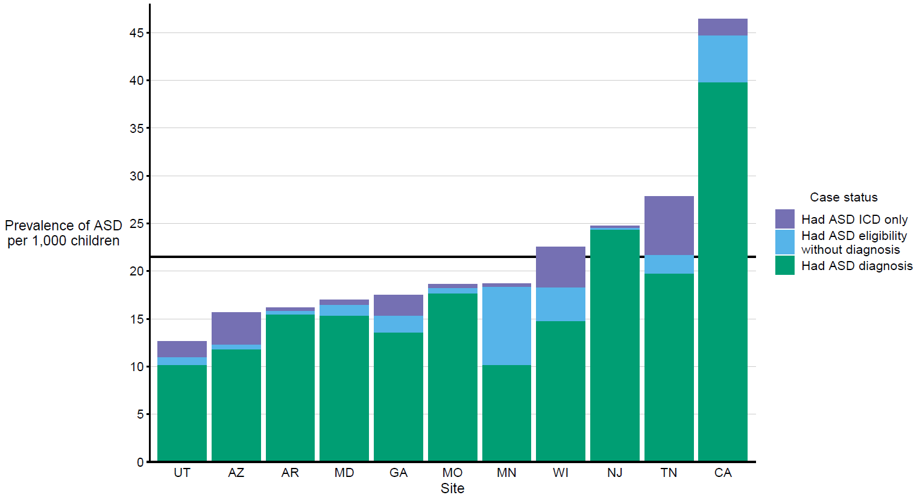
Prevalence* of autism spectrum disorder per 1,000 children aged 4 years, by identification type and site
Autism and Developmental Disabilities Monitoring Network, 11 sites, United States, 2020
* Horizontal line is the overall Autism and Developmental Disabilities Monitoring Network prevalence of 21.5 per 1,000 children aged 4 years. Children with documented
ASD statements could also have ASD classifications in special education or ASD ICD codes.

Slide 19
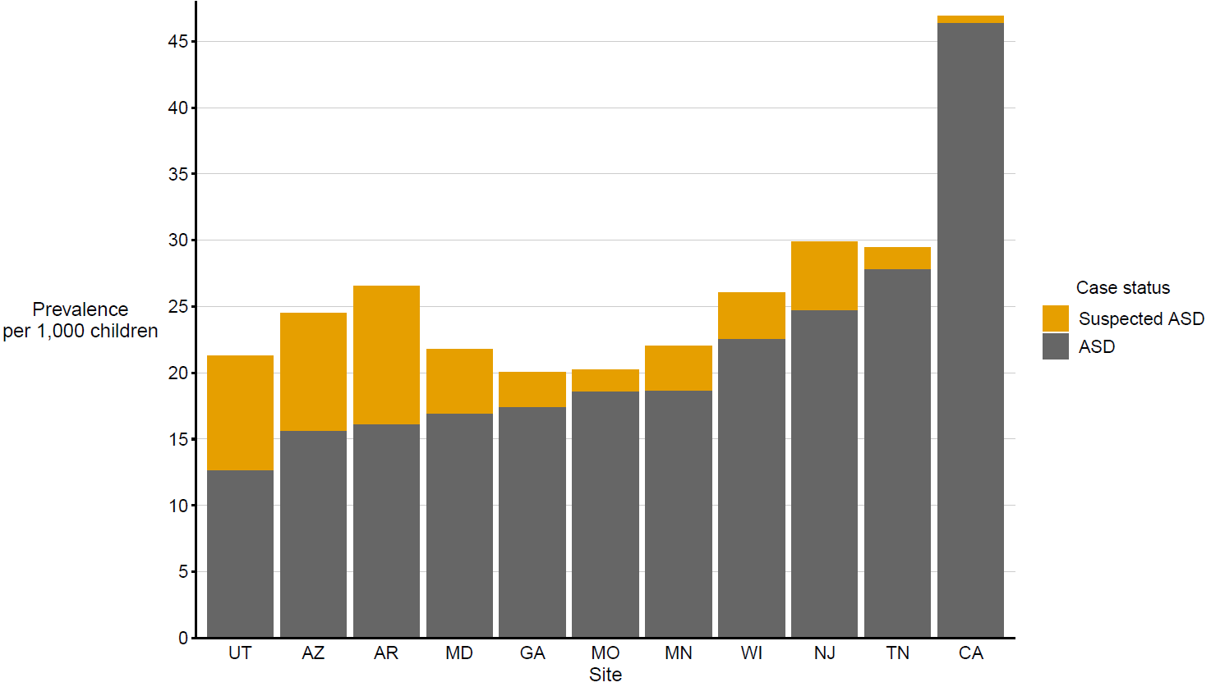
Comparison of prevalence of children aged 4 years with autism spectrum disorder (ASD) vs suspected ASD, by site
Autism and Developmental Disabilities Monitoring Network, 11 sites, United States, 2020

Slide 20
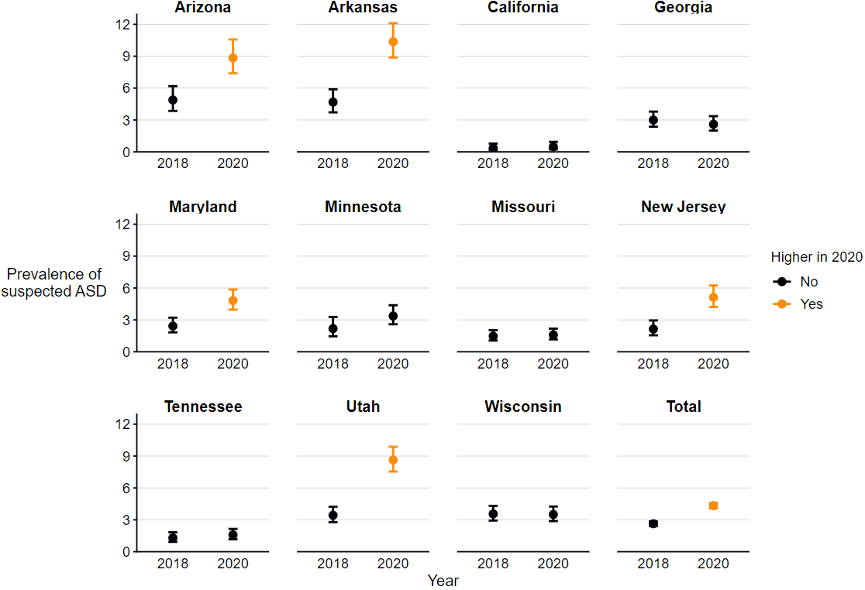
Prevalence of suspected autism spectrum disorder per 1,000 children aged 4 years
Autism and Developmental Disabilities Monitoring Network, 11 sites, United States, 2018 and 2020
* Higher if 2020 to 2018 prevalence ratio 95% CI excludes 1.0.

Slide 21
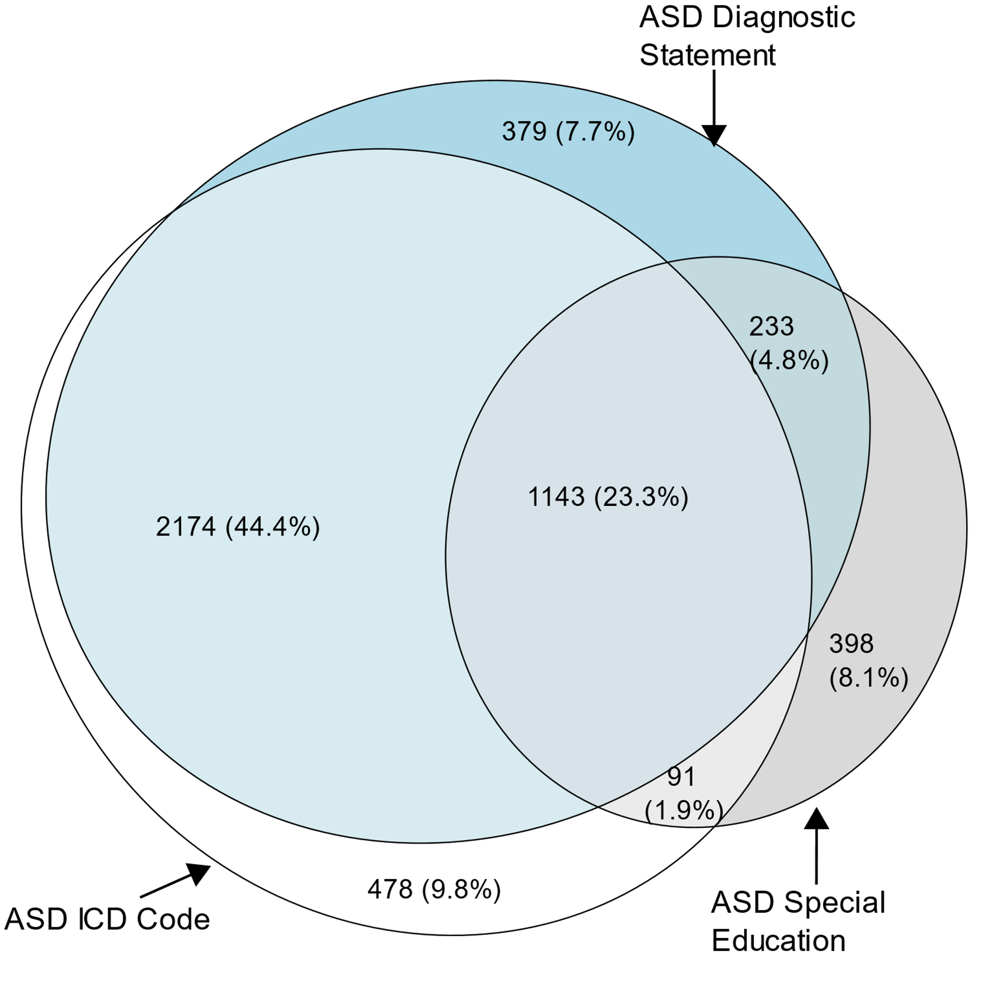
Euler diagram of different types of autism spectrum disorder identification among children aged 4 years with autism spectrum disorder (N=4,896)
Autism and Developmental Disabilities Monitoring Network, 11 sites, United States, 2020

Slide 22
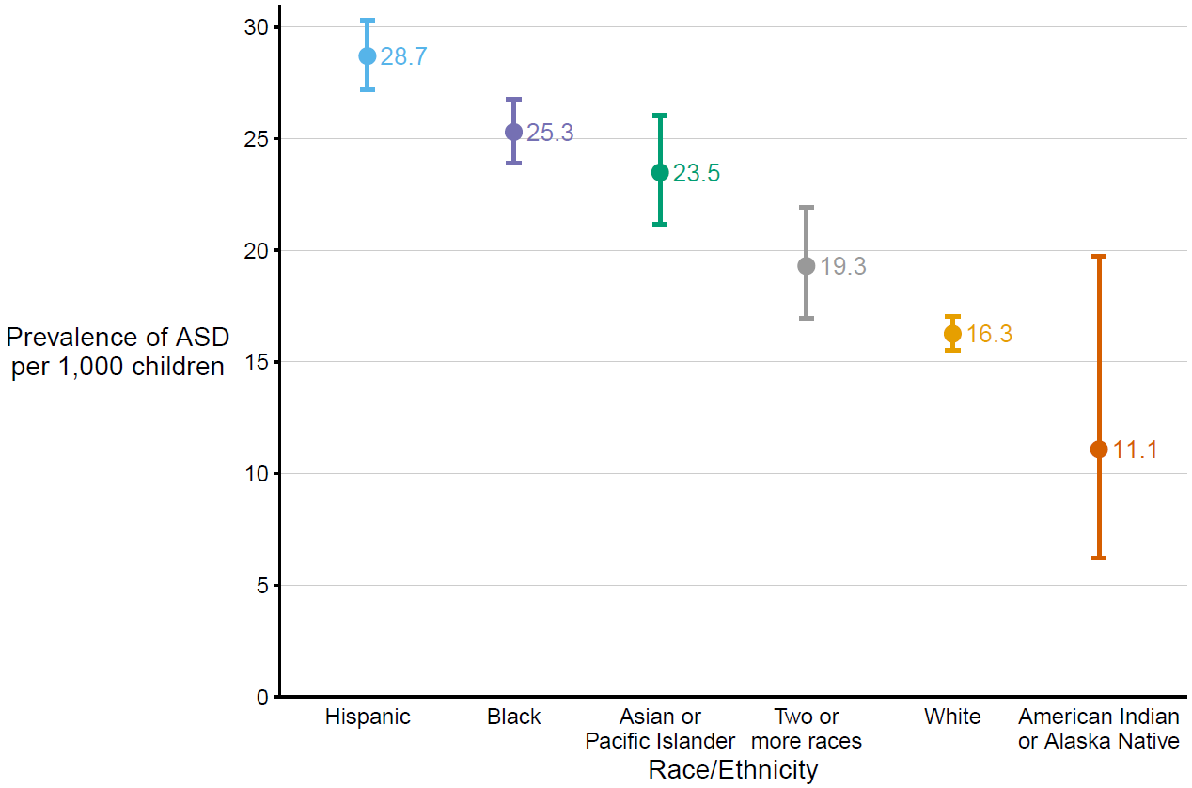
Prevalence of autism spectrum disorder per 1,000 children aged 4 years, by race/ethnicity
Autism and Developmental Disabilities Monitoring Network, 11 sites, United States, 2020

Slide 23
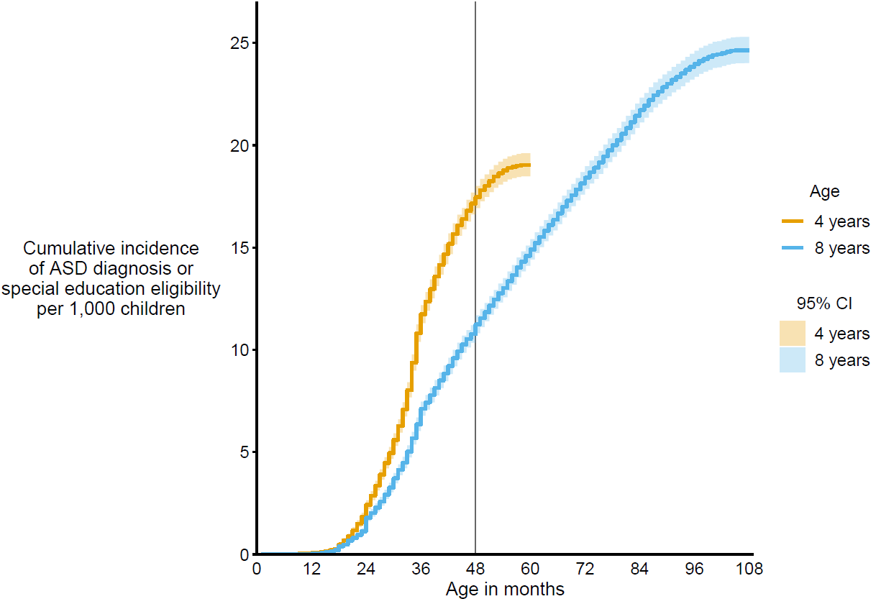
Cumulative incidence of autism spectrum disorder diagnosis or eligibility per 1,000 children aged 4 or 8 years
Autism and Developmental Disabilities Monitoring Network, 11 sites, United States, 2020

Slide 24
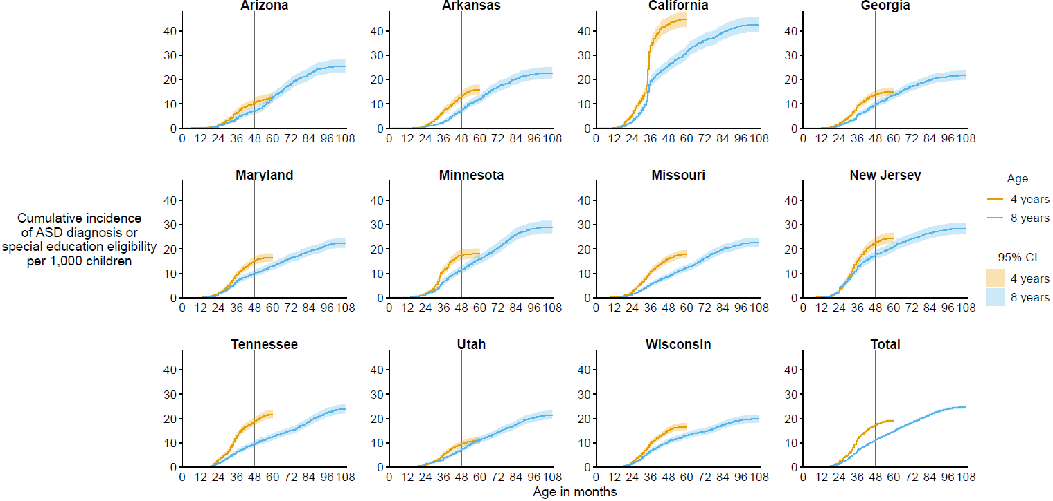
Cumulative incidence of autism spectrum disorder diagnosis or eligibility per 1,000 children aged 4 or 8 years, by site
Autism and Developmental Disabilities Monitoring Network, 11 sites, United States, 2020

Slide 25
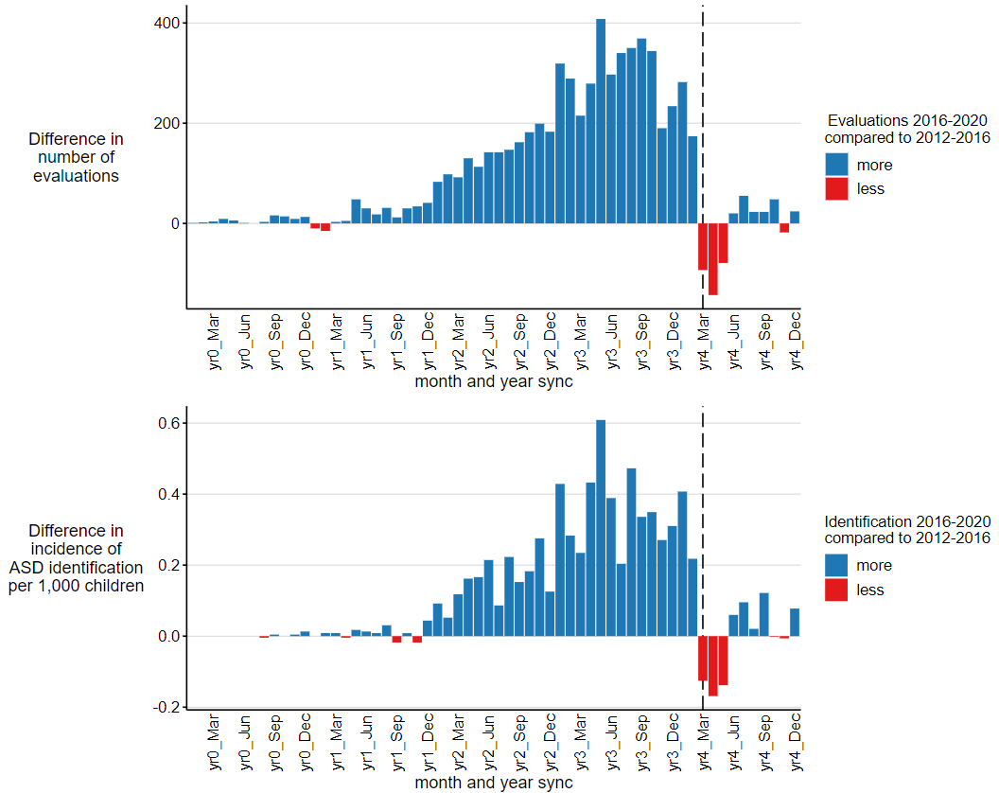
Difference in number of developmental evaluations and incidence of autism spectrum disorder identification per 1,000 children for children aged 4 years in 2020 during calendar years 2016–2020 and children aged 8 years in 2020 during calendar years 2012–2016, by month
Autism and Developmental Disabilities Monitoring Network, 11 sites, United States, 2020

Slide 26
End Slide

